Slide 1

Probability
Notes:
Origins 101--Probability

Slide 2
How Did We Calculate the Probability of a Protein Forming by Chance?
195
  1 in 1 x 10
Notes:
In the presentation about the origin of information in the cell, we talked about the probability of a protein forming by chance, but we didn’t go into much detail about how the probability was calculated.

Slide 3
Probability
Define probability
Review how to calculate probability
Look at probability calculations common in origins discussions
Notes:
In this presentation, we will define probability, review how to calculate it, and look at the kinds of probability calculations common in discussions about origins.

Slide 4
Probability
Likelihood or chance
Expressed as a fraction
Outcomes that Fit a Criterion
Total Possible Outcomes
Notes:
Probability is the likelihood or chance of something happening. / It is expressed as a fraction. / The bottom of the fraction is the number of possible outcomes that exist. / The top of the fraction is the number of outcomes that fit a certain criterion

Slide 5
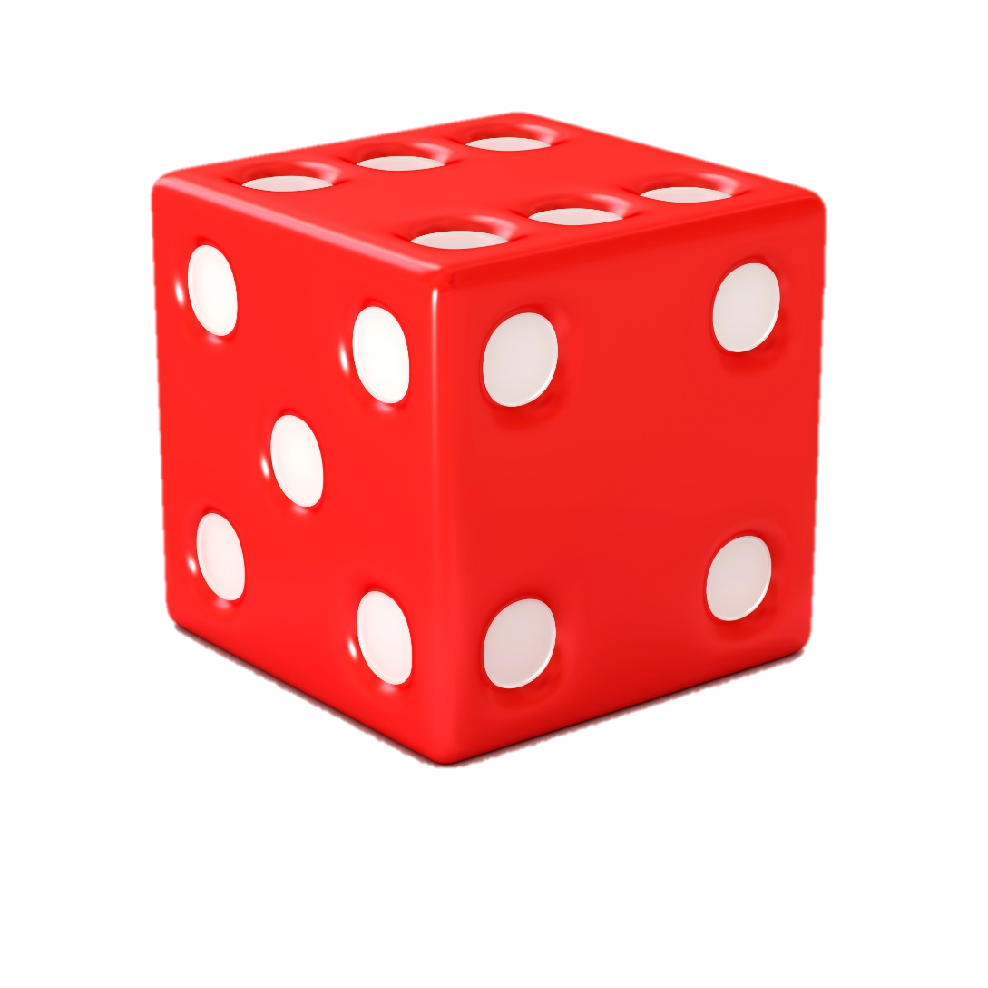
Probability of Rolling a “4”
1
Fit the Criterion
6
Possible Outcomes
Notes:
For example, look at this die. It has six sides, each containing a different number between 1 and 6. Because of this, rolling the die could produce 6 possible outcomes—a 1, 2, 3, 4, 5, or 6. / Because 6 different outcomes are possible, the bottom number of our fraction would always be a 6. / Because each number appears on only one face of the die, the top number of our fraction would have to be a 1. The probability of rolling a 4 would be 1/6, or 1 in 6. And so would the probability of rolling a 5, a 3, or a 1.

Slide 6

Probability of Landing on Red
1
Fit the Criterion
4
Total Possible
Notes:
Since this spinner contains only four possible outcomes (yellow, green, red, and blue), the probability of the spinner landing on any one of them-say red, for example—/ is ¼. / The 4 on the bottom means there are 4 possible outcomes. The 1 on top means there is only one outcome that is red. The probability would the same for yellow, green, and blue, as well.

Slide 7
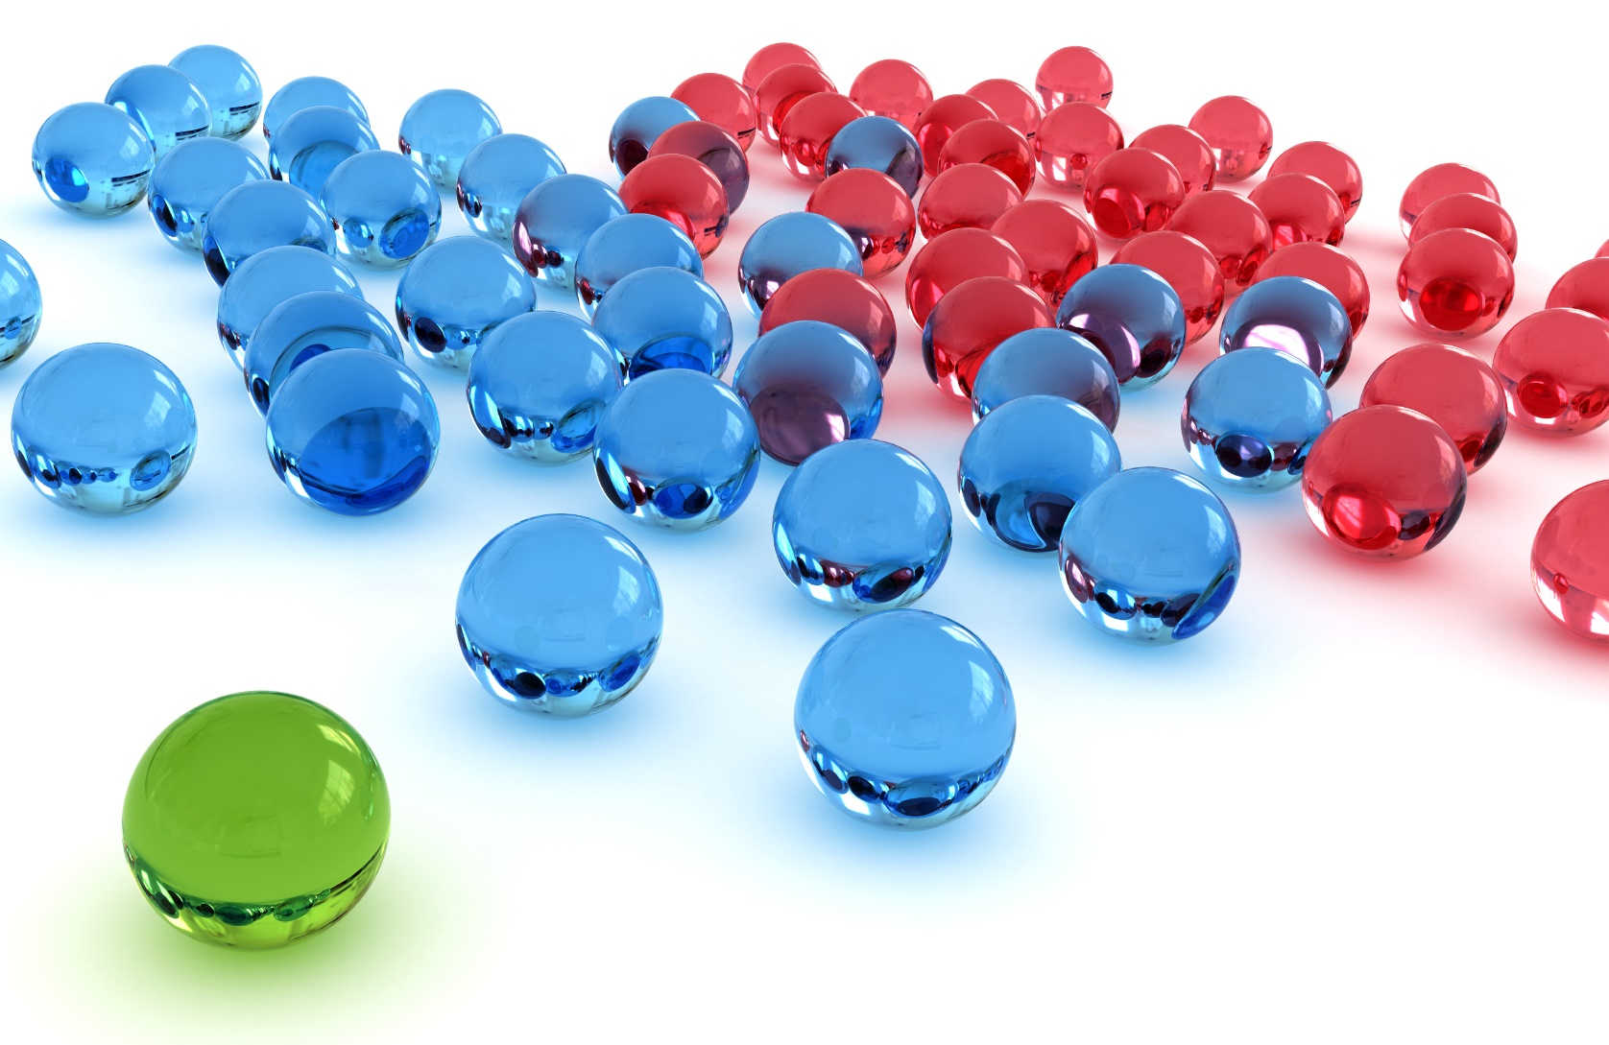
Probability of getting red
34
Red
34
Total
68
33
1
Total: 68
Notes:
Now let’s say we are going to draw a marble from a dish that contains 34 red marbles, / 33 blue marbles, / and 1 green one. / Since there are 68 marbles total in the jar, there are 68 possible outcomes, / so 68 is the bottom number in our fraction. / If we want to calculate the probability of drawing a red marble, the number of red marbles would be the top number. The probability of drawing a red marble would be 34 over 68, or 34 out of 68.

Slide 8
Probability of getting red
34
Red
1
Total
2
33
1
Total: 68
Notes:
When we state probabilities, we always reduce the fraction, so we would reduce 34 over 68 to one half.

Slide 9
Probability of getting blue
34
Blue
33
Total
68
33
1
Total: 68
Notes:
The probability of drawing a blue marble would be 33 over 68

Slide 10
Probability of getting green
34
Green
1
Total
68
33
1
Total: 68
Notes:
And the probability of drawing the green marble would be only 1 out of 68.

Slide 11
Probability of getting purple
34
Purple
0
Total
68
33
1
Total: 68
Notes:
The probability of drawing a purple marble is zero, because there are no purple marbles in the jar.

Slide 12
Probability of Multiple Events
1
1
1
6
6
36
Notes:
We can also calculate the probability of multiple events happening or the same event happening multiple times in a row. We do this by multiplying the individual probabilities. / Since the probability of rolling a 6 is 1/6, / the probability of rolling a 6 two times in a row would be 1/6 times 1/6, or 1/36.

Slide 13
Probability of Multiple Events
1
1
1
1
6
6
6
216
Notes:
The probability of rolling a 6 three times in a row is 1/6 times 1/6 times 1/6, or one over 216.

Slide 14
34
33
1
Total: 68
1
33
34
1,122
68
68
68
314,432
Notes:
To calculate the probability of drawing a green, / then a blue, / and then a red (assuming you put the marble back in the dish each time) / you would multiply the individual probabilities: (You can see how the bottom number increases rapidly.)

Slide 15
34
33
1
Total: 68
1
1
1
1
68
68
68
314,432
Notes:
The probability of drawing the only green marble three times in a row is very small.

Slide 16


Possible Outcomes
4
68
6
Notes:
It’s pretty easy to understand when the number of options are small, / like four colors on the spinner, / six sides on the die, / or 68 marbles in the jar. But the numbers can become hard to imagine pretty quickly when there are lots more possible outcomes.

Slide 17
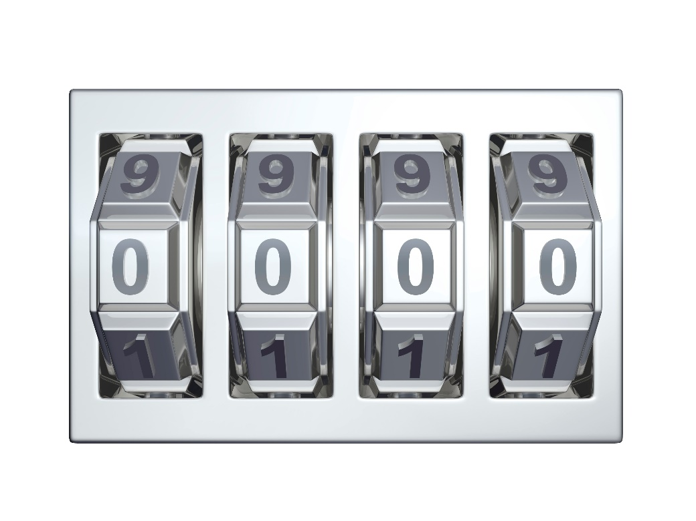
Number of:
Digits
Dials
Possible
Combinations?
Notes:
Take this combination lock, for example. / If we wanted to calculate the probability of finding a certain combination on this lock, we would need to know how many possible combinations there are. / To do that, we need to know two things: / the number of possible digits on each of the dials and how many dials there are.

Slide 18
Number of:
Digits
Dials
10
Notes:
Each dial has 10 possible digits (0-9) so we start with the number 10

Slide 19
Number of:
Digits
Dials
4
10
10
10
10
10
=10,000
Notes:
We use the number of dials as the exponent. / Remember that ten to the fourth power is the same thing as 10 times itself four times, / or 10,000. Notice that the number of zeroes on the 10,000 is the same as the exponent. This means there are 10,000 different combinations possible on this lock, so the denominator of a fraction about the probability of opening this lock would be 10,000.

Slide 20
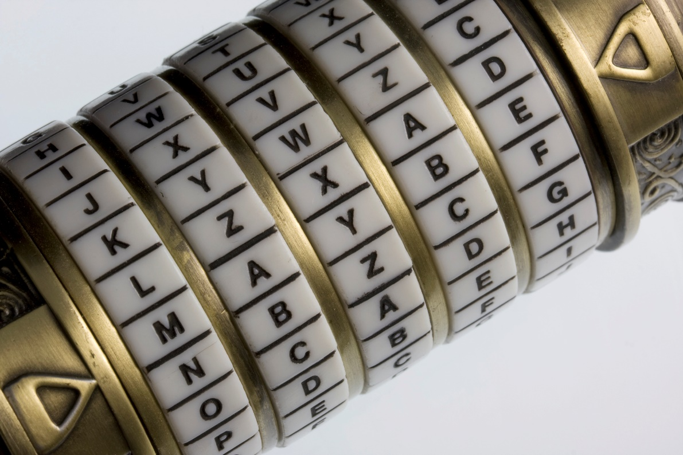
4
10
= 10,000
26
Notes:
Let’s do the same thing with a different kind of combination lock. Instead of ten digits from zero to nine on each dial, / this lock has the letters of the alphabet on each dial. Since there are 26 letters in the alphabet, there are 26 possibilities for each dial.

Slide 21
4
5
10
= 10,000
26
26
26
26
26
26
Notes:
Then, since there are five dials, we would use five as the exponent. 26 to the fifth power means we multiply 26 by itself five times.

Slide 22
4
5
10
= 10,000
26
= 11,881,376
Notes:
Which means there are nearly 12 million possible combinations on this lock.

Slide 23
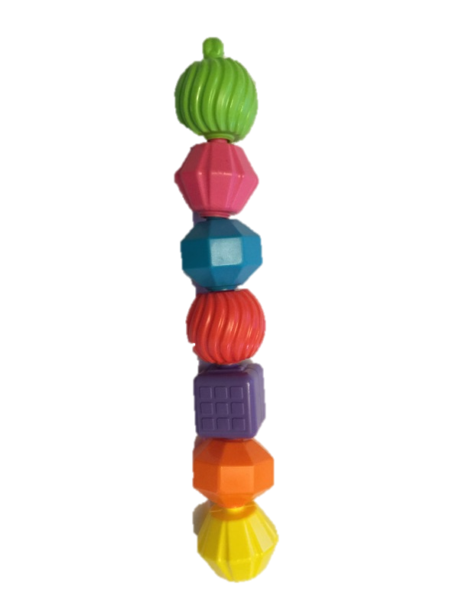

How many possible combinations exist?
150 amino acids long
5
150
26
20
Notes:
Let’s think about an amino acid chain that has 150 amino acids. / How many possible ways can those 150 amino acids be combined? / Think back to this combination lock. / We started with the number of letters on each dial, which was 26. / Then we used the number of dials—in this case 5—as the exponent. / Since there are 20 different kinds of amino acids—kind of like an alphabet with only 20 letters instead of 26—we start with the number 20. / Then because the chain contains 150 amino acids—kind of like having 150 dials on a combination lock—we use 150 as the exponent.
The total number of possible combinations is sometimes referred to as combinatorial space. And finding one specific outcome—like the right combination on a lock—/ is sometimes called “searching combinatorial space.”

Slide 24
How many possible combinations exist?
150 amino acids long
5
150
26
20
195
1 x 10
Signature in the Cell, Stephen C. Meyer, page 181
Notes:
Another way to express the same number is one times ten to the one hundred ninety-fifth power—or a one with 195 zeros after it, (which is how we got this figure in the previous presentation.)

Slide 25
The Probability for a Specific
Amino Acid Sequence
Notes:
Now that we know how many possible combinations there are, we can think about the probability of finding any one of them.

Slide 26
The Probability for a Specific
Amino Acid Sequence
Outcomes that Fit a Criterion
195
Total Possible Combinations
1 x 10
Notes:
The number we just calculated is the number of possible combinations, / so that would be the bottom of the fraction.

Slide 27
The Probability for a Specific
Amino Acid Sequence
Outcomes that Fit a Criterion
Total Possible Combinations
100000000000000000000000000000000000000000000000000000000000000000000000000000000000000000000000000000000000000000000000000000000000000000000000000000000000000000000000000000000000000000000000000
Notes:
…which would look like this if we wrote out all 195 zeros!

Slide 28
The Probability for a Specific
Amino Acid Sequence
Outcomes that Fit a Criterion
1
195
Total Possible Combinations
1 x 10
Notes:
Out of all those options, only one would have that specific amino acid sequence, / so the top of the fraction would be a 1.

Slide 29
The Probability for a Specific
Amino Acid Sequence
Outcomes that Fit a Criterion
1
195
Total Possible Combinations
1 x 10
Notes:
Therefore, the probability of forming any one, specific sequence of 150 amino acids by chance is 1 in 10 ^{to} the one hundred ninety-fifth power. This probability is way too low to be realistic.

Slide 30
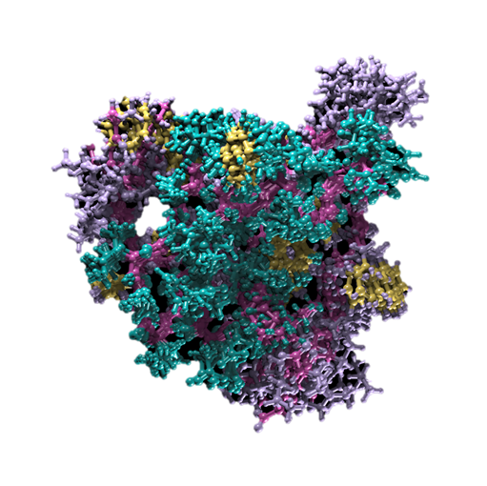
What if we allowed for any useful protein regardless of its amino acid sequence?
Notes:
But what if we allowed for any potentially useful protein, regardless of its amino acid sequence? / Remember that an amino acid chain has to be able to fold before it can be a useful protein. To accurately calculate the probability of forming a useful proteins by chance, then, we will only consider the number of amino acid sequences that are capable of folding.

Slide 31
What proportion of amino acid sequences can fold?
?
74
1 in 10
195
1 x 10
Signature in the Cell, Stephen C. Meyer, page 212
Notes:
Douglas Axe performed some experiments / and concluded that only about 1 in 10 to the 74th amino acid sequences is able to fold into a useful protein, so we’ll use that number instead of the 1 x 10 to the one hundred ninety-fifth.

Slide 32
Factors that Affect Probability
Specific amino acid sequences
Ability to fold
Chirality
Chemical bonding
Notes:
But we also need to consider two additional factors that affect probability— / chirality / and chemical bonding—which make the problem much worse.

Slide 33
Factors that Affect Probability
Specific amino acid sequences
Ability to fold
Chirality (“right-handed” or “left-handed”)
Chemical bonding
Amino acid forms
  Right-handed
  Left-handed
Only left-handed ones are used in living cells
Notes:
Amino acids occur in two forms— called right handed and left handed. Chirality refers to their right- or left-handedness. / Only left-handed ones are used in living cells.

Slide 34
Factors that Affect Probability
Specific amino acid sequences
Ability to fold
Chirality (“right-handed” or “left-handed”)
Chemical bonding
Probability of choosing a single, left-handed amino acid = ½
1
Left-handed
2
2 possibilities
(left & right)
Signature in the Cell, Stephen C. Meyer, page 212
Notes:
The probability of choosing a single, left-handed amino acid should be about 1 in 2

Slide 35
Factors that Affect Probability
Specific amino acid sequences
Ability to fold
Chirality (“right-handed” or “left-handed”)
Chemical bonding
The probability of choosing 150 left-handed amino acids in a row is (1/2)¹⁵⁰, or 1 in 10⁴⁵
45
1 in 10
Signature in the Cell, Stephen C. Meyer, page 212
Notes:
Using this figure, the probability of choosing 150 left-handed amino acids in a row is one half multiplied by itself 150 times, or one in ten to the 45th power.

Slide 36
Factors that Affect Probability
Specific amino acid sequences
Ability to fold
Chirality
Chemical bonding
Notes:
Chemical bonding also affects the probability of forming proteins. Amino acids bond in different ways, but proteins only use a certain kind of bond, called a peptide bond, to link their amino acids.

Slide 37
Factors that Affect Probability
Specific amino acid sequences
Ability to fold
Chirality
Chemical bonding
Probability of two amino acids joining by a peptide bond = ½
1
2
Signature in the Cell, Stephen C. Meyer, page 212
Notes:
The probability of two amino acids joining by a peptide bond should also be about 1 in 2.

Slide 38
Factors that Affect Probability
Specific amino acid sequences
Ability to fold
Chirality
Chemical bonding
The probability of 150 amino acids joining only by peptide bonding is (1/2)¹⁴⁹, or 2 in 10⁴⁵
45
2 in 10
Notes:
Since a chain of 150 amino acids has 149 chemical bonds linking them, we calculate the probability by multiplying one half by itself 149 times. This makes the probability of getting 149 peptide bonds in a row about 2 in 10 to the 45th power.
Note: Stephen Meyer (Signature in the Cell, page 212) calculates the probability using 150 bonds (instead of 149), resulting in a probability of 1 x 10^45. Since each additional bond causes the probability to be multiplied by a factor of ½, reducing the number of bonds from 150 to 149 means that the probability is twice as much as before. This makes the probability on this slide 2 x 10^45 instead of 1 x 10^45 and the calculation on slide 44 2 x 10^164 rather than 1 x 10^164.

Slide 39
Probability of one functional protein by chance
Notes:
With all that background, we are ready to calculate the probability of getting just one functional protein by chance.

Slide 40
34
33
1
Total: 68
1
33
34
1,122
68
68
68
314,432
Notes:
We do it the same way that we calculated the probability of picking a certain sequence of marbles from the jar—by multiplying the probabilities of the individual events.

Slide 41
Probability of one functional protein by chance
150 amino acids long
1
10
74
Foldable amino acid sequence
Signature in the Cell, Stephen C. Meyer, page 212
Notes:
To calculate the probability of getting one small protein that is just 150 amino acids long by chance, we need to multiply three separate probabilities: The probability of getting a specific sequence of amino acids that is capable of folding…

Slide 42
Probability of one functional protein by chance
150 amino acids long
1
1
10
74
10
45
Only “left-handed” amino acids
Signature in the Cell, Stephen C. Meyer, page 212
Notes:
by the probability of getting 150 left-handed amino acids in a row

Slide 43
Probability of one functional protein by chance
150 amino acids long
1
1
2
10
74
10
45
45
10
Joined with only peptide bonds
Notes:
By the probability of them being joined with peptide bonds.

Slide 44
Probability of one functional protein by chance
150 amino acids long
1
1
2
10
74
10
45
45
10
164
Probability = 2 in 1 x 10
Signature in the Cell, Stephen C. Meyer, page 212
Notes:
When we multiply these individual probabilities, we add their exponents—which is where the 164 comes from.

Slide 45
Probability of one functional protein by chance
2
Probability =
2 in 1 x 10
164
164
10
Signature in the Cell, Stephen C. Meyer, page 212
Notes:
This means that the probability of getting even one folded protein capable of performing a function / is no better than two in ten to the 164th power.

Slide 46
These figures are estimates, not measurements
We have to make some allowance for variation
The probabilities are far beyond anything reasonable, whether they are slightly too high or too low
Notes:
These figures are estimates, not measurements, so we have to make some allowance for variation in the final answer. But it doesn’t matter. The probabilities are far beyond anything reasonable, whether they are slightly too high or too low.

Slide 47
The Problem of Contamination
These calculations do not reflect the problem of contamination.
In the real world, other chemicals are present that would interfere with protein formation, reducing the probability effectively to zero.
Real-World Probability = 0
Notes:
These calculations do not reflect the problem of contamination. / In the real world, other chemicals are present that would interfere with protein formation. This would effectively reduce the probability to zero.

Slide 48
Could It Happen Anyway?
Suppose we ignore the problem of contamination,
And suppose we ignore the problem of where the amino acids would come from,
And suppose we ignore the problem of finding the right conditions for the amino acids to react together,
Is it reasonable to think that a protein might form by chance?
Notes:
Suppose we ignore the problem of contamination, / and suppose we ignore the problem of where the amino acids would come from, / and suppose we ignore the problem of finding the right conditions for the amino acids to react together. / Is it reasonable to think that a protein might form by chance?

Slide 49
How many opportunities have there been for this to happen?
Notes:
One way to evaluate this is by thinking about how many opportunities there have been for that event to happen.

Slide 50
What Probabilities Are Reasonable?
Probability of a protein forming by chance
(assuming the universe was composed only of amino acids)
Number of events scientists say have occurred in the history of the universe
?
2
10
164
Notes:
We could do this by comparing the probability of a protein forming by chance, with the number of events that scientists say have occurred in the history of the universe. / But how would we know how many events have happened?

Slide 51
Events in the History of the Universe
10
80
Elementary particles in the universe
Elementary particles = protons, neutrons, and electrons
Signature in the Cell, Stephen C. Meyer, page 212
Notes:
William Dembski has attempted to figure this out. First, he estimated the number of elementary particles in universe.

Slide 52
Events in the History of the Universe
10
80
10
43
Interacting with each other
Notes:
And multiplied that by the number of possible interactions with each other per second

Slide 53
Events in the History of the Universe
10
80
10
43
10
16
Since the beginning of time
(in seconds)
Notes:
Finally, he multiplied that by the number of seconds since the beginning of time, based on current scientific theory. We don’t know for sure how old the universe is, but scientists estimate it is about 13 billion years old, which is about 10¹⁶ seconds.

Slide 54
Events in the History of the Universe
10
80
10
43
10
16
1
10
139
Notes:
By multiplying these three estimates, he calculates the total events in the entire history of the universe to be 1 x 10 to the 139. That is a one with 139 zeroes after it.

Slide 55
Comparing Probabilities
150 amino acids long
Total universe
events =
139
1 x 10
Protein
probability =
162
2 in 1 x 10
Notes:
Now compare these two numbers. / Notice that the number of events in the history of the universe / is smaller than the number necessary to allow for the formation of a protein by chance. In fact, it is a trillion, trillion times smaller! In other words, getting a functional protein by chance requires more probabilistic resources than have been available in the history of the universe. Add to this the fact that most proteins are much longer than 150 amino acids. Most have several hundred or even several thousand amino acids. And we can see that making a functional protein by chance is mathematically impossible.

Slide 56

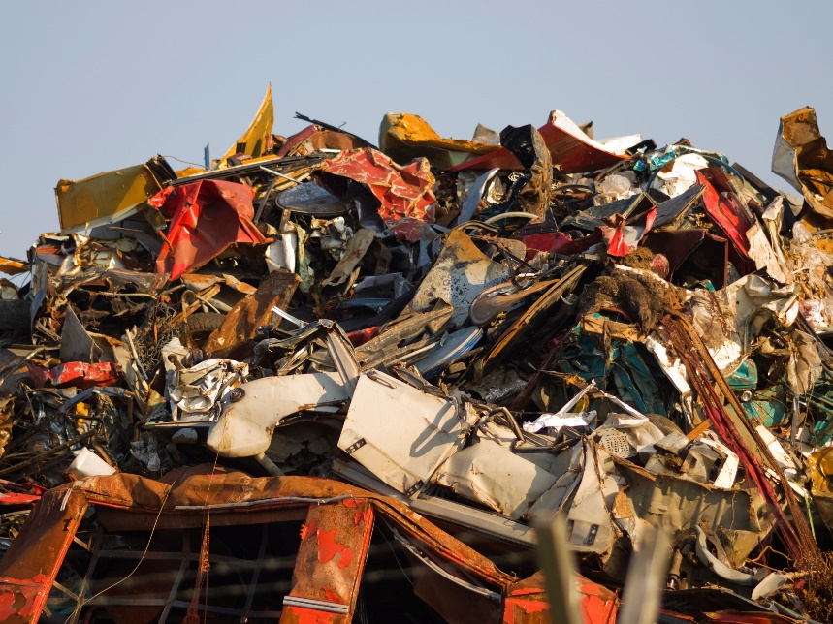
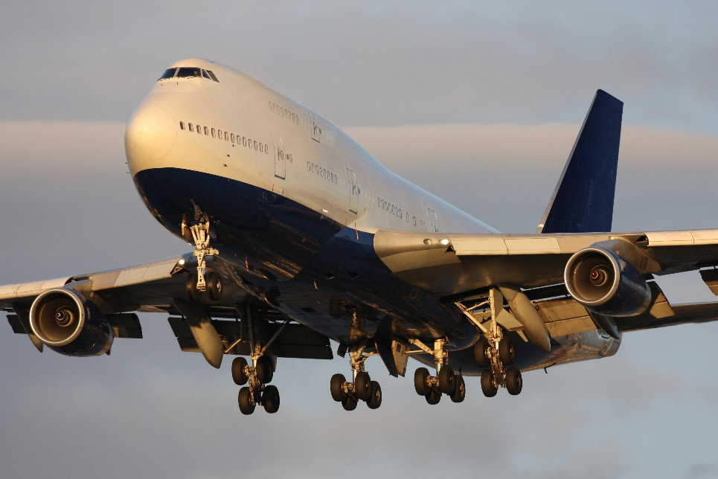
How likely would this be?
Like a Boeing 747 being assembled by a tornado blowing through a junkyard
Notes:
The probability is so low that it has been compared to the probability of a tornado blowing through a junkyard and producing a Boeing 747 airplane.
Tornado 32349874 fergregory
Junk yard 7515063 vm
Boeing 747 4941515 Daniel Barnes

Slide 57
Conclusions
Even if the universe were made entirely of amino acids, it is unrealistic to expect a protein to form by chance.
Living organisms require hundreds or thousands of proteins in order to live.
Creation is the best explanation for the origin of living organisms.
Notes:
From our study of probabilities, we can conclude that even if the universe were made entirely of amino acids, it is unrealistic to expect a protein to form by chance. / Living organisms require hundreds or thousands of proteins in order to live. / Creation is the best explanation for the origin of living organisms.

Slide 58
Images By
Images may appear on more than one slide. Citation is given on the first slide where each image appears.
[1] Slide design, Susan Landon
[5] Dice 16134810, JuSun, Getty Images (US), Inc. Subscription Agreement
[6] Spinner 9277784, quisp65, Getty Images (US), Inc. Subscription Agreement
[7] Marbles 5339131, sweetym, Getty Images (US), Inc. Subscription Agreement
[17] Combination lock 2840126, mipan, Getty Images (US), Inc. Subscription Agreement
[20b] Combination lock 6498864, marekuliasz, Getty Images (US), Inc. Subscription Agreement
[23b] Snap and Lock blocks, Carol Raney
[30b] Insulin 9717900, theasis, Getty Images (US), Inc. Subscription Agreement
[61a] Tornado 32349874, fergregory, Getty Images (US), Inc. Subscription Agreement
[61b] Junk yard 7515063, vm, Getty Images (US), Inc. Subscription Agreement
[61c] Boeing 747 4941515, Daniel Barnes, Getty Images (US), Inc. Subscription Agreement

Slide 59
Special Thanks
Jim Gibson
Geoscience Research Institute
and the
Foundation for Adventist Education

Slide 60

© Origins Curriculum Resources 2015

Slide 61

© Southern Adventist University 2015

Slide 62

© Seventh-day Adventist North American Division 2015

Slide 63

© General Conference of Seventh-day Adventists 2015

Slide 64

© SCORE Southern Center for Origins Research & Education 2015

