Slide 1

Data, Interpretation, and Evaluating Scientific Claims
Notes:
Origins 101—Data, Interpretation, and Evaluating Scientific Claims

Slide 2
Data and interpretation
  Define
  Give examples
  Practice telling the difference between them
Effects of worldviews on interpretation
Appropriate and inappropriate conclusions from data
How to evaluate the claims of science
Notes:
We’ve talked a lot about data and interpretation so far. / In this presentation, we will define them, give examples, and practice telling the difference between them. / We will also compare the effects of worldviews on interpretation, / differentiate between appropriate and inappropriate conclusions from data, / and learn some suggestions for how to evaluate the claims of science.

Slide 3
Definition of Data
Data are facts or pieces of information
Datum (singular)
Data
  Plural (facts or pieces of information)
  Singular collective noun (a body of facts or information)
Notes:
Let’s start with some definitions. Data are facts or pieces of information. The word datum is singular and would refer to just one fact. Data is usually considered to be plural—referring to multiple facts or pieces of information. But sometimes it is used as a singular collective noun—referring to a body of facts or information

Slide 4
Where do data come from?
Observations
Measurements
layers
Notes:
We get data from things we observe and things we measure or quantify in some way.

Slide 5

Data—Observed
The colors on this frog
Notes:
We can observe the colors on this frog

Slide 6
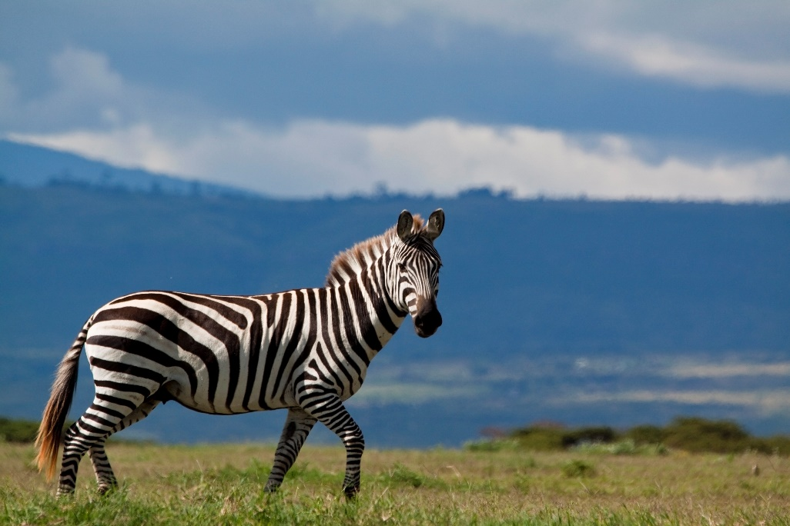
Data—Observed
Zebra stripe patterns
Notes:
Or that the stripes go different directions on this zebra.

Slide 7

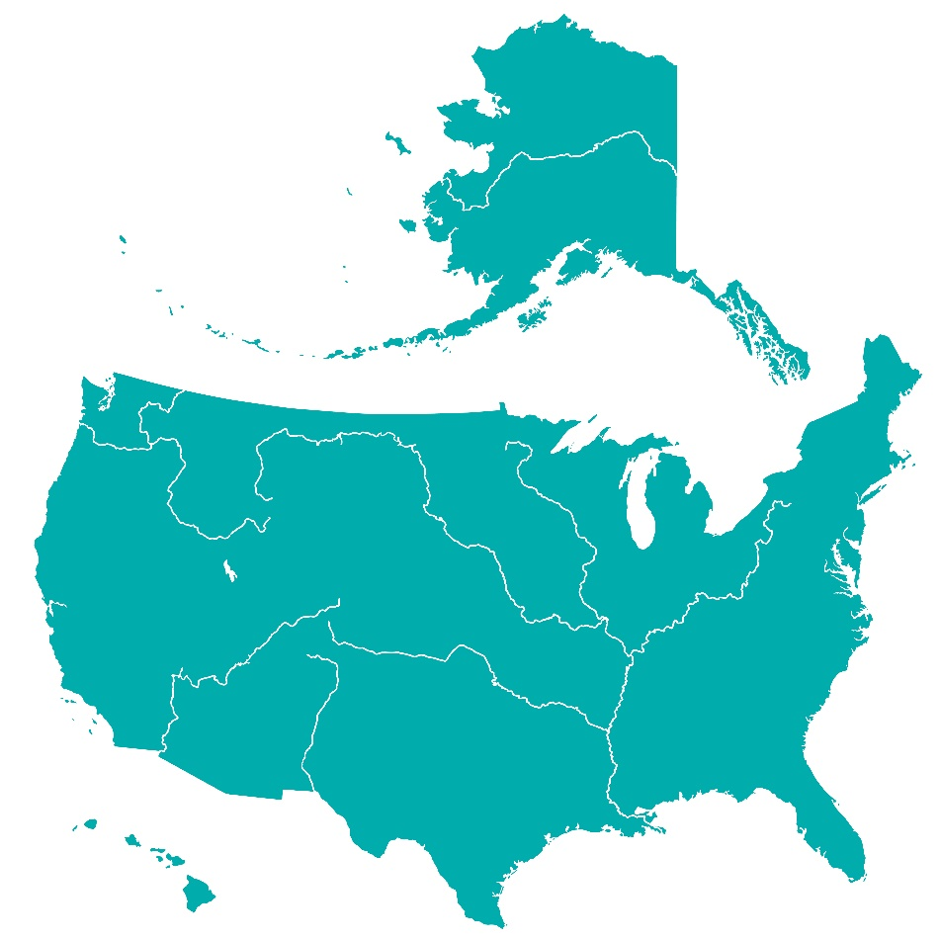
Data—Observed
The Mississippi River flows toward the Gulf of Mexico
Notes:
We can observe that the Mississippi River flows toward the Gulf of Mexico…

Slide 8

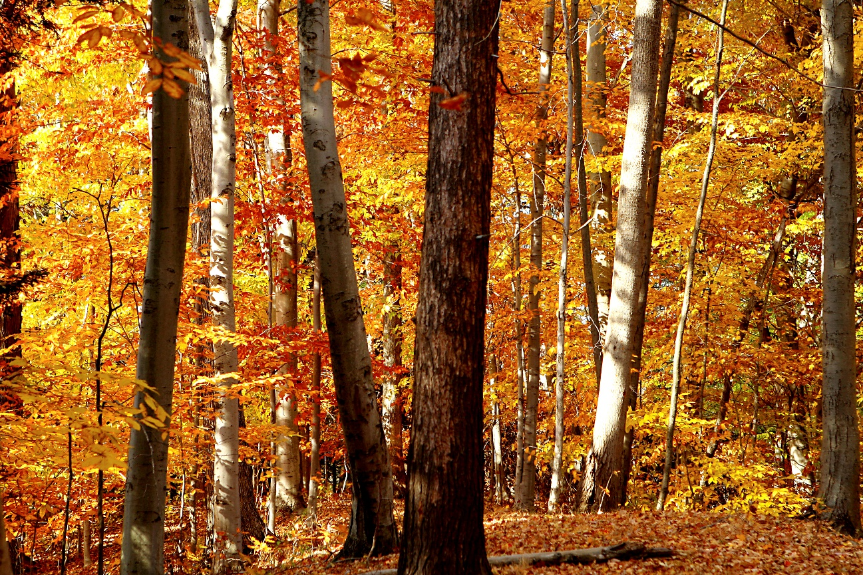
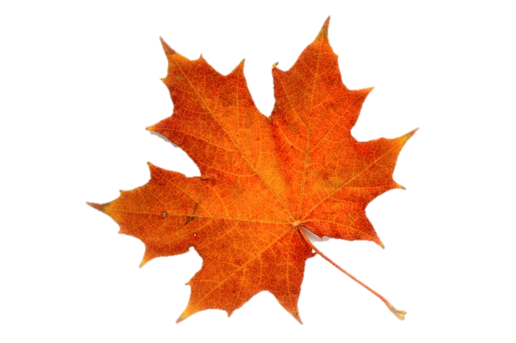
Data—Observed
The leaves of non-evergreen trees turn colors in the fall
Notes:
…that the leaves of non-evergreen trees turn colors in the fall…

Slide 9
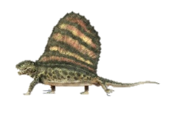
Data—Observed
Dimetrodon fossils are found in the Permian layers
Notes:
….and that Dimetrodon fossils are found in the Permian layers.

Slide 10
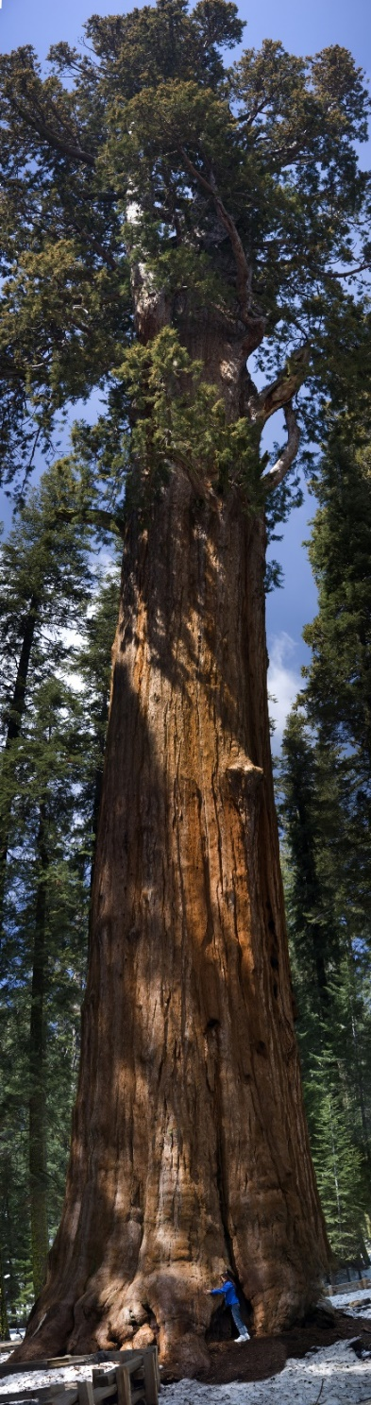
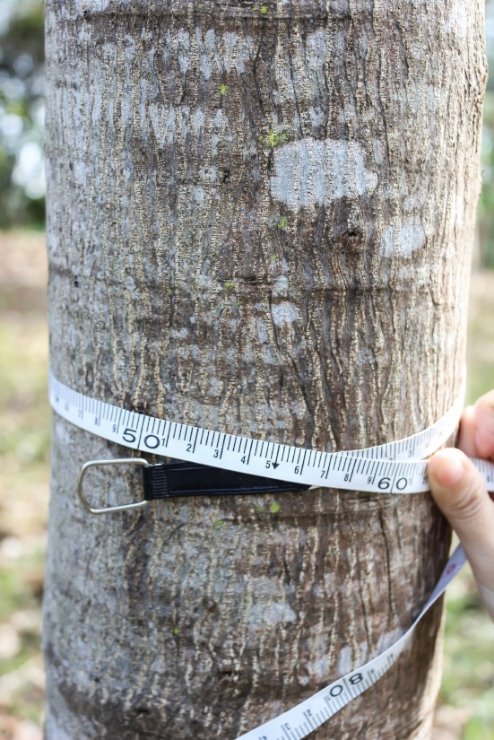
Data--Measured
This Sequoia tree is 250 feet tall
The distance around this tree trunk is 55 cm
Notes:
We can measure things like the height of a Sequoia tree / or the distance around a tree trunk.

Slide 11
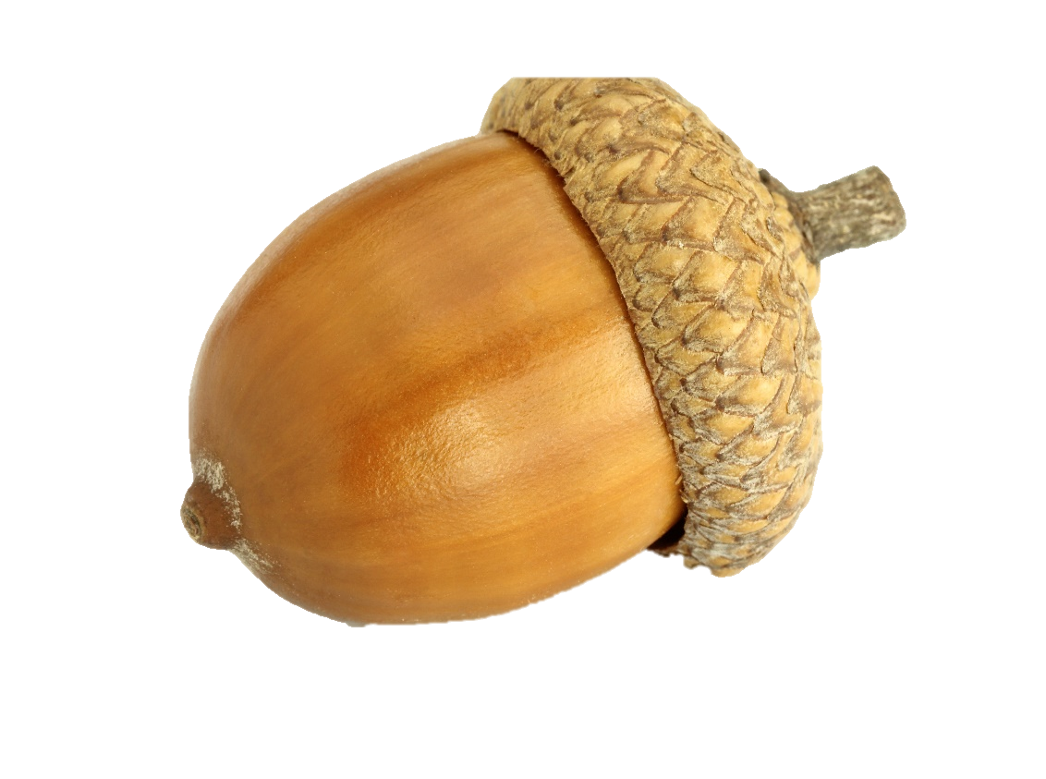
Data--Measured
This acorn is 18 mm long
Notes:
We can measure the length of an acorn,

Slide 12
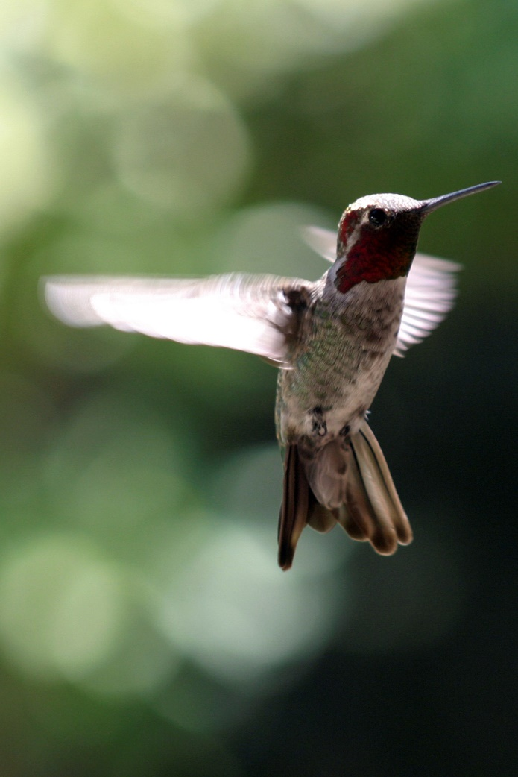
Data--Measured
Hummingbird wings beat up to 70 times per second
Notes:
The number of time a hummingbird’s wings beat per second,

Slide 13
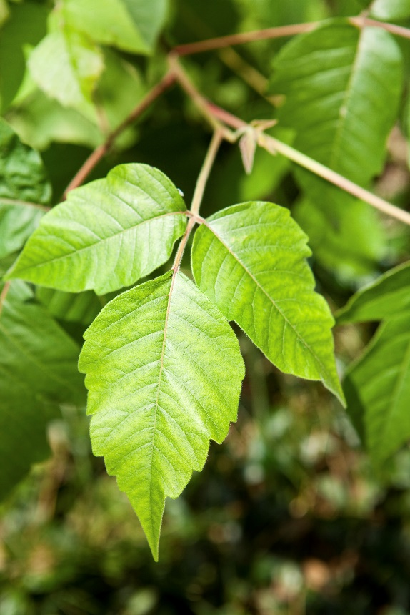
Data--Measured
Poison ivy plants have clusters of 3 leaves
Notes:
And how many leaves are on a poison ivy plant

Slide 14
Definition of Interpretation
A conclusion we draw about the data
May deal with How or Why
Notes:
An interpretation is a conclusion we draw about the data. / It may deal with how or why something happens.

Slide 15
Interpretation
  How leaves change color in the fall
Notes:
Like how leaves turn colors in the fall

Slide 16
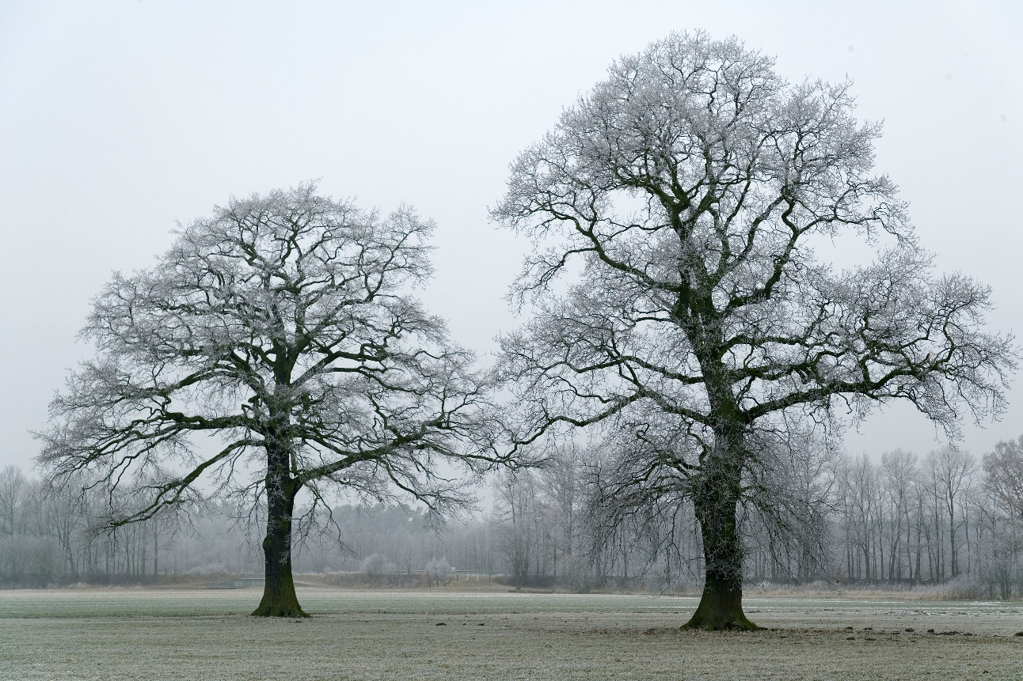
Interpretation
  Why one tree is taller than the other
Notes:
why one tree is taller than another.

Slide 17

Interpretation
  Why hummingbird wings beat faster than eagles’ wings
Notes:
Or why hummingbird wings beat faster than eagles’ wings

Slide 18
Scientific Process
Gathering
Data
Interpreting
Data
Notes:
The scientific process is all about gathering data and interpreting data.

Slide 19
Scientific Process
Observe/Ask
Gathering
Data
Make Hypothesis
Interpreting
Data
Gather Data/Experiment
Draw Conclusions
Notes:
Data is important at two places in the scientific process—/ the data you notice to begin with, / and the data you gather as you experiment. / Interpretations are important at two places as well. / The hypothesis you make is kind of like a preliminary interpretation, / and the conclusions you draw at the end are interpretations.

Slide 20

Interpretations can be…
Right
Wrong
Notes:
Interpretations can be right / or they can be wrong.

Slide 21
Interpretations can be…
Mutually Exclusive
Creation
Evolution
Notes:
And sometimes different interpretations are mutually exclusive—which means that they both can’t be true at the same time.

Slide 22
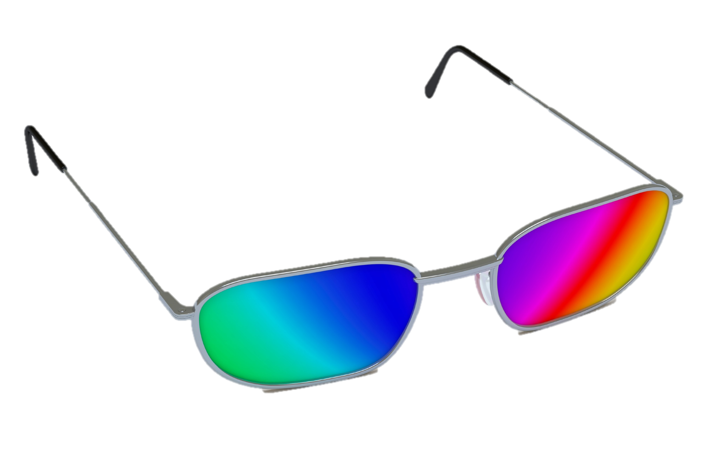
Interpretations are affected by…
Worldview
Notes:
Interpretations are affected by the worldview of the scientist who makes them.

Slide 23
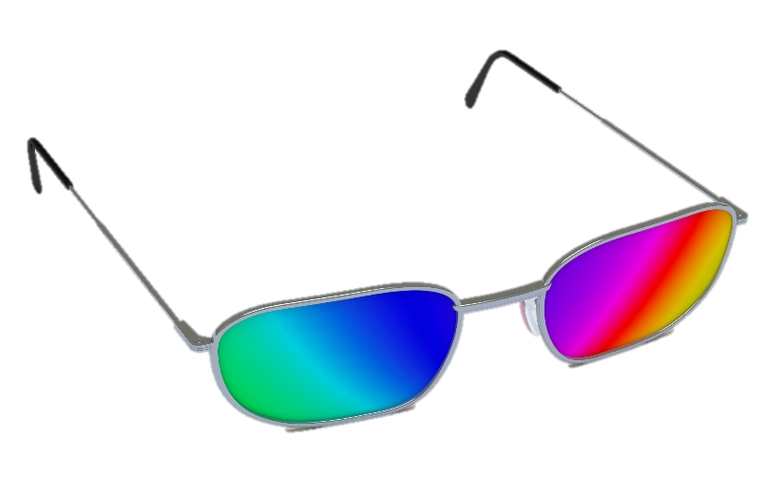
Interpretations are affected by…
Worldview
Where did I come from?
How can I know what is true?
Notes:
Your worldview is like a lens through which you view your world. It colors the way you think about all kinds of things—including life’s most important questions / like where did I come from? / Or How can I know what is true?

Slide 24
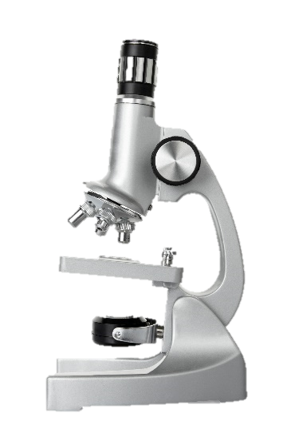

Biblical Worldview
Naturalism
Nature, Science, & the Supernatural
Nature
& Science
Notes:
Let’s define two worldviews that we will be talking a lot about. Naturalism is a worldview that believes nature is all that exists and uses the scientific method to investigate reality. A biblical worldview believes that reality includes both the natural and the supernatural, and looks to the Bible for ultimate truth.

Slide 25
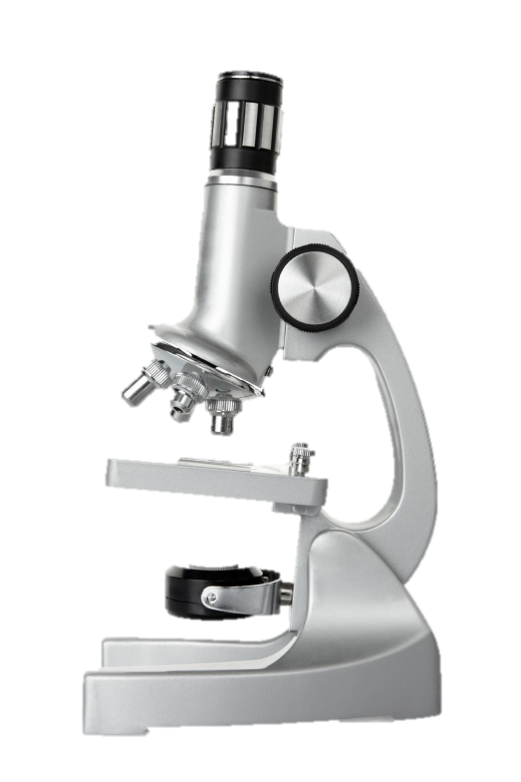
Biblical Worldview
Naturalism
Natural
explanations
Natural
explanations
Data from senses
Data from senses
Notes:
Both of these worldviews value science and look for natural explanations about reality / by gathering data through our senses.

Slide 26
Biblical Worldview
Naturalism
WILL
Consider
Divine Intervention
Will NOT
Consider
Divine Intervention
Notes:
But a biblical worldview will also consider the possibility of divine intervention—/ which naturalism will not.

Slide 27
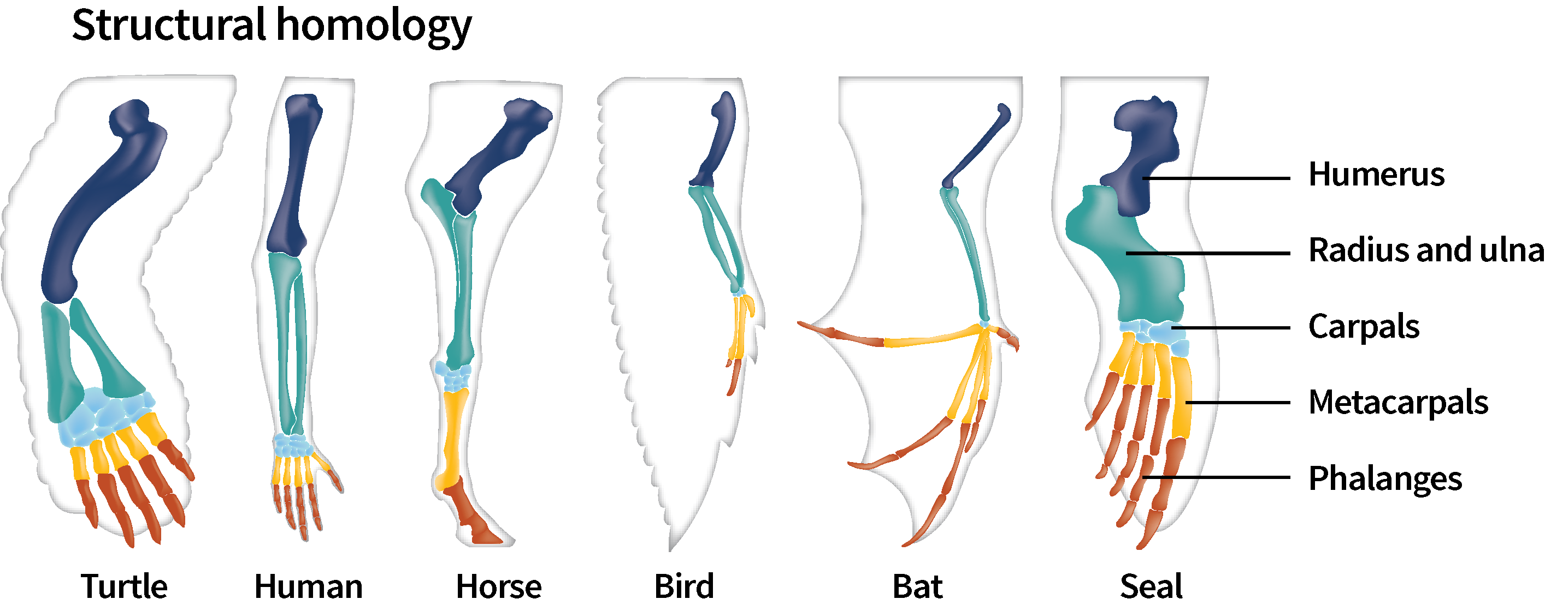
Data
Same pattern of bone structure
Notes:
Let’s take a look at the way these worldviews affect the interpretation of scientific data. / Lots of animals have the same pattern of bone structure in their forearms. / This is data that can be observed by anyone.

Slide 28
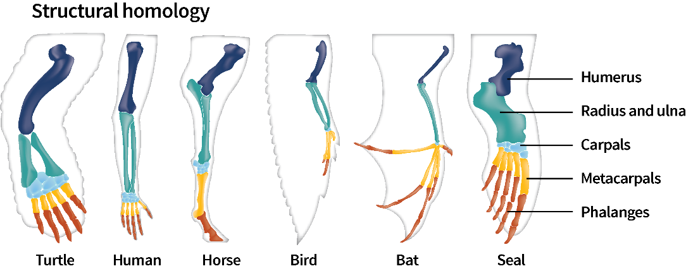
Interpretation
Biblical Worldview
Naturalism
Effective
design
Common
ancestor
Notes:
Scientists with different worldviews look at the same data but arrive at different interpretations of the data. / A scientist with a naturalistic worldview will conclude that all these animals have the same pattern of bone structure because they evolved from a common ancestor. / But a scientist with a biblical worldview will conclude that God efficiently used an effective design in multiple animals.

Slide 29
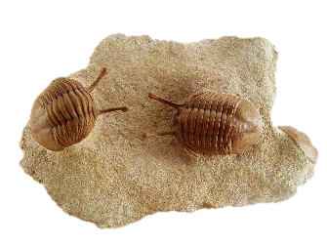
Data
Cenozoic
Mesozoic
Phanerozoic
Paleozoic
Precambrian
Notes:
A variety of trilobites are found throughout the Paleozoic layers. / Their presence in these layers and their absence from the layers above is observable data.

Slide 30
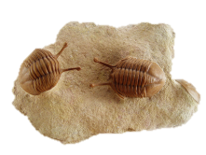
Interpretation
Biblical Worldview
Naturalism
Cenozoic
Living creatures that died and were fossilized
Living creatures that died and were fossilized
Mesozoic
Phanerozoic
Paleozoic
Precambrian
Notes:
Scientists from both worldviews conclude that trilobites were living creatures that died and were fossilized.

Slide 31
Interpretation
Biblical Worldview
Naturalism
Cenozoic
Trilobites evolved early in the history of life
Trilobites
were created
Mesozoic
Phanerozoic
Paleozoic
Precambrian
Notes:
But scientists from different worldviews have different ideas about where the trilobites came from to begin with. A scientist with a naturalistic worldview would say that trilobites evolved early in the history of life, but a scientist with a biblical worldview would say that trilobites were created.

Slide 32
Interpretation
Biblical Worldview
Naturalism
Cenozoic
Trilobites
were among the first creatures to be buried and preserved in the worldwide flood
Trilobites became extinct during catastrophic events
Mesozoic
Phanerozoic
Paleozoic
Precambrian
Notes:
Scientists from different worldviews have different ideas about what kind of catastrophic events caused the trilobites to become extinct.

Slide 33
Can you tell the difference?
Dinosaur fossils appear in the Mesozoic layers
Dinosaurs did not exist until after the Permian layers were deposited
Notes:
Can you tell which of these statements represents data and which is an interpretation? / Dinosaur fossils appear in the Mesozoic layers. / Dinosaurs did not exist until after the Permian layers were deposited.

Slide 34
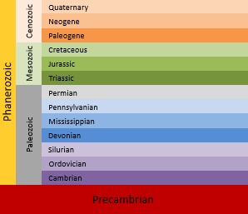
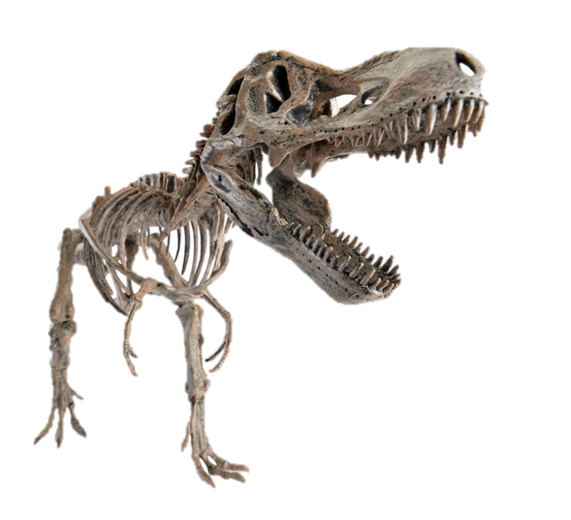
Can you tell the difference?
Dinosaur fossils appear in the Mesozoic layers
Dinosaurs did not exist until after the Permian layers were deposited
Interpretation
Data
Notes:
The location of dinosaur fossils in certain layers is observable data. / Using their relative location to draw conclusions about when they existed is interpretation.

Slide 35
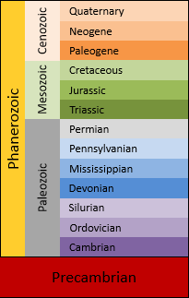
Identify the Data
Dinosaurs died in the flood
No dinosaur fossils have been found below the Triassic
Meteorite strikes caused the extinction of the dinosaurs
Some dinosaurs survived the flood but became extinct later during the Ice Age
No dinosaur fossils are found in the Cenozoic
Notes:
Listen to each of these statements and decide whether you think it is data or interpretation. Pause the video if you need more time to think about it.

Slide 36
Identify the Data
Dinosaurs died in the flood
No dinosaur fossils have been found below the Triassic
Meteorite strikes caused the extinction of the dinosaurs
Some dinosaurs survived the flood but became extinct later during the Ice Age
No dinosaur fossils are found in the Cenozoic
Notes:
The two statements in yellow are data The fact that dinosaur bones are only found in the Mesozoic layers—not below the Triassic or above the Cretaceous in the Cenozoic—is data. It can be verified by anyone who does the research. The other three statements about what happened to the dinosaurs are not things that can be verified by observation or experimentation. They are interpretations of the data that are derived from implications of the respective worldviews.

Slide 37
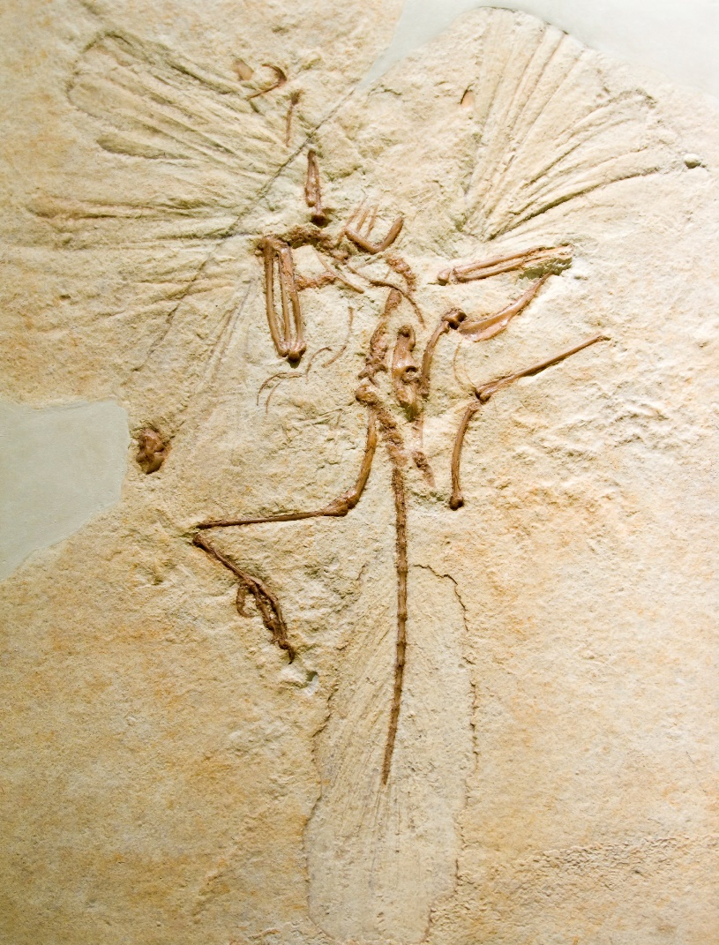
Identify the Data
Birds have feathers
Certain creatures with dinosaurian skeletons also had feathers
Dinosaurs evolved into birds
God created both birds and some dinosaurs with feathers
Smaller dinosaurs living in higher biomes needed feathers to keep warm
Notes:
As you listen to another set of statements, see if you can differentiate the data from the interpretations. (read the statements) Pause the video if you need more time to think about your answers.

Slide 38
Identify the Data
Birds have feathers
Certain creatures with dinosaurian skeletons also had feathers
Dinosaurs evolved into birds
God created both birds and some dinosaurs with feathers
Smaller dinosaurs living in higher biomes needed feathers to keep warm
Notes:
The fact that birds have feathers is observable data that can be easily verified.

Slide 39
Identify the Data
Birds have feathers
Certain creatures with dinosaurian skeletons also had feathers
Dinosaurs evolved into birds
God created both birds and some dinosaurs with feathers
Smaller dinosaurs living in higher biomes needed feathers to keep warm
Notes:
The fossil evidence indicates that certain creatures with dinosaurian skeletons also had feathers, so this is data as well.

Slide 40
Identify the Data
Birds have feathers
Certain creatures with dinosaurian skeletons also had feathers
Dinosaurs evolved into birds
God created both birds and some dinosaurs with feathers
Smaller dinosaurs living in higher biomes needed feathers to keep warm
Notes:
The claim that dinosaurs evolved into birds is an interpretation of that data just mentioned showing that some fossils with dinosaurian skeletons also have feathers

Slide 41
Identify the Data
Birds have feathers
Certain creatures with dinosaurian skeletons also had feathers
Dinosaurs evolved into birds
God created both birds and some dinosaurs with feathers
Smaller dinosaurs living in higher biomes needed feathers to keep warm
Notes:
The idea that God created both birds and some dinosaurs with feathers is also an interpretation of data. Both of these interpretations are influenced by the worldviews of the scientists who make them. Remember that interpretations can be true or they can be false. And sometimes—like in this case—interpretations can be mutually exclusive. Dinosaurs cannot have both evolved from birds AND been created by God with feathers.

Slide 42
Identify the Data
Birds have feathers
Certain creatures with dinosaurian skeletons also had feathers
Dinosaurs evolved into birds
God created both birds and some dinosaurs with feathers
Smaller dinosaurs living in higher biomes needed feathers to keep warm
Notes:
This last statement is also an interpretation, that suggests why dinosaurs might have benefited from having feathers. It is not directly observable but would be based on a combination of several kinds of evidence.

Slide 43
Some interpretations are more specific
The more detailed the interpretation, the more data is needed to support it
Notes:
Some interpretations are more specific than others. / The more specific an interpretation, the more data is needed to support it

Slide 44
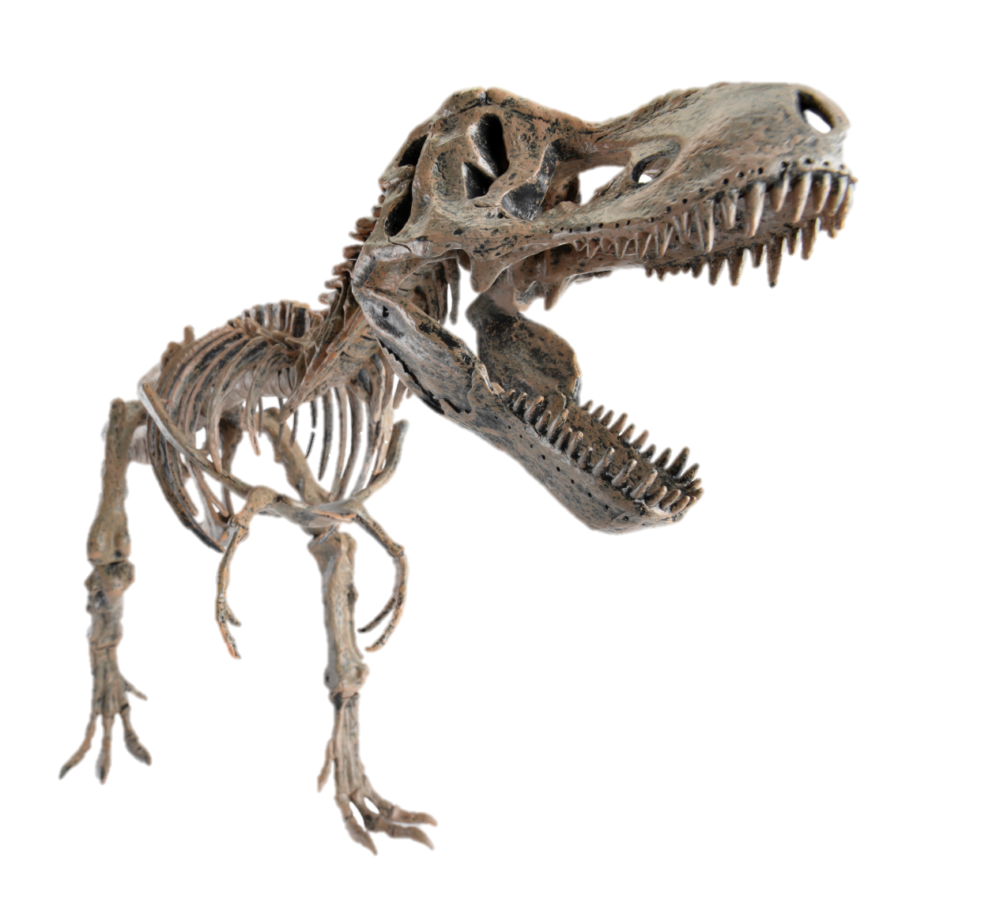
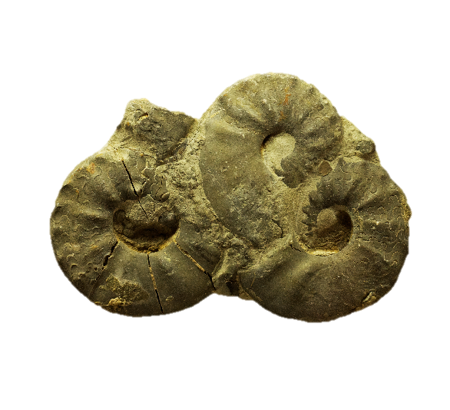
Data
Notes:
Take these ammonite fossils or this T-rex skeleton for example. Their placement in the fossil record is data.

Slide 45
Interpretations
These creatures used to be alive, died, and became fossilized
These creatures died because of a meteorite strike
These creatures died in Noah’s flood
Notes:
A fairly simple interpretation of the data is that these creatures used to be alive, died, and became fossilized. / A more specific claim would be that these creatures died because of a meteorite strike / or because of Noah’s flood. More data would be needed to support these more specific claims.

Slide 46
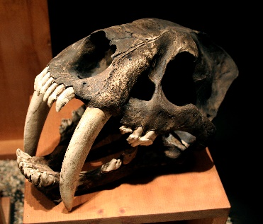
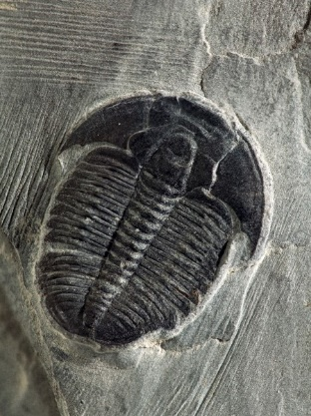
Data
Notes:
The location of these fossils in the layers of the geologic column is data.

Slide 47
Interpretations
This trilobite fossil from the Paleozoic was buried before the Smilodon fossil in the Cenozoic
The trilobite was buried weeks before the Smilodon
The trilobite was buried millions of years before the Smilodon
Notes:
That the trilobite fossil from the Paleozoic was buried before the Smilodon in the Cenozoic is a fairly simple interpretation of the data based on the principle of superposition. / The idea that the trilobite was buried weeks before the Smilodon is a more specific interpretation, / as is the idea that it was buried millions of years before.

Slide 48
Interpretations
This trilobite fossil from the Paleozoic was buried before the Smilodon fossil in the Cenozoic
The trilobite was buried weeks before the Smilodon
The trilobite was buried millions of years before the Smilodon
Requires more evidence
Notes:
It takes more evidence to substantiate interpretations that include specific amounts of time than it does to support the simple claim that the trilobite was buried first.

Slide 49
Be careful not to make interpretations that are not justified by the data
Notes:
We need to be careful not to make interpretations that are not justified by the data.

Slide 50
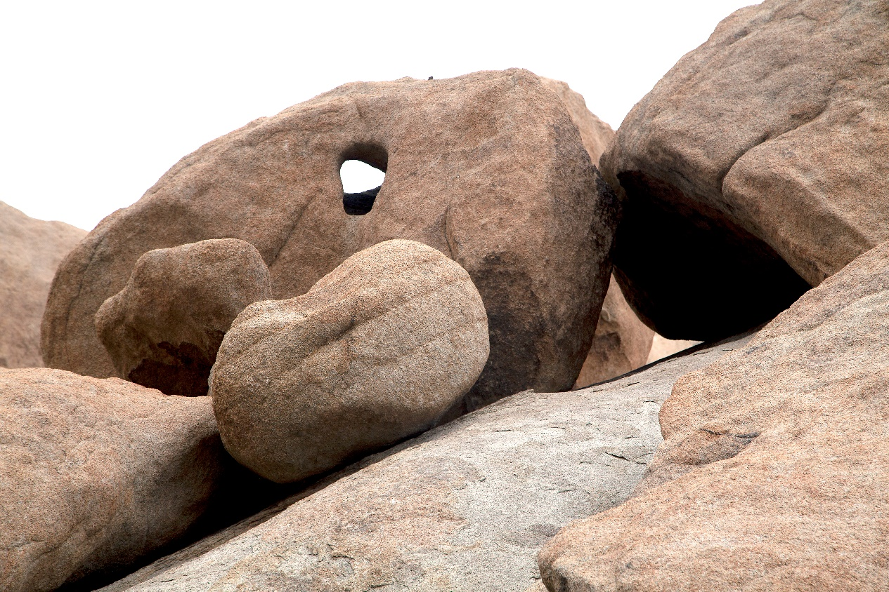
Appropriate or Inappropriate Conclusions
Appropriate or Inappropriate Conclusions
Large boulders
Appear to have been deposited by fast-flowing water
Deposited there by Noah’s Flood
Large boulders
Appear to have been deposited by fast-flowing water
Deposited there by Noah’s Flood
Notes:
Look at these boulders for example. Their size and position are data. Depending on the data, an appropriate interpretation may be that they appear to have been deposited there by fast-flowing water. But to conclude that they were definitely deposited there by Noah’s Flood would be a conjecture not justified by the data.

Slide 51
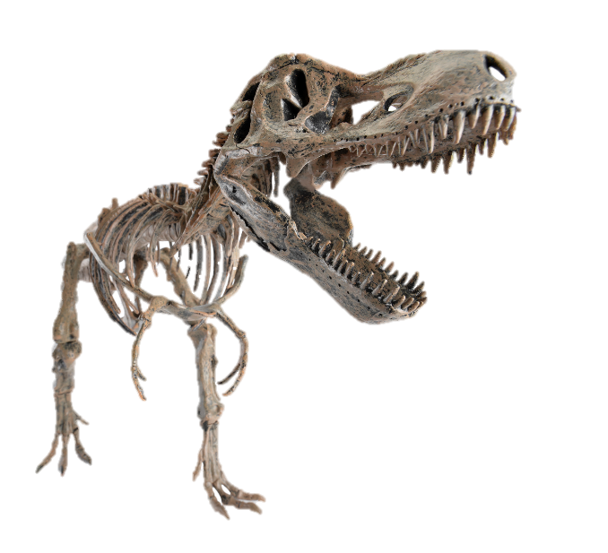
Appropriate or Inappropriate Conclusions
Data
Interpretation
Soft tissue found in dinosaur bones
Dinosaurs died in the flood
Dinosaur bones are thousands rather than millions of years old
Notes:
Paleontologists have discovered some soft tissue—like blood vessels and bone cells—in fossilized dinosaur bones. / That is data. / Which interpretation best fits this particular piece of evidence? / That dinosaurs died in the flood? / or that dinosaur bones are thousands rather than millions of years old?

Slide 52
Appropriate or Inappropriate Conclusions
Data
Interpretation
Soft tissue found in dinosaur bones
Dinosaurs died in the flood
Dinosaur bones are thousands rather than millions of years old
Notes:
Since we wouldn’t expect soft tissue to be preserved for millions of years, a reasonable interpretation of this data would be that dinosaur bones are only thousands rather than millions of years old. Without any additional evidence, speculating on how the dinosaur died goes beyond this particular data.

Slide 53

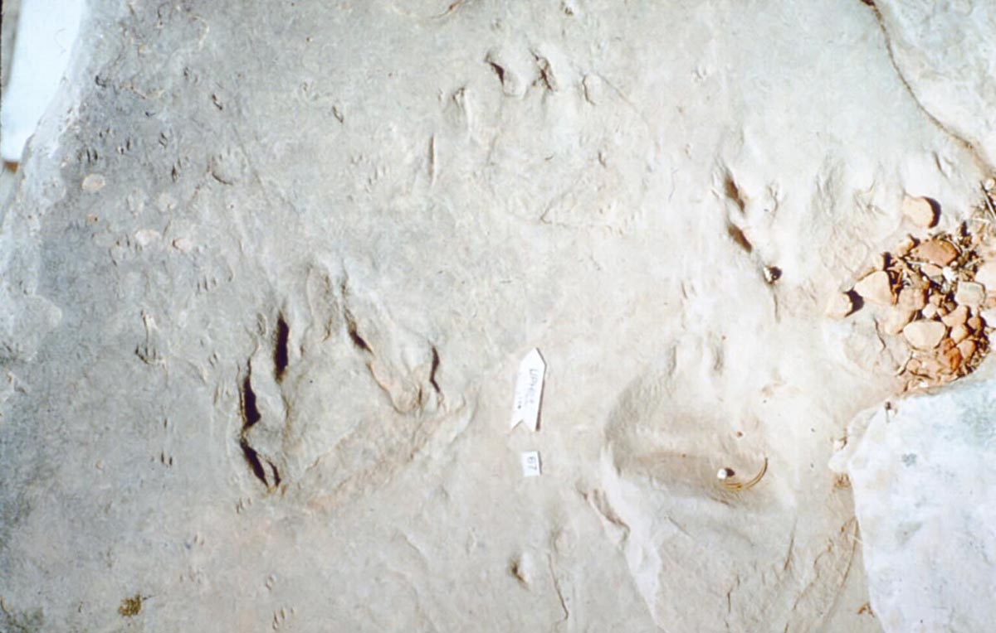
Appropriate or Inappropriate?
The fossil trackways look most like the tracks made under water
The creatures who made these tracks were definitely trying to escape during Noah’s Flood
Notes:
Let’s look at one final example. Dr. Leonard Brand studied fossil trackways in the Coconino Sandstone of the Grand Canyon. The traditional interpretation of the trackways was that they had been made on desert sand dunes. Dr. Brand performed some laboratory experiments to see whether the trackways were most like tracks made on dry sand, moist sand, or wet sand. Which of these conclusions is inappropriate because it goes beyond the data?

Slide 54
Appropriate or Inappropriate?
The fossil trackways look most like the tracks made under water
The creatures who made these tracks were definitely trying to escape during Noah’s Flood
Notes:
Dr. Brand’s results did, in fact, show that the trackways were most like the tracks made underwater in his experiments, so this conclusion is appropriate. / Without additional evidence, though, it would be inappropriate to conclude that the animals who made these tracks were definitely trying to escape during Noah’s Flood.

Slide 55
Data and Interpretation
Explanations not supported by the data
Noah’s Flood?
Explanations supported by the data
Data
Notes:
Let this black box represent the data we have just looked at—the boulder, soft tissue in the dinosaur bone, and the fossil trackways. / Then let this oval represent the reasonable, appropriate interpretations we have suggested to explain the data. / Let this larger rectangle represent other interpretations that go beyond the data. While it may actually be true that the boulder was deposited, the dinosaur was killed, and the trackways were deposited during the flood, we need to be careful not to jump to that conclusion without enough data to support it. If we do, we can damage the reputation of creationists by giving the impression that we are not careful scientists.

Slide 56
The more data that is explained by an interpretation, the more confidence we may have in the interpretation
Notes:
The more data that is explained by an interpretation, the more confidence we may have in the interpretation.

Slide 57
Avoid using the word “proof”
Scientists:
Don’t prove things
Gather evidence
Remain open to the possibility that new evidence will change previous conclusions
Notes:
Another important thing to remember when we talk about interpretations of data is that scientists avoid using the word proof. Scientists really don’t prove things. They gather evidence but are always open to the possibility that new evidence will change their previous conclusions.

Slide 58
Avoid using the word “proof”
Better to say:
The evidence
is consistent with
creation or the flood
Notes:
So when we are talking about scientific evidence, it is better to say that the evidence is consistent with creation or the flood, rather than that the evidence proves something.

Slide 59
Notes:
This doesn’t mean we are any less confident that God created the world or that there was a worldwide flood. But it does acknowledge that our belief in those things is based on more than just the scientific evidence.

Slide 60
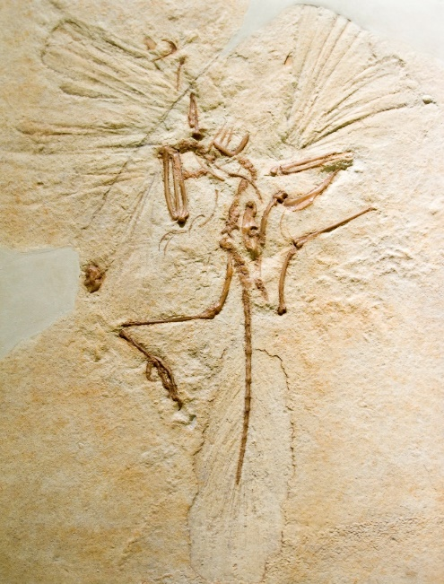
How to Evaluate Scientific Claims
1. Distinguish between data and interpretation
“Dinosaurs evolved
into birds”
Data
Interpretation
Notes:
So, how should we evaluate scientific claims? / The first step is to distinguish between the data and interpretation. / Let’s say you see a story on the news about the discovery of a dinosaur fossil with the imprint of a feather, / and the scientist being interviewed states that dinosaurs evolved into birds. / Being able to recognize that the presence of the feather imprint in the fossil is the data / and the claim about dinosaurs evolving into birds is an interpretation of that data that requires additional evidence is a really good start.

Slide 61
How to Evaluate Scientific Claims
2. Evaluate how extensive the interpretation is
Is there enough data to substantiate more specific claims?
Buried
in the
flood
Buried
first
Buried millions
of years ago
Notes:
Next, evaluate how extensive the interpretation is. / Let’s say the claim is about a certain fossil. / Is the claim something simple like “this fossil was buried first, before the fossils in a higher layer” / or does it make a more extensive claim like how the fossil was buried / or when it was buried? / If it’s more specific or extensive, is there enough other evidence to support it?

Slide 62
How to Evaluate Scientific Claims
3. Identify the worldview that affected the interpretation
  Evolutionists are not always wrong
  Creationists are not always right
Notes:
Be aware of the worldview that probably affected the interpretation, but remember: / Evolutionists are not always wrong, / and creationists are not always right.

Slide 63
How to Evaluate Scientific Claims
Ask yourself whether the interpretation conflicts with any other evidence?
  Scientific data
  Evidence from the Bible
If so, what other interpretations are possible?
Notes:
Ask yourself whether the interpretation conflicts with any other evidence. / This could include scientific data or other evidence from the Bible. / If the interpretation does conflict with any other evidence, what other interpretations are possible?

Slide 64
Unanswered Questions
Notes:
Sometimes evaluating scientific claims will leave you with unanswered questions, but that’s okay. For ideas about how to handle them, watch our next presentation.

Slide 65
Images By
Images may appear on more than one slide. Citation is given on the first slide where each image appears.
[1] Slide design, Susan Landon
[5] A colorful Red-Eyed Tree Frog 14376031, ABDESIGN, Getty Images (US), Inc. Subscription
[6] Zebra from Istock 12841852, WLDavies, Getty Images (US), Inc. Subscription
[7a] Sunset over New Orleans 63275535, Sam Camp, Getty Images (US), Inc. Subscription
[7b] Terrestrial map of USA 34615996, AlexanderZam, Getty Images (US), Inc. Subscription
[8a] Maple leaf 11952274, xxmmxx, Getty Images (US), Inc. Subscription
[8b] Autumn leaf 992654, ILLYCH, Getty Images (US), Inc. Subscription
[8c] Forest brilliance 4250904, emptyclouds, Getty Images (US), Inc. Subscription
[9] Dimetrodon 178583890, leonello, Thinkstock, Thinkstock Image Subscription Agreement
[10a] Measuring tree 40780366, Thawatchai1991, Getty Images (US), Inc. Subscription
[10b] Sequoia 5648787, imagentix, Getty Images (US), Inc. Subscription
[11] Acorn 16215518, dionisvero, Getty Images (US), Inc. Subscription
[12] Humming bird wings beating 266672, kevdog818, Getty Images (US), Inc. Subscription
[13] Poison ivy 9649643, sdominick, Getty Images (US), Inc. Subscription
[15] Two trees 1319354, RelaxFoto.de, Getty Images (US), Inc. Subscription

Slide 66
Images By
[22] Eyewear 22951606, PashaIgnatov, Getty Images (US), Inc. Subscription
[24a] Bible by candlelight 474122041, Jeffjaq, Thinkstock, Thinkstock Image Subscription Agreement
[24b] Microscope, 14983265, AndreaAstes, Getty Images (US), Inc. Subscription
[27] Structural homology, Susan Landon
[29] Trilobites Russian (Ordovician) 596507, bobainsworth, Getty Images (US), Inc. Subscription
[34] Tyrannosaurus Rex skeleton 23393902, LeventKonuk, Getty Images (US), Inc. Subscription
[37] Archaeopteryx 178406740, demarfa, Thinkstock, Thinkstock Image Subscription Agreement
[44b] Ammonites 54540080, Wlad74, Getty Images (US), Inc. Subscription
[46a] Saber-toothed cat skull 825334, pixeldigits, Getty Images (US), Inc. Subscription
[46b] Elrathia kingii Trilobite 144970604, Russell Shively, Thinkstock, Thinkstock Image Subscription Agreement
[50] Boulders 42552526, Rmiramontes, Getty Images (US), Inc. Subscription
[53a] Leonard Brand, PhD, http://www.llu.edu/pages/faculty/directory/faculty.html?uid=lbrand, used with permission
[53b] Coconino tracks, Leonard Brand, used with permission

Slide 67
Special Thanks
Foundation for Adventist Education

Slide 68

© Origins Curriculum Resources 2015

Slide 69

© Southern Adventist University 2015

Slide 70

© Seventh-day Adventist North American Division 2015

Slide 71

© General Conference of Seventh-day Adventists 2015

Slide 72

© SCORE Southern Center for Origins Research & Education 2015

