Slide 1
Before watching this presentation, you are encouraged to watch Three-Step Conflict Resolution, which summarizes a portion of the book Choose You This Day by Leonard Brand and Richard Davidson

Slide 2

Unanswered Questions
Notes:
Origins 101—Unanswered Questions

Slide 3

Three-Step Conflict Resolution
Conflict & Confusion
Research & Study
Resolution & Insight
Takes time
Leonard Brand and Richard Davidson
Choose You This Day
Notes:
This three-step conflict resolution model suggested by Leonard Brand and Richard Davidson in Choose You This Day illustrates how apparent conflicts between scientific evidence and evidence from Scripture have been and continue to be resolved by more research and study. This process often takes considerable time

Slide 4
Unanswered Questions
Notes:
In the meantime, while continued study happens, what do we do with unanswered questions?

Slide 5
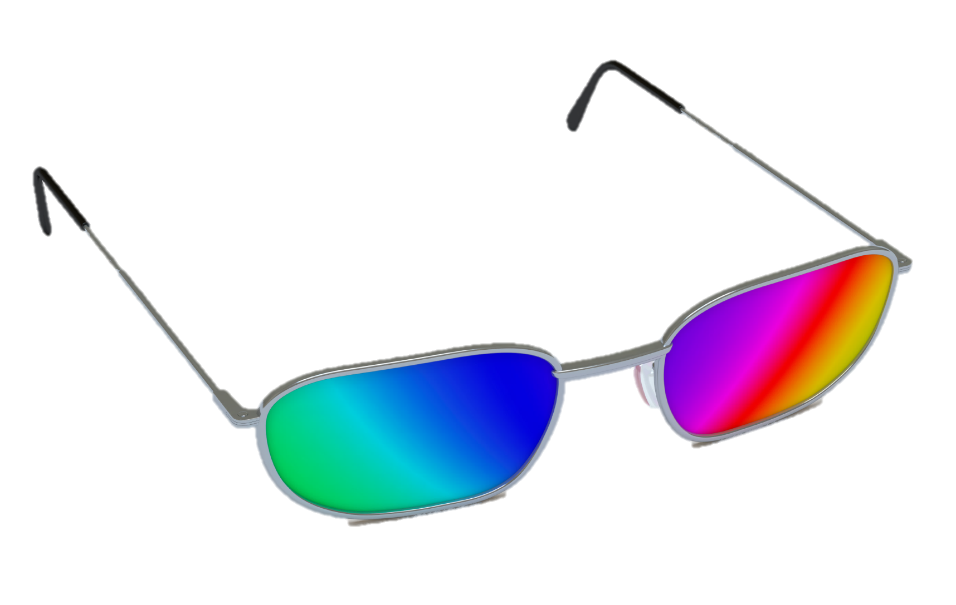
Notes:
Worldview affects EVERYONE and has a lot to do with how people handle unanswered questions.. Most people—including both creationists and evolutionists--are unwilling to abandon a worldview just because of unanswered questions.

Slide 6
?
Interpretation
Data
Notes:
Let’s say there is data that suggest a specific interpretation. / But there may be data missing or there may be conflicting data that leave us with unanswered questions.

Slide 7
Faith
Interpretation
Data
Notes:
The bridge that continues to connect us to our interpretation, even in the face of unanswered questions, is faith. Faith in what?

Slide 8
Worldview
Faith in a worldview
Interpretation
Data
Notes:
Our worldview. It’s possible that some people might be willing to abandon their worldview when they don’t have all the answers. But those who have chosen their worldview after careful analysis aren’t likely to give it up that quickly. If they believe strongly enough in their worldview, they are more likely to bridge the gap with faith and continue to look for the missing evidence.

Slide 9
Biblical Worldview
Faith
Creation/Flood
Data
Notes:
For example, a scientist with a biblical worldview will look for explanations of data that are consistent with events described in the Bible.

Slide 10
Naturalism
Faith
Evolution/
Long Ages
Data
Notes:
While a scientist with a naturalistic worldview will consider only natural explanations of the data because those would be consistent with his/her worldview.

Slide 11
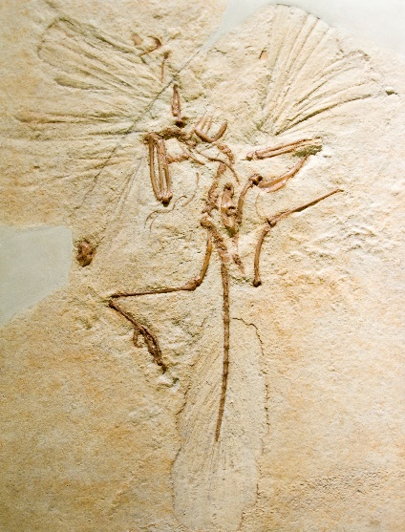
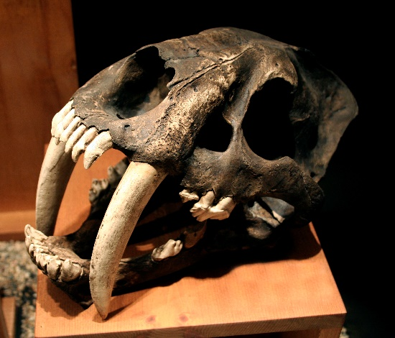
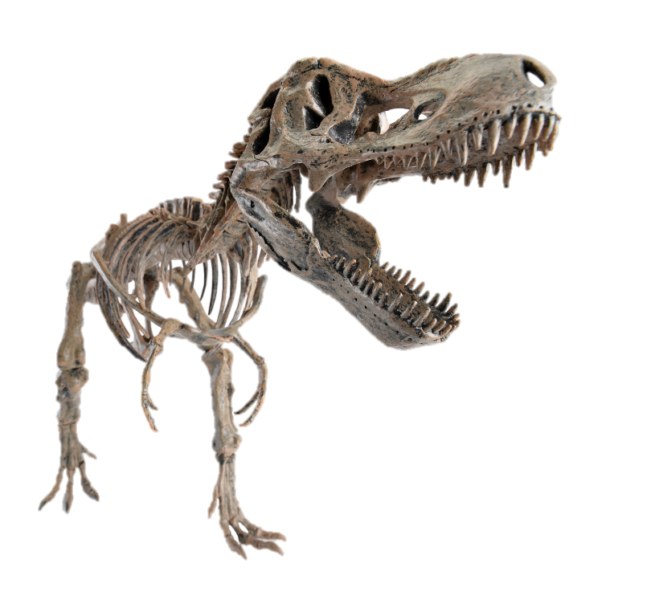
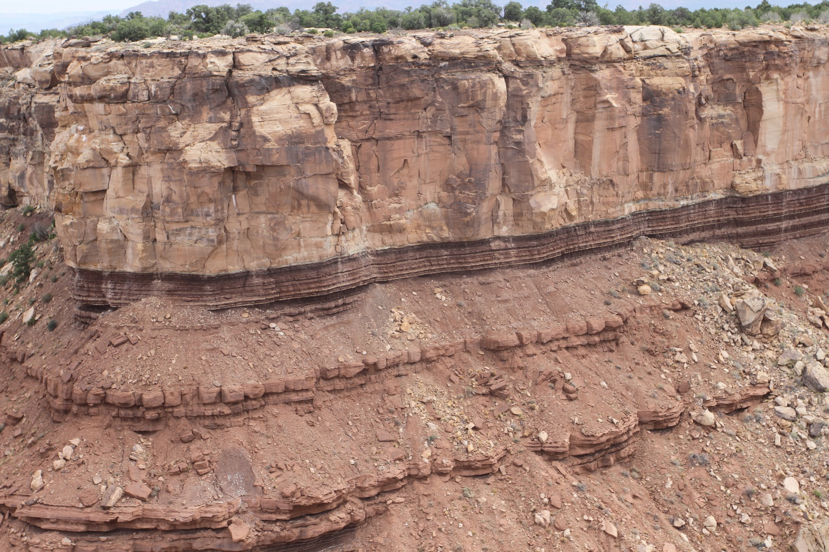
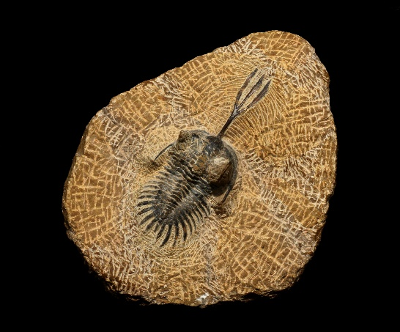
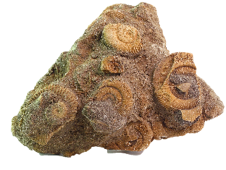
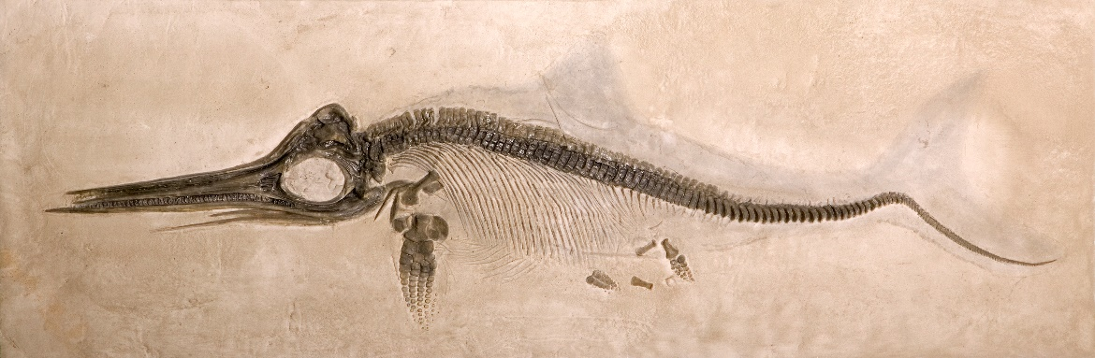
Age of Rocks
& Fossils?
Notes:
Let’s look at a specific example—the age of the rocks and fossils found in the geologic column

Slide 12

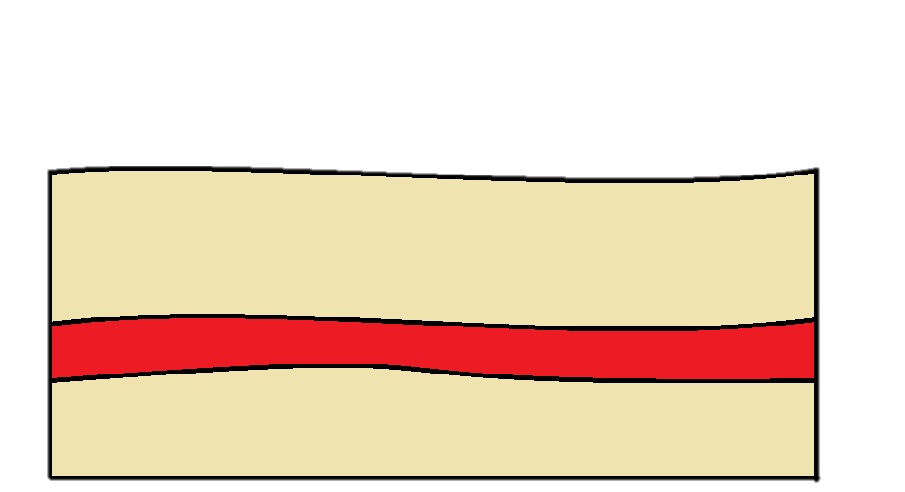
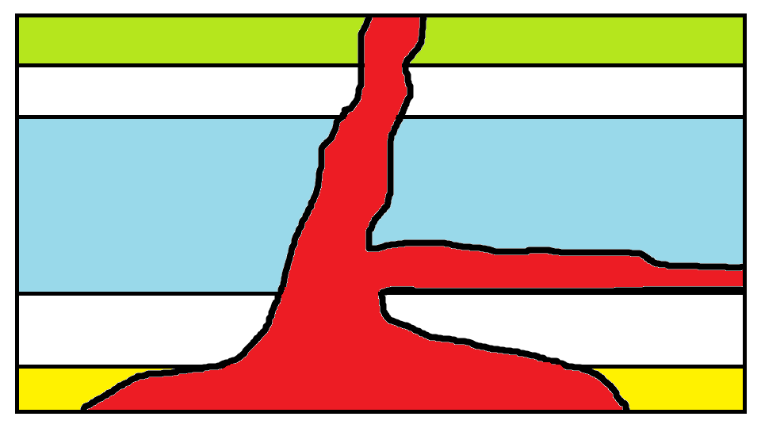
Conflicting Evidence
Millions of years
Notes:
Conflicting evidence exists. If you haven’t already, we recommend watching the Geologic Column B series. Episodes 12-15 describe the process of radiometric dating and how the radiometric dates of the volcanic rock within the geologic column seem to indicate that it is many millions of years old.

Slide 13
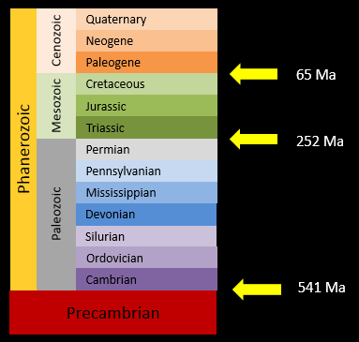
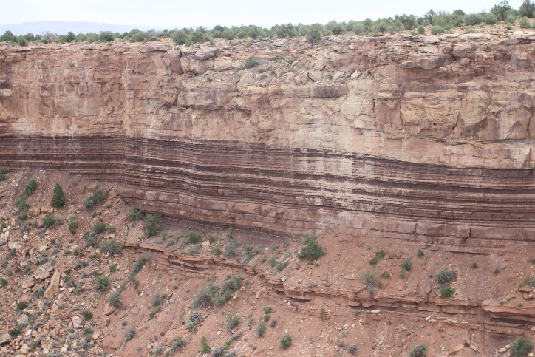
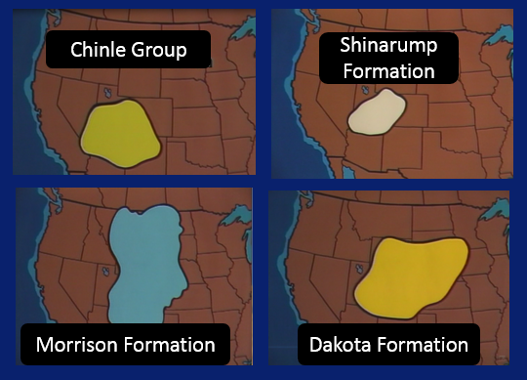
Conflicting Evidence
Millions of Years
Shorter Time Span
Radiometric dating gives ages in the millions of years
Flat gaps
Lack of bioturbation
Widespread layers
Notes:
In contrast, / other data described in episode 11 of the Geologic Column B series suggests that the geologic column was formed in a much shorter time span.

Slide 14
Naturalism
Faith
?
GC laid down over many millions of years
Radiometric
Dating
Flat Gaps
Notes:
A scientist with a naturalistic worldview sees that radiometric dates are consistent with the geologic column being laid down over many millions of years / but can’t explain how the flat contact between certain layers could remain flat and free from bioturbation for the millions of years of supposed exposure. / Because he has confidence in his naturalistic worldview, / he exercises faith, and continues to interpret the data in a way that is consistent with that worldview even though unanswered questions remain.

Slide 15
Biblical Worldview
Faith
?
GC laid down quickly during and immediately after the flood
Flat Gaps
Lack of Bioturbation
Radiometric Dates
Notes:
A scientist with a biblical worldview sees that flat gaps and lack of bioturbation are consistent with the geologic column being laid down relatively quickly during the flood but can’t explain why the radiometric dates of the volcanic rocks within the geologic column are measured in millions of years instead of thousands. Because he has confidence in his biblical worldview, he exercises faith, and continues to interpret the data in a way that is consistent with that worldview even though unanswered questions remain.

Slide 16

Inspired Word of God
Notes:
Why would someone put that sort of confidence in the Bible? / Several lines of evidence provide a strong foundation for believing in the authority of Scripture:

Slide 17
Inspired Word of God
Manuscript evidence
Notes:
More copies of biblical manuscripts exist than any other piece of classic literature, with remarkable consistency between them, as demonstrated by the discovery of the Dead Sea Scrolls.

Slide 18
Inspired Word of God
Internal consistency
66 books written by over 40 different writers, over 1,500 years
Notes:
There is an impressive internal consistency among the 66 books, even though they were written by over 40 different writers, over more than 1,500 years.

Slide 19
Inspired Word of God
Evidence from
Archaeology
History
Fulfilled prophecy
Notes:
Solid evidence that the Bible is the inspired word of God is available from archaeology, history, and fulfilled prophecy.

Slide 20
Inspired Word of God
Changed lives
Notes:
Perhaps one of the most compelling reasons to believe in the Bible is the evidence of changed lines.

Slide 21
Inspired Word of God
No need to fear that honest investigation will disprove it
Notes:
Because the Bible is the inspired word of God, / we do not need to fear that honest investigation will disprove it

Slide 22

Inspired Word of God
Standard
Notes:
The Bible is the standard against which all the elements of our belief system must be assessed

Slide 23
Inspired Word of God
Biology, geology, etc.
Notes:
While there is a body of data from biology, geology, and many other fields that are consistent with creation and the flood, we believe in them primarily because of the Bible

Slide 24


Faith
?
Interpretation
Data
Notes:
It is our faith in the Bible that forms a bridge between the data we have already and the interpretations that are consistent with our worldview.

Slide 25
Recorded at
Chattanooga Public RadioSM
Classical 90.5 WSMC

Slide 26
Images By
Images may appear on more than one slide. Citation is given on the first slide where each image appears.
[2] Slide design, Susan Landon
[5] Eyewear 22951606, PashaIgnatov, Getty Images (US), Inc. Subscription
[11a] Moenkope/Shinarump contact, Leonard Brand, used with permission
[11b] Archaeopteryx 178406740, demarfa, Thinkstock, Thinkstock Image Subscription Agreement
[11c] Saber-toothed cat skull 825334, pixeldigits, Getty Images (US), Inc. Subscription
[11d] Tyrannosaurus Rex skeleton 23393902, LeventKonuk, Getty Images (US), Inc. Subscription
[11e] Dactylioceras ammonite 553823, Gloda, Getty Images (US), Inc. Subscription
[11f] Trilobite 35519138, demarfa, Getty Images (US), Inc. Subscription
[11g] Ichthyosaur 5364039, Tyrannosaur, Getty Images (US), Inc. Subscription
[12a] Lava between two rock layers, Thomas Bartlett
[12b] Erupt 175129634, Colematt, Thinkstock, Thinkstock Image Subscription Agreement
[12c] Magma illustration, Thomas Bartlett
[13b] Screen shots from Evidences DVD, Geoscience Research Institute, 1990, used with permission
[16] Vintage old book 95272278, Sharon Bronte, Thinkstock, Thinkstock Image Subscription Agreement
[22] Scales 39240126, jerry2313, Getty Images (US), Inc. Subscription

Slide 27
Special Thanks
Foundation for Adventist Education

Slide 28

© Origins Curriculum Resources 2015

Slide 29

© Southern Adventist University 2015

Slide 30

© Seventh-day Adventist North American Division 2015

Slide 31

© General Conference of Seventh-day Adventists 2015

Slide 32

© SCORE Southern Center for Origins Research & Education 2015

