Slide 1
The Creation-Evolution Debate
Notes:
Origins 101: / Introduction to the Creation-Evolution Debate

Slide 2
Origins
Beginnings
Notes:
Origins means beginnings.

Slide 3
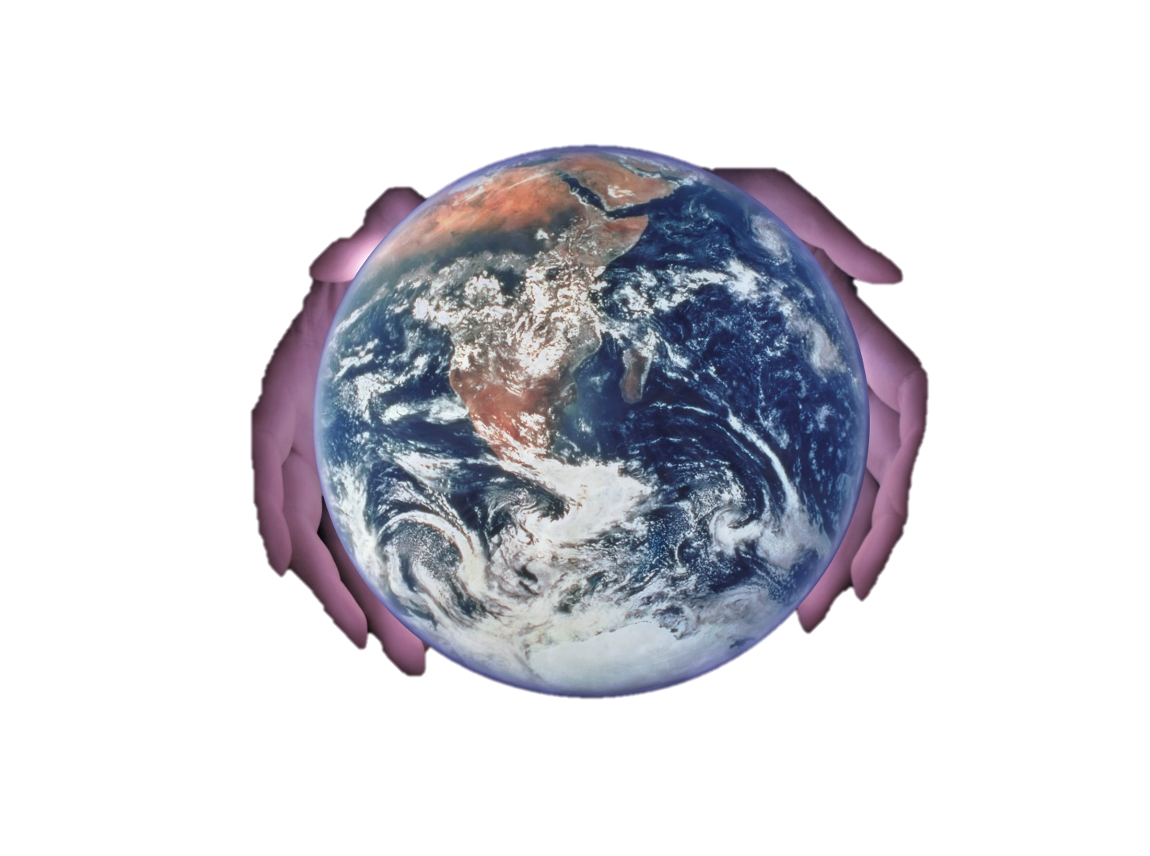
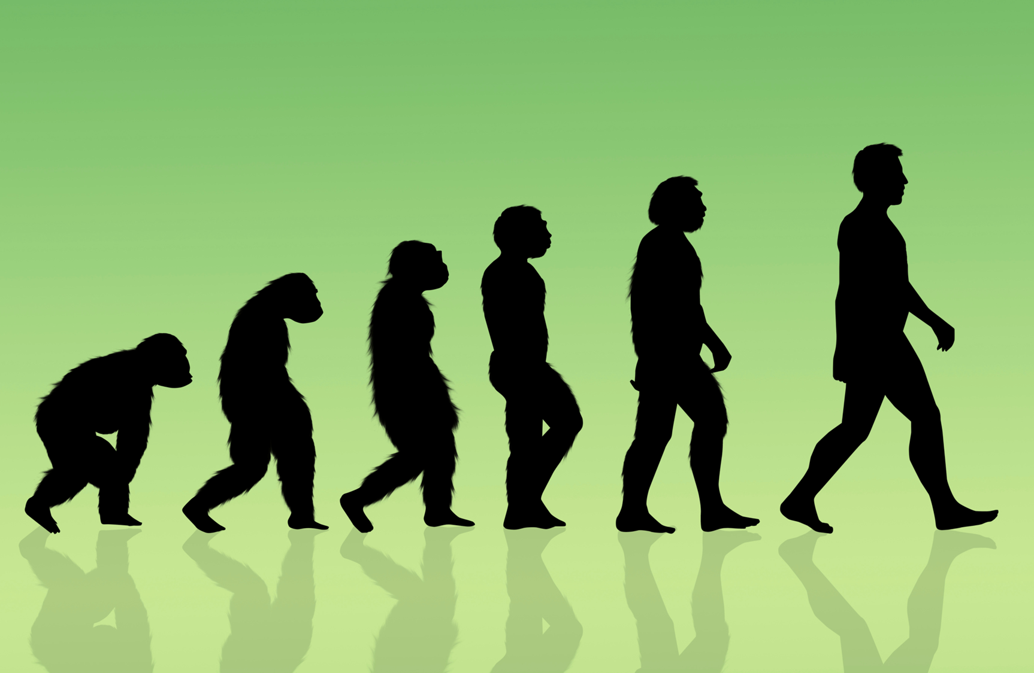
Creation
Evolution
Notes:
There are two main ideas about where we came from: creation and evolution. In the Origins 101 series, we will explore these ideas and look at some of the evidence that is presented to support them.

Slide 4
In the beginning, God created the heavens and the earth.
Genesis 1:1
The earth's creatures have evolved through a series of contingent and fortuitous events.
Stephen Jay Gould
Scientific American, Oct. 1994
Notes:
The Bible states that we were created by God. In contrast, / many scientists claim that the earth’s creatures have evolved through a series of random but fortunate events.

Slide 5
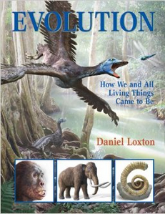
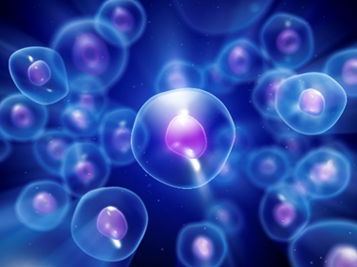
Claims About Evolution
Evolution is the most important idea in all of biology
Notes:
Let’s take a look at some claims about evolution. Remember that these are claims—not truth statements. / One book for children / claims that evolution is the most important idea in all of biology / that evolution created both the terrible teeth of a T-rex / and the beauty of a rose petal, / and that it can generate new diseases.

Slide 6
The Fact of Evolution
“…scientific debate over descent with modification virtually ended by the mid-1870s. Evolution was, and is, an established fact.”
Evolutionary Analysis, 4th edition, by Scott Freeman and Jon C. Herron, (2007) p. 73
Notes:
One author claims that the debate ended long ago, and that evolution is now an established fact.

Slide 7
The Fact of Evolution
"The idea that life has evolved…is as much a descriptive fact about nature as the fact that the sky is blue. ”
Evolution: What the Fossils say and Why It Matters by Donald R. Prothero (2007) p. 6
.
Notes:
Another author claims that evolution is as much a descriptive fact about nature as the fact that the sky is blue.

Slide 8
The Fact of Evolution
“The fact of evolution is comparable to the theory of gravitation.”
Evolution: What the Fossils say and Why It Matters by Donald R. Prothero (2007) p. 6
.
Notes:
In the same place, he compares the fact of evolution to the theory of gravitation.

Slide 9
What is Evolution?
Change over time
Change in living things over time
Notes:
In order to explore the ideas of creation and evolution, we need to understand some terms. There are different definitions of evolution. / We’ll start with the simplest one: change over time—/ specifically change in living things over time.

Slide 10
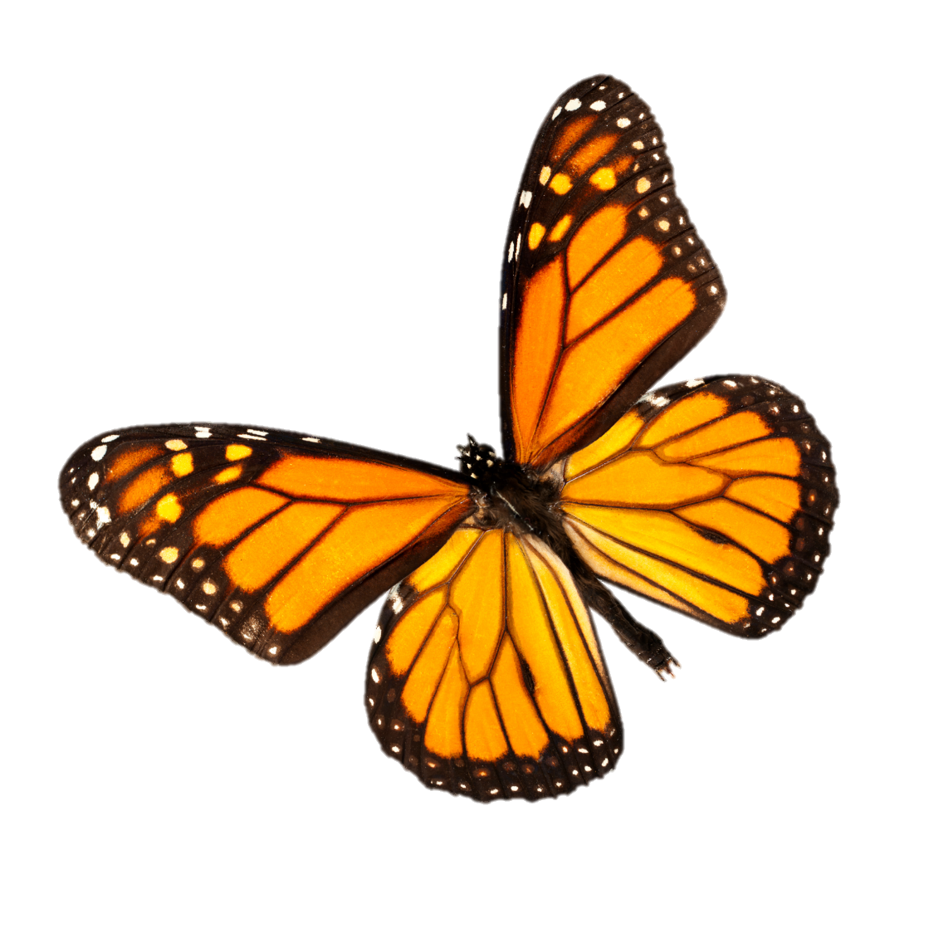
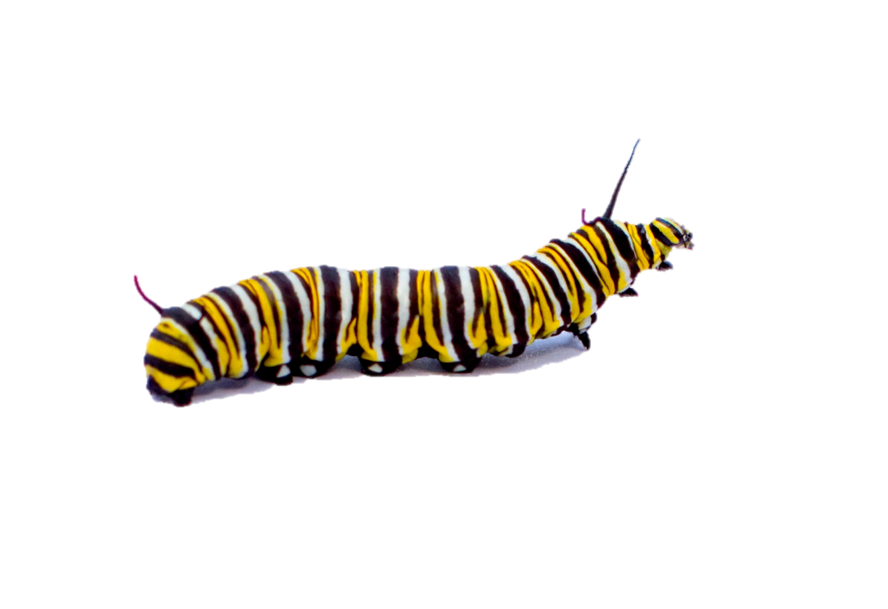
Notes:
Lots of things change—/ babies grow into children and eventually adults; / caterpillars change into butterflies / buds develop into flowers, / and green leaves turn bright colors in the fall. But these kinds of changes are not what we mean when we talk about evolution. What DO we mean?

Slide 11
Biological changes that turn one kind of living thing into another, different kind of living thing
Notes:
Not just changes in living things—/ but changes that turn one kind of living thing into another, different kind of living thing.

Slide 12
Evolution
Millions of years ago, without direction, after life emerged by chance from nonliving materials, living things evolved, producing new kinds of creatures and resulting in the great diversity we see today
Notes:
Perhaps the most robust definition of evolution is the one that says millions of years ago, without direction, after life emerged by chance from nonliving materials, living things evolved, producing new kinds of creatures and resulting in the great diversity we see today.

Slide 13
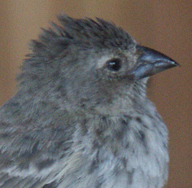
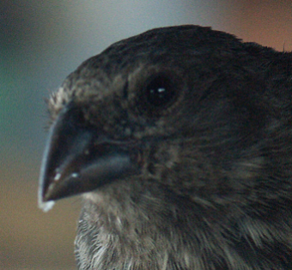
Evolution
Microevolution
Macroevolution
Small changes
Large changes
Notes:
A couple other terms we will be using are microevolution and macroevolution. Since micro means small /and macro means large, /a simple way to think about the terms is to think of small changes and large changes. / All scientists agree that small changes—like the size of Finch beaks—happen over time within populations of living creatures. / But what about big changes? There are different ideas of what constitutes macroevolution, but the bottom line is that macroevolution describes a process of much greater change— the kind and amount of change necessary to transform single living cells into various kinds of animals…

Slide 14
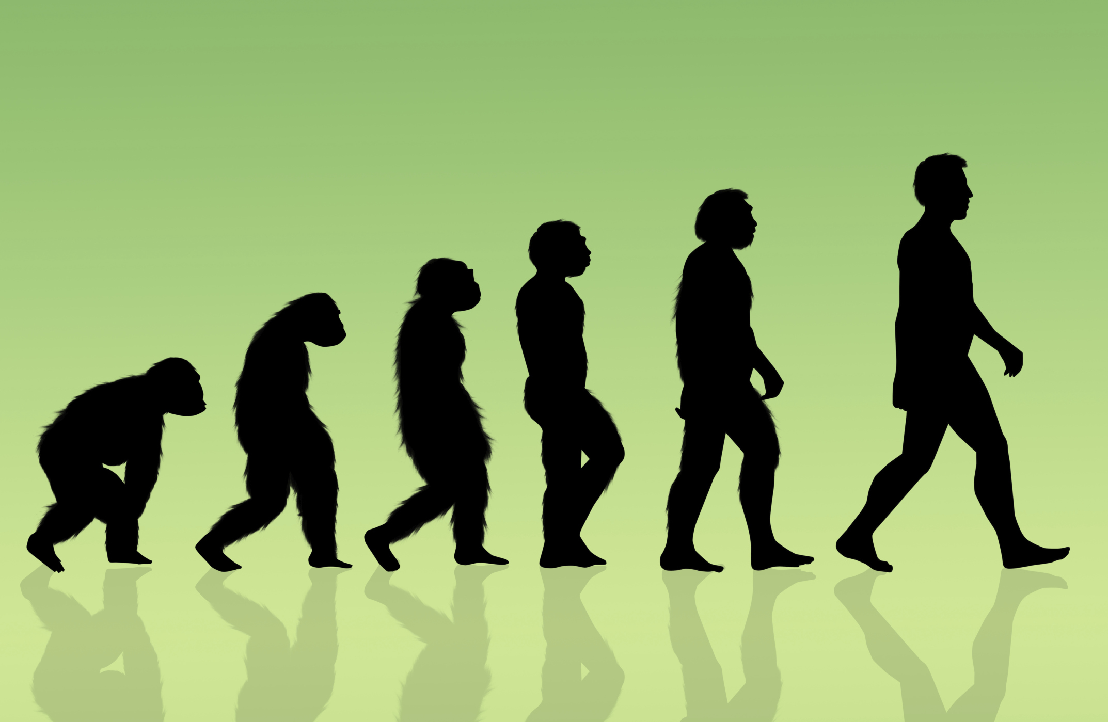
Notes:
…and eventually humans.

Slide 15
Microevolution
Macroevolution
Notes:
Are microevolution and macroevolution two different processes?

Slide 16
?
Microevolution = Macroevolution
=
Notes:
Or are they the same thing?

Slide 17
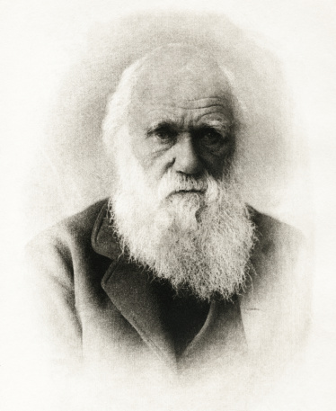
Microevolution = Macroevolution
Yes
=
Notes:
Some scientists believe—like Darwin did-- that lots of microevolutionary change over millions of years adds up to macroevolution.

Slide 18
No!
Microevolution
Macroevolution
=
Notes:
Other scientists do not.

Slide 19
Microevolution
Macroevolution
Change
in nature is limited
Notes:
While there is scientific evidence for microevolution, / the evidence indicates that the amount of change that can happen in nature is limited.

Slide 20
Learn to evaluate the evidence
Explore the claims of evolution
Next: Evolution Defined
Notes:
Throughout the Origins 101 series, / we will continue to explore the claims of evolution / and learn how to evaluate the evidence used to support both evolution and creation. / Next time we will see how the life and death of finches on the Galapagos Islands can help us understand and evaluate the claims of evolution.

Slide 21
Recorded at
Chattanooga Public RadioSM
Classical 90.5 WSMC

Slide 22
Images By
Images may appear on more than one slide. Citation is given on the first slide where each image appears.
[1] Slide design, Susan Landon
[3a] Hands holding world 3152279, IvanJekic, Getty Images (US), Inc. Subscription
[3b] Human evolution 178524048, RosellaApostoli, Thinkstock, Thinkstock Image Subscription Agreement
[5a] Dinosaur 31496000, Juanmonino, Getty Images (US), Inc. Subscription
[5b] Picture of book http://www.amazon.com/Evolution-How-Living-Things-Came/dp/1554534305
[5c] Red rose 8559596, Liliboas, Getty Images (US), Inc. Subscription
[5d] Blue cells under micrscope 000012229229 Henrik5000, Getty Images (US), Inc. Subscription
[10a] Man running 48935004, 4x6, Getty Images (US), Inc. Subscription
[10b] Boy running 5026040, lovleah, Getty Images (US), Inc. Subscription
[10c] Infant 45632588, dml5050, Getty Images (US), Inc. Subscription
[10d] Monarch butterfly 19129666, AmbientIdeas, Getty Images (US), Inc. Subscription
[10e] Caterpillar 14987058, Cameramannz, Getty Images (US), Inc. Subscription

Slide 23
Images By
[10f] Autumn leaf 992654, ILLYCH, Getty Images (US), Inc. Subscription
[10g] Green leaf 11952274, xxmmxx, Getty Images (US), Inc. Subscription
[10h] Lotus 10296869, hanhanpeggy, Getty Images (US), Inc. Subscription
[10i] Lotus bud 17366036, caoyu36, Getty Images (US), Inc. Subscription
[11] Whale evolution, Dr. Philip Gingerich, John Klausmeyer, & The University of Michigan Museums of Natural History, used with permission
[13a] Small Ground Finch Geospiza fuliginosa, Tim Standish, used with permission
[13b] Medium Ground Finch Geospiza fortis, Tim Standish, used with permission
[17] Charles Darwin 16835919, picture, Thinkstock, Thinkstock Image Subscription Agreement

Slide 24
Special Thanks
Foundation for Adventist Education

Slide 25
© Origins Curriculum Resources 2015

Slide 26
© Southern Adventist University 2015

Slide 27
© Seventh-day Adventist North American Division 2015

Slide 28
© General Conference of Seventh-day Adventists 2015

Slide 29
© SCORE Southern Center for Origins Research & Education 2015

