Slide 1
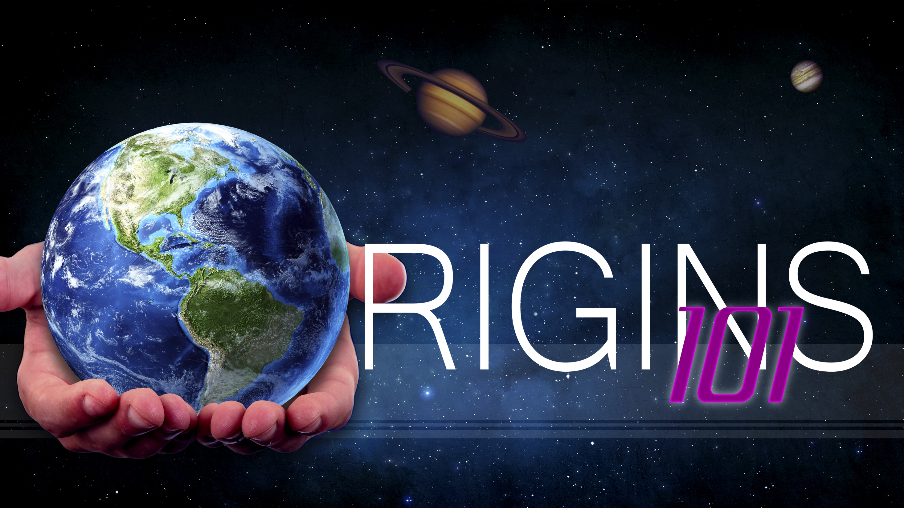
Natural Selection
Notes:
Origins 101—Natural Selection

Slide 2

Microevolution:
Change in gene frequency
in a population over time
Notes:
In our last presentation, we defined microevolution as change in gene frequency in a population over time.

Slide 3
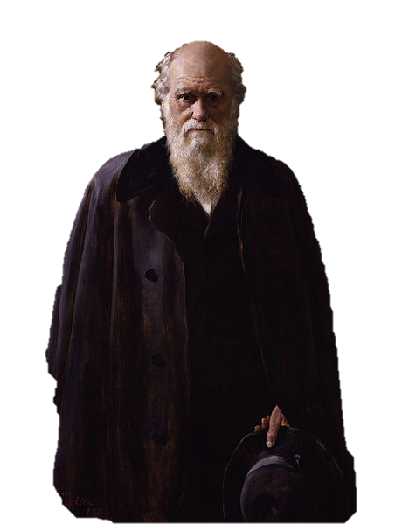
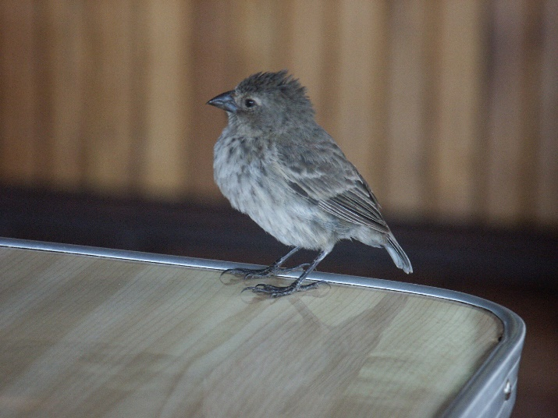
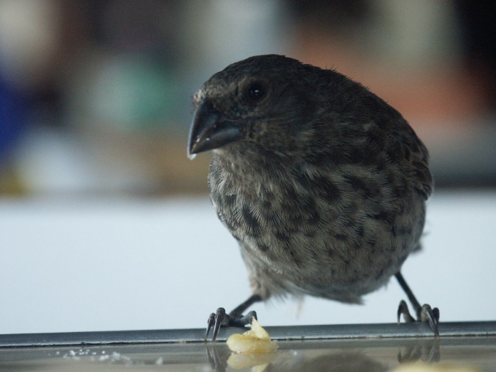
Natural Selection
Notes:
The example of how this happened within the finch population on the Galapagos Islands illustrates the idea that Charles Darwin is most famous for—/ natural selection.

Slide 4
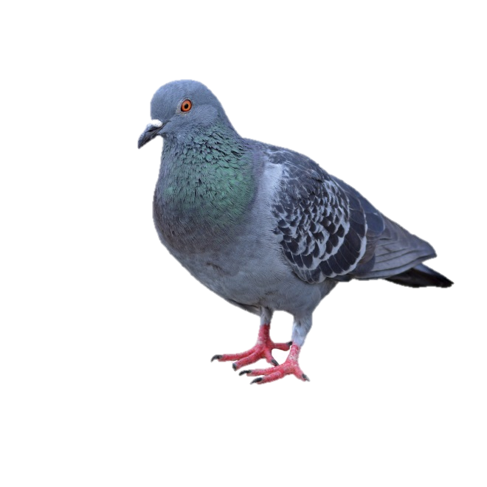
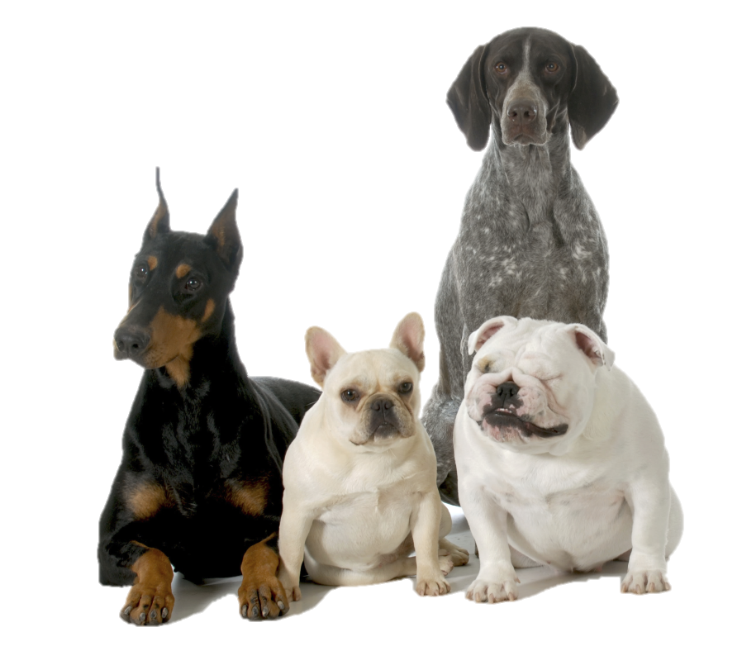
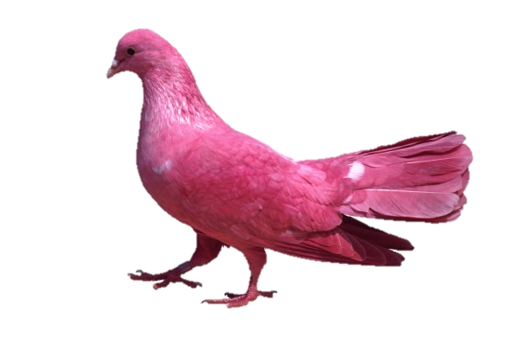
Artificial Selection
Notes:
Darwin first thought of this idea because of what he knew about artificial selection.

Slide 5
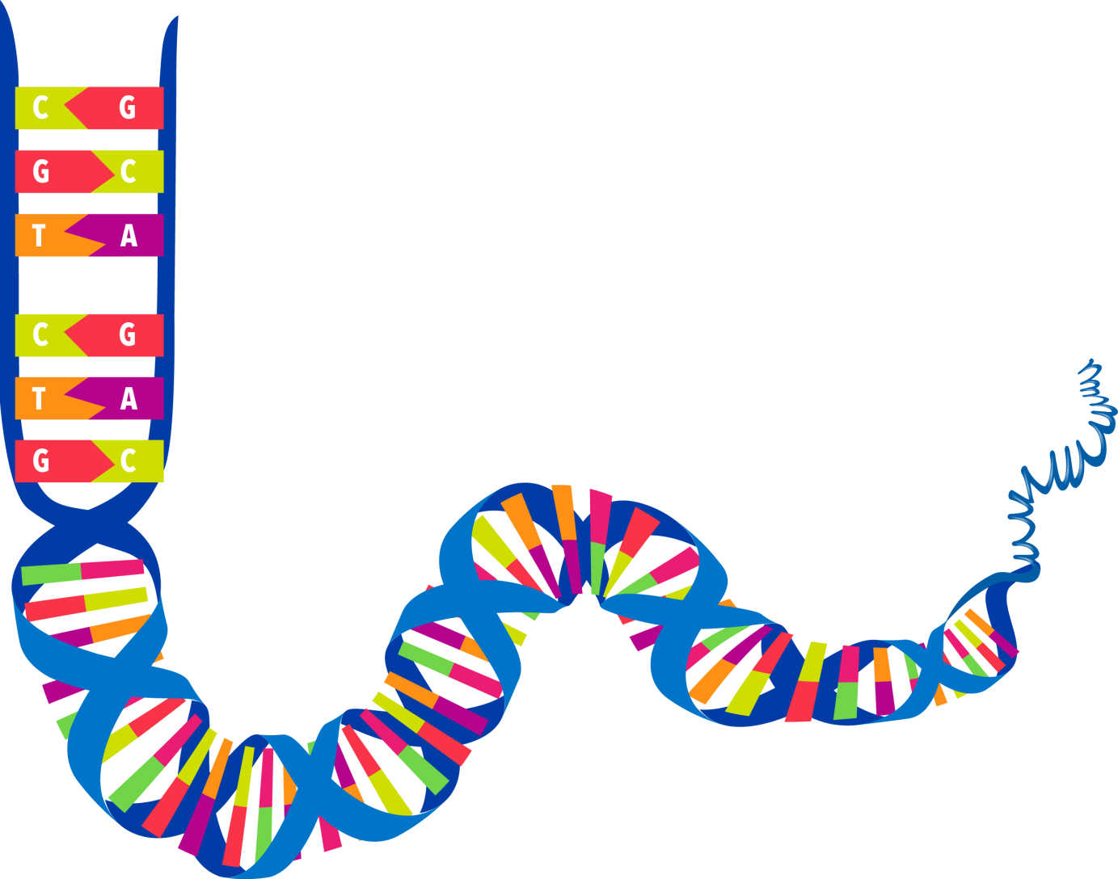



Genes
Notes:
Darwin knew nothing about genes / but he did know that dog breeders could influence the kinds of traits dogs had by carefully choosing to breed only the dogs with certain traits.

Slide 6

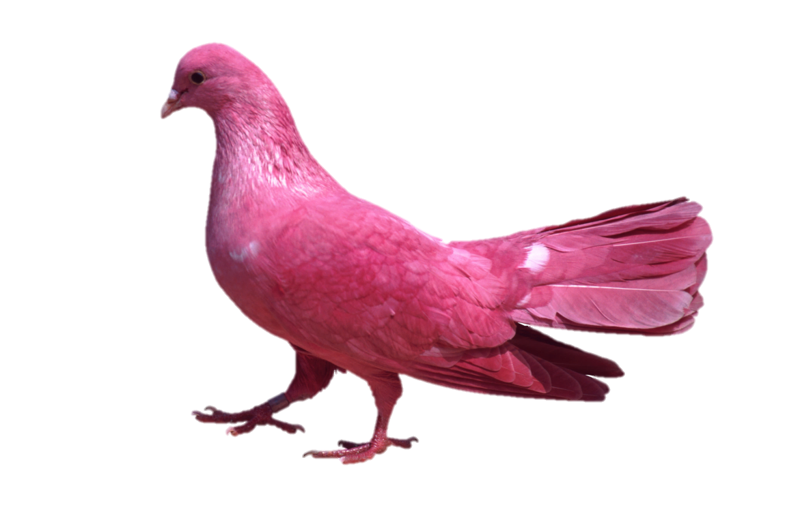
Notes:
He did the same thing with his hobby—which was breeding pigeons.

Slide 7
Artificial Selection
Notes:
This process of purposely influencing which traits are passed on to the next generation is called artificial selection.

Slide 8
Artificial
Natural
Selection
Notes:
Darwin thought a similar process might be going on in nature, / but without anyone or anything guiding the process. / This idea—which Darwin called natural selection—can be explained using what are often called Darwin’s four postulates:

Slide 9
1. Overproduction
& Competition
More offspring are born than can survive
Notes:
Number 1: More offspring are born than can survive on the available resources, / which leads to competition. / Organisms must compete with each other for those resources.

Slide 10


2. Variation
Will influence which organisms survive and reproduce
Notes:
Number 2: Variation exists in the population and will influence which organisms survive to pass on their genes and which don’t.

Slide 11
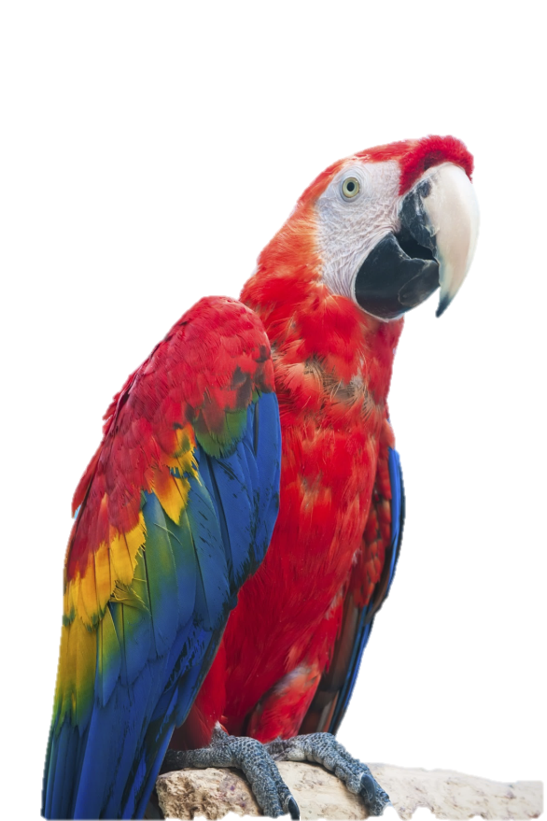
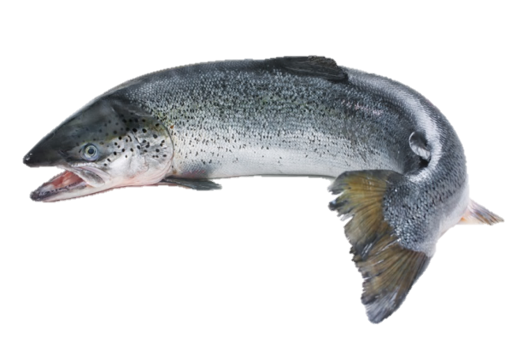
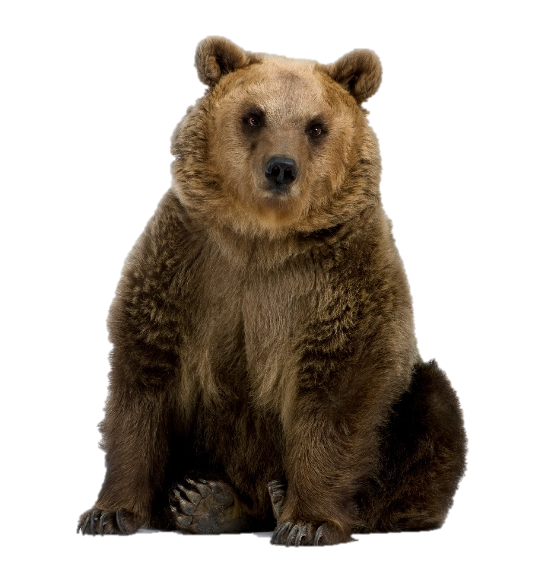
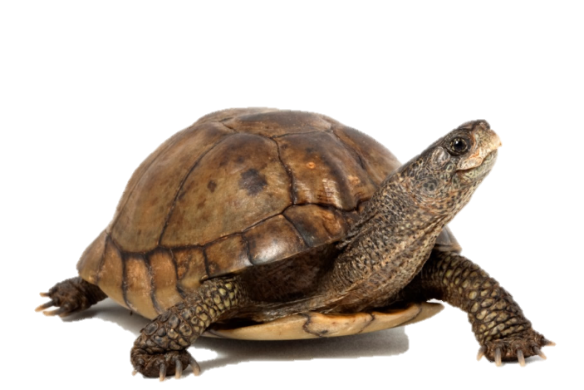
3. Adaptations
Beneficial
Helpful
Advantageous
TRAITS
Notes:
Number 3: Adaptations are the beneficial traits that give an organism an advantage in the struggle for survival.

Slide 12
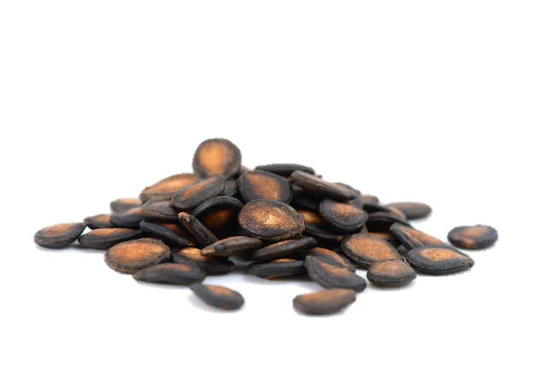
3. Adaptations
Drought—large beaks
Notes:
During drought conditions in the Galapagos Islands, having a large beak was most advantageous for a finch / because most of the seeds available at the time were large.

Slide 13

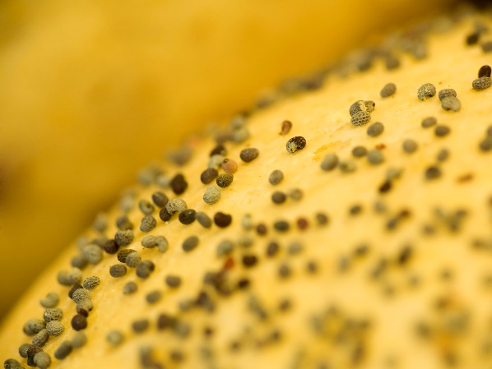
3. Adaptations
Wet—small beaks
Notes:
But during especially wet weather, when small seeds were more plentiful, a small beak was the more helpful adaptation.

Slide 14
4. Natural Selection
Some survive and reproduce
Because of favorable traits that can be passed on to offspring
Notes:
Number 4: Darwin called this process by which some creatures survive and reproduce and others don’t—natural selection. And unless they are affected by some chance event, the creatures most likely to survive and reproduce are those with the most favorable traits that can be passed on to their offspring.

Slide 15
4. Natural Selection
“Survival of the Fittest”
Fitness: having the most babies
Notes:
Have you ever heard the phrase “survival of the fittest?” This refers to the idea that the organisms with the traits necessary to survive, are more likely to live long enough to have babies and pass their genes on to the next generation. / In this context, fitness is defined as having the most babies.

Slide 16
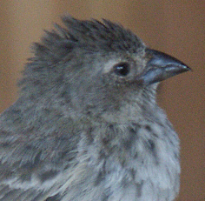
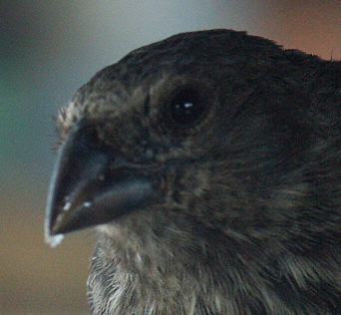
Survival of the Fittest
Wet
Drought
Small-beaked birds
Large-beaked birds
Notes:
During the drought conditions, / the large-beaked birds were most fit / because they survived to have more offspring. During the wet conditions, / the small-beaked birds were most fit / because they survived to have more offspring.

Slide 17
Darwin’s 4 Postulates
1. Overproduction/Competition
2. Variation
3. Adaptations
4. Natural Selection
Notes:
According to Darwin, as natural selection

Slide 18
Darwin’s 4 Postulates
1. Overproduction/Competition
2. Variation
3. Adaptations
4. Natural Selection
Notes:
Acts on the variation present within a population,

Slide 19
Darwin’s 4 Postulates
1. Overproduction/Competition
2. Variation
3. Adaptations
4. Natural Selection
Notes:
Those that compete best live to reproduce while others do, not,

Slide 20
Darwin’s 4 Postulates
1. Overproduction/Competition
2. Variation
3. Adaptations
4. Natural Selection
Gene frequency changes
Microevolution
Notes:
gene frequency changes, / and microevolution occurs.

Slide 21
Darwin’s Contribution
Mechanism: Natural Selection
“Survival of the Fittest”
Notes:
Other scientists had suggested evolution before, / but Darwin’s specific contribution to the theory was his suggestion that natural selection was the mechanism that caused evolution. / He borrowed the term “survival of the fittest” from Herbert Spencer because it fit what he was trying to explain.

Slide 22
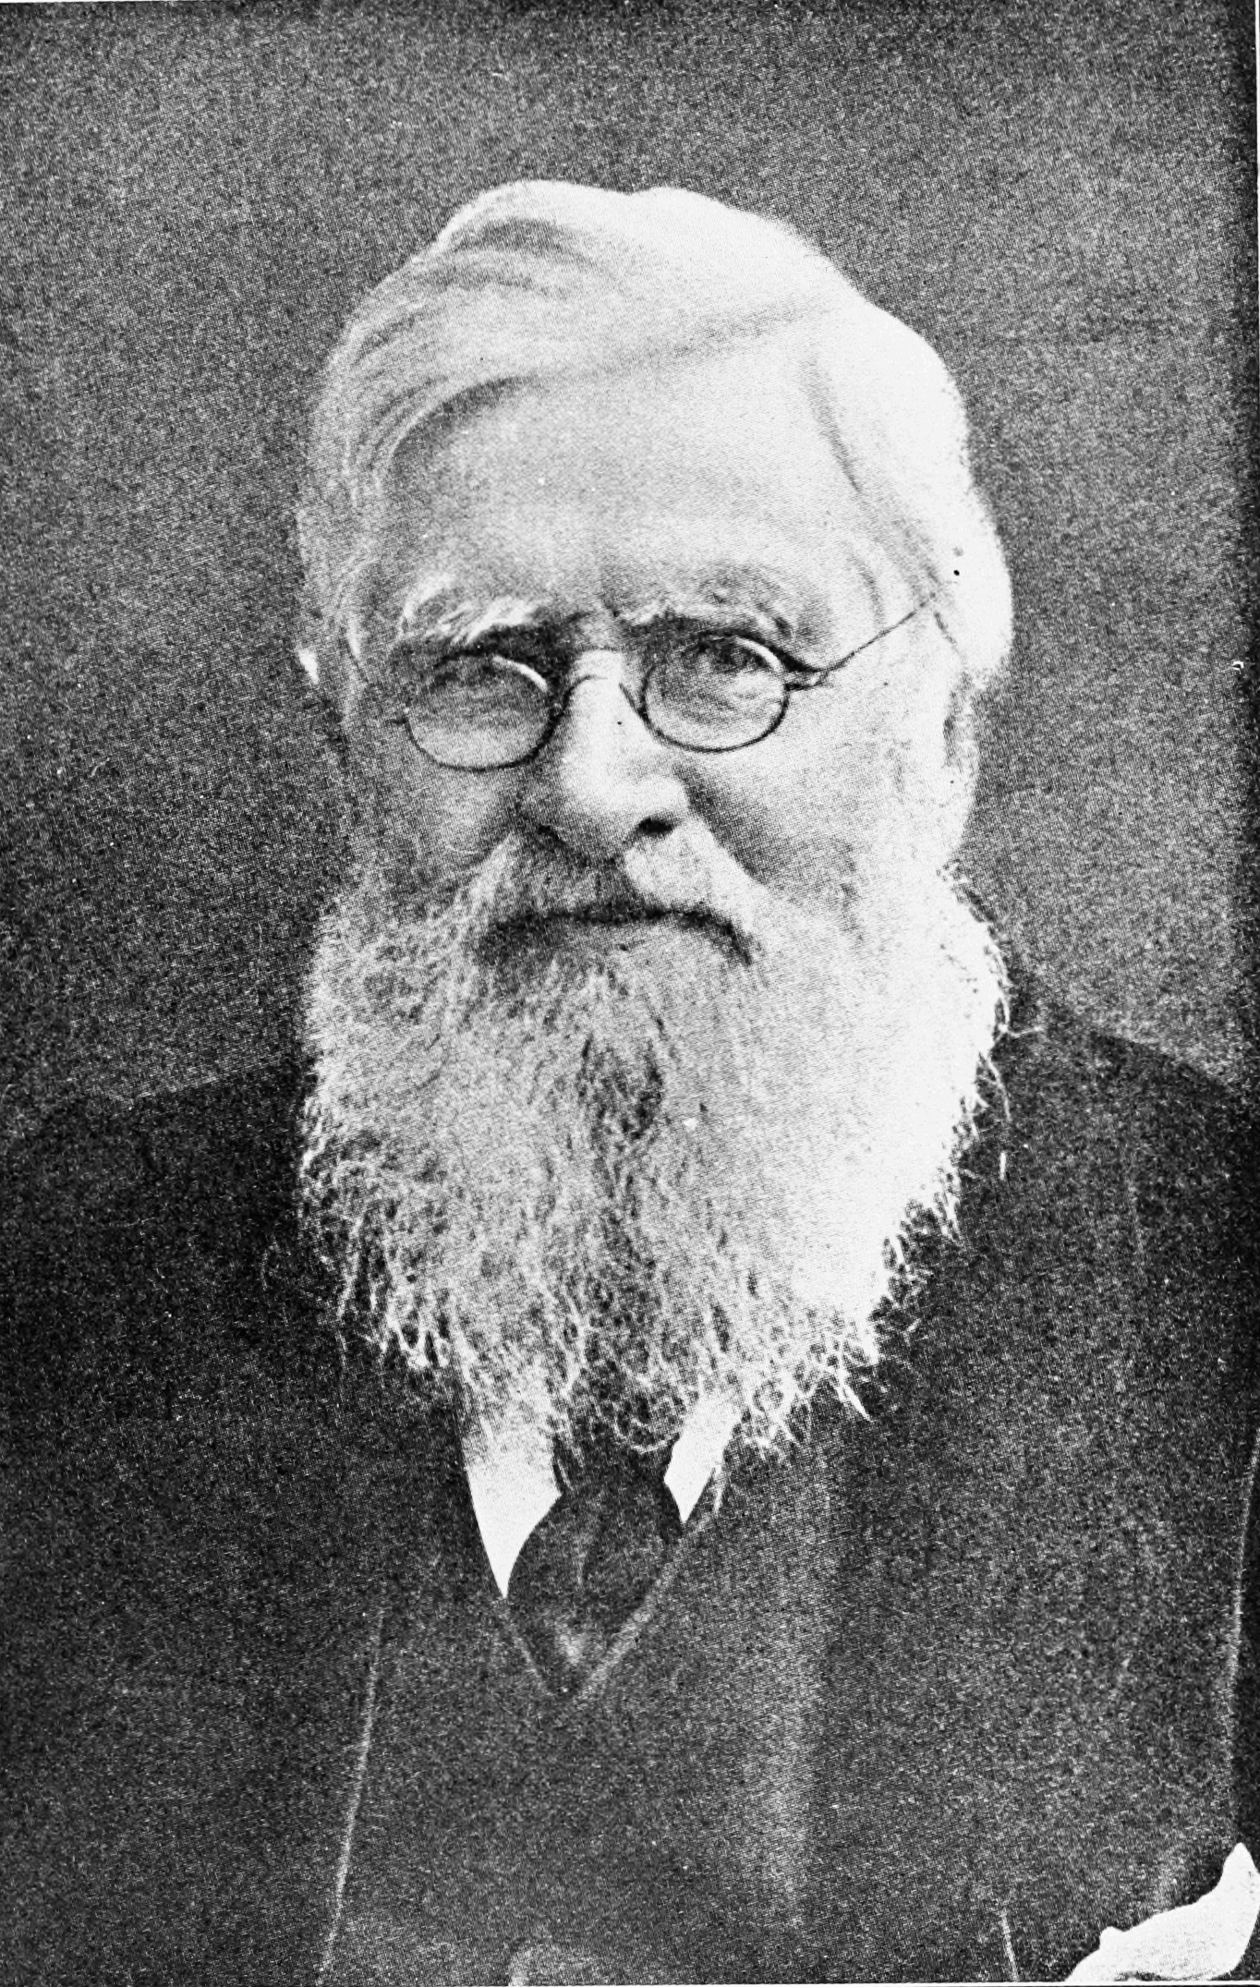
Alfred Wallace
&
Charles Darwin
Notes:
Darwin thought of the idea in 1838, but he waited to publish it because of the controversy he knew his theory would generate. / In the meantime, a man named Alfred Wallace thought of the same idea and wrote Darwin for advice about an article. / They ended up publishing the idea jointly.

Slide 23
Natural Selection
Wet
Drought
Small-beaked birds
Large-beaked birds
Gene frequency changes
Notes:
Darwin was right about natural selection happening in nature. / The survival of those with helpful adaptations changes the gene frequency in a population.

Slide 24
The Fact of Evolution
Change in gene frequency because of natural selection
Microevolution
Notes:
When people refer to evolution as a fact, they are referring to this change in gene frequency because of natural selection.

Slide 25
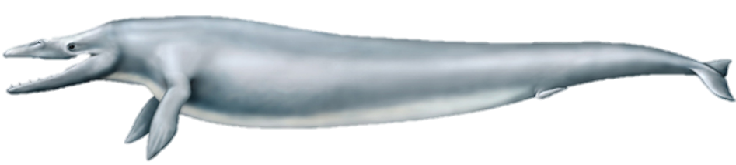
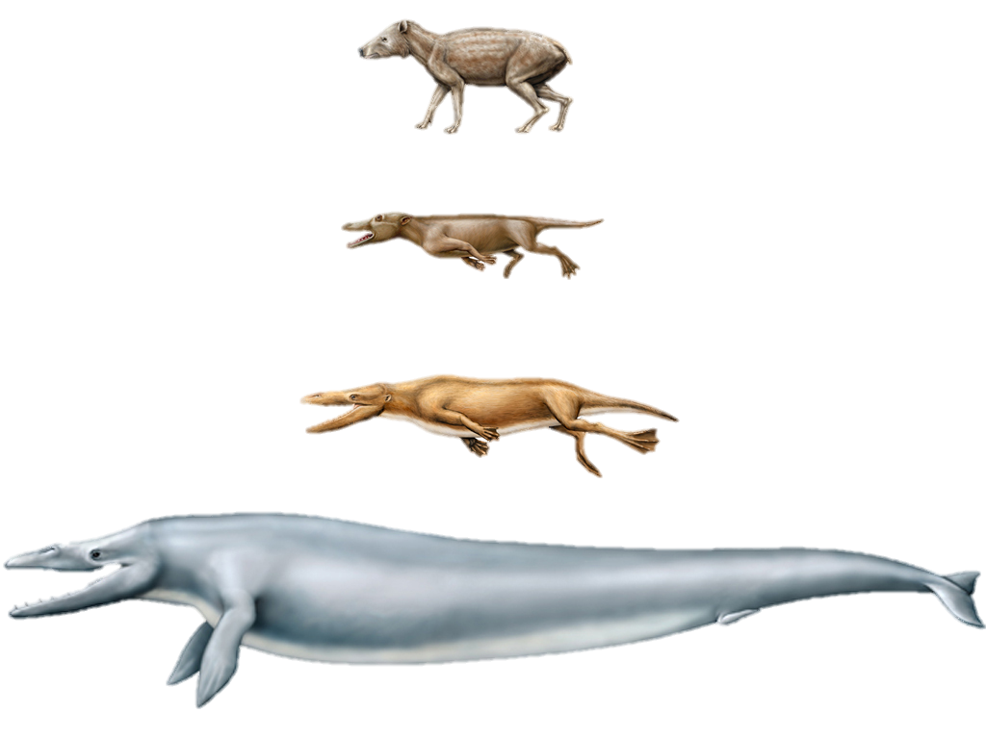

Natural
Selection
Macroevolution
Notes:
What cannot be demonstrated / is that natural selection is capable of producing the major changes necessary /to change one animal into another kind of animal.

Slide 26
Sources of Variation
Notes:
Origins 101: / Sources of Variation

Slide 27
Recorded at
Chattanooga Public RadioSM
Classical 90.5 WSMC

Slide 28
Images By
Images may appear on more than one slide. Citation is given on the first slide where each image appears.
[1] Slide design, Susan Landon
[3a] Small Ground Finch Geospiza fuliginosa, Tim Standish, used with permission
[3b] Medium Ground Finch Geospiza fortis, Tim Standish, used with permission
[3c] Charles Robert Darwin by John Collier, Uploaded by Dcoetzee,, http://commons.wikimedia.org/wiki/File:Charles_Robert_Darwin_by_John_Collier.jpg, public domain
[4a] Pigeon 452498905, thawats, Thinkstock, Thinkstock Image Subscription Agreement
[4b] Pink pigeon 71029211, John Foxx, Thinkstock, Thinkstock Image Subscription Agreement
[4c] Four dogs 462241365, WilleeCole, Thinkstock, Thinkstock Image Subscription Agreement
[5a] DNA, Susan Landon
[11a] Macaw 453680067, sydeen, Thinkstock, Thinkstock Image Subscription Agreement
[11b] Atlantic salmon 182261618, AlexRaths, Thinkstock, Thinkstock Image Subscription Agreement
[11c] Coahuilan box turtle 93385233, amwu, Thinkstock, Thinkstock Image Subscription Agreement
[11d] Brown bear 13749720, GlobalP, Getty Images (US), Inc. Subscription

Slide 29
Images By
[12b] Melon seeds 40447322 antpkr, Getty Images (US), Inc. Subscription
[13] Seeds 7103827, Jo De Vulder, Shutterstock standard license, overlay - Joaquin Hernandez
[16a] Small ground finch, Tim Standish, used with permission
[16b] Darwin's Finch, Buster&Bubby, https://www.flickr.com/photos/buster-and-bubby/9845129465/in/photostream/, CC BY-NC-ND 2.0.
[22] Alfred Russel Wallace, http://commons.wikimedia.org/wiki/File:PSM_V74_D405_Alfred_Russel_Wallace.png, public domain
[25a-d] Whale Evolution, Dr. Philip Gingerich, John Klausmeyer, & The University of Michigan Museums of Natural History, used with permission

Slide 30
Special Thanks
Foundation for Adventist Education

Slide 31

© Origins Curriculum Resources 2015

Slide 32

© Southern Adventist University 2015

Slide 33

© Seventh-day Adventist North American Division 2015

Slide 34

© General Conference of Seventh-day Adventists 2015

Slide 35

© SCORE Southern Center for Origins Research & Education 2015

