Slide 1
To help you understand the information in this presentation, it would be helpful for you to watch these first:
Origins 101 (1-3)
DNA, Chromosomes, and Genes
Mutations 1
Mutations 2

Slide 2
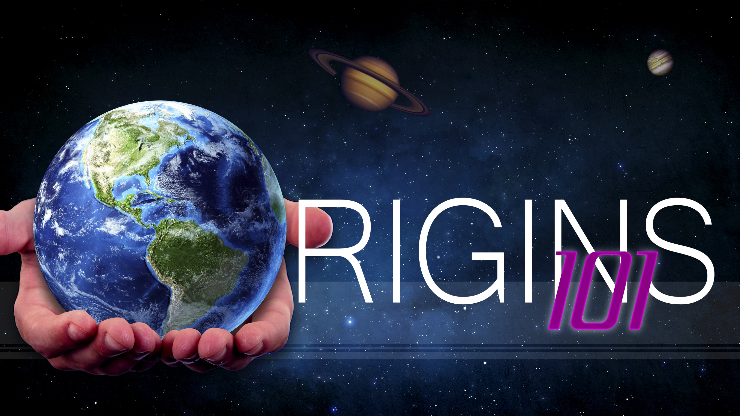
Sources of Variation
Notes:
Origins 101: / Sources of Variation

Slide 3
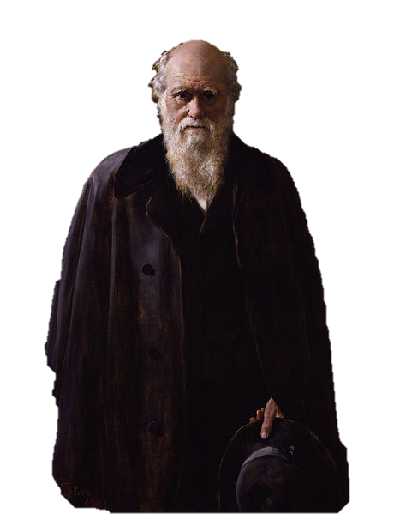
Overproduction
Variation
Adaptation (advantageous traits)
Natural Selection
Notes:
You have already learned that variation is an important piece of Darwin’s theory of evolution.

Slide 4
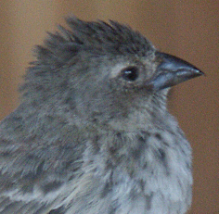
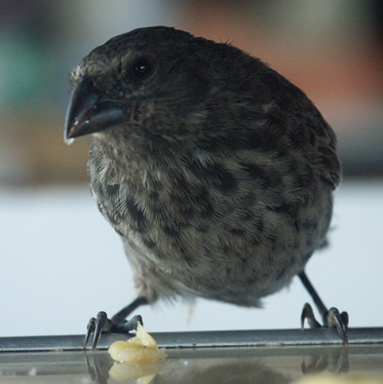
Variation
Notes:
It was variation in beak size that enabled the finch population on the Galapagos Islands to survive periods of drought or heavy rain.

Slide 5
Natural Selection
The process known as natural selection enabled the finches with the most advantageous beak size to survive.
Natural selection cannot create traits.
Natural selection can only work once a certain trait exists.
Notes:
The process known as natural selection enabled the finches with the most advantageous beak size to survive. / But it’s important to understand that natural selection cannot create beneficial traits. / It can only work once a certain trait exists in the population.

Slide 6

Variation
Notes:
It was variation in beak size that enabled the finch population on the Galapagos Islands to survive periods of drought or heavy rain.

Slide 7
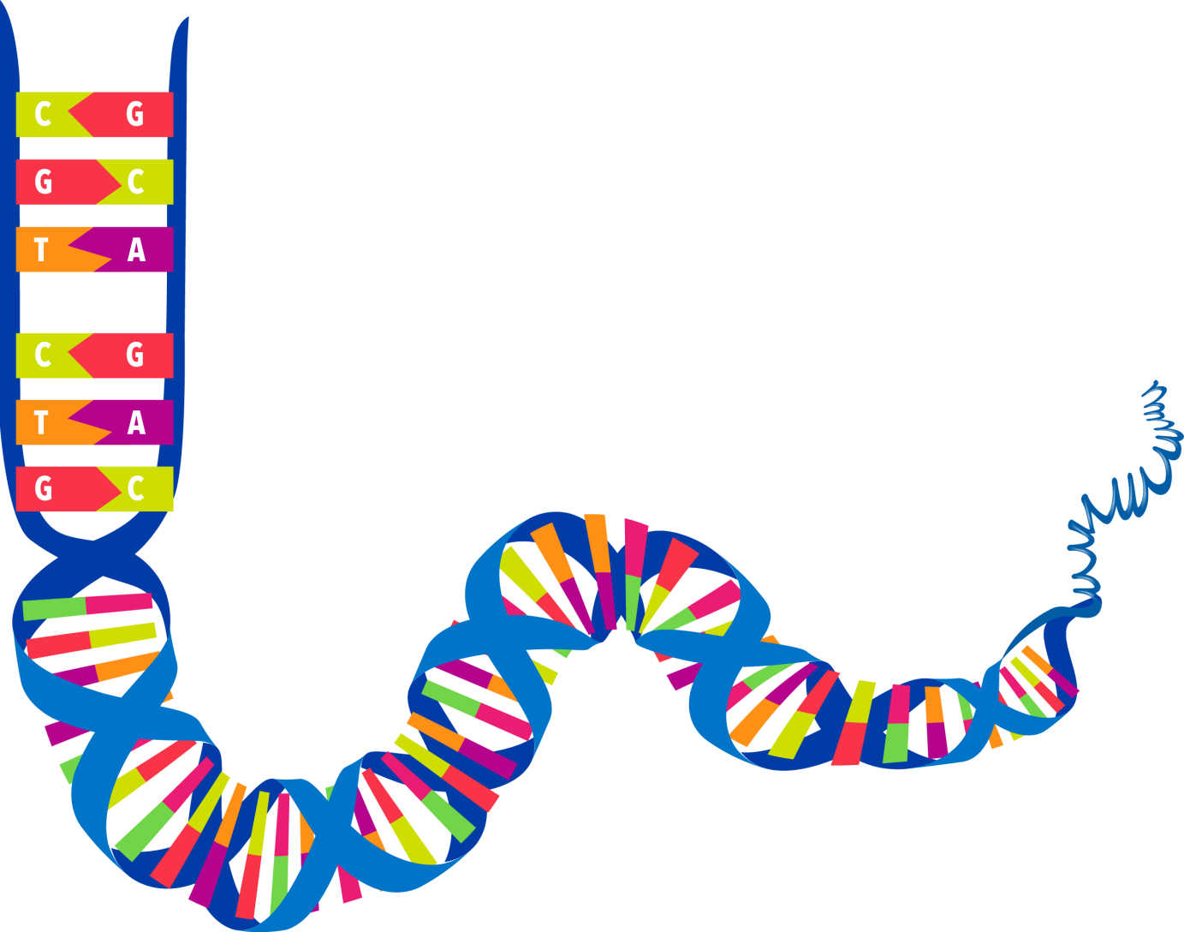
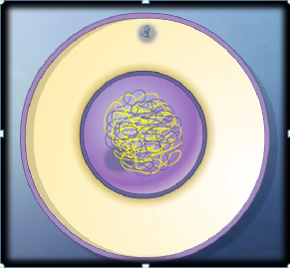
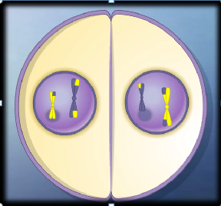

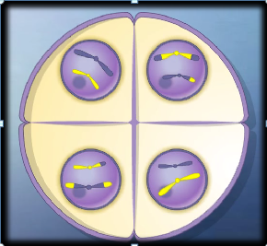

Genes
Notes:
In Darwin’s day, scientists could only guess where variation came from, / but today we know a lot about how traits are passed genetically from one generation to the next.

Slide 8
Sources of Variation
Recombination of genes during reproduction
Mutations
Epigenetics
Notes:
Scientists have identified several sources of variation in the traits within a population: / the recombination of genes during reproduction, / mutations, / and epigenetics.

Slide 9
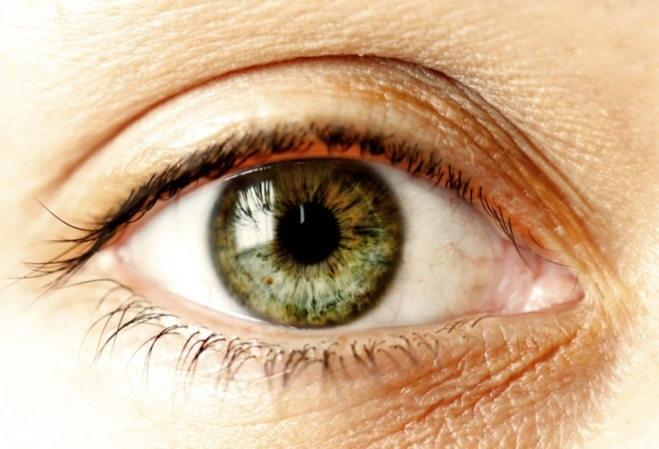


Sources of Variation
Recombination
Variation happens naturally as genetic information from a parent is reshuffled
Genes from mom and dad can combine in a limited number of ways
No new information
Notes:
A certain amount of variation happens naturally during the process of meiosis as genetic information from a parent is reshuffled. / Then genes from both mom and dad can combine in a limited number of ways to create variation in things like the hair color, height, and facial features of their offspring. / It’s important to realize that this does not create any new information. It just reshuffles the genetic information that was already there.

Slide 10
Sources of Variation
Mutations
Mistakes
Random
Usually harmful
Weeded out by natural selection
Notes:
Variation also comes from mutations—/ or mistakes that are made during the process of Meiosis./ Mutations are accidental, random changes in the genetic instructions, and they are usually harmful. / Since natural selection weeds out traits that are not beneficial, it would make sense for traits that happen as a result of negative mutations to be eliminated from the population in time.

Slide 11
Mutations
Early
Later
CAN cause major structural changes
Always lethal
Organisms can survive
Can NOT cause major changes in body plans
Meyer, Stephen. Darwin’s Doubt, page 315
Notes:
Scientists have conducted experiments that purposely cause mutations in organisms to see if it is possible to produce major changes in body plans. / They found that mutations which happen early in the developmental process can produce major structural changes in the organism, / but those mutations are always lethal. / Although organisms can survive mutations which happen later in the developmental process, / those changes are always too small to alter the body plan.

Slide 12
Mutations
Early
Later
Major changes are not viable
Viable changes are not major
Meyer, Stephen. Darwin’s Doubt, page 315
Notes:
Another way to say this is that major changes are not viable. / And viable changes are not major.

Slide 13
Sources of Variation
Epigenetics
Epi—over, near, or in addition to
Influences from the environment
Notes:
Another source of variation is called epigenetics. / The prefix “epi” means over, near, or in addition to. Epigenetic changes come, not from actual changes in an organism’s genes, / but from something in the environment that changes the way the genes are used or expressed.

Slide 14

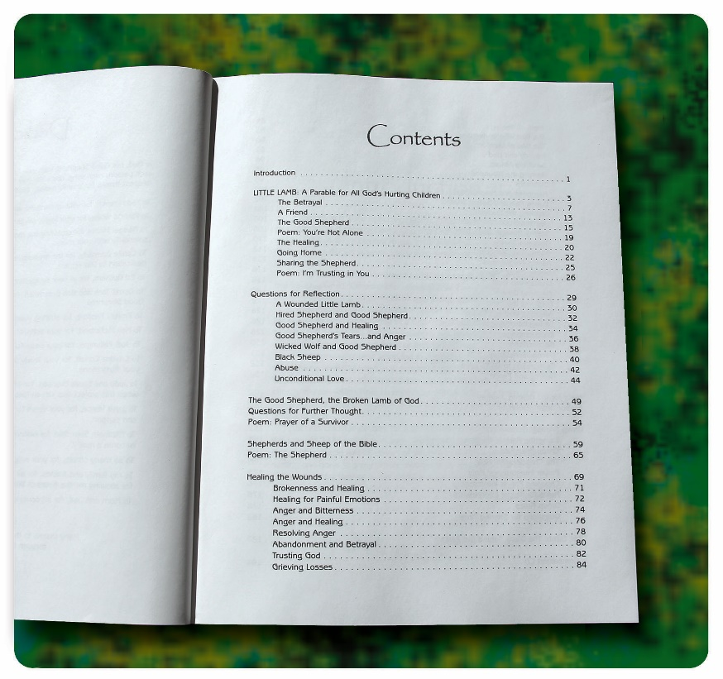
Sources of Variation
Epigenetics
Epi—over, near, or in addition to
Influences from the environment
Gene
Notes:
Remember that a gene can be compared to a chapter in a book. Now imagine what would happen if two pages in the chapter got stuck together. That would not be a change in the words on the page, but it would be a change that would prevent you from reading the words on the pages that were stuck together. Epigenetic changes are like that. They do not increase or decrease the amount of information in the gene, but they alter how that information can be used.

Slide 15
Microevolution = Macroevolution
?
Many small variations from:
  Recombination
  Mutations
  Epigenetics
Acted on by natural selection
Over millions of years
Notes:
As you have learned, many scientists equate microevolution with macroevolution. / They believe that many small variations / acted on by natural selection over millions of years / result in major changes.

Slide 16
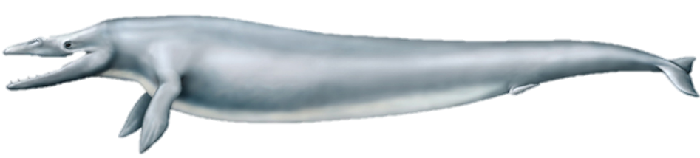
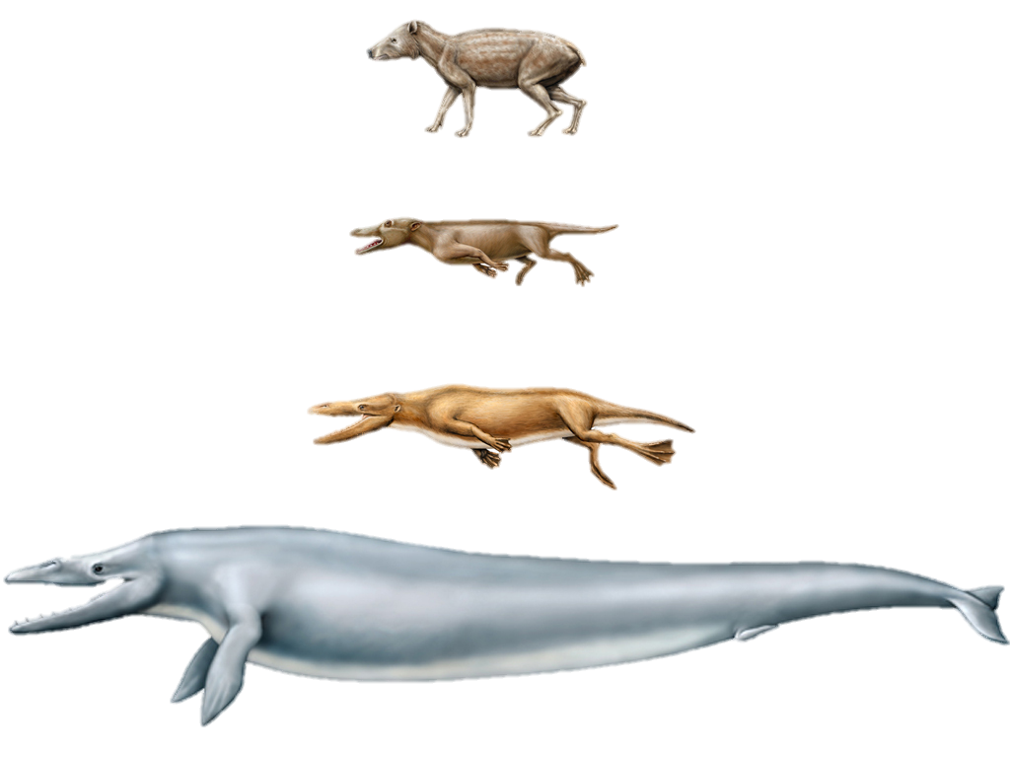

Microevolution = Macroevolution
?
Many small variations from:
  Recombination
  Mutations
  Epigenetics
Acted on by natural selection
Over millions of years
New information required
Notes:
But because the major changes necessary to create new body plans and processes requires new information,

Slide 17
Microevolution = Macroevolution
No new information from:
  Recombination
  Mutations
  Epigenetics
Acted on by natural selection
Over millions of years
New information required
Notes:
and these sources of variation do not produce new information, other scientists—even some who believe in evolution—/ question whether these sources of variation, combined with natural selection are capable of producing macroevolution.

Slide 18
Next: Darwinism and Neo-Darwinism
Notes:
Does that mean that scientists are giving up on the theory of evolution? Find out next time as Origins 101 continues with —Darwinism and Neo-Darwinism.

Slide 19
Recorded at
Chattanooga Public RadioSM
Classical 90.5 WSMC

Slide 20
Images By
Images may appear on more than one slide. Citation is given on the first slide where each image appears.
[1] Slide design, Susan Landon
[3] Charles Robert Darwin by John Collier, Uploaded by Dcoetzee,, http://commons.wikimedia.org/wiki/File:Charles_Robert_Darwin_by_John_Collier.jpg, public domain
[4a] Small Ground Finch Geospiza fuliginosa, Tim Standish, used with permission
[4b] Medium Ground Finch Geospiza fortis, Tim Standish, used with permission
[7a] DNA, Susan Landon
[7b] Screenshots of Meiosis animation, purchased from Edumedia, https://www.edumedia-sciences.com/en/a418-meiosis
[9a] Baby with blue eyes 5016485, dolgachov, Getty Images (US), Inc. Subscription
[9b] Green eye 456008111 BetulTurhalDoganay, Thinkstock, Thinkstock Image Subscription Agreement
[9c] Young woman 79215090 Blend Images, Thinkstock, Thinkstock Image Subscription Agreement
[10a] Point mutation, Ron Hight
[10b] Frame shift deletion, Ron Hight
[10c] Gene inversion, Ron Hight

Slide 21
Images By
[14a] Photo of book, Ron Hight
[14b] DNA, Susan Landon
[16a-d] Whale Evolution, Dr. Philip Gingerich, John Klausmeyer, & The University of Michigan Museums of Natural History, used with permission.

Slide 22
Special Thanks
Foundation for Adventist Education

Slide 23

© Origins Curriculum Resources 2015

Slide 24

© Southern Adventist University 2015

Slide 25

© Seventh-day Adventist North American Division 2015

Slide 26

© General Conference of Seventh-day Adventists 2015

Slide 27

© SCORE Southern Center for Origins Research & Education 2015

