Slide 1
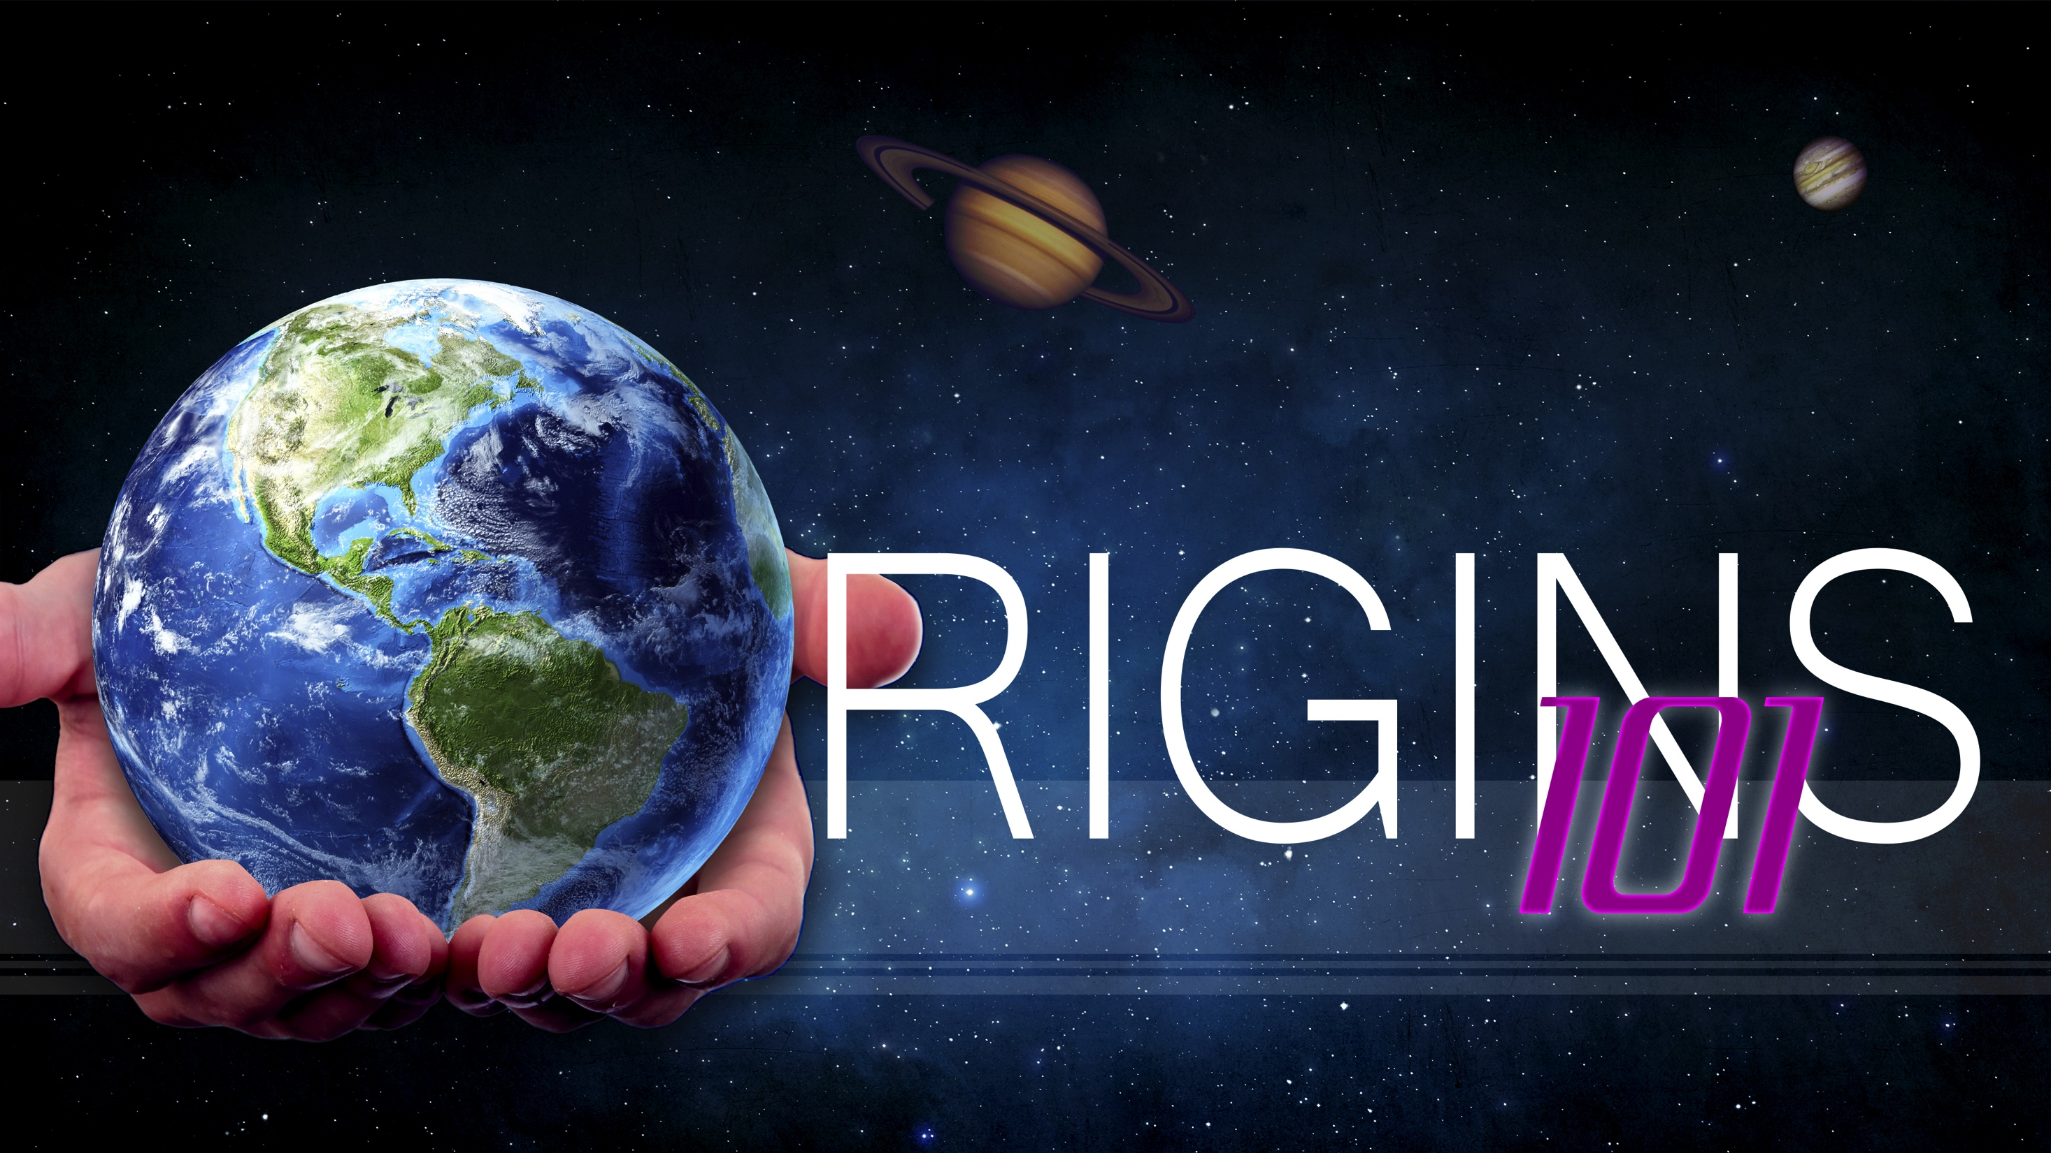
Origin of Information in the Cell
Notes:
Origins 1-1—The Origin of Information in the Cell

Slide 2

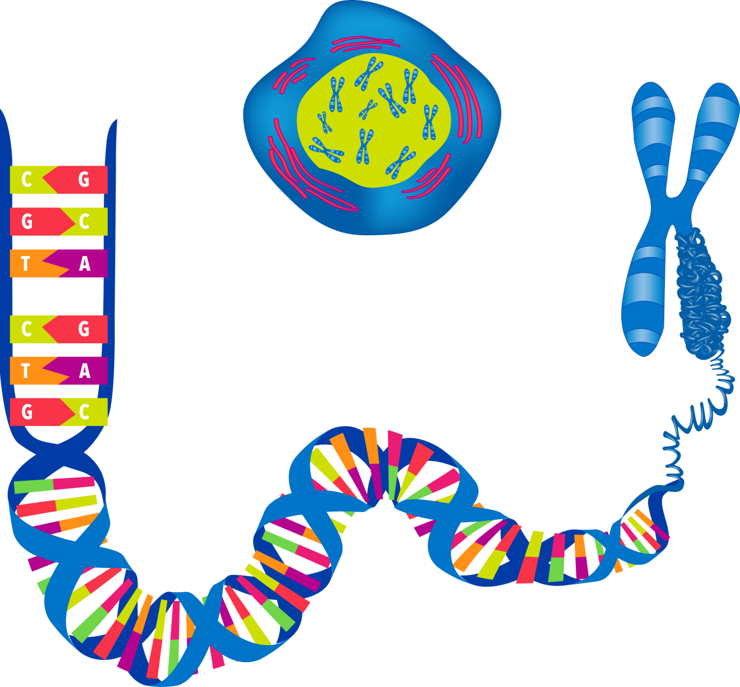



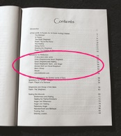
Information in DNA
DNA
Bases:
A, T, C, G
Book
Codons:
Words
Genes:
Chapters
Notes:
In previous presentations we have talked about the astonishing amount of genetic information contained in DNA. Where did all this information come from?

Slide 3
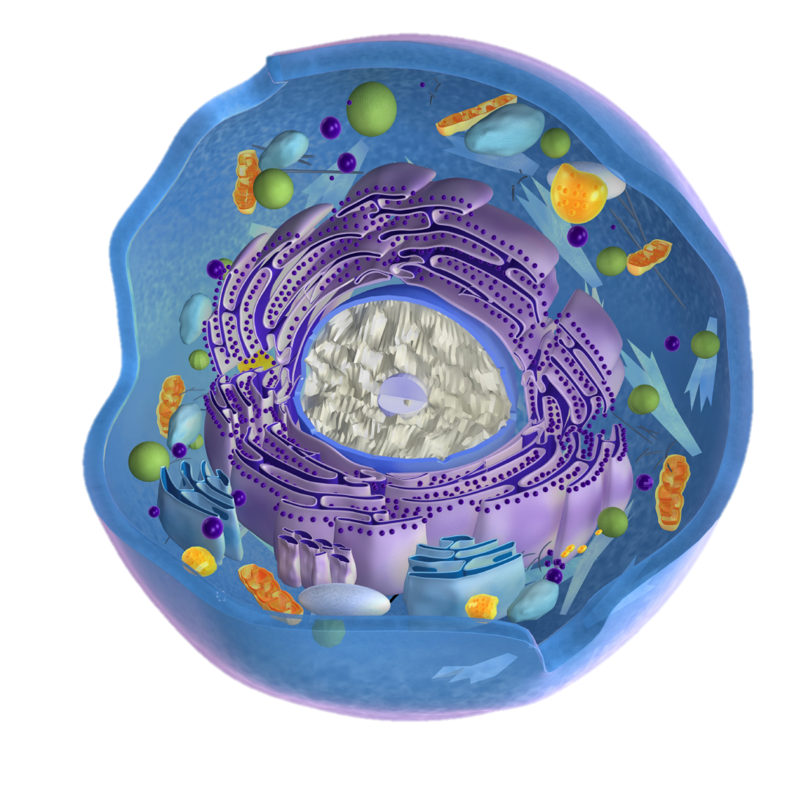
Origin of Information
“Any theory of the origin of life must resolve the critical question of the origin of biological information.”
Faith, Reason, and Earth History, page 148
Notes:
Any theory of the origin of life must resolve the critical question of the origin of biological information. To understand more about this information, we need some background.

Slide 4
the the the
the the the
the the the
Notes:
Think about this sequence of letters and spaces. It is an orderly sequence of specific letters, that repeats over and over but doesn’t carry any meaningful information.

Slide 5
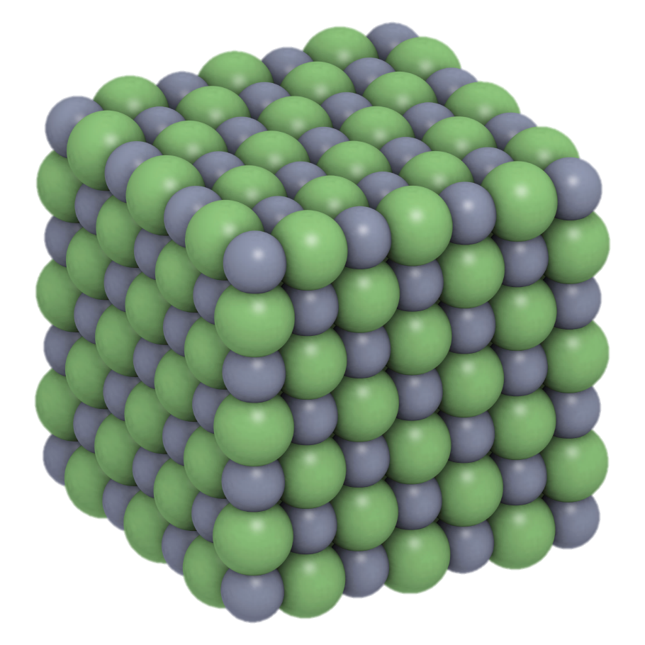
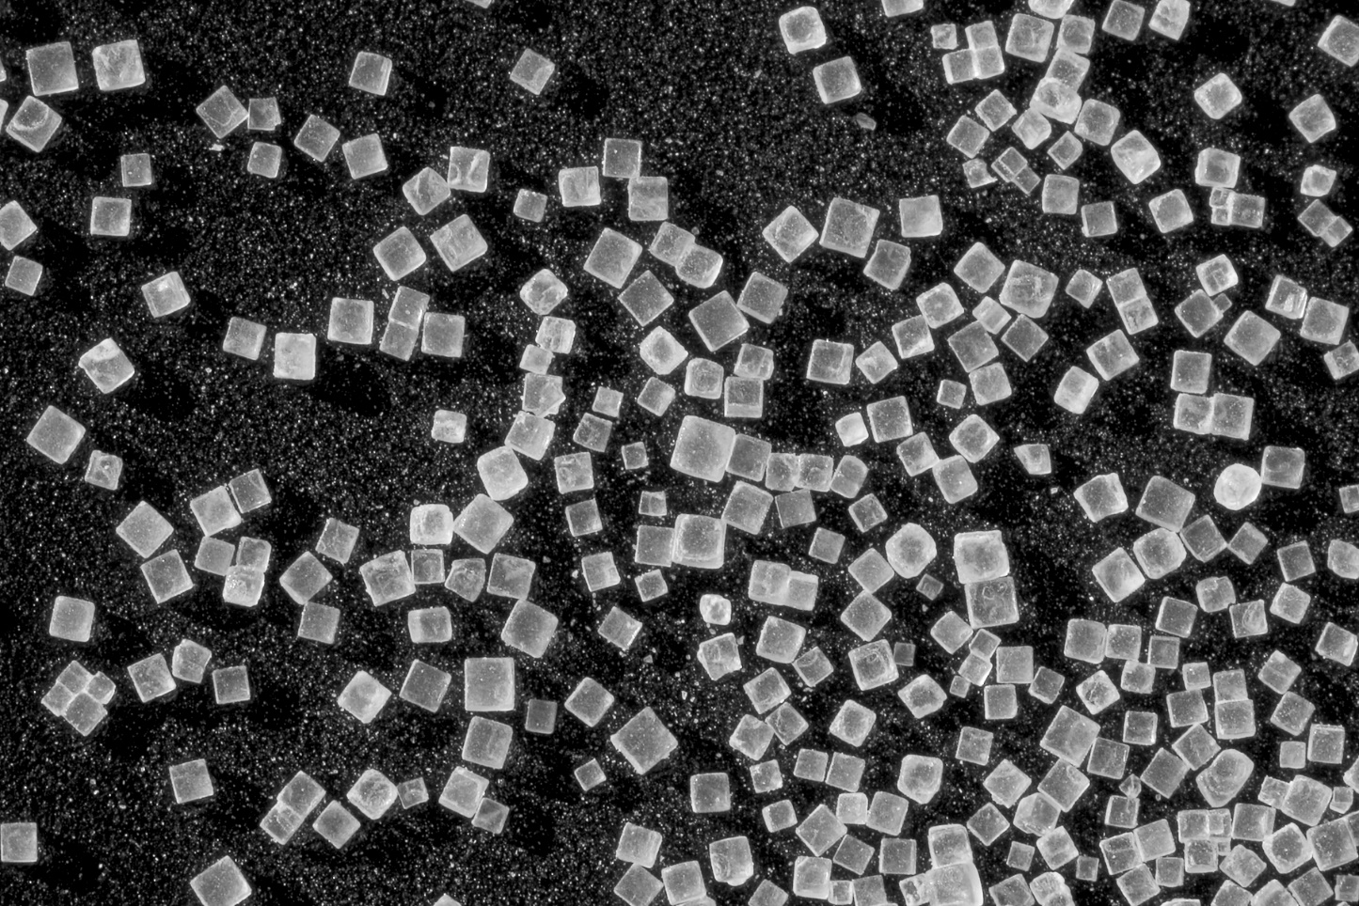
Salt Crystals
the the
the the
the the
Specific repeating order
Notes:
It is similar to the repeating order we find in some inanimate objects, like table salt for example. Each salt crystal is shaped like a cube because of the specific, repeating order of its molecules.

Slide 6

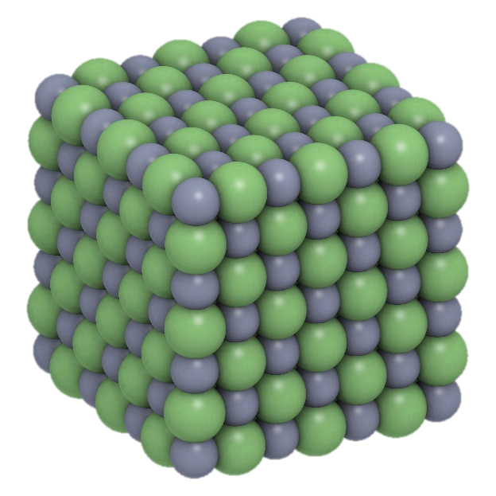
Order
Complexity
Specific repeating order (like a crystal)
the the
the the
the the
NOT specific repeating order
Complex (irregular)
Eownckwi fgoekwns skewildnsi
Notes:
In contrast, look at this series of letters. / Instead of being an orderly repetition of a specific sequence, there is a complex and irregular collection of letters.

Slide 7
Order
Complexity
Specific repeating order (like a crystal)
the the
the the
the the
NOT specific repeating order
Complex (irregular)
Eownckwi fgoekwns skewildnsi
Notes:
Notice that neither the orderly repetition or the irregularly complex sequence of letters says anything meaningful.

Slide 8
Order
Complexity
Specific repeating order (like a crystal)
the the
the the
the the
NOT specific repeating order
Complex (irregular)
Eownckwi fgoekwns skewildnsi
Notes:
The information found in cells is specific, but not repeating. And it is complex.

Slide 9
Order
Complexity
Specific repeating order (like a crystal)
NOT specific repeating order
Complex (irregular)
Eownckwi fgoekwns skewildnsi
Please pass the lemonade
Notes:
But instead of being random gibberish like this, / it has meaning

Slide 10
Order
Complexity
Specific repeating order (like a crystal)
NOT specific repeating order
Complex (irregular)
Eownckwi fgoekwns skewildnsi
Specified Complexity
Contains information
Please pass the lemonade
Notes:
Because it is specific and complex, we call it specified complexity. And because it has meaning, we say it contains information.

Slide 11
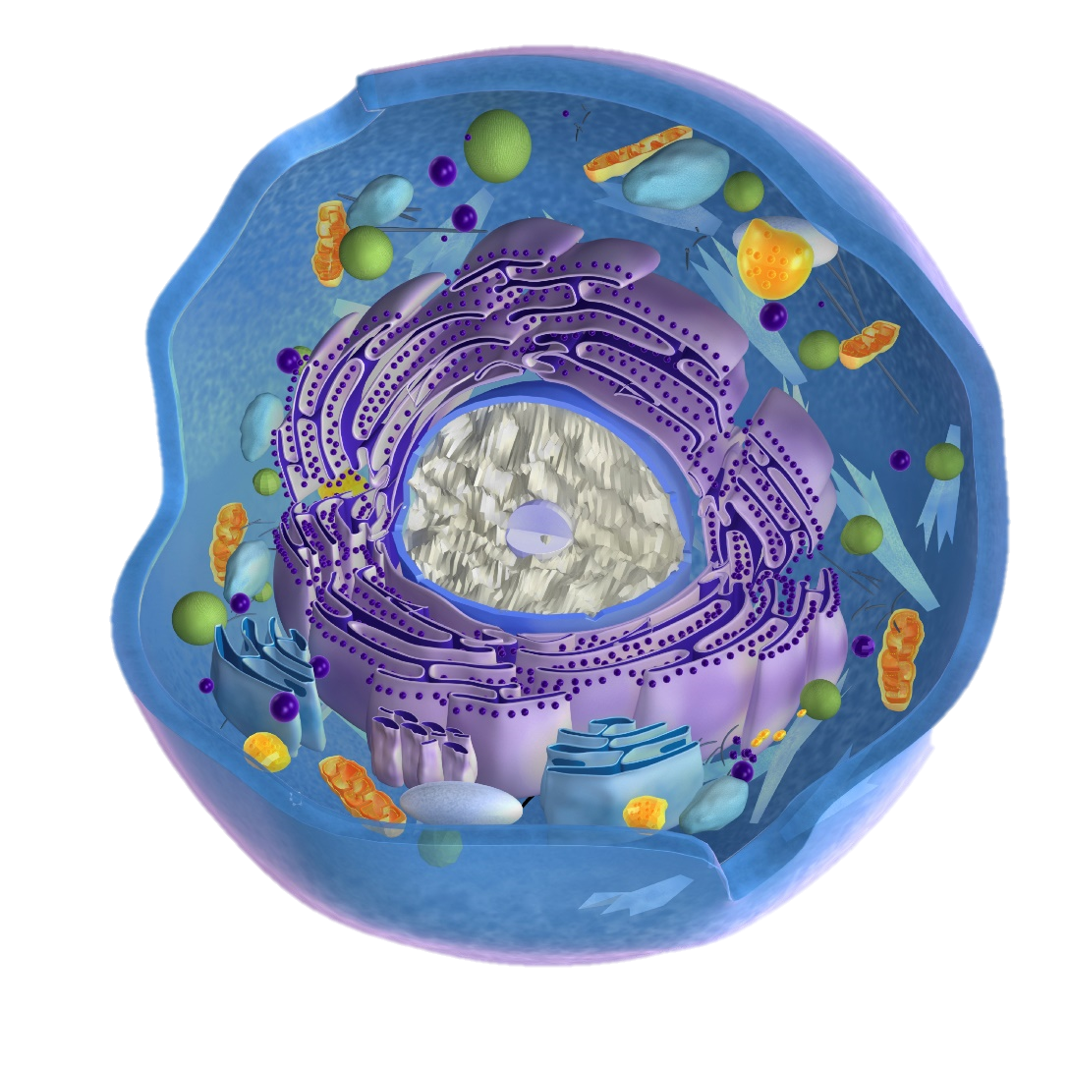

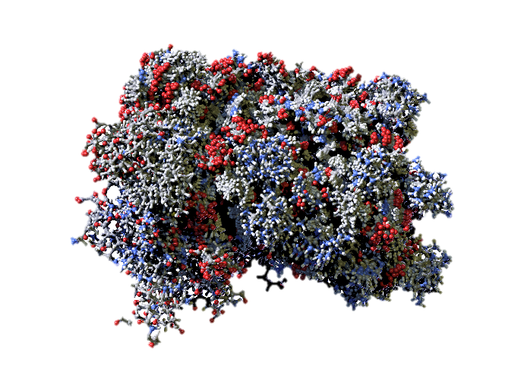
Where do we find this information?
Proteins
DNA
Notes:
So where do we find the specific and complex information in cells? / In proteins and DNA.

Slide 12
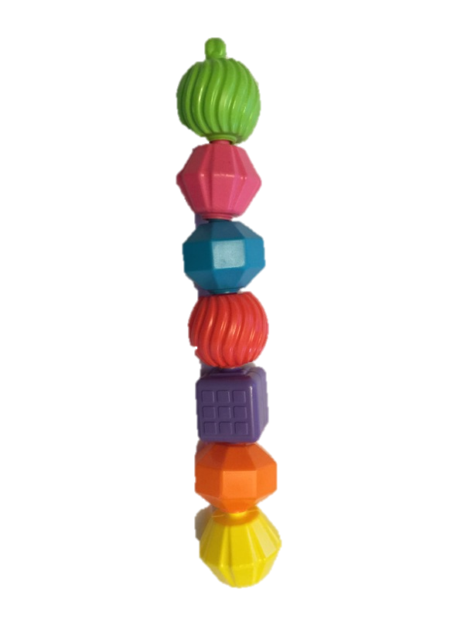
Proteins
Made of amino acids (there are 20, like an alphabet)
Joined together like a chain
Need exactly the right ones in exactly the right order
Notes:
Remember that proteins are made of amino acids. There are 20 different kinds of amino acids, just like there are 26 letters in our alphabet. And just like letters combine to make words that mean something, amino acids join together in a certain order to make proteins which contain meaningful information. Most proteins contain hundreds, or even thousands, of amino acids.

Slide 13
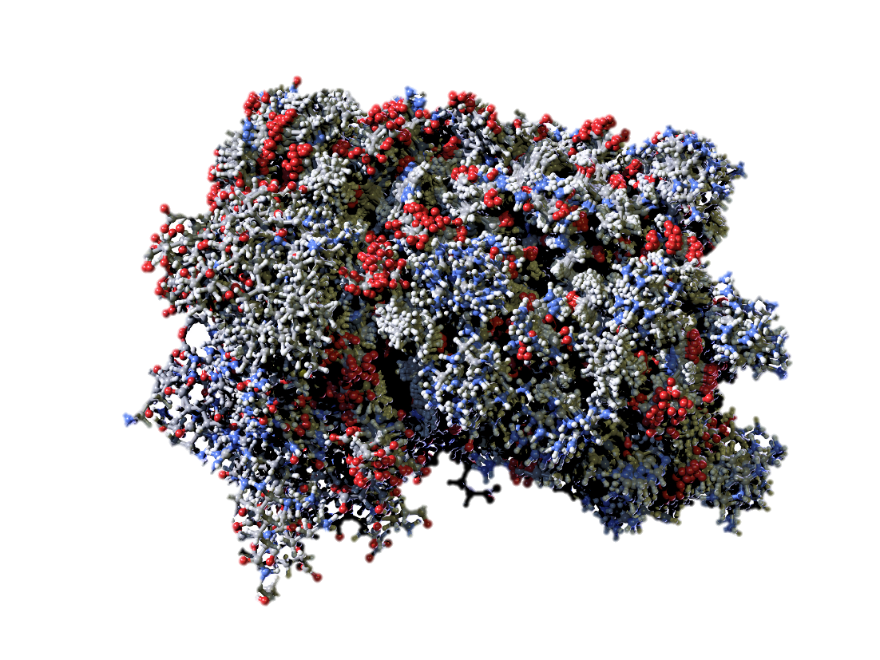
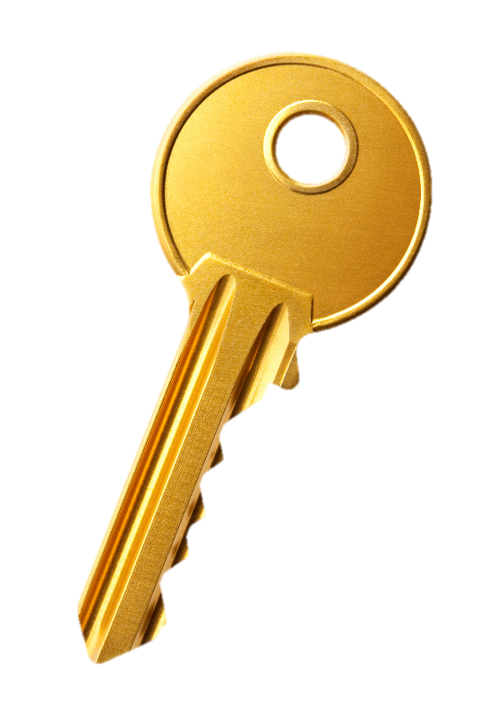
Proteins
Then they fold into a specific 3D shape which enables them to fit together with other molecules, like the teeth of a key fit into a lock.
Notes:
Then the amino acid chains have to fold together into a specific 3D shape which enables the proteins to fit with other molecules, like the teeth of a key fit into a lock.

Slide 14
Proteins
The sequence of amino acids is determined by information
We can’t have life without proteins.
Where did they come from?
Notes:
The sequence of amino acids is determined by information. We can’t have life without proteins. Where did they come from?

Slide 15
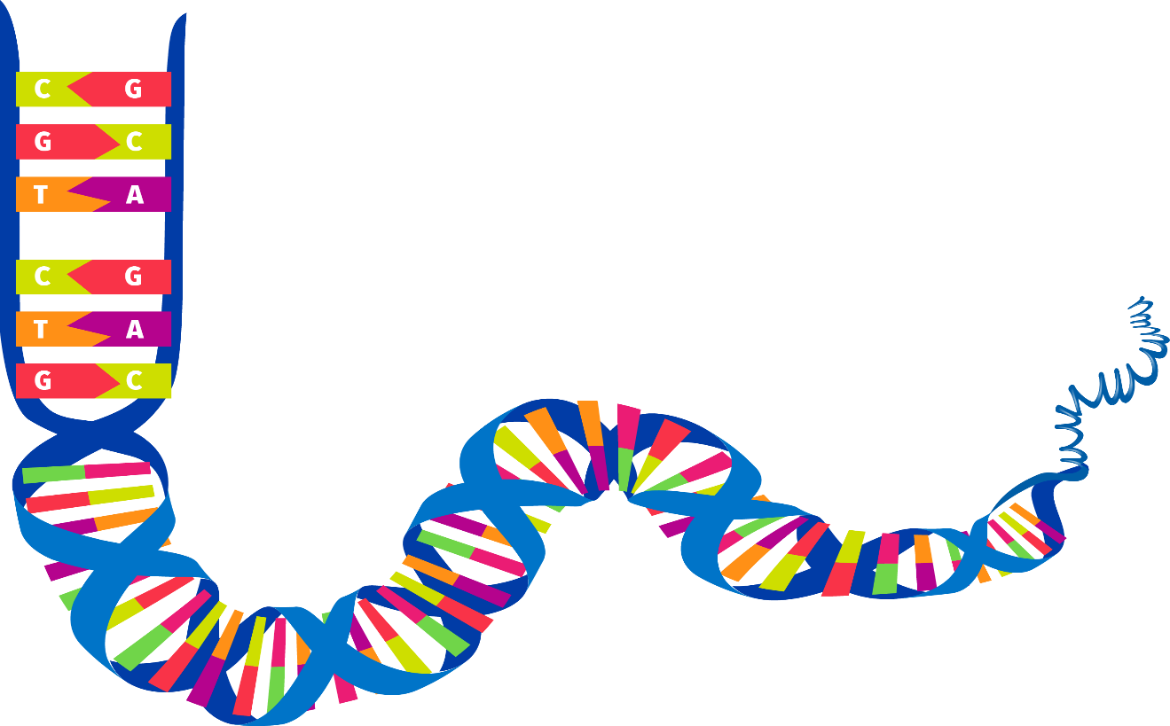
Proteins
No natural laws control which amino acids are more likely to join together (if there were, it would limit the possibilities)
Notes:
No natural laws control which amino acids are more likely to join together. If there were, it would actually limit the possibilities.

Slide 16
Proteins
Instructions for assembling amino acids into proteins come from the information contained in the DNA molecule
Notes:
The instructions for assembling amino acids into proteins actually come from the information contained in the DNA molecule.

Slide 17
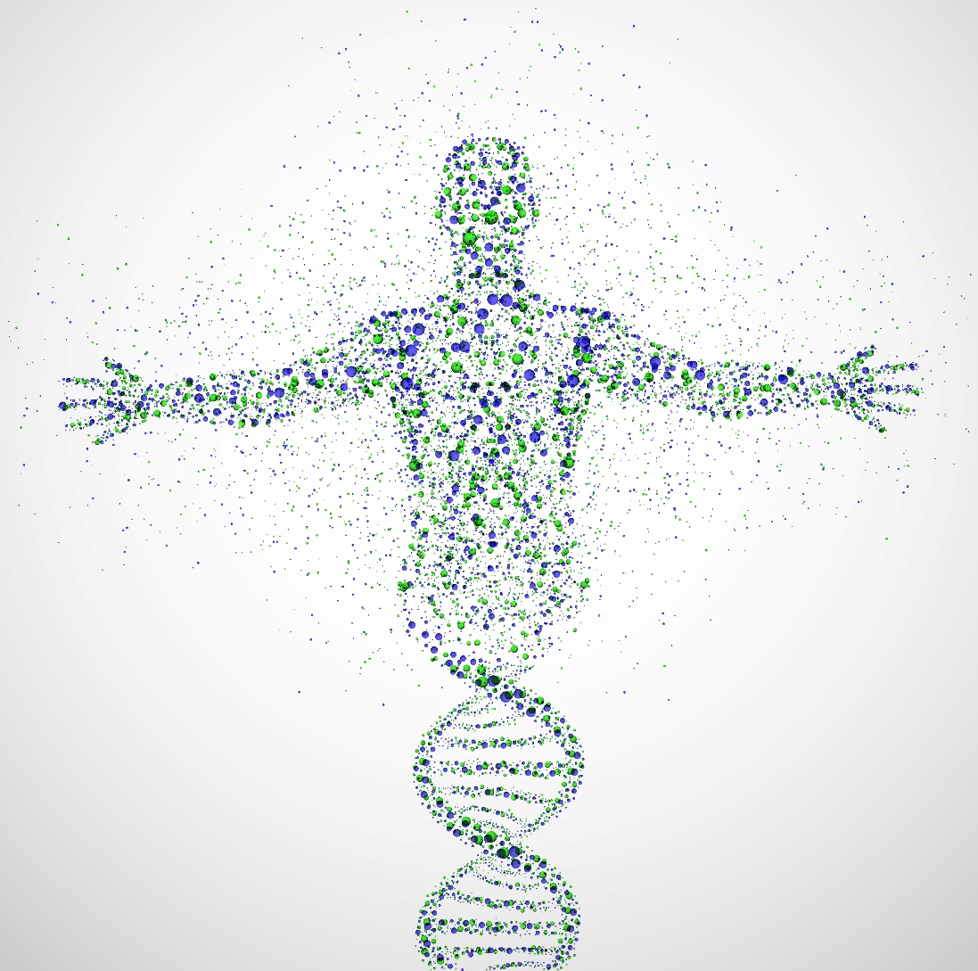
DNA
“One of the most extraordinary discoveries of the twentieth century was that DNA actually stores information…in the form of a four-character digital code.”
Stephen Meyer quoted in Case for a Creator, page 224
Notes:
The fact that DNA stores information—in the form of a four-character digital code—is considered to be one of the most extraordinary discoveries of the last century.

Slide 18
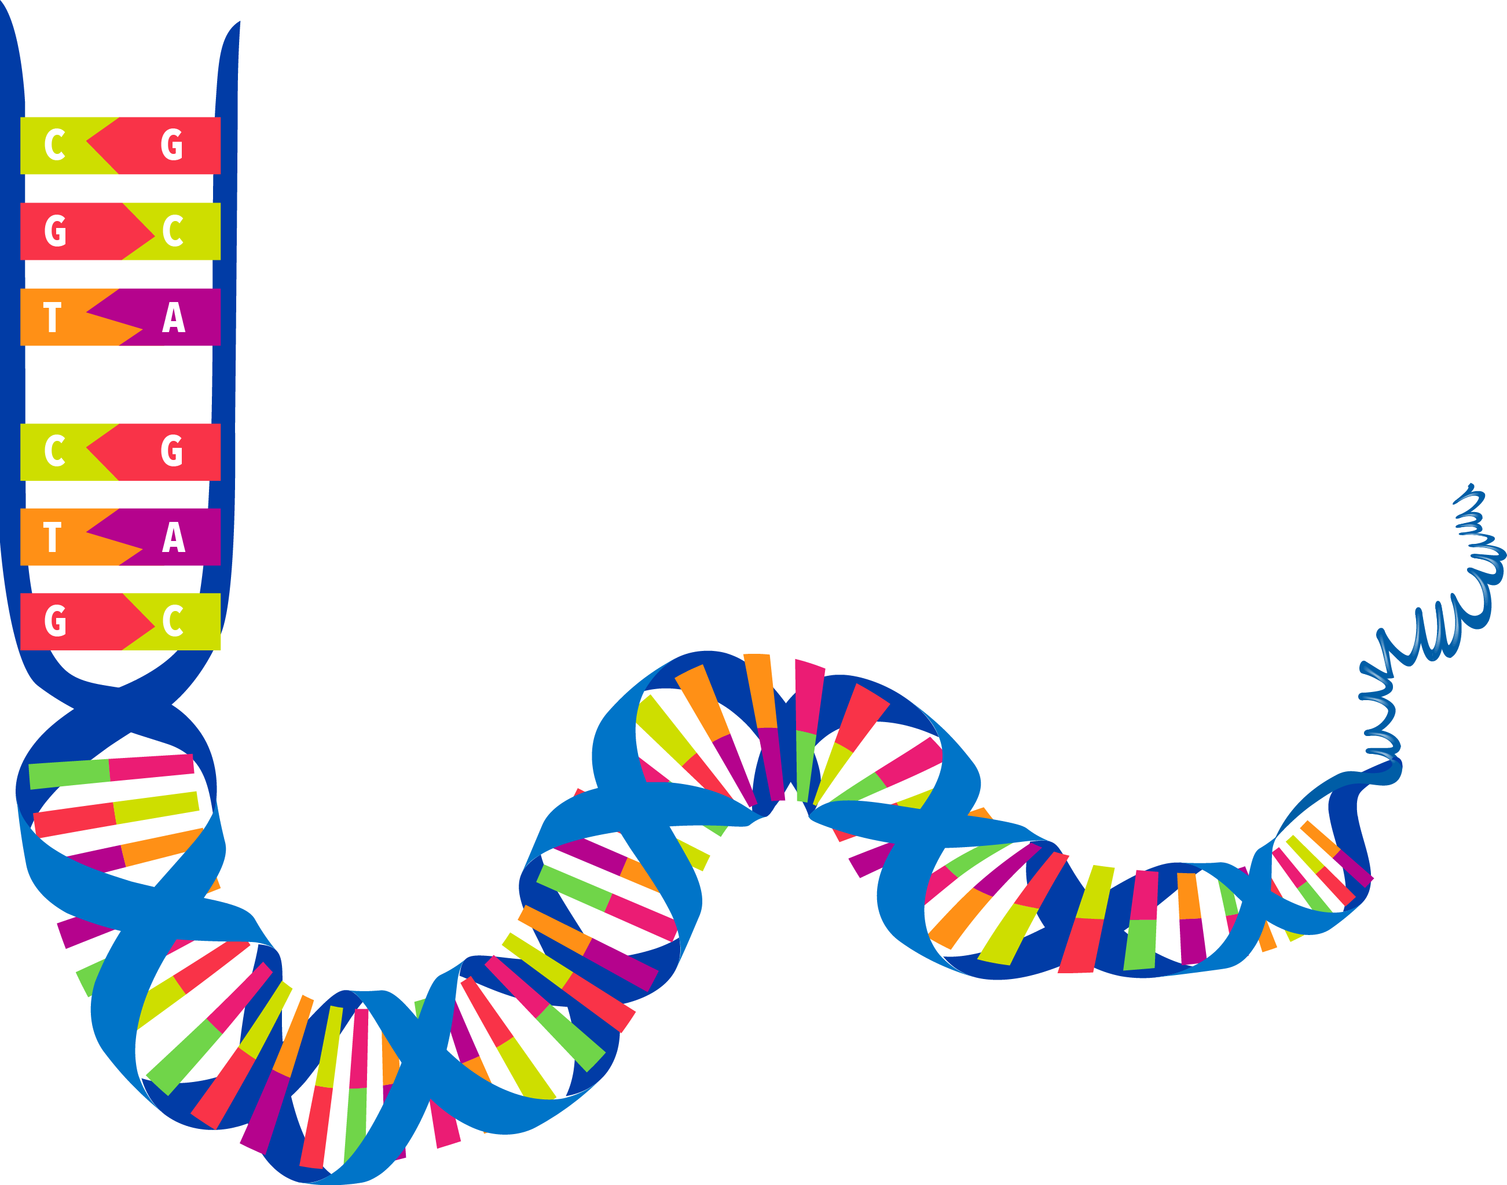
DNA
DNA is composed of sequences of subunits called nucleotide bases
There are four bases (like a short alphabet)
A
G
C
T
Notes:
DNA is composed of sequences of subunits called nucleotide bases. There are four bases-- / abbreviated A, C, G, and T--that are like a short alphabet.

Slide 19
DNA
The order of the nucleotide bases contains information
This information specifies the sequences of amino acids
No natural laws specify the order in which the bases occur
A
C
G
T
Notes:
The order of the nucleotide bases contains information. / This information specifies the sequences of amino acids that make up the proteins. / No natural laws specify the order in which the bases occur.

Slide 20
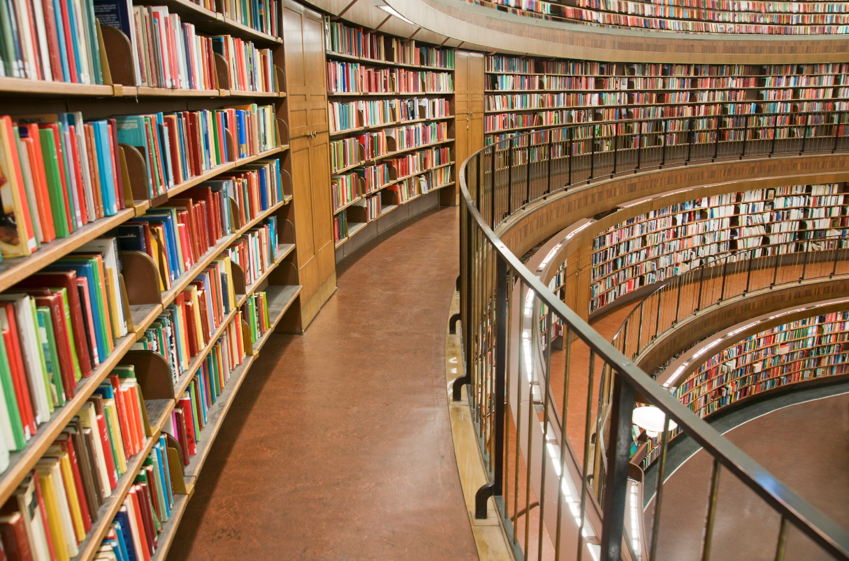
DNA Like a Library
Notes:
Sometimes we say that DNA is like a blueprint, but it’s really more like a library filled with blueprints for making all kinds of biological machines and larger structures within living organisms.

Slide 21

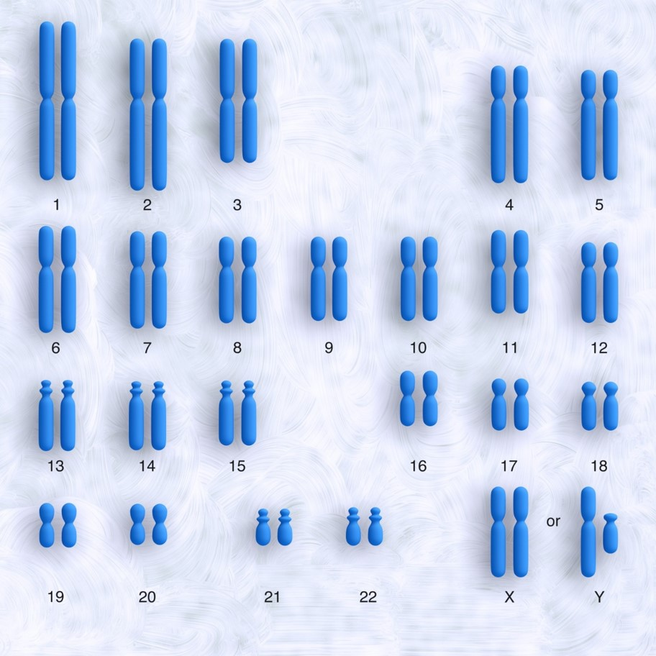
6 ft of DNA
Notes:
Each cell contains 6 feet of tightly coiled DNA.
Case for a Creator 219-220

Slide 22
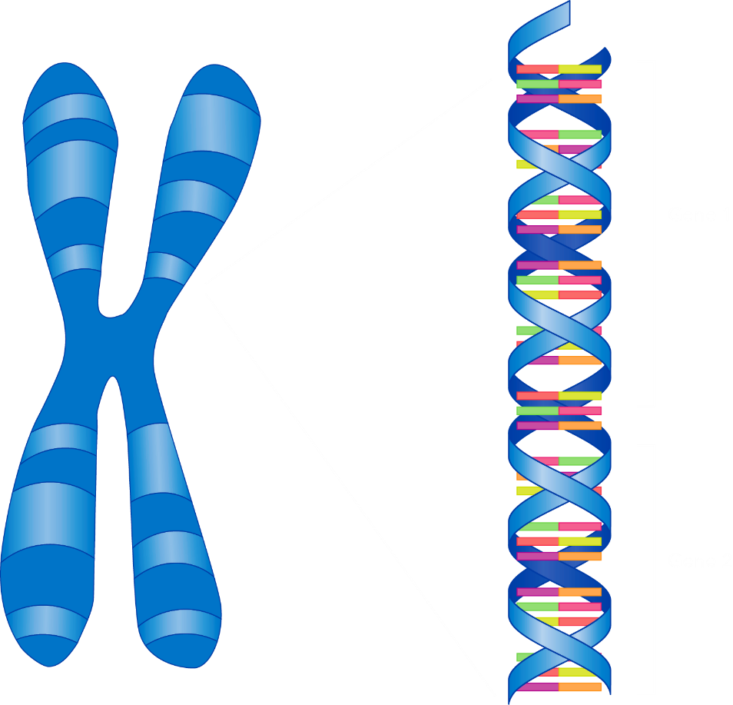
6 ft of DNA
20,000-30,000 genes
Notes:
It’s difficult to know for sure, but it has been estimated that a full set of human chromosomes contains between twenty and thirty thousand genes.

Slide 23
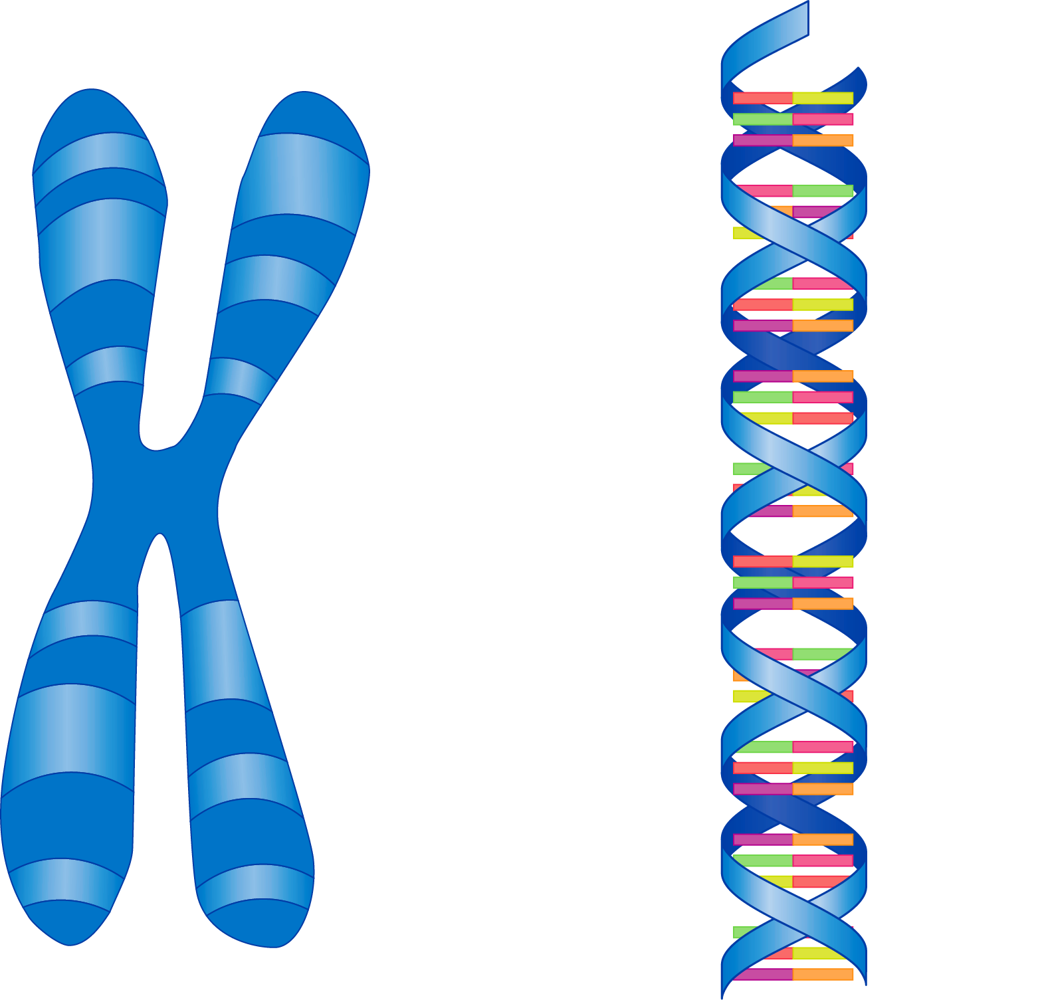
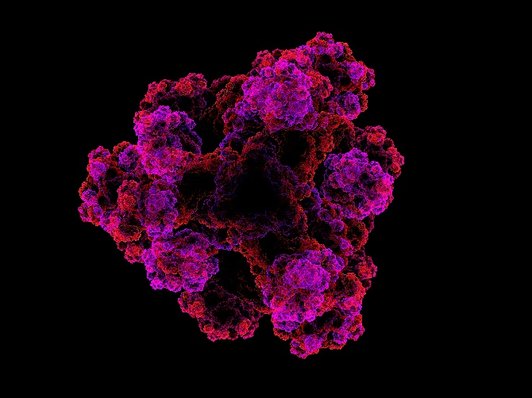
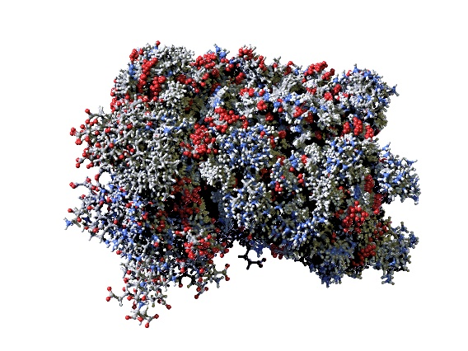
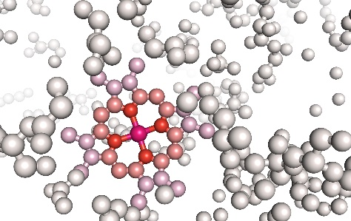
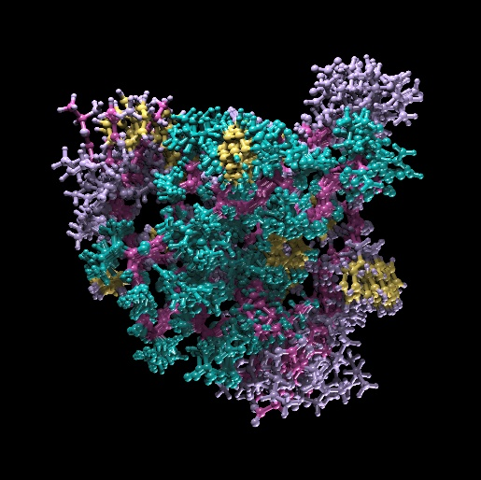
several kinds of proteins each
(some as many as 20,000)
20,000-30,000 genes
Notes:
Many of these genes can produce parts of several different proteins. / It is thought that some of the more complex genes / may be involved in producing as many as 20,000 different kinds of proteins

Slide 24
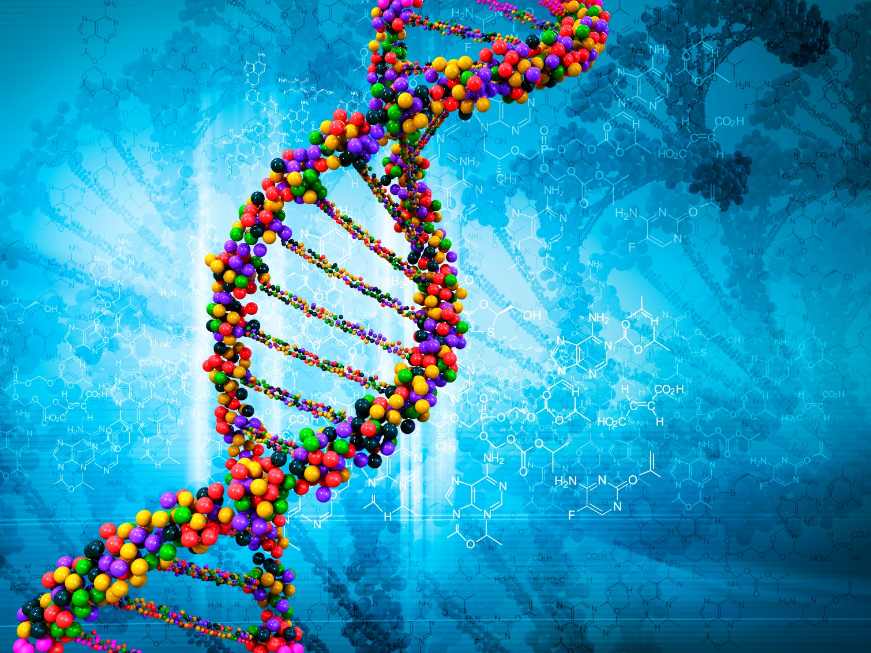
The astounding capacity of microscopic DNA to harbor this mountain of information, carefully spelled out in a four-letter chemical alphabet vastly exceeds that of any other known system.
Case for a Creator, page 220
Notes:
The astounding capacity of microscopic DNA to harbor this mountain of information, carefully spelled out in a four-letter chemical alphabet vastly exceeds that of any other known system.

Slide 25
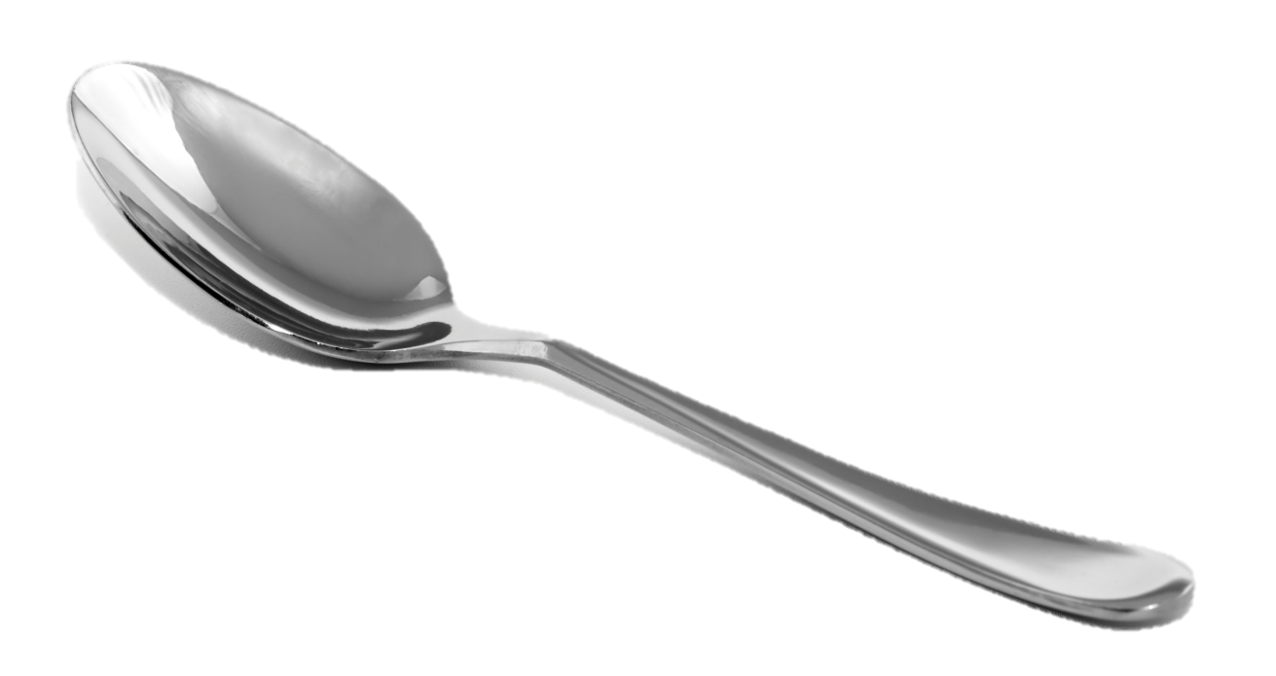
DNA of 1,000,000,000 species
“In fact, he (Michael Denton) said the information needed to build the proteins for all the species of organisms that have ever lived—a number estimated to be approximately one thousand million—could be held in a teaspoon and there would still be room left for all the information in every book ever written.” (Case for a Creator, page 220)
Notes:
In fact, according to Michael Denton, the information needed to build the proteins for all the species of organisms that have ever lived could be held in a teaspoon and there would still be room left for all the information in every book ever written.

Slide 26

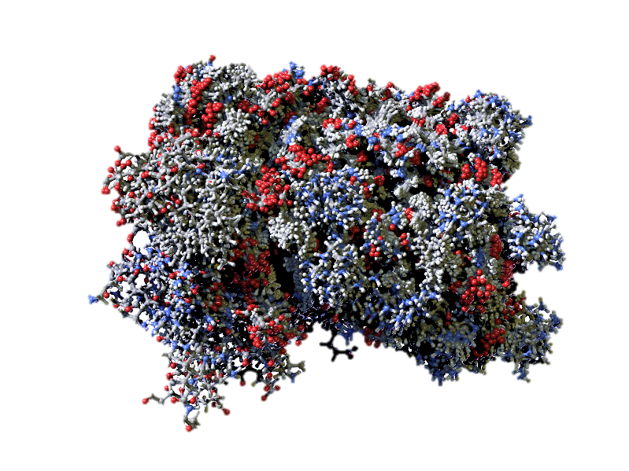
Where did that information come from?
?
Notes:
So we know that the instructions for making proteins come from the DNA. / But where did that information come from?

Slide 27
Experience
What caused
something
in the past
What causes
something
today
Notes:
When we want to know what caused something to happen in the past, / we can start by asking what causes that same thing to happen in the present. And then--unless there is a compelling reason to think otherwise--/ we assume it happened in the past the same way it happens in the present.

Slide 28
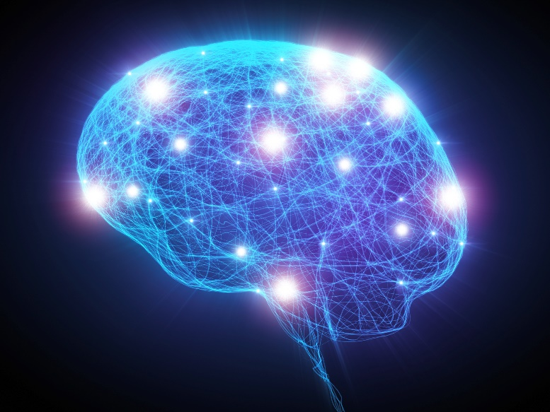
Experience
Information
?
Information
?
Notes:
So when we want to know where information came from in the past, / we ask ourselves where information comes from today. / And we know from experience that information always comes from a mind. / So unless we have some compelling reason to believe otherwise, we would expect that the information in DNA also came from a mind.

Slide 29
Three Other Possibilities?
Any reasonable naturalistic route to life?
  Random chance
  Natural selection
  Chemical affinities and self ordering
Notes:
Scientists have explored at least three other possibilities: / random chance, / natural selection, / and various chemical affinities or options for self-ordering.

Slide 30
1. Random chance?
Protein with 150 amino acids
  Have to use just left-handed ones
  Have to link up in just the right order
  Have just the right bonds between the amino acids
  1 in 1 x 10
195
Notes:
Scientists have estimated the probability of getting a fairly small protein by chance. / It is estimated that the probability of 150 left-handed amino acids / linking up in just the right order / with just the right bonds between them / is just 1 in 1 x 10 to the 195th power.

Slide 31
100000000000000000000000000000000000000000000000000000000000000000000000000000000000000000000000000000000000000000000000000000000000000000000000000000000000000000000000000000000000000000000000000
Notes:
That’s a 1 with 195 zeroes after it.

Slide 32
1. Random chance?
These probabilities only apply to artificial situations like a chemistry lab where contaminants are excluded. In nature, contamination would prevent anything useful from happening, even by chance.
IF one protein was somehow present, that would only be one of 300-500 protein molecules needed for a cell
Notes:
These probabilities only apply to artificial situations like a chemistry lab where contaminants are excluded. In nature, contamination would prevent anything useful from happening, even by chance. / But even if one protein was somehow present, that would only be one of 300-500 protein molecules needed for a cell that is only minimally complex.

Slide 33
1. Random chance?
“To suggest chance against those odds is really to invoke a naturalistic miracle.”
Stephen Meyer
quoted in Case for a Creator
page 229
Notes:
According to Stephen Myer, “to suggest chance against those odds is really to invoke a naturalistic miracle.”

Slide 34
1. Random chance?
“Virtually all origin-of-life experts have utterly rejected that approach.”
Stephen Meyer
quoted in Case for a Creator
page 229
Notes:
Although the idea that information could have arisen by random chance is still alive at the popular level, “virtually all origin-of-life experts have utterly rejected that approach.”

Slide 35
2. Natural Selection?
Natural
Selection
Offspring with favorable traits
Survive
Reproduce Better
Notes:
Another explanation scientists have explored for the origin of information in the cell is natural selection. / Recall that natural selection is the process by which offspring with advantageous or beneficial traits survive and reproduce better than those without the advantageous traits. (page 231)

Slide 36
2. Natural Selection?
Natural
Selection
Offspring with favorable traits
Survive
Reproduce
Better
Notes:
Notice that organisms have to be able to reproduce before natural selection can work.

Slide 37
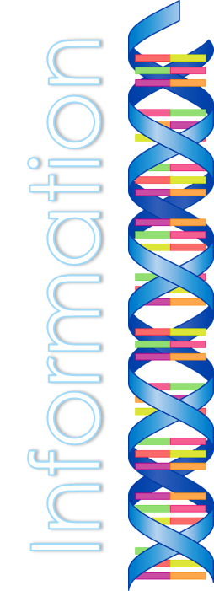
2. Natural Selection?
Natural
Selection
Offspring with favorable traits
Survive
Reproduce
Better
Notes:
The problem is, you can’t have a self-replicating organism / without the information in DNA, which really means we are trying to explain the existence of information / using something that can happen only AFTER the information already exists!

Slide 38
3. Chemical Affinities and Self Ordering
Dean Kenyon, author of Biochemical Predestination, later repudiated the conclusions of his own book
“We have not the slightest chance of a chemical evolutionary origin for even the simplest of cells”
Notes:
A third idea that scientists have explored is some form of self organization. Dean Kenyon, one of the first scientists to suggest that amino acids and nucleotide bases had some sort of self-ordering ability later repudiated the conclusions of his own book saying, “We have not the slightest chance of a chemical evolutionary origin for even the simplest of cells.”

Slide 39
3. Chemical Affinities and Self Ordering
Amino acids don’t demonstrate bonding affinities
Even bigger theoretical difficulty: If they did, self organization “wouldn’t yield a genetic message, only a repetitive mantra.”
Case for a Creator, page 233
Notes:
Amino acids don’t demonstrate any bonding affinities, but even if they did, self-organization wouldn’t yield meaningful information—just the meaningless repetition of a salt crystal.

Slide 40
Experience
What caused
something
in the past
What causes
something
today
Notes:
Especially without a compelling reason to think otherwise--

Slide 41
Experience
Information
?
Information
?
Notes:
we assume information originated in the beginning the same way it originates in the present

Slide 42
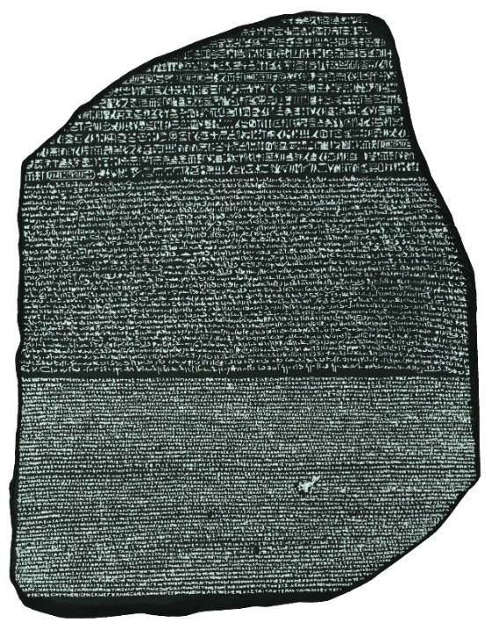


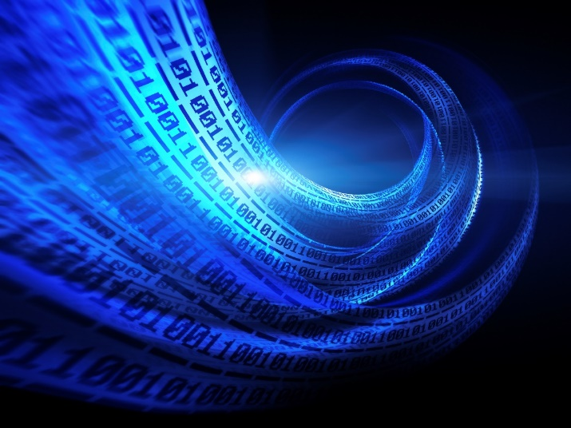
“Information is the hallmark of mind.”
Stephen Myer in Case for a Creator, 244
Notes:
Whether we’re talking about books, / computer code, / or the Rosetta Stone, / information is the hallmark of mind.

Slide 43

Conclusion
Any reasonable naturalistic route to life?
  Random chance
  Natural selection
  Chemical affinities and self ordering
Design
Not Reasonable
Reasonable
Notes:
None of these possibilities that scientists have explored appear to be reasonable explanations for the origin of the information in the cell. / But it is reasonable to believe that the information in our cells came from the same place information comes from today—an intelligent mind.

Slide 44
Probability
Notes:
In our next presentation, we will define probability, review how to calculate it, and look at the kinds of probabilities we often encounter in discussions about origins.

Slide 45
Recorded at
Chattanooga Public RadioSM
Classical 90.5 WSMC

Slide 46
Images By
Images may appear on more than one slide. Citation is given on the first slide where each image appears.
[1] Slide design, Susan Landon
[2a] Stack of colorful books 465612383, ferlistockphoto, Thinkstock, Thinkstock Image Subscription Agreement
[2b] Cell by Susan Landon
[2c] DNA by Susan Landon
[2d] Book 177425492, badahos, Thinkstock, Thinkstock Image Subscription Agreement
[2e] Chapter by Ron Hight
[3] Cell 45876032, 7activestudio, Getty Images (US), Inc. Subscription
[5a] Table salt 1292548, cezars, Getty Images (US), Inc. Subscription
[5b] Crystal structure of sale 55460888, molekuul, Getty Images (US), Inc. Subscription
[11a] Human interferon 11172232, theasis, Getty Images (US), Inc. Subscription
[11c] DNA, Susan Landon
[12a] Chain 16733020, ChrisGorgio, Getty Images (US), Inc. Subscription
[12b] Pop & Lock beads, Carol Raney
[13] Key 19010870, Malerapaso, Getty Images (US), Inc. Subscription
[17] DNA man 22791272, Lonely, Getty Images (US), Inc. Subscription
[20] Library 15778899, PinkBadger, Getty Images (US), Inc. Subscription

Slide 47
Images By
[21b] Chromosomes 134153911, somersault18:24, Thinkstock, Thinkstock Image Subscription Agreement
[22b] Gene, Susan Landon
[23c] Fractal protein 14691625, fabiofs, Getty Images (US), Inc. Subscription
[23e] Inside protein molecule 11234250, shunyufan, Getty Images (US), Inc. Subscription
[23f] Insulin 9717900, theasis, Getty Images (US), Inc. Subscription
[24] Digital illustration of DNA 16692030, cosmin4000, Getty Images (US), Inc. Subscription
[25] Teaspoon 10182146, Homiel, Getty Images (US), Inc. Subscription
[28] Brain 32711818, Henrik5000, Getty Images (US), Inc. Subscription
[42a] Rosetta Stone, Unknown, http://commons.wikimedia.org/wiki/File:Rosetta_Stone_BW.jpeg, public domain
[42b] Binary code 28284516, nadla, Getty Images (US), Inc. Subscription
[42c] Computer programmer 38144734, baranozdemir, Getty Images (US), Inc. Subscription
[42d] Human knowledge 25673130, exdez, Getty Images (US), Inc. Subscription

Slide 48
Special Thanks
Foundation for Adventist Education

Slide 49
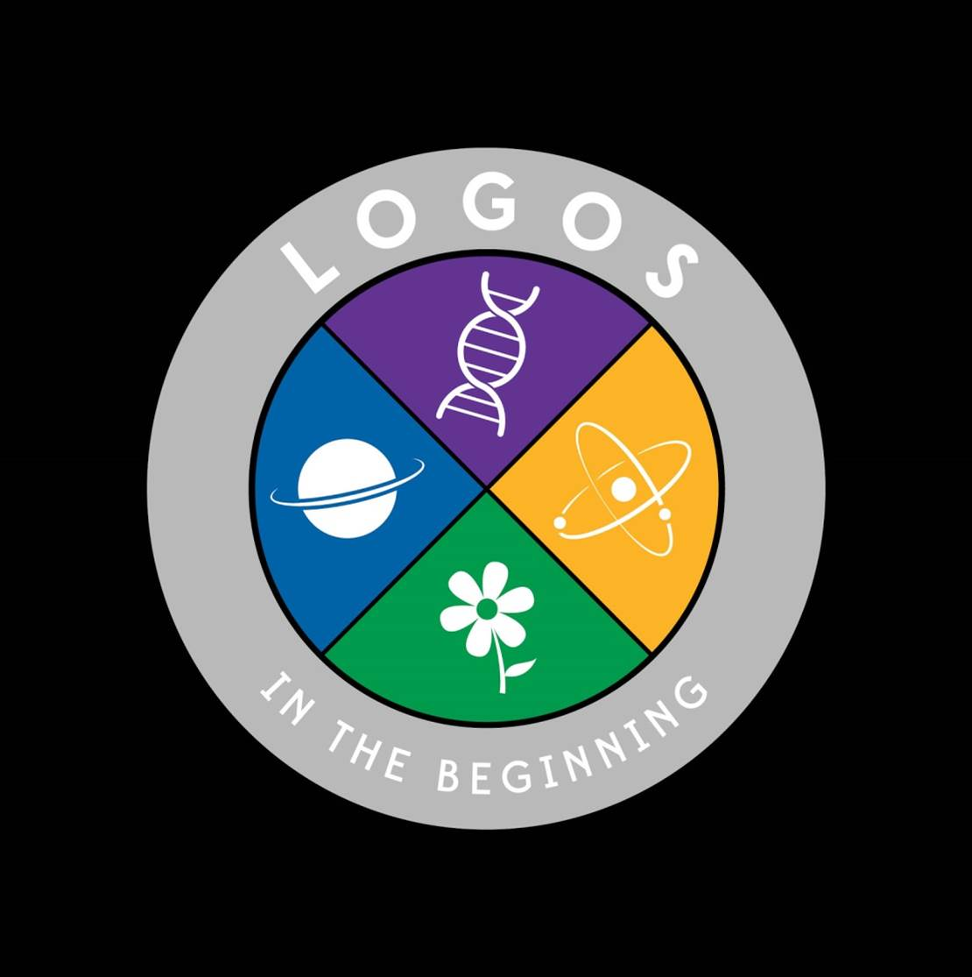
© Origins Curriculum Resources 2015

Slide 50

© Southern Adventist University 2015

Slide 51

© Seventh-day Adventist North American Division 2015

Slide 52

© General Conference of Seventh-day Adventists 2015

Slide 53
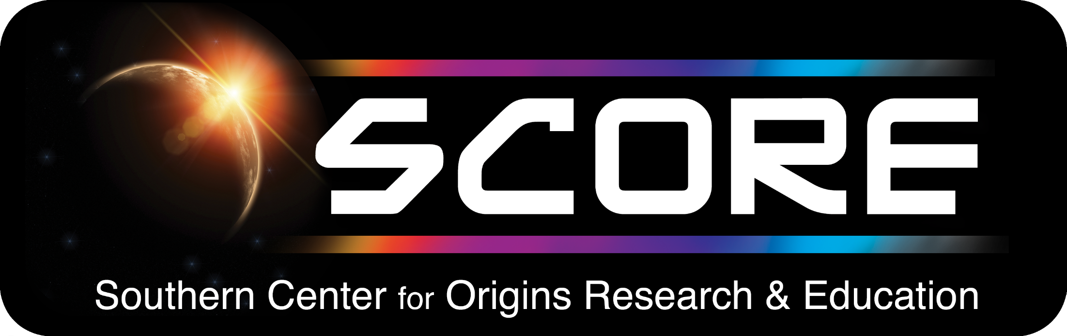
© SCORE Southern Center for Origins Research & Education 2015

