Slide 1
The Big Bang Theory
And the Origin of the Universe
1 - 4
Notes:
This series of four presentations will explore the Big Bang Theory and the origin of the universe.

Slide 2
1. Exploring Our Universe – A Story
Notes:
In the first, we will explore the history of our search to understand the universe.

Slide 3
2. The Big Bang Theory
Notes:
In the second, we will describe what the Big Bang Theory actually claims.

Slide 4
3. The Big Bang–Observation or Speculation?
Notes:
Then we will examine whether the Big Bang Theory is based on observable evidence or just on speculation.

Slide 5
4. Implications of the Big Bang
Notes:
Finally, we will look at some interesting implications of the Big Bang Theory.

Slide 6
Scientific Process
Get an idea
Perform
experiments
Create theory
Use theory
“Science, although incredibly useful and powerful, never provides more than tentative conclusions” (page 3)
Notes:
Let’s begin by reviewing the scientific process, which is incredibly useful and powerful. However, as we will see throughout this presentation, it never provides more than tentative conclusions.

Slide 7
Scientific Process
Get an idea
Perform
experiments
Create theory
Use theory
Notes:
Science begins with an idea—maybe from an observation, or a question. / The scientist performs experiments to test his or her idea, / and if the results of the experiments are consistent with the idea, a theory is created. / If the results of the experiment don’t match the idea, it will be revised or replaced. / Once scientists have created a theory, they will use it to learn more about the world around them.

Slide 8
Scientific Process
predictions
Get an idea
Perform
experiments
Create theory
Use theory
Support theory
Support theory
Support theory
Notes:
Scientists use the theory to make predictions, / and then they perform experiments to test their predictions. / Over time, they may amass quite a lot of evidence that supports the theory.

Slide 9
Scientific Process
Improve
or replace theory
Get an idea
Perform
experiments
Create theory
Use theory
?
?
Support theory
Notes:
Sometimes, however, the results of the experiments don’t support the theory. / And eventually the theory may need to be improved or even replaced.

Slide 10
Scientific Process
predictions
New
theory
Get an idea
Perform
experiments
Create theory
Use theory
Notes:
Then the same process starts all over again. We make predictions and compare them with the results of the experiments.

Slide 11
Exploring Our Universe – A Story
Notes:
This presentation tells the story of how we have used this process to learn a lot about our universe.

Slide 12
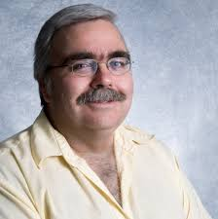
History Highlights the Fundamental Limitations of Science
Presented in 2015 at the Biblical Foundations of Faith and Learning Conference and published in the conference proceedings:
Caviness, Ph.D., Ken (2016) "History Highlights the Fundamental Limitations of Science," The Journal of Biblical Foundations of Faith and Learning: Vol. 1 : Iss. 1 , Article 1.
Kenneth E. Caviness
Southern Adventist University
Notes:
The information comes from a presentation by Dr. Ken Caviness called “History Highlights the Fundamental Limitations of Science” and is used with his permission.

Slide 13
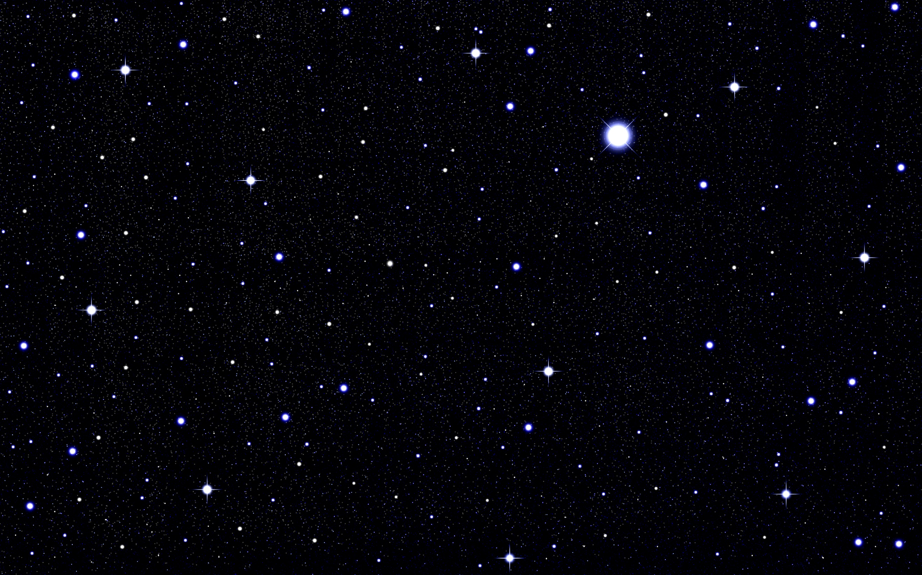
Notes:
“Humans have been fascinated by the stars since the dawn of recorded human history.”

Slide 14
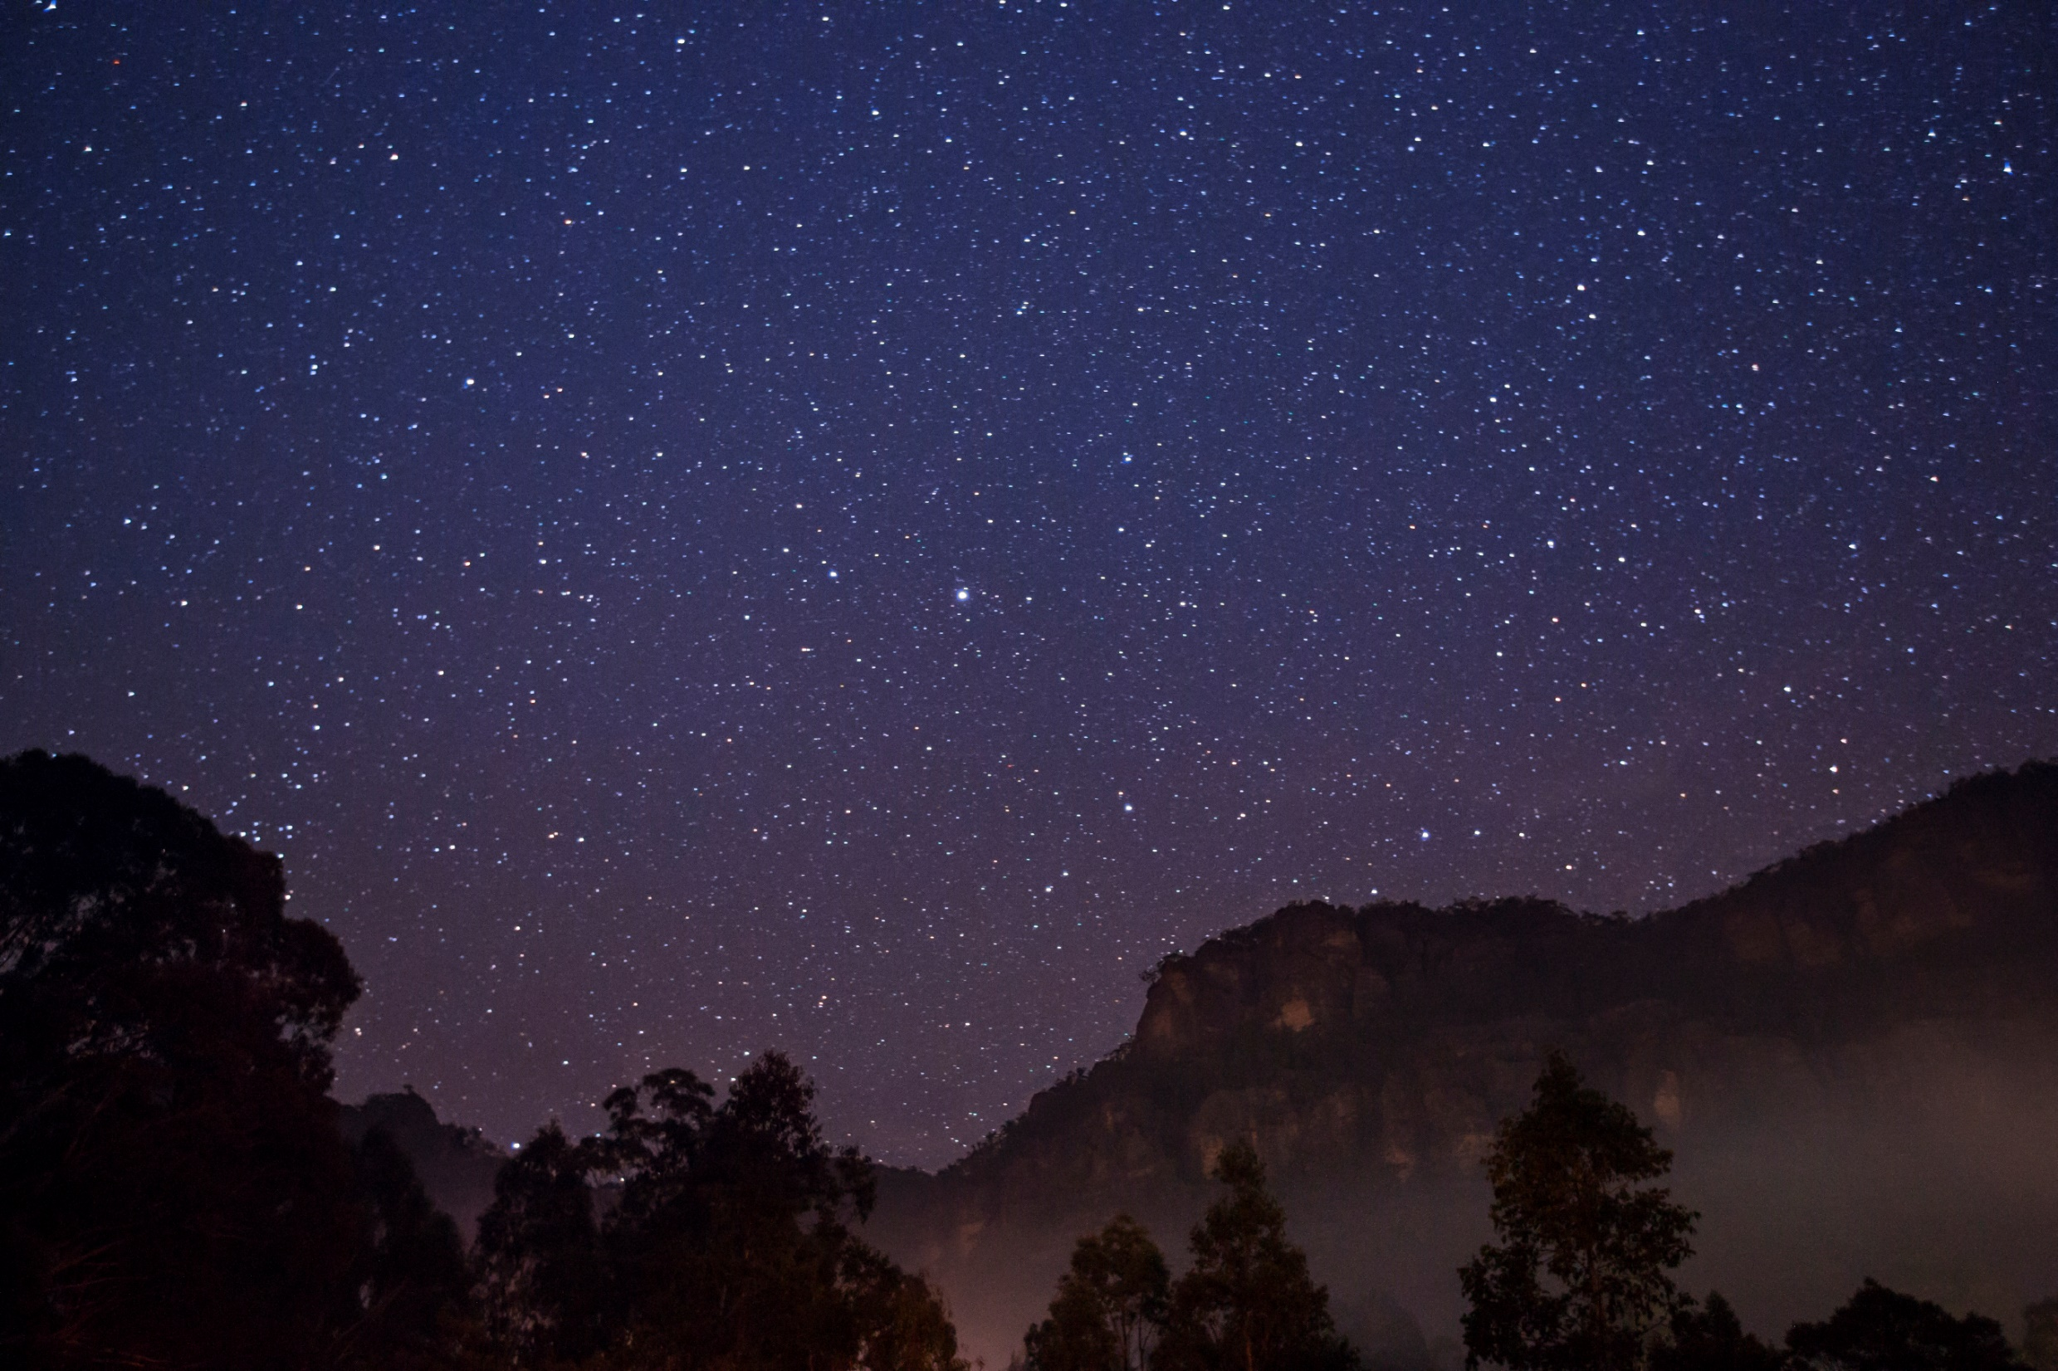
Patterns led to explanations
Notes:
“Even in ancient times the patterns of motion of the heavenly bodies were considered significant, / and study of the patterns led to attempted explanations.” (page 3)

Slide 15
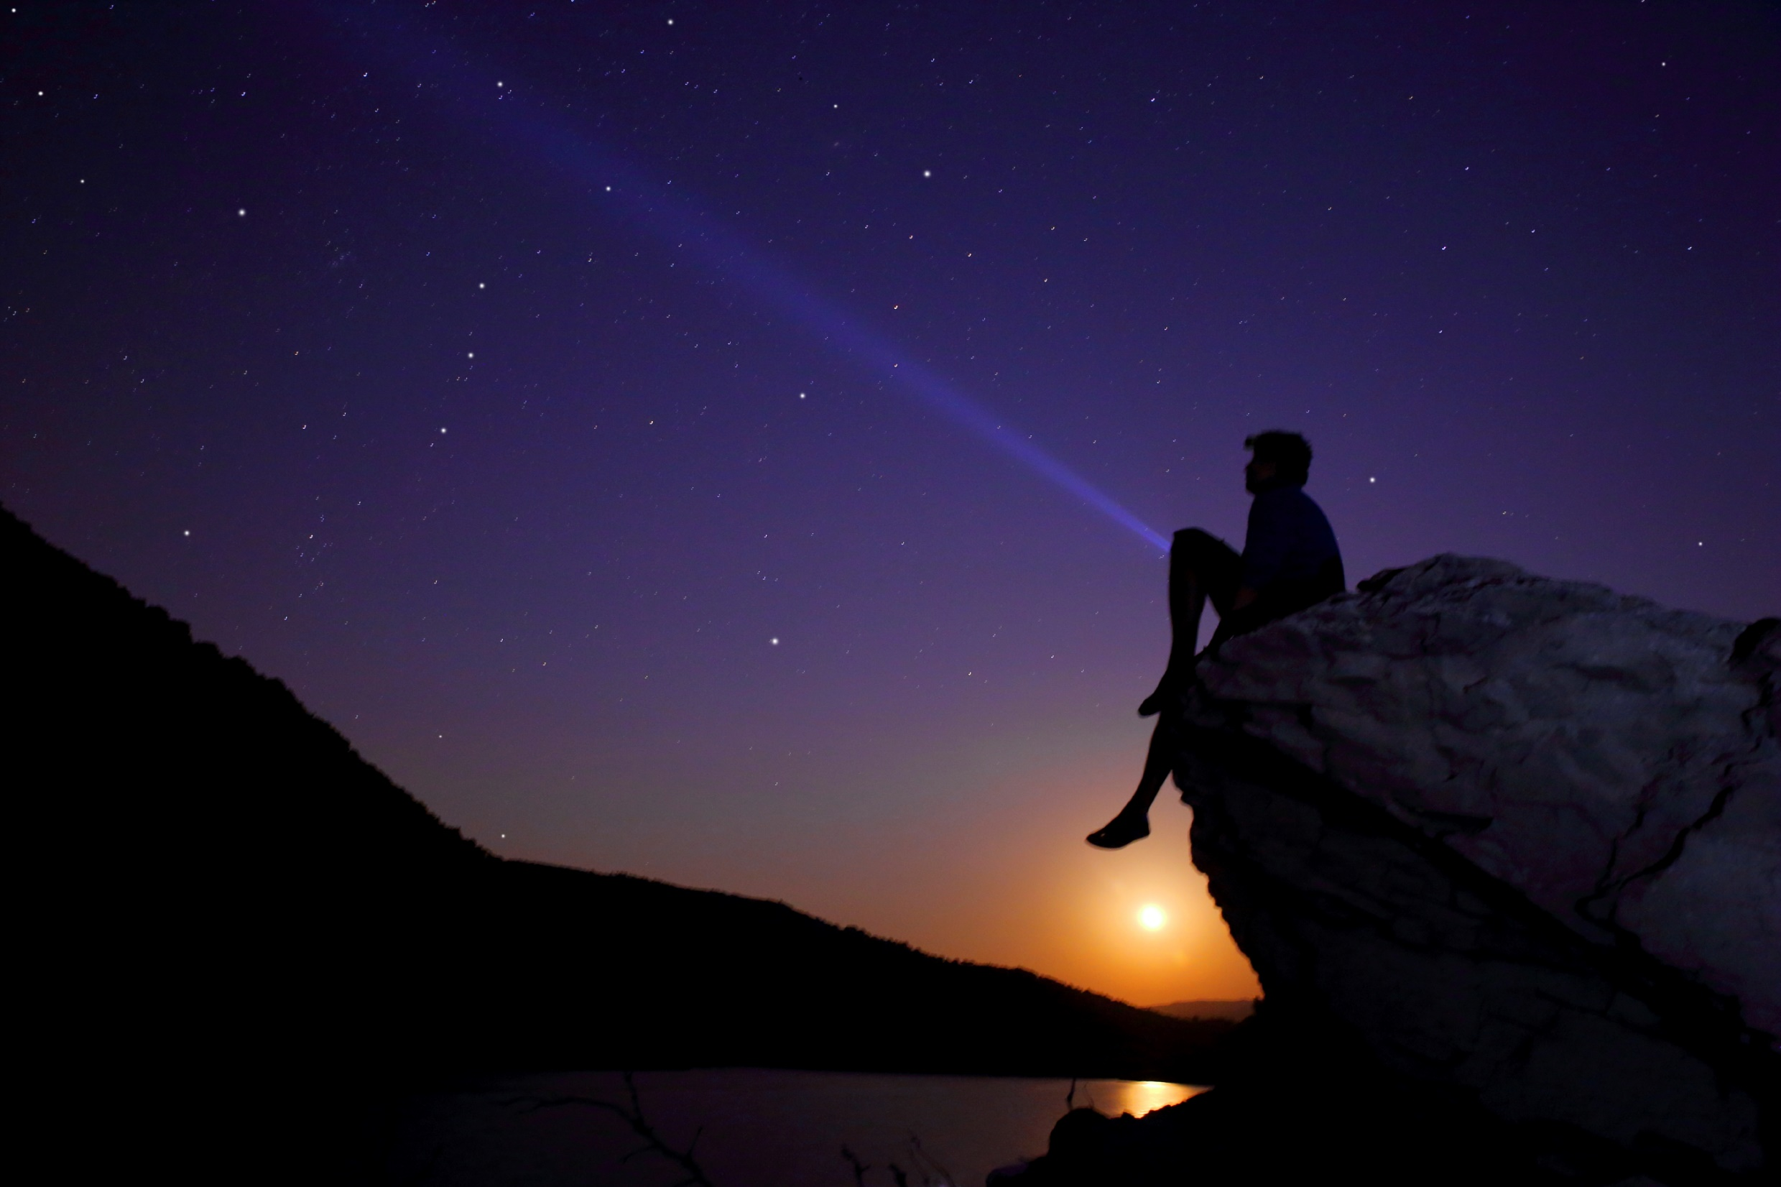
Human = tentative
Notes:
“Since these explanations or models were constructed by humans to explain observations made by humans, / it would have been reasonable to regard them as tentative…

Slide 16
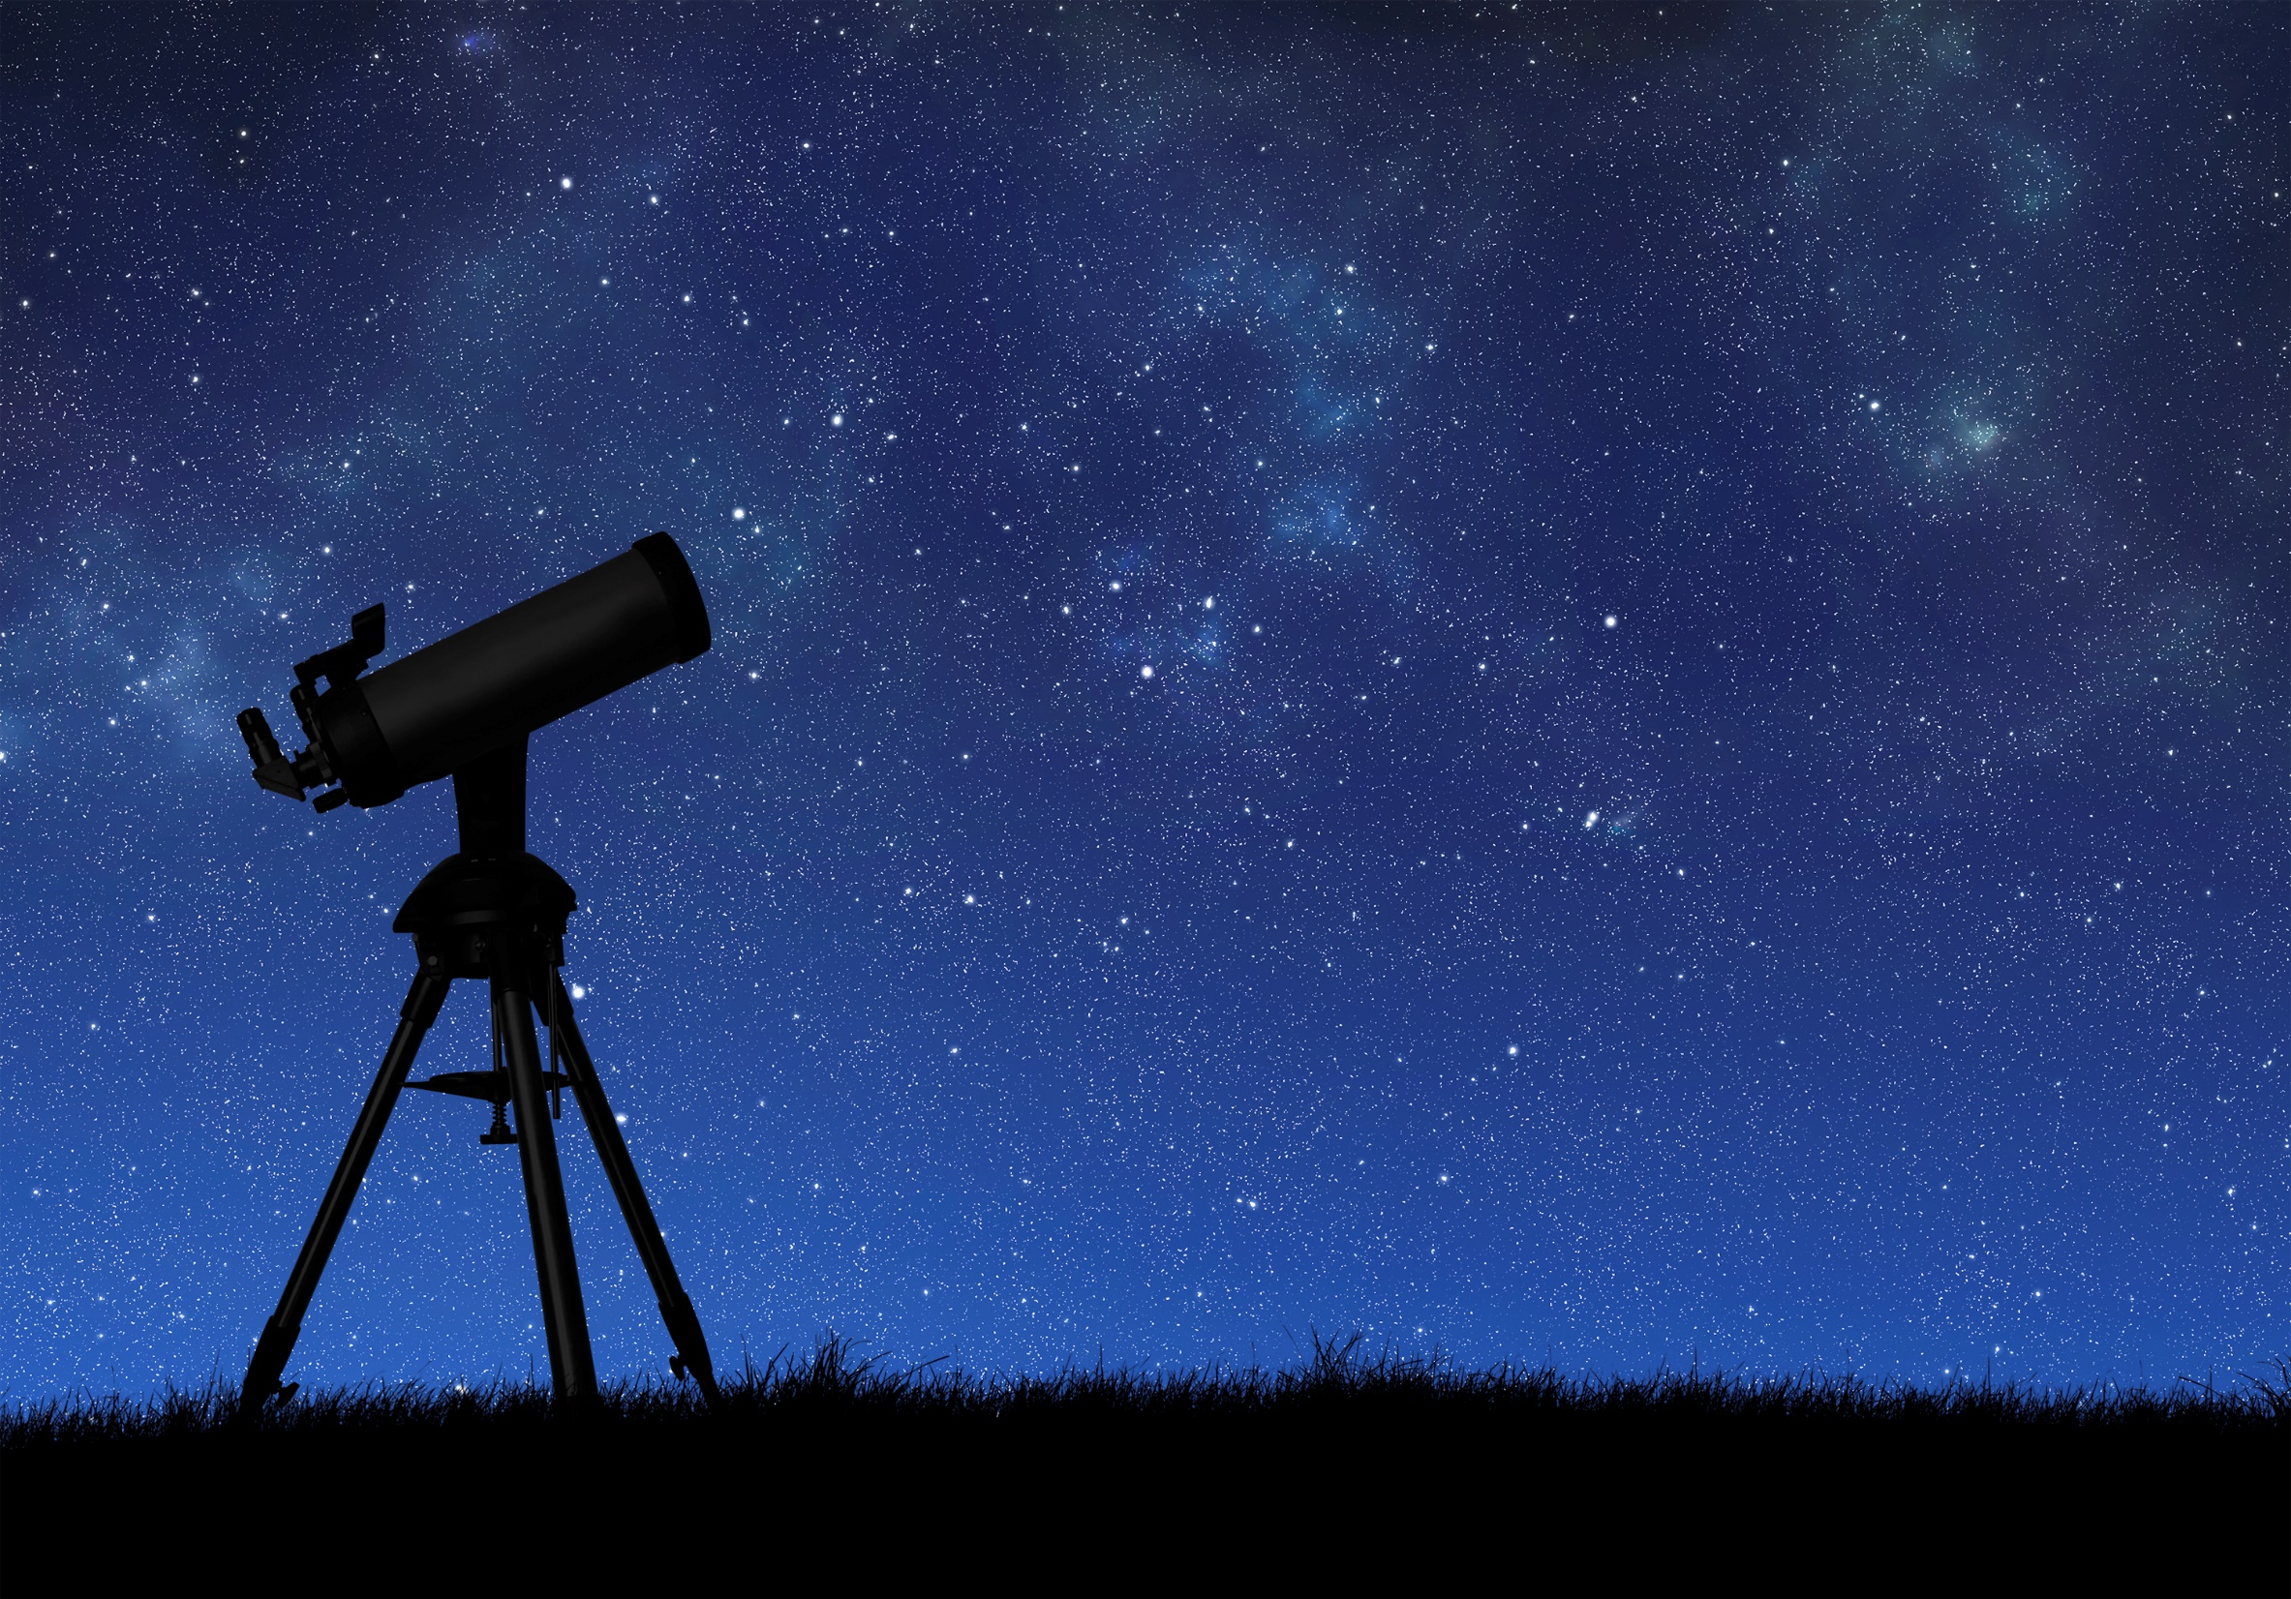
Subject to change
Notes:
…subject to [change in the future] when new observations and discoveries did not fit with a previously accepted model.” But it wasn’t that simple…
[page 3]

Slide 17
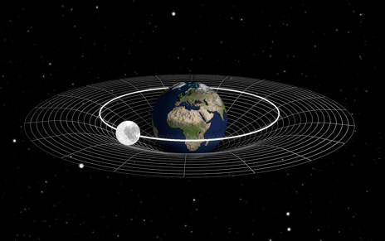
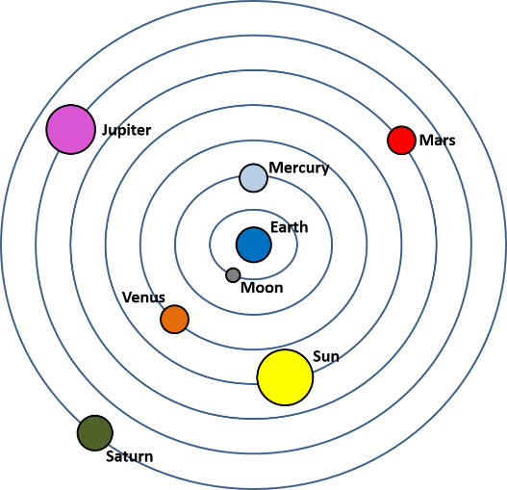
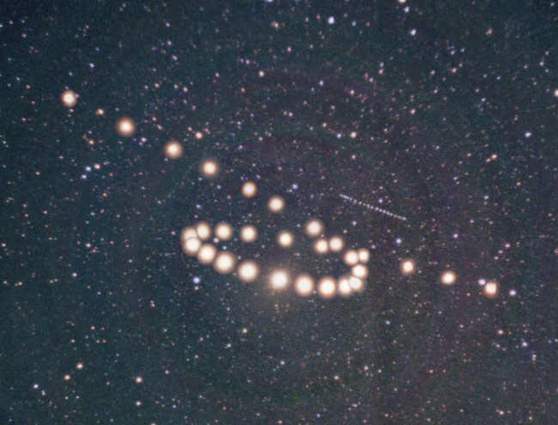
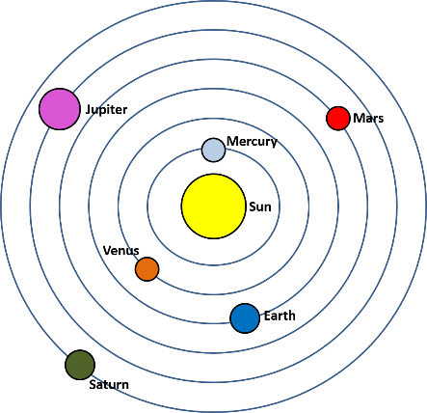
Gm1m2
F =
r
2
Made discoveries
Constructed theories
Notes:
We will learn how scientists from the ancient Greeks to the present made discoveries and constructed theories to understand the “motions of the heavens.”
Evan made the earth and orbiting moon
[17a] Geocentric Theory, Myles Ketelson
[17b] Earth and orbiting moon, Evan Robinson
[17c] Z is for Mars courtesy of Courtney Seligman, http://apod.nasa.gov/apod/ap060422.html, Credit & Copyright: Tunc Tezel
[17d] Heliocentric, Thomas Bartlett

Slide 18
Gm1m2
F =
r
2
Notes:
In the process, as new observational data called into question well-accepted theories…

Slide 19
Reactions to new evidence
Denying either the observations or the theory
Modifying the theory
Replacing the theory
Notes:
…the scientific community reacted in one of three ways: by
Denying either the observations or the theory
Modifying the theory or
Replacing the theory

Slide 20
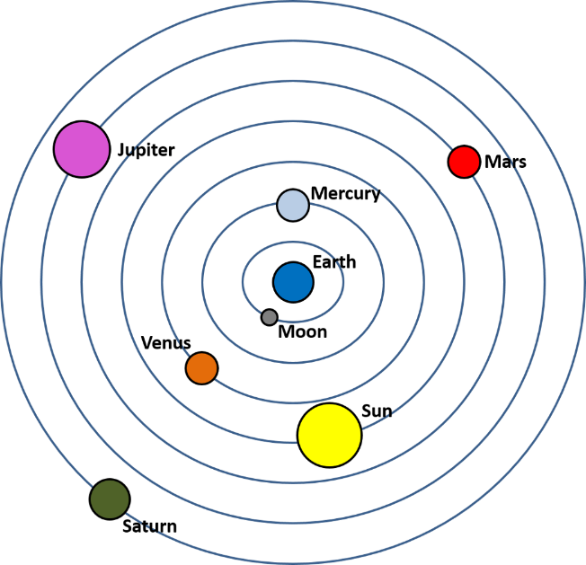
Aristotle, Ptolemy and Epicycles:
An Early Scientific Model
Notes:
We will begin with an early scientific model…

Slide 21
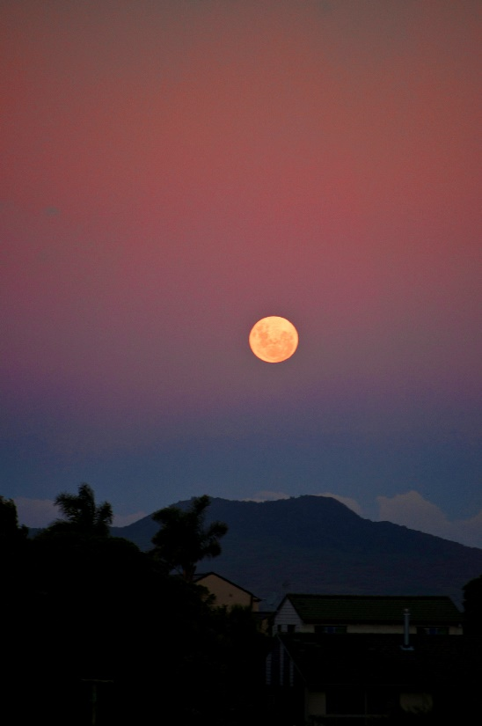
Aristotle
Notes:
The Greek philosopher Aristotle believed that earthly matter falls to the Earth / but heavenly matter remains in the heavens, / traveling in circles, the most perfect of all possible motions (page 4)
(got picture from origins folder—find citation) ADD other pics

Slide 22
The earth is stationary and at the center
Geocentric
Geo = earth
Centric = center
Notes:
The geocentric theory said that the earth was stationary and at the center of the universe.
(Got this from external drive, origins pictures folder—find documentation for it)

Slide 23
Could explain much of the data
When we drop things, they fall to the ground
The sun, moon, and stars do not fall to the ground
The sun rises, crosses the sky, and sets
The moon rises and sets
We see motion all around us but feel the Earth under our feet, rock solid and unmoving
Notes:
The original geocentric model could adequately explain much of the data available at the time. / We have repeated experience with dropping things to the ground. No matter how often I pick up a stone, no matter how high I lift it, when released the stone falls back to the ground. Earthly things remain on Earth, or when removed, try to return to Earth. / On the other hand, the sun, moon, and stars do not fall to the ground. It was not really so ridiculous to suppose that they were made of something different from earthly matter. / We see the sun rise, cross the sky, and set every day. / The moon also rises and sets. / We see motion all around us, but feel the Earth under our feet, rock solid and unmoving. Based on these observations, the geocentric model looks quite reasonable: The Earth is the center of all this heavenly and earthly motion.

Slide 24
Could NOT explain other data
Celestial bodies appeared to orbit the Earth daily
The waxing and waning of the moon varies monthly
Yearly seasonal cycles
Time of sunrise and sunset
Length of the day
Height the sun reaches
Which constellations are visible
The “Wanderers”
Notes:
But there were other observations that could not be explained by the Geocentric theory. / Although celestial bodies appeared to orbit the Earth daily, / the waxing and waning of the moon varies on a monthly cycle. / The time of sunrise and sunset, the length of the day, the height the sun reaches overhead, and which constellations are visible in the sky, as well as their rising and setting times all varied according to a yearly cycle. / More mysteriously, the movements of five stars, known to the ancient Greeks as wanderers, could not be explained by this model.

Slide 25
Could not explain the “Wanderers”
Notes:
These stars, which usually moved faster than the normal “fixed” stars, would periodically seem to back up temporarily before continuing their orbit. The Babylonians were aware of the complex motion of the five known planets probably as early as the second millennium B.C., but the first scientific model explaining the motion was not developed until the first or second century A.D.
http://apod.nasa.gov/apod/ap031216.html
http://cseligman.com/text/sky/retrograde.htm

Slide 26
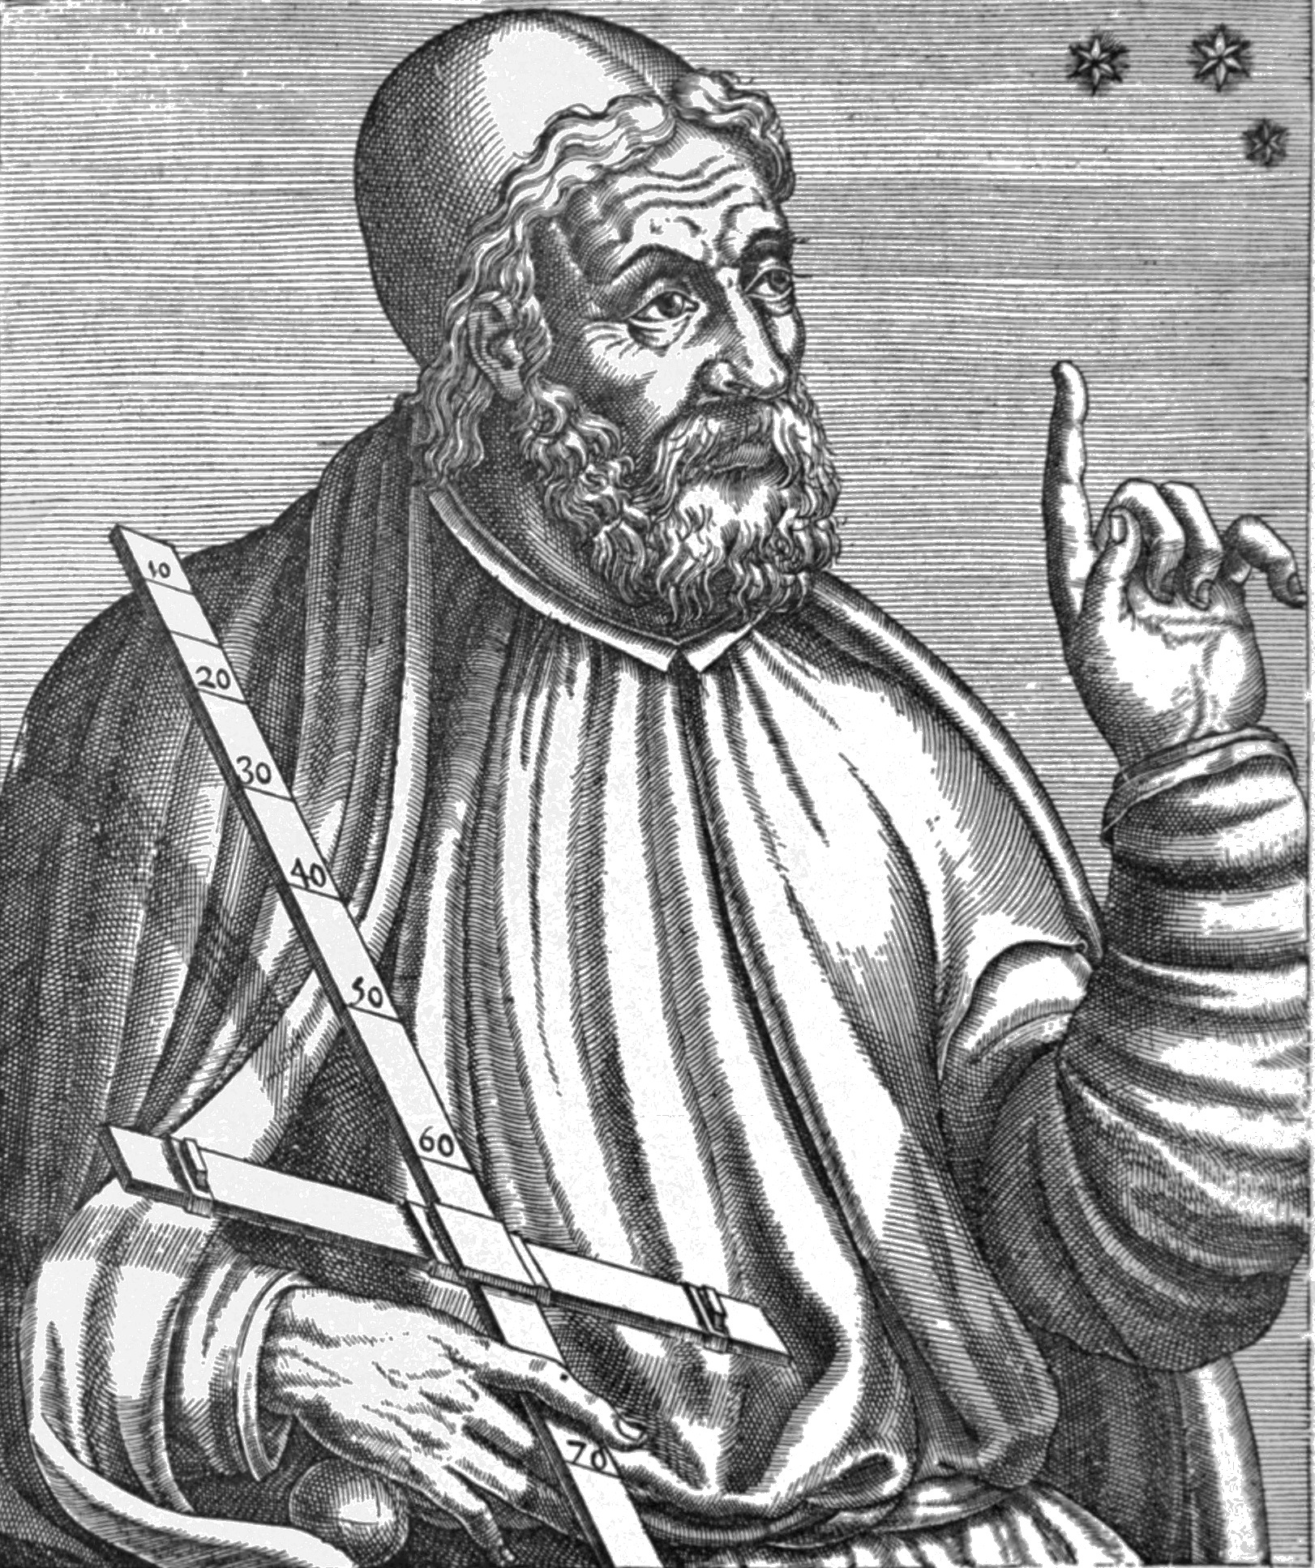
Ptolemy’s Epicycles
Notes:
The first scientific model explaining the motion was elaborated by Claudius Ptolemy of Alexandria after about A.D. 150. Rather than orbiting the Earth directly, like the yellow circle in this graphic, each planet’s path was an epicycle, which was still basically a circular path around the Earth, but along the way its orbit includes multiple smaller circles called epicycles—like the red circle in the graphic.
Ptolemy: (Public domain) https://en.wikipedia.org/wiki/Ptolemy#/media/File:PSM_V78_D326_Ptolemy.png
http://faculty.fullerton.edu/cmcconnell/Models/ptolemy.gif
http://faculty.fullerton.edu/cmcconnell/Planets.html

Slide 27
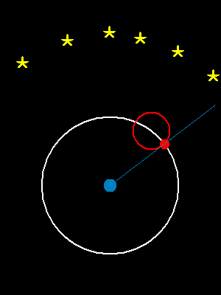
Ptolemy’s Epicycles
Notes:
This animation shows how the epicycles could produce the retrograde motion of the “wandering” planets.
http://faculty.fullerton.edu/cmcconnell/Models/ptolemy.gif
http://faculty.fullerton.edu/cmcconnell/Planets.html

Slide 28
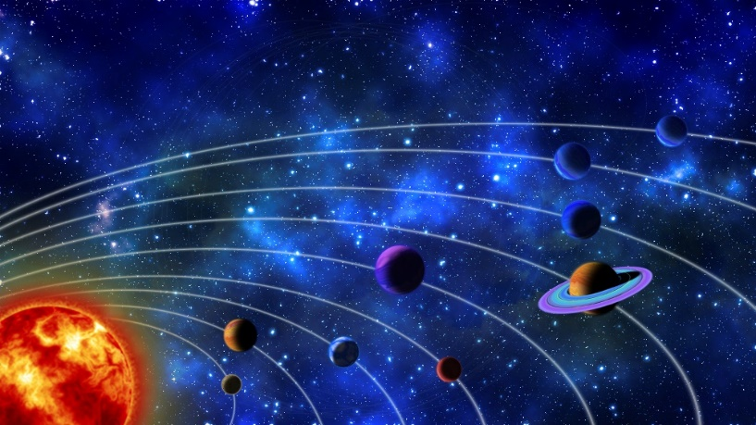
Standard explanation for planetary orbits for 1000+ years
Extremely successful theory!
Predict planetary positions
Notes:
Ptolemy modified the existing geocentric model by including epicycles. This made the model more complicated but added to its explanatory power. / Geocentrism plus epicycles could predict planetary positions, where geocentrism alone could not. / This was an extremely successful theory—/ the standard explanation of planetary orbits for more than a millennium
Geocentric Universe, Thomas Bartlett

Slide 29
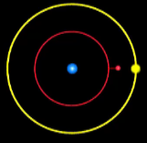
Ptolemy’s Epicycles
Very successful theory, but…
Two notable deficiencies
Too arbitrary
Too many adjustable parameters, so flexible it can fit any data
Notes:
But even this highly successful theory had problems. Because It was too arbitrary and had too many adjustable parameters, it was eventually replaced by a simpler and more elegant model.

Slide 30
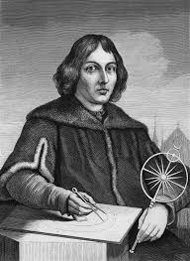
Copernicus
The heliocentric model
Notes:
…published by a man named Nicolaus Copernicus.
Nicolaus Copernicus, Unknown, https://commons.wikimedia.org/wiki/File:Copernicus.jpg, public domain

Slide 31
Heliocentric Model (Copernicus – 1543)
Did away with complex epicycles
Treated the sun as the center
Explained retrograde motion simply and elegantly
Explained
Motion of “fixed” stars
Visibility of constellations
Seasons
Notes:
(look for citation)
In 1543 Nicolaus Copernicus published his heliocentric model. / This new model did away with the complex epicycles / by simply treating the sun as the center about which the Earth and the other planets circled. / The mysterious retrograde motion was simply and elegantly explained by planets near the sun periodically overtaking the planets further away from the sun. / The Earth’s rotation on its axis and its orbit around the sun explained the motion of the “fixed stars”, the gradual changing of the visible constellations throughout the year, and when coupled with the tilt of its axis, the seasons.

Slide 32
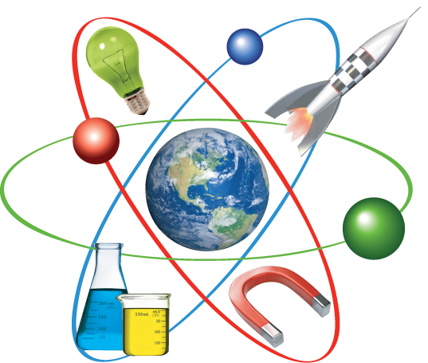
Simpler and more “elegant”
Greater predictive power
Not true – only (perhaps) more nearly true
Widely accepted worldview for over 1,000 years was REPLACED
Notes:
This new model, with its greater predictive power, replaced the previous theory, / which had been widely accepted for over 1,000 years! / In the end, though, Copernicus’s heliocentric model wasn’t true either—only perhaps, more nearly true.

Slide 33
Scientific theories
All theories are tentative
Something better may come along
We may eliminate models that make incorrect predictions
Science – Most Powerful Tool Ever
Notes:
What does this tell us about scientific theories? / Very simply that all theories are tentative. No scientific model can be considered to be the last word. / Even after years of use, something better may come along. Indeed, science is not a means of finding truth. / At best we may eliminate models that make incorrect predictions and hope that the explanations we end up with are approximately true, while keeping in mind that we may find a better approximation in the future. / This does not undermine the value of science, but puts it in proper perspective: it is important to understand the uses and the limitations of any tool in order to use it effectively, and science is arguably the most powerful tool ever invented.
https://sites.google.com/a/apps.isd13.org/highland-science-3-5/

Slide 34
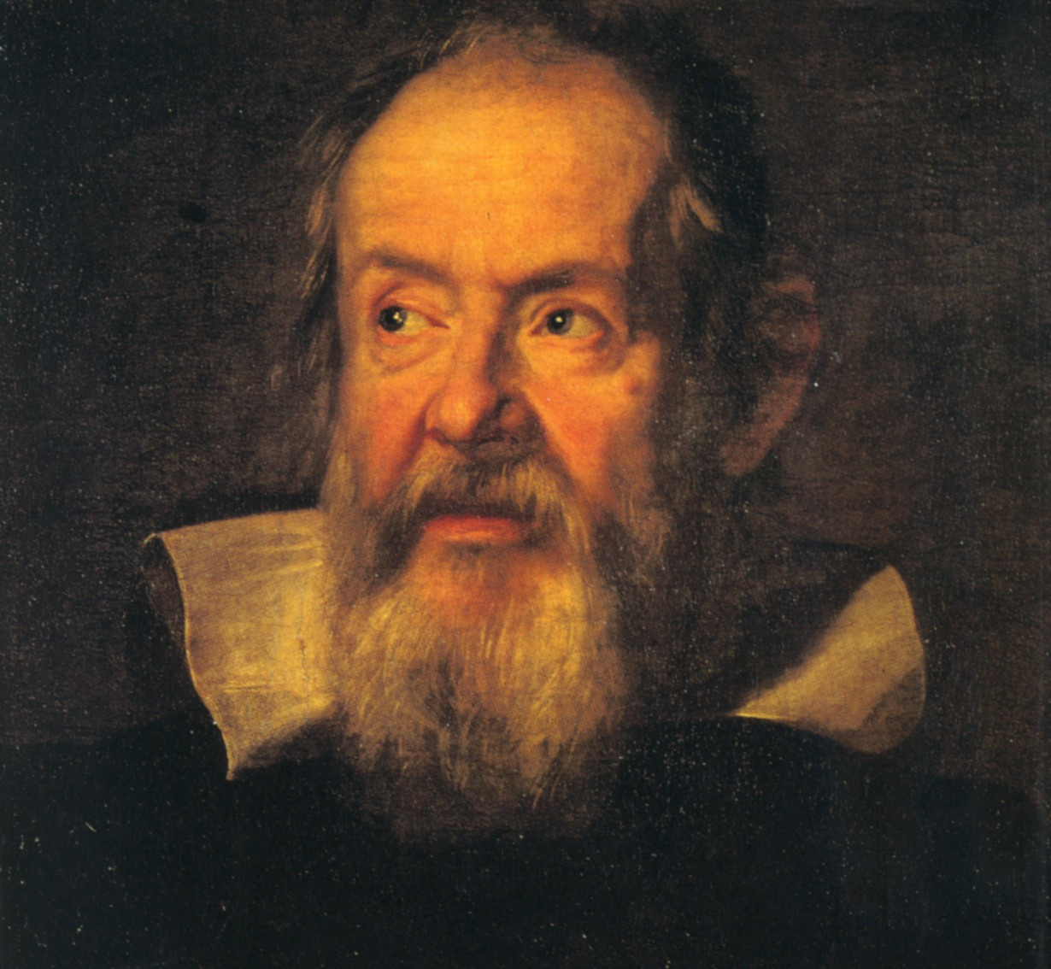
Galileo & Kepler
Notes:
The exploration of our universe continued with two more scientists named Galileo Galilei and Johannes Kepler.
Galileo Galilei, Justus Suttermans, https://commons.wikimedia.org/wiki/File:Galileo-sustermans.jpg, public domain
Johannes Kepler, Unknown artist, http://en.wikipedia.org/wiki/File:Johannes_Kepler_1610.jpg, Public Domain.

Slide 35
Galileo
Heavenly bodies are not as perfect as previously assumed
Venus and Earth orbit the sun
Earth is not the center of all motion
Lunar craters
Sunspots
Phases of Venus
Four largest moons of Jupiter
Notes:
Galileo supported the heliocentric model (perhaps prematurely). His improvements to the telescope enabled him to make several major discoveries: / Lunar craters, / sunspots, / phases of Venus, / and four largest moons of Jupiter. These discoveries added support for the heliocentric model but did not provide direct evidence that the Earth moves. / Lunar craters and sunspots indicate that the heavenly bodies are not as perfect as previously assumed. / The phases of Venus pointed strongly to both Venus and Earth orbiting the sun. / The moons of Jupiter show that Earth is not the center of all motion. Yet for most scholars this was not enough to tip the balance in favor of heliocentrism. There was then, as now, a tendency to cling to the explanation consistent with the current popular worldview, even in the face of mounting evidence against it. The large amount of observational data gathered by Galileo was instrumental in the next leap forward in our knowledge of the universe.

Slide 36
Kepler’s 3 laws of planetary motion
Corrected heliocentric model
Could explain more about planetary motion
Notes:
Using large amounts of recently collected data, Kepler created an astronomical model that provided the needed correction to the heliocentric model / and could explain more about planetary motion than ever before.
Johannes Kepler, Unknown artist, http://en.wikipedia.org/wiki/File:Johannes_Kepler_1610.jpg, Public Domain.

Slide 37
Kepler’s 3 laws of planetary motion
Sun at the center
Elliptical orbit
Notes:
Like Copernicus, Kepler thought the sun is in the center. / But unlike previous scientists, Kepler recognized that the shape of the orbit is elliptical not circular.

Slide 38
Kepler’s 3 laws of planetary motion
orbits
The orbits of planets are ellipses, not circles, with the sun at one focus of each ellipse.
A planet’s speed does not remain constant, but varies in a predictable way.
The square of the period of the orbit is proportional to the cube of its semi-major axis, the average of the closest and farthest distances to the sun.
Notes:
This became Kepler’s first law, and it required that they abandon the Greek idea that circles were perfect. / His second law states that a planet’s speed does not remain constant, but varies in a predictable way. You can learn the third one some day too, but for now just remember that, with just three general statements…
Johannes Kepler, Unknown artist, http://en.wikipedia.org/wiki/File:Johannes_Kepler_1610.jpg, Public Domain.

Slide 39
Kepler’s 3 laws of planetary motion
orbits
Explain all the available data
Allowed predictions of where planets would be in the future
Comparing the data with the predictions, Kepler’s model was recognized as true
Notes:
…Kepler could explain all the data available to him from past observations of the planets. / Not only that, but they also allowed him to predict where the planets would be in the future with better accuracy than the models of either Ptolemy or Copernicus. / As scientists compared the data with Kepler’s 3 laws, his model was recognized as true, and the others false.
Johannes Kepler, Unknown artist, http://en.wikipedia.org/wiki/File:Johannes_Kepler_1610.jpg, Public Domain.

Slide 40
No guarantee of truth could reasonably be given to Kepler’s model of the solar system, any more than to its predecessors. All that could be said is that it fit the data better than the others considered at that time. Truth cannot be determined by human theories. One must acknowledge that a better model providing even more accurate predictions and better fit to the data might be invented at any time.
Notes:
Yet, no guarantee of truth could reasonably be given to Kepler’s model of the solar system, any more than to its predecessors. All that could be said is that it fit the data better than the others. Truth cannot be determined by human theories. One must acknowledge that a better model providing even more accurate predictions and better fit to the data might be invented at any time. And sure enough, a better model soon emerged.

Slide 41
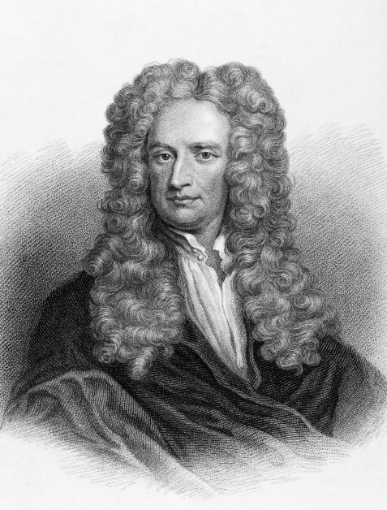
Law of Universal Gravitation
Newton
Simpler
Fewer assumptions
New predictions
Set the stage
Gm1m2
F =
r
2
Explains all the known observational data
Notes:
The work done by Galileo and Kepler eventually led to Newton’s law of universal gravitation, / which states that the force between any two bodies is proportional to the product of their masses and inversely proportional to the square of the distance between them. / Using just this one formula, Newton was able to explain all the known observational data of the time either as well as or better than previous paradigms, which was a huge triumph for science! / It explained everything that Kepler’s three laws explained, but did it with simpler and fewer assumptions. As it was used, additional implications became apparent, new predictions were made and confirmed by experiment and observation and the stage was set for a new era of astronomical discovery
Newton from iStock 11723925

Slide 42
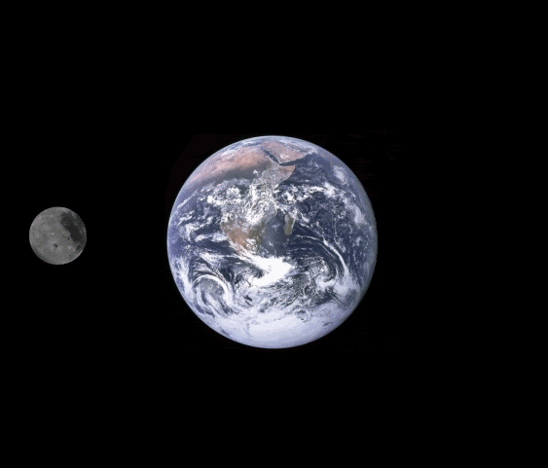
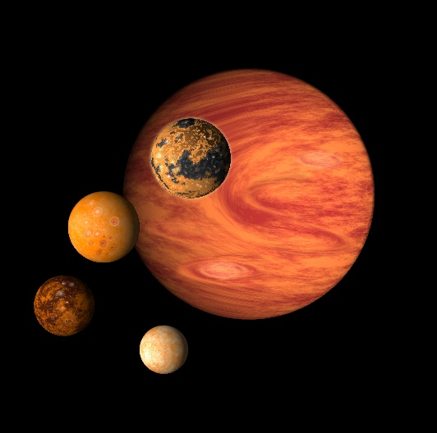
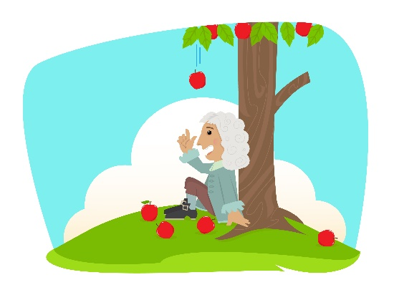
Just 1 theory…
Notes:
With just one theory, scientists could now explain that gravitational attraction keeps the planets, comets, and asteroids orbiting the sun in elliptical paths, / keeps Earth’s moon orbiting Earth / and Jupiter’s moons orbiting Jupiter, / makes the apple fall from the tree to the ground below, / causes the tides, and even pulls the Earth into a spherical shape—a genuinely new and unexpected idea at the time.
Apple falling graphic from iStock 57569842

Slide 43
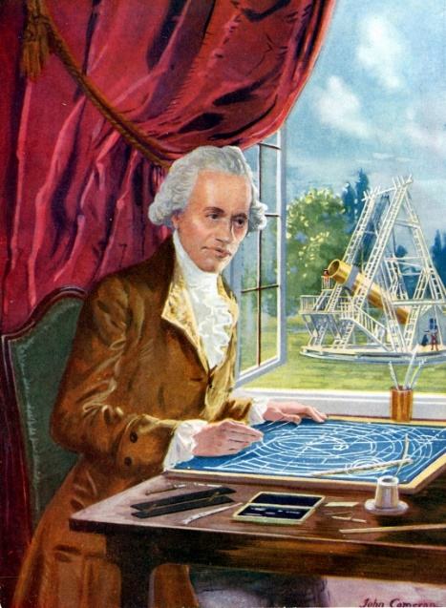
Opportunity to test the theory
Herschel
Gm1m2
Evidence
(but not proof)
for the new model
F =
r
2
Uranus obeyed the same
laws proposed for the other planets
Notes:
An opportunity to test the theory came when Sir William Herschel accidentally discovered the planet Uranus in 1781. / Astronomers tracked the new planet and discovered that it obeyed the same laws proposed for the already known planets, / providing the first new supportive evidence – but not proof – for the new model.
William Herschel 92831586, Photos.com, Thinkstock, Thinkstock Image Subscription

Slide 44
Discrepancies Quandry
Ignore the conflicting observations
Abandon the theory
Trust the theory and keep searching
Notes:
But over the following years, more precise observations showed a discrepancy between theory and experiment, leaving astronomers in a quandary. / They could ignore the conflicting observations (perhaps the default human reaction much of the time), / or in light of this new evidence, they could abandon the theory and seek a new explanation, as Copernicus had done. / The remaining option was to trust the theory and deduce the existence of factors not yet taken into account.

Slide 45
Trust the theory and keep searching
“noblest triumph of theory”
Adams &
Le Verrier
(1840s)
Gm1m2
F =
r
2
Neptune discovered
within 1 degree of the predicted position
Notes:
Two men, working independently in the 1840s, decided to trust the theory / and predicted the existence and position of a previously unsuspected planet beyond the orbit of Uranus. Le Verrier presented his final prediction for the location of the unknown planet to the French Academy / and in a private communication to Johann Galle of the Berlin Observatory. The same evening the letter arrived, / Galle discovered Neptune at a point within one degree of the predicted position. / This discovery was acclaimed as “the noblest triumph of theory” / and no serious doubts remained about the truth of Kepler’s laws and Newton’s theory of universal gravitation. Yet it is still worth insisting on the distinction between supporting evidence and proof.
http://www.publicdomainpictures.net/view-image.php?image=66396&picture=old-envelope

Slide 46
Slight divergence from the theoretical orbits predicted by model
Trust the theory and keep searching
Gm1m2
F =
r
2
Pluto discovered
Human error & coincidence
Notes:
It is interesting how history sometimes repeats itself. / Astronomers tracking the orbits of Uranus and Neptune reported a slight divergence from the theoretical orbits predicted by Newton’s model. / The model was by now so thoroughly established that the most natural thing in the world / was to predict yet another planet in orbit beyond Neptune. / Sure enough—astronomers found what they thought was another planet—Pluto. In this case, however, it turns that the discovery was a combination of human error and coincidence. / The primary source of the original divergence was an incorrect estimate of Neptune’s mass, which was eventually corrected from data collected by the Voyager flyby mission.

Slide 47
Wishful thinking
Gm1m2
F =
r
2
In 2006
Pluto was reclassified
as a dwarf planet
Notes:
In 2006, Pluto was reclassified by the International Astronomical Union as a dwarf planet—a new category that encompassed many recently discovered objects beyond Neptune. / In this case, the past success of a theory, / coupled with erroneous data, / led to an incorrect interpretation and a discovery hailed as further confirmation of the theory, / but which turned out to be only wishful thinking.

Slide 48
Real but often unrecognized DANGER
Considering as confirmation (or even proof) any data that agree
Ignoring data that disagree with a cherished model
Over-reliance on any scientific model
Weakness in the way we think
Notes:
This is a real but often unrecognized danger of over-reliance on any given scientific model, / and a weakness of the way humans think—/ too often ignoring any data seeming to disagree with a cherished model, / while considering as confirmation (or even proof) any data that seem to agree.

Slide 49
Gm1m2
F =
r
2
?
Notes:
The Pluto fiasco was a failure of observation and interpretation, / but it did not shake the universal acceptance of Newton’s model as the truth about celestial mechanics. However it eventually WAS shaken by other evidence. / A tiny discrepancy in Mercury’s orbit, which could not be explained by Newton’s theory, made astronomers wonder if there could be another planet between Mercury and the sun. So certain were the searchers that the proposed new planet was even given a name—Vulcan. But Vulcan was never found and its existence was eventually ruled out. Although not realized at the time, / this was the death-knell for a so-called “Universal Law”

Slide 50
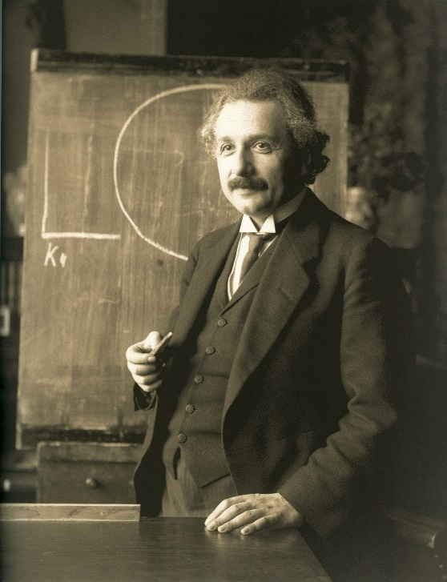
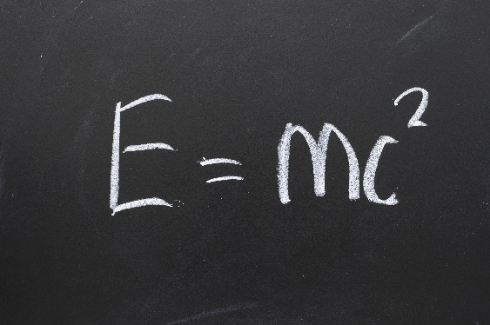
Gm1m2
General theory of relativity
F =
r
2
Notes:
Various modifications of the theory were attempted but failed. / Only abandoning Newtonian theory in favor of another could the scientific explanation of planetary motion be saved.
Replace Newton here as well
Einstein: https://en.wikipedia.org/wiki/Albert_Einstein#/media/File:Einstein_1921_by_F_Schmutzer_-_restoration.jpg
Formula Shutterstock 72186403

Slide 51
Gm1m2
F =
r
2
Notes:
In the same way that each of these models were replaced by theories that could explain more data, / even Newton’s theory of universal gravitation has been superseded.
Evan made the earth and orbiting moon

Slide 52
Einstein’s General Theory of Relativity
More accurate predictions
Explains discrepancy
Additional predictive power
Explains the cause of gravity
Notes:
The model that eventually replaced Newton’s theory is Einstein’s Theory of General Relativity. / This theory delivers more accurate predictions and additional predictive power. / It explains the discrepancy in Mercury’s orbit / as well as smaller / And it explains the cause of gravity itself, about which Newton refused to speculate.

Slide 53
Einstein’s General Theory of Relativity
Mass warps space
Warped space tells matter (and light) how to move
Equivalence Principle—it is impossible to distinguish locally between acceleration and gravitation
Notes:
According to Einstein , orbits are not caused by a force reaching out from one mass to another across empty space. / Instead, he suggests that the fabric of spacetime itself is warped by the presence of mass—similar to the “dimple” formed on the surface of a trampoline when a large weight is set on it. Just like a marble rolling on the trampoline might be caught in the depression and orbit the central weight, the planets are actually traveling “straight ahead” in the region of curved spacetime caused by the sun and our moon is actually traveling “straight ahead” in the region of curved spacetime caused by the Earth. The central idea of general relativity can be described this way: / Mass warps space / and warped space tells matter (and light) how to move. / Einstein’s equivalence principle states that it is impossible to distinguish locally between acceleration and gravitation, an exciting and productive unification of ideas previously considered distinct.

Slide 54
General Relativity explains
Gravitational red shift
Gravitational lensing
Gravitational time dilation
Gravity waves
Notes:
General relativity also explains phenomena undreamed of in Newton’s day.

Slide 55
Newton’s Law General Relativity
Gm1m2
F =
r
2
“natural law”
Not true
theory
Notes:
Newton’s Law and General Relativity often agree. But when they disagree, / General Relativity gets the right answers. It has all the earmarks of being truth about how the universe operates. / The irony, of course, is that a “natural law”—tested and trusted over hundreds of years—/ was replaced by a “theory”—as we refer to the General Theory of Relativity. But the theory is right where the law was wrong. / Despite the insights that came from using Newton’s explanations, despite the fact that they gave the right answers, / the Newtonian view of the universe was simply not true.

Slide 56
Einstein’s General Theory of Relativity
Finally
True?
It is not
Quantum Physics
Approximation of the truth
Notes:
Is this better model, now – finally– true? / In fact, we already know it is not. At the very small scale, at distances comparable to or smaller than the size of molecules and atoms, both Newtonian physics and General Relativity give wrong answers / and Quantum physics must be used. / But it too must be considered only an approximation of the truth

Slide 57
Scientific Process
Get an idea
Perform
experiments
Create theory
Use theory
Notes:
Let’s return to the process which creates scientific theories / and then uses those theories to learn more.

Slide 58
Scientific Process
predictions
Get an idea
Perform
experiments
Create theory
Use theory
Support theory
Support theory
Support theory
Notes:
By making predictions / and then performing experiments to test them, scientists often amass quite a lot of evidence over time to support a particular theory.

Slide 59
Scientific Process
Improve
or replace theory
Get an idea
Perform
experiments
Create theory
Use theory
?
?
Support theory
Notes:
But eventually, the results of the new experiments may no longer support the theory. / And eventually the theory may need to be improved or even replaced.

Slide 60
Scientific Process
predictions
New
Theory
Supported
Get an idea
Perform
experiments
Create theory
Use theory
Notes:
Then the same process starts all over again.

Slide 61
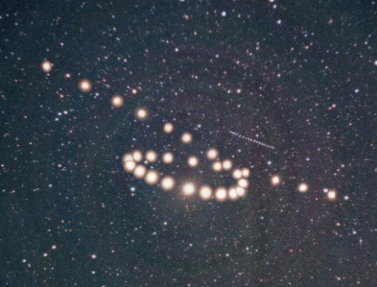
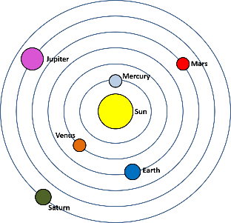
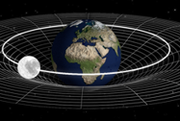
Scientific Process
Get an idea
Perform
experiments
Create theory
Use theory
New
Theory
Gm1m2
F =
r
2
Notes:
We have seen this process at work as scientists through the centuries have tried to understand our universe. This historical sequence of scientific models and paradigm shifts should bring home a fundamental truth about science itself.

Slide 62
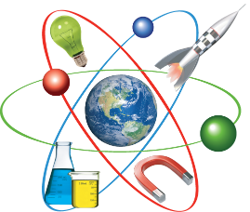
Take-Home Lessons
Science is tentative, limited, and cannot guarantee truth.
New theories that explain more than previous models should be thought of as “approaching truth more closely.”
Science is inadequate as a way of learning truth, as an epistemological foundation.
Notes:
Science is tentative, limited, and cannot guarantee truth. The results of science are undoubtedly useful, but may not be true in any real sense. / New theories that explain more than previous models should be thought of as “approaching truth more closely,” but history gives us no reason to believe that all errors of observation or interpretation have now been eliminated. / Although science is an incredibly valuable tool, it is inadequate as a way of learning truth.

Slide 63
Scientific Process
Get an idea
Perform
experiments
Create theory
Use theory
New
Theory
Gm1m2
F =
r
2
Notes:
This story provides an important backdrop, for a fairly recent theory about the origin of the universe.

Slide 64
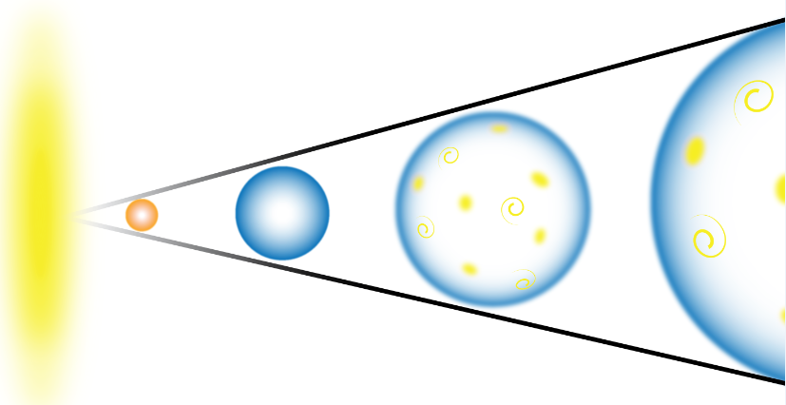
The Big Bang Theory
Notes:
We will explore The Big Bang Theory in our next presentation.

Slide 65
Caviness, Ph.D., Ken (2016) "History Highlights the Fundamental Limitations of Science," The Journal of Biblical Foundations of Faith and Learning: Vol. 1 : Iss. 1 , Article 1.
Available at: http://knowledge.e.southern.edu/jbffl/vol1/iss1/1
Special Thanks to
Kenneth E. Caviness
Southern Adventist University
Notes:
Special thanks to Dr. Ken Caviness for permission to use the content of his paper as the basis for this presentation.

Slide 66
Images By
Images may appear on more than one slide. Citation is given on the first slide where each image appears.
[2] Milky Way at sunrise Silhouette of a range 77475745, ClaudioVentrella,
[12] Dr. Kenneth Caviness, used with permission
[13] Night Sky 90606913, Hulya Erdem, Getty Images (US), Inc. Subscription.
[14] Campfire smoke and starry skies 83243531, shells1, Getty Images (US), Inc. Subscription.
[15] Searching the Galaxyv 74804737, aydinmutlu, Getty Images (US), Inc. Subscription.
[16] Telescope 64613185, olegkalina, Getty Images (US), Inc. Subscription.
[17a] Geocentric Theory, Thomas Bartlett
[17b] Earth and orbiting moon, Evan Robinson
[17c] Z is for Mars courtesy of Courtney Seligman, http://apod.nasa.gov/apod/ap060422.html, Credit & Copyright: Tunc Tezel
[17d] Heliocentric, Thomas Bartlett
[21a] Statue of Aristotle 164110513, thelefty, Thinkstock, Thinkstock Image Subscription
[21b] Summer playing 3326211, &#169 maks dezman, Getty Images (US), Inc. Subscription.
[21c] Moonlight landscape 94163213, Stolk, Getty Images (US), Inc. Subscription.

Slide 67
Images By
[25a] Retrograde Mars courtesy of Courtney Seligman, http://apod.nasa.gov/apod/ap031216.html, Credit & Copyright: Tunc Tezel
[26] Representation of Ptolemy, Unknown, https://commons.wikimedia.org/wiki/File:PSM_V78_D326_Ptolemy.png, Public Domain
[26b} animation?
[27] Ptolemy's epicycle on deferent model for the planet Mars, Tommy Huerta and Craig McConnell, http://faculty.fullerton.edu/cmcconnell/Planets.html
[28c] Geocentric Universe, Thomas Bartlett
[30a] Nicolaus Copernicus, Unkown, https://commons.wikimedia.org/wiki/File:Copernicus.jpg, public domain
[34a] Portrait of Galileo Galilei, Justus Sustermans, https://commons.wikimedia.org/wiki/File:Galileo-sustermans.jpg, Public Domain
[34b] Johannes Kepler, Unknown artist, http://en.Wikipedia.org/wiki/File:Johannes_Kepler_1610, Public Domain.
[36c] Solar system 70790639, sbhaumik, Getty Images (US), Inc. Subscription.
[41a] Isaac Newton 11723925, Georgios Kollidas, Getty Images (US), Inc. Subscription.
[42a] Side by side Earth and moon size comparison 4313258, pjmorley, Getty Images (US), Inc. Subscription.
[42c] Jupiter and its moons 100127690, Aloysius Patrimonio, Thinkstock, Thinkstock Image Subscription
[42d] Apple falling Isaac Newton 57569842, bilhagolan, Getty Images (US), Inc. Subscription.
[42e] Sea sunrise 79164989, VR_Studio, Getty Images (US), Inc. Subscription.
[43a] William Herschel 92831586, Photos.com, Thinkstock, Thinkstock Image Subscription

Slide 68
Images By
[45] Old Envelope, George Hodan, http://www.publicdomainpictures.net/view-image.php?image=66396&picture=old-envelope, Public Domain
[50b]E=MC2 72186403, maminez, Shutterstock license
[50c] Einstein 1921, F Schmutze, https://commons.wikimedia.org/wiki/File:Einstein_1921_by_F_Schmutzer.jpg, Public Domain
[64] Big Bang Myles Ketelsen

Slide 69
Special Thanks
Foundation for Adventist Education

Slide 70
© Origins Resources 2017

Slide 71
© Southern Adventist University 2017

Slide 72
© Seventh-day Adventist North American Division 2017

Slide 73
© General Conference of Seventh-day Adventists 2017

Slide 74
© SCORE Southern Center for Origins Research & Education 2017

