Slide 1
The Big Bang Theory
And the Origin of the Universe
2
Notes:
The Big Bang Theory and the Origin of the Universe

Slide 2
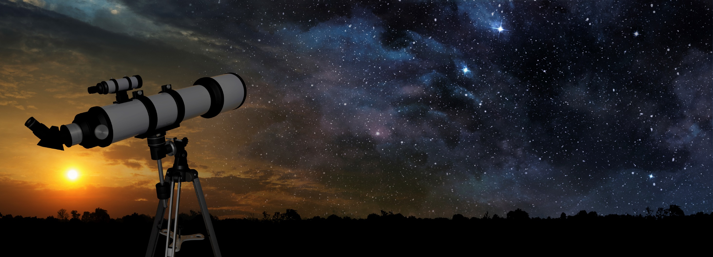
1. Our Exploration of the Universe – A Story
Notes:
In the first presentation of this series…

Slide 3
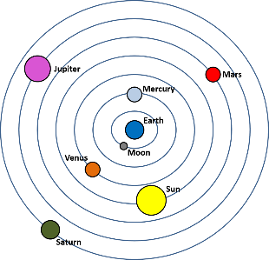
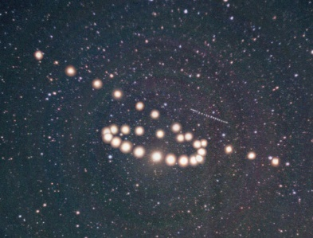
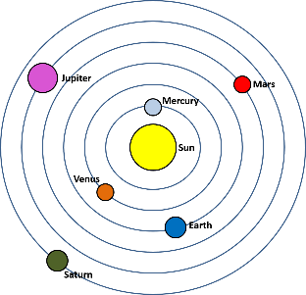
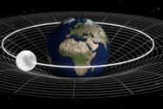
Scientific Process
Get an idea
Perform
experiments
Create theory
Use theory
New
Theory
Gm1m2
F =
r
2
Notes:
…we learned about the scientific process and the sequence of theories scientists have used to explain the universe. / The original geocentric model could explain some phenomena, but not the retrograde motion of certain planets. / Ptolemy’s modification of the model explained the retrograde motion with epicycles but wasn’t perfect either / and was eventually replaced by Copernicus’s heliocentric model of the universe. / Additional work by Galileo and Kepler amassed additional explanations / and led to Newton’s law of gravity, which eventually superseded previous ideas. In spite of its great explanatory power, / even that was eventually replaced by Einstein’s General Theory of Relativity, which now vies with quantum physics to explain the mysteries of the universe.

Slide 4

Take-Home Lessons
Scientific theories are tentative
A more accurate theory may come along
Science is inadequate as a way of determining truth
Notes:
From history we learn that all scientific theories are tentative, / that a more accurate theory may come along at any time, / and therefore that science is inadequate as way of determining truth. With that in mind…

Slide 5
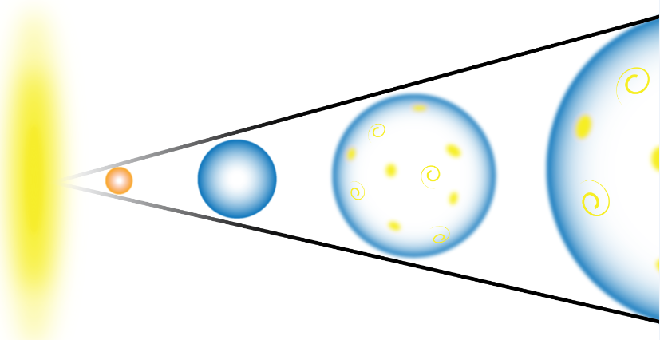
The Big Bang as a Scientific Theory
Notes:
…let’s look at a specific theory that many people think best explains the origin of our universe—The Big Bang Theory

Slide 6
Singularity
Notes:
The big bang model suggests that at one point, over 13 billion years ago, everything in the universe was packed into an infinitely small space—so small, in fact, that it didn’t really take up any space at all. / This situation is referred to as a singularity.

Slide 7

Explosion
Notes:
According to the theory…/ something happened that made all that energy begin expanding. / We often refer to it as an explosion, / but that really isn’t accurate.

Slide 8
Expansion
Notes:
Then the universe continued to expand and galaxies formed.

Slide 9
Singularity
Notes:
It’s extremely difficult to imagine how everything in the universe could once have been a singularity, so let’s think a little more about that.

Slide 10
Singularity
No D
1D
2D
3D
No size
distance
area
volume
Notes:
Singularity is a mathematical term for a point that has no size or dimension. / No matter how big or small we draw the dot, it still represents a point without any size or dimension. / Look at this rectangular prism. / It has three dimensions—length, width, and height. / Using these three dimensions, we could calculate its volume. / This square has only two dimensions—length and width, / from which we could calculate area. / This line has only one dimension, which we could measure. / Contrast all those with this dot, which represents a point with no dimensions / and no size/ How could the whole universe have possibly fit into a point with no size or dimension?

Slide 11
Matter and energy can change back and forth
Energy
Matter
Notes:
Something that may help us understand, is the fact that matter and energy can change back and forth from one to the other. / Matter can become energy. / And energy can become matter. /(Wait for it to repeat)

Slide 12
Energy doesn’t take up space
Energy
Notes:
The singularity would have begun as energy. / Since energy does not take up space, / it makes it a little easier to imagine the whole universe being condensed into a dimensionless point.

Slide 13
Notes:
Scientists don’t know what made the singularity begin to expand in the first place. But they think they have some pretty good ideas about what happened after. / Notice three things about this illustration: / These circles represent the universe getting larger. / The color changing from red to blue represents the universe cooling as it expands. / The yellow shapes and swirls represent the galaxies forming and moving away from each other.

Slide 14

Notes:
An easy way to picture the expansion is to imagine blowing up a balloon. If you were to draw dots on the balloon, the dots would get further apart as the balloon expands.
Boy blow up balloon 484646920, NiwatSingsamarn, Getty Images (US), Inc. Subscription

Slide 15
Energy
Notes:
Even though scientists don’t know where all that energy came from to begin with / or what caused it to expand, they all agree on one thing: / The Big Bang points back to a definite beginning of the universe, which made a lot of scientists uncomfortable.

Slide 16
Scientific Process
Get an idea
Perform
experiments
Create theory
Use theory
Notes:
Scientists are using the theory to make predictions and learn more about the universe.

Slide 17
3. The Big Bang–Observation or Speculation?
Notes:
We’ll learn more about that next time as we consider whether the Big Bang is based on observable data or mere speculation.

Slide 18
Sources
Hawking, Stephen. A Brief History of Time, the updated and expanded tenth anniversary edition. New York: Telegraph Group Ltd., 1996.
Heeren, Fred. Show Me God: What the Message from Space is Telling Us About God. Olathe, KS: Day Star Publications, 2004.
Jastrow, Robert. God and the Astronomers. 2nd ed. New York: Norton, 1992.
Jastrow, Robert, and Michael R. Rampino. Origins of Life in the Universe. Cambridge: Cambridge University Press, 2008.
Pandit, Subodh K. Does God Really Exist? Come Search with Me. 4th ed. United States of America: SearchSeminars, 2015. (Illustration from Slide 10)

Slide 19
Images By
Images may appear on more than one slide. Citation is given on the first slide where each image appears
[2] Milky Way at sunrise Silhouette of a range 77475745, ClaudioVentrella,
[3a] Geocentric Theory, Thomas Bartlett
[3b] Z is for Mars courtesy of Courtney Seligman, http://apod.nasa.gov/apod/ap060422.html, Credit & Copyright: Tunc Tezel
[3c] Geocentric Universe Thomas Bartlett
[3d] Earth and orbiting moon, Evan Robinson
[5] Big Bang Myles Ketelsen
[14] Boy blowing up balloon 484646920, NiwatSingsamarn, Getty Images (US), Inc. Subscription

Slide 20
Special Thanks
Kenneth Caviness, PhD
Physics Professor, Southern Adventist University
and the
Foundation for Adventist Education

Slide 21

© Origins Resources 2017

Slide 22

© Southern Adventist University 2017

Slide 23

© Seventh-day Adventist North American Division 2017

Slide 24

© General Conference of Seventh-day Adventists 2017

Slide 25

© SCORE Southern Center for Origins Research & Education 2017

