Slide 1
The Big Bang Theory
And the Origin of the Universe
3
Notes:
The Big Bang Theory and the Origin of the Universe

Slide 2
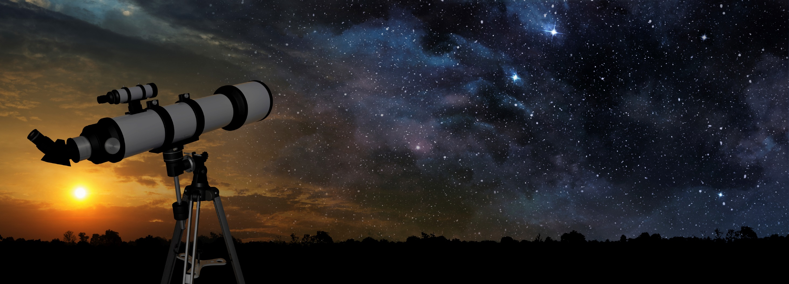
3. The Big Bang—Observation or Speculation?
Notes:
The Big Bang—Observation or Speculation?

Slide 3
Scientific Process
Get an idea
Perform
experiments
Create theory
Notes:
So far, we have learned that science is a process. / Scientists gather data from observations and experiments and eventually formulate a theory.

Slide 4
Scientific Process
predictions
Get an idea
Perform
experiments
Create theory
Use theory
Support theory
Support theory
Support theory
Notes:
Then they use the theory to make predictions, / and they perform experiments to test their predictions. / Over time, they may amass quite a lot of evidence that supports the theory.

Slide 5
Scientific Process
Improve
or replace theory
Get an idea
Perform
experiments
Create theory
Use theory
?
?
Support theory
Notes:
But sometimes the results of the experiments don’t support the theory. / And sometimes the theory may need to be improved or even replaced.

Slide 6
Scientific Process
predictions
New
theory
Get an idea
Perform
experiments
Create theory
Use theory
Notes:
Then the same process starts all over again. We make predictions and compare them with the results of the experiments.

Slide 7
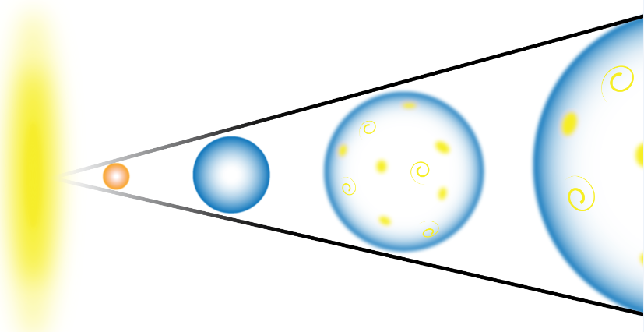
Notes:
Then we learned about a specific theory—called the Big Bang Theory—that offers an explanation for the origin of our universe.

Slide 8
Scientific Process
Get an idea
Perform
experiments
Create theory
Use theory
Notes:
In this presentation, we are going to take a closer look at the Big Bang as a scientific theory and try to answer a few questions. But first we need to think about the scientific process in a little more detail.

Slide 9
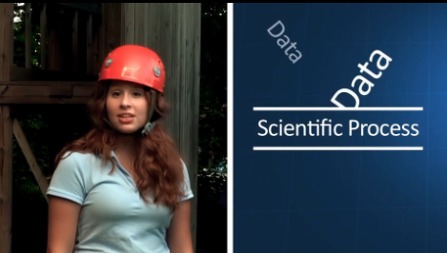
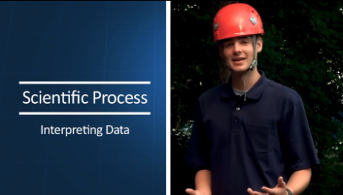
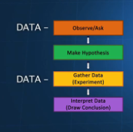
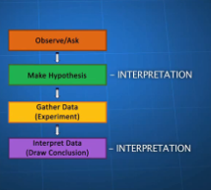
Science = Data & Interpretation
Notes:
In a previous video, / you have learned that the scientific process includes gathering data / and interpreting data.

Slide 10
Get an idea
Perform
experiments
Create theory
Use theory
Observe/Ask
Make Hypothesis
Gather Data
(Experiment)
Interpret Data
(Experiment)
Notes:
Scientists may get their ideas from observations they make or questions they ask. / Then they make an educated guess—called a hypothesis—about the answer to their questions. / They gather data by performing experiments / and then draw conclusions from their data.

Slide 11
Big Bang = Data OR Interpretation?
?
Notes:
We will be asking whether the Big Bang is data, / or interpretation, / or maybe both…

Slide 12
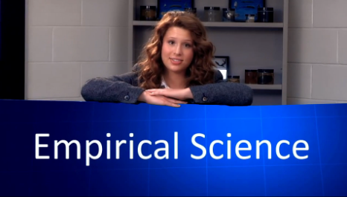

Notes:
In another video, you learned the difference between empirical science and historical science.

Slide 13
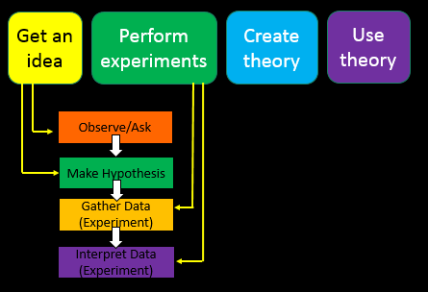
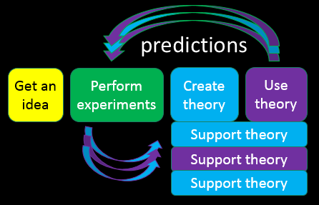
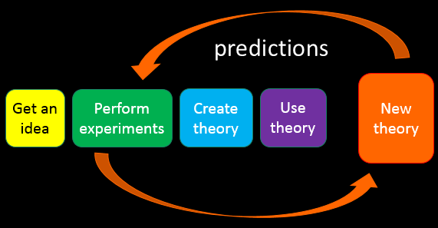
Notes:
The scientific process we’ve been talking about so far is empirical science, / where scientists make observations, form hypotheses, experiment, and draw conclusions. / As the body of data grows, generalizations are made, resulting in theories. / Then more predictions are made and more experiments are carried out. Predictions and observations are continually compared, and theories are modified accordingly.

Slide 14
Seeks to explain events in the past that were not observed and cannot be tested directly
Notes:
Historical science, on the other hand, seeks to explain events in the past that were not observed and cannot be tested directly.

Slide 15
?
Notes:
We’ll be asking whether the Big Bang Theory is part of empirical science, / historical science, / or maybe both…

Slide 16
Which parts are actually based on observations?
Which parts try to explain things from the past?
Notes:
In other words, / which parts of the Big Bang Theory are actually based on observations / and which parts are seeking to explain events from the past that necessarily must be more speculative in nature?

Slide 17
Observations
Red shift
Background radiation
Hydrogen/helium ratio
Notes:
We will start by learning about three kinds of observational data connected with the Big Bang Theory.

Slide 18
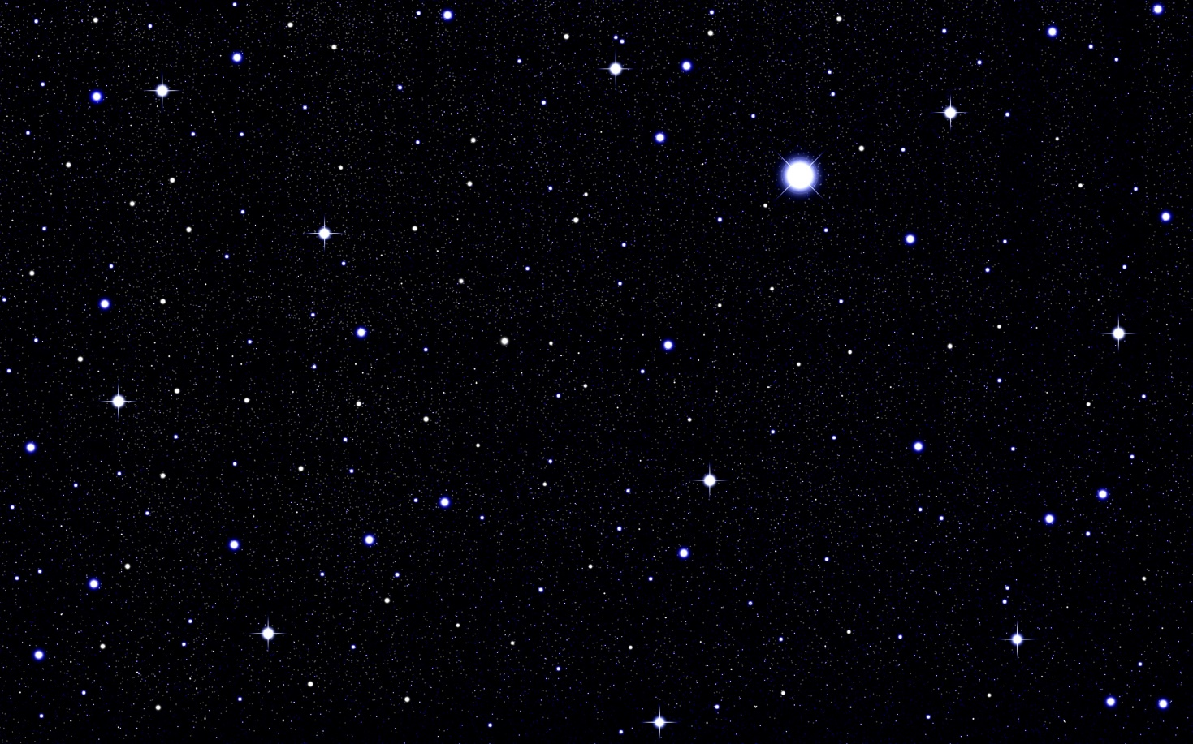
Eternal
Observations
Red shift
Background radiation
Hydrogen/helium ratio
Notes:
For centuries, the universe had been thought to be eternal, / until some startling discoveries were made in the twentieth century.
Title+ID#, Author, Getty Images (US), Inc. Subscription

Slide 19
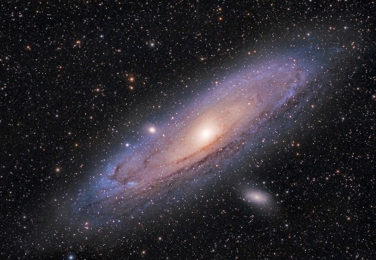

Observations
Red shift
Background radiation
Hydrogen/helium ratio
Vesto Melvin Slipher
Notes:
An astronomer named Vesto Melvin Slipher was the first to discover that most of the galaxies nearest to earth were moving rapidly away from us. / (wait)

Slide 20
Faster
Faster
Observations
Red shift
Background radiation
Hydrogen/helium ratio
Edwin Hubble
Faster
Faster
Notes:
Edwin Hubble continued to study these retreating galaxies and learned that the galaxies farthest away from Earth / were moving the fastest. / How were they able to tell? By measuring light waves…

Slide 21
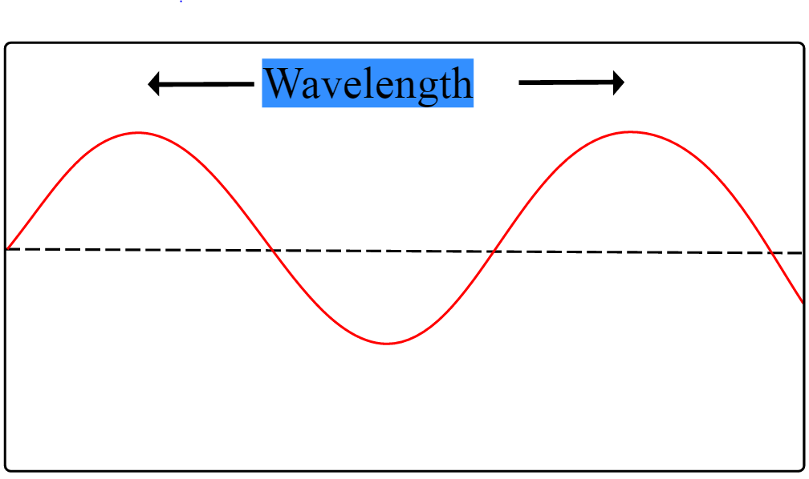
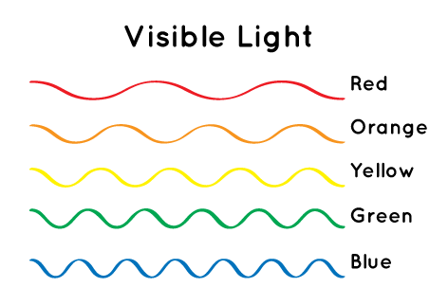
Wavelengths = Colors
Notes:
Light waves come in different lengths, and what humans see as colors are different wave lengths. / Wave lengths are just the distance between the top of one wave / and the top of the next wave. /
Wave lengths from .gov site: http://spaceplace.nasa.gov/blue-sky/en/

Slide 22
Wavelengths = Colors
Approximate Wavelengths
Red 625 to 750 nm
Orange 590 to 625 nm
Yellow 570 to 590 nm
Green 495 to 570 nm
Blue 450 to 475 nm
nm = nanometers
Notes:
The longest ones appear red, / and the shortest appear blue.
(Approximate wavelengths came from WolframAlpha via Ken Caviness.)

Slide 23

Red Shift
Notes:
When the source of light is moving away from an observer, / the light shining back toward earth appears redder because the waves are being stretched out. / This called red shift.
Wave lengths from .gov site: http://spaceplace.nasa.gov/blue-sky/en/

Slide 24

Blue Shift
Notes:
When the source of light is moving toward an observer, / the light appears bluer because the waves are being pressed together. / This is called blue shift.
Wave lengths from .gov site: http://spaceplace.nasa.gov/blue-sky/en/

Slide 25
Red Shift
Notes:
The red shift that Slipher and Hubble saw as they studied the distant galaxies is observable data. / They interpreted that data to mean that the universe is expanding, a conclusion which was also supported by other scientists who were working with Einstein’s general relativity equations.

Slide 26
Data
Interpretation
Notes:
The red shift is observable data. / The conclusion that the universe is expanding / is an interpretation of the red shift data.

Slide 27
Notes:
Extrapolating backward from that conclusion, scientists inferred that at some point in the distant past the entire universe would have been infinitesimally small and infinitely dense.

Slide 28
Big Bang
Notes:
The term big bang was disparagingly applied by astronomer Fred Hoyle to the beginning that must, at some time in the past, have started the expansion of the universe.

Slide 29
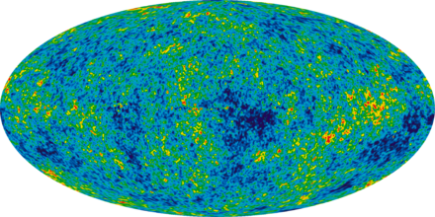
Observations
Red shift
Background radiation
Hydrogen/helium ratio
Notes:
In addition to the red shift observed by astronomers, there was additional observable data.
Radiation graphic (public domain)
https://en.wikipedia.org/wiki/Cosmic_microwave_background#/media/File:Ilc_9yr_moll4096.png

Slide 30
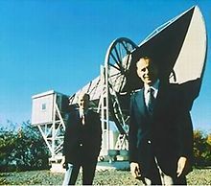
Background Radiation
Alpher &
Hermann
Penzias
& Wilson
Notes:
As scientists thought about the idea of a big bang starting the expansion of the universe, / Ralph Alpher and Robert Hermann predicted that there should still be radiation from that initial explosion detectable in the universe. Before anyone set out to purposely search for the radiation, / Arno Penzias and Robert Wilson from AT & T Bell Laboratories discovered it by accident in 1965. / While looking for something else, they detected radiation that seemed to be coming with equal intensity from all directions, instead of from the sun or any other particular object or galaxy. It seemed that the entire universe was the source of this cosmic microwave background radiation, which is exactly what would have been expected from the initial big bang radiation.
Penzias & Wilson: https://en.wikipedia.org/wiki/Robert_Woodrow_Wilson#/media/File:Wilson_penzias200.jpg

Slide 31
prediction
Get an idea
Create theory
Use theory
Support theory
Notes:
Let’s see how this fits with the scientific process. / Scientists observed the red shift, inferred an expanding universe, / and extrapolated back in time, coming up with the Big Bang Theory. / Using that theory, they predicted that they should still be able to detect the leftover background radiation. / The detection of the predicted radiation provided evidence in support of the theory.

Slide 32
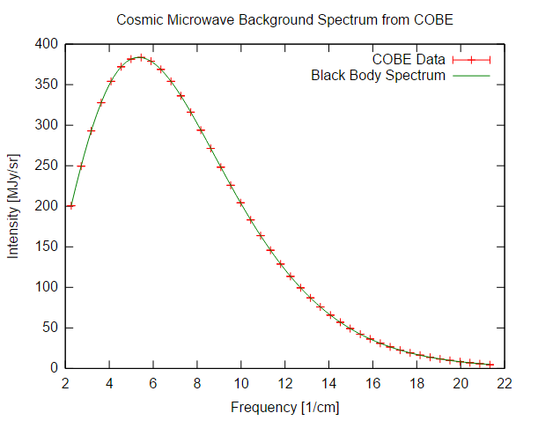
prediction
Get an idea
Create theory
Use theory
Blackbody curve
Notes:
It had been specifically predicted that when graphed, the radiation should form a specific curve, / called a blackbody curve

Slide 33
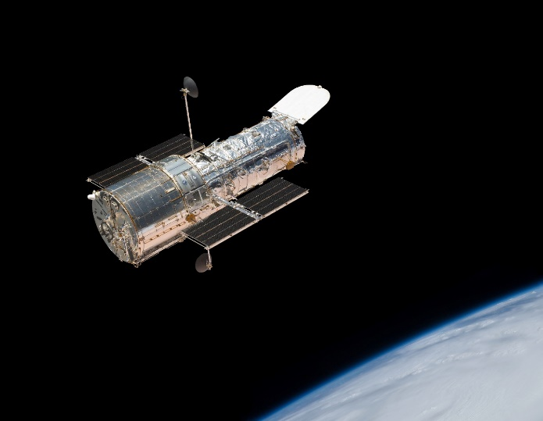
prediction
COBE
Get an idea
Create theory
Use theory
Support theory
Blackbody curve
Notes:
Many years later, in 1990, / NASA’s COBE (Cosmic Background explorer) allowed cosmologists to measure the radiation accurately enough to see if it matched the blackbody curve. / Using an instrument designed specifically to make this comparison, scientists were able to determine that the radiation does, in fact match the predicted curve. /
Double check graphic: Shutterstock 194177834

Slide 34
Data
Notes:
This cosmic microwave background radiation in the specific pattern of wavelengths that matches the blackbody spectrum is observable data that matches predictions made about the big bang.

Slide 35
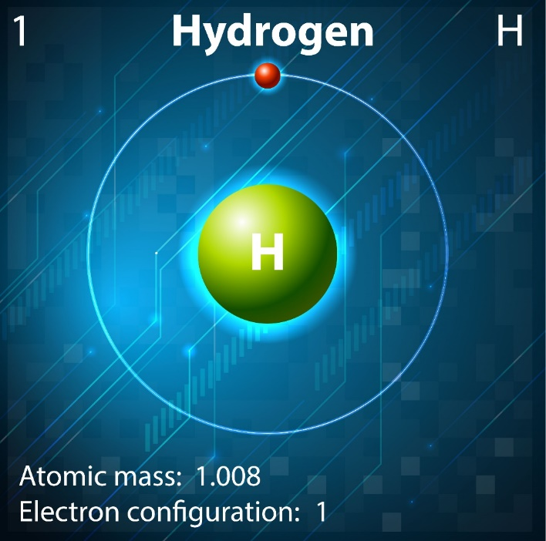
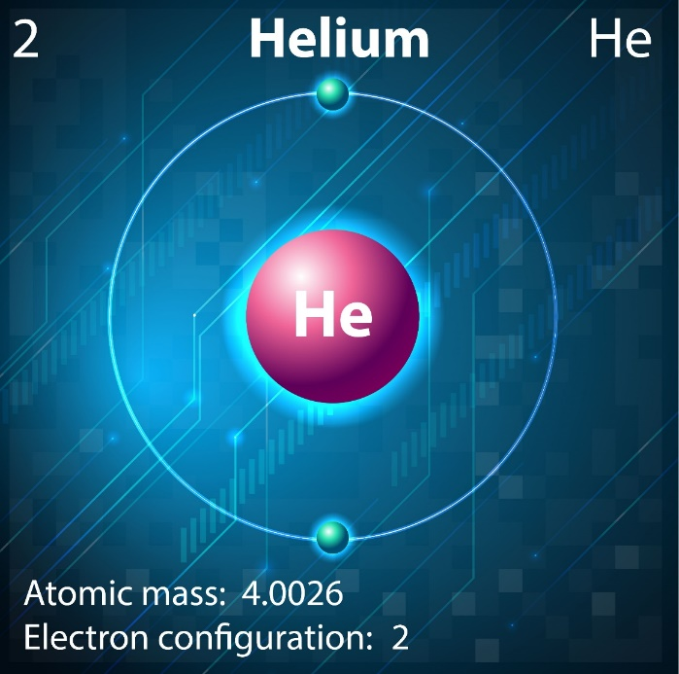
Observations
Red shift
Background radiation
Hydrogen/helium ratio
Notes:
In addition to the red shift observed and the background radiation detected, / we will look a one more piece of observable data.
Hydrogen: Shutterstock 152409845
Helium: Shutterstock 152410109

Slide 36

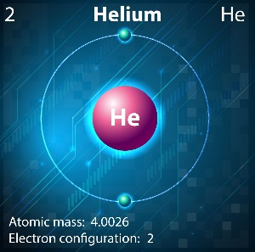
prediction
Get an idea
Create theory
Use theory
Notes:
Another prediction scientists made based on the big bang theory involves the ratio of hydrogen to helium and other light elements in the universe.

Slide 37

25%
75%
Notes:
Based on their understanding of the structure of the elements and their behavior under various conditions, / scientists have predicted that the universe should contain approximately 75% hydrogen / and 25% helium (with tiny amounts of other elements).

Slide 38
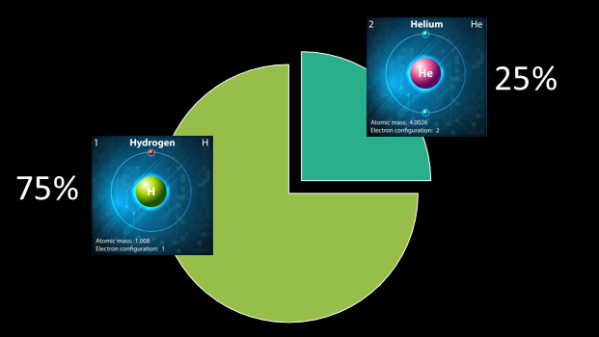
prediction
Get an idea
Create theory
Use theory
Support theory
Data
Notes:
Measurements obtained using spectroscopic studies of the stars produce results in precisely the predicted ratios. / The existence of these elements in this ratio is observational data which matches the prediction made based on the big bang theory.

Slide 39
No other explanation for helium
“Without an event that is indescribably hotter than anything we know today, we cannot explain why helium exists in more than trace amounts, since it is impossible for helium to result in any great quantity from the burning of stars alone.” (Heeren, Show Me God: What the Message from Space is Telling Us about God page 161)
“It is, moreover, very difficult to explain in any other way why there should be so much helium in the universe.” (Stephen Hawking, A Brief History of Time, page 123)
Notes:
Not only do the elements exist in the predicted ratios, but there is no other explanation for the existence of so much helium.

Slide 40
Summary
Data
Red Shift
Interpretation
Expanding universe
Notes:
To summarize: The red shift was observable data. / Scientists interpreted that data to mean that galaxies were speeding away from our galaxy, the Milky Way.

Slide 41
Summary
Extrapolation
Big Bang Theory
Notes:
Extrapolation back in time led to the big bang theory

Slide 42
Data
Predictions
Data
Notes:
Based on this theory, / scientists predicted the existence of cosmic microwave background radiation / and the ratio of hydrogen to helium and other lighter elements. / As it turned out, the observable data matched these predictions.

Slide 43
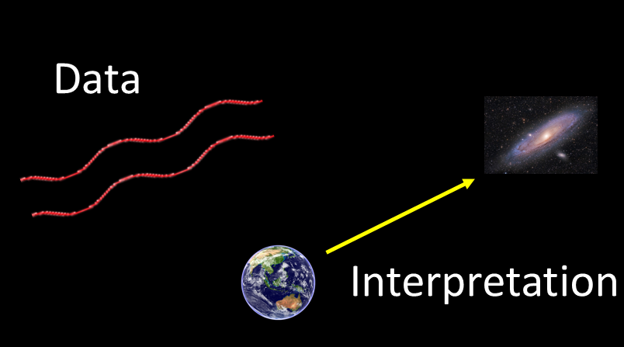
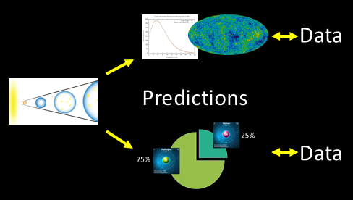
It is important to distinguish between these evidence-based observations, predictions, and conclusions…
Notes:
But it is important to distinguish between these evidence-based observations, predictions, and conclusions…

Slide 44
NOT based on observation
Energy
Notes:
and other ideas surrounding the big bang theory that are NOT based on observational data. / For example, the source of all the energy contained in the original singularity is unknown.

Slide 45

NOT based on observation
“…the Universe was created 15 billion years ago in a fiery explosion, and in the searing heat of that first moment, all the evidence needed for a scientific study of the cause of the great explosion was melted down and destroyed.”
Robert Jastrow,
God and the Astronomers, 2nd edition, page 10
Energy
Notes:
What caused the universe to begin expanding is also unknown. / About this, astronomer Robert Jastrow says that all the evidence needed for a scientific study of the cause of the great explosion was melted down and destroyed in the searing heat of that first moment.

Slide 46
NOT based on observation
Energy
Close enough to form matter
Far enough away to avoid creating a black hole
Notes:
In addition, / how the particles which formed after the big bang managed to stay close enough to each other to coalesce into matter, / but far enough away from each other to avoid creating a gigantic black hole is unknown.

Slide 47
NOT based on observation
“There is no explanation in the big bang theory for the seemingly fortuitous fact that the density of matter has just the right value for the evolution of a benign, life-supporting universe.”
Robert Jastrow
God and the Astronomers 2nd edition, page 93
Close enough to form matter
Far enough away to avoid creating a black hole
Notes:
About this, Jastrow says…”There is no explanation in the big bang theory for the seemingly fortuitous fact that the density of matter has just the right value for the evolution of a benign, life-supporting universe.”

Slide 48
It is easy to overlook the difference between conclusions drawn from actual observations…
Notes:
To the untrained eye, it is easy to overlook the difference between conclusions drawn from actual observations…

Slide 49
…and ones that are only speculative explanations
Energy
Particles close enough but not too close
Notes:
…and ones that are only speculative explanations for certain phenomena

Slide 50
Energy
?
Notes:
Yet being able to tell the difference may be the single most important factor in accurately evaluating a theory and in communicating effectively with others about it.

Slide 51
Big Bang = Data OR Interpretation?
?
Notes:
At the beginning of this presentation, we set out to determine which part of the Big Bang Theory is data and which is interpretation.

Slide 52
Data
Interpretation
Notes:
And we saw that it includes both.

Slide 53
Which parts are actually based on observations?
Which parts try to explain things from the past?
Notes:
We also asked which parts of the Big Bang Theory qualify as empirical science, / and which fall into the category of historical science.

Slide 54
Resulted from observable data
Used to make useful predictions
Notes:
Forming theories based on observable data and using those theories to make useful predictions are definitely part of the process of empirical science.

Slide 55
Energy
Particles close enough but not too close
Notes:
But suggesting where the energy came from or what caused it to expand falls into the category of historical science.

Slide 56
The Big Bang doesn’t explain anything
about our ultimate origin.
It only raises questions science can’t answer.
Notes:
Because that first major event, was neither observable nor repeatable, / the Big Bang theory really doesn’t explain anything about our ultimate origin. / It only raises question science can’t answer.

Slide 57
4. Implications of the Big Bang
Notes:
Next time, we will explore three interesting implications of the Big Bang Theory

Slide 58
Images By
Images may appear on more than one slide. Citation is given on the first slide where each image appears
[2] Milky Way at sunrise Silhouette of a range 77475745, ClaudioVentrella,
[7] Big Bang Myles Ketelsen
[9] Screen shots from Origins Institute video Data, Interpretation, and the Scientific Process
[12] Screen shots from Origins Institute video Science: Not as Simple as You Might Think
[18] Night Sky 519576362, hulya-erkisi, Getty Images (US), Inc. Subscription
[19] Andromeda Galaxy 530045185, PavelSmilyk, Thinkstock, Thinkstock Image Subscription Agreement
[21a] Wavelength, Ysangkok, https://commons.wikimedia.org/wiki/File:Wavelength.svg, CC-BY-SA-3.0
[21b] Visible Light, http://spaceplace.nasa.gov/blue-sky/en/, Fair Use
[23] Planet Earth Isolated on White 477710070, Fredex8, Getty Images (US), Inc. Subscription
[29] Nine Year Microwave Sky, NASA/WMAP Science Team, https://commons.wikimedia.org/wiki/File:Ilc_9yr_moll4096.png, Public Domain
[30a] Wilson Penzias200, unknown, https://commons.wikimedia.org/wiki/File:Wilson_penzias200.jpg, Public Domain
[32] Cosmic Microwave Background Spectrum from COBE, Quantum Doughnut, https://commons.wikimedia.org/wiki/File:Cmbr.svg, Public Domain
[33] Hubble Space Telescope 194177834, MarcelClemens, Shutterstock license
[35a] Hydrogen 152409845, BlueRingMedia, Shutterstock license
[35b] Helium 152410109, BlueRingMedia, Shutterstock license

Slide 59
Special Thanks
Kenneth Caviness, PhD
Physics Professor, Southern Adventist University
and the
Foundation for Adventist Education

Slide 60

© Origins Resources 2017

Slide 61

© Southern Adventist University 2017

Slide 62

© Seventh-day Adventist North American Division 2017

Slide 63

© General Conference of Seventh-day Adventists 2017

Slide 64

© SCORE Southern Center for Origins Research & Education 2017

