Slide 1
The Big Bang Theory
And the Origin of the Universe
4
Notes:
The Big Bang Theory, number 4

Slide 2
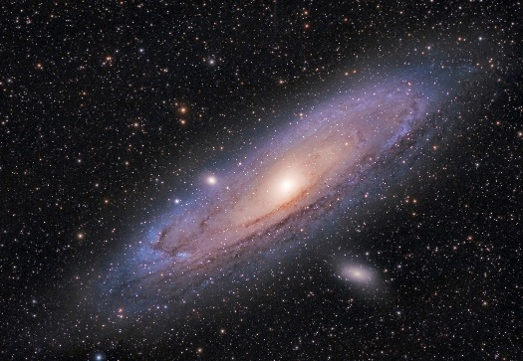

Summary
Data
Red Shift
Interpretation
Expanding universe
Notes:
We have learned that the Big Bang Theory originated with observable data. / After noticing the red shift, scientists interpreted that data to mean that galaxies were speeding away from our earth.

Slide 3
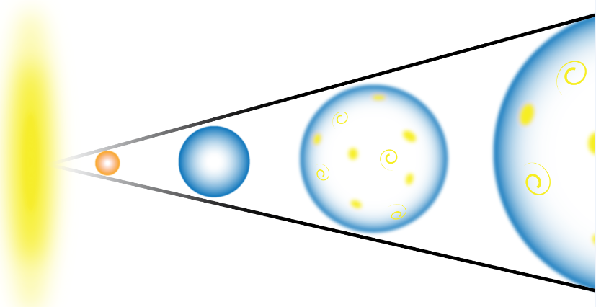
Summary
Extrapolation
Big Bang Theory
Notes:
Extrapolation back in time led to the big bang theory

Slide 4
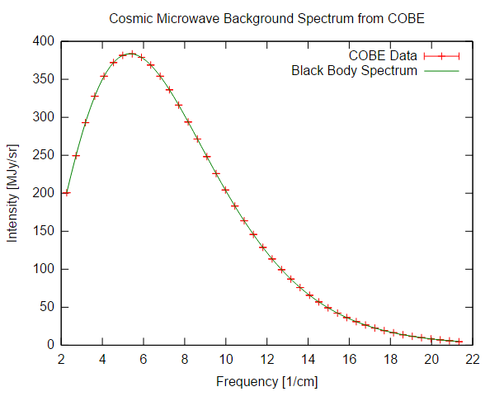
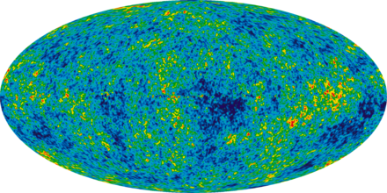
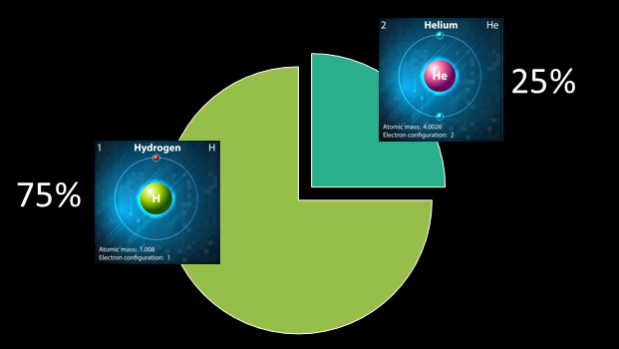
Data
Predictions
Data
Notes:
Based on this theory, / scientists predicted the existence of cosmic microwave background radiation / and the ratio of hydrogen to helium and other lighter elements. / As it turned out, the observable data matched these predictions.

Slide 5

NOT based on observation
Energy
Notes:
However, there is no observable data that can explain the source of all the energy contained in the original singularity, / what caused the universe to begin expanding in the first place, / or how the particles which formed after the big bang were able to coalesce into matter.

Slide 6
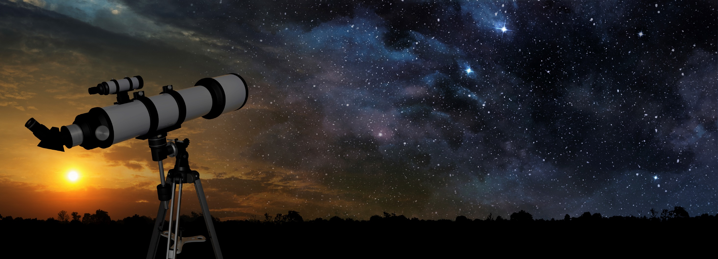
Implications of the Big Bang
Notes:
In the final presentation of this series, we will explore a few interesting implications of the Big Bang theory.

Slide 7
Implication #1 – An Absolute Beginning
Scientists agree that the evidence points to an absolute beginning of the universe.
Unsettling
Notes:
Scientists agree that the evidence points to an absolute beginning of the universe. / But, for many who had previously accepted the idea of an eternal universe, this was unsettling.

Slide 8
Kalam Argument
Everything that has a beginning
…has a cause
If the universe had a beginning…
…has a cause
Notes:
According to an ancient logical argument, everything that has a beginning / has a cause. / So, if the universe has a beginning, / it would have a cause.

Slide 9
Implication #1 – An Absolute Beginning/Cause
If the universe had a beginning…
…has a cause
…has a Creator?
A cause opens the door to a Creator.
Notes:
If the universe has a cause, / that opens the door to the possibility of a Creator, which is why some scientists found the Big Bang unsettling. The idea of a Creator would be incompatible with their naturalistic worldview.

Slide 10
Implication #2 -- Organized Precision
Too close together
=
Black hole
Not close enough
=
No galaxies
Notes:
Implication number two involves the precision with which the expansion happened. / If the particles which formed after the big bang stayed too close together, a giant black hole should have formed. / If the particles hadn’t been close enough, they would not have been able to coalesce into matter and eventually form galaxies.

Slide 11
Implication #2 -- Organized Precision
No black hole
Close enough to form matter
Precision suggests design and purpose
Notes:
Scientists marvel at the fact that the particles did manage to get close enough to form matter / without forming a black hole. / The expansion of the universe in precisely the right way suggests design and purpose.

Slide 12
Implication #3 – Relationship between Science and Scripture
The big bang and creation are similar in at least one important way
“The essential element in the astronomical and biblical accounts of Genesis is the same; the chain of events leading to man commenced suddenly and sharply, at a definite moment in time, in a flash of light and energy.” Robert Jastrow, God and the Astronomers, p. 14
Notes:
The third implication we will look at involves the relationship between science and Scripture. / At least one possible similarity between the big bang theory and creation was noticed by both scientists and theologians. / Astronomer Robert Jastrow described it this way: “the essential element in the astronomical and biblical accounts of Genesis is the same; the chain of events leading to man commenced suddenly and sharply, at a definite moment in time, in a flash of light and energy.”

Slide 13
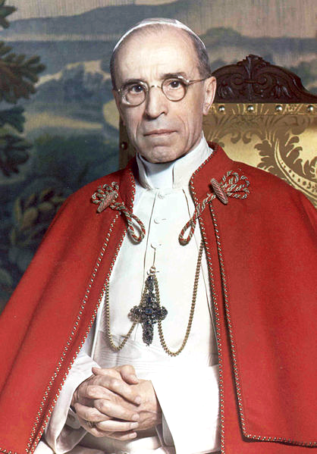
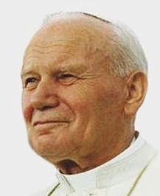
Implication #3 – Relationship between Science and Scripture
The Big Bang theory does not conflict with the Catholic concept of creation.
Pope Pius XII
Pope John Paul II
Notes:
Influenced by the potential similarities between creation and the new scientific theory, the Catholic Church adjusted its position on origins. Speaking to the Pontifical Academy of Sciences, Pope Pius the 12th in 1951 and Pope John Paul the 2nd in 1996 indicated that the Big Bang theory does not conflict with the Catholic concept of creation.
Pope Pius XII: https://commons.wikimedia.org/wiki/File:His_Holiness_Pope_Pius_XII.png
Pope John Paul II:https://commons.wikimedia.org/wiki/File:JohannesPaul2-portrait.jpg
Sources:
https://en.wikipedia.org/wiki/Religious_interpretations_of_the_Big_Bang_theory
http://www.catholicherald.co.uk/commentandblogs/2014/10/31/pope-franciss-comments-on-the-big-bang-are-not-revolutionary-catholic-teaching-has-long-professed-the-likelihood-of-human-evolution/
http://www.catholicherald.co.uk/commentandblogs/2014/10/31/pope-franciss-comments-on-the-big-bang-are-not-revolutionary-catholic-teaching-has-long-professed-the-likelihood-of-human-evolution/
“The Big Bang, which is today posited as the origin of the world, does not contradict the divine act of creation; rather, it requires it”, he stated. Similarly, he argued, “evolution of nature is not inconsistent with the notion of creation because evolution pre-supposes the creation of beings which evolve.”

Slide 14

Implication #3 – Relationship between Science and Scripture
“The Big Bang…does not contradict the divine act of creation; rather, it requires it.”
Notes:
Speaking to the same Academy in 2014, Pope Francis said “The Big Bang does not contradict the divine act of creation; rather, it requires it.”
Pontifical Academy of Sciences
https://en.wikipedia.org/wiki/Religious_interpretations_of_the_Big_Bang_theory
http://www.catholicherald.co.uk/commentandblogs/2014/10/31/pope-franciss-comments-on-the-big-bang-are-not-revolutionary-catholic-teaching-has-long-professed-the-likelihood-of-human-evolution/
http://www.catholicherald.co.uk/commentandblogs/2014/10/31/pope-franciss-comments-on-the-big-bang-are-not-revolutionary-catholic-teaching-has-long-professed-the-likelihood-of-human-evolution/
Avoid interpretations of scripture based on the latest scientific theory
“The Big Bang, which is today posited as the origin of the world, does not contradict the divine act of creation; rather, it requires it”, he stated. Similarly, he argued, “evolution of nature is not inconsistent with the notion of creation because evolution pre-supposes the creation of beings which evolve.”

Slide 15

Implication #3 – Relationship between Science and Scripture
?
Notes:
To evaluate whether these statements are true or not, Christians need to ask how the Big Bang theory matches the Bible’s description of creation, which might not be quite as simple as it sounds.
Left: Vintage old book 95272278, Sharon Bronte, Thinkstock
Right: Miles Ketelsen

Slide 16
Tools of the Trade
Science
Bible Study
Observations
Experiments
Analysis of data
Interpretation
Compare Scripture
with Scripture
Linguistic Analysis
Determining the Context
Notes:
Just like scientists use the tools of their trade to gather and interpret data, / Bible scholars use a different set of tools to interpret the meaning of the biblical text, and not everyone reaches the same conclusion.

Slide 17

If the entire universe was created during creation week…
…there is a time problem
with the Big Bang theory
Notes:
Those who believe the Bible teaches that the entire universe was created during the six-day creation week / believe there is a time problem with the Big Bang theory.

Slide 18
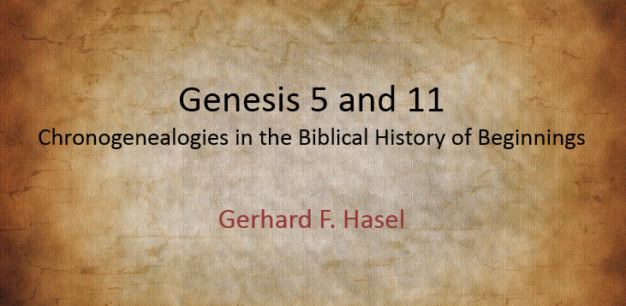
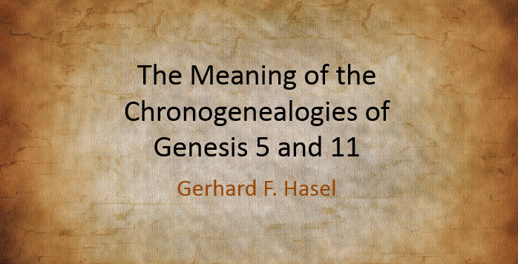
Notes:
According to the Chronogenealogies in Genesis 5 and 11—described in these two articles by Gerhard Hasel--

Slide 19
If the entire universe was created during creation week, we have a time problem
Billions of years
Several thousand years ago
Notes:
…creation happened several thousand years ago, / not billions of ago as the Big Bang theory claims.

Slide 20
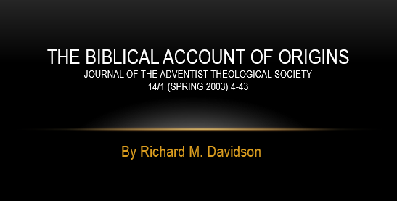
Implication #3 – Relationship between Science and Scripture
Affirms:
Literal, historical
Created out of nothing
Earth “unformed and unfilled”
Six literal 24-hour days
Biblical text is open to either “no gap” or “passive gap”
Rejects:
Active gap (ruin, restoration)
Southern.edu/origins/Article Summaries
Notes:
Dr. Richard Davidson offers insights about the creation account in his article. / He affirms the literal, historical nature of Genesis 1 and 2; / affirms that God created “the heavens and the earth” out of nothing at the time of their absolute beginning; / recognizes that the earth was unformed and unfilled at first; / and affirms that the forming and filling happened during six successive, literal, 24-hour days. / Although he rejects the active gap theory, / he concludes that the biblical text allows for either the “no gap” or the “passive gap.”

Slide 21
either option possible biblically
No Gap
Passive Gap
Genesis 1:1-2 are on day one
Raw materials are included in the first day of the seven-day creation week
Time problem with Big Bang theory
Genesis 1:1-2 go together but are separated from verse 3 by a gap
Raw materials of the earth in their unformed-unfilled state were created before—perhaps long before—the seven days of creation week
Not necessarily a time problem with Big Bang theory
WHEN—Multiple or Single Beginning?
Notes:
In the “no gap” option, Genesis 1:1-2 are on day one. / All the raw materials are included in the first day of the seven-day creation week. / In this scenario—where the entire universe is created during creation week—there would be a conflict with the billions of years that accompany the Big Bang theory. / In the “passive gap” option, Genesis 1:1-2 go together but are separated from verse 3 by a gap. / The raw materials in their unformed unfilled state were created before—perhaps long before—the seven days of creation week. / If this is the case, there might not be a time conflict with the Big Bang theory.
While the author prefers the passive gap theory, he acknowledges a possible openness of Genesis 1:1-2 that allows for either option.

Slide 22
Implication #3 – Relationship between Science and Scripture
Danger:
Relating our interpretation of Scripture
too closely with the latest scientific theory
Notes:
However, even if there isn’t a definite time problem, / there is still a danger in relating our interpretation of Scripture too closely with the latest scientific theory, even when they seem to have similarities.

Slide 23

Take-Home Lessons
All scientific theories are tentative
Interpretation
of Scripture
Scientific Theory
Notes:
Remember the take-home lessons from the first presentation in this series. / All scientific theories are tentative. / If we have associated our interpretation of Scripture with a particular scientific theory, / what happens when that theory is displaced by another theory?

Slide 24
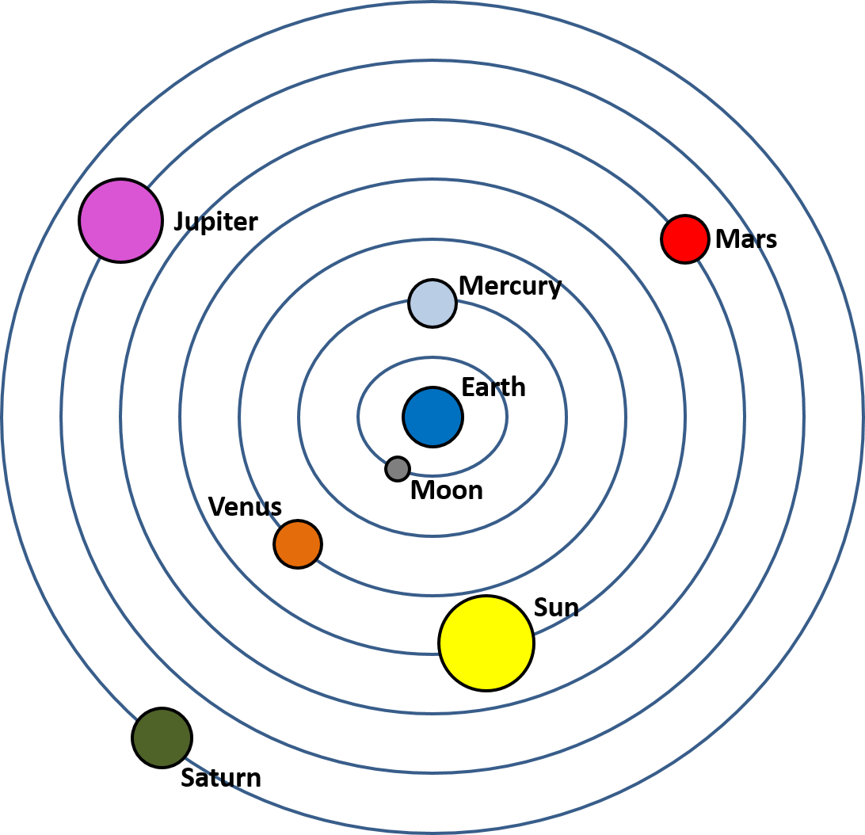
Geocentric Theory
Sun orbits earth
  Standard science
  Orthodox Christian belief
No reason yet to question it
Notes:
An interesting example from history illustrates this point. During Galileo’s lifetime, a geocentric universe—where the sun orbits the earth—/ was both standard
science / and orthodox Christian belief. / Before Copernicus and Galileo, there had been no reason to question it.

Slide 25
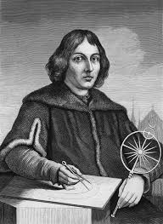
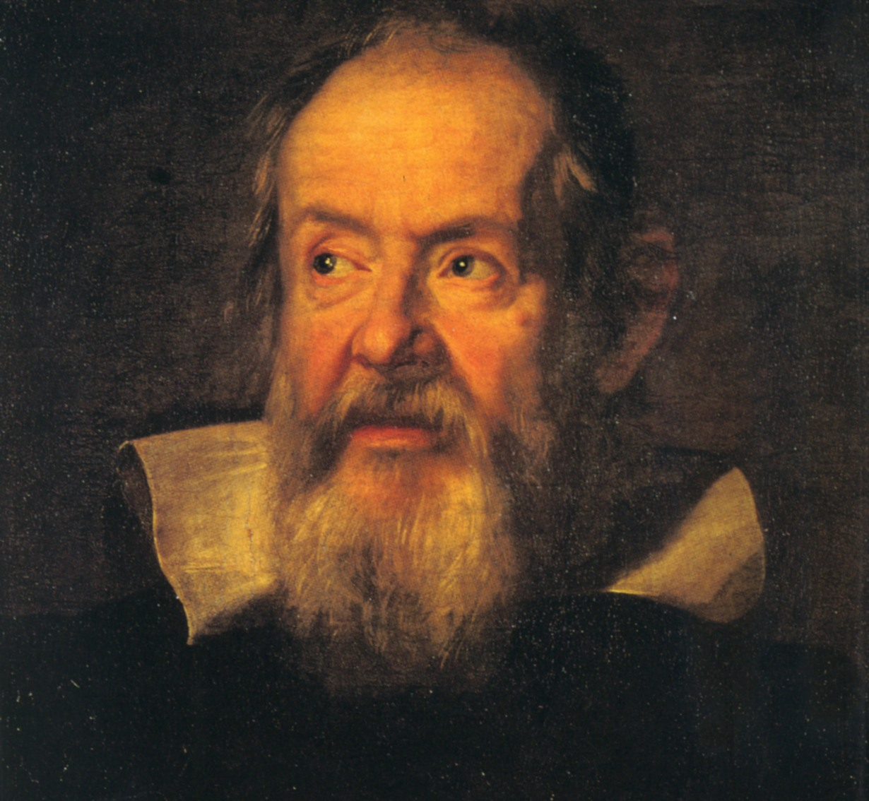
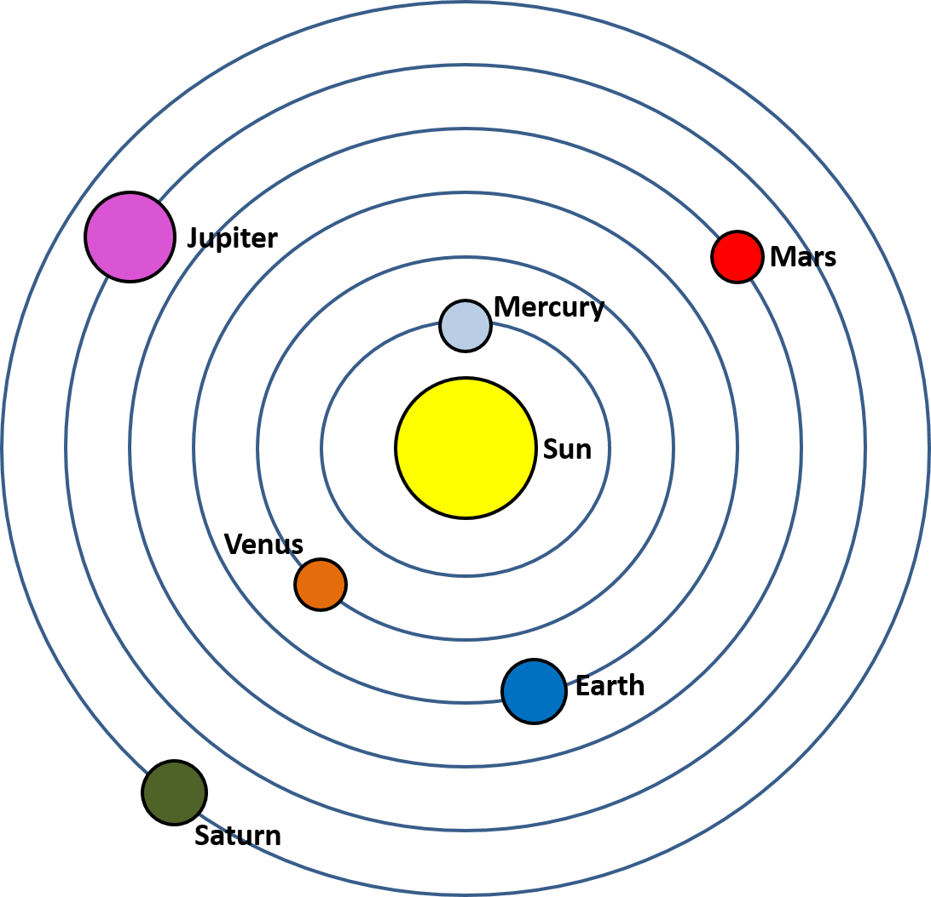
Heliocentric Theory
Copernicus
Galileo
Earth turns on its
axis and revolves
around the sun
Notes:
But the new scientific claim that the earth turns on its axis and revolves around the sun instead, created a conflict.

Slide 26
Heliocentric Theory
The sun also rises, and the sun goes down, and hastens to the place where it arose.
Ecclesiastes 1:5 see also Psalm 19:6
The world is established so that it cannot be moved.
Psalm 93:1 see also 104:5
Notes:
It appeared that the heliocentric model of the universe conflicted with verses from the Bible that seemed to indicate that the sun moved but the earth stood still.
(Include examples or not?) For example, Ecclesiastes 1:5 describes the sun rising and setting, and multiple verses in Psalms describe the world as not moving

Slide 27
Interpretation
of Scripture
Scientific Theory
Notes:
As scientists continued to collect more data, it was eventually determined that the earth does, in fact, orbit the sun. / Because their interpretation of Scripture was so closely tied to the science of the day, / the rejection of the old model in favor of the new one shook the faith of some in the reliability of the Bible.

Slide 28
Greek philosophy
Notes:
Bible scholars eventually realized that the idea of a geocentric universe actually came more from Greek philosophy than from the Bible itself, but for some, the damage to their faith in Scripture had already been done.

Slide 29
Take-Home Lessons
All scientific theories are tentative
It is not wise to base interpretations of scripture on the latest scientific theory.
Notes:
We can learn from this story that it is not wise to base interpretations of scripture on the latest scientific theory.

Slide 30
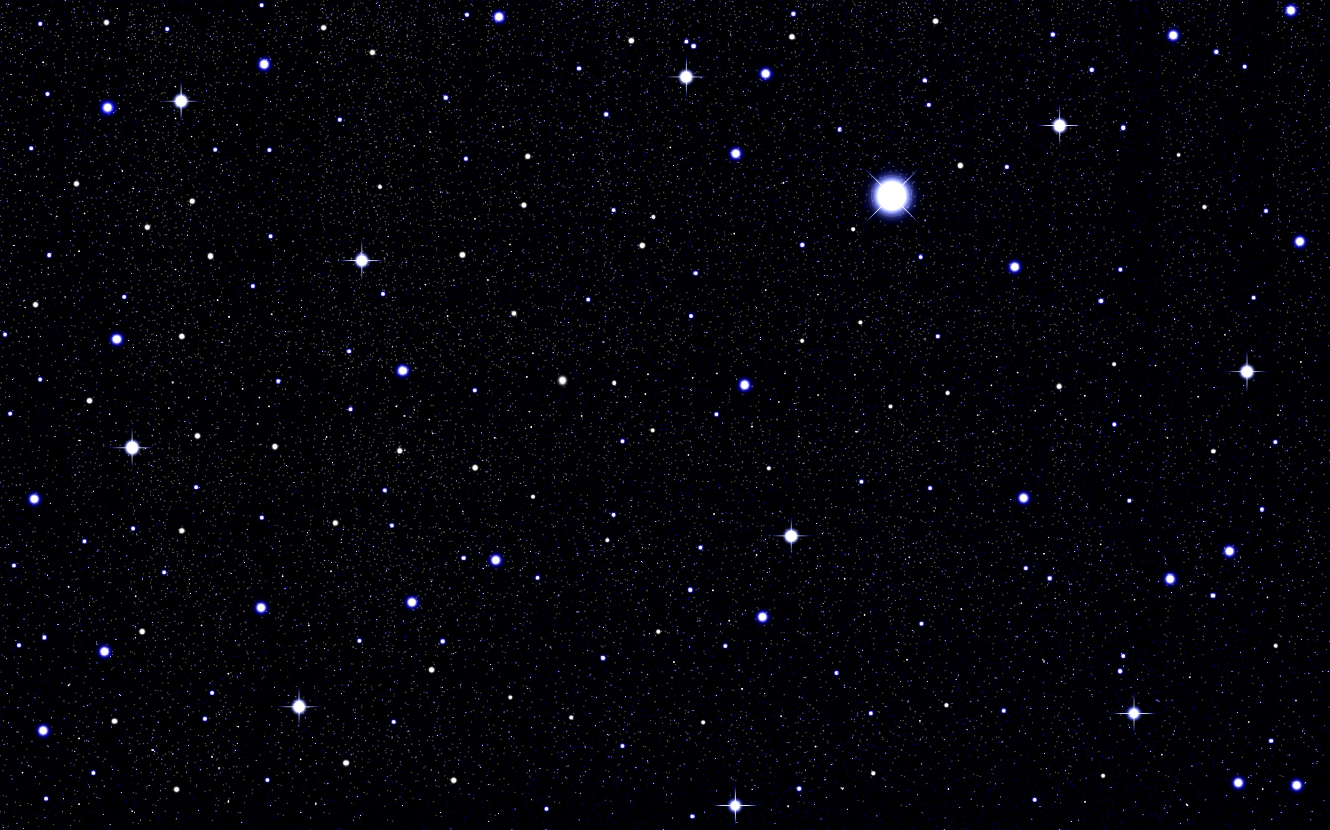
Review of 3 Implications:
1. The evidence points to an absolute beginning
Notes:
Let’s review the three implications we’ve looked at: / Number 1: The evidence points to an absolute beginning. This makes some scientists uncomfortable because that could suggest a Creator.

Slide 31
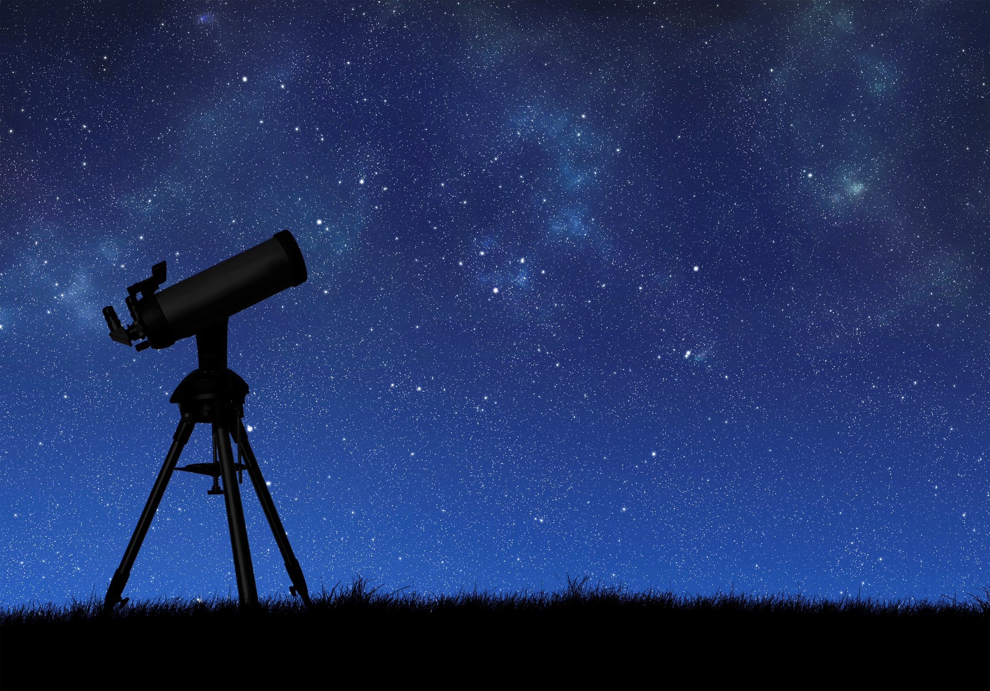
By the word of the Lord were the heavens made…
Psalm 33:6
Notes:
…which is exactly what the Bible says.
By the word of the Lord the heavens were made,
And by the breath of His mouth all their host. Ps. 33:6

Slide 32
Review of 3 Implications:
1. The evidence points to an absolute beginning
2. Precision suggests design and purpose
Notes:
Number 2: The precision with which the universe expanded also suggests design and purpose.

Slide 33
“I stretched out the heavens with My hands.”
Is. 45:12
Notes:
…which is also consistent with what the Bible says.
I stretched out the heavens with My hands Is. 45:12

Slide 34
Review of 3 Implications:
1. The evidence points to an absolute beginning
2. Precision suggests design and purpose
3. It is best not to tie our interpretations of Scripture to the latest scientific theory
Notes:
But because history shows us that all scientific theories are tentative, it’s best not to tie our interpretations of Scripture to the latest scientific theory, including the Big Bang theory.

Slide 35
The heavens are telling of the glory of God… Psalm 19:1
The heavens declare His righteousness. Psalm 50:6 and 97:6
In the heavens You will establish Your faithfulness.
Psalm 89:2
Notes:
We should continue to learn all we can about our universe, though, and the Bible says that as we do, we can understand more about the glory, / righteousness, / and faithfulness / of our Creator God.
The heavens are telling of the glory of God;
And their expanse is declaring the work of His hands Ps. 19:1
And the heavens declare His righteousness Ps. 50:6 and Ps. 97:6
In the heavens You will establish Your faithfulness. Ps. 89:2

Slide 36
Images By
Images may appear on more than one slide. Citation is given on the first slide where each image appears
[2a] Andromeda Galaxy 530045185, PavelSmilyk, Thinkstock, Thinkstock Image Subscription Agreement
[2b] Planet Earth Isolated on White 477710070, Fredex8, Getty Images (US), Inc. Subscription
[3] Big Bang Myles Ketelsen
[4a] Cosmic microwave background spectrum from COBE, Quantum Doughnut, https://commons.wikimedia.org/wiki/File:Cmbr.svg, Public Domain
[4b] Nine Year Microwave Sky, NASA/WMAP Science Team, https://commons.wikimedia.org/wiki/File:Ilc_9yr_moll4096.png, Public Domain
[4d] Hydrogen 152409845, BlueRingMedia, Shutterstock license
[4e] Helium 152410109, BlueRingMedia, Shutterstock license
[6] Milky Way at sunrise Silhouette of a range 77475745, ClaudioVentrella,
[13a] His Holiness Pope Pius XII, The Vatican, https://commons.wikimedia.org/wiki/File:His_Holiness_Pope_Pius_XII.png, Public Domain
[13b] JohannesPaul2-portrait, Uncredited, https://commons.wikimedia.org/wiki/File:JohannesPaul2-portrait.jpg, Public Domain
[14] Pope Francis, Jeffrey Bruno, https://en.wikipedia.org/wiki/File:Canonization_2014-_The_Canonization_of_Saint_John_XXIII_and_Saint_John_Paul_II_(14036966125).jpg, CC BY SA 2.0
[15a] Vintage Old book 95272278, Sharon Bronte, Thinkstock, Thinkstock Image Subscription Agreement
[17a] Creation - in God's Hand, ©GoodSalt.com, Justinen Creative
[25a] Nicolaus Copernicus, Unknown, https://commons.wikimedia.org/wiki/File:Copernicus.jpg, public domain
[25b] Galileo Galilei, Justus Suttermans, https://commons.wikimedia.org/wiki/File:Galileo-sustermans.jpg, public domain
[30] Night Sky 90606913, Hulya Erdem, Getty Images (US), Inc. Subscription
[31] Telescope, 474361220, olegkalina , Getty Images (US), Inc. Subscription

Slide 37
Special Thanks
Kenneth Caviness, PhD
Physics Professor, Southern Adventist University
Stephen Bauer, PhD
Religion Professor, Southern Adventist University
and the
Foundation for Adventist Education

Slide 38
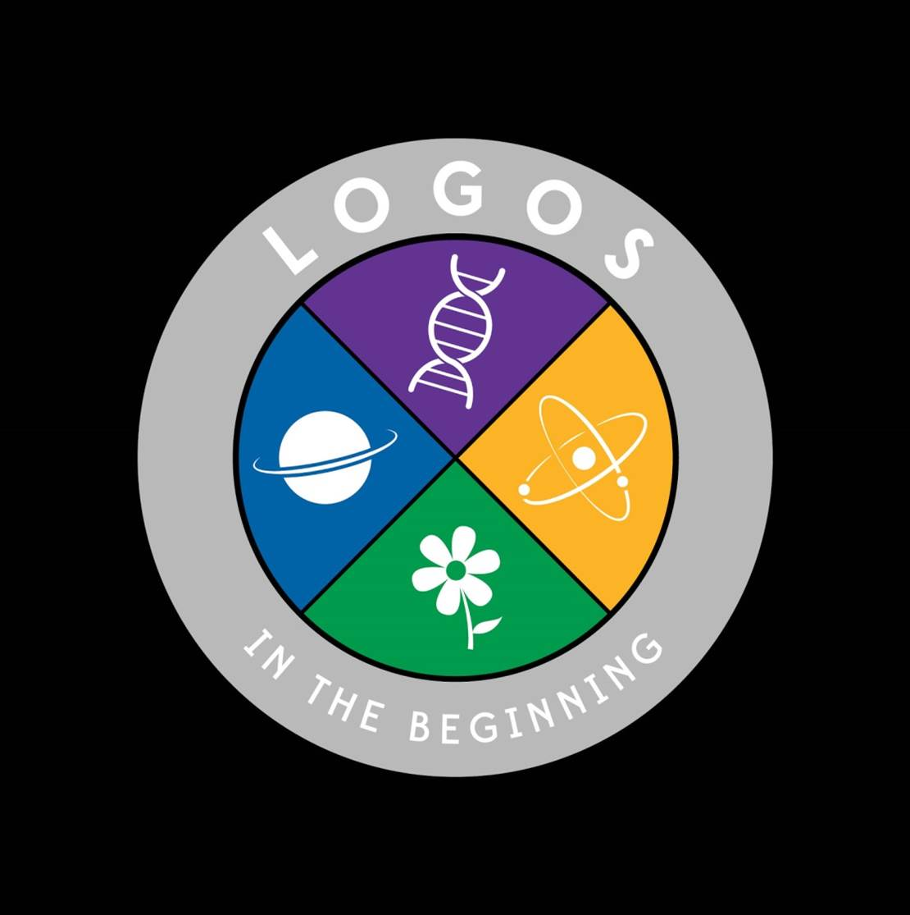
© Origins Resources 2017

Slide 39
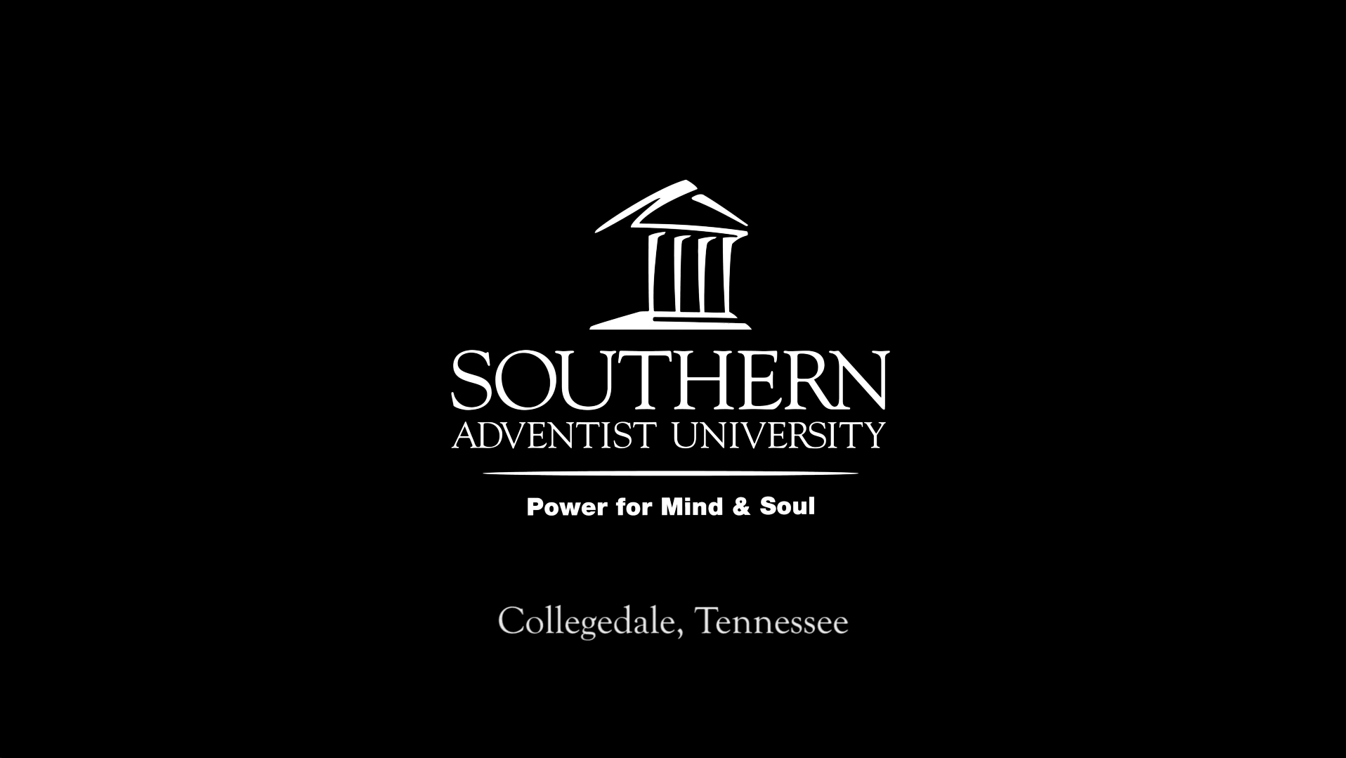
© Southern Adventist University 2017

Slide 40

© Seventh-day Adventist North American Division 2017

