Slide 1

DNA, Chromosomes and Genes
How are they related?
Notes:
How are DNA, Chromosomes, Genes related?

Slide 2
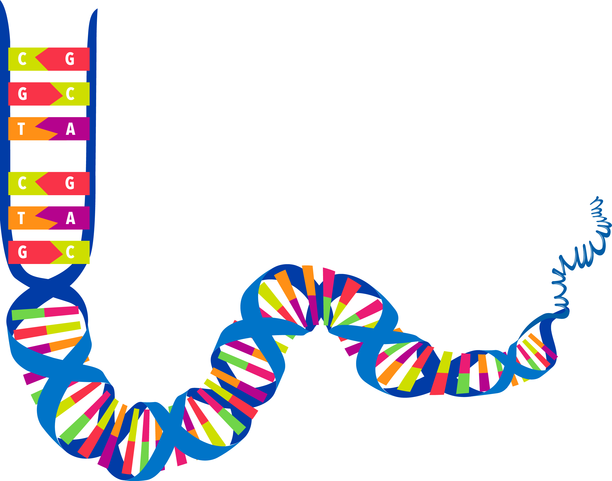
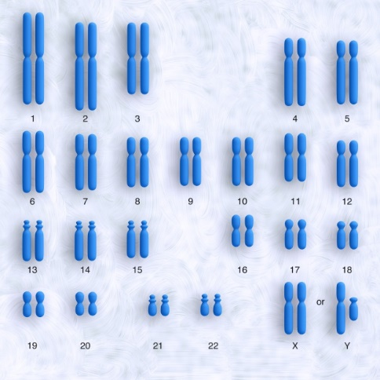
DNA
Chromosomes
Genes
http://commons.wikimedia.org/wiki/File:Chromosome.gif
Notes:
We hear these words a lot, and we know they have to do with our genetic information, but there is often confusion about the relationship between these words

Slide 3
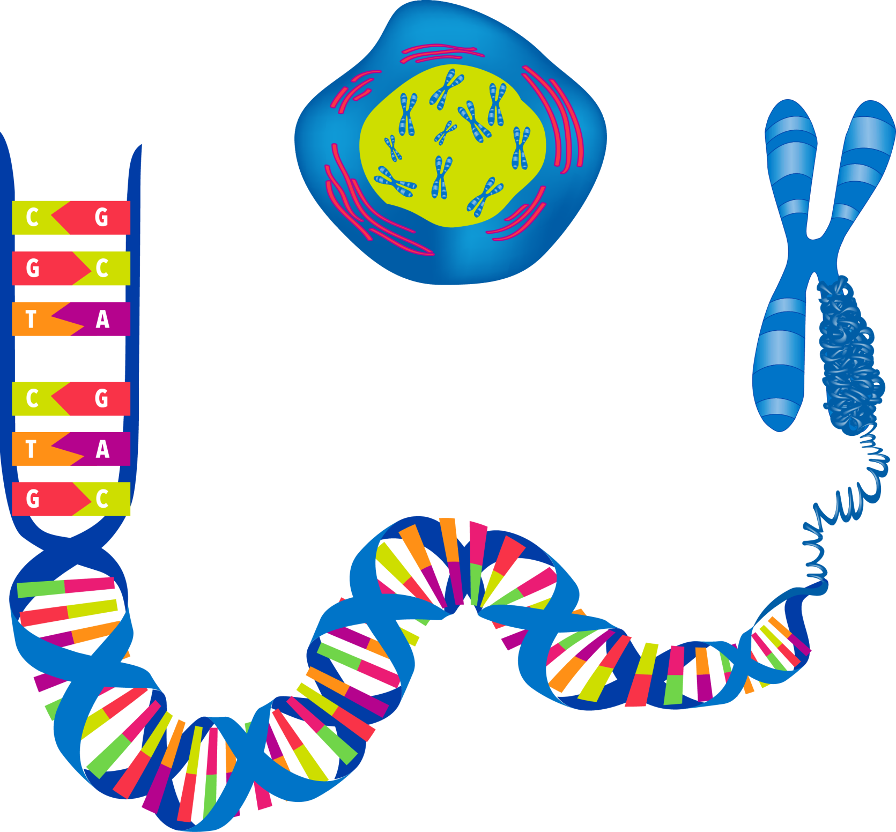
?
DNA
Chromosomes
Genes
http://commons.wikimedia.org/wiki/File:Chromosome.gif
Notes:
Are they three separate things or three different parts of the same thing? Can the three words be used interchangeably? In this PPT, we will learn the relationship between DNA, Chromosomes, and Genes.

Slide 4
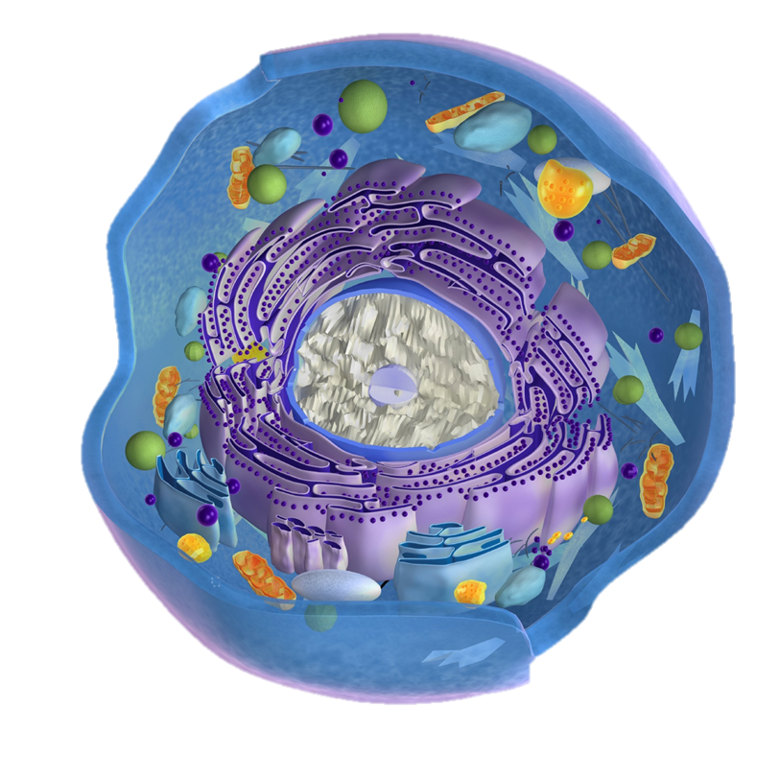
Cell
Notes:
Your body is made up of about 100 trillion cells. Although each cell is like a factory with thousands of complex machines carrying on many different processes, the cell is microscopic and can only be seen with the aid of a microscope. In fact, about 5 average-sized cells could fit in the space of a period.

Slide 5
Nucleus
http://commons.wikimedia.org/wiki/File:Eukaryotic_Cell_(animal).jpg
Notes:
The nucleus is the “command center” or “brain” of the cell.

Slide 6

Nucleus
http://commons.wikimedia.org/wiki/File:Chromosome_en.svg
DNA
Notes:
Inside the nucleus of every cell in your body is your DNA—the complete set of instructions for making a “you.”

Slide 7
http://commons.wikimedia.org/wiki/File:DNA_human_male_chromosomes.gif
Notes:
But all of your DNA is not found in one long strand…

Slide 8
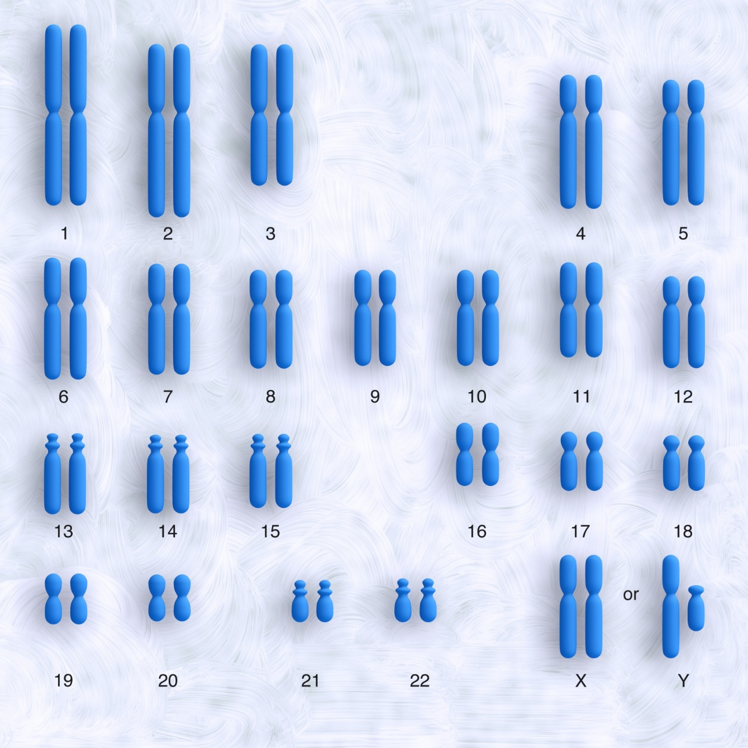
Chromosomes
http://commons.wikimedia.org/wiki/File:DNA_human_male_chromosomes.gif
Notes:
…it is actually located in multiple, shorter strands called chromosomes. Humans have 23 pairs of chromosomes.

Slide 9
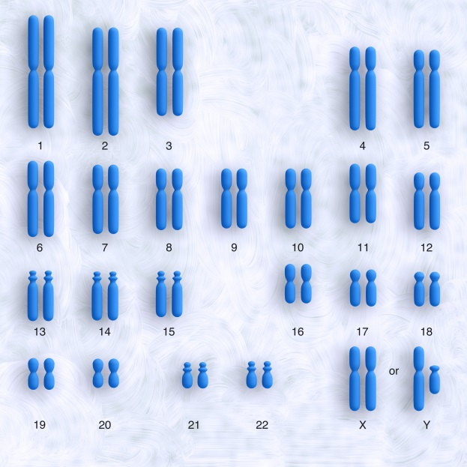
http://commons.wikimedia.org/wiki/File:DNA_human_male_chromosomes.gif
Notes:
The complete set of instructions for making an organism is not found in any one chromosome, or even in one pair of chromosomes. Each chromosome contains different genetic information,

Slide 10

DNA =
http://commons.wikimedia.org/wiki/File:DNA_human_male_chromosomes.gif
Notes:
so it’s really ALL the information on all 23 pairs of chromosomes put together that what we mean when we talk about your DNA.

Slide 11

Notes:
Most everyone recognizes this familiar “twisted ladder” as the structure of DNA.

Slide 12

Notes:
When the ladder is untwisted,

Slide 13

Notes:
… you can see that each side of the ladder is made up of a separate sequence of something called nucleotide bases.

Slide 14
A
T
C
G
Notes:
Each base is one of only four possibilities. We call them A, T, G, and C, and it’s helpful to think of them as letters of a (short!) alphabet.

Slide 15
T
G
C
A
G
C
C
A
C
Notes:
These four bases appear in different orders and combinations on the ladder

Slide 16
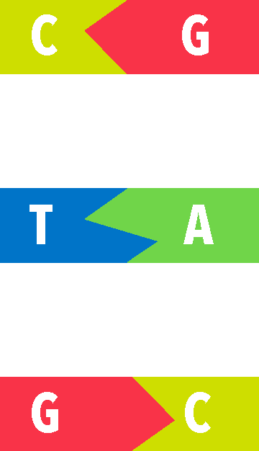
Notes:
Nucleotide bases from one strand / join with nucleotide bases from the other strand to form the “rungs” of the ladder.
A always joins with T
G always joins with C

Slide 17
Codon = word
http://en.wikipedia.org/wiki/Three_prime_untranslated_region
Notes:
Three bases in a row make up a codon, which you can think of as a 3-letter word.

Slide 18
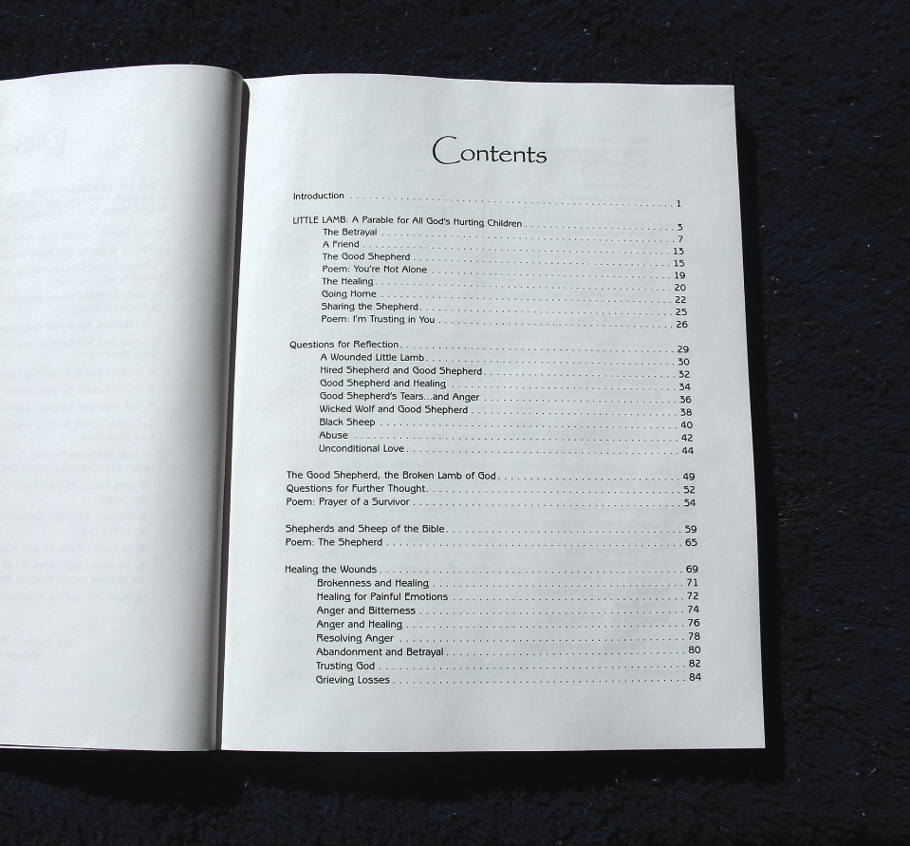
Gene = chapter
Gene
http://fr.wikipedia.org/wiki/G%C3%A8ne
Notes:
A certain sequence of codons—which may include dozens, hundreds, or even thousands of bases—is called a gene. If codons are like words, genes are like chapters in a book.

Slide 19
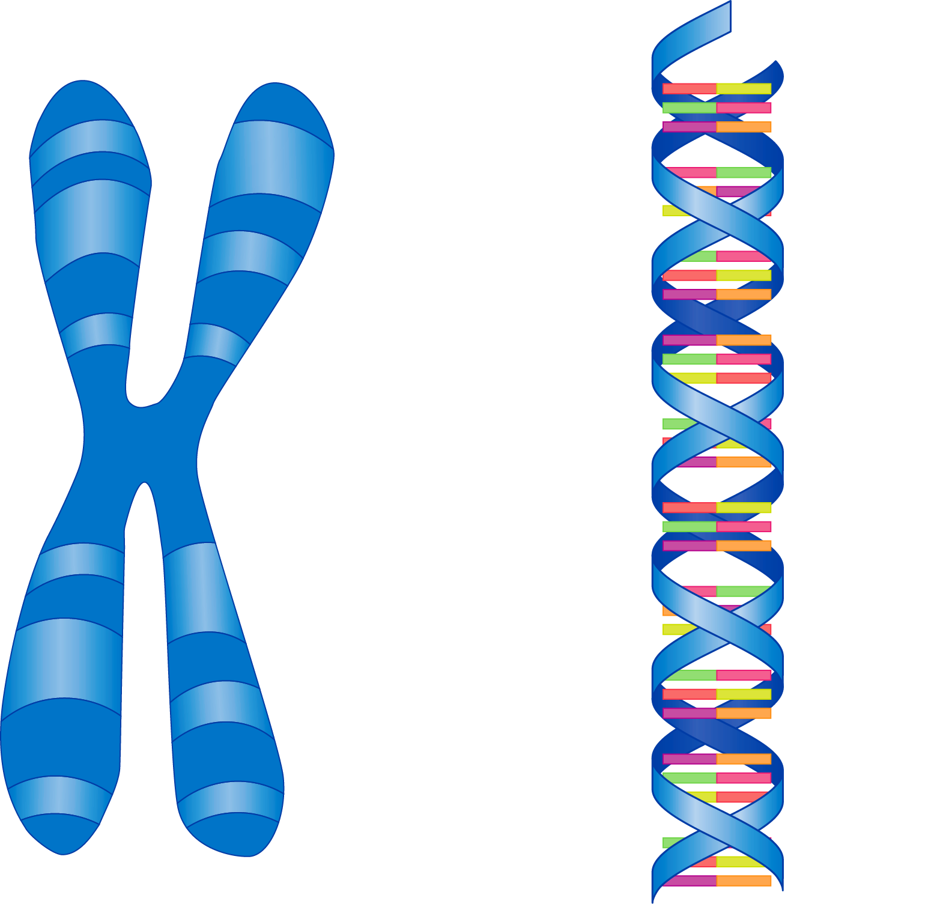

Chromosome = book
Chromosome
http://en.wikipedia.org/wiki/P%C5%99%C3%ADru%C4%8Dn%C3%AD_slovn%C3%ADk_nau%C4%8Dn%C3%BD
Notes:
A certain sequence of genes makes up a chromosome, which can be compared to a single book

Slide 20


ALL Chromosomes/dna = series of books
Notes:
All your chromosomes together—which means all your DNA--could be compared to a whole series of books.

Slide 21
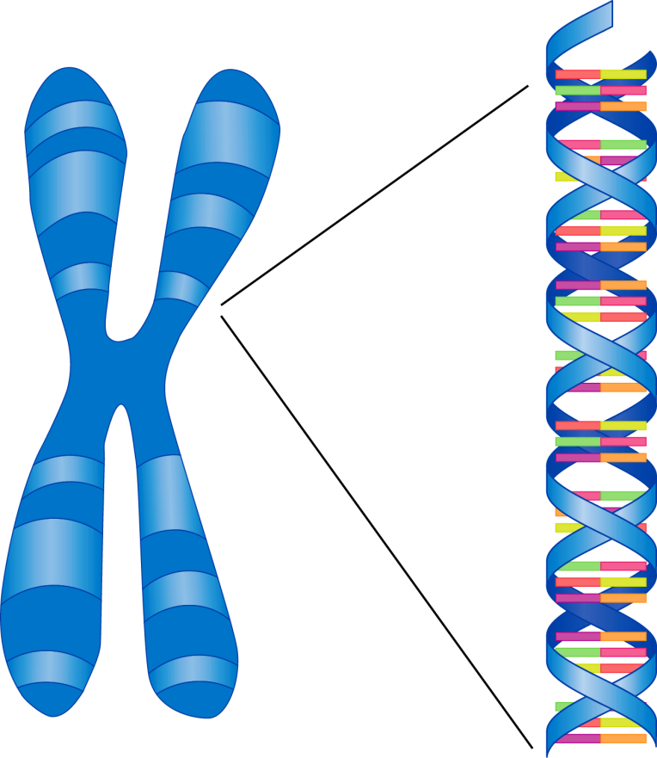
Let’s Review
Chromosome
Genes
http://en.wikipedia.org/wiki/P%C5%99%C3%ADru%C4%8Dn%C3%AD_slovn%C3%ADk_nau%C4%8Dn%C3%BD
Notes:
Genes are made up of smaller units called codons

Slide 22
Let’s Review
Chromosome
Genes
Codons
http://en.wikipedia.org/wiki/P%C5%99%C3%ADru%C4%8Dn%C3%AD_slovn%C3%ADk_nau%C4%8Dn%C3%BD
Notes:
Genes are made up of smaller units called codons

Slide 23
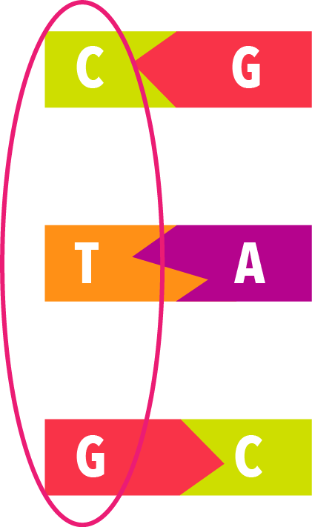
Let’s Review
Chromosome
Genes
Codons
http://en.wikipedia.org/wiki/P%C5%99%C3%ADru%C4%8Dn%C3%AD_slovn%C3%ADk_nau%C4%8Dn%C3%BD
Notes:
Genes are made up of smaller units called codons

Slide 24





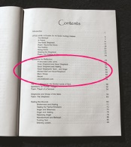
DNA
Bases:
A, T, C, G
Chromosome:
Codons:
Book
Words
Genes:
Chapters
Notes:
Or going from smallest to largest: Individual nucleotide bases (which are like letters) make up the codons (which are like words) that make up the genes (which are like chapters) that make up chromosomes (which are like individual books) which all together make up all your DNA (and are like a series of books)

Slide 25
Recorded at
Chattanooga Public RadioSM
Classical 90.5 WSMC

Slide 26
Original Graphics by
Susan Landon

Slide 27
Images By
Images may appear on more than one slide. Citation is given on the first slide where each image appears.
[1] DNA strand (straight), Susan Landon
[2a] DNA strand, Susan Landon
[2b] Chromosomes 134153911, somersault18:24, Thinkstock, Thinkstock Image Subscription Agreement
[3a] Cell nucleus with chromosomes, Susan Landon
[3b] DNA and chromosome, Susan Landon
[4] Cell 000045876032 7activestudio, Getty Images (US), Inc. Subscription
[12] Untwisted DNA ladder, Susan Landon
[13] Separated DNA ladder, Susan Landon
[16] Nucleotide bases, Susan Landon
[18] Photo of Table of Contents page, Hight
[19] Book 177425492, badahos, Thinkstock, Thinkstock Image Subscription Agreement
[20] Stack of colorful books 465612383, ferlistockphoto, Thinkstock, Thinkstock Image Subscription Agreement

Slide 28
Special Thanks
Tim Trott, PhD
Biology Professor, Southern Adventist University
and the
Foundation for Adventist Education

Slide 29
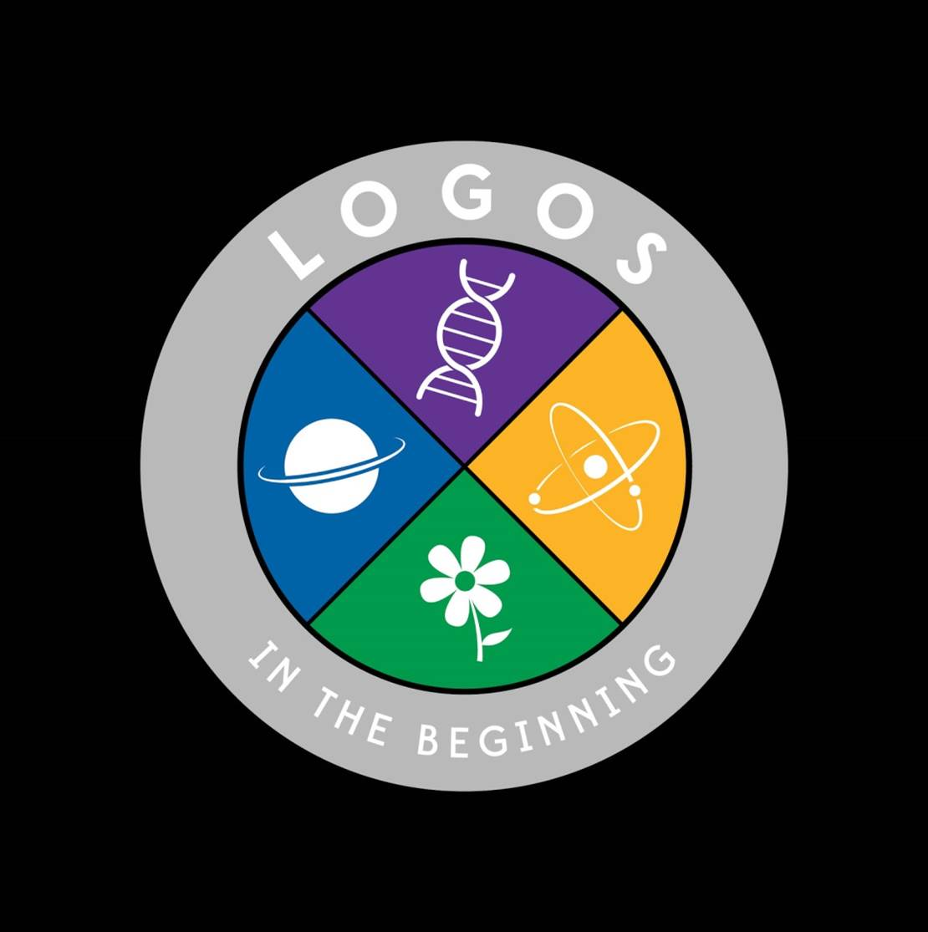
© Origins Curriculum Resources 2015

Slide 30

© Southern Adventist University 2015

Slide 31

© Seventh-day Adventist North American Division 2015

Slide 32

© General Conference of Seventh-day Adventists 2015

Slide 33

© SCORE Southern Center for Origins Research & Education 2015

