Slide 1
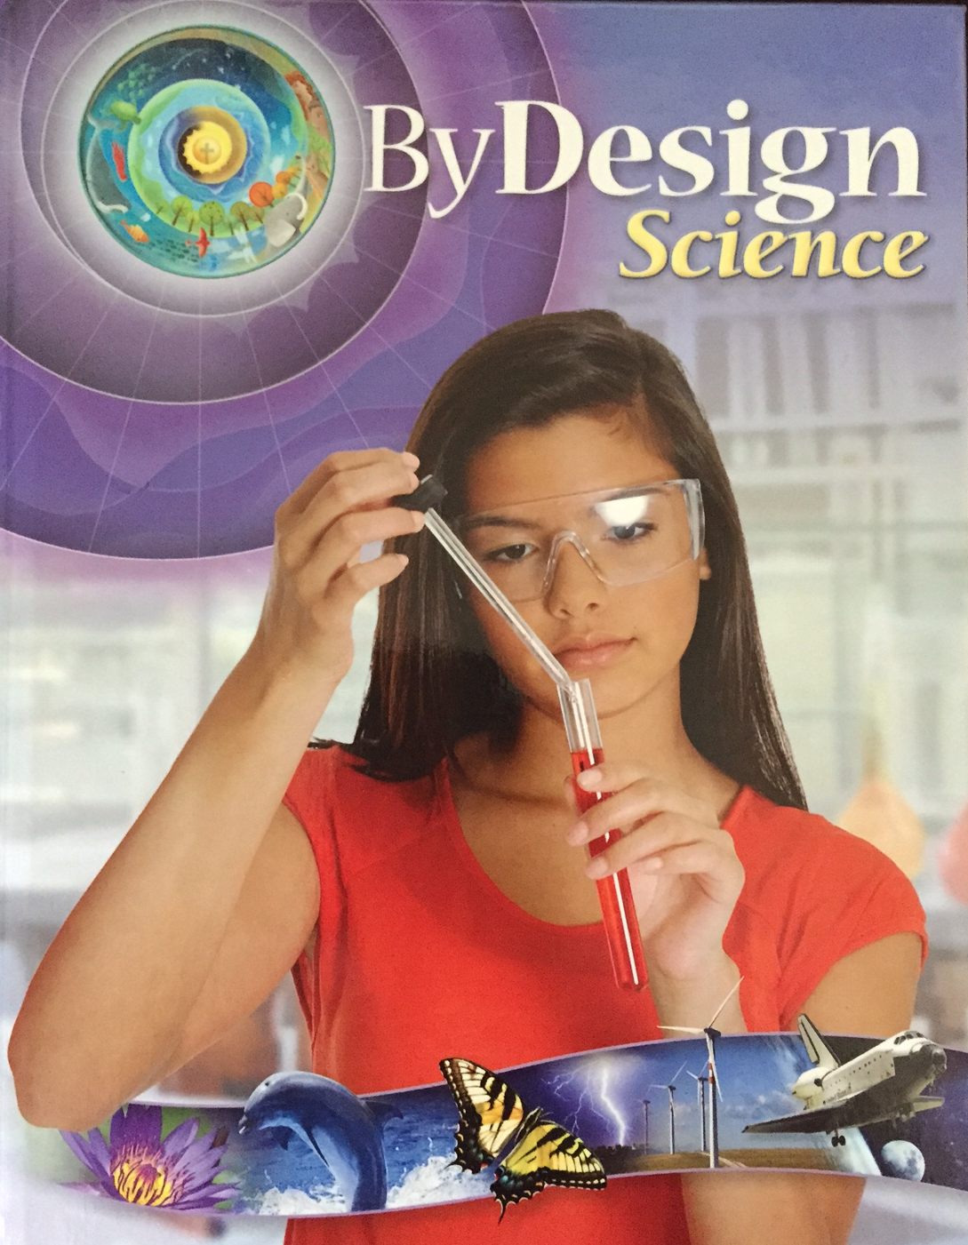
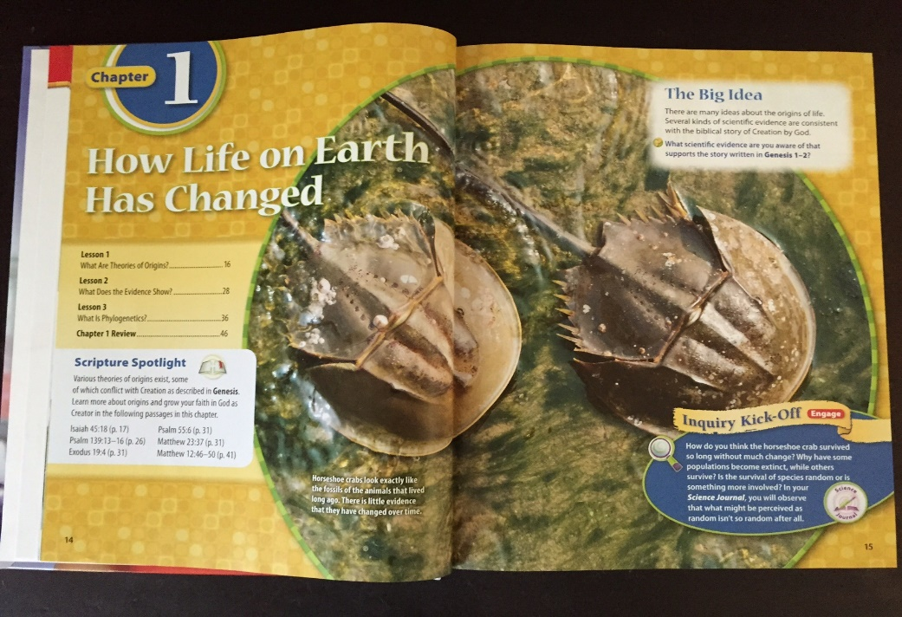
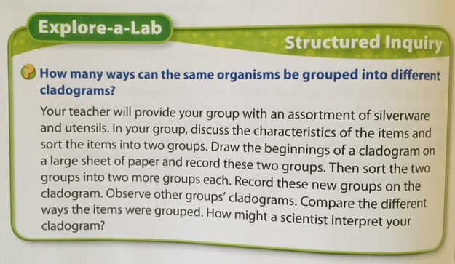
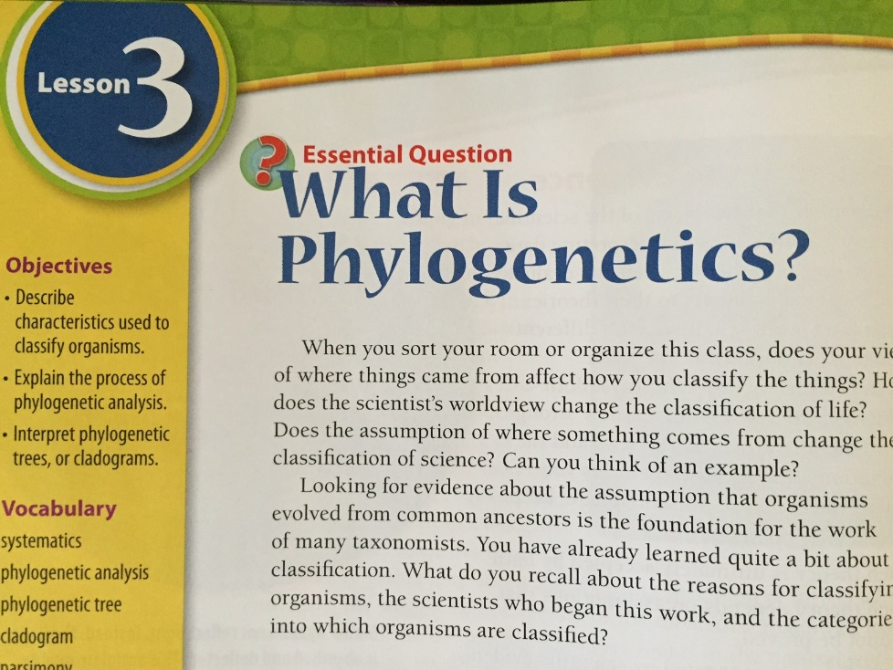
Chapter 1
Explore-a-Lab
Page 42
Grade 8
Lesson 3
Notes:
This presentation explains the Explore-a-Lab in grade 8, chapter 1, lesson 3, on page 42.

Slide 2

Phylogenetic
Analysis
Process used by evolutionary scientists to group organisms based on multiple shared characteristics.
Notes:
This activity is in the lesson on phylogenetic analysis, which is a process used by evolutionary scientists to group organisms based on multiple shared characteristics.

Slide 3
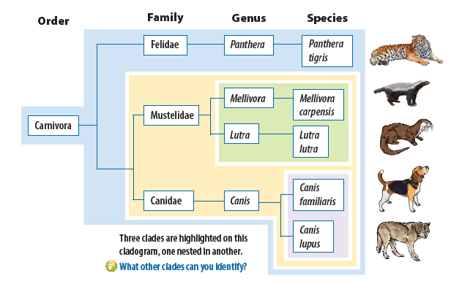
Phylogenetic Trees
Cladograms
Notes:
The results of their analysis are displayed in diagrams called phylogenetic trees or cladograms (like the one shown on page 39 or this one which is from page 42)

Slide 4
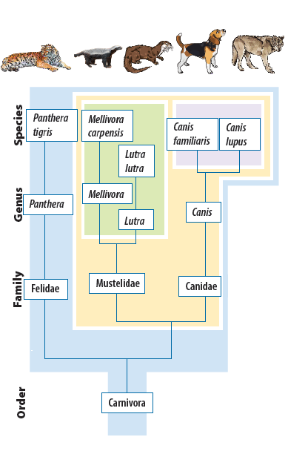
Notes:
It may be easier to think of turning the cladogram on its side like this so the order carnivora is at the base of the diagram…

Slide 5
Notes:
and the rest of the lines are in the shape of a football goal, like this…

Slide 6
Notes:
…this…

Slide 7
Notes:
…and these

Slide 8
Notes:
Notice the colors on this diagram. Each color represents a grouping of animals that scientists call a “clade.” Smaller clades are nested within larger clades.

Slide 9
Notes:
These two clades are nested inside of a larger one.

Slide 10
Notes:
Which is nested within an even larger one.

Slide 11
Notes:
Because their location on the cladogram is determined by the characteristics they share, scientists conclude that the organisms at the ends of the branches within a particular clade are the most closely related genetically. / These two at the ends of the branches in the light blue clade are more closely related to each other…

Slide 12
Notes:
…than these, which are further away from each other on the cladogram.

Slide 13
Notes:
These two at the ends of the branches in the green clade are more closely related to each other…

Slide 14
Notes:
…than these, which are further away from each other on the cladogram.

Slide 15
Notes:
Even though these may look like they should be closely related, they really aren’t because one is in the blue clade and the other is in the green clade.

Slide 16
The Question
Notes:
The Explore-a-Lab asks the question: How many ways can the same organisms be grouped into different cladograms? Students will discover that items can be grouped in many different ways depending on which characteristics they select, which has important implications as students learn about the theory of evolution.
The point of this activity is to compare the results of several different sorting activities. If your class is too small to have several groups, each group could sort the same utensils multiple times using different characteristics to generate several different sets of results.

Slide 17
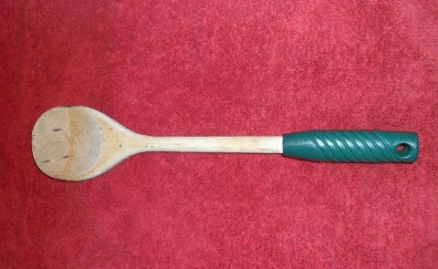
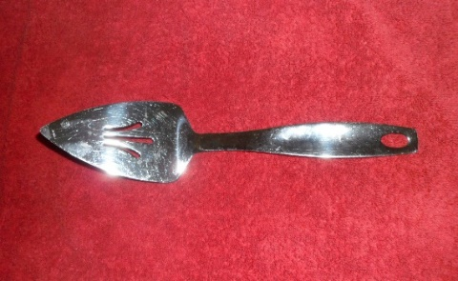
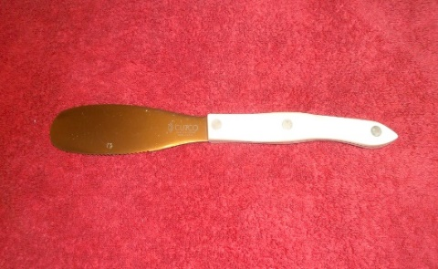
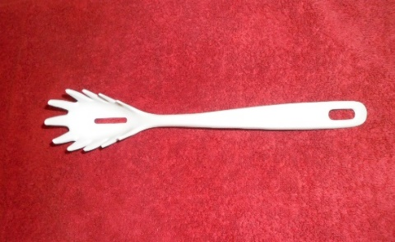
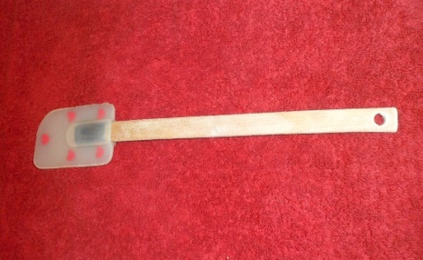
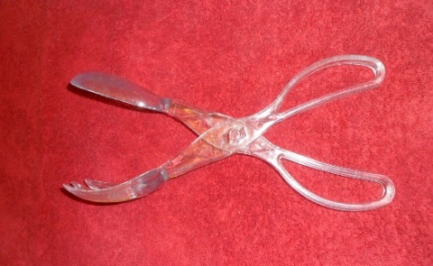
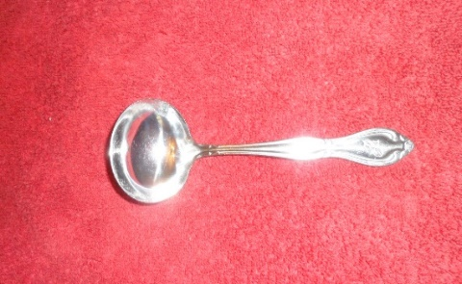
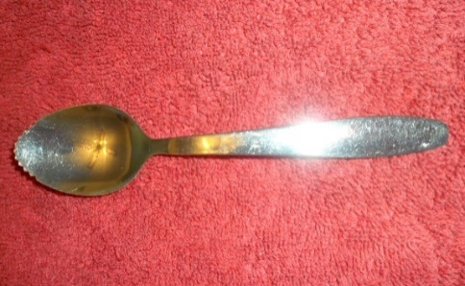
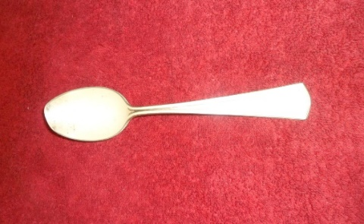
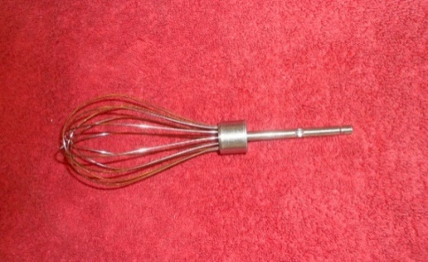
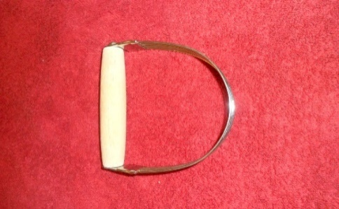
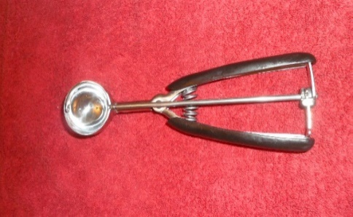
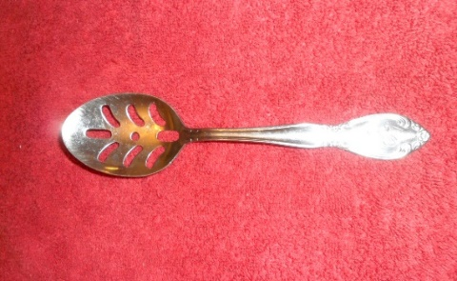
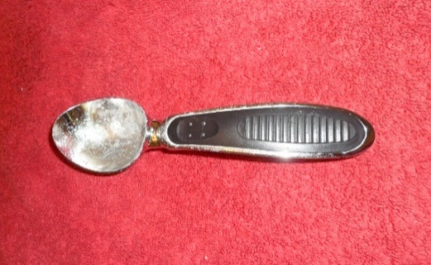
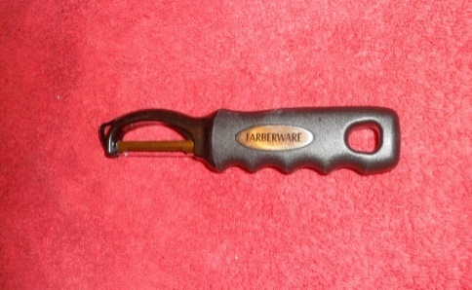
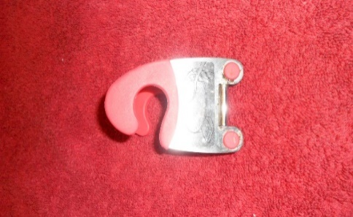
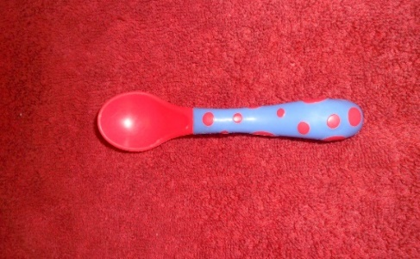
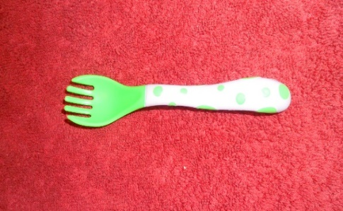
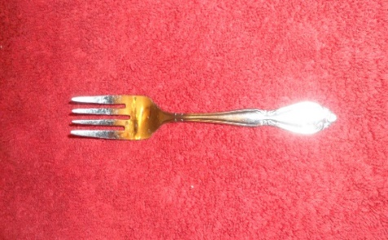
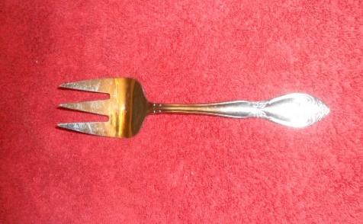
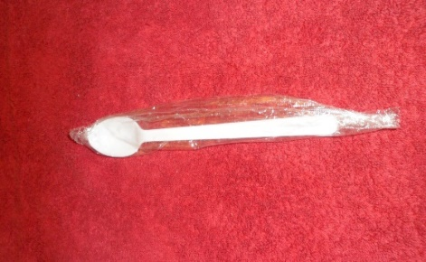
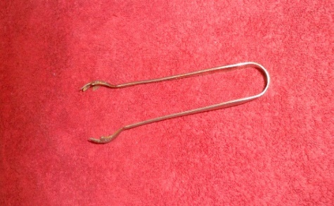
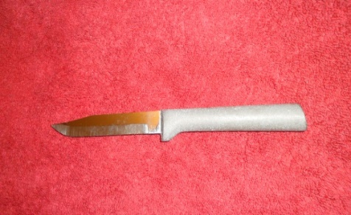
Notes:
Provide each group of students with a variety of kitchen utensils like these. It is important that each group have the same utensils.

Slide 18
Instructions for Students
1. In your groups, discuss the characteristics of the items and sort them into two groups based on whatever characteristic you choose.
Notes:
Instruct your students to discuss the characteristics of the kitchen utensils and them sort them into groups based on any characteristic they choose.

Slide 19
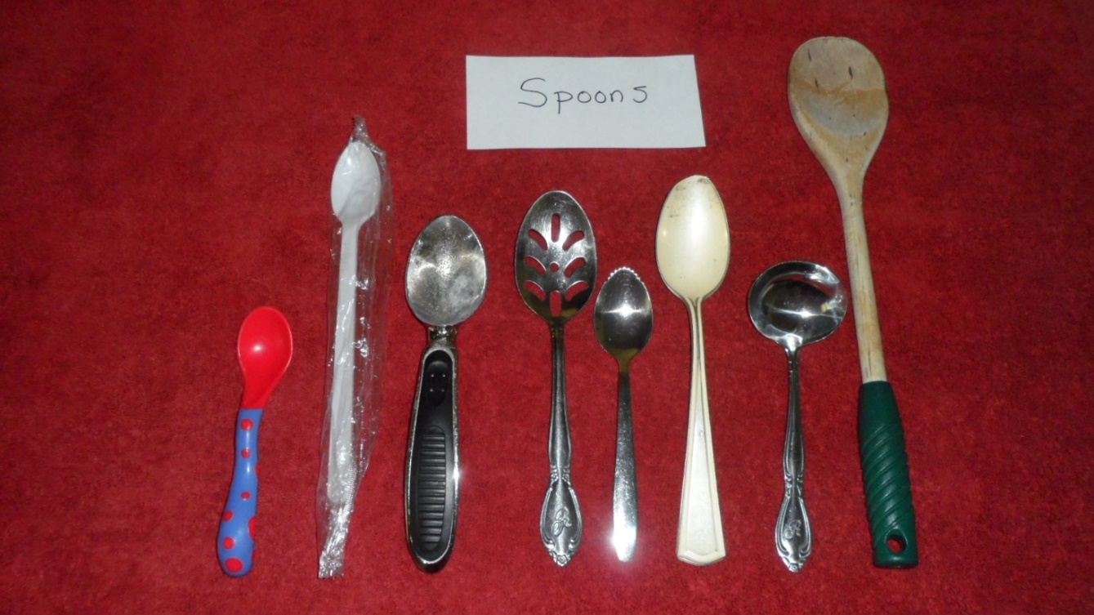
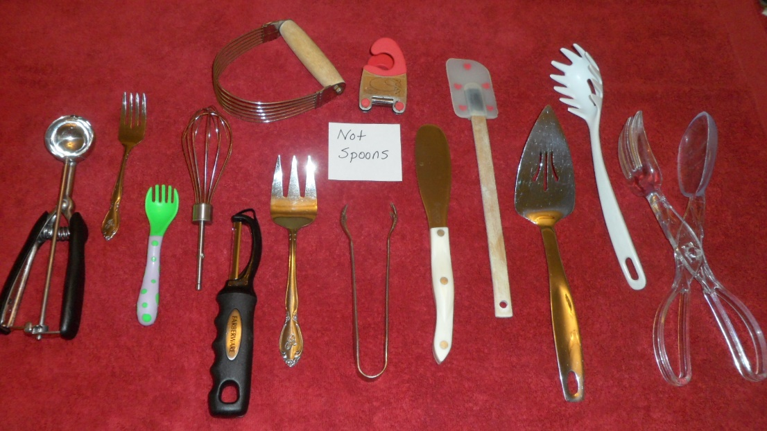
Spoons
Non-Spoons
Notes:
This is one of many possibilities students may come up with.

Slide 20
2. Begin drawing a cladogram on a large sheet of paper and record these two groups.
Instructions for Students
Notes:
Once students have sorted the utensils into two groups, instruct them to begin drawing a cladograms on a large sheet of paper.

Slide 21


Grouping #1
Spoons
Grouping #2
Not Spoons
Kitchen Utensils
Notes:
Tell them to begin their cladograms near the bottom of their paper and leave room at the top to expand it further. Instead of the pictures shown here, your students could list the utensils in each group.

Slide 22
3. Sort each of the two groups into at least two more groups and add them to your cladograms.
Instructions for Students
Notes:
Instruct your students to sort each group into at least two more groups and add them to their cladograms.

Slide 23
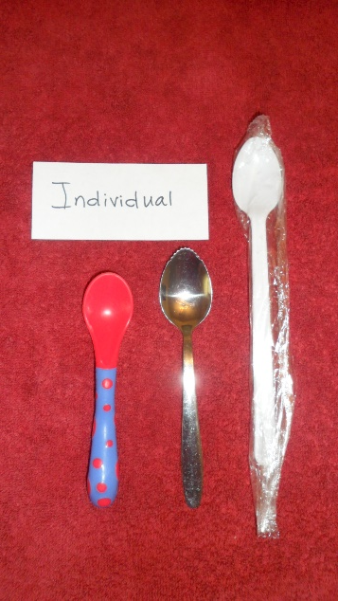
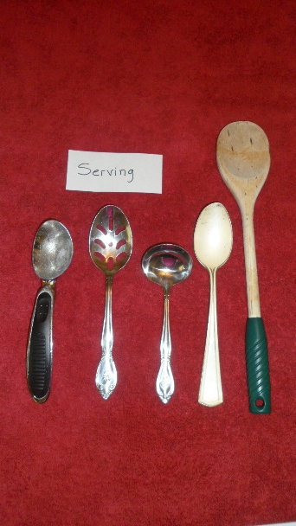
Individual
Spoons
Serving
Spoons
Notes:
The spoons could be divided into two groups this way: spoons for individual use and serving spoons.

Slide 24


Individual
Serving
Grouping #1
Spoons
Grouping #2
Kitchen Utensils
Notes:
Which could be placed on the cladograms like this.

Slide 25
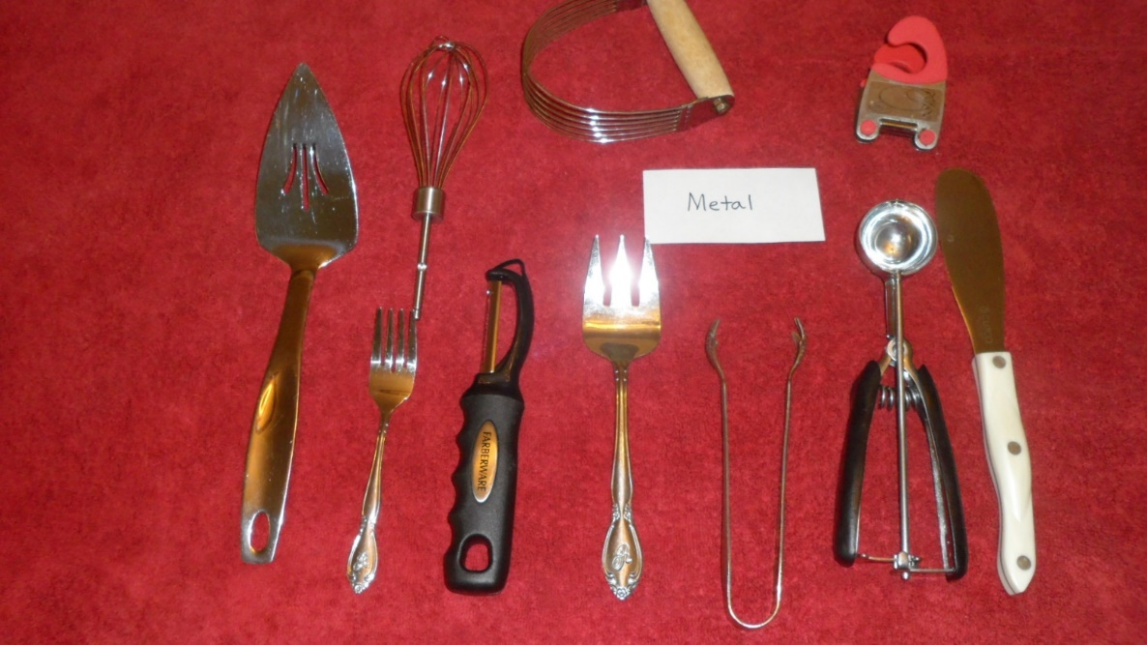
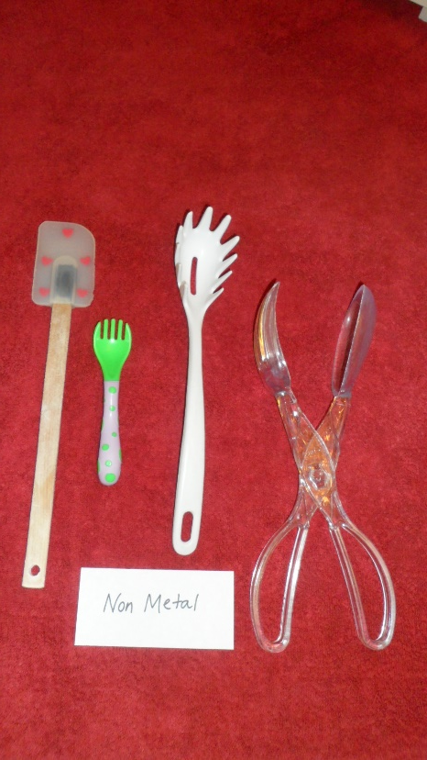
Metal
Non-Metal
Notes:
If the non-spoon group was sorted into two more groups based on whether they contain any metal or not…

Slide 26


Individual
Serving
Metal
Non-Metal
Grouping #1
Spoons
Grouping #2
Kitchen Utensils
Notes:
They could be placed on the cladograms like this.

Slide 27
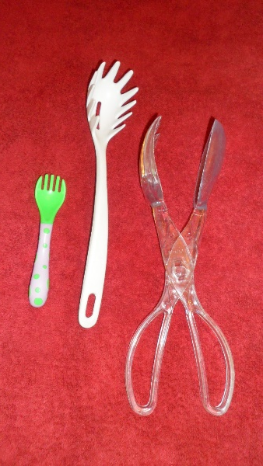
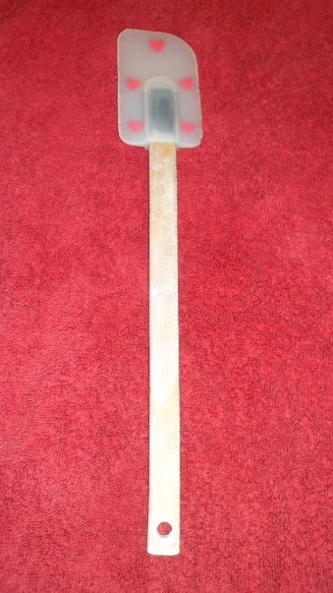
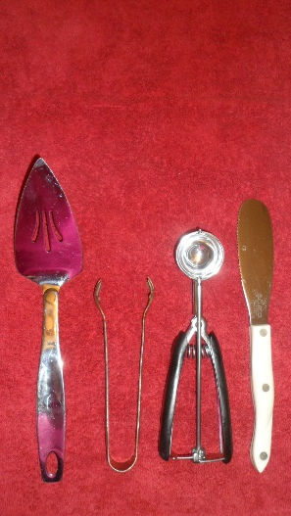
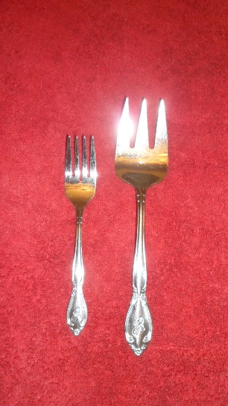
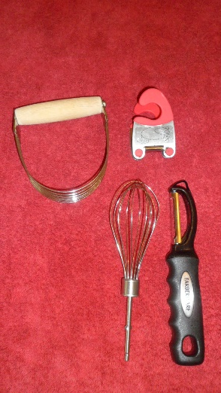

Metal
Non-Metal
Notes:
You may want to encourage your students to divide the utensils into even smaller groups

Slide 28

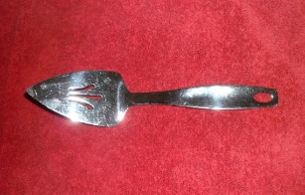

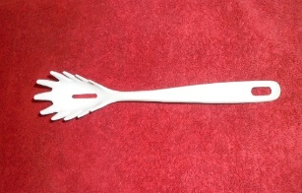
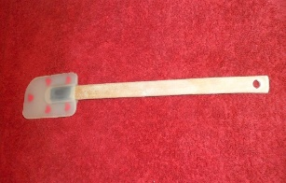

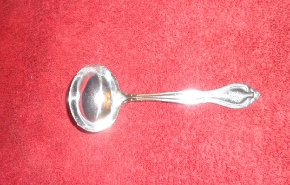


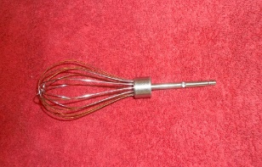
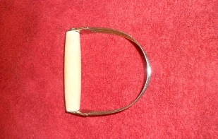

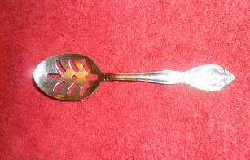


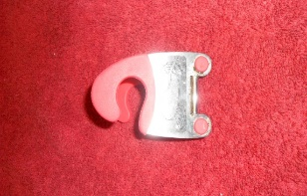


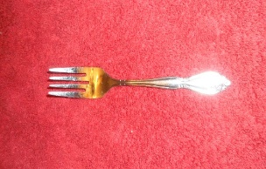
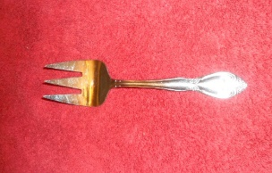



Option 2
Notes:
In order to generate more results that we can compare, consider different characteristics we could have used to sort the same utensils.

Slide 29


Contains
Metal
Contains
No Metal
Notes:
Let’s say that a group decided to sort first by whether or not the utensils contains any metal.

Slide 30


Grouping #1
Metal
Grouping #2
Non-Metal
Kitchen Utensils
Notes:
The first step of their cladograms would look like this.

Slide 31
Grouping #1
Metal
Grouping #2
Non-Metal
Kitchen Utensils
Notes:
Sorting the non-metal utensils again…

Slide 32


Serving
Individual
Notes:
Could result in these two groups…

Slide 33


Serving
Individual
Grouping #1
Metal
Grouping #2
Non-Metal
Kitchen Utensils
Notes:
…which could look like this on the cladogram.

Slide 34


3 groups
2 groups
Notes:
You may want to encourage students to sort the utensils into more than just two steps at any step along the way

Slide 35
Grouping #1
Metal
Grouping #2
Non-Metal
Kitchen Utensils
Notes:
There are lots of possibilities for sorting the group of metal utensils.

Slide 36





Wire
Spoons
Serving
Pointy
Misc
Notes:
Here are 5 possible groupings of the metal utensils:

Slide 37
Wire
Spoons
Serving
Pointy
Misc
Notes:
Expect your students to disagree on exactly how to group the utensils. This is a good thing, which will help make the point of this activity. For example, someone might argue that the spaghetti tongs should go in the pointy group.

Slide 38
Wire
Spoons
Serving
Pointy
Misc
Notes:
Someone else might want to classify them with other serving items.

Slide 39
Wire
Spoons
Serving
Pointy
Misc
Notes:
It could be argued that the grapefruit spoon could be in the pointy group or the spoon group

Slide 40
Wire
Spoons
Serving
Pointy
Misc
Notes:
Some might suggest that the miscellaneous group be split up?

Slide 41
Option 3
Notes:
Here is a third example of sorting options so that we’ll have several groupings to compare.

Slide 42


Just one material
Mixture of materials
Notes:
Let’s say this time we categorize by the material each utensil is made of.

Slide 43



Plastic
Silver
Stainless
Steel
Grouping #1
One material
Grouping #2
Mixture
Kitchen Utensils
Notes:
Those made of only one material are made either of stainless steel, plastic, or silver.

Slide 44




Metal and soft plastic
Metal and hard plastic
Wood and metal
Wood and rubber
Grouping #1
One material
Grouping #2
Mixture
Kitchen Utensils
Notes:
The utensils made of more than one material could be divided into wood and rubber, wood and metal, metal and soft plastic, and metal and hard plastic.

Slide 45
Plastic
Silver
Stainless
Steel
Grouping #1
One material
Grouping #2
Mixture
Kitchen Utensils
Notes:
When your students make their cladograms, they would show all these categories…

Slide 46
Metal and soft plastic
Metal and hard plastic
Wood and metal
Wood and rubber
Grouping #1
One material
Grouping #2
Mixture
Kitchen Utensils
Notes:
…and all these categories on the same cladograms.

Slide 47
Notes:
Here’s the point of this exercise. Remember how the proximity of two organisms on a cladogram is supposed to show how similar they are to each other?

Slide 48

Notes:
Keep that in mind as we compare where the cookie scoop ended up in the three sorting exercises we just did.

Slide 49

Spoons/Non-Spoons
Metal/Non-Metal
1
Notes:
In the first sorting activity, we first sorted into two groups—spoons and non-spoons. Then we sorted into two more groups—metal and non-metal. The cookie scoop ended up in a group with a couple of cake servers and a pair of tongs.

Slide 50

Spoons/Non-Spoons
Metal/Non-Metal
Metal/Non-Metal
Spoon-like
1
2
Notes:
In the second sorting activity, the cookie scoop ended up between an ice-cream scoop and a gravy ladle.

Slide 51

Spoons/Non-Spoons
Metal/Non-Metal
Material
Metal/Non-Metal
Spoon-like
3
1
2
Notes:
And in the third sorting activity it ended up in a group with a little gadget that clips to the edge of a pot so you can rest a wooden spoon in it. How can a cookie scoop be most like a pair of tongs one time, an ice cream scoop another time, and a gadget like this another time? It all depends on the characteristics you use in the sorting process.

Slide 52
Phylogenetic Trees
Cladograms
Notes:
The same thing happens when scientists sort organisms using phylogenetic trees, although cladograms of species normally show fewer variations than a cladogram of kitchen utensils. Where the organisms end up—and which other organisms they are closest to—is determined by which characteristics are used in the sorting process.

Slide 53

Notes:
That is why some cladograms suggest that our closest relatives are chimpanzees…

Slide 54



Orangutan
Gorilla
Bonobos
Notes:
…while others suggest we are most like gorillas, orangutans, or bonobos.

Slide 55
4. Observe other groups’ cladograms. Compare the proximity of certain utensils to each other on different cladograms.
Instructions for Students
Notes:
Instruct your students to observe each other’s cladograms. Compare the proximity of certain utensils to each other on different cladograms. Perhaps each student should select one utensil and compare what it is grouped with in each of the other groups. Help them discover that the characteristics used in the sorting process, determine which utensils end up close together.

Slide 56
Data
The characteristics we sort by are observable data:
Wooden
Metal
Pointed
Sharp
Small or large
Notes:
The characteristics we sort by are observable data.

Slide 57
Data
Interpretation
The characteristics we sort by are observable data:
Wooden
Metal
Pointed
Sharp
Small or large
Relationships between object or organisms
Scientists choose between multiple possibilities
Based on characteristics used in the sorting process
Notes:
But the suggested relationships between objects or organisms are interpretations of that data. Any cladograms is only one of many possible arrangements. If different characteristics are selected to sort by, a different arrangement of organisms will be suggested.

Slide 58
Conclusions
Cladograms assume evolution
Useful tool for sorting organisms by shared characteristics
Cladograms do not provide evidence for evolution
Notes:
Cladograms assume evolution happened, and then try to figure out who is most closely related to whom. Although phylogenetic analysis may be a useful tool for sorting organisms by shared characteristics, cladograms do not provide actual evidence that evolution really happened.

Slide 59
Recorded at
Chattanooga Public RadioSM
Classical 90.5 WSMC

Slide 60
Images By
Images may appear on more than one slide. Citation is given on the first slide where each image appears.
[1] Photos of By Design book, Carol Raney
[3] Graphic from By Design textbook, Grade 8, page 42, used with permission
[17 and onward] All photos of utensils, Carol Raney
[53] Chimpanzee 450718547, GlobalP, Thinkstock, Thinkstock Image Subscription
[54a] Western gorilla 475787275, Aneese, Thinkstock, Thinkstock Image Subscription
[54b] Orangutang 503089753, jodie777, Thinkstock, Thinkstock Image Subscription
[54c] Bonobo 467924225, USO, Thinkstock, Thinkstock Image Subscription

Slide 61
Special Thanks
Foundation for Adventist Education

Slide 62

© Origins Curriculum Resources 2015

Slide 63

© Southern Adventist University 2015

Slide 64

© Seventh-day Adventist North American Division 2015

Slide 65

© General Conference of Seventh-day Adventists 2015

Slide 66

© SCORE Southern Center for Origins Research & Education 2015

