Slide 1
The Geologic Column
Absolute Dating--Radioactive Decay
Notes:
Absolute Dating—Radioactive Decay

Slide 2
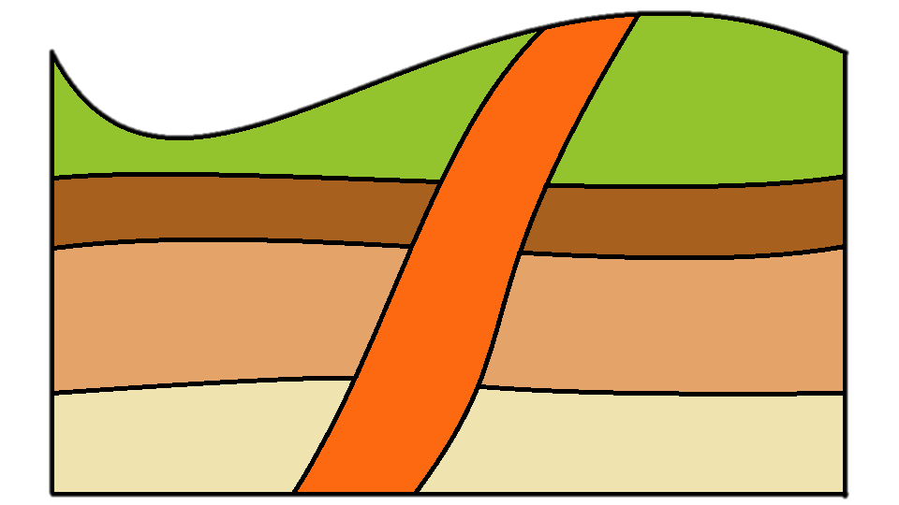
Relative Dating
4
3
5
2
1
Notes:
Recall that relative dating involves figuring out the order in which various geologic events happened.

Slide 3
Relative Age
Youngest
Oldest
Notes:
Except in rare circumstances, lower layers are older than upper layers. But just by looking at them, we cannot tell exactly how old they are or how much time elapsed between them.

Slide 4
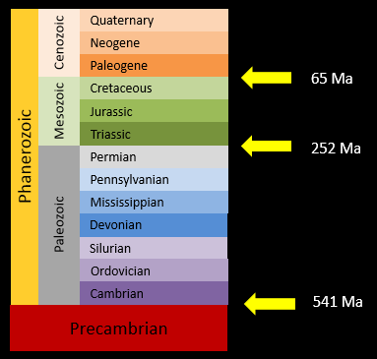
Absolute Dating
Estimating the actual age of rock layers or fossils
Notes:
But scientists often talk –not just about relative age, but about the actual or absolute age of rock layers or fossils found in them. How are these actual ages calculated?

Slide 5
Absolute Dating
Radiometric dating
Radioactive decay
Notes:
By using a process called radiometric dating., which we’ll learn about that in the next video…

Slide 6
Absolute Dating
Radiometric dating
Radioactive decay
Notes:
…but first we need to understand a process called radioactive decay

Slide 7
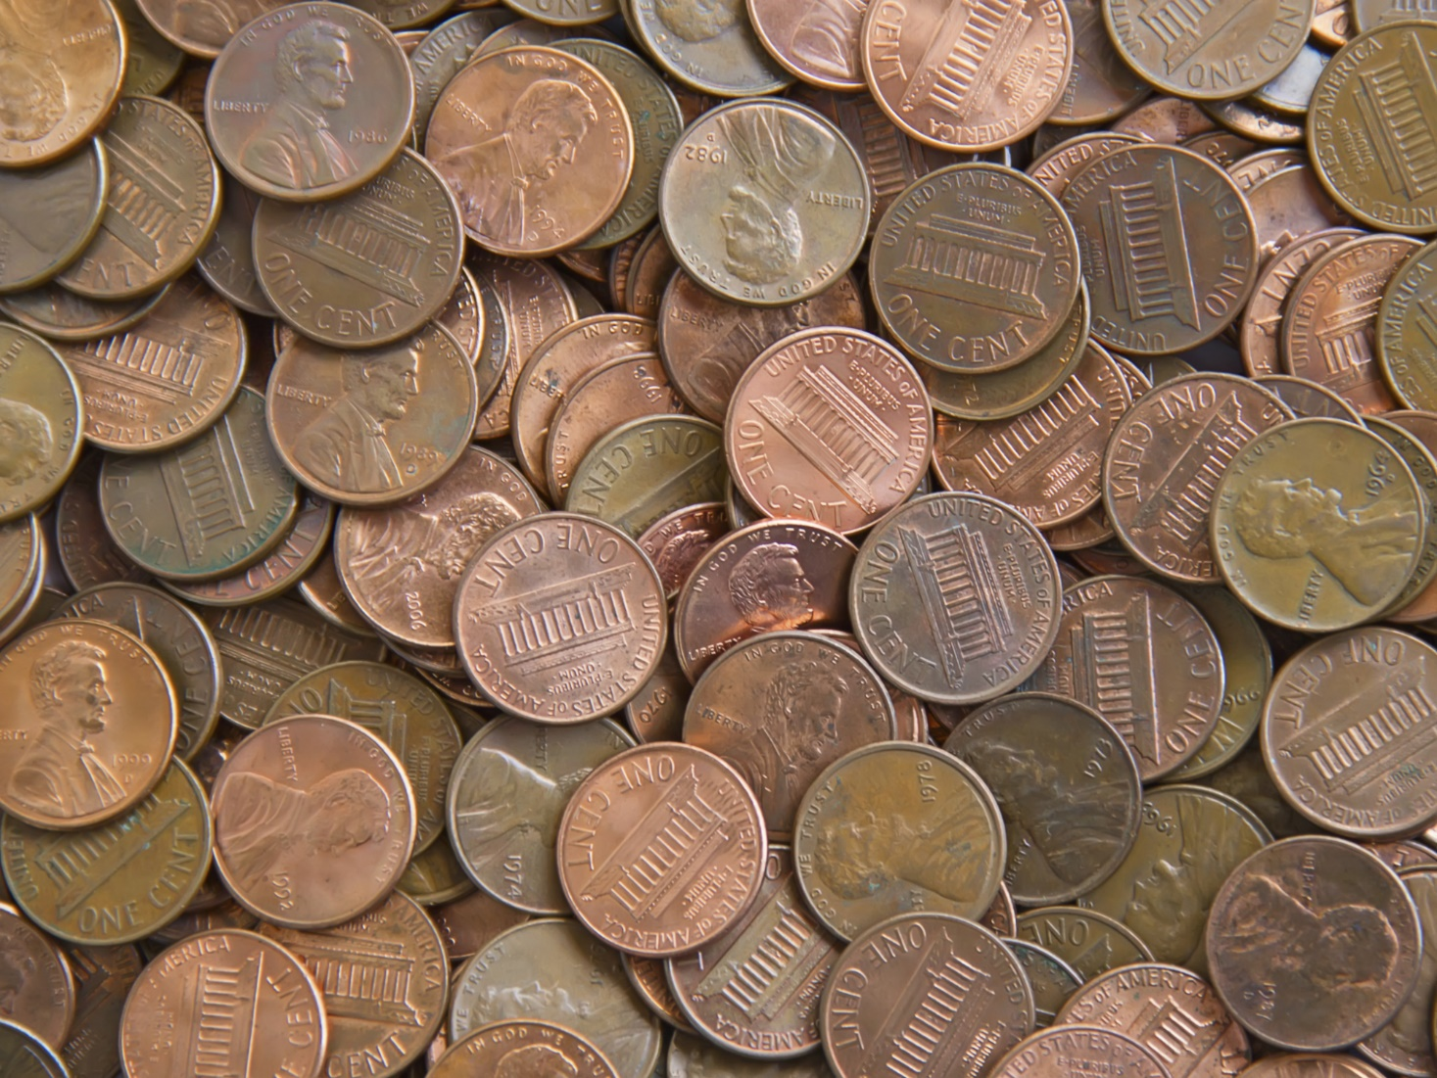
Notes:
To do this, Imagine you have 100 pennies.

Slide 8
Notes:
Statistically, if you flip them all, about half will be heads and half will be tails.

Slide 9
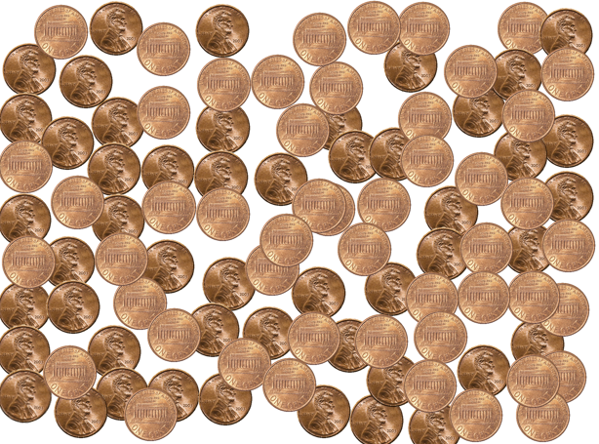
Notes:
So when we flip the 100 pennies…

Slide 10
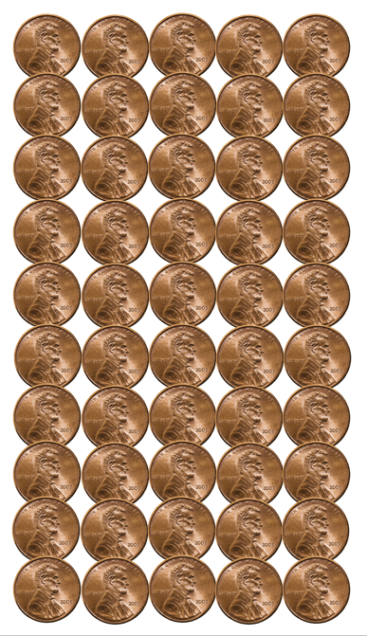
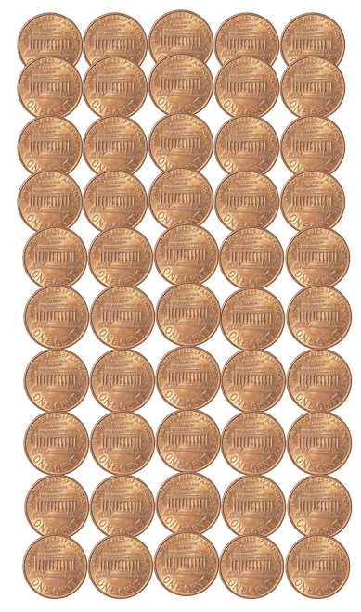
Notes:
We aren’t surprised that 50 are heads and 50 are tails

Slide 11
Notes:
We will leave the 50 heads in a pile. / One minute later, we will re-flip the 50 pennies that were tails

Slide 12
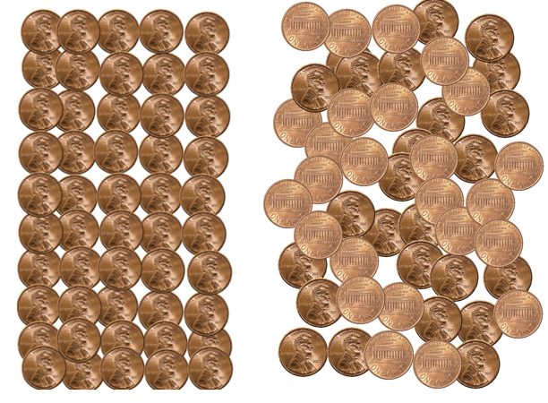
Notes:
When we do, about half the pennies flipped are heads and the other half are tails.

Slide 13
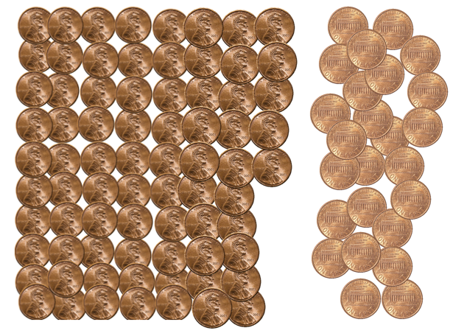
Notes:
So now we have about 75 heads in one pile with about 25 tails in the other.

Slide 14
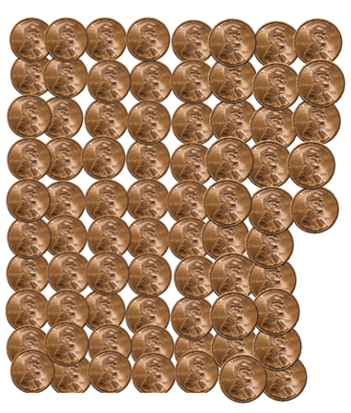
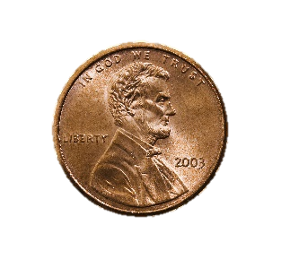
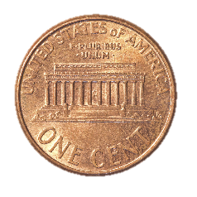
Notes:
One minute later, we will flip the remaining 25 pennies again.

Slide 15
Notes:
After adding the heads to our growing group, / we wait a minute and flip the other pennies one more time

Slide 16
Notes:
About half come up heads and we continue to repeat the process.

Slide 17
Notes:
Notice that as we continue to flip the pennies, the group of heads continues to get larger, while the group we’re flipping gets smaller and smaller.

Slide 18
Notes:
Every minute, we flip the remaining pennies again

Slide 22
Notes:
…until all our pennies are in the heads group.

Slide 23
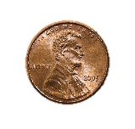
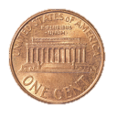
Notice 3 Things:
One group (heads) increased steadily while the other group decreased steadily.
Both groups changed steadily as we flipped the pennies every minute.
We could not know for sure whether any individual penny would be heads or tails, but we knew that about half the group would be heads and half tails.
Notes:
Read slide…then add:
Keep these three things in mind as learn about radioactive decay.

Slide 24
Element
The simplest substance possible
Cannot be separated into simpler substances
Notes:
An element is the simplest substance possible. It cannot be separated into simpler substances.

Slide 25
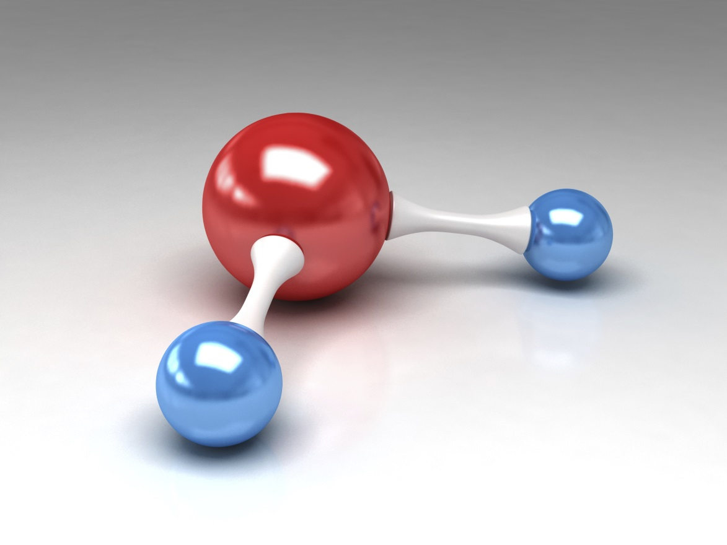
H2O
O
H
H
Notes:
Think about water—H20. /Because water is made up of both hydrogen and oxygen, it is not an element. But the individual hydrogen and oxygen atoms that make up water ARE elements because neither of them can be separated into simpler substances.

Slide 26
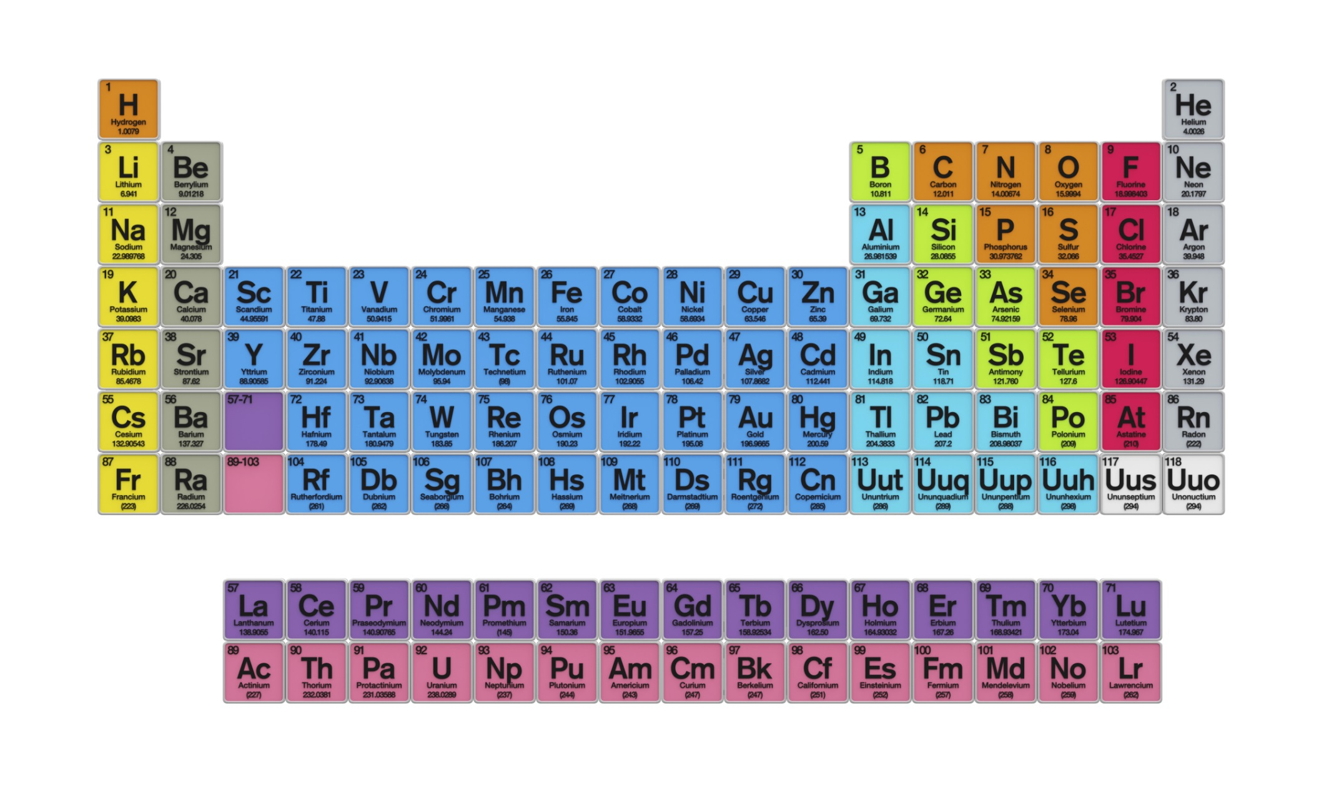
Periodic Table of the Elements
Notes:
This is called the Periodic Table of the Elements. Each square in this table represents an element that scientists have discovered.

Slide 27
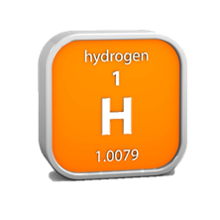
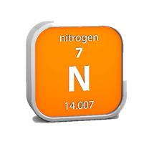
Elements
Notes:
Some of these elements are things you’re familiar with—/ like nitrogen, / carbon, and / hydrogen. Other things may be less familiar—/ like rubidium / or strontium.

Slide 28
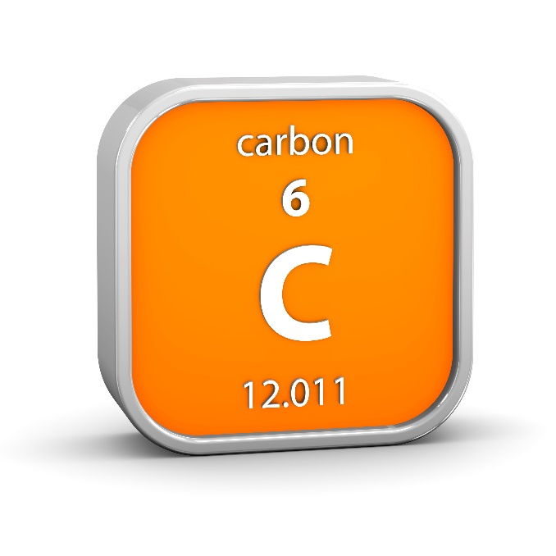
Notes:
Each element is made up of protons and neutrons. / The top number tells how many protons are in an atom of the element.

Slide 29
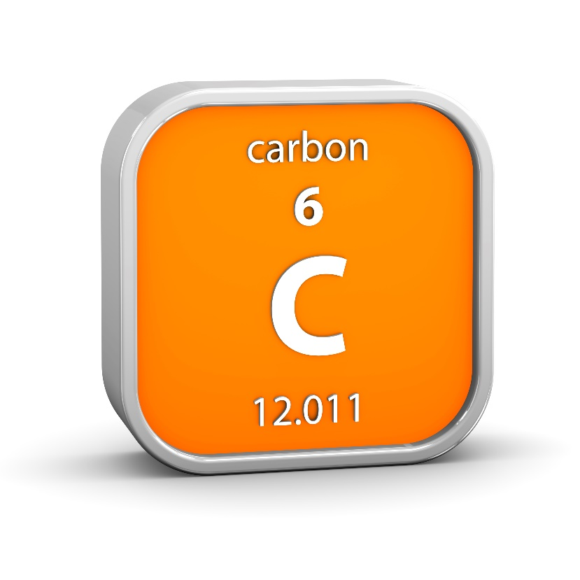
Isotopes
C12
6 protons & 6 neutrons
C14
6 protons & 8 neutrons
Notes:
Isotopes are atoms of the same element that have the same number of protons…

Slide 30
Isotopes
C12
6 protons & 6 neutrons
C14
6 protons & 8 neutrons
Notes:
…but different numbers of neutrons.

Slide 31
Isotopes
Stable
DON’T
break down
(decay)
Unstable
DO
break down
(decay)
Notes:
Some isotopes are stable, / which means they do not break down. Other isotopes are unstable, / which means that over time they do break down, or decay, into isotopes of a different element.

Slide 32
Radioactive Decay
Rubidium
Strontium
37
38
87
87
Notes:
One example of radioactive decay is when rubidium decays over time into strontium.
37 38
Rb Sr
87 87

Slide 33
Radioactive Decay
Potassium
Argon
19
18
40
40
Notes:
Another example / is when potassium decays overtime into argon.
18
K Ar
40 40

Slide 34
Parent
&
Daughter
Rubidium
Strontium
37
38
87
87
Notes:
The original unstable isotope is called the parent isotope, / and the new stable isotope formed when the parent isotope decays is called the daughter isotope.
37 38
Rb Sr
87 87

Slide 35
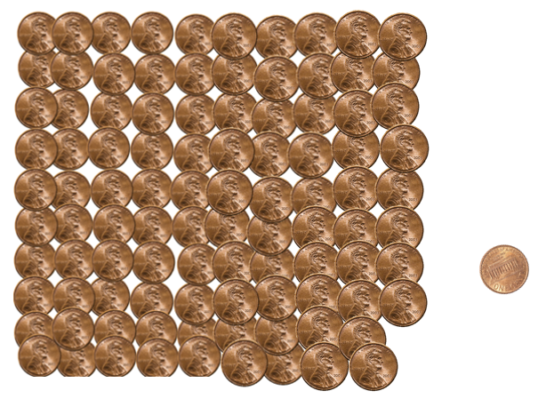
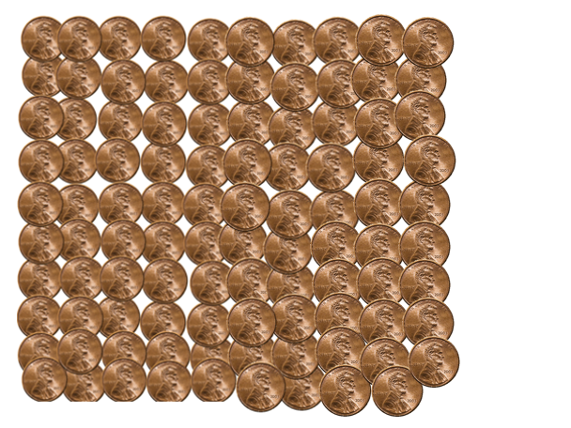
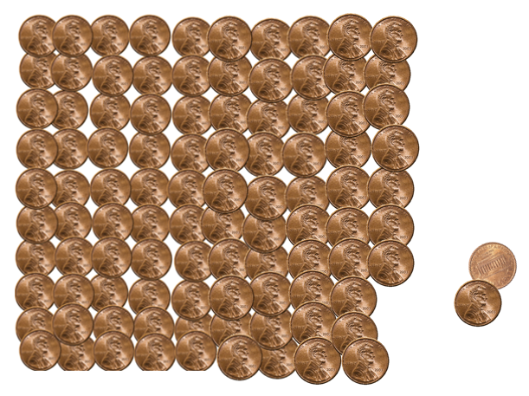
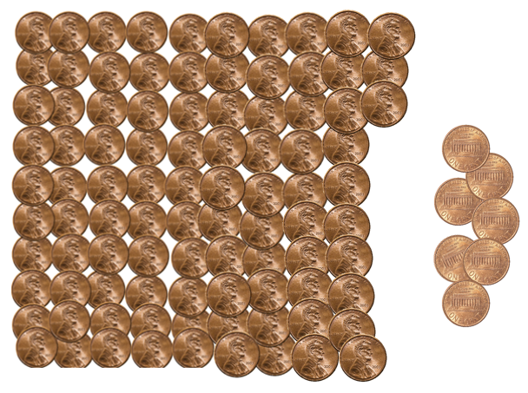
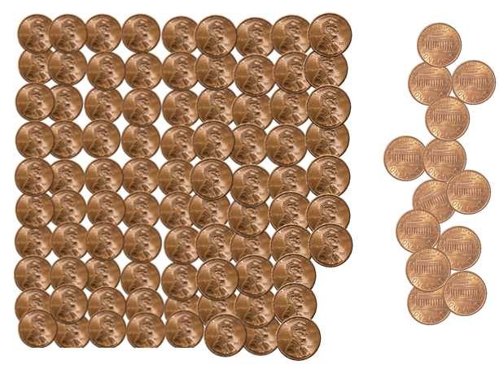
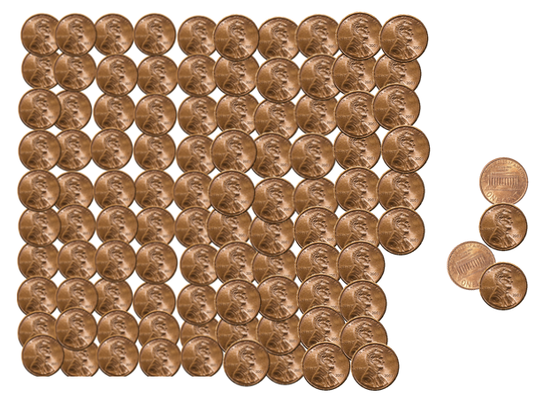
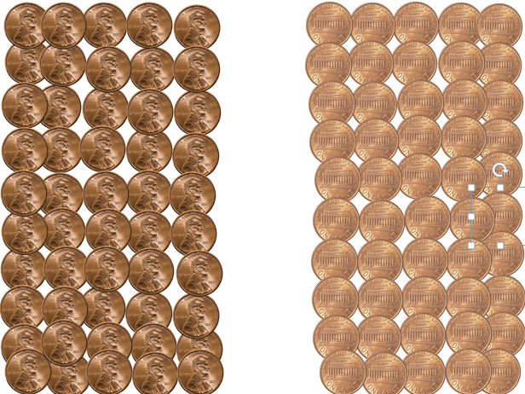
1.
One group (heads) increased steadily while the other group decreased steadily.
Notes:
Think back to the three things we noticed about the penny flipping activity:
Just like one group of pennies increased steadily while the other group decreased steadily, / the parent isotope decreases steadily / while the daughter isotope increases during the process of radiative decay.

Slide 36
2.
Both groups changed steadily because we flipped the pennies every minute.
Unstable isotopes (parent isotopes) decay at known, steady rates called the half-life.
The amount of time it takes for one half of the amount of parent isotope to decay into daughter isotope.
Notes:
Both groups of pennies changed steadily because we purposely flipped the pennies every minute. / We did that to show that unstable parent isotopes decay at known, steady rates. This rate—called the half life / is the amount of time it takes for one half of the amount of parent isotope to decay into daughter isotope.

Slide 37
Radioactive Decay
1
2
3
4
5
6
7
8
9
All
Amount of Parent Isotope
1/2
1/4
1/8
1/16
Time
Notes:
The curve on this graph illustrates how half the parent isotope decays during each half life. / This dot represent the full amount of parent isotope present at the beginning. / After one half life, only half of the original is left. / After the second half life only a quarter is left. / After three half lives only an eighth remains. / With each successive half life, smaller and smaller amounts of the parent isotope remain until it is too small to measure.

Slide 38
3.
Rocks are made of individual crystals
Crystals are made up of several individual elements
Any of these elements that are unstable will eventually decay
Rock
Unstable elements
Stable elements
Crystal
Notes:
Let’s let this gray shape represent a rock. / Rocks are made of individual crystals. / They come in many different shapes, but we will represent them with these green boxes. / Each crystal is usually made up of several individual elements (like silicon, oxygen, and iron). / When the crystal includes any unstable elements (represented by these peach-colored shapes) they will eventually decay into different isotopes. This radioactive decay is a random process.

Slide 39
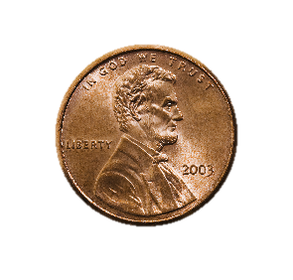
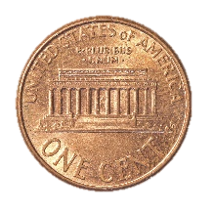
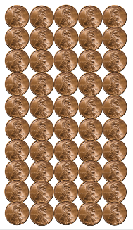
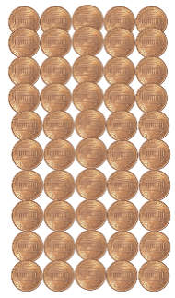
3.
We could not know for sure whether any individual penny would be heads or tails
But we knew that about half would be heads and half would be tails.
We cannot know for sure when any individual atom in a crystal will decay.
We know how long it takes for half the radioactive atoms in the entire rock sample to decay.
Half-Life
Notes:
Just like we could not know for sure whether any individual penny would be heads or tails, we cannot know for sure when any individual atom in a crystal will decay. But just like we know that about half the group would be heads and half tails, we know how long it takes for half the radioactive atoms in the rock to decay.

Slide 40
The Geologic Column
Radiometric Dating
Notes:
To learn how this process helps scientists estimate the age of the rock layers, watch our next video…

Slide 41
Recorded at
Chattanooga Public RadioSM
Classical 90.5 WSMC

Slide 42
Images By
Images may appear on more than one slide. Citation is given on the first slide where each image appears.
[1a] Zion National Park 489588635, kaiborder, Thinkstock, Thinkstock Image Subscription Agreement
[1b] Folded rocks 24286621 Matauw, Getty Images (US), Inc. Subscription Agreement
[1c] Blue Mesa Petrified Forest National Park 479232619, estivillml, Thinkstock, Thinkstock Image Subscription Agreement
[1d] Bryce Canyon National Park, Keith Snyder
[1e] Folded rocks, Raul Esperante, used with permission
[1f] Grand Canyon, taken by Ed Chatelain, used with permission
[2] Rock formation, Thomas Bartlett
[7] US Coins 467034301, swisshippo, Thinkstock, Thinkstock Image Subscription Agreement
[8] One cent coin 178610077, asafta, Thinkstock, Thinkstock Image Subscription Agreement
[11] Stopwatch 164473206, Ola-Ola, Thinkstock, Thinkstock Image Subscription Agreement

Slide 43
Images By
[25a] Drop of Liquid Falling Into Water dv1135004, Digital Vision., Thinkstock, Thinkstock Image Subscription Agreement
[25b] Water molecule 456116921, wir0man, Thinkstock, Thinkstock Image Subscription Agreement
[26] Periodic Table of the Elements 487671929, Nerthuz, Thinkstock, Thinkstock Image Subscription Agreement
[27a] Hydrogen material sign 178500618, nmcandre, Thinkstock, Thinkstock Image Subscription Agreement
[27b] Rubidium material sign 180861989, nmcandre, Thinkstock, Thinkstock Image Subscription Agreement
[27c] Strontium material sign 180862867, nmcandre, Thinkstock, Thinkstock Image Subscription Agreement
[27d] Carbon material sign 178500628, nmcandre, Thinkstock, Thinkstock Image Subscription Agreement
[27e] Nitrogen material sign 178500631, nmcandre, Thinkstock, Thinkstock Image Subscription Agreement
[33a] Potassium material sign 177748596, nmcandre, Thinkstock, Thinkstock Image Subscription Agreement
[33b] Argon material sign 175762772, nmcandre, Thinkstock, Thinkstock Image Subscription Agreement

Slide 44
Special Thanks
Chris Hansen, PhD
Physics Professor, Southern Adventist University
Ken Caviness, PhD
Physics Professor, Southern Adventist University
and the
Foundation for Adventist Education

Slide 45
© Origins Curriculum Resources 2015

Slide 46
© Southern Adventist University 2015

Slide 47
© Seventh-day Adventist North American Division 2015

Slide 48
© General Conference of Seventh-day Adventists 2015

Slide 49
© SCORE Southern Center for Origins Research & Education 2015

