Slide 1
The Geologic Column
Radiometric Dating
Notes:
Radiometric Dating

Slide 2
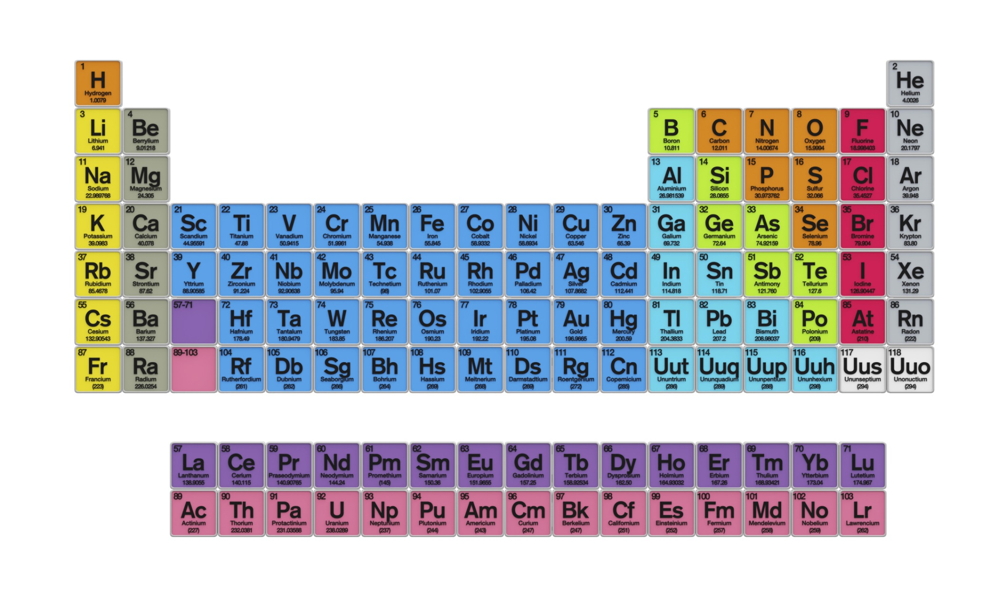
Radioactive Decay
Rubidium
Strontium
37
38
87
87
Notes:
In the last presentation, we learned about the process of radioactive decay, / where an isotope of one element decays into an isotope of another element. After a quick review, we will learn how scientists use this process to estimate the age of rock layers in the geologic column.

Slide 3
Parent
&
Daughter
Rubidium
Strontium
37
38
87
87
Notes:
One example of radioactive decay is the parent isotope rubidium decaying to form the daughter isotope strontium.

Slide 4
Radiometric Dating
This decay process from parent to daughter occurs at a known, steady rate called a half-life
Notes:
This decay process from each parent isotope to daughter isotope occurs at a known, steady rate called the half-life.

Slide 5
Half-Life
Parent Isotope | Daughter Isotope | Half-Life
Uranium-238 | Lead-206 | 4.5 billion years
Rubidium-87 | Strontium-87 | 48.8 billion years
Potassium-40 | Argon-40 | 1.25 billion years
Samarium-147 | Neodymium-143 | 106 billion years
Notes:
This table shows the half-lives of several sets of parent and daughter isotopes. In this example you can see that the half life of rubidium-87 is 48.8 billion years.

Slide 6
Radioactive Decay
1
2
3
4
5
6
7
8
9
All
Amount of Parent Isotope
1/2
1/4
1/8
1/16
Time
Notes:
This curve shows that with each half life, half the remaining parent isotope decays until it is gone.

Slide 7
Parent
1
2
3
4
5
6
7
8
9
All
Amount of Parent Isotope
1/2
1/4
1/8
1/16
Time
Notes:
You can think of the area under the curve as the ever decreasing amount of the parent isotope. But remember it doesn’t just disappear completely. It turns into daughter isotope…

Slide 8
Daughter
1
2
3
4
5
6
7
8
9
All
Amount of Parent Isotope
1/2
1/4
1/8
1/16
Time
Notes:
… which is represented by the increasing area above the curve.

Slide 9
Radioactive Decay
1
2
3
4
5
6
7
8
9
All
Amount of Parent Isotope
1/2
1/4
1/8
1/16
Time
Notes:
So, at any given place on the curve / a certain amount of parent product / and a certain amount of daughter product make up the whole sample.

Slide 10
Radiometric Dating
1
2
3
4
5
6
7
8
9
All
Amount of Parent Isotope
1/2
1/4
1/8
1/16
Time
Notes:
In the process of radiometric dating, scientists measure the amount of parent and daughter isotopes in a rock sample. Then they compare the measurements to see how many half-lives of decay would have produced that ratio of parent and daughter isotopes.

Slide 11
Radiometric Dating
1
2
3
4
5
6
7
8
9
All
Amount of Parent Isotope
1/2
1/4
U-238
1/8
1/16
Time
Notes:
Let’s say that a sample is found to be half uranium 238, which is the parent isotope,

Slide 12
Radiometric Dating
1
2
3
4
5
6
7
8
9
All
Pb-206
Half-life of uranium 238 =
4.5 billion years
Amount of Parent Isotope
1/2
1/4
U-238
1/8
1/16
Time
Notes:
and half lead 206, which is the daughter isotopes. / Half of each would mean that one half-life had passed. / Since the half-life of uranium 238 is 4.5 billion years, the sample’s age should be about 4.5 billion years.

Slide 13
Radiometric Dating
1
2
3
4
5
6
7
8
9
All
Pb-206
Amount of Parent Isotope
1/2
1/4
U-238
1/8
1/16
Time
Notes:
Notice how the bar that represents uranium and the bar that represents lead meet at the location of one of the red dots, which indicates how many half lives have passed.

Slide 14
Radiometric Dating
1
2
3
4
5
6
7
8
9
All
Half-life = 4.5 billion years
Amount of Parent Isotope
1/2
4.5 x 2 = 9 billion years
1/4
1/8
1/16
Time
Notes:
Now let’s say that only one quarter of the sample is parent product (uranium 238 again) / and three quarters of the sample is its daughter product lead 206./ As we slide the bars to the right, watch to see when the place where the two bars meet /lines up with one of the red dots.
Because it lines up with one of the red dots here / that indicates that two half-lives have passed. / Since the half-life of uranium 238 is 4.5 billion years, twice that would be 9 billion years

Slide 15
Radiometric Dating
1
2
3
4
5
6
7
8
9
All
Amount of Parent Isotope
1/2
1/4
1/8
1/16
Time
Notes:
In real life, samples are more likely to be between exact half-lives, which just means that the scientists have to do math that is a little more challenging in order to calculate the age of whatever material they are dating.

Slide 16
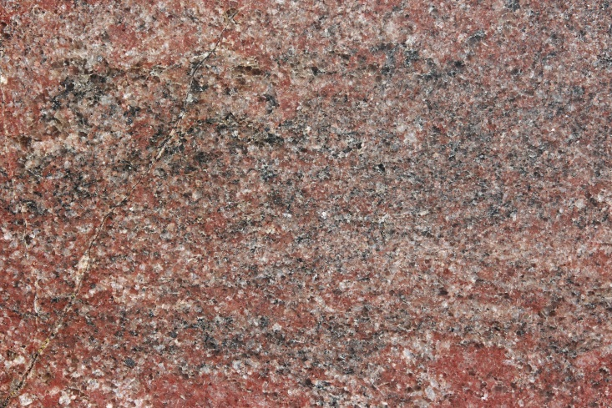
Radiometric Dating
Igneous
From magma or lava
Granite
Notes:
Radiometric dating methods are used mostly to date igneous rocks—like granite, for example—which are formed when magma or lava cools and solidifies.

Slide 17
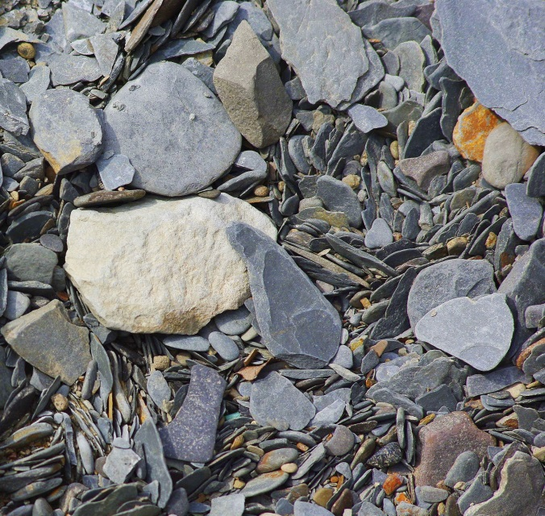
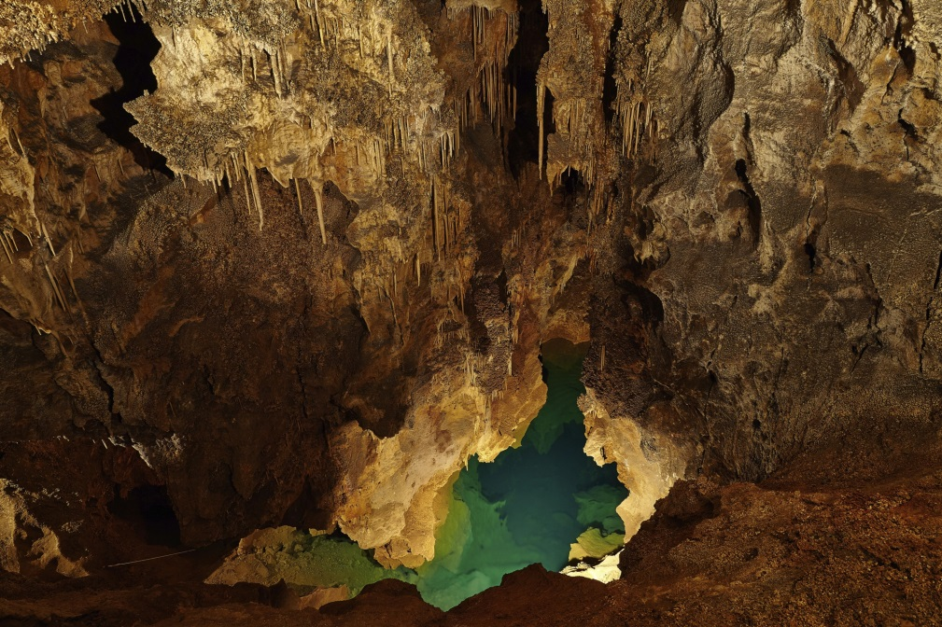
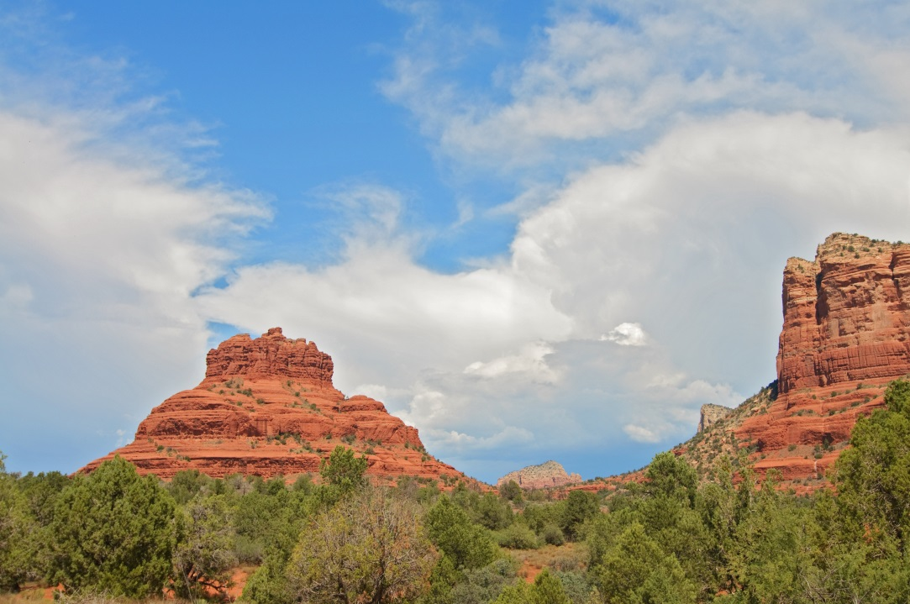
Radiometric Dating
Sedimentary rocks
Notes:
Radiometric dating is not used to date sedimentary rocks / like sandstone, / shale, and / limestone.

Slide 18
Quaternary
Cenozoic
Neogene
Paleogene
Cretaceous
Mesozoic
Jurassic
Triassic
Phanerozoic
Permian
Pennsylvanian
Mississippian
Paleozoic
Devonian
Silurian
Ordovician
Cambrian
Precambrian
Notes:
Since most of the geologic column is made up of sedimentary layers, where do geologists find the igneous material to try to date? / Wherever anything from a volcano has been preserved in the rocks.

Slide 19
Notes:
Sometimes lava flows over an existing sedimentary layer

Slide 20
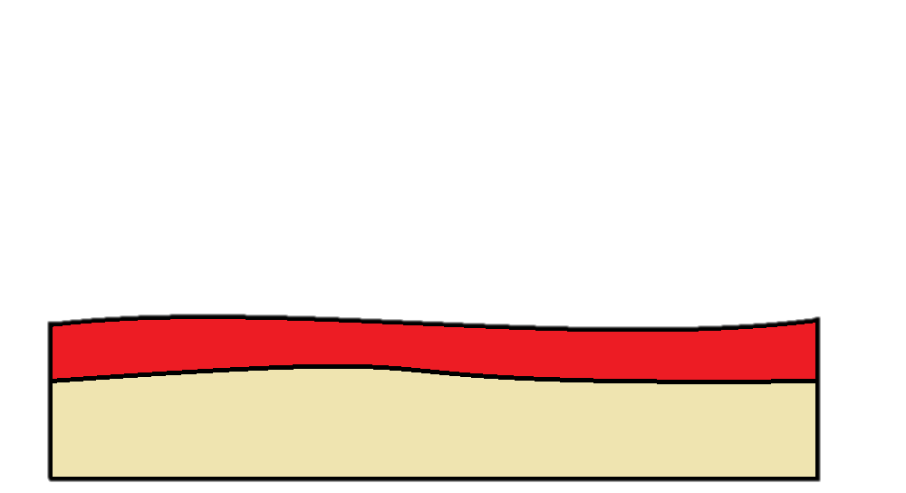

Slide 21
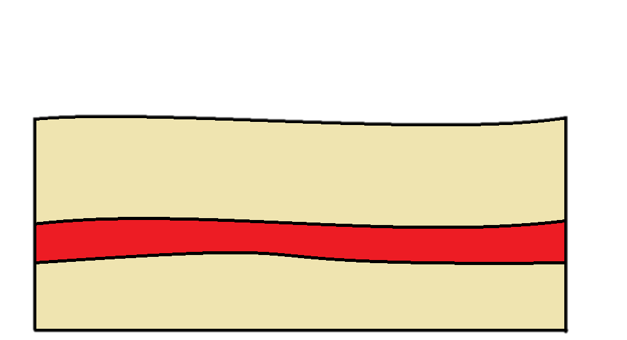
Sediment
Lava
Sediment
Notes:
and then is covered by another sedimentary layer. / While the sedimentary layers cannot be used for radiometric dating, / the lava layer can.

Slide 22
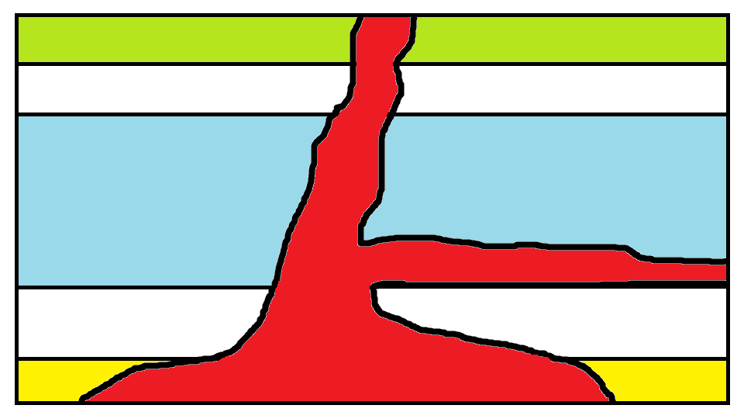
Notes:
Other times, magma that is still underground can push its way into or between sedimentary layers. Preserved layers of volcanic ash can also be used for radiometric dating.

Slide 23
Quaternary
Cenozoic
Neogene
Paleogene
Cretaceous
Mesozoic
Jurassic
Triassic
Phanerozoic
Permian
Pennsylvanian
Mississippian
Paleozoic
Devonian
Silurian
Ordovician
Cambrian
Precambrian
Notes:
These things are widespread enough throughout the geologic column that geologists have been able to calculate the dates suggested by the geologic time scale.

Slide 24
Accuracy?
Notes:
Just how accurate is this process for determining how old rock layers and fossils are?

Slide 25
Geologic Column
Radiometric Dating—Accuracy and Assumptions
Notes:
Find out in the our next presentation

Slide 26
Recorded at
Chattanooga Public RadioSM
Classical 90.5 WSMC

Slide 27
Images By
Images may appear on more than one slide. Citation is given on the first slide where each image appears.
[1a] Zion National Park 489588635, kaiborder, Thinkstock, Thinkstock Image Subscription Agreement
[1b] Folded rocks 24286621 Matauw, Getty Images (US), Inc. Subscription Agreement
[1c] Blue Mesa Petrified Forest National Park 479232619, estivillml, Thinkstock, Thinkstock Image Subscription Agreement
[1d] Bryce Canyon National Park, Keith Snyder
[1e] Folded rocks, Raul Esperante, used with permission
[1f] Grand Canyon, taken by Ed Chatelain, used with permission
[2a] Periodic Table of the Elements 487671929, Nerthuz, Thinkstock, Thinkstock Image Subscription Agreement
[2b] Rubidium material sign 180861989, nmcandre, Thinkstock, Thinkstock Image Subscription Agreement
[2c] Strontium material sign 180862867, nmcandre, Thinkstock, Thinkstock Image Subscription Agreement

Slide 28
Images By
[16] Granite background 486750575, Abykov, Thinkstock, Thinkstock Image Subscription Agreement
[17a] Limestone cave 477215889, Gudella, Thinkstock, Thinkstock Image Subscription Agreement
[17b] Shale 486884397, KiddFoto, Thinkstock, Thinkstock Image Subscription Agreement
[17c] Sedona, Red Sandstone, AZ, USA 101819969, Noel Moore, Thinkstock, Thinkstock Image Subscription Agreement
[18] Erupt 175129634, Colematt, Thinkstock, Thinkstock Image Subscription Agreement
[19-21] Layers, Thomas Bartlett
[22] Magma illustration, Thomas Bartlett

Slide 29
Special Thanks
Chris Hansen, PhD
Physics Professor, Southern Adventist University
Ken Caviness, PhD
Physics Professor, Southern Adventist University
Foundation for Adventist Education

Slide 30
© Origins Curriculum Resources 2015

Slide 31
© Southern Adventist University 2015

Slide 32
© Seventh-day Adventist North American Division 2015

Slide 33
© General Conference of Seventh-day Adventists 2015

Slide 34
© SCORE Southern Center for Origins Research & Education 2015

