Slide 1
Irreducible Complexity
Notes:
What is Irreducible Complexity?

Slide 2
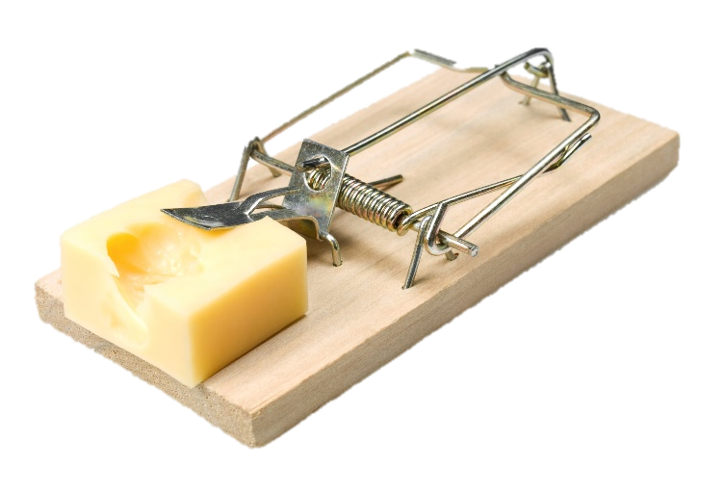
Something is irreducibly complex if:
It has several parts….
Hammer
Bar
Spring
Wooden base
Notes:
Something is irreducibly complex / if it has several parts…

Slide 3
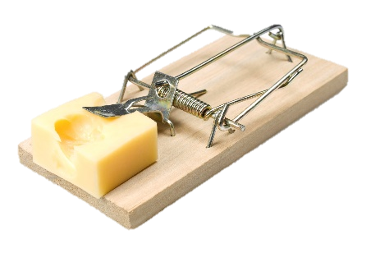
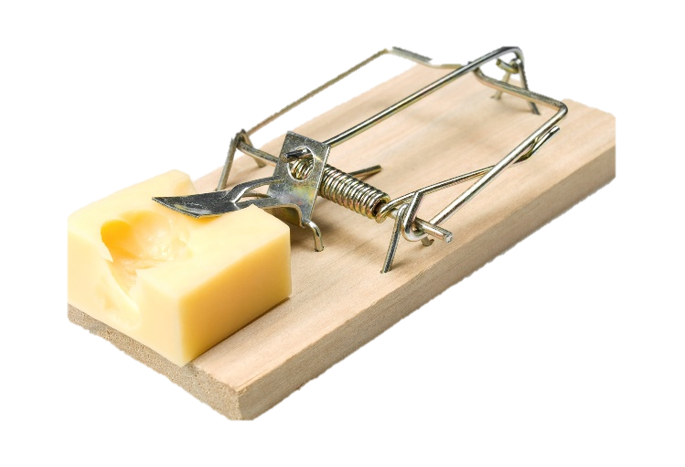
To contribute to the basic function
That work together….
Hammer
+
+
+
= Mouse Trap
Bar
Wooden base
Spring
Notes:
that work together / to contribute to the basic function of the object.

Slide 4

If one of the parts is removed…
Wooden base
Hammer
Bar
Spring
Notes:
If any one of the parts is removed,

Slide 5
The system can’t function anymore
Hammer
Bar
Spring
Notes:
the system can’t function any more

Slide 6
Irreducibly Complex?
To tell if something is irreducibly complex we have to:
- Specify the function of the system
- Identify all the system components
- Ask if all these parts are necessary in order for it to
function
Are these parts necessary?
What is this thing supposed to do ?
Base, hammer, spring, catch, bar….
Notes:
To tell if something is irreducibly complex, / we have to specify the function of the system. In other words, we ask What is this thing supposed to do? Then we Identify all the system parts, / and ask if all these parts are necessary in order for it to function

Slide 7

Parts of a Mouse Trap
A flat wooden platform for a base
A metal hammer
A spring
A catch to release when pressure is applied
Metal bar connected to the catch that holds the hammer back when the trap is set.
Notes:
Take a mouse trap for example: / It has a flat wooden platform, / a metal hammer, / a spring, / a catch to release when pressure is applied, / and a metal bar that holds the hammer back when the trap is set.

Slide 8
Which parts are necessary?
Notes:
Which of these parts are necessary for the mouse trap to be effective?

Slide 9
Which parts are necessary?
Without the wooden base, there would be nothing to attach the other parts to.
Notes:
Without the wooden base, / there would be nothing to attach the other parts to.

Slide 10
Which parts are necessary?
Without the spring, other parts would be loose and wiggle about.
Notes:
Without the spring, / the other parts would be loose and wiggle about.

Slide 11
Which parts are necessary?
Without the hammer, we couldn’t catch the mouse.
Notes:
Without the hammer, we wouldn’t be able to catch the mouse. / (wait for bites)

Slide 12

Which parts are necessary?
Without the catch or metal bar, the spring would make the hammer snap as soon as you let go of it.
Notes:
Without the catch or metal bar, / the spring would make the hammer snap as soon as you let go of it.

Slide 13

When all the parts are necessary for the mouse trap to function, it is irreducibly complex
Notes:
When all the parts are necessary for the mouse trap to function, we say it is irreducibly complex. That means it could not be any less complex and still be able to function.

Slide 14

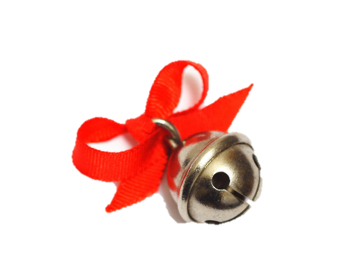
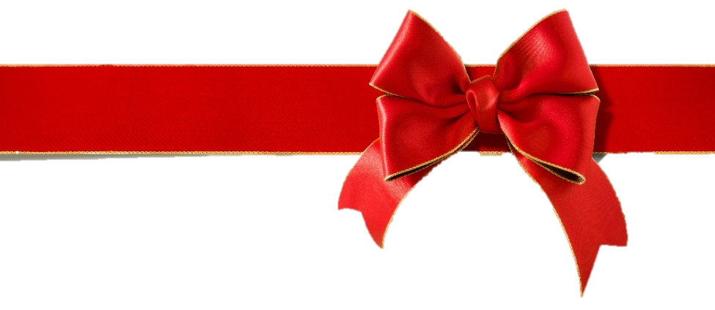
A
Notes:
But what if there was something on the mouse trap that didn’t need to be there for it to function? / Like the red “A” painted on the wooden base, / or maybe a ribbon for decoration, / or a little bell that would ring when a mouse is caught? Since the mouse trap could still function without those things, they would not be considered part of the irreducibly complex system.

Slide 15


Irreducible Complexity
Notes:
The mouse trap is a simple example used by Michael Behe in his book Darwin’s Black Box to explain the irreducible complexity that we see in much more complex systems in nature.

Slide 16
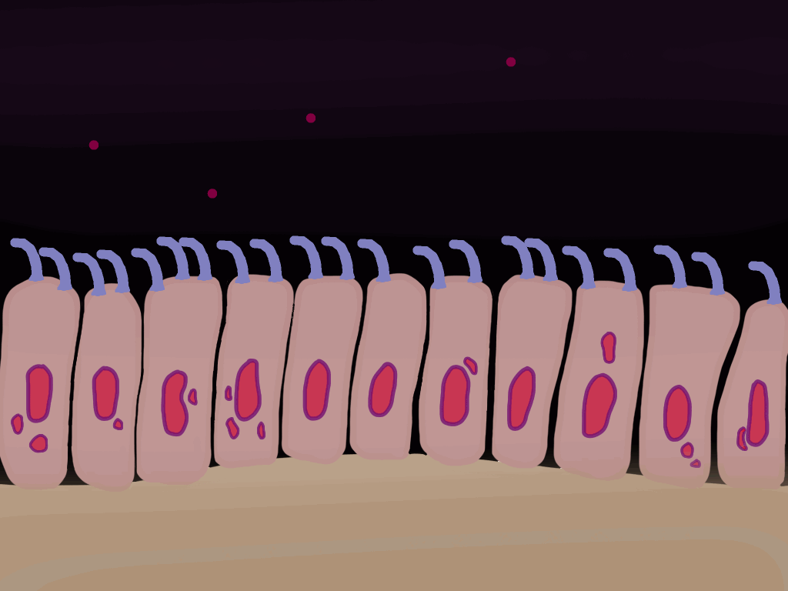

Flagella
Cilia
Notes:
Our next presentation describes two irreducibly complex molecular machines at work in our bodies that are WAY more complex than a mouse trap.

Slide 17
Recorded at
Chattanooga Public RadioSM
Classical 90.5 WSMC

Slide 18
Design and Animation
Joaquin Hernandez

Slide 19
Images By
Images may appear on more than one slide. Citation is given on the first slide where each image appears.
[2] Mousetrap with cheese 11692882, xxmmxx ,Getty Images (US), Inc. Subscription
[6] Cartoon boy, PowerPoint clip art
[14a] Red bow 000045850528 waiwai08, Getty Images (US), Inc. Subscription
[14b] Bell 4878946, rionm, Getty Images (US), Inc. Subscription
[15a] Photo of book, Carol Raney
[16a] Cilia animation, Joaquin Hernandez
[16b] Bacteria animation K003/5544, ANDRZEJ WOJCICKI/SCIENC PHOTO LIBRARY, https://www.sciencephoto.com/media/483595/view,

Slide 20
Special Thanks
Foundation for Adventist Education

Slide 21

© Origins Curriculum Resources 2015

Slide 22

© Southern Adventist University 2015

Slide 23

© Seventh-day Adventist North American Division 2015

Slide 24

© General Conference of Seventh-day Adventists 2015

Slide 25

© SCORE Southern Center for Origins Research & Education 2015

