Slide 1
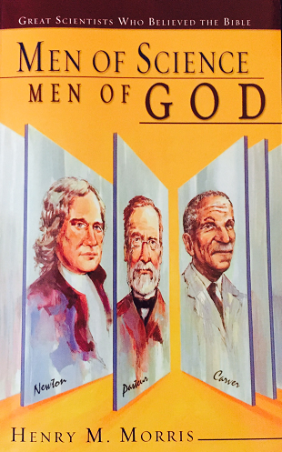
Men of Science Men of God Great Scientists Who Believed the Bible
How to Use
In Your Classroom
Notes:
This presentation will provide a brief summary of the book Men of Science, Men of God and suggest ways it can be used in the elementary or middle school classroom.

Slide 2
Introduction
Opinion
No place in the scientific mind for intangibles like faith in:
In a supernatural Creator
Divinely inspired book (Bible)
No scientist can be a creationist
Opinion
Notes:
To combat the wide-spread but incorrect opinion that there is no place in the scientific mind for intangibles like faith in a supernatural Creator or a divinely inspired book and the opinion that no scientist can be a creationist…

Slide 3
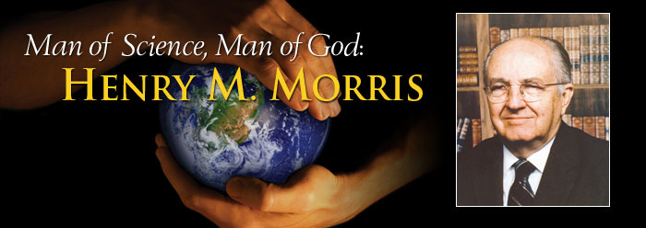
Published by Master Books, A Division of New Leaf Publishing Group
ISBN-13: 978-0-89051-080-3
ISBN-10: 0-89051-080-6
Notes:
Dr. Henry M. Morris studied the religious beliefs of many of the world’s greatest scientists and wrote this book to share his findings.
(banner picture of Dr. Morris from icr.org)

Slide 4
Introduction
Opinion
No place in the scientific mind for intangibles like faith in:
In a supernatural Creator
Divinely inspired book (Bible)
No scientist can be a creationist
Opinion
Notes:
In contrast with these opinions…

Slide 5
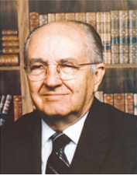
Absolutely no reason why a scientist should not also be a man of religious faith
Many scientists of the past and present have been and are Bible-believing Christians
Notes:
Dr. Morris believes there is absolutely no reason why a scientist should not also be a man of religious faith / and demonstrates in this book that many scientists of the past and present have been and are Bible-believing Christians.

Slide 6
101 Brief
Biographies
Scientific contributions
Christian testimony
Exploratory Survey
Notes:
The book’s introduction describes it as an exploratory survey and hopes it will inspire others to investigate the religious belief of scientists more thoroughly. The book includes 101 brief biographies that describe each scientist’s professional contributions and Christian testimony.

Slide 7
Criteria for Inclusion
Scientist of real achievement and significance in the development of science
Professing Christian who believed in the divine authority of the Bible
Believed that the universe, life, and man were directly and specially created by the transcendent God of the Bible
Author might disagree with interpretations of scripture
No attempt is made to evaluate their personal conduct
Notes:
Each scientist included in this book was a scientist of read achievement and significance in the development of science, was a professing Christian who believed in the divine authority of the bible, and believed that the universe, life, and man were directly and specially created by the transcendent God of the Bible. / Although the author might disagree with some of their interpretations of the Bible, he emphasizes the fact that these scientists believed in the divine authority of the Bible. No attempt is made to evaluate their personal conduct as professing Christians. A few were included who were not Christians but were great scientists who were leaders in the scientific fight against evolution
(to see the red type correctly, put in presentation mode)

Slide 8
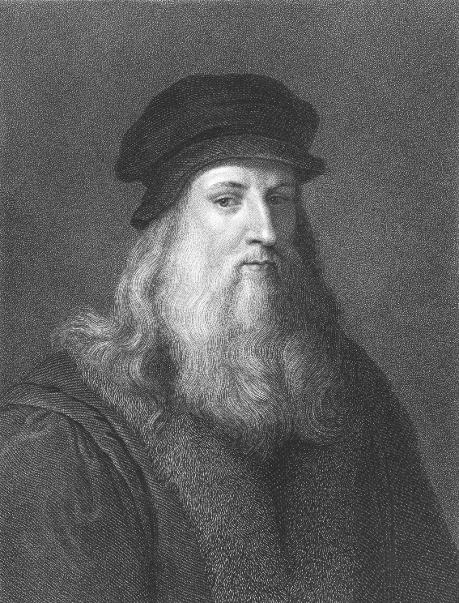
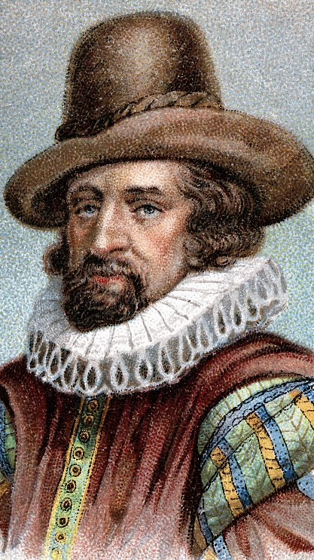
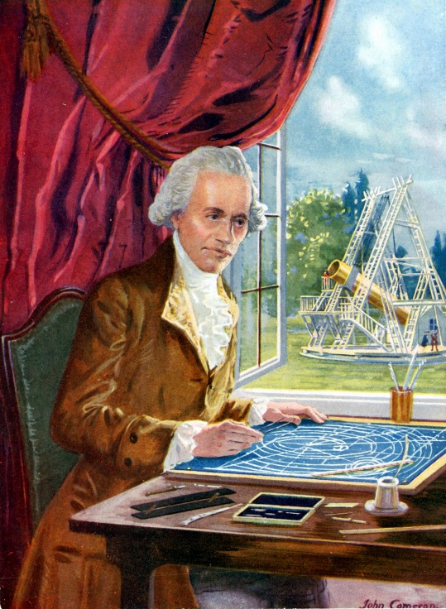
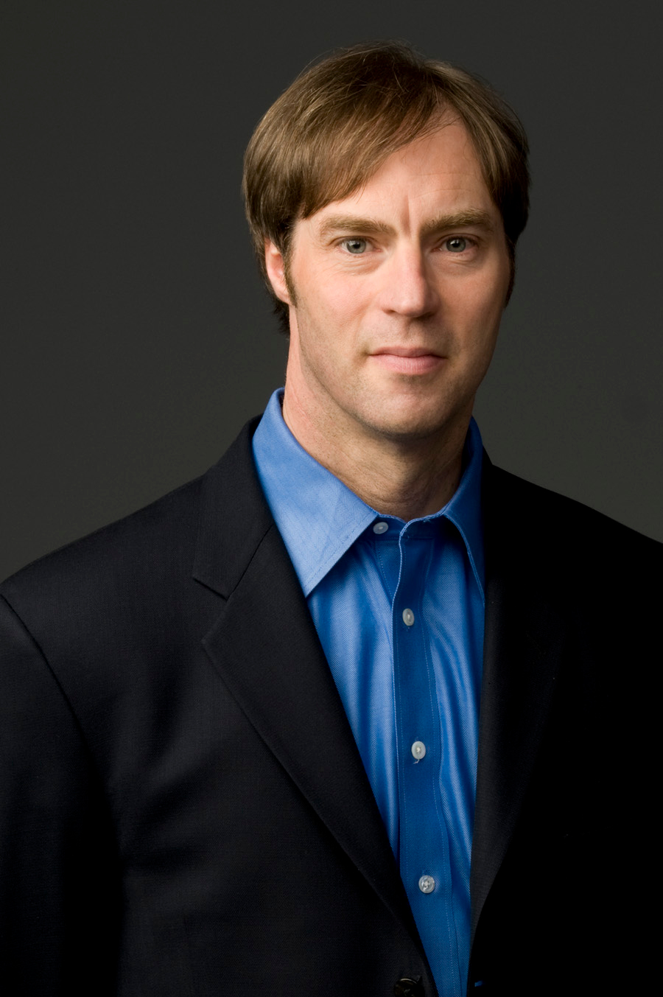
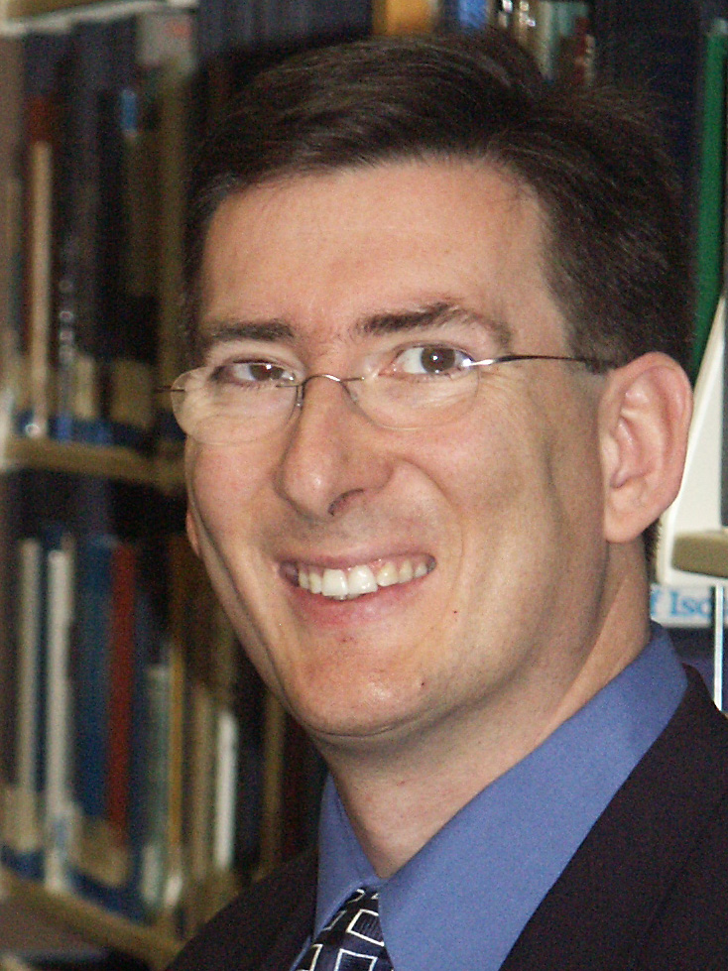
Chapter 1—Thousands of believing scientists
In spite of the notion that there is a fundamental conflict between Biblical Christianity and science, thousands of scientists of the past and present have been and are Bible-believing Christians
Notes:
In the first chapter, Dr. Morris points out that in spite of the notion that there is a fundamental conflict between Biblical Christianity and science, thousands of scientists of the past and present have been and are Bible-believing Christians.
(not naming them in presentation—the names below are just for my records)
Left to right: Leonardo DaVinci, Francis Bacon, William Herschel, (those three from thinkstock), Stephen Meyer, and Tim Standish (from internet)

Slide 9


Christian
Roots of
Science
Notes:
He also points out that modern science had its origins in a culture at least nominally committed to a belief in the Bible and at a time in history marked by a great return to Biblical faith.

Slide 10
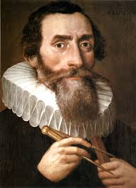
Science & Technology
God’s Mandate
God created man in His own image…God blessed them; and God said to them, “Be fruitful and multiply, and fill the earth, and subdue it; and rule…over living thing that moves on the earth.” Genesis 1:27-28
“thinking God’s thoughts after Him”
Notes:
Many early scientists believed that the development of science and technology was specifically commissioned by God in His mandate to Adam and Eve.
Kepler and others have maintained that studying the world and its processes is merely “thinking God’s thoughts after Him.”
(Kepler picture from internet, licensed for reuse)

Slide 11
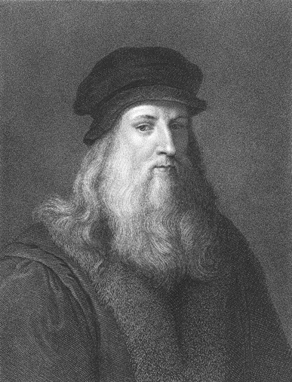
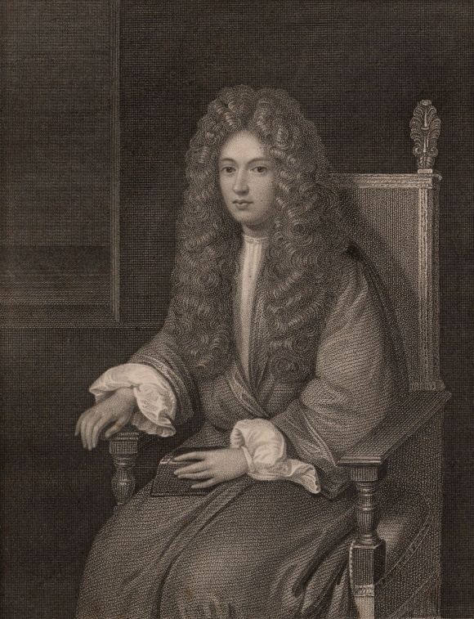
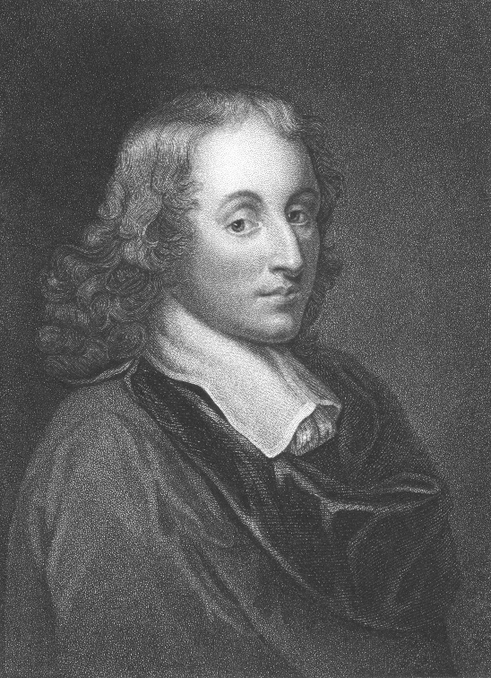

Chapter 3—Founders of Modern Science
Leonardo da Vinci
Scientist & Inventor
Robert Boyle
Founder of
Modern Chemistry
Johann Kepler
Founder of
Physical Astronomy
Blaise Pascal
Mathematician
Francis Bacon
Formulated the
Scientific Method
Notes:
One of the most compelling chapters in Men of Science Men of God is chapter 3, which describes the belief of many founders of science. Included are Leonardo da Vinci—the founder of modern science; / Johann Kepler—the founder of physical astronomy; / Francis Bacon—who formulated the “scientific method;” / Blaise Pascal—the well-known mathematician; /Robert Boyle—the founder of modern chemistry and numerous others from the fields of Natural history, geology, statistics, economics, botany, medicine

Slide 12
The Age of Newton
Just before Darwin
Just after Darwin
The Modern Period
The Revival of
Creationism
Ch 4
Ch 5
Ch 6
Ch 7
Ch 8
Notes:
Successive chapters list and describe believing scientists from these historical periods.

Slide 13
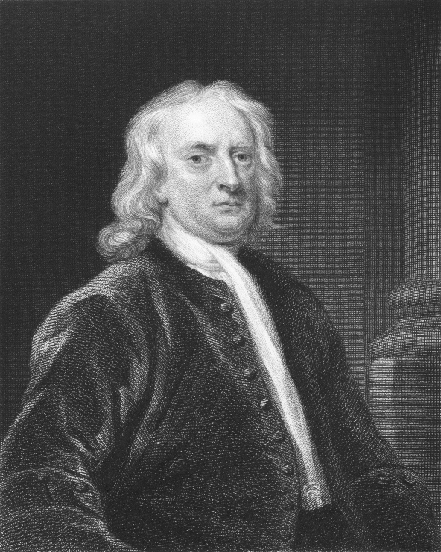
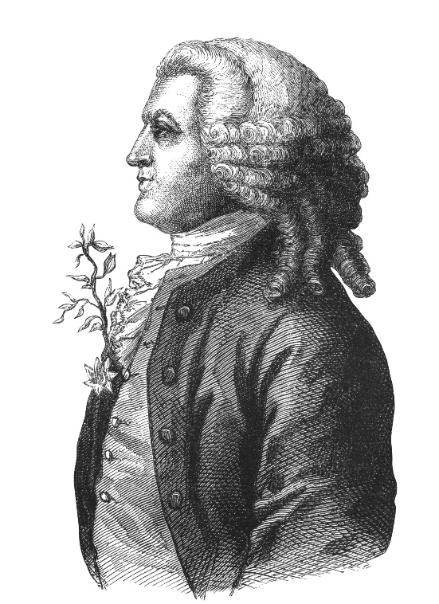
The Age of Newton
Just before Darwin
Just after Darwin
The Modern Period
The Revival of
Creationism
Ecology
Geology
Astronomy
Paleontology
Isaac Newton
Law of gravitation
three laws of motion
calculus
Carl Linnaeus
Taxonomy
Math/Calculus
Notes:
Chapter 4 includes Sir Isaac Newton, one of the greatest scientists who ever lived, Carl Linnaeus, the father of biological taxonomy, as well as leaders in the fields of ecology, geology, astronomy, paleontology, math, and calculus.

Slide 14

William Herschel
“The undevout astronomer must be mad.”
Notes:
An outstanding astronomer from this period—William Herschel—is quoted as saying, “The undevout astronomer must be mad.”

Slide 15
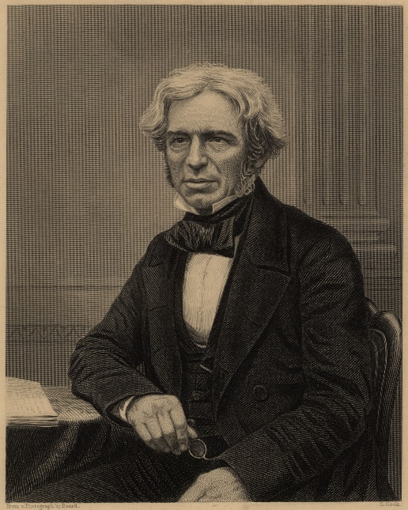
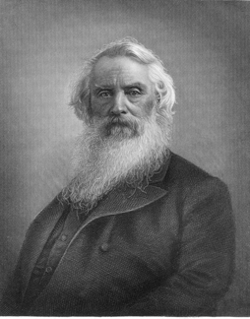
The Age of Newton
Just before Darwin
Just after Darwin
The Modern Period
The Revival of
Creationism
Humphrey Davy
Chemist
Joseph Henry
Inventor
Electromagnetic Motor
& Galvanometer
John Dalton
Father of
Modern Atomic Theory
Georges Cuvier
Comparative Anatomy
Michael Faraday
Physicist
Electricity, Magnetism,
Invented Generator
Samuel Morse
Inventor
Telegraph—”What hath God wrought!”
Notes:
In spite of increasing religious skepticism during the period just before Darwin, faith in God and the Bible were still strong. Believing scientists of this time included physicist Michael Faraday and inventor Samuel Morse, / as well as Joseph Henry, John Dalton, Georges Cuvier, and Humphrey Davy.

Slide 16
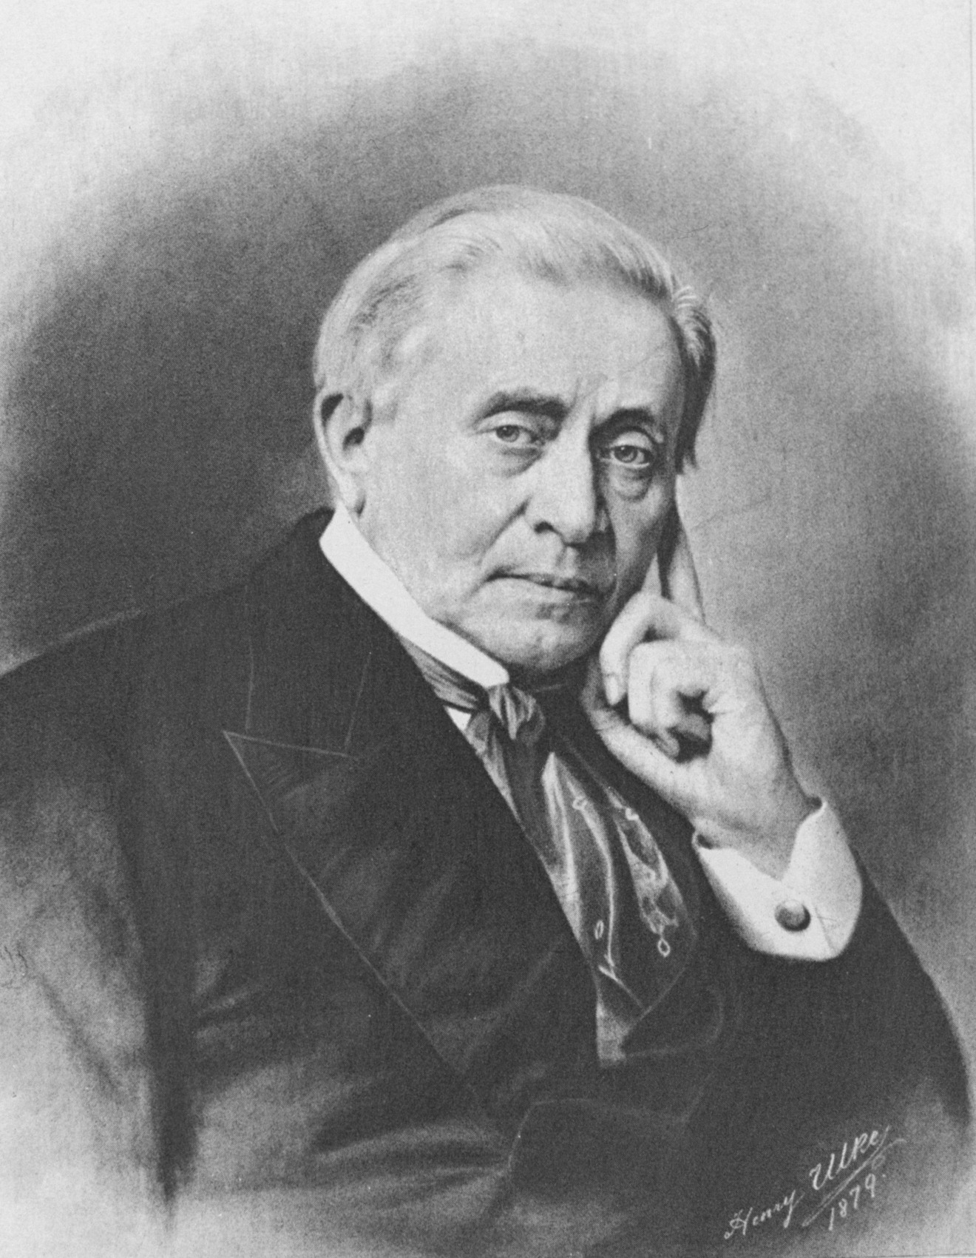
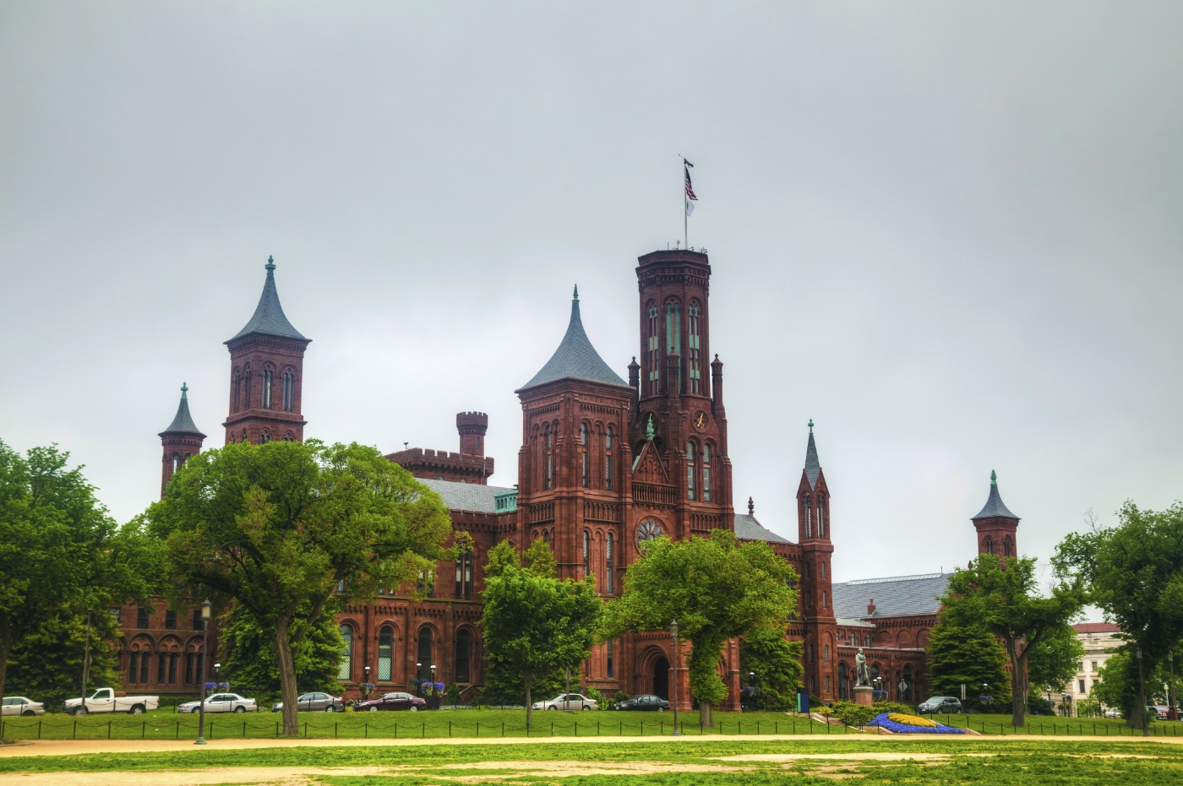
Joseph Henry
First Secretary and Director of the Smithsonian Institution
“in all his experimentation making it a regular practice to stop, to worship God, and then to pray for divine guidance at every important juncture of the experiment” (page 49)
Notes:
Joseph Henry was a great physicist from this time period who was also the first secretary and director of the Smithsonian Institute. In all his experimentation he was known to stop, worship God, and then pray for divine guidance at important places in his experiments.
(Portrait of Joseph Henry from internet—licensed for reuse)

Slide 17
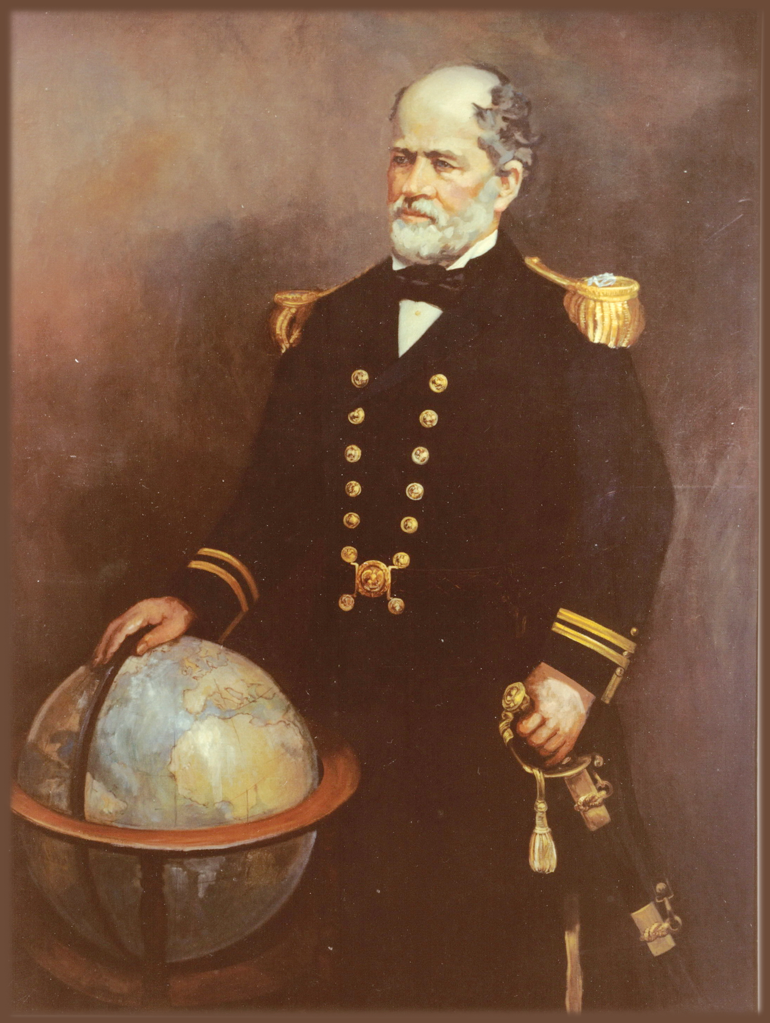
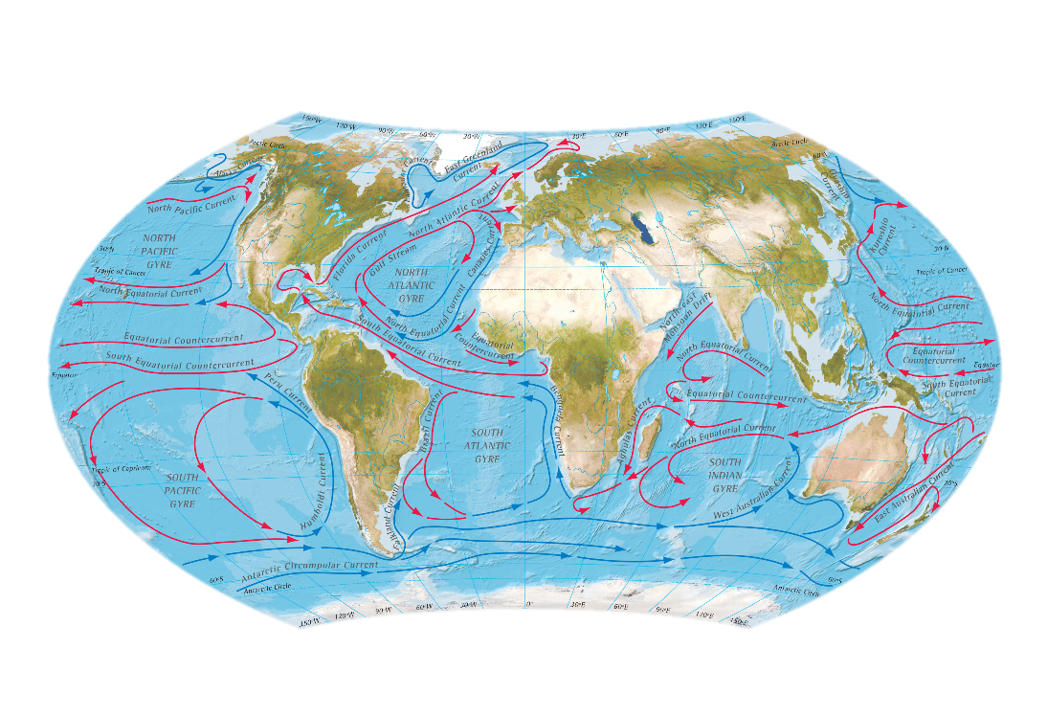
Discoveries directly related to the Bible
Matthew Maury
Pathfinder of the Seas
“Paths of the sea” (Ps 8:8)
Notes:
Two scientists in chapter 5 made discoveries that were directly related to their belief in the Bible. One was Matthew Maury, who was known as the Pathfinder of the Seas. He “believed that if God said there were paths in the seas, it should be possible to find them” (page 49) spent the majority of his career charting ocean currents.

Slide 18
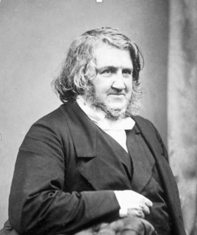
Discoveries directly related to the Bible
James Simpson
Chloroform
Adam’s “deep sleep”
Genesis 2:21
Notes:
The other was James Simpson, who discovered chloroform and laid the foundation for modern anesthesiology. It is said that the motivation for his research came from Adam’s “deep sleep” in Genesis.

Slide 19
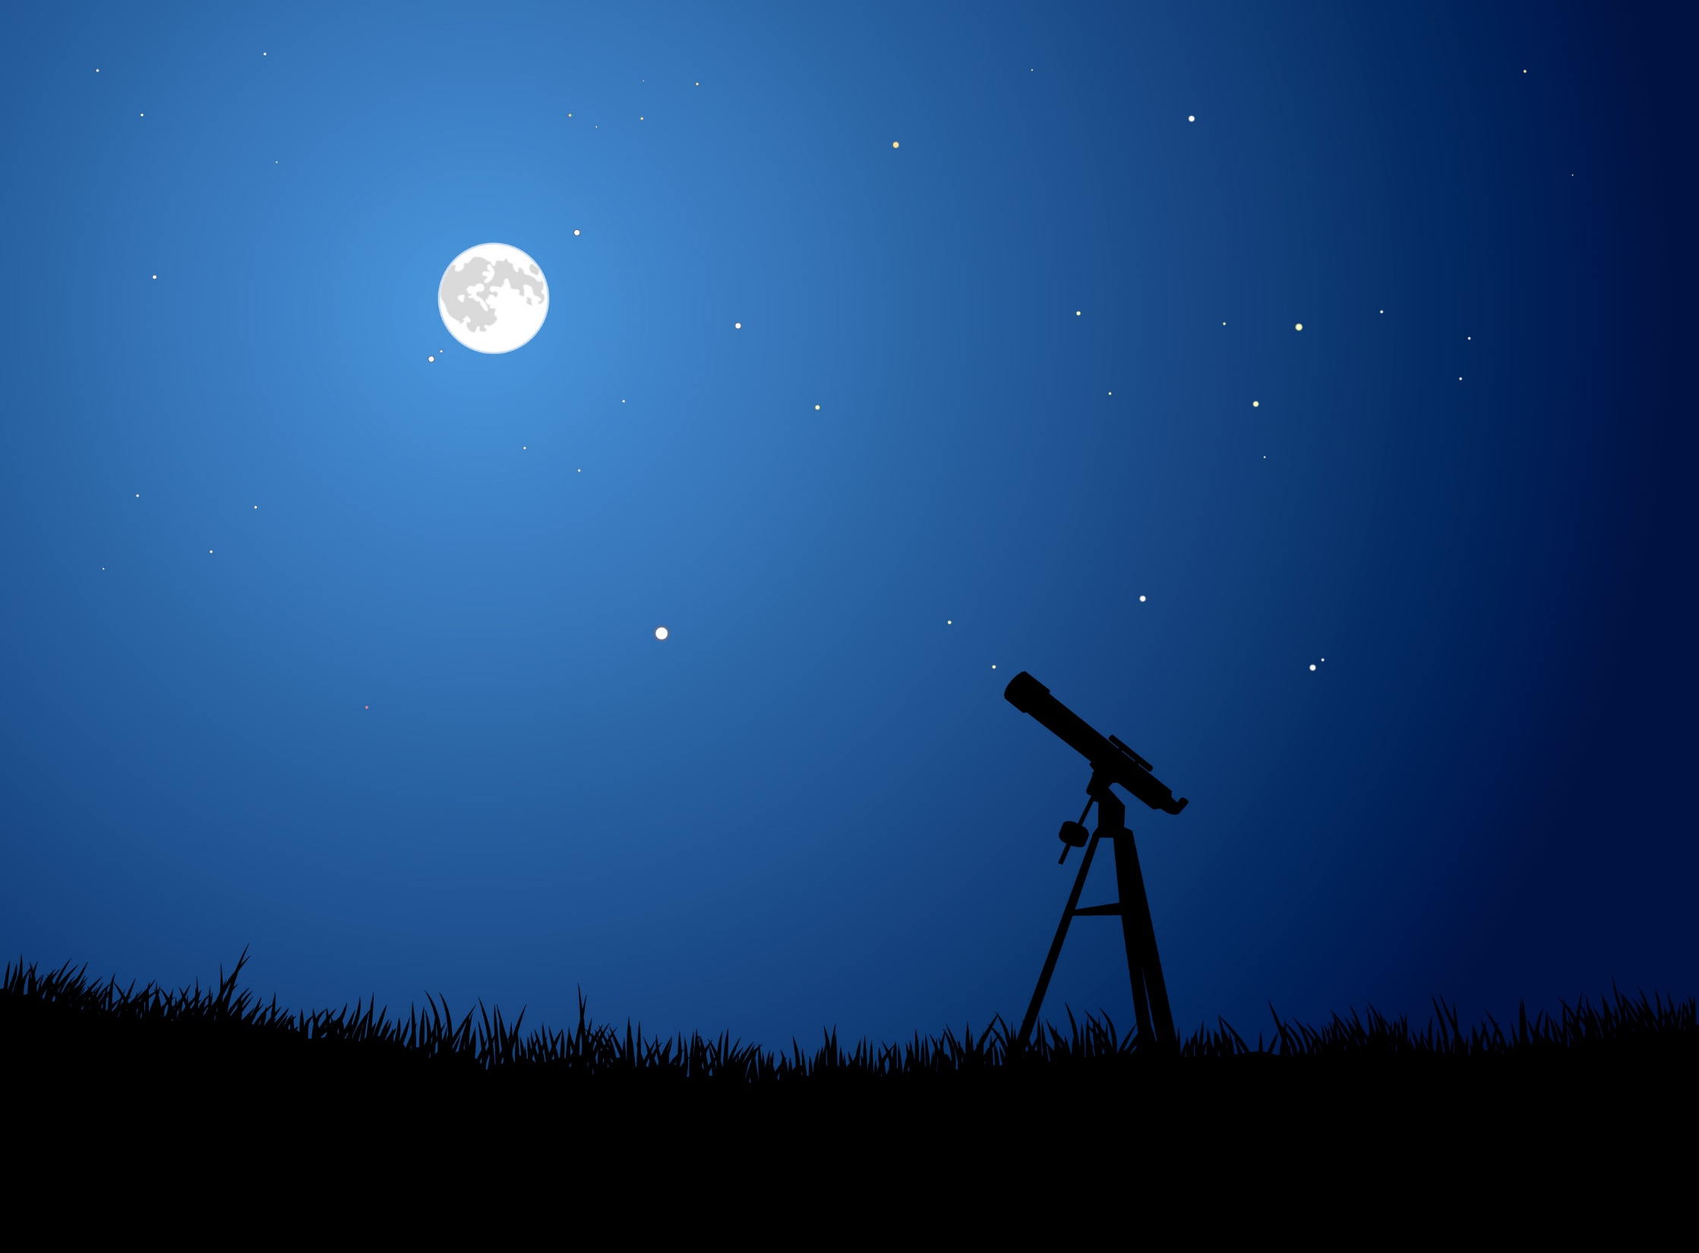
John Herschel
(son of William)
“All human discoveries seem to be made only for the purpose of confirming more and more strongly the truths come from on high and contained in the sacred writings.” (page 42)
Notes:
During this time period, John Herschel—another outstanding astronomer like his father William—said that “All human discoveries seem to be made only for the purpose of confirming more and more strongly the truths come from on high and contained in the sacred writings.”

Slide 20
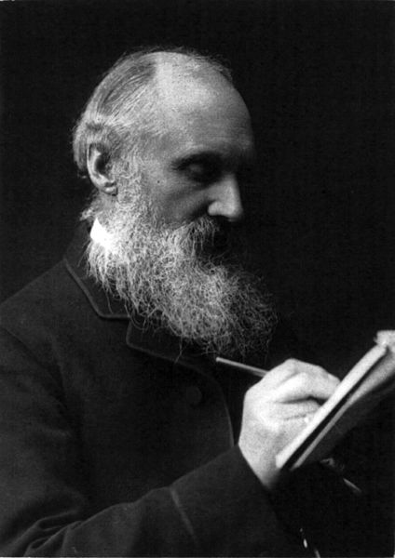
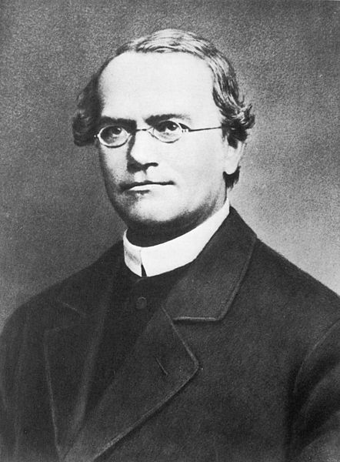
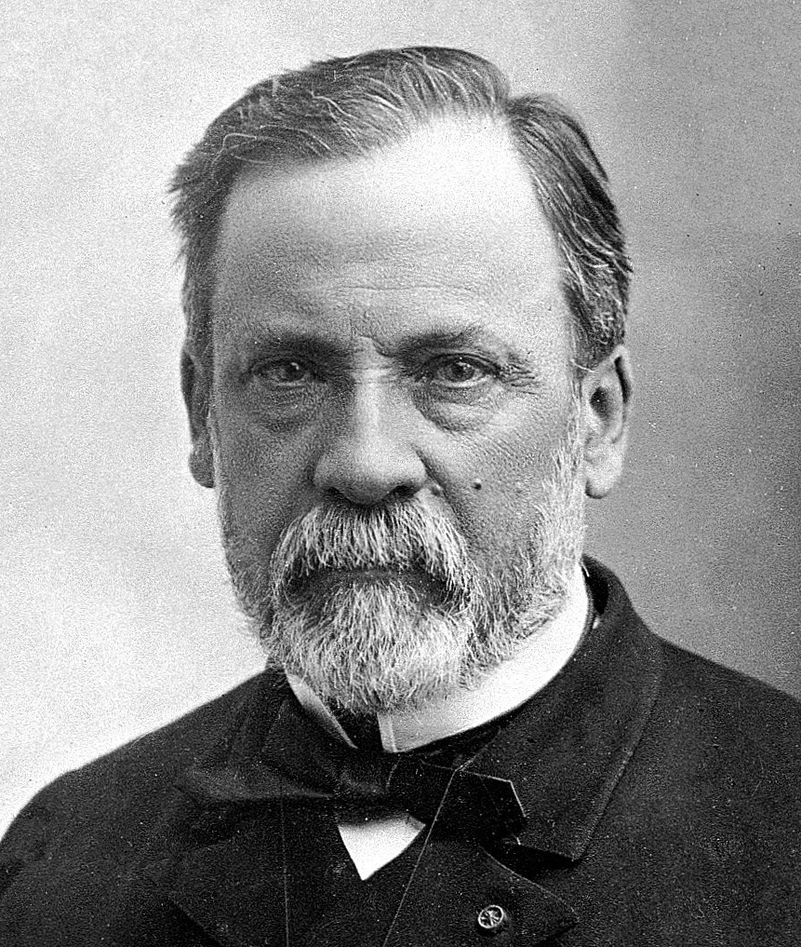
The Age of Newton
Just before Darwin
Just after Darwin
The Modern Period
The Revival of
Creationism
Kelvin
Mendel
Pasteur
Physics
Genetics
Germ Theory
Notes:
(Pasteur, Kelvin, and Mendel pictures from internet, licensed for reuse)
Even in the difficult years after the publication of Darwin’s book, there were still many outstanding scientists who believed the Bible, including Lord Kelvin,--a physical scientist who worked on thermodynamics, Gregor Mendel—the father of genetics, and Louis Pasteur—whose germ theory replaced the idea of spontaneous generation. And many others who stood in opposition to the theory of evolution.

Slide 21

1864
Declaration
of Students
of the Natural and Physical Sciences
717
Scientists
Notes:
Included in chapter 6 is a description of the Declaration of Students of the Natural and Physical Sciences that was signed in 1864 by
717 scientists.

Slide 22

1864
Affirming
Scientific Integrity
of Scripture
717
Scientists
Notes:
In response to Drawinism, these scientists affirmed their confidence in the scientific integrity of Scripture.

Slide 23
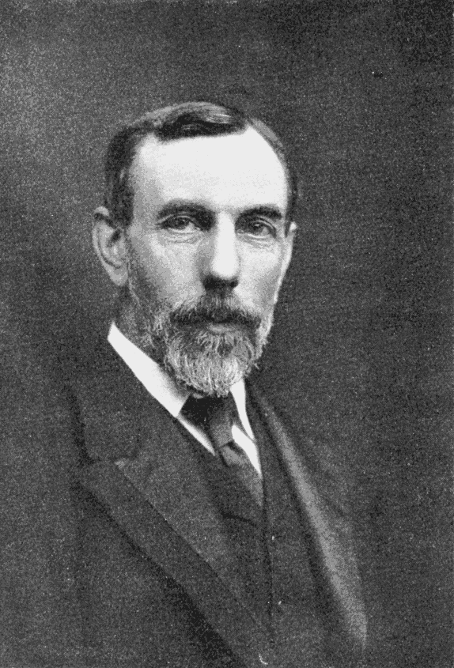
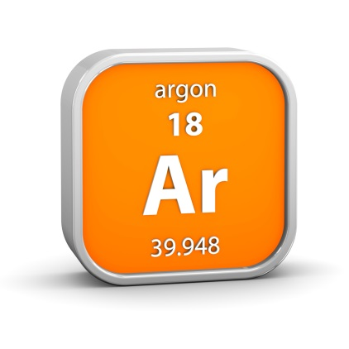
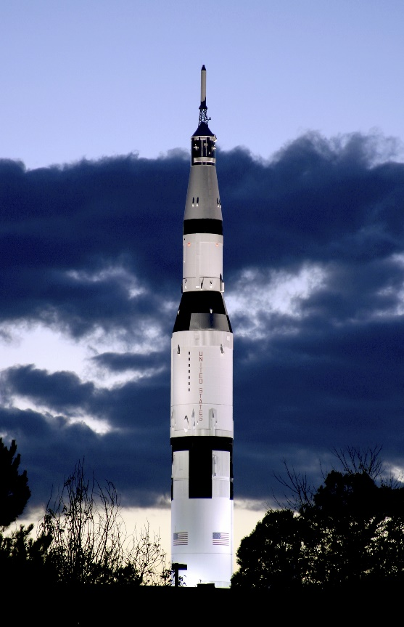
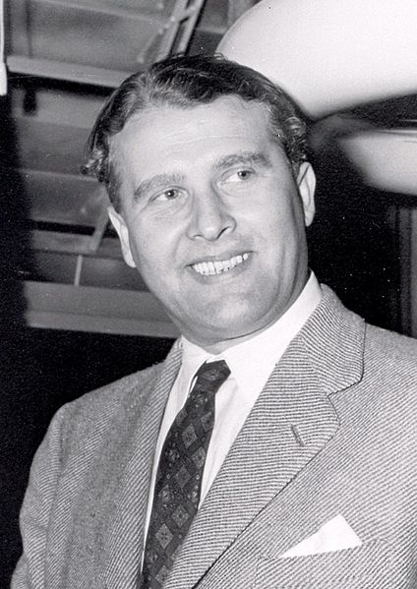
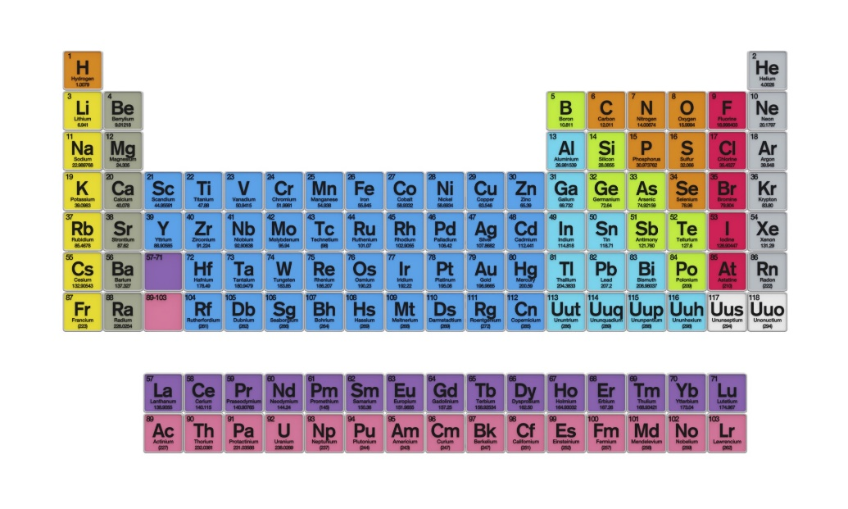
The Age of Newton
Just before Darwin
Just after Darwin
The Modern Period
The Revival of
Creationism
Wernher von Braun
William Ramsay
Notes:
During the modern period, as Darwinism was becoming entrenched, there were noticeably fewer scientists of faith. / These included William Ramsay—who studied radioactive decay and was the co-discoverer of argon and other inert gases / and Wernher von Braun—a German rocket scientist during WWII who migrated to the United States after the war and became the director of NASA.

Slide 24
Chapter 8—The Revival of Creationism
Thousands of Bible-believing scientists
Proposing creation as a serious scientific alternative to evolution
Dozens of creationist organizations
Notes:
Chapter 8 doesn’t attempt to include biographies of scientists who are still living but describes a dramatic revival of creationism. In addition to dozens of creationist organizations, there are now thousands of Bible-believing scientists today who are proposing creation as a serious scientific alternative to evolution.

Slide 25
Appendix
Index
Over 40 of the 101 scientists listed with their discipline, discovery, invention, or contribution
All in alphabetical order with page numbers
Notes:
The appendix contains over 40 of the 101 scientists from the book listed in chronological order along with their discipline, discovery, invention, or contribution. The index contains all scientists from the book listed in alphabetical order with page numbers.

Slide 26

Beginning of Year
“Kick Off”
Throughout
The Year
Science Fair
Notes:
There are lots of ways that the compatibility of science and faith can be emphasized all year long. The next few slides contain suggestions for a “kick off” project, ideas to use throughout the year, and ways to incorporate this topic into a year-end science fair. You may choose to do them all or select individual activities from the lists. Perhaps starting with a few and building from year to year will be the most practical option.

Slide 27

Beginning of Year
“Kick Off”
By Design textbooks
Inquiry Handbook/Science Skills section at beginning of each book
Grade 6 especially helpful
Notes:
If you are using the By Design science textbooks from Kendall Hunt Religious Publishing, a beginning of the year “kick off” would fit nicely with the Inquiry Handbook/science skills section at the beginning of each book. The content of the 6th grade book would fit especially well.

Slide 28

Beginning of Year
“Kick Off”
By Design textbooks
Inquiry Handbook/Science Skills section at beginning of each book
Grade 6 especially helpful
Set of four videos
Especially video 3—Leonard Brand
Notes:
In addition, you may wish to show a set of four short Origins Curriculum Resources videos that help to explain the scientific process. Video 3 includes an interview with a modern scientist whose belief in the Bible has been beneficial in furthering his scientific research.
(WE NEED TO DECIDE IF THIS IS WHAT WE WANT THE ACTUAL NAME OF OUR RESOURCES TO BE)

Slide 29

Beginning of Year
“Kick Off”
By Design textbooks
Inquiry Handbook/Science Skills section at beginning of each book
Grade 6 especially helpful
Set of four videos
Especially video 3—Leonard Brand
Christian Roots of Science (GRI video)
Notes:
An additional resource you may want to check out is this set of DVDs from the Geoscience Research Institute called Thinking Creation. The first DVD in this series is called the Christian Roots of Science and provides much more information on the idea that modern science began and flourished in a Christian environment.

Slide 30
Notes:
After an introduction that focuses on the compatibility of science and faith…

Slide 31
Beginning of Year
“Kick Off”
Have each student select a scientist
Create a poster (keep to display at an end-of-year science fair)
Make a presentation to the class
Chapter 3
Notes:
Focus on Chapter 3 of Men of Science, Men of God. Have each student select a scientist from the chapter to study. He or she could create a poster about the scientist and make a presentation to the class. Collect student posters and keep them to display at an end-of-year science fair.

Slide 32

Create a Timeline
For each scientist
Picture
Lifespan
Scientific achievements
Display at end-of-year science fair
Throughout
The Year
Notes:
As a class, create a timeline to display on a wall or bulletin board. Add additional scientists to the timeline throughout the year. Include pictures, lifespans, and descriptions or illustrations of their scientific achievements. Save the timeline to display at an end-of-the-year science fair.

Slide 33
Throughout
The Year
Timeline
Notes:
Include believing scientists from outside the book as well. In addition to the scientists that are featured throughout the By Design textbooks, the book In Six Days contains 50 PhD scientists who believe in creation that could be included.

Slide 34
(Ch 4-6)
Read 1 bio
per day
Throughout
The Year
Notes:
From the remaining chapters of the book, read about one scientist per day—perhaps after lunch or at the beginning of science class. Or invest in multiple copies for students to read independently. As you work your way through the rest of the book, keep track of which scientists would fit best into the four different units--life science, human body, earth and space science, or physical science. Then another year you can read each biography during the unit where it fits best).

Slide 35


Invite a
Guest
Speaker
Throughout
The Year
Notes:
Invite a Christian scientist to speak to your class

Slide 36
Modern
Believing
Scientists
Throughout
The Year
Ch 8
Notes:
Have students explore the websites of creationist organizations like those mentioned in chapter 8 to learn about scientists who believe.

Slide 37




grisda.org
Icr.org
Answersingenesis.org
discovery.org
Notes:
Be sure to include these:
The Geoscience Research Institute, which is staffed by Seventh-day Adventist scientists
The Discovery Institute
The institute for creation research, which includes a whole section of Man of Science, Man of God features, and
Answers in Genesis

Slide 38




IllustraMedia
Throughout
The Year
Notes:
Once a month, show a video featuring scientists who believe in creation and the Bible. A great source for these kinds of videos is Illustra Media, which has made The Privileged Planet, Metamorphosis, Unlocking the Mystery of Life, and Flight-- the Genius of Birds

Slide 39
End of Year
Science Fair
Christian scientists (then and now)
Display timeline created throughout the school year
Display posters created by students about individual scientists
Notes:
Near the end of the year have a science fair. On a prominent wall, display the class timeline created throughout the school year. Beside their regular science fair projects, have each student display the poster he/she created about an individual scientist at the beginning of the year.

Slide 40

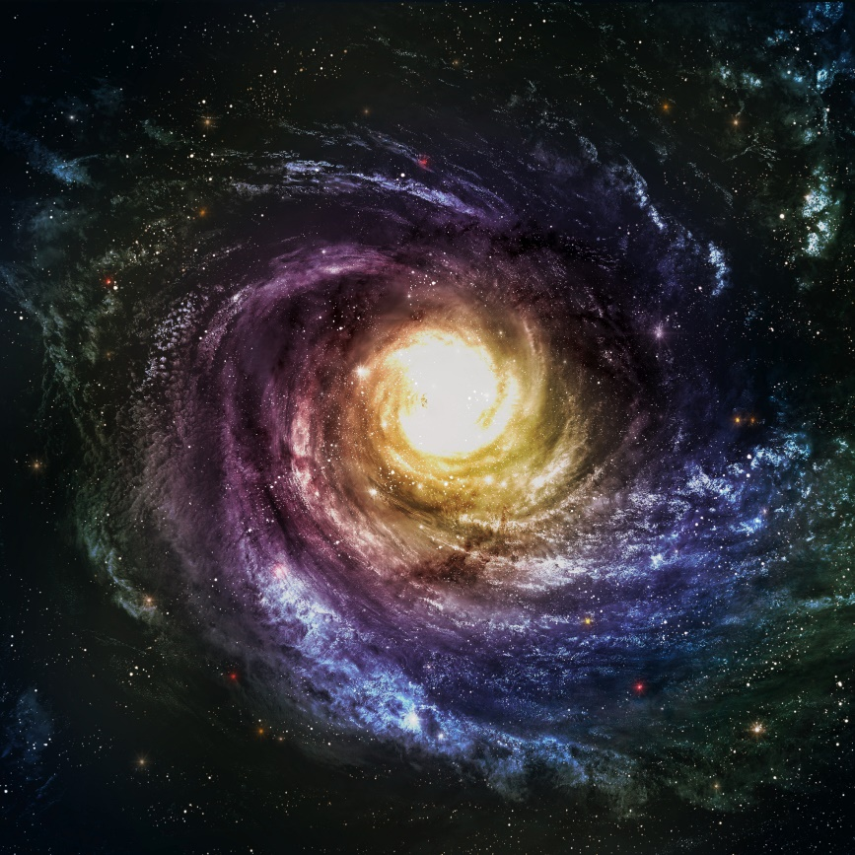

When I consider the heavens…what is man that you are mindful of him?
End of Year
Science Fair
Open with worship
Music
Scripture
Beautiful pictures
Meaningful quotes from believing scientists
“The undevout astronomer must be mad.” William Herschel
Notes:
Begin the science fair with a short worship program that includes music and readings related to God’s creation.
Consider dividing students into groups to find music, scripture, beautiful pictures, and meaningful quotes from famous Christian scientists that would go with the four science units (life science, human body, earth/space science, and physical science). Quotes could be read by students dressed up as the scientist who made the statement. Consider creating a responsive reading to get the audience involved. Without belaboring the point, weave science and the worship of God together.

Slide 41
Recorded at
Chattanooga Public RadioSM
Classical 90.5 WSMC

Slide 42
Stock Images By
Images may appear on more than one slide. Citation is given on the first slide where each image appears.
[1] Photo of Men of Science Men of God, Carol Raney
[3] Dr. Henry M. Morris, http://www.icr.org/article/science-man-god-henry-m-morris, © 2009 Institute for Creation Research, www.icr.org. Used by permission.
[8a] Leonardo daVinci, Engraving from 1850's, polymath, scientist, inventor, painter 96372752, Georgios Kollidas , Thinkstock, Thinkstock Image Subscription
[8b] Francis Bacon 92845629, Photos.com, Thinkstock, Thinkstock Image Subscription
[8c] William Herschel 92831586, Photos.com, Thinkstock, Thinkstock Image Subscription
[8d] Stephen Myer, http://www.discovery.org/p/11, used with permission
[8e] Tim Standish, used with permission
[9] Vintage old book 95272278, Sharon Bronte, Thinkstock, Thinkstock Image Subscription
[10] Johannes Kepler, Unknown artist, http://en.wikipedia.org/wiki/File:Johannes_Kepler_1610.jpg, Public Domain.
[12d] Blaise Pascal on engraving from 1800s 97011251, Georgios Kollidas, Thinkstock, Thinkstock Image Subscription
[12e] Robert Boyle 92836880, Photos.com, Thinkstock, Thinkstock Image Subscription
[14a] Isaac Newton engraving from 1850s, engraved by E. Scriven 97876888, Georgios Kollidas, Thinkstock, Thinkstock Image Subscription
14b] Carl Linnaeus 160312886, Denis Kozlenko, Thinkstock, Thinkstock Image Subscription
[16a] Michael Faraday 92836754, Photos.com, Thinkstock, Thinkstock Image Subscription

Slide 43
Stock Images By
[ 16b] Portrait of American Inventor Samuel Finley Breese Morse 92846485, Photos.com, Thinkstock, Thinkstock Image Subscription
[17a] Portrait of Joseph Henry, Henry Ulke, http://commons.wikimedia.org/wiki/File:Joseph_Henry_(1879).jpg,, Public domain.
[17b] Smithsonian Institution 181958499, AndreyKrav, Thinkstock, Thinkstock Image Subscription
[18a] Map of ocean currents 112706597, Dorling Kindersley, Thinkstock, Thinkstock Image Subscription
[18b] Matthew Maury painting, Ella Sophonisba Hergesheimer, http://commons.wikimedia.org/wiki/File:Commander_Matthew_Fontaine_Maury_USN_painting.jpg, PD-old
[19] Sir James Young Simpson, Henry Laing Gordon, http://commons.wikimedia.org/wiki/File:Simpson_James_Young_signature_picture.jpg, Public Domain.
[20] Telescope 4542879, befehr, Getty Images (US), Inc. Subscription Agreement
[21a] William Thomson Lord Kelvin, T. & R. Annan & Sons, http://commons.wikimedia.org/wiki/File:William_Thomson,_Lord_Kelvin_cph.3b11884.jpg, No known restrictions on publication
[21b] Gregor Mendel, artist unknown, http://upload.wikimedia.org/wikipedia/commons/b/ba/Gregor_Mendel_2.jpg, Public Domain

Slide 44
Stock Images By
[21c] Louis Pasteur, uploaded by Materialscientist, http://af.wikipedia.org/wiki/Louis_Pasteur#mediaviewer/File:Louis_Pasteur.jpg, Public Domain.
[22] Parchment 185017434, Didecs, Thinkstock, Thinkstock Image Subscription
[23] Old Book 94501148, Photos.com, Thinkstock, Thinkstock Image Subscription
[24a] William Ramsay, Unknown, http://commons.wikimedia.org/wiki/File:PSM_V67_D098_William_Ramsay.png, PD US
[24b] Saturn 5 140235692, perkijl, Thinkstock, Thinkstock Image Subscription
[24c] Wernher von Braun, NACA, http://commons.wikimedia.org/wiki/File:Wernher-von-Braun.jpg, Public Domain.
[27] Idea graphic 187824692 Makeitdouble, Thinkstock, Thinkstock Image Subscription
[28b] Photo of By Design Science textbook, Carol Raney
[30] Photo of Thinking Creation, Carol Raney
[36a] Scientist at work 78779794, Fuse, Thinkstock, Thinkstock Image Subscription
[36b] Male and female scientists 170083468, Monkey Business Images Ltd, Thinkstock, Thinkstock Image Subscription
[39] Screen shots of DVDs from amazon.com
[41] Spiral galaxy 177794827, Forplayday, Thinkstock, Thinkstock Image Subscription

Slide 45
Special Thanks
Foundation for Adventist Education

Slide 46

© Origins Curriculum Resources 2015

Slide 47

© Southern Adventist University 2015

Slide 48

© Seventh-day Adventist North American Division 2015

Slide 49

© General Conference of Seventh-day Adventists 2015

Slide 50

© SCORE Southern Center for Origins Research & Education 2015

