Slide 1
Mutations 2
Notes:
Mutations—part 2

Slide 2
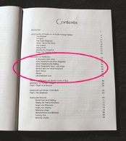
DNA
Bases:
A, T, C, G
Chromosome:
Codons:
Book
Words
Genes:
Chapters
Notes:
You have learned that individual nucleotide bases (which are like letters) make up the codons (which are like words) that make up the genes (which are like chapters) that make up chromosomes (which are like individual books) which all together make up all your DNA (and are like a series of books)

Slide 3
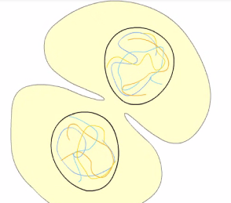
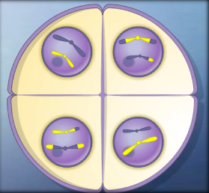
Mutations in Cell Division
Mitosis
Meiosis
Not passed on to offspring
Can be passed on to offspring
Notes:
You have also learned that mistakes—which are called Mutations—can happen during the process of cell division. Many mistakes are caught and corrected, but some are not. Mistakes that happen during the replication of regular body cells can result in diseases such as cancer but cannot be passed on to offspring. Mutations that happen to reproductive cells (sperm and egg) can be passed on to offspring. If a mutation in reproductive cells is bad enough, the offspring may not develop properly or may die early.

Slide 4
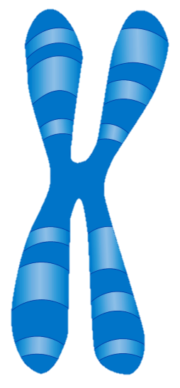
Mutations can affect:
A single gene
An entire chromosome
Gene
Notes:
Mutations can affect a single gene or an entire chromosome.

Slide 5
Mutations can affect:
A single gene
An entire chromosome
Gene
2
4
Notes:
We’ll talk about 2 kinds of mutation that can affect a single gene and four kinds of mutations that can affect entire chromosomes.

Slide 6
Gene
1. Sequence Mutations
2. Frameshift Mutations
Notes:
The two that affect single genes are sequence mutations and frameshift mutations.

Slide 7
1. Sequence mutation
Gene
Pancake
Panvake
Notes:
A sequence mutation—sometimes called a point mutation—happens when one nucleotide base is substituted for another. Kind of like when a “v” is substituted for the “c” in pancake.
As this strand of DNA was copied, this “A” was replaced by a “C”.

Slide 8
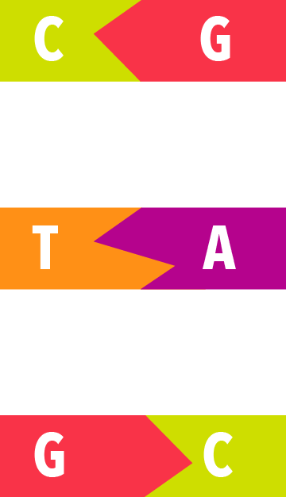
A
T
C
G
Notes:
Since A always joins with T and C with G,

Slide 9
1. Sequence mutation
Gene
Pancake
Panvake
Notes:
the new “C” would have to join with a “G”. In this way both base pairs are replaced by others

Slide 10
2. frameshift mutation
Gene
Insertion:
Pancaake
Pancake
Deletion:
Pancake
Panake
Notes:
The second kind of mutation that affects a single gene is a frameshift mutation, which happens when an extra base is inserted (kind of like when this extra “a” is added to the word pancake) or when a base is deleted (kind of like when the “c” was deleted from the word pancake). When an extra letter is added, it pushes all the letters after it further to the right. When a letter is deleted, all the letters after it move to the left.

Slide 11
Notes:
Here is an illustration of a frameshift deletion. Figure 1 represents the original strand of DNA. Figure 2 shows that while the DNA was being copied, an “A” was left out by mistake, leaving a gap in the sequence. Everything to the right of the missing “A” shifts to the left to fill the gap. Figure 3 shows the new strand of DNA. The section to the left of where the deletion occurred is just the same as it was before. The gap left by the deletion has been filled by shifting the rest of the bases to the left.

Slide 12
Notes:
The new strand of DNA is one base shorter than the original strand. Because many of the base pairs shifted to the left, the groups of three are different now. Notice that the sequence used to be C, T, A. But not it is T, A, G. Since each sequence of three bases carries information, the information carried by the sequence of three may be damaged or lost as the sequence changes.

Slide 13
0
Notes:
Something similar happens in a frameshift insertion. This time, an extra base is inserted by mistake between two other bases, making the new strand of DNA longer than the original one was. In the new strand, the newly inserted base pair causes all the rest of the bases to shift to the right.

Slide 14
Notes:
Because of the newly inserted base pair, the groups of three are no longer the same. The sequence TGT in the original DNA strand is now TTG. What used to be TGG becomes TTG. And AAT is now GAA. Because each of these sequences of three carries information, or has meaning, the information carried in the DNA is no longer accurate.

Slide 15
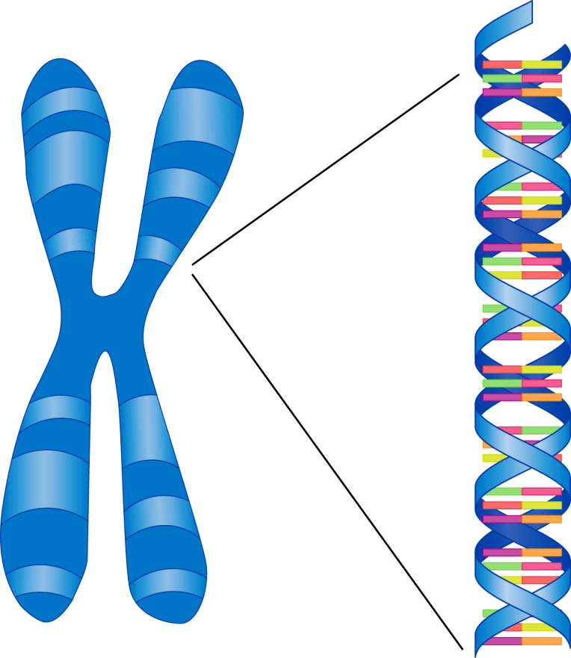
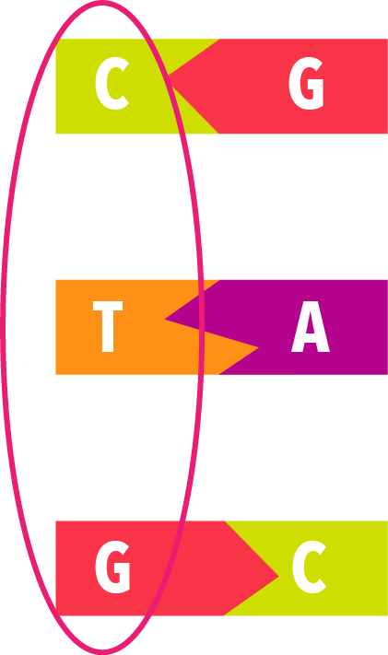
Chromosome
Genes
Codons
http://en.wikipedia.org/wiki/P%C5%99%C3%ADru%C4%8Dn%C3%AD_slovn%C3%ADk_nau%C4%8Dn%C3%BD
Notes:
Remember that three individual bases in a row make up a codon. The specific order in which the bases and codons appear has meaning. If the codons get rearranged, the meaning is no longer correct.

Slide 16
The cat ate the rat
Thc ata tet her at
Notes:
To help you understand a frameshift mutation, look at this example. Notice that this sentence is made up of three-letter words. You can think of each word as a codon. Like a codon, each three-letter word has meaning. / Watch what happens to the groups of three letters when the “E” is deleted from the word “the.” As the rest of the letters shift to the left, the groups of letters are arranged, and the meaning of the sentence is lost.

Slide 17
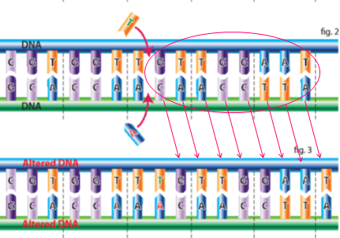
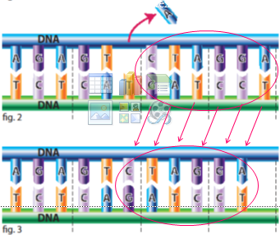
The cat ate the rat
Thc ata tet her at
Notes:
The same thing happens in a frameshift mutation. As individual base pairs are added or deleted, all the rest of the base pairs shift to the right or to the left. Codons are rearranged, and the meaning of the information they carry is changed.

Slide 18
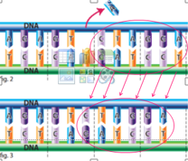
Review 2 that affect a single gene
2
Gene
Sequence/Point Mutation
Frameshift Mutation
Notes:
Before we move on, /let’s review the two kinds of mutations that affect a single gene. / A sequence mutation or point mutation changes the gene at a single point in the sequence by substituting one base for another, but it doesn’t change the number of base pairs in the gene. / A frameshift mutation adds or loses a base pair, shifting the rest of the bases either to the right or the left.

Slide 19
Mutations can affect:
An entire chromosomes
Gene duplication
Gene deletion
Gene inversion
Translocation
Notes:
The four kinds of mutations that can affect entire chromosomes are quick and easy to explain. They are: gene duplication…

Slide 20
Mutations can affect:
An entire chromosomes
Gene duplication
Gene deletion
Gene inversion
Translocation
Notes:
Gene deletion…

Slide 21
Mutations can affect:
An entire chromosomes
Gene duplication
Gene deletion
Gene inversion
Translocation
Notes:
Gene inversion…

Slide 22
Mutations can affect:
An entire chromosomes
Gene duplication
Gene deletion
Gene inversion
Translocation
Notes:
…and translocation

Slide 23
1. Gene duplication
An entire chromosomes
Notes:
Sometimes instead of a gene being copied once like it should be / it gets duplicated twice. This is called gene duplication.

Slide 24
2. Gene deletion
An entire chromosomes
Notes:
Or an entire gene can be deleted…

Slide 25
2. Gene deletion
An entire chromosomes
Notes:
And not appear at all in the new chromosome. This is called gene deletion.

Slide 26
3. Gene inversion
An entire chromosomes
Notes:
In gene inversion, a whole gene can be flipped around and inserted into the new chromosome backwards. Notice how the “D, E, F” gene gets turned completely around so that it’s in the opposite order “F, E, D” in the new chromosome.

Slide 27
4. Translocation
An entire chromosomes
Notes:
Finally, In translocation, a segment of DNA from one chromosome is moved to another chromosome. Here you see a piece of chromosome 1 ends up on chromosome 2 and a piece of chromosome 2 ends up on chromosome 1.

Slide 28
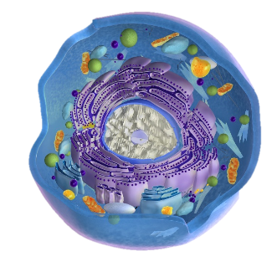
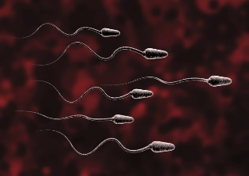
Mutations in Cell Division
Mitosis
Meiosis
Not passed on to offspring
Can be passed on to offspring
Notes:
Any of the mutations we have discussed can happen during either mitosis or meiosis. / Only mutations that happen during meiosis are inherited by offspring. Mistakes that happen during mitosis cannot be passed on the next generation.

Slide 29
Effects of mutations
How serious the results of a mutation are depends on:
The type of mutation
The number of genes involved
The location of the mutation
Notes:
How serious the results of a mutation are depends on the type of mutation, the number of genes involved, and the location of the mutation.

Slide 30
Effects of mutations
A mutated gene can produce a protein that doesn’t function properly.
A cell could lose its ability to make one of the proteins it needs.
Some mutations can cause genetic disorders.
Notes:
A mutated gene can produce a protein that doesn’t function properly any more. Or the cell could lose its ability to make a certain protein at all! Some mutations can cause genetic disorders.

Slide 31
Philadelphia chromosome
Notes:
For example, a translocation between chromosome 9 and 22 is called a Philadelphia chromosome and is associated with various kinds of leukemia.

Slide 32
Some genetic disorders
PKU
Cystic Fibrosis
Williams Syndrome
Breast and ovarian cancer
Sickle Cell Disease
Albinism
Tay-Sachs Disease
Notes:
Other examples of genetic disorders include Cystic Fibrosis, certain cancers, and Sickle Cell Disease

Slide 33
Rarely, if ever, is a mutation beneficial.
Sickle Cell Disease
(better able to survive Malaria)
Notes:
Rarely, if ever, is a mutation beneficial. The mutation that causes Sickle Cell Disease does allow people to combat Malaria. So someone who lives in a place where Malaria is common might be benefitted in the fight against Malaria, but he or she would still have to deal with the Sickle Cell Disease.

Slide 34
mutations
It’s important to understand mutations because of the important role they are supposed to play in the theory of evolution.
Origins 101
Notes:
It’s important to understand mutations because of the important role they are supposed to play in the theory of evolution. / To understand the theory of evolution and whether mutations are capable of playing the role suggested for them, watch the series of videos called Origins 101.

Slide 35
Recorded at
Chattanooga Public RadioSM
Classical 90.5 WSMC

Slide 36
Original Graphics by
Ron Hight
Susan Landon

Slide 37
Images By
Images may appear on more than one slide. Citation is given on the first slide where each image appears.
[2] DNA, chromosome, and cell, Susan Landon
[2a] Photo of Table of Contents page, Ron Hight
[2c] Book 177425492, badahos, Thinkstock, Thinkstock Image Subscription Agreement
[3a] Mitosis animation, purchased from Edumedia, https://www.edumedia-sciences.com/en/a70-mitosis
[3b] Meiosis animation, purchased from Edumedia, https://www.edumedia-sciences.com/en/a418-meiosis
[4a] DNA Susan, Landon
[4b] Chromosome, Susan Landon
[7b] Point mutation, Ron Hight
[8] Nucleotide bases, Susan Landon
[11] Frameshift deletion, Ron Hight
[13] Frameshift insertion, Ron Hight

Slide 38
Images By
[23a] Gene duplication, Ron Hight
[24a] Gene deletion, Ron Hight
[26a] Gene inversion, Ron Hight
[27a] Translocation, Ron Hight
[28a] Cell 000045876032 7activestudio, Getty Images (US), Inc. Subscription
[28b] Sperm cell 178755818, ThorstenSchmitt, Thinkstock, Thinkstock Image Subscription Agreement
[31b] Chromosomes 134153911, somersault18:24, Thinkstock, Thinkstock Image Subscription Agreement

Slide 39
Special Thanks
Tim Trott, PhD
Biology Professor, Southern Adventist University
Foundation for Adventist Education

Slide 40
© Origins Curriculum Resources 2015

Slide 41
© Southern Adventist University 2015

Slide 42
© Seventh-day Adventist North American Division 2015

Slide 43
© General Conference of Seventh-day Adventists 2015

Slide 44
© SCORE Southern Center for Origins Research & Education 2015

