Slide 1
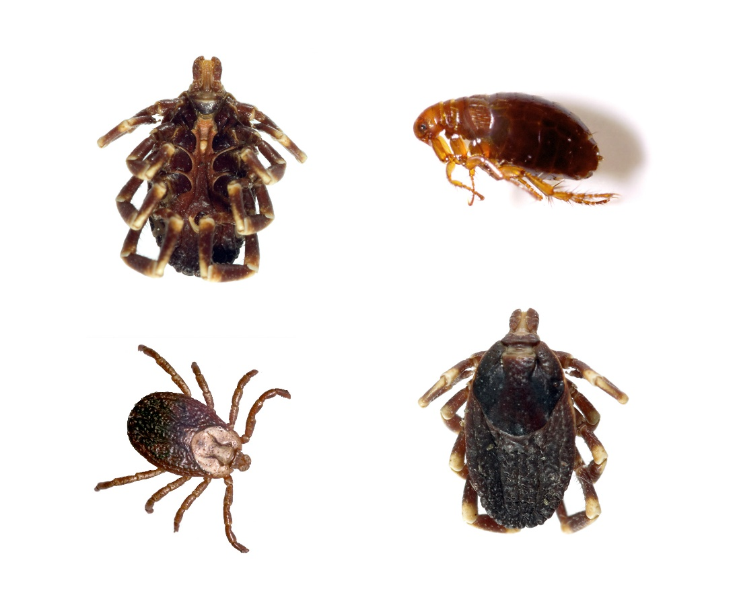
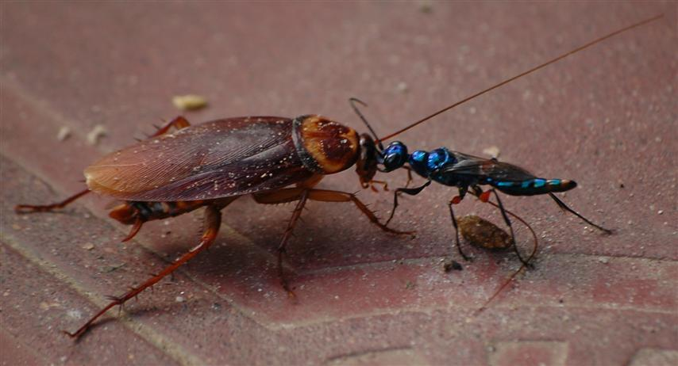
Parasitism and Theodicy
Part 1
Notes:
Parasitism and Theodicy, part 1

Slide 2
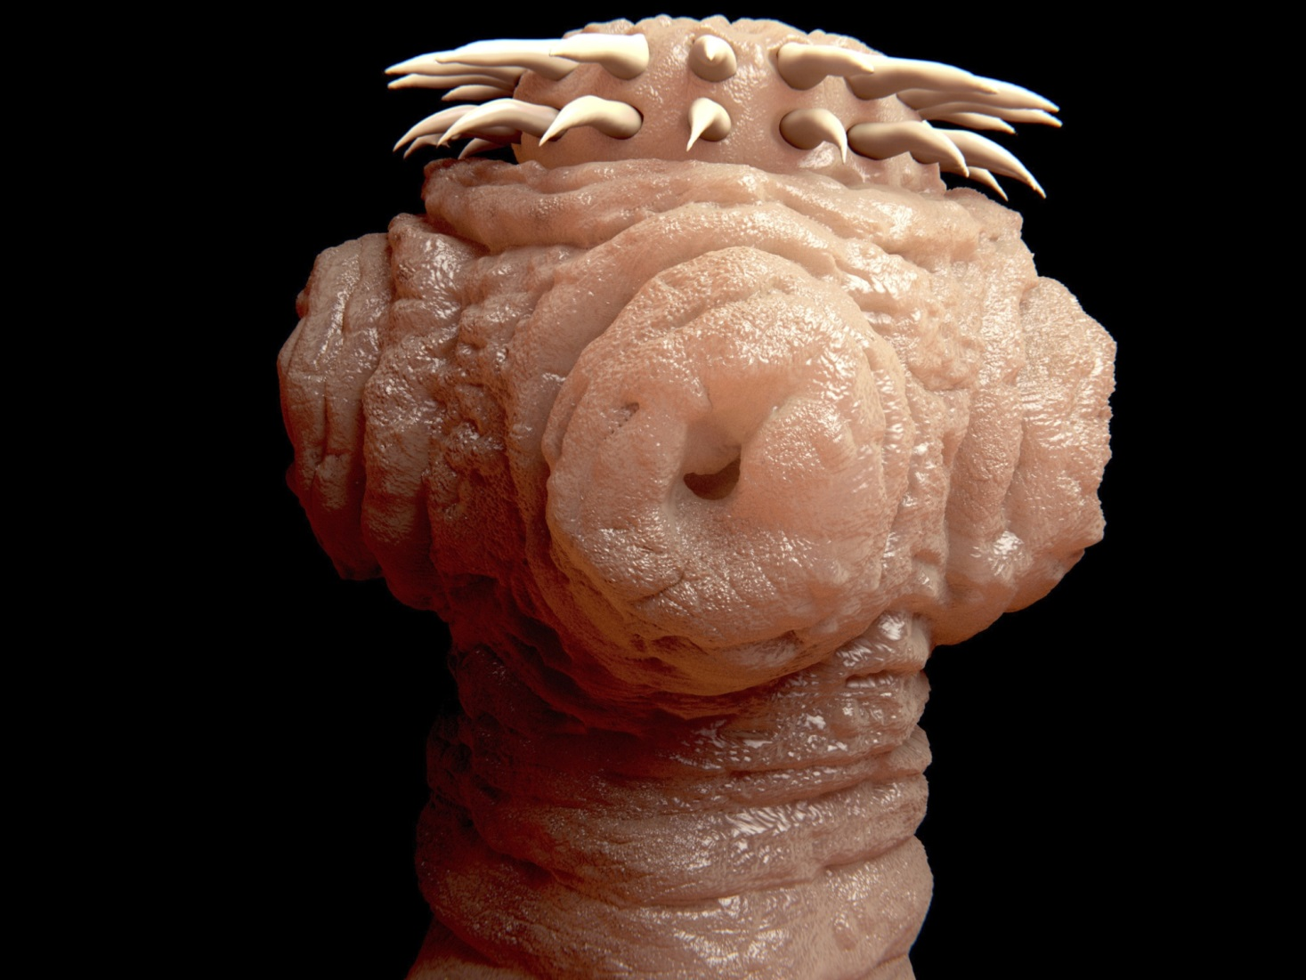
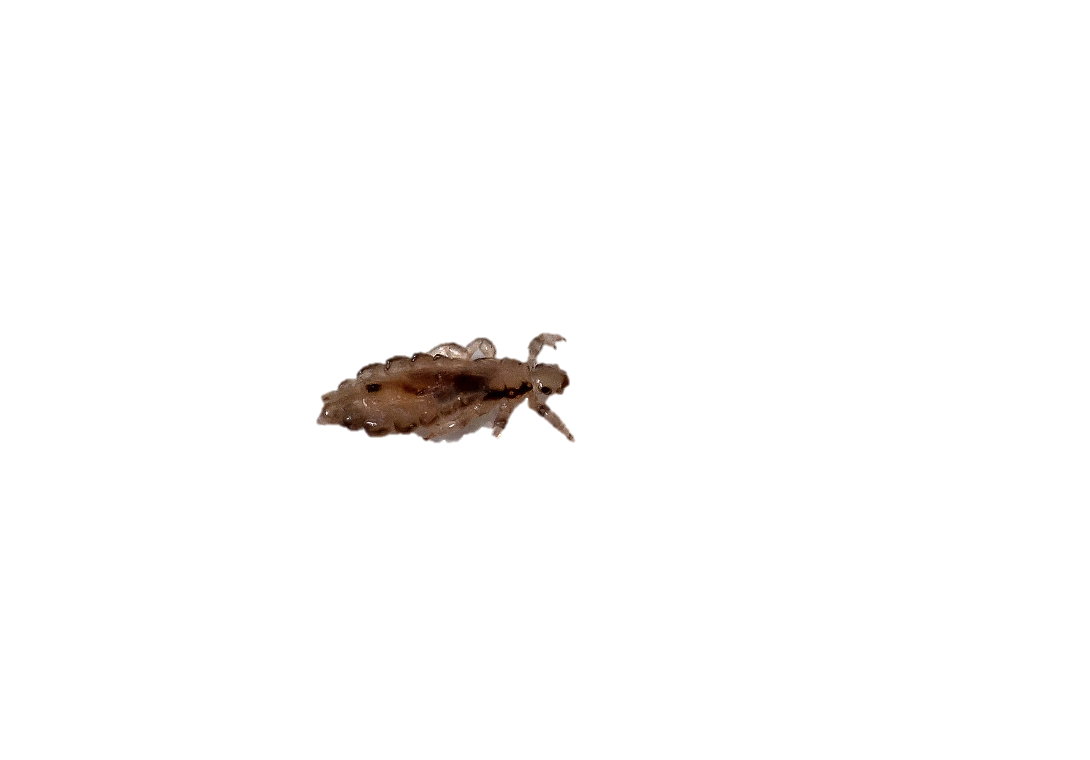
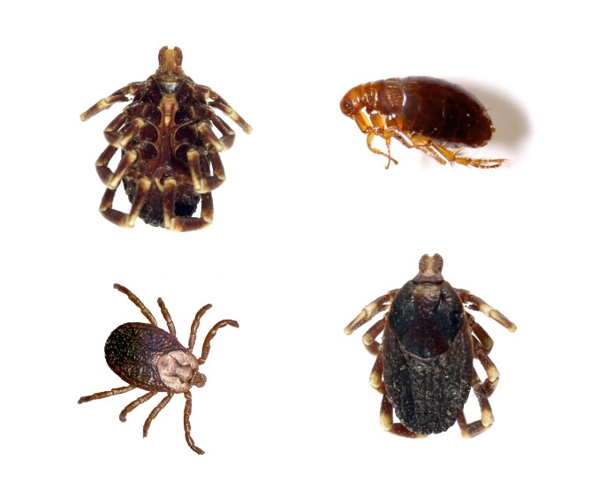
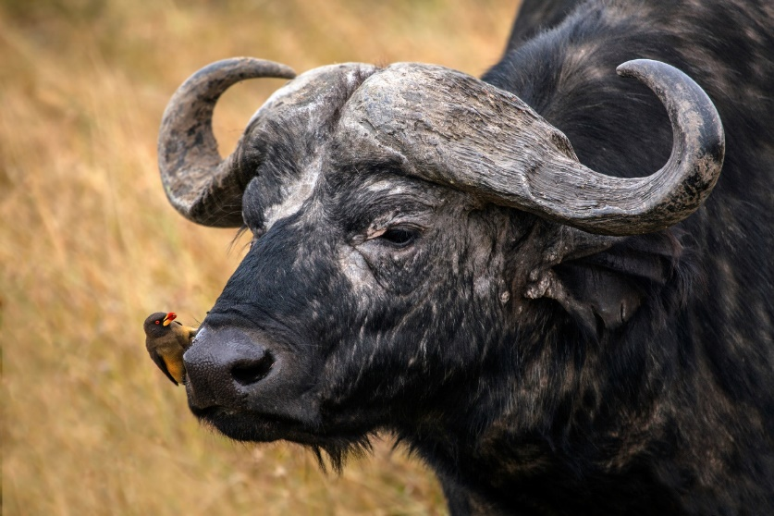
Parasite
A parasite lives on or in a host, getting food from, or at the expense of, its host
Notes:
A parasite lives on or in a host, getting food from or at the expense of its host, without benefitting the host in any way. / Examples include ticks and fleas, / lice, / ox pickers, / and tapeworms.

Slide 3
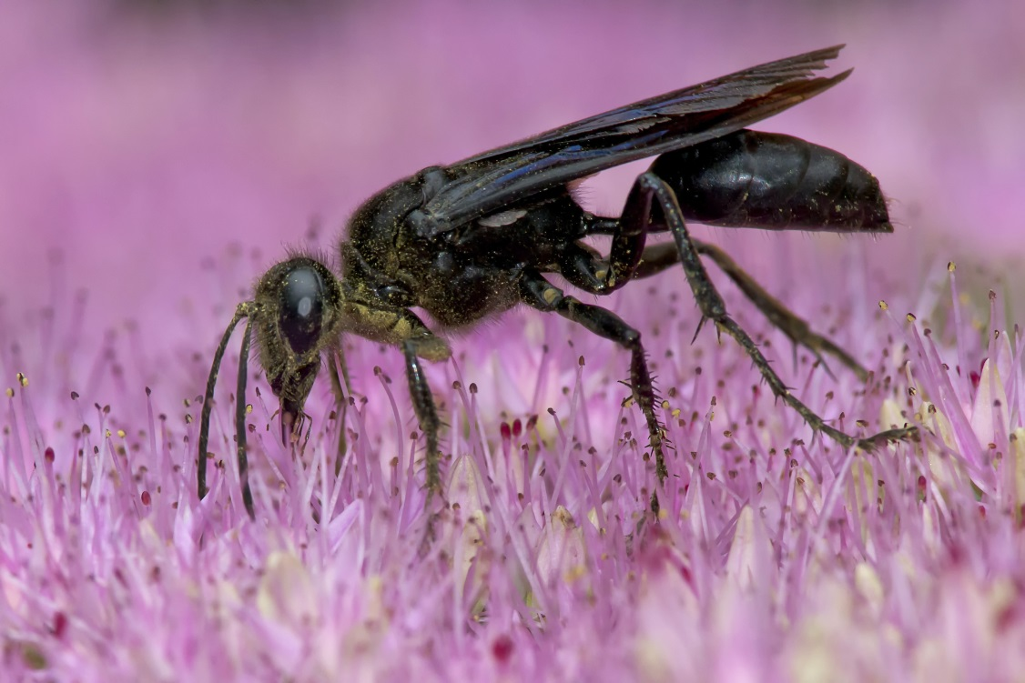
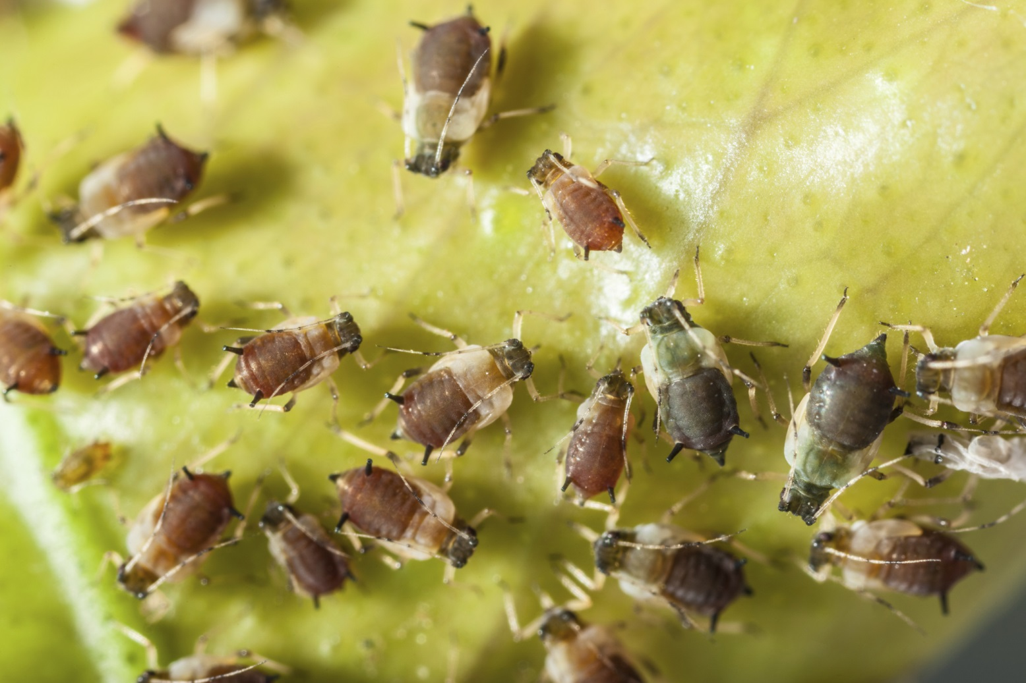
Parasitoid relationship
When a parasite actually kills its host
Notes:
A parasitoid relationship is one in which the parasite actually kills its host. / One example of this is a black wasp. / A female black wasp injects a single egg into an aphid (a sap-sucking insect that destroys plants). The wasp egg hatches and the larvae eats the aphid alive from the inside out.

Slide 4
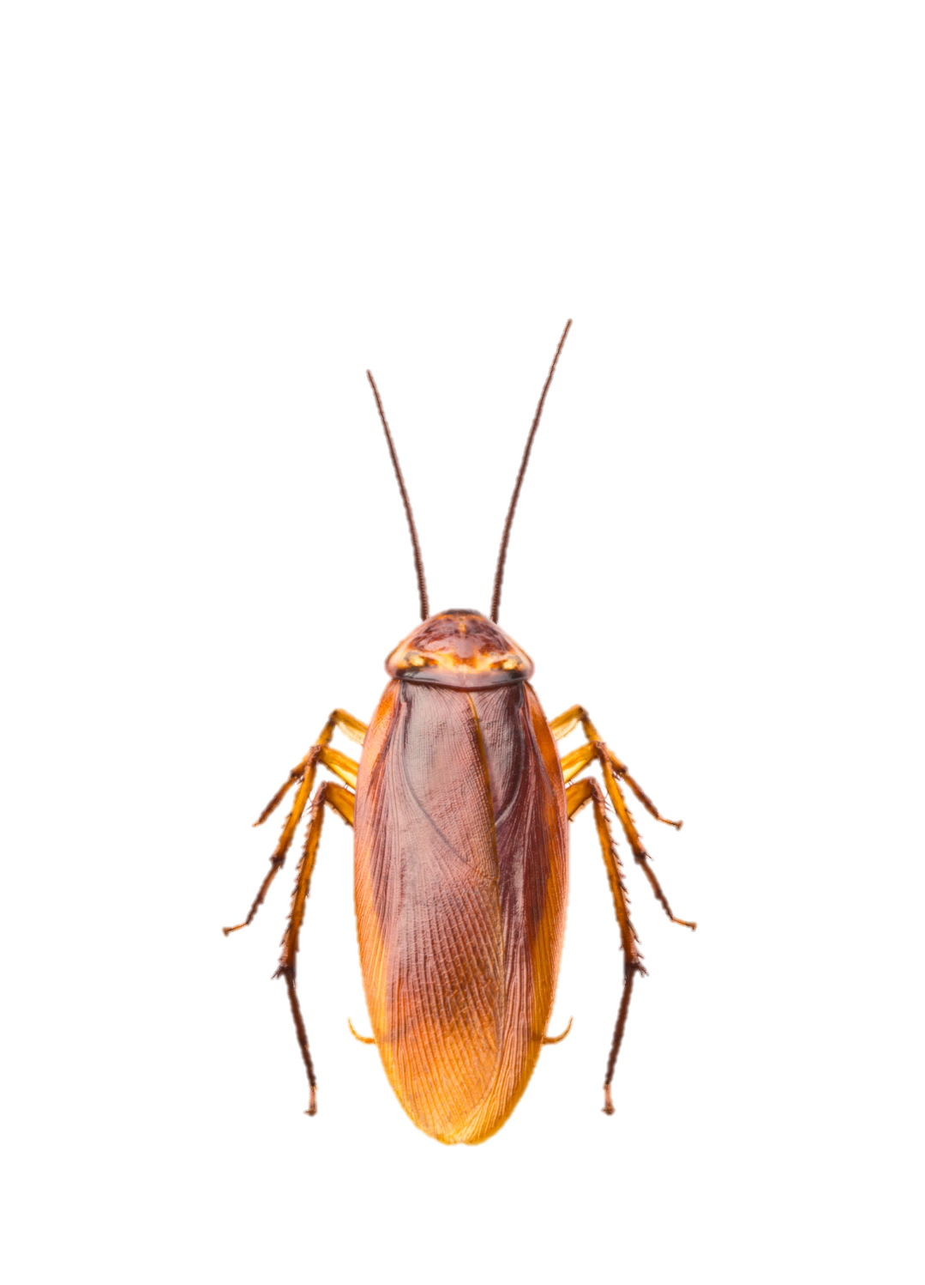
Parasitoid relationship
When a parasite actually kills its host
Notes:
Another example is the emerald jewel wasp, which specifically targets cockroaches. / After paralyzing the roach, the wasp stings the roach in the brain, refuels itself on roach blood, and leads the roach to a burrow. The wasp lays an egg on the roach and barricades the roach in the burrow. In a few days the egg hatches and the larvae begin to eat the roach alive. Six weeks from the first sting, an adult wasp emerges from the dead roach's body to begin the process all over again.

Slide 5
How can we explain something so awful in the world God created?
Notes:
When we see these parasitic wasps in nature, we can’t help but ask the question, “How can we explain something so awful in the world God created?

Slide 6

Why would a good God allow evil to exist?
Evil
Powerful
Loving
Not powerful
Loving
Powerful
?
Notes:
If God was evil and powerful, we wouldn’t be surprised to find parasitic wasps in nature. / Or if God was loving but not powerful enough to prevent evil, that would help explain the existence of evil. / But if God is loving and all powerful, how can we explain the existence of things like parasitic wasps in the world He created? / Why would a good God allow evil to exist?

Slide 7
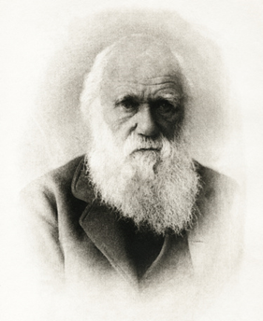
Charles Darwin
Notes:
Many people throughout history, including Charles Darwin, have struggled with this problem

Slide 8
Theodicy
Attempts to answer this question:
  How can evil exist if God is loving, all-powerful, and just?
Notes:
Attempts to answer the question of how evil can exist if God is loving, all-powerful, and just / are called theodicy.

Slide 9
Theodicy
Theo (God) + dicy (justice)
The justification of God
Notes:
Quite literally, theodicy means the justification of God

Slide 10
Many theodicies exist
As Christians with a biblical worldview,
we look to the Bible for answers
Notes:
Many theodicies exist. / As Christians with a biblical worldview, we look to the Bible for answers. The Bible offers a clear explanation for why evil exists in a world created by a good God.

Slide 11

In the beginning God created…
…and it was very good!
Notes:
In Genesis 1, the Bible tells us that what God created in the beginning was very good.

Slide 12
How can we explain something so awful in the world God created?
He didn’t create them that way
Notes:
So we know that God did not create the parasitic wasps as they now behave

Slide 13
What happened?
Notes:
What happened? How did the “very good” world God created come to have parasitic wasps and other evil things?

Slide 14
Biblical theodicy
Freedom of choice
Notes:
God created Adam and Eve with freedom of choice

Slide 15
Biblical theodicy
Adam and Eve chose to sin
Notes:
and unfortunately, they chose to sin by disobeying God

Slide 16
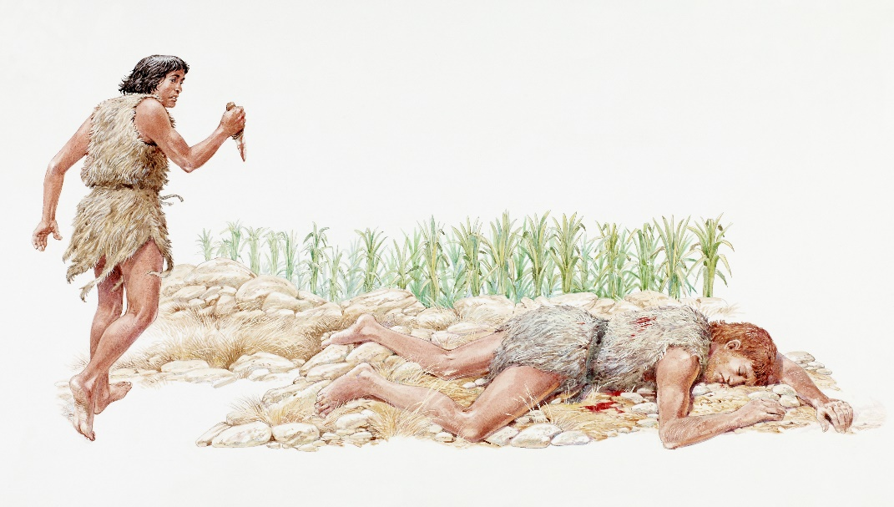
Consequences of Sin
People (Gen 3:16-19)
  Pain in childbirth
  Hard work
Notes:
In Genesis 3 we read about some very specific consequences of their sin. / God told them that childbirth would be painful for women, /and men would have to work hard to grow food. People experienced all kinds of other evil as well, / including murder.

Slide 17
Consequences of Sin
People (Gen 3:16-19)
  Pain in childbirth
  Hard work
Natural World
Against its will, all creation was subjected to God’s curse. (Rom 8:20 NLT)
Notes:
The Bible also explain that the natural world was affected by sin. Romans says that “against its will, all creation was subjected to God’s curse.”

Slide 18
Consequences of Sin
People (Gen 3:16-19)
  Pain in childbirth
  Hard work
Natural world (Gen 3:18)
  Thorns
  Thistles
Notes:
God told Adam and Eve that thorns and thistles would begin to grow, / and although we don’t know exactly how it happened, evils like death, predation, and parasitism became a part of nature.

Slide 19
Theodicy
  How can evil exist if God is loving, all-powerful, and just?
Notes:
When we try to explain the existence of evil in God’s creation…

Slide 20
Short answer
Free
Choice
Sin
Notes:
…we often say it is the result of sin or of free choice.

Slide 21

Results of human choice
?
Notes:
It’s pretty easy to understand how some kinds of evil are the direct result of human choice. / But how could human choices cause evil things in nature like parasitic wasps?

Slide 22
Parasitism and Theodicy
Part 2
Notes:
To find out, watch Parasitism and Theodicy, part 2

Slide 23


These ideas about theodicy come from:
If God Is Good and All-powerful, How Can He Allow Suffering?
By Stephen Bauer
Notes:
These ideas about theodicy come from this chapter by Dr. Stephen Bauer in the book Always Prepared.

Slide 24
Recorded at
Chattanooga Public RadioSM
Classical 90.5 WSMC

Slide 25
Images By
Images may appear on more than one slide. Citation is given on the first slide where each image appears.
[1a] Ticks and Flea 114163615 Amando Frazao, Thinkstock, Thinkstock Image Subscription Agreement
[1b] Jewel Wasp, unknown artist, http://www.odditycentral.com/animals/insect-body-snatchers-how-the-jewel-wasp-turns-cockroaches-into-zombies.html. Creative Commons Attribution-Non-Commercial-No Derivative works 3.0 Unported license.
[ [2b] Ox picker 29141776, 2630ben, Getty Images (US), Inc. Subscription
[2d] Head of a tapeworm 465954259 selvanegra, Thinkstock, Thinkstock Image Subscription Agreement
[3a] Great black wasp 465171185 PaulReevesPhotography, Thinkstock, Thinkstock Image Subscription Agreement
[3b] Aphids colony 480244113 Dario Lo Presti, Thinkstock, Thinkstock Image Subscription Agreement
[4a] Cockroach 177409316 somchaisom, Thinkstock, Thinkstock Image Subscription Agreement
[7] Charles Darwin 16835919, picture, Getty Images (US), Inc. Subscription

Slide 26
Images By
[10] Vintage old book 95272278, Sharon Bronte, Thinkstock, Thinkstock Image Subscription Agreement
[12] Hot Springs 457377547, Bkamprath, Thinkstock, Thinkstock Image Subscription Agreement
[16] Illustration of Cain and Abel 85594750, Dorling Kindersley, Thinkstock, Thinkstock Image Subscription Agreement
[23a] Photo of Always Prepared, Carol Raney
[23b] Stephen Bauer, http://www1.southern.edu/academics/academic-sites/religion/faculty/bauer.html)

Slide 27
Special Thanks
Stephen Bauer, PhD
Religion Professor, Southern Adventist University
and the
Foundation for Adventist Education

Slide 28

© Origins Curriculum Resources 2015

Slide 29

© Southern Adventist University 2015

Slide 30

© Seventh-day Adventist North American Division 2015

Slide 31

© General Conference of Seventh-day Adventists 2015

Slide 32

© SCORE Southern Center for Origins Research & Education 2015

