Slide 1
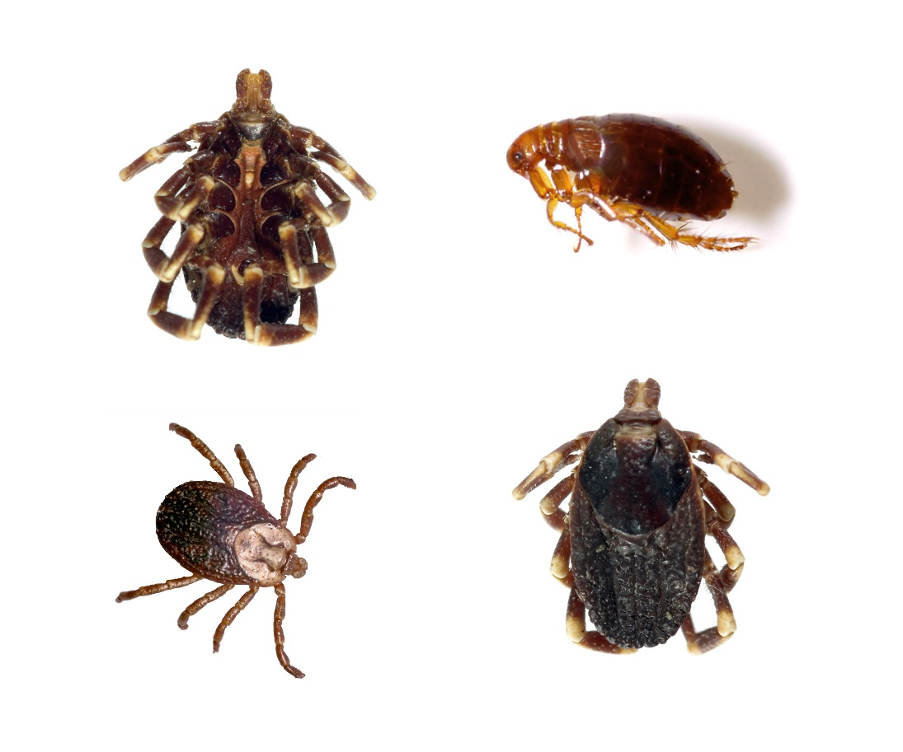
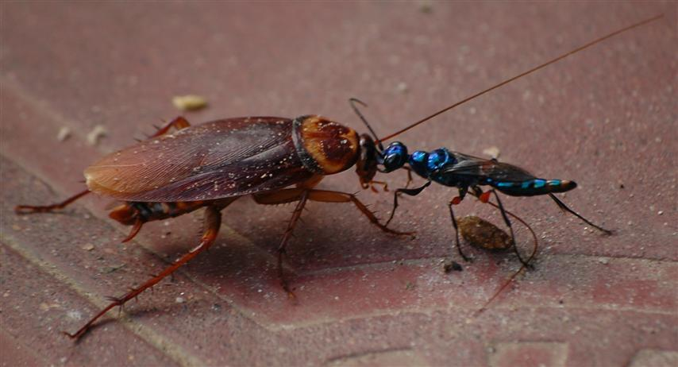
Parasitism and Theodicy
Part 2
Notes:
Parasitism and Theodicy, part 2

Slide 2
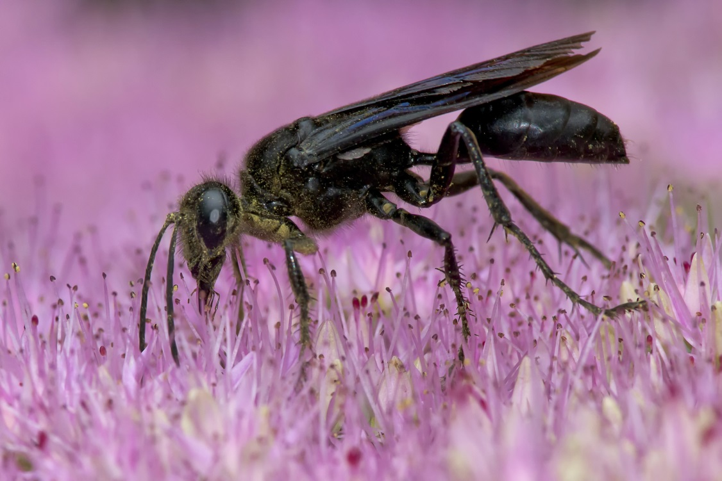
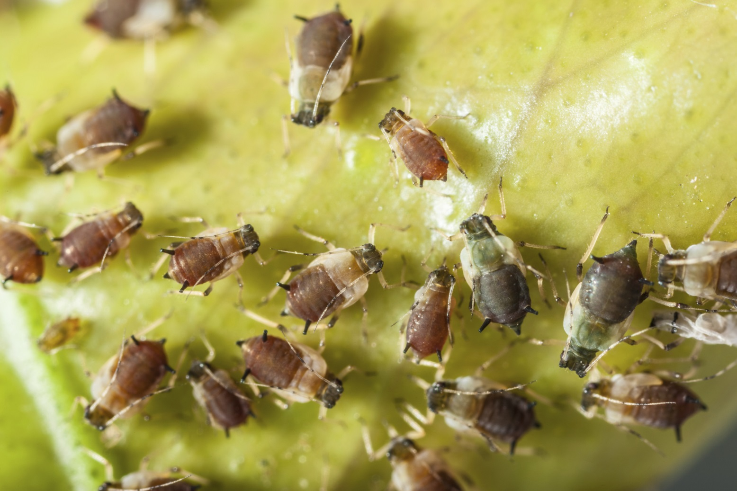
Parasitoid relationship
When a parasite actually kills its host
Notes:
In part 1 we learned about some pretty awful parasites that eat other creatures from the inside out.

Slide 3
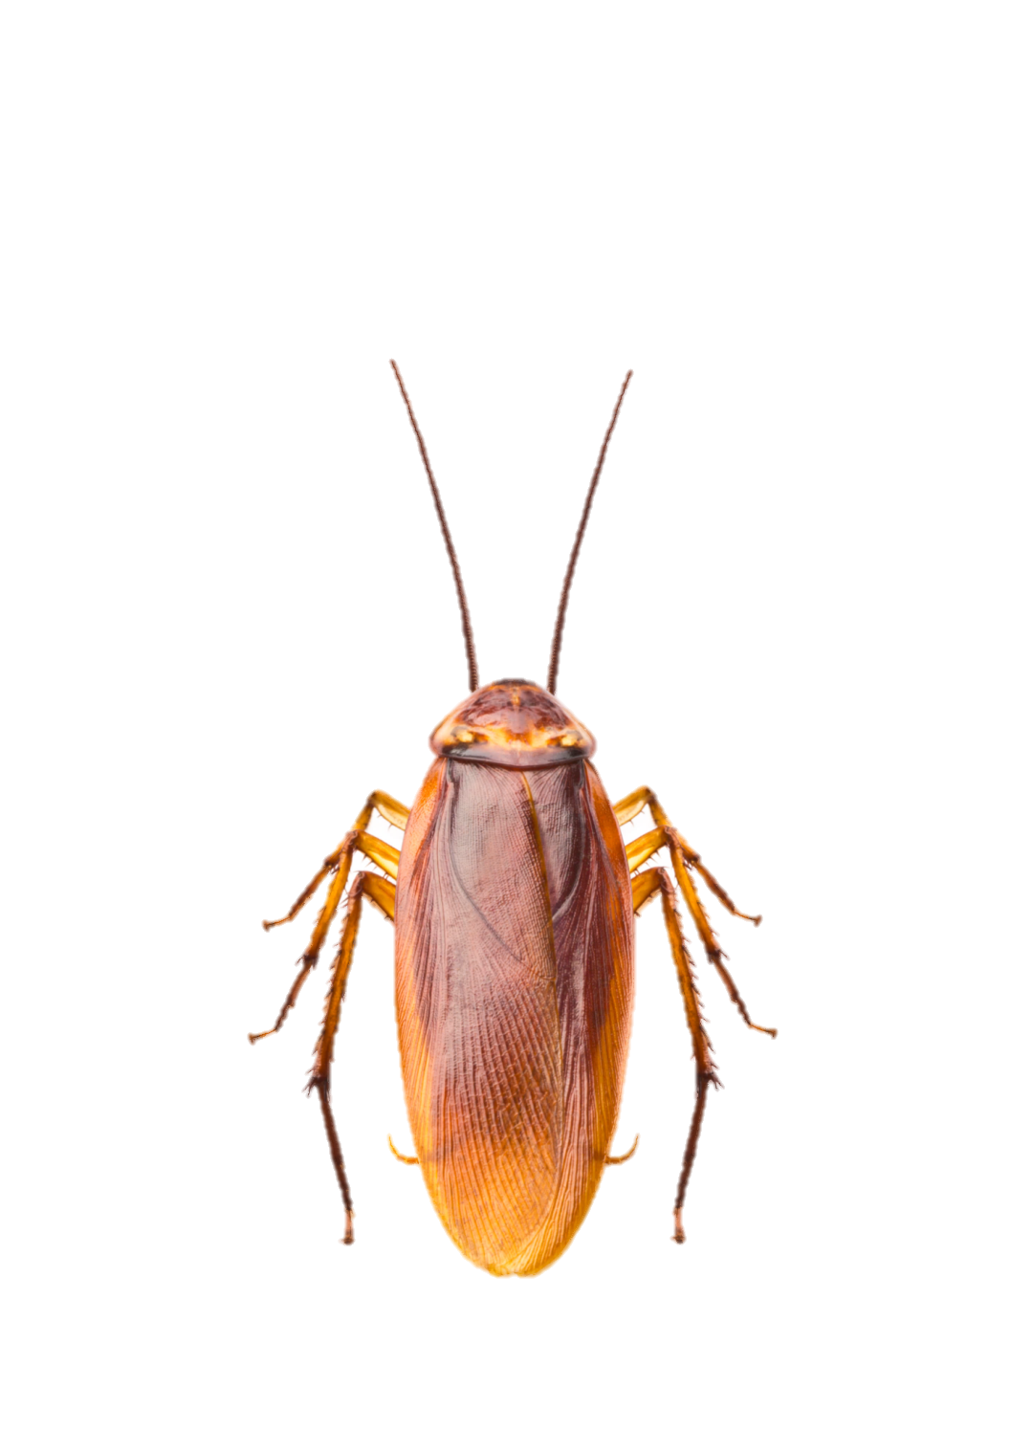
What about evil? (If God is good, powerful, and just)
Notes:
Creatures like this in nature raise an important question: How do we explain this kind of evil, if God is good, all powerful, and just?

Slide 4
Theodicy
Attempts to answer this question:
How can evil exist if God is loving, all-powerful, and just?
Notes:
Attempts to explain this question are called theodicy

Slide 5
Biblical theodicy
Evil is the result of sin
Notes:
According to the Bible, evil is the result of sin.

Slide 6
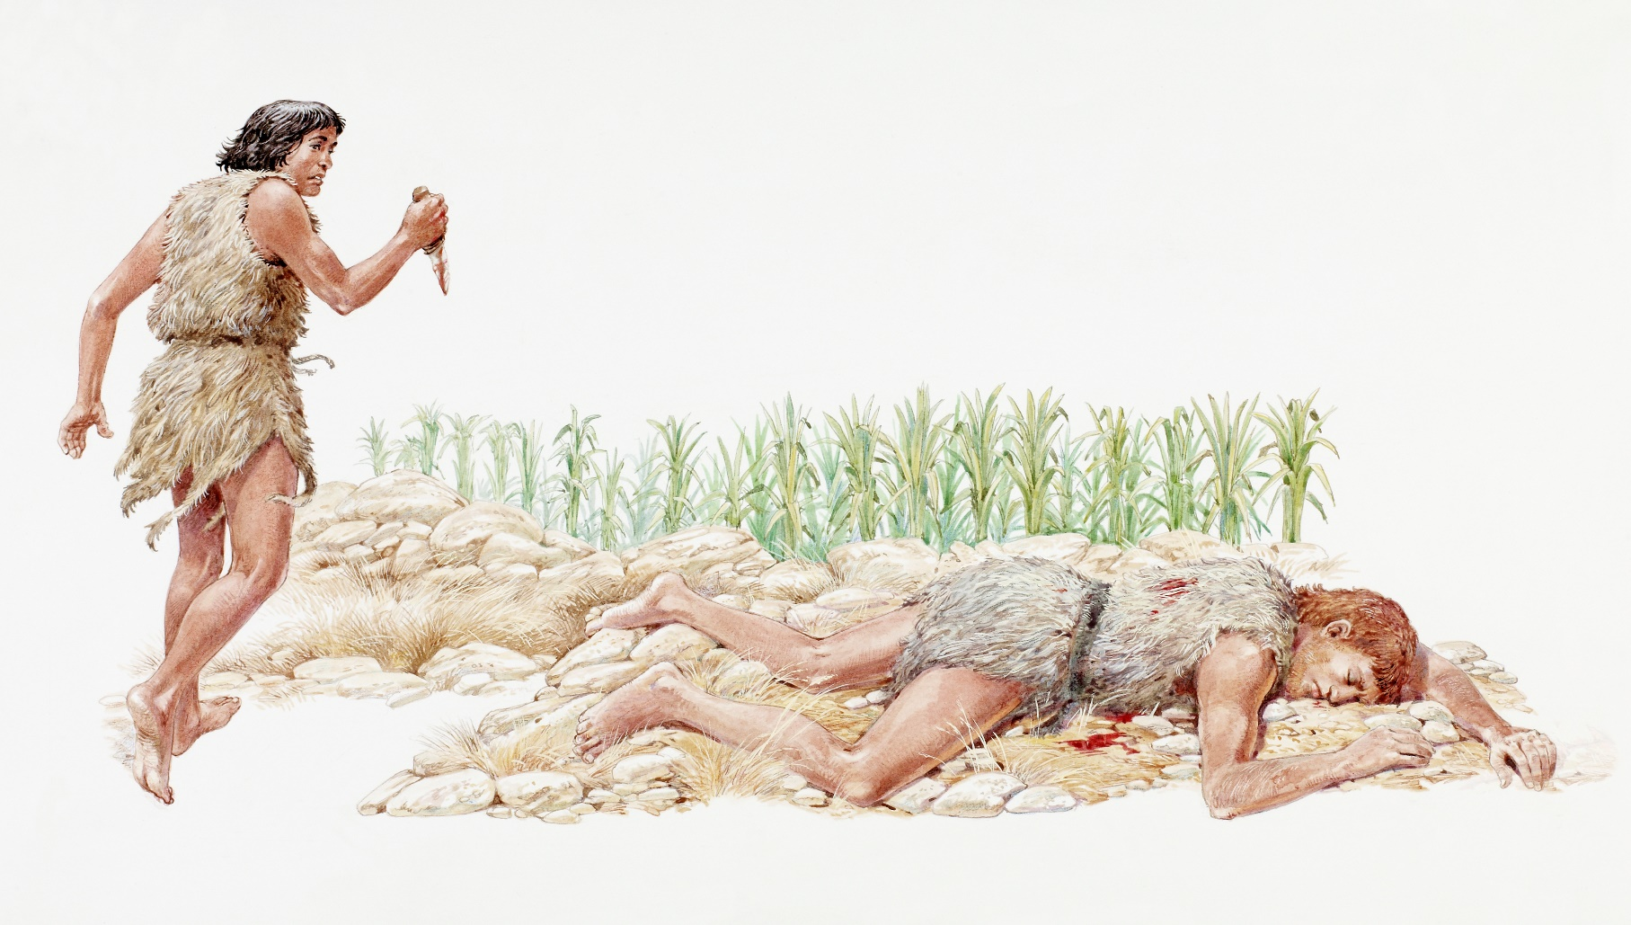
Result of human choice
Notes:
Specifically the result of human choice

Slide 7
Result of human choice
Notes:
It’s easy to see how free choice relates to evil things like murder or rape. One person’s choice directly affects another person.

Slide 8
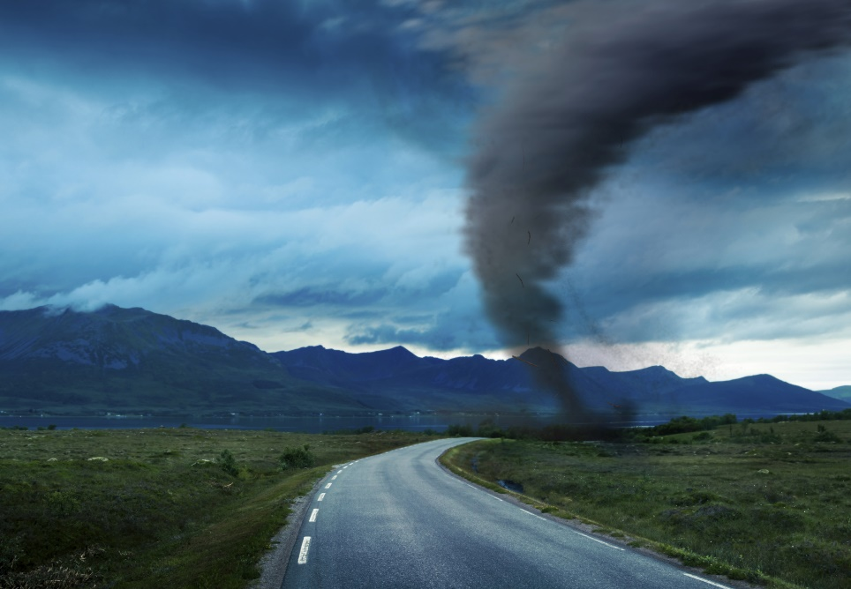
Result of human choice
?
Notes:
But what about parasitic wasps or natural disasters like tornados, hurricanes, or tsunamis? How could those things be the result of humans’ free choice?

Slide 9
Two kinds of evil
Moral Evil
Natural Evil
Notes:
To understand this, we need to think about two kinds of evil: Moral evil and natural evil

Slide 10
God
Notes:
Let’s back up to a time before evil existed in our world.

Slide 11
God
Original human
limitations
Notes:
When God created humans, He intentionally created them with certain boundaries or limitations

Slide 12
God
Original human
limitations
Food
Notes:
For example, they were not allowed to eat whatever they wanted. The fruit of one tree was off-limits.

Slide 13
God
Original human
limitations
Sabbath
Notes:
In addition, Sabbath rest was instituted to prevent their work from absorbing them so much that they would forget who God is and who they were in relation to Him.

Slide 14
God
Original human
limitations
Food
Sabbath
Notes:
These two limitations seemed designed to help Adam and Eve recognize that they were finite creatures under the sovereignty of an infinite God

Slide 15
God
Original human
limitations
Food
Notes:
Satan tempted them to throw off the parameters designed by God. / When they ate the forbidden fruit, they rebelled against their limitations in relation to the sovereign authority of their Creator.

Slide 16
God
Original human
limitations
Food
Rebellion
Notes:
How could a good God deal with the rebellion?

Slide 17
God
Original human
limitations
Notes:
Was there a way He could get them again acknowledge their proper position under their sovereign Creator?

Slide 18
God
Original human
limitations
Consequences:
Painful childbirth
Thorns & thistles
Cursed ground
Death
Notes:
Certain consequences resulted from their disobedience, which all have one thing in common.

Slide 19
God
Original human
limitations
Even more
limitations
Consequences:
Painful childbirth
Thorns & thistles
Cursed ground
Death
Notes:
The consequences given by God in Genesis 3 express an increase in finite limitations on Adam and Eve.

Slide 20
God
Original human
limitations
Satan’s rule
Sin &
death
Even more
limitations
Consequences:
Painful childbirth
Thorns & thistles
Cursed ground
Death
Notes:
In addition to losing their sovereignty over the earth, Adam and Eve experienced one more limitation. / They found themselves under the sovereignty of a hostile power—Satan. This bondage to sin and Satan is the ultimate demonstration of our limits as creatures and our need of a deliverer.

Slide 21
Two kinds of evil
Moral Evil
Natural Evil
Notes:
When we try to understand or explain the existence of evil—both moral evil and natural evil… / there is more to think about than just the rebellious choices made by Adam and Eve and their descendants

Slide 22
God
Original human
limitations
Satan’s rule
Sin
death
Even more
limitations
Consequences:
Painful childbirth
Thorns & thistles
Cursed ground
Death
Notes:
…we also need to consider (1) the additional limitations placed on humanity by God as a result of sin (2) and the effects of Satan’s temporary rule of this earth. Because of some combination of these two things…

Slide 23
Natural Evil
Natural Evil
Notes:
…natural evil exists in our world.

Slide 24
Natural Evil
Satan’s rule
Sin
death
Even more
limitations
Consequences:
Painful childbirth
Thorns & thistles
Cursed ground
Death
Notes:
Natural evil, which is partly imposed by God and partly caused by Satan’s usurping of dominion over this world and wreaking havoc as he tries to transcend his own God-given limits, should be seen as a tool to help teach us our limits and our need of God. Natural evil confronts us with our limitations and reminds us whose power we and the world are temporarily under. It calls us to acknowledge our limits and depend on a God who is wiser than we are and sovereign over both us and Satan.

Slide 25
God
God-imposed limits
Satan’s rule
Sin &
death
Notes:
Fortunately, Satan’s authority is not complete. / He can only operate within the parameters established for him by God.

Slide 26
God
God-imposed limits
“Behold, all that he has is in your power, only DO NOT put forth your hand on him.”
Job 1:12
Satan’s rule
Sin &
death
“Behold, he is in your power, only SPARE HIS LIFE.” Job 2:6
Notes:
In the story of Job, God allowed Satan to destroy Job’s possessions but did not allow Satan to hurt him. / Later, God allowed Satan to attack Job’s body, but did not allow him to take Job’s life.

Slide 27
God
God-imposed limits
“For the good of the entire universe through ceaseless ages Satan must more fully develop his [Satan’s] principles, that his charges against the divine government might be seen in their true light by all created beings, and that the justice and mercy of God and the immutability of His law might forever be placed beyond all question.”
Great Controversy, 497
Satan’s rule
Sin &
death
Notes:
Ellen White in the Great Controversy says: (Read slide)

Slide 28
Behold,
I make all things new.
Rev 21:5
When the time is right
Notes:
Eventually, when the time is right, God will destroy sin and evil and re-create the world in its original perfection.

Slide 29
Notes:
Parasites and other forms of suffering and death will no longer exist.

Slide 30
Biblical theodicy
People
“…long for our bodies to be released from sin and suffering.” Rom 8:23
Natural world
“…looks forward to the day when it will join God’s children in glorious freedom from death and decay.” Rom 8:21
Notes:
Until that time we “long for our bodies to be released from sin and suffering.” / The Bible says that even the natural world “looks forward to the day when it will join God’s children in glorious freedom from death and decay.”

Slide 31
These ideas about theodicy come from:
If God Is Good and All-powerful, How Can He Allow Suffering?
By Stephen Bauer
Notes:
The ideas about theodicy presented here come from this article by Dr. Stephen Bauer in the book Always Prepared. To hear Dr. Bauer’s thoughts about how to find meaning in suffering, watch Parasitism and Theodicy, part 3.

Slide 32
Recorded at
Chattanooga Public RadioSM
Classical 90.5 WSMC

Slide 33
Images By
Images may appear on more than one slide. Citation is given on the first slide where each image appears.
[1a] Ticks and Flea 114163615 Amando Frazao, Thinkstock, Thinkstock Image Subscription Agreement
[1b] Jewel Wasp, unknown artist, http://www.odditycentral.com/animals/insect-body-snatchers-how-the-jewel-wasp-turns-cockroaches-into-zombies.html. Creative Commons Attribution-Non-Commercial-No Derivative works 3.0 Unported license.
[2a] Great black wasp 465171185 PaulReevesPhotography, Thinkstock, Thinkstock Image Subscription Agreement
[2b] Aphids colony 480244113 Dario Lo Presti, Thinkstock, Thinkstock Image Subscription Agreement
[3a] Cockroach 177409316 somchaisom, Thinkstock, Thinkstock Image Subscription Agreement
[5] Vintage old book 95272278, Sharon Bronte, Thinkstock, Thinkstock Image Subscription Agreement
[6] Illustration of Cain and Abel 85594750, Dorling Kindersley, Thinkstock, Thinkstock Image Subscription Agreement
[7a] Photo of a fresh crime scene 462193457, Fergregory, Thinkstock Image Subscription Agreement
[8b] Tornado on road 466433611, andreusK, Thinkstock Image Subscription Agreement
[28a] Palm leaf and tropical beach 121963079, Alexandr Ozerov, Thinkstock Image Subscription Agreement
[28b] Hot Springs 457377547, Bkamprath, Thinkstock Image Subscription Agreement
[28c] Rhododendrons, beautiful Alpine flowers 177985750, Panaramka, Thinkstock Image Subscription Agreement
[31a] Photo of Always Prepared, Carol Raney
[31b] Stephen Bauer, Ph.D., http://www1.southern.edu/academics/academic-sites/religion/faculty/bauer.html)

Slide 34
Special Thanks
Stephen Bauer, PhD
Religion Professor, Southern Adventist University
and the
Foundation for Adventist Education

Slide 35
© Origins Curriculum Resources 2015

Slide 36
© Southern Adventist University 2015

Slide 37
© Seventh-day Adventist North American Division 2015

Slide 38
© General Conference of Seventh-day Adventists 2015

Slide 39
© SCORE Southern Center for Origins Research & Education 2015

