Slide 1
Parasitism & Theodicy, part 3
Finding Meaning in Suffering
Notes:
Parasitism & Theodicy, part 3—Finding Meaning in Suffering

Slide 2
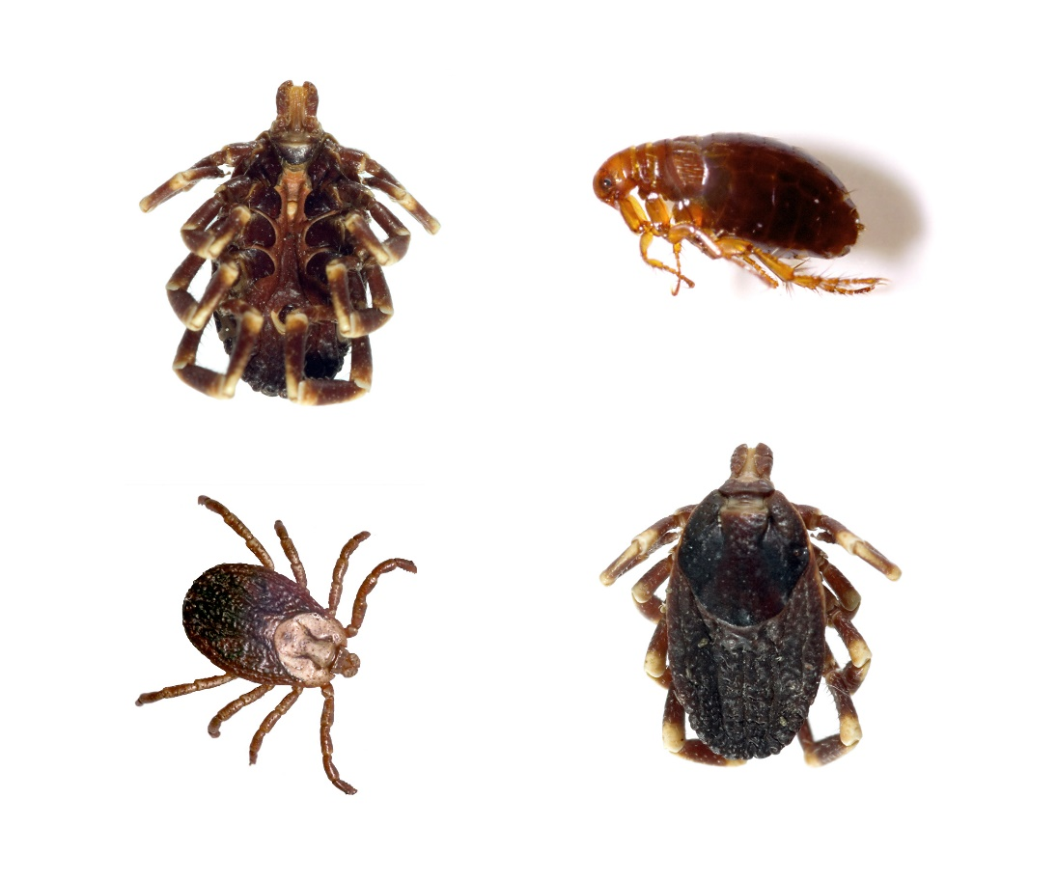
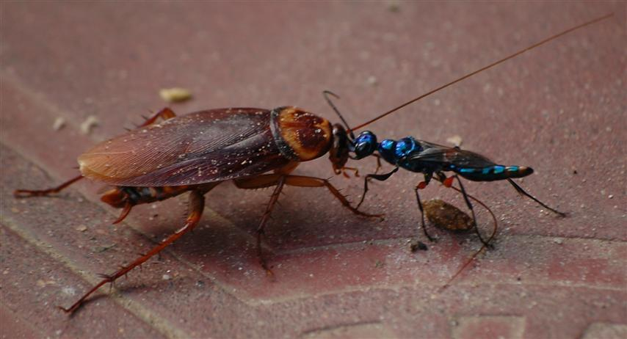
Parasitism and Theodicy
Notes:
In parts 1 and 2 of Parasitism and Theodicy we have explored explanations for the presence of evil in the world.

Slide 3

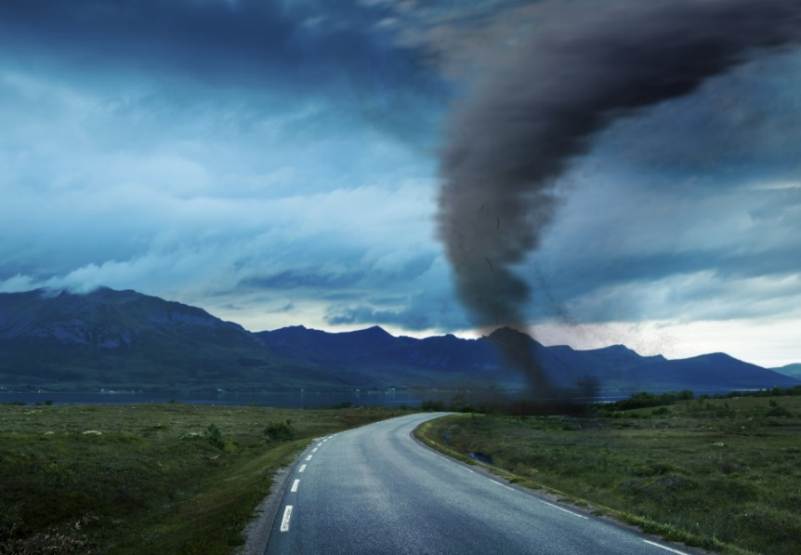
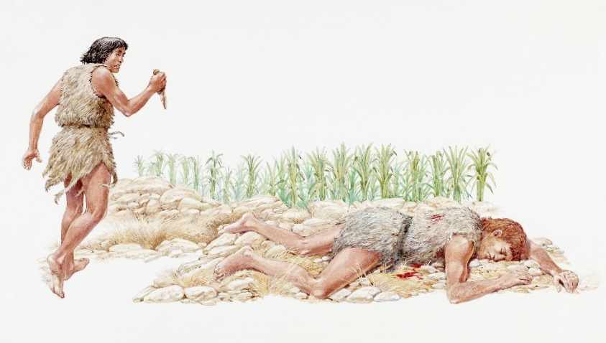
Two kinds of evil
Moral Evil
Natural Evil
Notes:
We have looked at two kinds of evil: moral evil and natural evil.

Slide 4

Natural Evil
Satan’s rule
Sin
death
Even more
limitations
Consequences:
Painful childbirth
Thorns & thistles
Cursed ground
Death
Notes:
We have discussed how natural evil--which is partly imposed by God and partly cause by Satan’s usurping of dominion over this world--calls us to acknowledge our limits and depend on a God who is wiser than we are and sovereign over both us and Satan.

Slide 5



Notes:
We know that eventually God will recreate our world without parasites or evil of any kind.

Slide 6

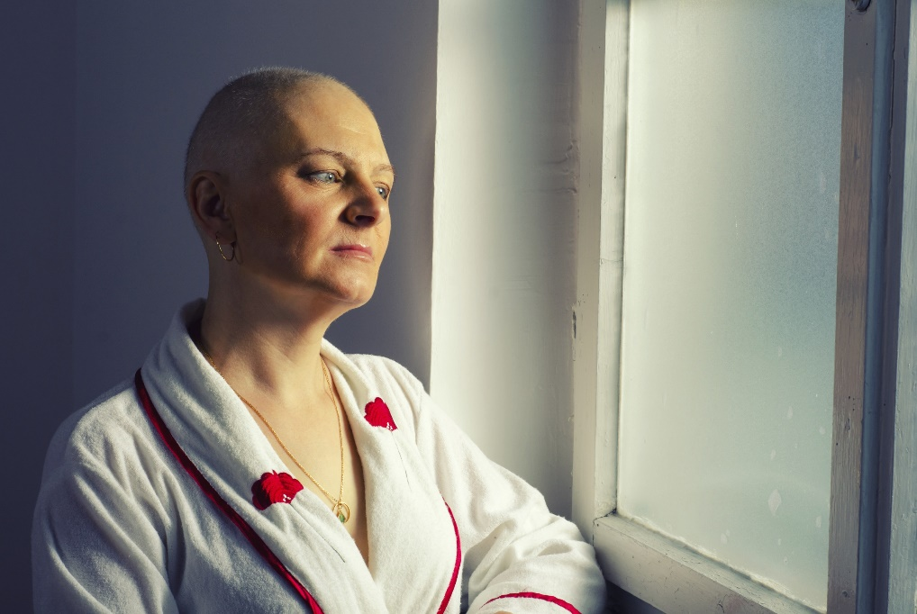
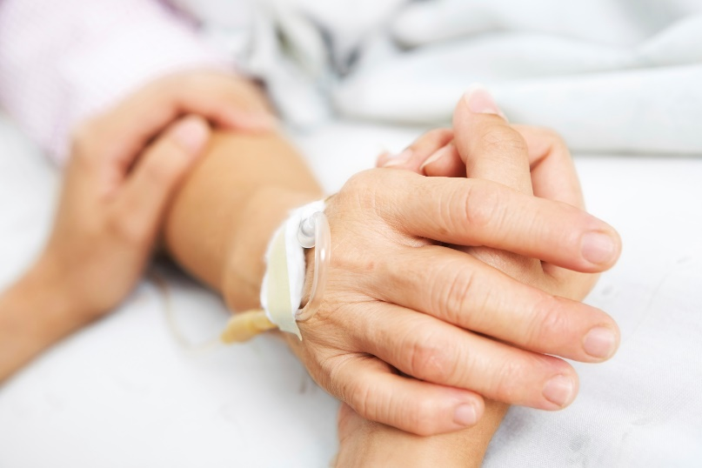
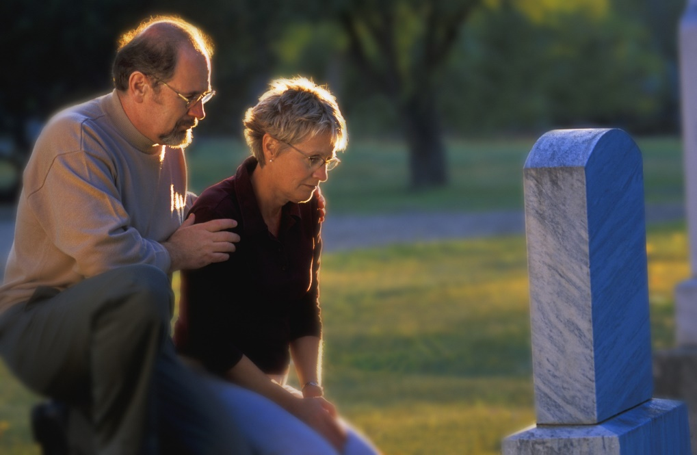

Notes:
But until then, how do we find meaning and comfort during suffering and death?

Slide 7

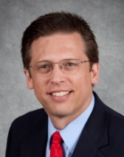
If God Is Good and All-powerful, How Can He Allow Suffering?
By Stephen Bauer
Notes:
This presentation will share personal insights from Stephen Bauer’s article in Always Prepared

Slide 8

Notes:
Imagine a small child who suddenly needs surgery. He doesn’t understand why his parents, who have protected him and cared for him are now letting strangers poke, prod, and hurt him. He does not have an understanding of the bigger picture, so is not yet able to understand why his parents are allowing this to happen to him or that it is in his best interest.

Slide 9
What God Knows
What we know
Notes:
In the same way, we know and see only a fraction of the bigger picture that God sees. Like the small child, we have neither the experience nor the wisdom to understand why God allows certain things to happen.

Slide 10
Finding meaning in suffering
Acknowledge our limits
Recognize mystery
1.
What we know
Notes:
The first step in finding meaning in suffering is to acknowledge how small our box is—/ how limited our knowledge is when compared with the big, eternal picture that God sees. / Once we acknowledge our limits, we realize there are mysteries beyond our understanding.

Slide 11
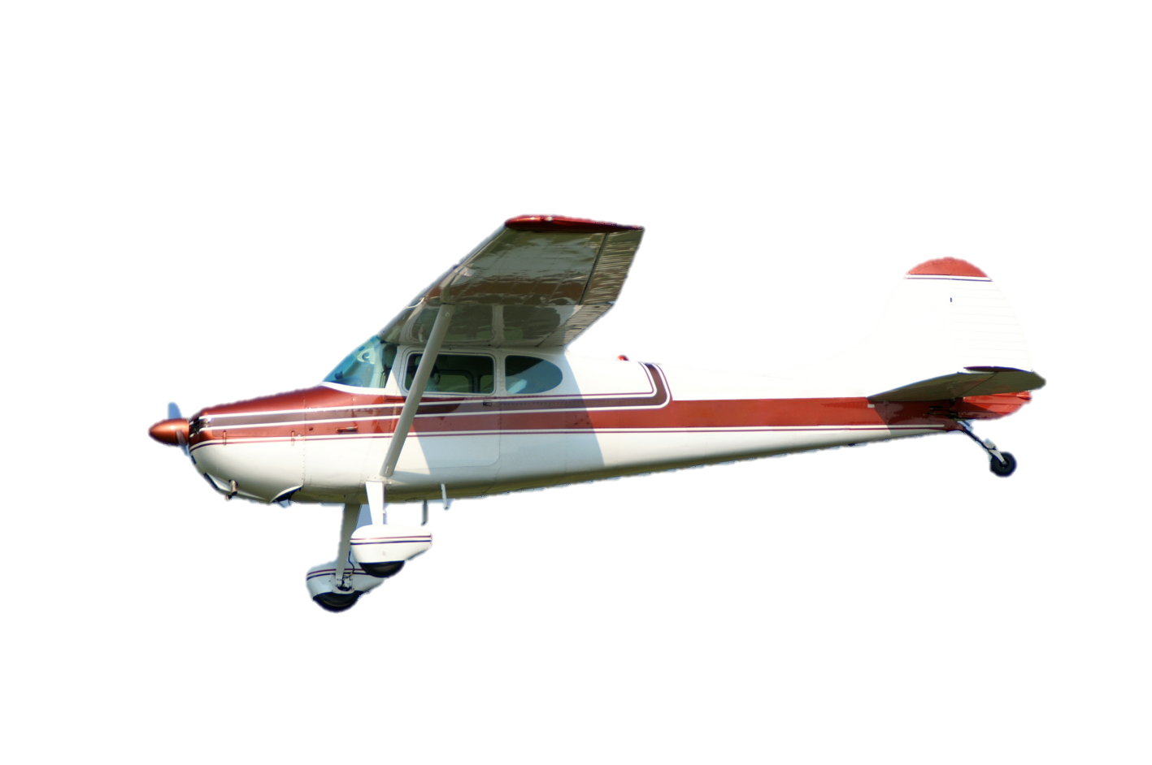
Student Pilot
Notes:
Now imagine a student learning to fly an airplane. Let this rectangle represent the student’s limited knowledge and skills.

Slide 12
Flight Instructor
Student Pilot
Notes:
In order to teach important lessons, the flight instructor may allow the student to exceed his or her limitations--but only within the limits that would allow the flight instructor to still recover the situation.

Slide 13
Flight Instructor
Student Pilot
Outside Control of Flight Instructor--Death
Notes:
A good flight instructor would never allow the student pilot to go so far outside of his or her limitations that the instructor would be powerless to correct the situation.

Slide 14
God
Me
Notes:
Now think about a human being with certain limitations. God knows that life is not possible outside the limitations He has designed. In order to teach valuable lessons, God may allow me to exceed my limitations

Slide 15
God
Me
Beyond God’s Control
Notes:
but like a good flight instructor, He would not willingly allow me to go where He can no longer recover the situation.

Slide 16
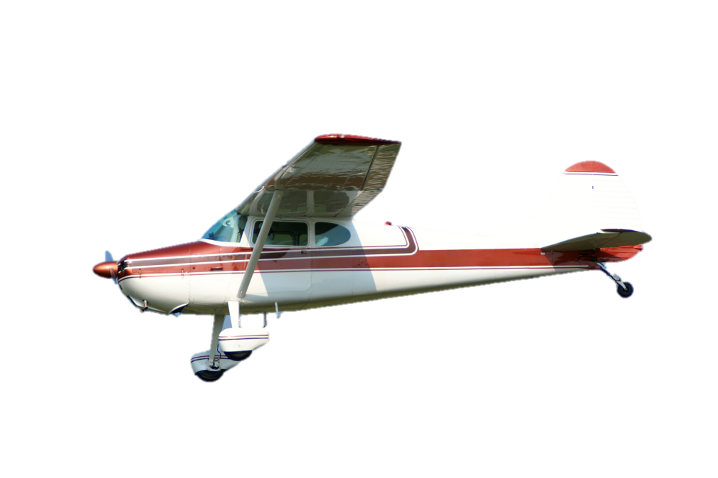
God
Flight Instructor
Me
Student
Pilot
DEATH
Beyond Flight Instructor’s Control
Beyond God’s Control
DEATH
Notes:
Notice an important difference in the illustration that relates to the problem of suffering and death. In the example of the student pilot and the flight instructor, an important limitation is death. / The flight instructor steps in to prevent mistakes that would result in death, because he is incapable of recovering the situation. For us, death is an uncontrollable catastrophe, / but for God, death is a manageable problem that He can use. Because death is not a problem beyond God’s ability to recover, He does not always step in to prevent it.

Slide 17
May allow natural evils, including death, in order to save us eternally
God
Me
DEATH
Won’t give us up without a fight
Notes:
How can it be loving for God to allow death? God will not let a situation endanger our eternal welfare against our will, / but because death helps us acknowledge who we are as limited creatures in need of God, / He may allow suffering and even death to confront us and push us towards corrections compatible with eternal life—because He has the power to recover us from all that and more. / And He won’t give us up without a fight.

Slide 18
God
Original human
limitations
Satan’s rule
Sin
death
Even more
limitations
Consequences:
Painful childbirth
Thorns & thistles
Cursed ground
Death
Notes:
Although suffering and death were never part of God’s original plan for us, / He makes use of both the greater limits He imposed / and Satan’s volitional activity as disciplinary tools to help us bottom out so we will look up to Him and be saved eternally

Slide 19
Recorded at
Chattanooga Public RadioSM
Classical 90.5 WSMC

Slide 20
Images By
Images may appear on more than one slide. Citation is given on the first slide where each image appears.
[2a] Ticks and Flea 114163615 Amando Frazao, Thinkstock, Thinkstock Image Subscription Agreement
[2b] Jewel Wasp, unknown artist, http://www.odditycentral.com/animals/insect-body-snatchers-how-the-jewel-wasp-turns-cockroaches-into-zombies.html. Creative Commons Attribution-Non-Commercial-No Derivative works 3.0 Unported license.
[3a] Photo of a fresh crime scene 462193457, Fergregory, Thinkstock Image Subscription Agreement
[3c] Illustration of Cain and Abel 85594750, Dorling Kindersley, Thinkstock, Thinkstock Image Subscription Agreement
[3d] Tornado on road 466433611, andreusK, Thinkstock Image Subscription Agreement
[5a] Palm leaf and tropical beach 121963079, Alexandr Ozerov, Thinkstock Image Subscription Agreement
[5b] Hot Springs 457377547, Bkamprath, Thinkstock Image Subscription Agreement
[5c] Rhododendrons, beautiful Alpine flowers 177985750, Panaramka, Thinkstock Image Subscription Agreement
[6a] Senior woman with seriously ill husband in hospital 178400371, MonkeyBusinessImages, Thinkstock, Thinkstock Image Subscription Agreement
[6b] Bald cancer patient in hospital 450509411, Prudkov, Thinkstock, Thinkstock Image Subscription Agreement

Slide 21
Images By
[6c] Daughter holding her mother's hand in hospital 155325629, Atno Ydur, Thinkstock, Thinkstock Image Subscription Agreement
[6d] Couple visiting grave 77891165, Design Pics, Thinkstock, Thinkstock Image Subscription Agreement
[6e] WWII veteran funeral 160369613, Ramona Murdock, Thinkstock, Thinkstock Image Subscription Agreement
[7a] Photo of Always Prepared, Carol Raney
[7b] Stephen Bauer, Ph.D. http://www1.southern.edu/academics/academic-sites/religion/faculty/bauer.html
[8] Boy lying with teddy bear in hospital 494386791, Wavebreakmedia Ltd, Thinkstock, Thinkstock Image Subscription Agreement
[11] Private Airplane 167230130, Nancy Nehring, Thinkstock, Thinkstock Image Subscription Agreement

Slide 22
Special Thanks
Stephen Bauer, PhD
Religion Professor, Southern Adventist University
and the
Foundation for Adventist Education

Slide 23

© Origins Curriculum Resources 2015

Slide 24

© Southern Adventist University 2015

Slide 25

© Seventh-day Adventist North American Division 2015

Slide 26

© General Conference of Seventh-day Adventists 2015

Slide 27

© SCORE Southern Center for Origins Research & Education 2015

