Slide 1
3-Step Conflict Resolution
From Choose You This Day
by Leonard Brand and Richard Davidson
Notes:
Three-Step Conflict Resolution

Slide 2


Science Challenges the Bible
?
Notes:
At various times throughout history, science has challenged the Christian understanding of the Bible. The questions raised by science have sometimes shaken the confidence of many in the reliability of Scripture. (pages 11-12)

Slide 3

The Bible is the inspired word of God, and we do not need to fear that honest investigation will disprove it. (page 16)
The Bible is the standard against which all the elements of our belief system must be assessed. (page 16)
Notes:
In Choose You This Day, the authors start by assuming that the Bible is the inspired word of God and we do not need to fear that honest investigation will disprove it. The Bible is the standard against which all the elements of our belief system must be assessed. (page 16)

Slide 4
Three-Step Conflict Resolution
Stage 1
Stage 2
Stage 3
Notes:
Then they describe a three-step process for handling the apparent conflicts between science and scripture.

Slide 5
Three-Step Conflict Resolution
Conflict & Confusion
Research & Study
Resolution & Insight
1
2
3
Notes:
Step 1 is conflict and confusion; / step 2 is research and study; / and step 3 is resolution and insight

Slide 6
Three-Step Conflict Resolution
1
Conflict & Confusion
Research & Study
Resolution & Insight
Conflict & Confusion
?
Science
Religion
Notes:
In step 1 a conflict appears between the claims of science and scripture. / This can happen when science asks a difficult question of the Bible….

Slide 7
Three-Step Conflict Resolution
1
Conflict & Confusion
Research & Study
Resolution & Insight
Conflict & Confusion
?
Science
Religion
Notes:
…or when the Bible asks a difficult question of science.

Slide 8
Three-Step Conflict Resolution
Conflict & Confusion
Research & Study
Resolution & Insight
2
Research & Study
Science
Religion
Observations
Experiments
Analysis of data
Interpretation
Compare Scripture with Scripture
Linguistic Analysis
Determining the Context
Notes:
To solve the apparent conflict, / scientists collect more data and analyze it in ways they might not have thought of before. / Bible scholars compare scripture with scripture, analyze linguistic data, and work to understand the context of the passage more carefully than ever before.

Slide 9
Three-Step Conflict Resolution
Conflict & Confusion
Research & Study
Resolution & Insight
Resolution & Insight
Soon
Long time
Notes:
In a thoughtful interfacing of scientific and biblical interpretations, we seek resolution to the conflict. / Sometimes it’s possible to come to a resolution rather quickly. / Other times we may have to wait a long time to fully understand both scientific evidence and the Bible.

Slide 10
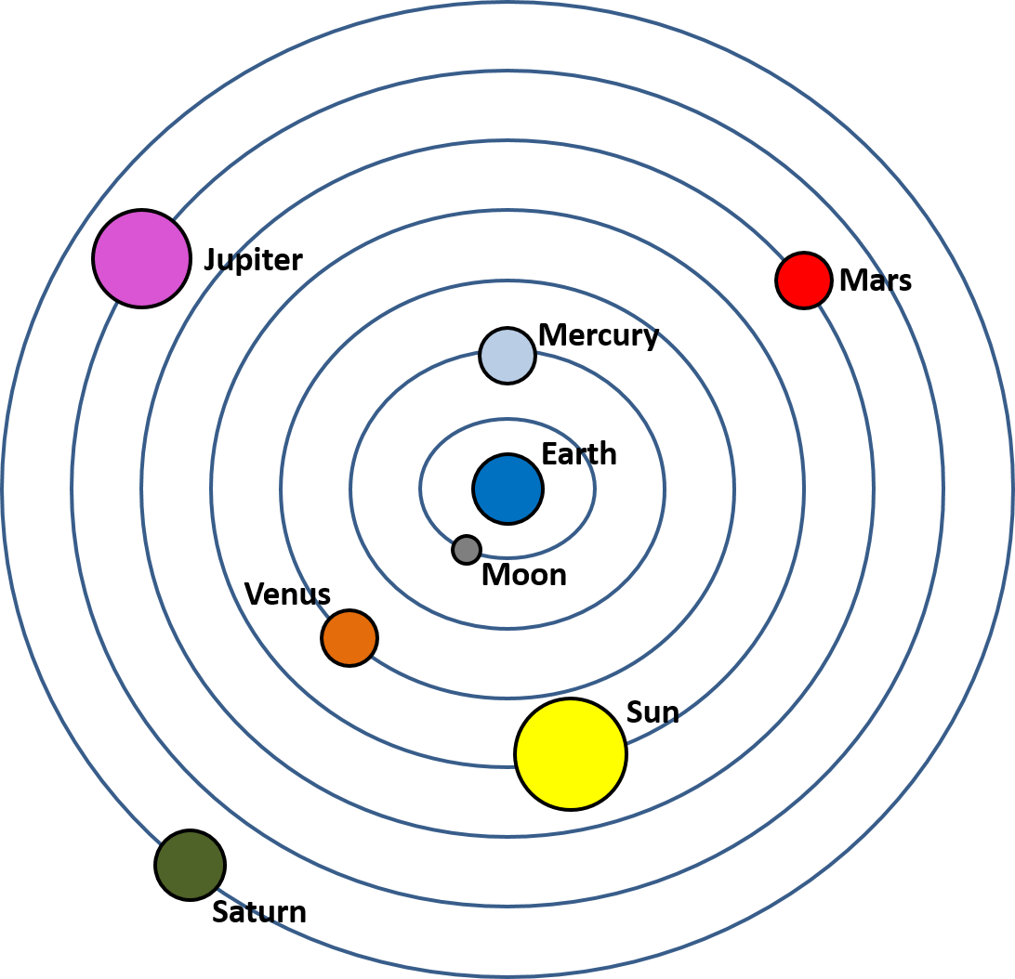
Geocentric Theory
Sun orbits earth
  Standard science
  Orthodox Christian belief
Notes:
Page 17
During Galileo’s lifetime, a geocentric universe—where the sun orbits the earth—was both standard
science and orthodox Christian belief. Before Copernicus and Galileo, there had been no reason to question it.

Slide 11
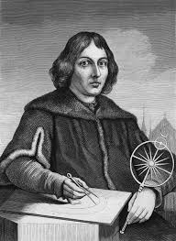
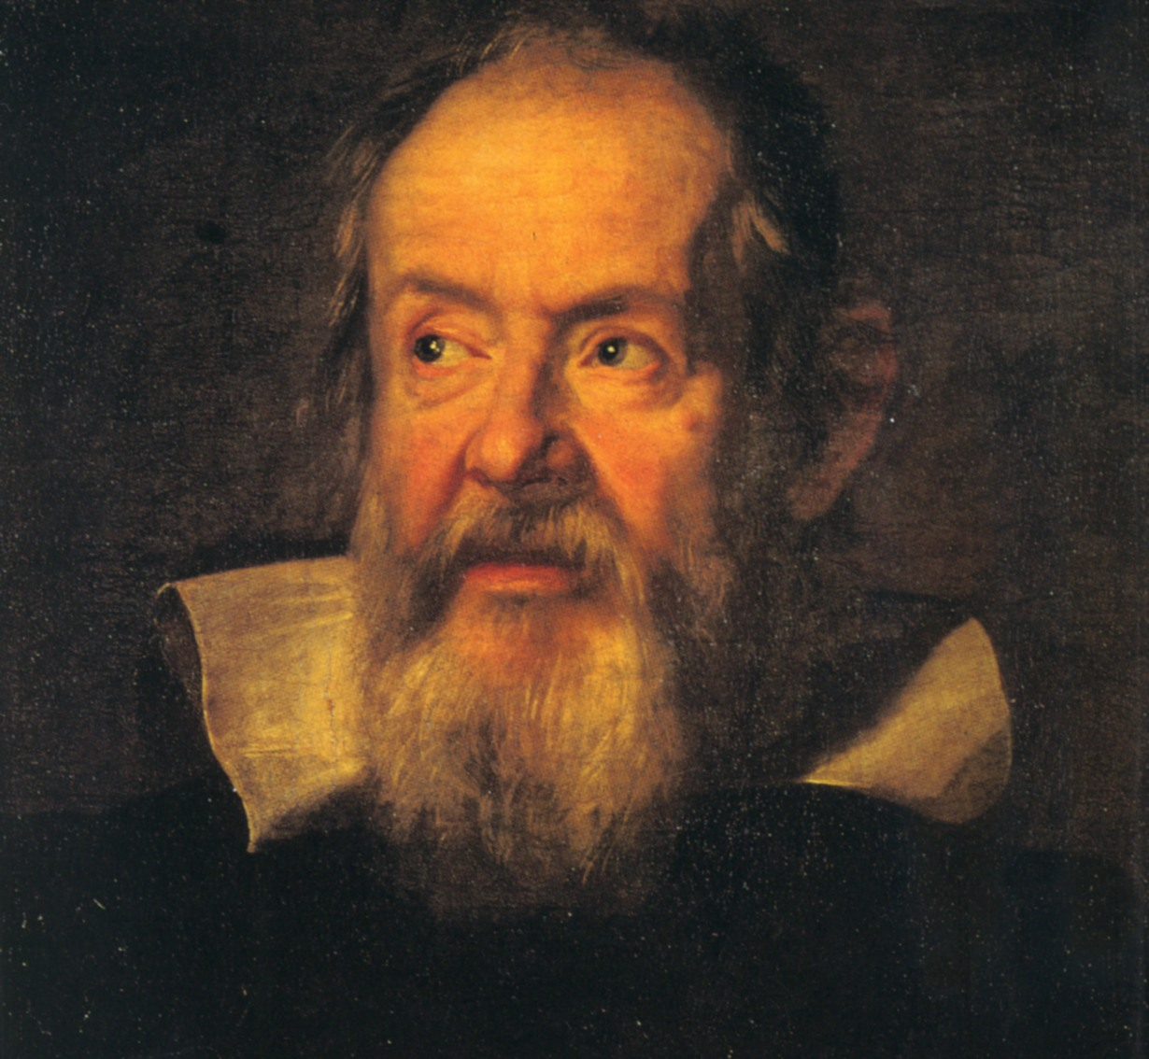
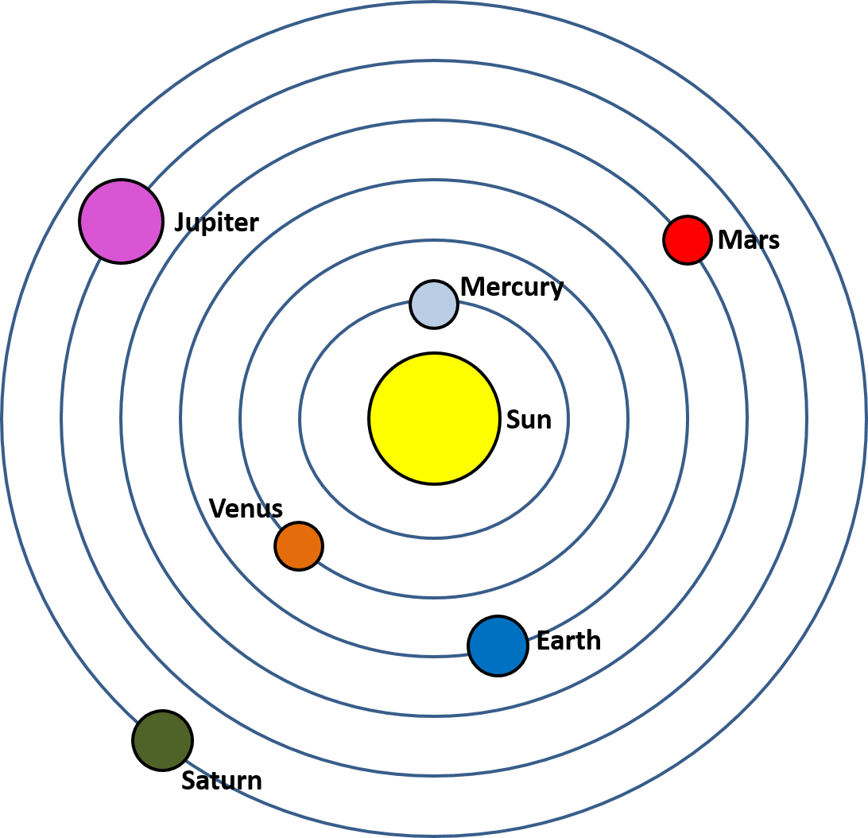
Heliocentric Theory
Copernicus
Galileo
Earth turns on its axis and revolves around the sun
Notes:
Page 17
But the new scientific claim that the earth turns on its axis and revolves around the sun instead, created a conflict.

Slide 12
Three-Step Conflict Resolution
Conflict & Confusion
Research & Study
Resolution & Insight
1
Notes:
It appeared that the heliocentric model of the universe conflicted with verses from the Bible that seemed to indicate that the sun moved but the earth stood still.

Slide 13
The sun also rises, and the sun goes down, and hastens to the place where it arose.
(Ecclesiastes 1:5 see also Psalm 19:6)
The world is established so that it cannot be moved. Psalm 93:1
You who laid the foundations of the earth so that it should not be moved forever. Psalm 104:5
Notes:
For example, Ecc 1:5 describes the sun rising and setting, / and multiple verses in Psalms describe the world as not moving

Slide 14
Three-Step Conflict Resolution
2
Research & Study
What did the author intend?
Science
Religion
Observations
Experiments
Analysis of data
Interpretation
Compare Scripture with Scripture
Linguistic Analysis
Determining the Context
Notes:
Scientists continued to collect more data and it was eventually determined that the earth, in fact, does orbit the sun./ Quite a while later, Bible scholars used the tools of their trade to examine what information the author intended to convey in the text.

Slide 15
The sun also rises, and the sun goes down, and hastens to the place where it arose.
(Ecclesiastes 1:5 see also Psalm 19:6)
The world is established so that it cannot be moved. Psalm 93:1
You who laid the foundations of the earth so that it should not be moved forever. Psalm 104:5
Notes:
Bible scholars determined that in their immediate context, these verses simply describe the way the sun appears to rise and set—just like we continue to describe it today. / The verses about the earth being established and not moving are found in passages about the greatness and majesty of God, and refer to the power of God in keeping the world safely and securely in its place. They are not describing the motion of the world, but the fact that the world is under God’s control.”

Slide 16
Three-Step Conflict Resolution
3
Conflict & Confusion
Research & Study
Resolution & Insight
Resolution & Insight
Geocentric universe came from Greek philosophy not the Bible
Took time
Notes:
In the end, scholars determined that the idea of a geocentric universe did not originally come from the Bible at all. / Because of Greek influence, the errors of their cosmology were actually being read into the Bible. The perceived conflict between science and the Bible hadn’t really existed at all. / The resolution to this perceived conflict took time.

Slide 17
Science Helped Us Understand the Bible
Notes:
In this case, hard questions asked by science helped us understand the Bible better.

Slide 18
Three-Step Conflict Resolution
1
Conflict & Confusion
Research & Study
Resolution & Insight
Conflict & Confusion
?
Science
Religion
Species Change
Fixity of Species
Notes:
The same thing happened later when science challenged another commonly held belief. / The fixity of species, as it was called, stated that “every animal and plant species was created fixed and unchangeable.” Many people believed the fixity of species was taught in the Bible, / but it was clear from their observations of the natural world that species of animals and plants had changed and continued to change. Once again, there appeared to be a conflict between science and scripture.
(page 23)

Slide 19
Three-Step Conflict Resolution
Conflict & Confusion
Research & Study
Resolution & Insight
2
Research & Study
Science
Religion
Species
Change
Genesis says changes would occur
Notes:
In stage two, / continued scientific research demonstrated that species change. / After deeper study of the Bible, scholars realized that Genesis does indicate changes would occur, particularly in the curses pronounced in Genesis 3.

Slide 20
Three-Step Conflict Resolution
3
Conflict & Confusion
Research & Study
Resolution & Insight
Resolution & Insight
Fixity of species came from
Greek philosophy
not the Bible
Took time
Notes:
Just like the geocentric universe, fixity of species originated in Greek philosophy and was being read into the Bible. Once again, the original conflict didn’t really exist at all, / but it took time to figure that out.

Slide 21
Science Helped Us Understand the Bible
Change in Species
Notes:
Once again, questions asked by science helped us understand the Bible better.

Slide 22
The Bible Contributes Scientific Insights
Notes:
Now let’s look at some examples where belief in the Bible has contributed scientific insights

Slide 23
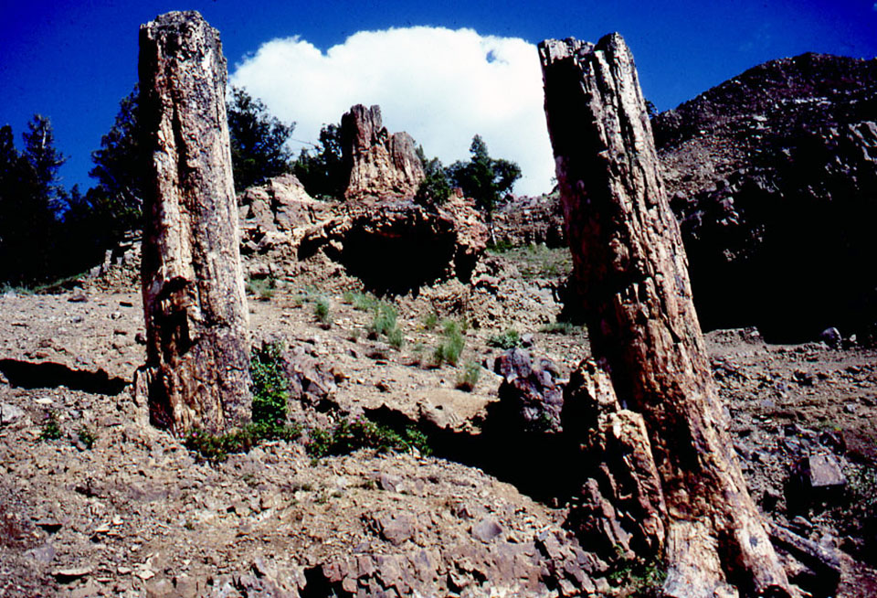
Three-Step Conflict Resolution
1
Conflict & Confusion
Research & Study
Resolution & Insight
Conflict & Confusion
?
Science
Religion
Long
Time
Short
Time
Yellowstone Fossil Forests
Notes:
The Bible describes life on earth as recent—only a few thousand years old. / the fossil forests in Yellowstone National Park appeared to conflict with this idea. / Scientists claimed that each fossil forest would have grown for up to a thousand years, been killed, buried by volcanic eruptions, and fossilized. Then another forest would grow and the cycle would be repeated. Scientists concluded this cycle had been repeated more than a hundred times. / The many thousands of years associated with the fossil forests was in conflict with the few thousand years of the Bible.
(page 47)

Slide 24
Three-Step Conflict Resolution
Conflict & Confusion
Research & Study
Resolution & Insight
2
Research & Study
Science
Religion
Uprooted, dead trees transported by volcanic mudflows and deposited upright
Short time span
(few thousand years)
Notes:
In-depth Bible study continued to indicate a short time span for life on earth. / Creationist researchers continued to examine the evidence and concluded that instead of successive forests growing in place, it was more likely that the fossil forests resulted from uprooted, dead trees being transported by repeated volcanic mudflows and deposited in the upright positions in which they are found (page 47)

Slide 25
Three-Step Conflict Resolution
3
Conflict & Confusion
Research & Study
Resolution & Insight
Resolution & Insight
Evidence of transport is consistent with the Bible
Took time
Notes:
Once again, it took time to resolve the apparent conflict.

Slide 26
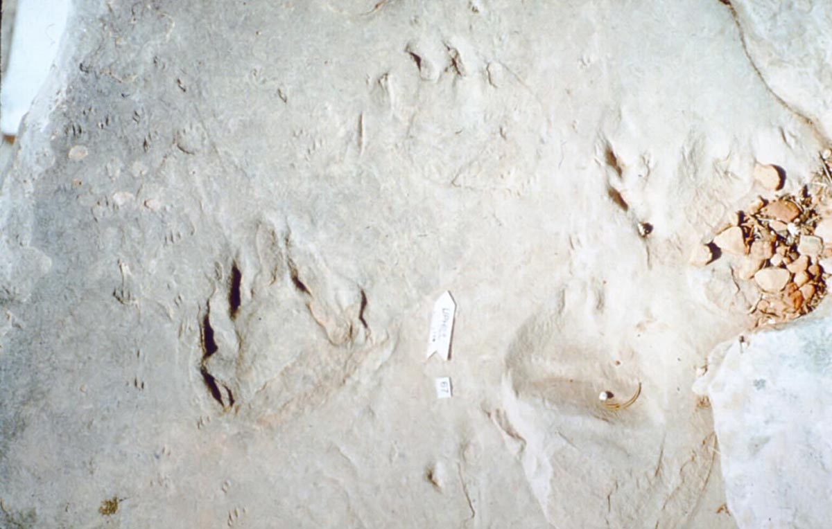
Three-Step Conflict Resolution
1
Conflict & Confusion
Research & Study
Resolution & Insight
Conflict & Confusion
?
Science
Religion
Desert
?
Notes:
Another example of how belief in the Bible has contributed scientific insights is found in the Coconino Sandstone in the Grand Canyon. / Fossil tracks found there are usually interpreted as having been formed on desert sand dunes. / But some scientists who believe in the Bible wondered how those tracks fit with the story of the flood.
Conconino sandstone trackways (page 48)

Slide 27
Three-Step Conflict Resolution
Conflict & Confusion
Research & Study
Resolution & Insight
2
Research & Study
Science
Religion
Laboratory experiments indicate tracks were likely made underwater
Consistent with the story of the Flood
Notes:
These scientists performed laboratory experiments, / demonstrating that the tracks were likely made underwater instead.

Slide 28
Three-Step Conflict Resolution
3
Conflict & Confusion
Research & Study
Resolution & Insight
Resolution & Insight
Tracks were made underwater
Took time
Notes:
Eventually, more research resolved what appeared to be a conflict between science and the Bible. These, and other examples from the book can give us confidence while we wait for current conflicts to be resolved.

Slide 29
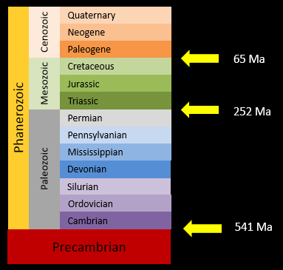
Current Conflict—Age of the Earth
1
Conflict & Confusion
Research & Study
Resolution & Insight
Conflict & Confusion
?
Science
Religion
Millions
of years
Thousands of years
Notes:
One current conflict is over the age of the earth. / Using radiometric dating, scientists claim that the earth is millions of years old, / while the Bible indicates that creation week was only several thousand years ago.

Slide 30
Three-Step Conflict Resolution
Conflict & Confusion
Research & Study
Resolution & Insight
2
Research & Study
Science
Religion
Research continues
Short time span
(few thousand years)
Notes:
In-depth Bible study continues to indicate a short time span for life on earth, / and scientists continue to study the process of radiometric dating to try to resolve the apparent conflict.

Slide 31
Three-Step Conflict Resolution
3
Conflict & Confusion
Research & Study
Resolution & Insight
Resolution & Insight
Resolution of this conflict is still in the future
Takes time
Notes:
Scientists who believe that the Bible is the inspired word of God and the standard against which all elements of our belief system must be assessed, continue to research and study. / They can rest assured that—however long it takes—the apparent conflict will eventually be resolved.

Slide 32
Images By
Images may appear on more than one slide. Citation is given on the first slide where each image appears.
[2a] Vintage old book 95272278, Sharon Bronte, Thinkstock, Thinkstock Image Subscription Agreement
[2b] Science icon 23262816, VLADGRIN, Getty Images (US), Inc. Subscription
[10] Geocentric Universe, Thomas Bartlett
[11a] Nicolaus Copernicus, Unknown, https://commons.wikimedia.org/wiki/File:Copernicus.jpg, public domain
[11b] Galileo Galilei, Justus Suttermans, https://commons.wikimedia.org/wiki/File:Galileo-sustermans.jpg, public domain
[11c] Heliocentric Universe, Thomas Bartlett
[23] Yellowstone Fossil Forest, Leonard Brand, used with permission

Slide 33
Special Thanks
Leonard Brand, PhD
Earth and Biological Sciences
Loma Linda University
Richard M. Davidson, PhD
Seventh-day Adventist Theological Seminary
Andrews University
and the
Foundation for Adventist Education

Slide 34

© Origins Curriculum Resources 2015

Slide 35

© Southern Adventist University 2015

Slide 36

© Seventh-day Adventist North American Division 2015

Slide 37

© General Conference of Seventh-day Adventists 2015

Slide 38

© SCORE Southern Center for Origins Research & Education 2015

