Slide 1
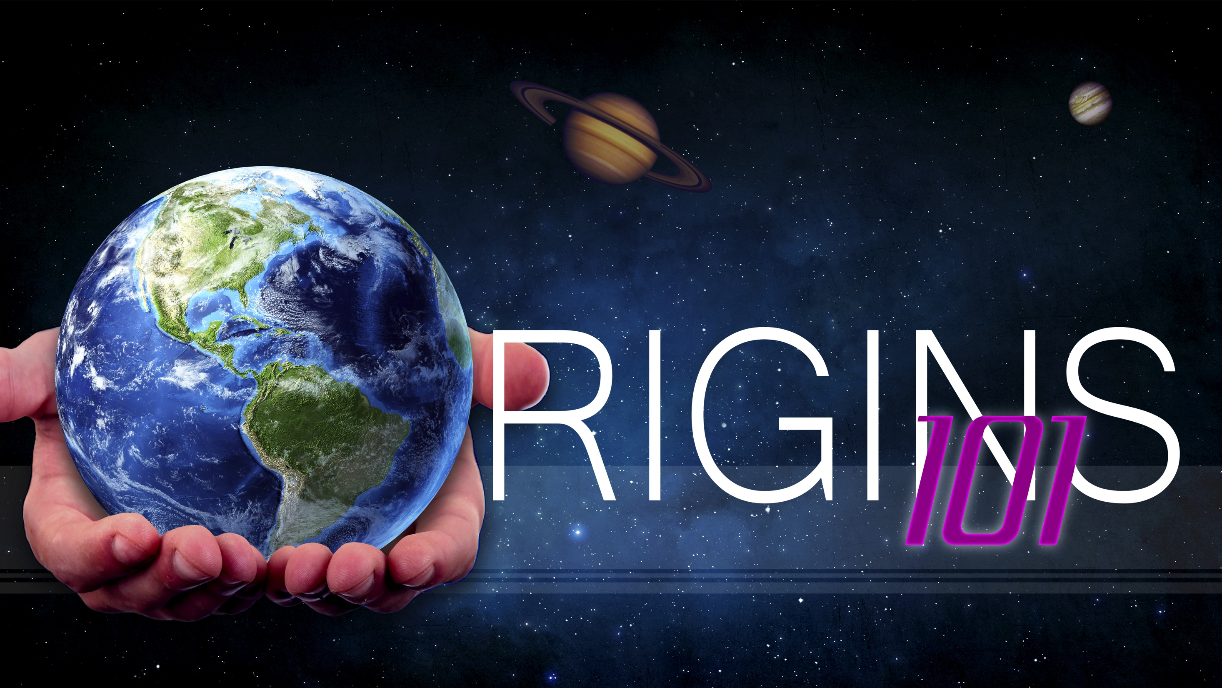
Design
Notes:
Origins 101--Design

Slide 2


What would you think?
Notes:
What would you think if you found an iPad or a cell phone in the woods somewhere? Would you be more likely to think their pieces had been blown together in a recent storm or that they had been left there by someone?

Slide 3

William Paley—18th Century
When we see evidence of planning, craftsmanship, beauty, and usefulness, we recognize that those things come from a designer.
Notes:
In the 18th century, a man named William Paley used a watch to illustrate the same point—that when we see evidence of planning, craftsmanship, beauty, and usefulness, we recognize that those things come from a designer.

Slide 4
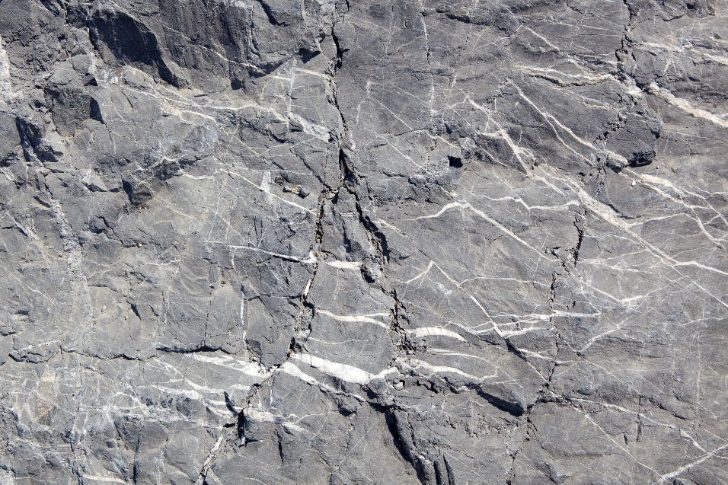

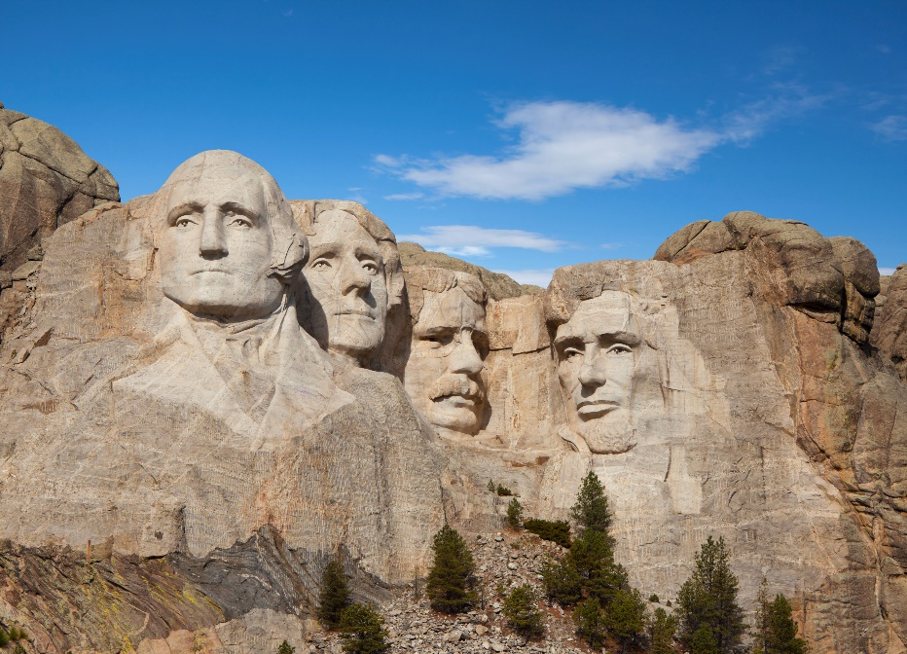
Design?
Design?
Notes:
Compare these rocks. Which picture shows the result of something purposely designed? Even though we recognize the artistic beauty of the naturally eroded arch, we intuitively recognize Mount Rushmore as the one that was designed.

Slide 5
More Rigorous Design Argument
Scientists have tried to identify design in a more empirical way.
William Dembski created the Explanatory Filter
Includes three criteria
Dembski infers design only after evaluating the object in question using three different criteria
Notes:
But scientists want to do more than just intuitively recognize design. / They want to identify design in a more empirical way. / In an attempt to make the design argument more rigorous, William Dembski created what he calls the Explanatory Filter. / Explanatory Filter includes three separate criteria, / and Dembski infers design only after evaluating the object in question using all three of these criteria.

Slide 6
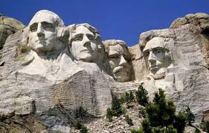
Explanatory Filter
Contingency factor
Does a law explain it?
NOT
Design
Yes
No
Notes:
He calls the first criterion the contingency factor. / This criterion basically asks whether any law explains the existence of the object in question—/ Mount Rushmore, for example. / If there IS a law that requires it to exist in that way, (in other words—if there was no other possible way it could exist) / then we would not infer design. / If there is not any law that requires it to have existed in that way, then we move on to the second criterion.

Slide 7
Explanatory Filter
Contingency factor
Complexity
Does a law explain it?
NOT
Design
Yes
No
Does chance explain it?
NOT
Design
Yes
10
150
Less than
No
Notes:
The second criterion has to do with complexity / and asks whether its existence could be explained by chance. / If it is simple enough that it could be explained by chance, / then we would not infer design. / But if the probability of something this complex occurring by chance is less than ten to the 150th power, / then we move on to the third criterion.

Slide 8
Explanatory Filter
Contingency factor
Complexity
3. Specificity
Does a law explain it?
NOT
Design
Yes
No
Does chance explain it?
NOT
Design
Yes
No
Notes:
The third criterion is specificity.

Slide 9

Slek owjkel silejks wwezjkl
Please pass the lemonade
Complexity
Complexity & Meaning
= Specificity
Notes:
To understand what specificity means, look at this sequence of letters. Imagine you were going to try to get this exact sequence of letters by drawing letter tiles randomly from a pile. It would be unlikely for you to draw this complex sequence randomly. / We call this complexity / But look at this sequence of letters. Like the first sequence, this sentence is also complex. / But in addition, the sequence of letters also carries meaning. When something complex also has meaning, we call it specified or say is has specificity.

Slide 10
Explanatory Filter
Contingency factor
Complexity
3. Specificity
(or specified complexity)
Does a law explain it?
NOT
Design
Yes
No
Does chance explain it?
NOT
Design
Yes
No
Is it specified?
(Does it have meaning?)
NOT
Design
No
Yes
Notes:
So the third criterion asks if it is specified. This means, “Does it match some pre-existing pattern so that it has meaning?” / If it does not have meaning, / then we do not infer design. / But if, in addition to being complex, it is also specified, we do infer design.

Slide 11


Does a law explain it?
No
Does chance explain it?
Design
No
Is it specified?
(Does it have meaning?)
Yes
Notes:
Let’s review the process using these examples. / There is no law that would require rocks to look like four of our past presidents or for certain parts to assemble into a cell phone or a pocket watch. /Mathematically it is not reasonable to expect these things to form by chance. / And all of these things involve not just complexity, but specific meaning. According to the explanatory filter, / each of these objects contains sufficient evidence to indicate that it was intelligently designed.

Slide 12

Not Just Complexity
Specified Complexity
“Please pass the lemonade.”
Irreducible Complexity
Minimum number of parts necessary to function
All parts present simultaneously
Notes:
We have seen that it requires more than just complexity to infer design. / Specified complexity is necessary. / Another kind of complexity that is necessary to infer design is irreducible complexity. / In order for something— like this mouse trap for example—to be irreducibly complex, / it must have a certain minimum number of parts to be able to function, / and all those parts must be present simultaneously.

Slide 13
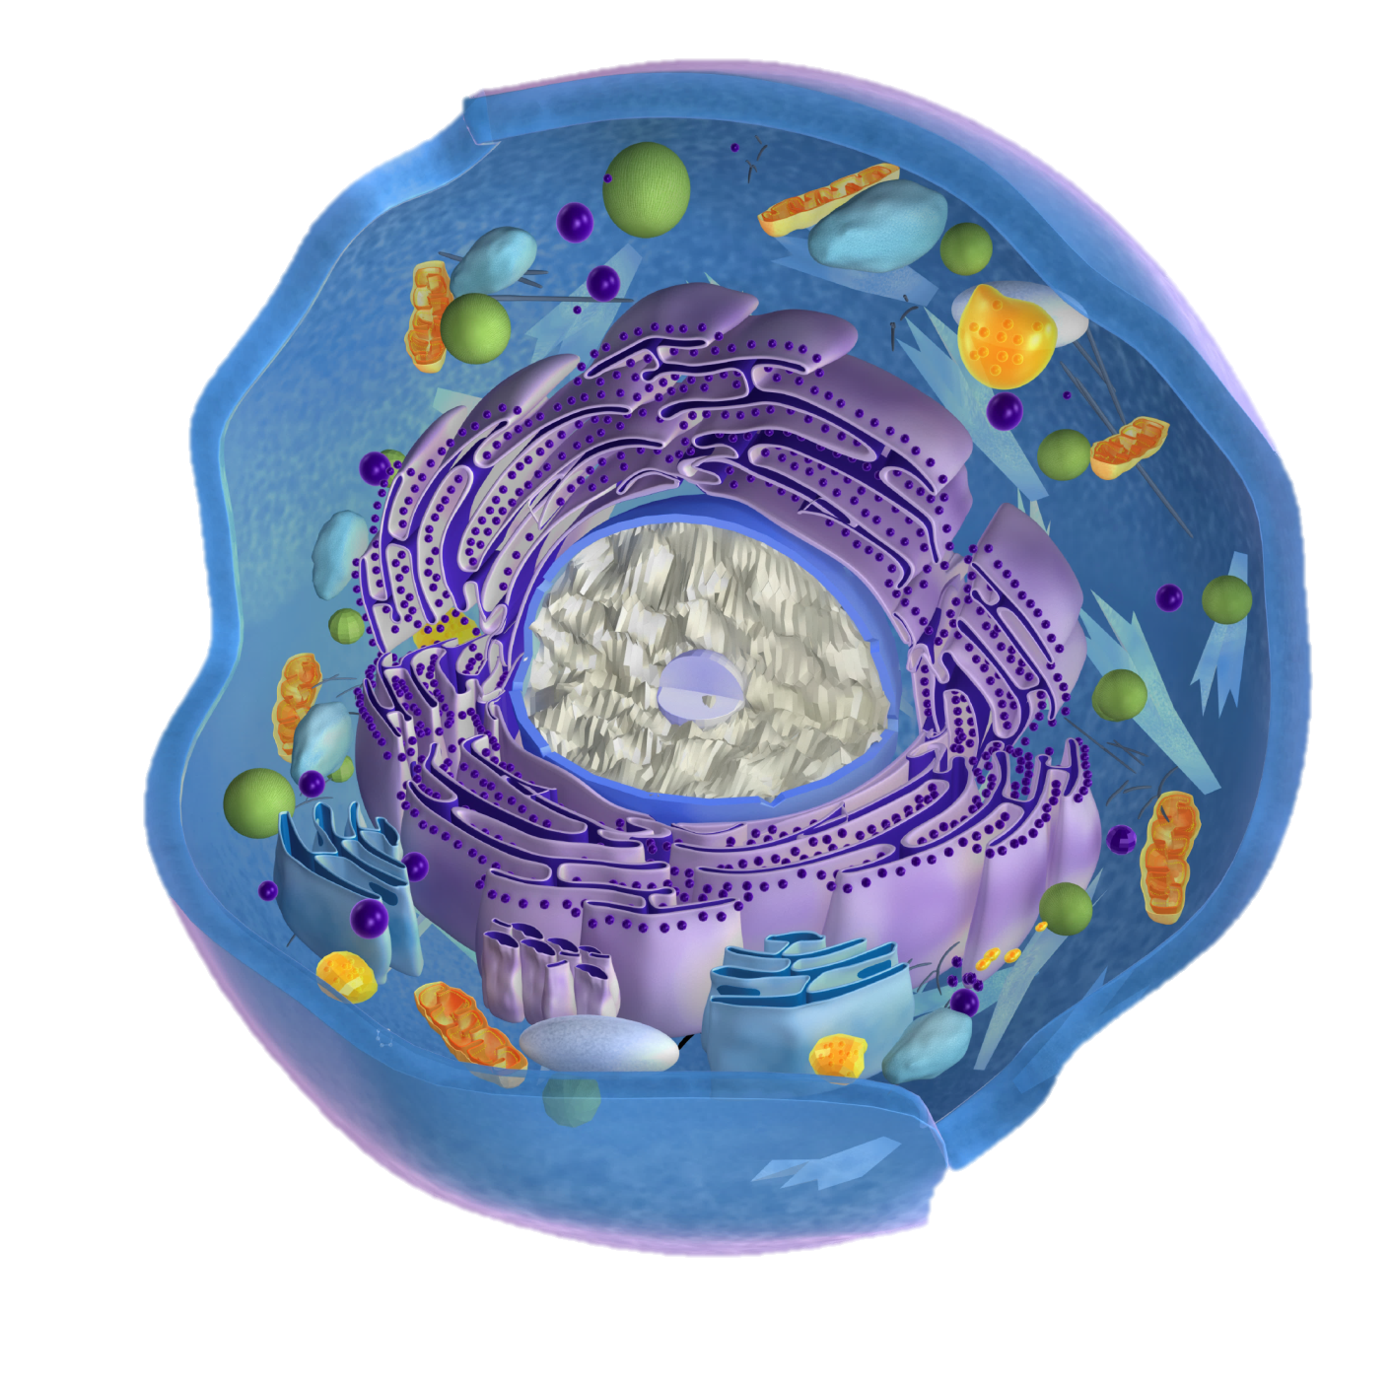
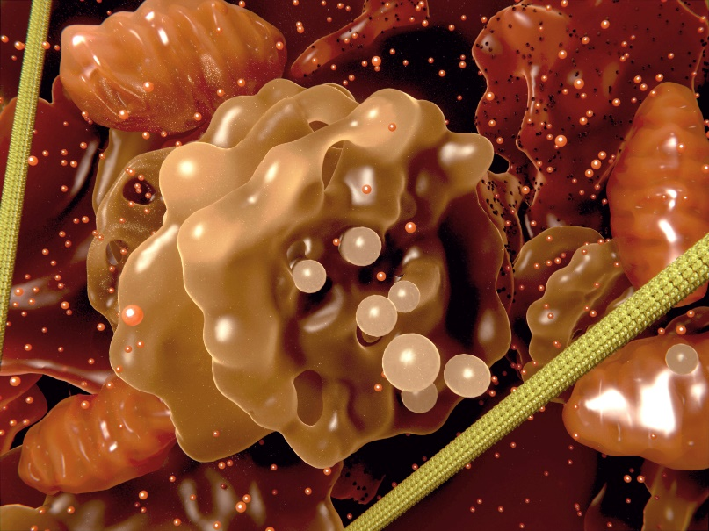
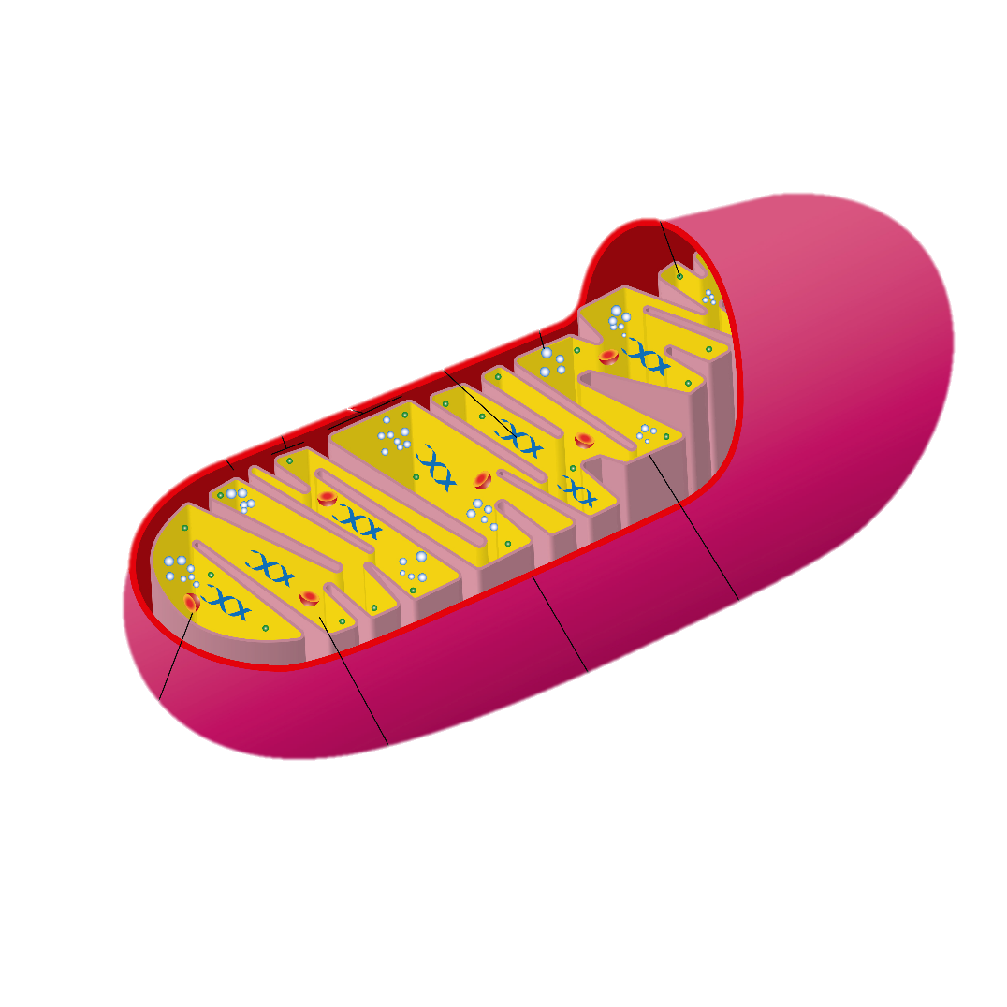
Irreducibly Complex Molecular Machines
Notes:
Each of your body’s hundred trillion cells contains hundreds of different organelles. Each organelle includes thousands of types of irreducibly complex machines—literally machines—with multiple moving parts that work together to perform specific jobs. Without them, the cell would not be alive.

Slide 14
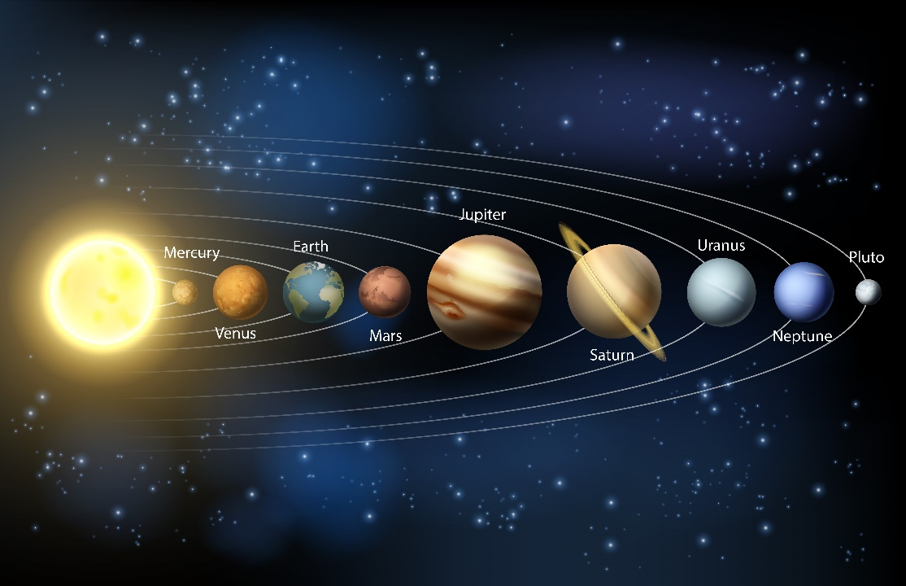
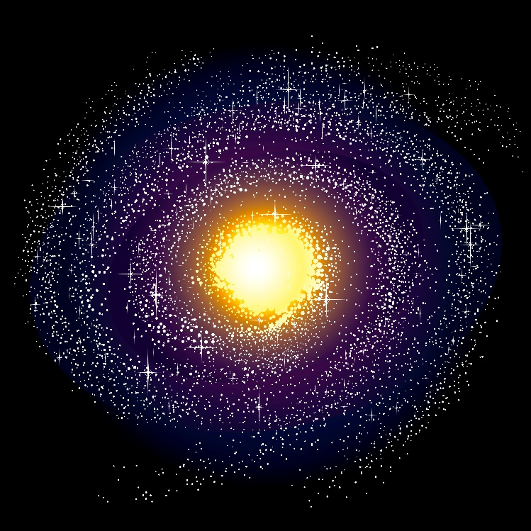
Finely-Tuned Universe
“The Heavens Are Telling: A Biblically Informed Cosmology,”
chapter 12 of In the Beginning—Science and Scripture Confirm Creation, edited by Bryan W. Ball
Notes:
But it’s not just living things that show evidence of a designer—our solar system, the Milky Way Galaxy, and the universe itself do too! Sometimes we talk about the “fine tuning” of the universe. What we mean is that there are lots of universal constants that have to be that way in order for life to exist on earth. Let’s look at some of them that are described in “The Heavens are Telling.”

Slide 15
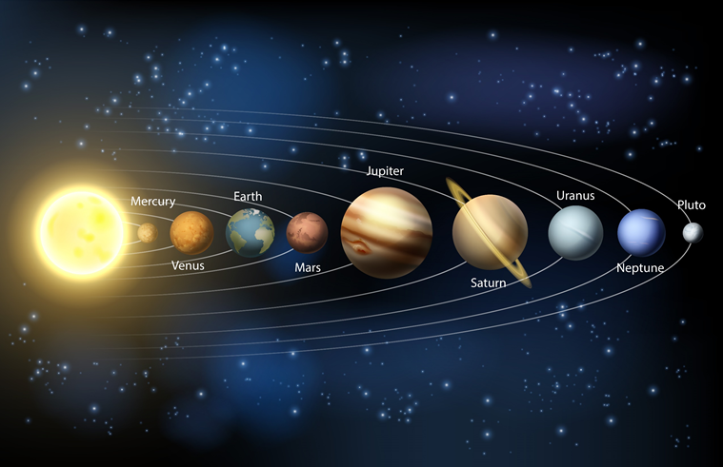
“Fine tuning”—Distance from star
Distance from star
Too hot to live on Venus
Too cold to live on Mars
We are between them in the “habitable zone”
Abundant liquid water
A 2% change in our orbit—either nearer or further—would probably wipe out life on earth
Notes:
One of those factors is how far our earth is from the star we orbit—in other words—how far we are from the sun. / It would be too hot to live on Venus / and too cold to live on Mars, / but where we are in between them—called the “habitable zone”—the temperature is right / and there is abundant liquid water available. / Just a 2% change in our orbit—either nearer or further away—would probably wipe out life on earth. (p 171)

Slide 16
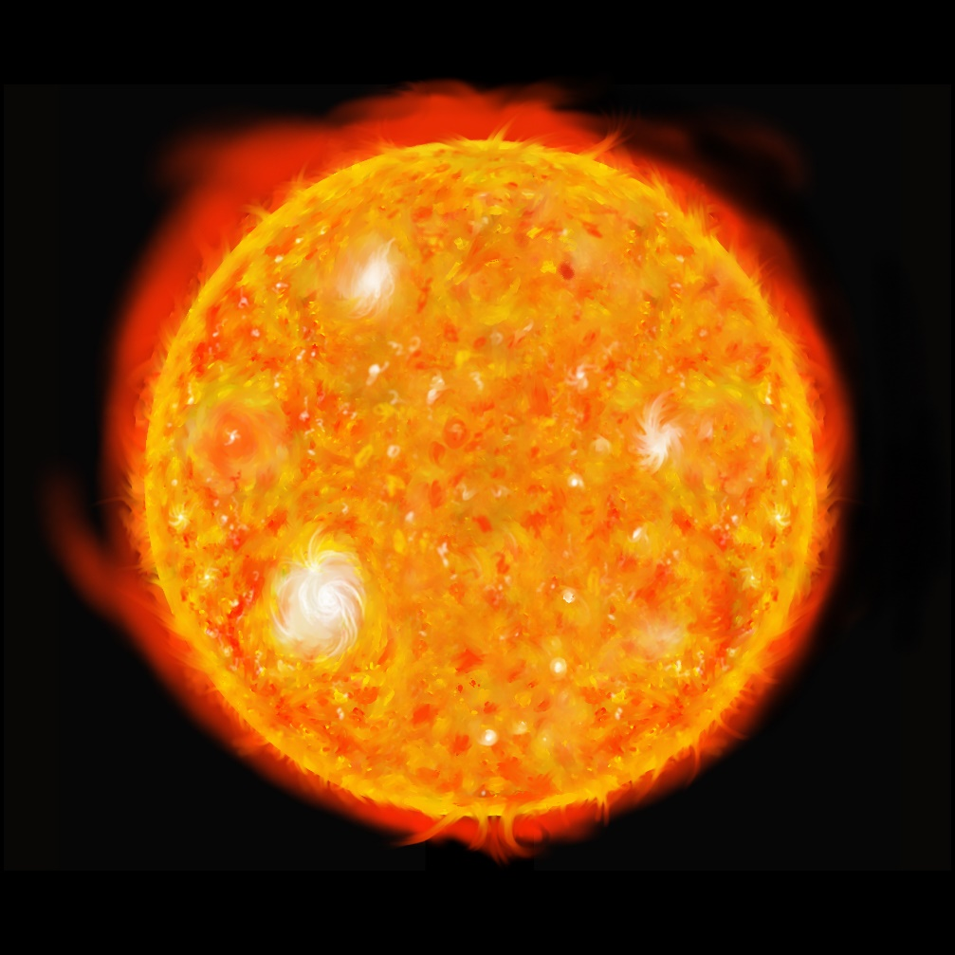
“Fine tuning”—Right kind of star
The right kind of star
Red giants and white dwarfs highly unlikely to support life
Red dwarfs have only a small habitable zone
Main sequence stars, like our sun, are better suited
If the sun had 20% more or less mass earth would be hotter than Venus or colder than Mars
Notes:
Another “fine tuning” factor required for life to exist on our planet is that we orbit the right kind of star. / It would be highly unlikely for red giants or white dwarfs to be able to support life. / Red dwarfs have only a small habitable zone, / but main sequence stars—like our sun—are better suited to support life. / If the sun had 20% more or less mass, earth would be hotter than Venus or colder than Mars.

Slide 17

“Fine tuning”—Orbit shape
Orbit shape
Almost a perfect circle (only slightly elliptical)
Elliptical orbit so long that oceans would either boil or freeze
Notes:
Even the shape of our orbit is important to the existence of life on earth. / Fortunately, our orbit is almost a perfect circle. Our slightly elliptical orbit is okay, / but a more pronounced elliptical shape would be so long that oceans would either boil or freeze!

Slide 18
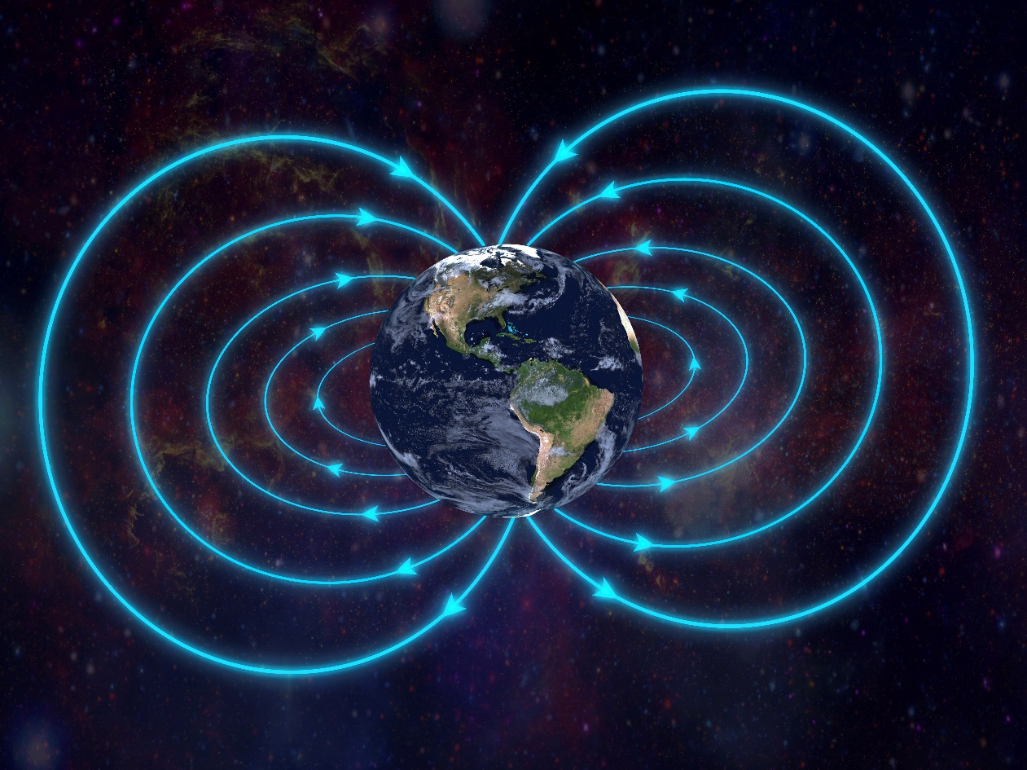
“Fine tuning”
The Earth’s:
Spin rate
Rotation angle
Magnetic field
Notes:
Other fine-tuning factors that allow life on earth to exist include the Earth’s spin rate, rotation angle, and magnetic field.

Slide 19
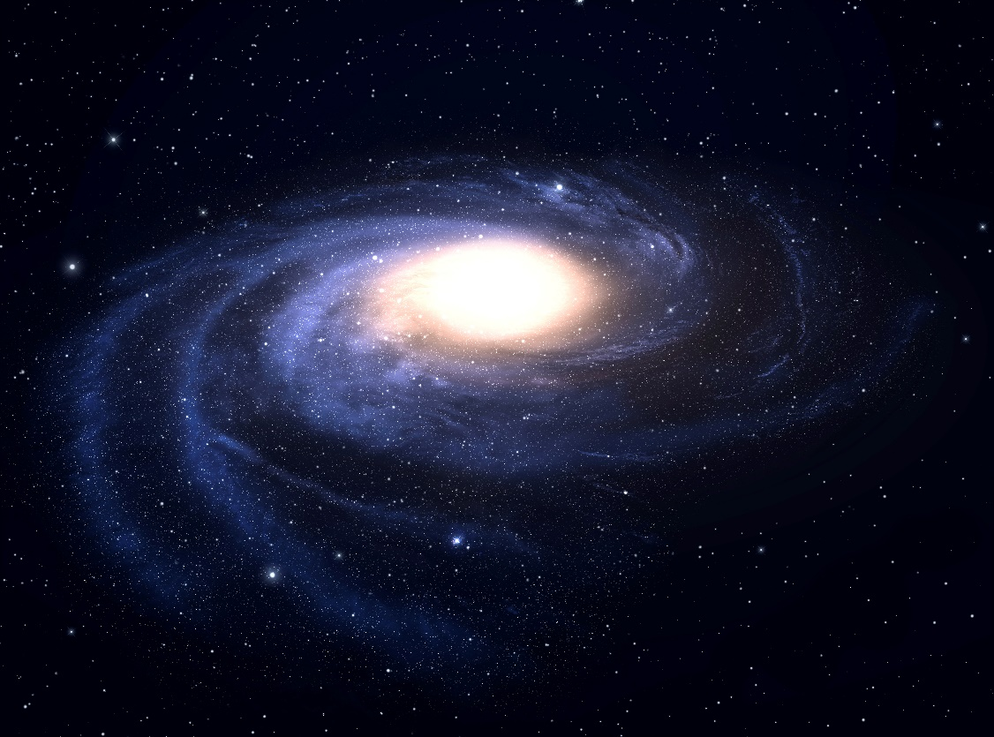
“Fine Tuning”--Location in the Galaxy
Not too near the center (dangerous radiation, exploding supernovae, etc.)
Inner edge of a spiral arm (may protect from radiation; far enough away from dust and debris of the arm)
Able to observe the rest of the cosmos
Notes:
Our location in the galaxy is also important. / It is important that we are not too near the center of the galaxy because of things like dangerous radiation and exploding supernovae. / Earth is located on the inner edge of one of the spiral arms, which may protect us from radiation and is far enough away from the dust and debris of the arm. / Perhaps most interesting of all, is the fact that earth is located in just the perfect position to be able to observe the rest of the cosmos!

Slide 20
“Fine tuning”—Forces of Nature
Four basic forces of nature
Gravity (Big G)—we couldn’t exist if Big G had a different value)
Electromagnetic force
Strong nuclear force
Weak nuclear force
Paul Davies in The Goldlilocks Enigma: Why Is the Universe Just Right for Life? describes about 30 of these fine-tuning examples
Notes:
Other fine-tuning examples include the four basic forces of nature—gravity, electromagnetic force, and the strong and weak nuclear forces. If any one of them was even slightly different, life would be impossible. Paul Davies in the Goldilocks Enigma talks about 30 of these fine-tuning examples.

Slide 21
The best explanation
for the evidence
is an intelligent Designer
Notes:
Given the evidence in living organisms, as well as the evidence in the universe itself, many scientists have concluded that the best explanation is an intelligent Designer.

Slide 22
Intelligent Design (ID) Movement
Creationists
Recognize that certain things in nature are best explained by an intelligent cause
Base claims on science, not any particular sacred text like the Bible
Do not necessarily identify the designer as the God of the Bible
Recognize that certain things in nature are best explained by an intelligent cause
Recognize both scientific evidence and the claims of scripture
Identify the Designer as the God of the Bible
Notes:
Some of these scientists are a part of something called the Intelligent Design, or ID, Movement. They believe
that certain things—like living things and the universe itself—are best explained by an intelligent cause. but that is not the same thing as being creationists. Although individual members of the ID movement may believe in God, / the movement bases its claims on science alone, not any particular sacred text like the Bible. / They do not necessarily identify the designer as the God of the Bible. / Creationists also recognize that certain things in nature are best explained by an intelligent cause. / They recognize both the scientific evidence and the claims of scripture / and identify the Designer as God, as revealed in the Bible.

Slide 23
Data, Interpretation, and Evaluating Scientific Claims
Notes:
So far in the Origins 101 series, we have talked quite a bit about the difference between data and interpretation. In our next presentation, we will practice telling the difference between data and interpretation and discuss how to evaluate the claims of science.

Slide 24
Recorded at
Chattanooga Public RadioSM
Classical 90.5 WSMC

Slide 25
Images By
Images may appear on more than one slide. Citation is given on the first slide where each image appears.
[1] Slide design, Susan Landon
[2a] iPad 19666234, LL28, Getty Images (US), Inc. Subscription
[2b] Cell phone 47986892, alexsl, Getty Images (US), Inc. Subscription
[3] Pocket watch 32569324, badmanproduction, Getty Images (US), Inc. Subscription
[4a] Rock 17623460, Emrah Oztas, Getty Images (US), Inc. Subscription
[4b] Arch 4295110, raphoto, Getty Images (US), Inc. Subscription
[4c] Mount Rushmore 14744554 Kubrak78, Getty Images (US), Inc. Subscription
[9] Scrabble letters 19496884, NoDerog, Getty Images (US), Inc. Subscription
[12] Mousetrap with cheese 11692882, xxmmxx ,Getty Images (US), Inc. Subscription
[13a] Organelles 34792482, selvanegra, Getty Images (US), Inc. Subscription
[13b] Cell 45876032, 7activestudio, Getty Images (US), Inc. Subscription
[13c] Mitochondrion 58561068 ClusterX, Getty Images (US), Inc. Subscription

Slide 26
Images By
[14a] Solar system 47204046, ChrisGorgio, Getty Images (US), Inc. Subscription
[14b] Milky Way galaxy 14966467, DavidSzabo, Getty Images (US), Inc. Subscription
[16] Sun 461451, Zuki, Getty Images (US), Inc. Subscription
[18] Magnetic field 14188754, alxpin, Getty Images (US), Inc. Subscription
[19] Spiral galaxy 31389530, Vladimir Arndt, Getty Images (US), Inc. Subscription

Slide 27
Special Thanks
Foundation for Adventist Education

Slide 28
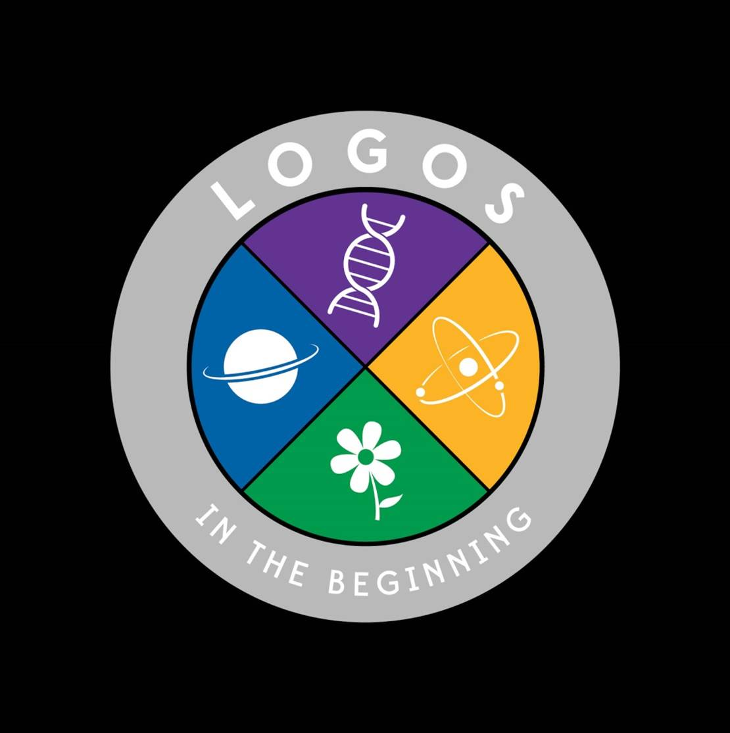
© Origins Curriculum Resources 2015

Slide 29

© Southern Adventist University 2015

Slide 30

© Seventh-day Adventist North American Division 2015

Slide 31

© General Conference of Seventh-day Adventists 2015

Slide 32

© SCORE Southern Center for Origins Research & Education 2015

