Slide 1

Evolution Defined
Notes:
Origins 101: / Evolution Defined

Slide 2

Change in living things over time
Notes:
A simple definition of evolution is change in living things over time.

Slide 3
Definition
Change in the genetic makeup of a specific population of living things
Change in gene frequency in a population over time
Notes:
More specifically, evolution is a change in the genetic makeup of a specific population of living things. / More precisely, it is referred to as the change in gene frequency in a population over time.

Slide 4
Change in gene frequency over time
Notes:
Let’s think about what these words mean. What do you remember about genes?

Slide 5
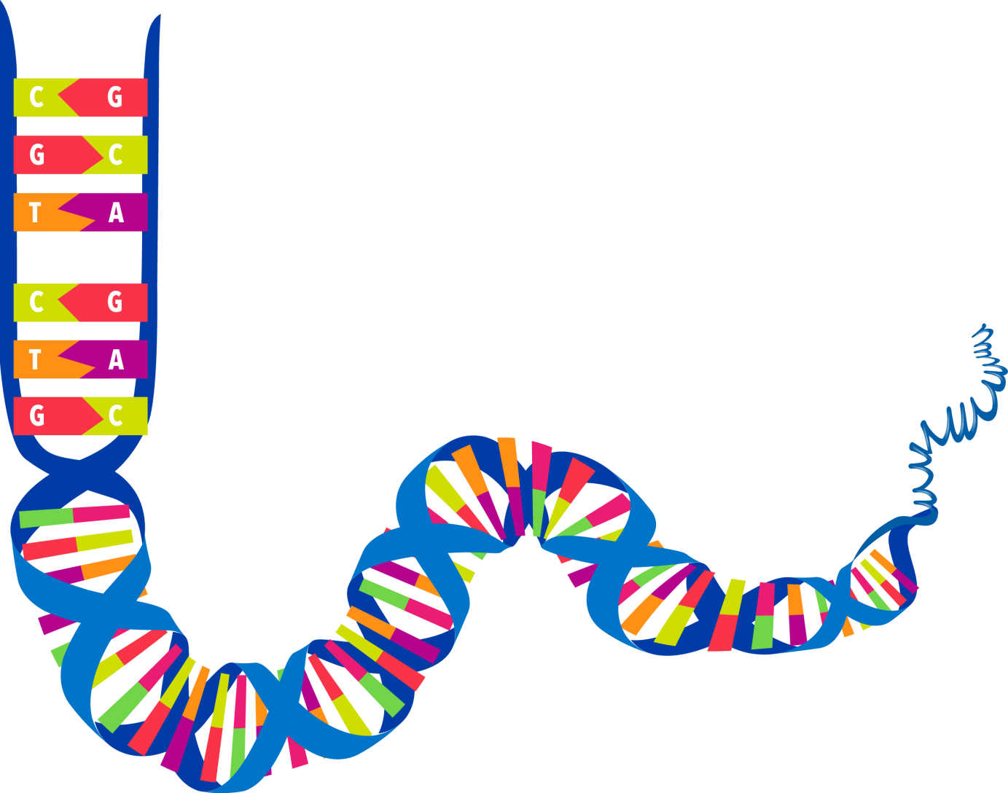
DNA
Notes:
You are probably familiar with DNA and how it contains instructions necessary to make a particular living organism.

Slide 6


DNA
Genes
Notes:
Smaller parts of DNA that contain instructions for specific traits are called genes.

Slide 7

Notes:
Traits light your height…

Slide 8

Notes:
…Hair color…

Slide 9

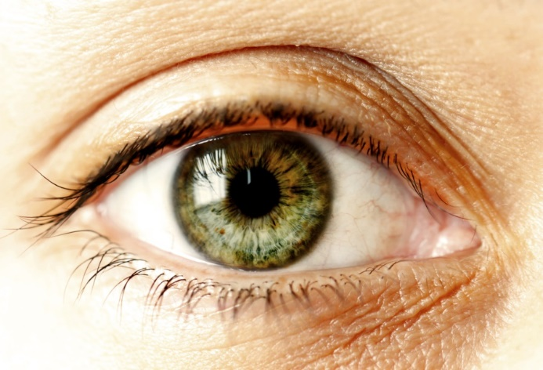

Notes:
…eye color…

Slide 10
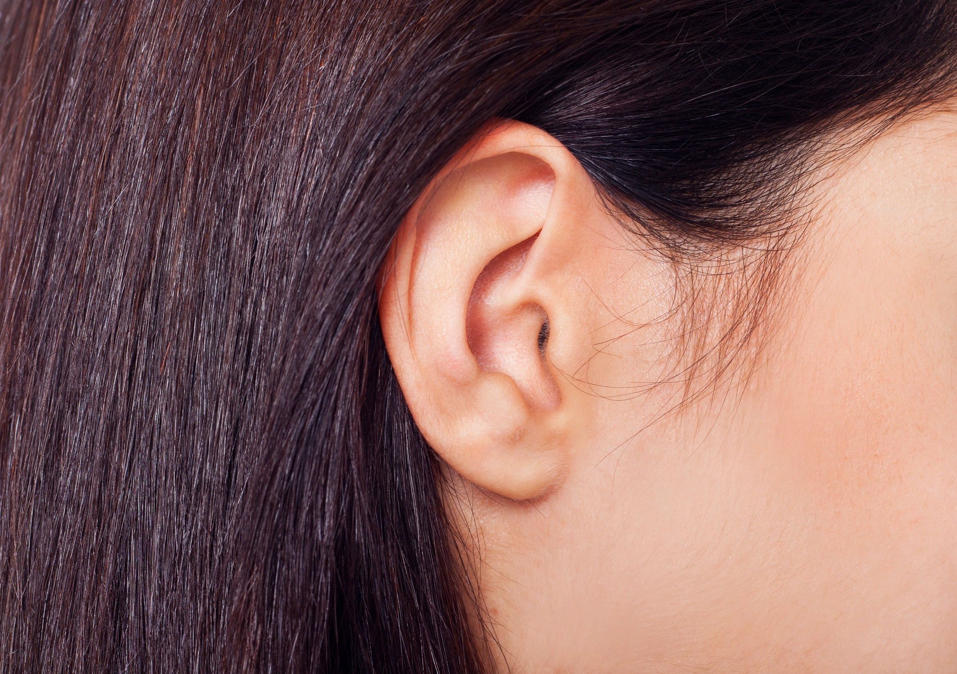
Notes:
…and even the shape of your ear lobe, are determined by your genes.

Slide 11
Genes
Traits are passed from one generation to the next generation through genes
Genes
Notes:
These traits are passed from one generation to the next through genes.

Slide 12

You inherited certain traits from your parents through their genes
Notes:
You inherited certain traits from your parents through their genes,…

Slide 13

Genes
You will pass on certain traits to your children through your genes
Notes:
…and you will pass on certain traits to your children through your genes.

Slide 14
Change in gene frequency over time
Notes:
Now let’s think about the word “frequency.”

Slide 15
Frequency
How often something happens
Notes:
Frequency means how often something happens.

Slide 16



Gene frequency
How often a certain gene appears in a population
Notes:
Gene frequency refers to how often a certain gene appears in a population.

Slide 17
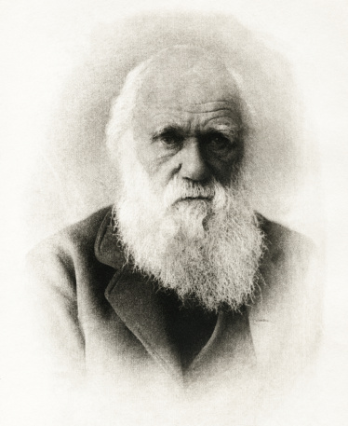
How does gene frequency change?
More offspring are born than can survive
Variation exists among the offspring
Some variations are advantageous
Notes:
How does gene frequency change? / Although Charles Darwin and the scientists of his time didn’t know anything about genes, Darwin did have some ideas about how changes happened in a population. He believed that more offspring are born than can survive on the available resources. / Variation exists among the offspring that are born. / Some variations give an organism more of an advantage than others.

Slide 18
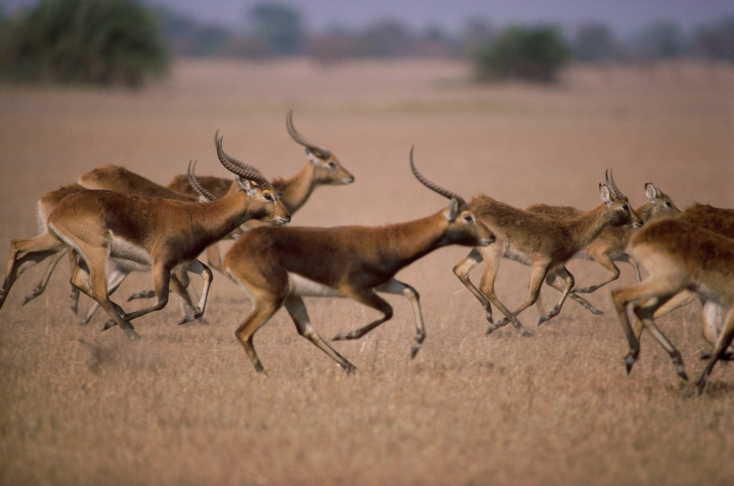
Variations
Notes:
For example, animals with slightly longer legs might be able to better outrun predators.

Slide 19
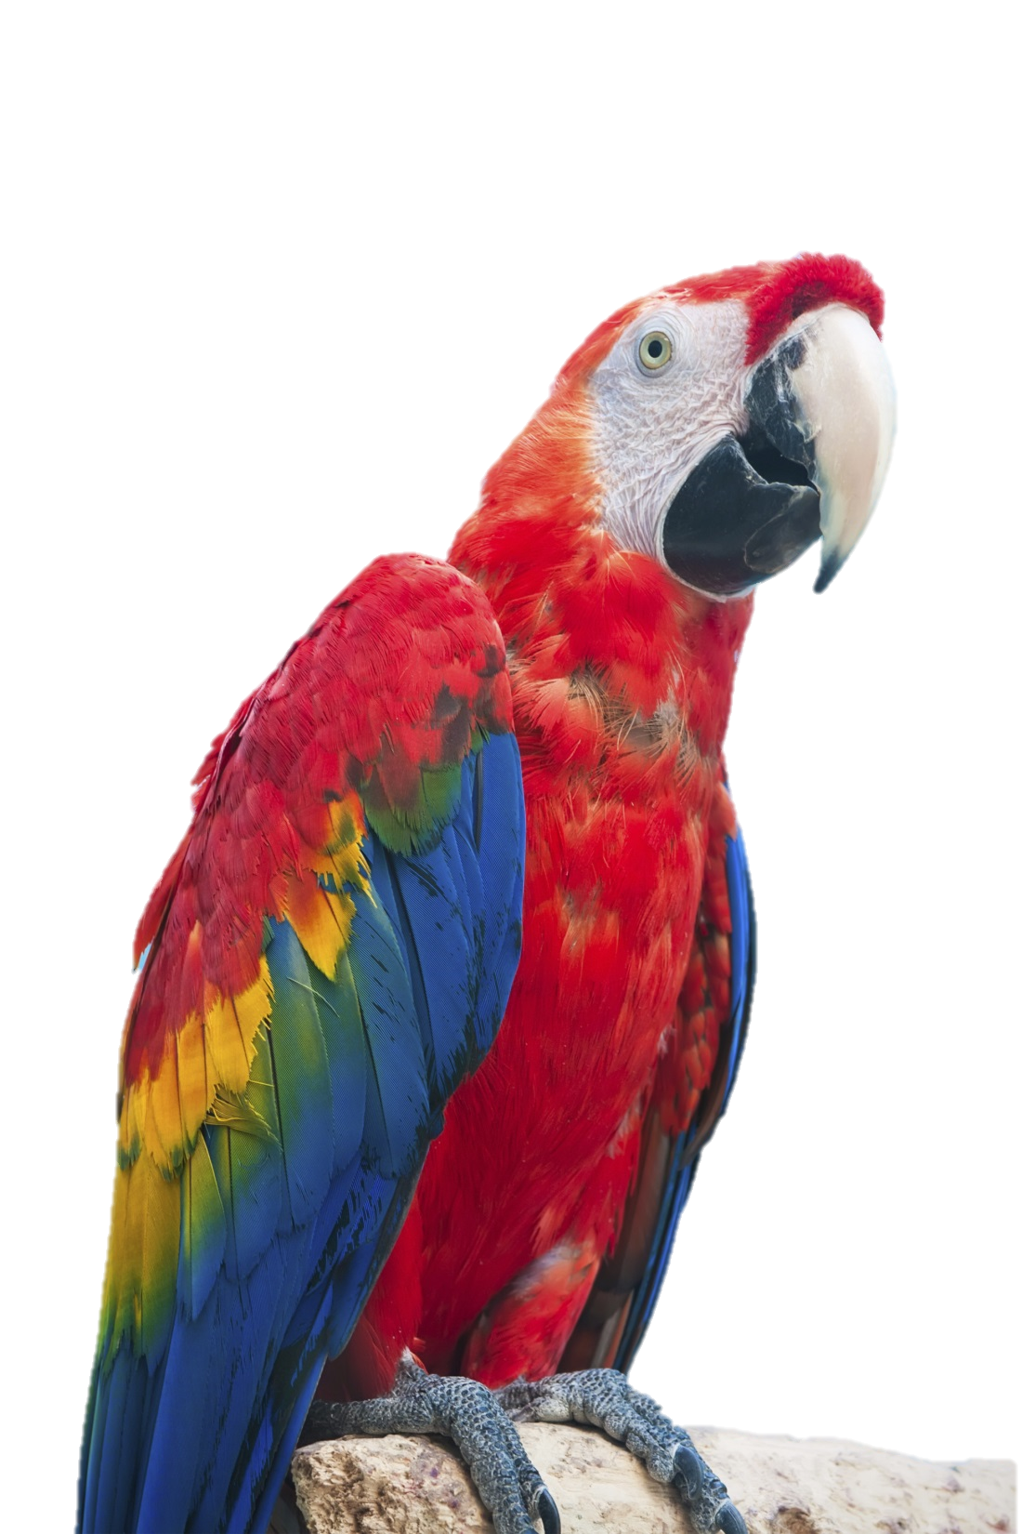
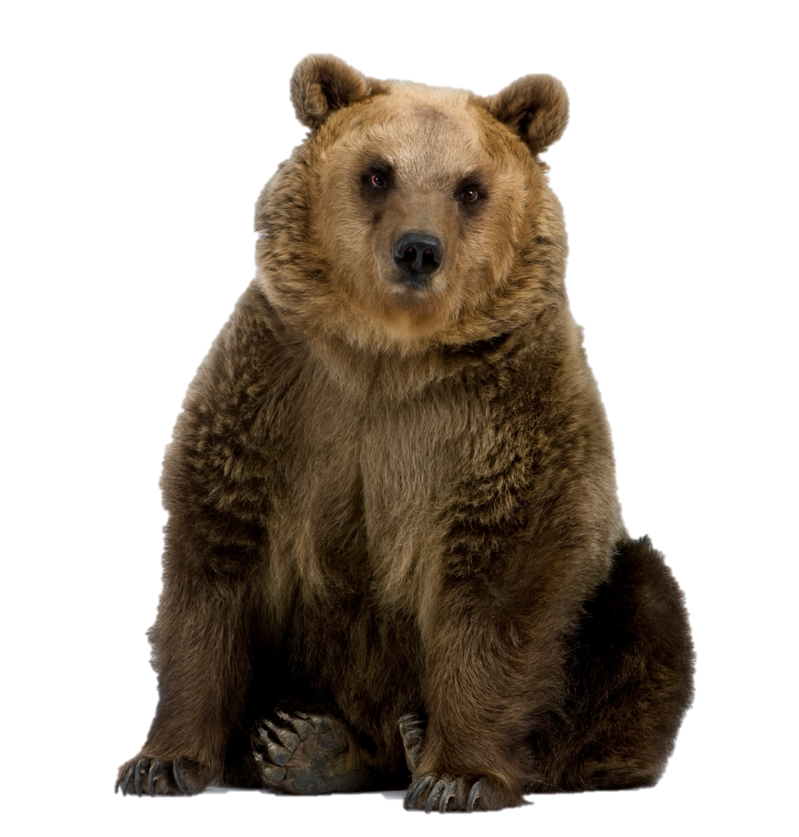
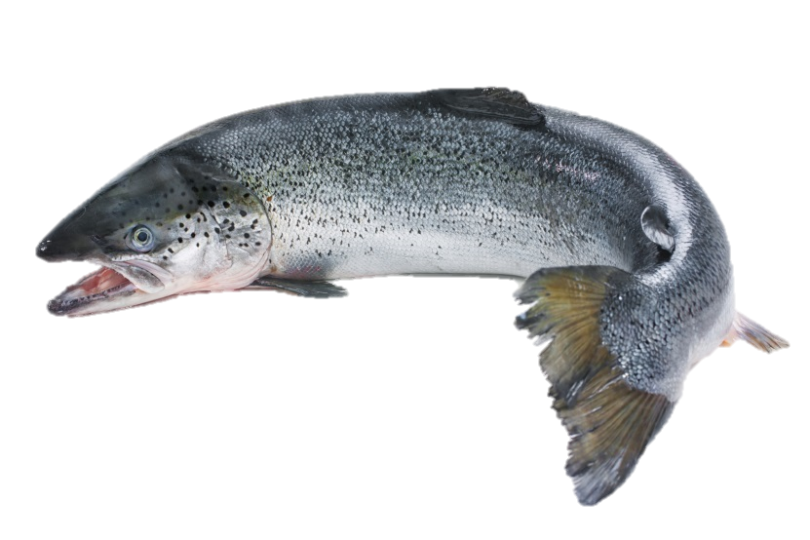
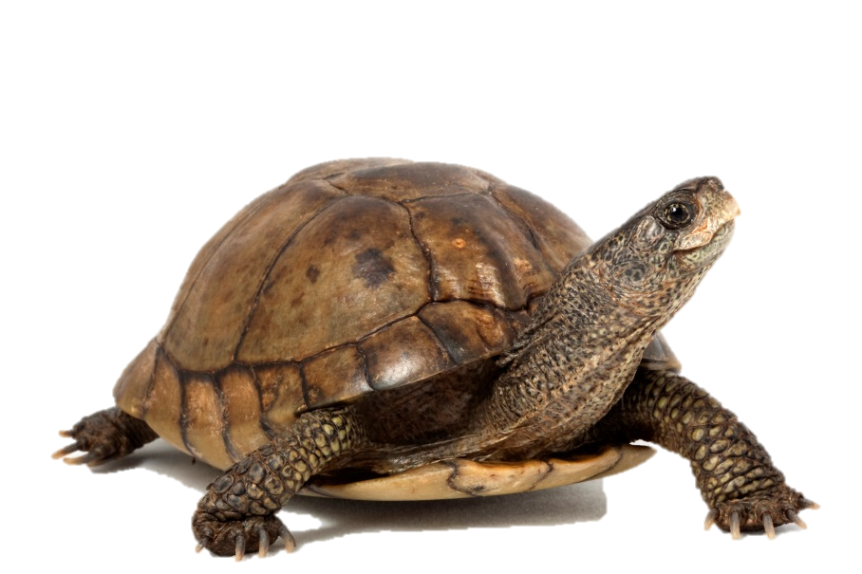
Variation within groups
Notes:
An animal with thicker fur would be more likely to survive the winter. / A brightly colored male bird might be more attractive to the female bird, increasing his chances of being able to reproduce. / A tortoise with a slightly longer neck might be able to reach food better. / A fish with larger fins might be able to swim better.

Slide 20
How does gene frequency change?
Individuals whose variations give them an advantage, survive and reproduce
As they have babies, the advantageous traits are passed on more often
Over time, the advantageous traits become more common in the population
Notes:
Individuals whose variations give them an advantage, survive and reproduce. / As they have babies, the advantageous traits are passed on more often. / Over time, those traits become more common in the population.

Slide 21
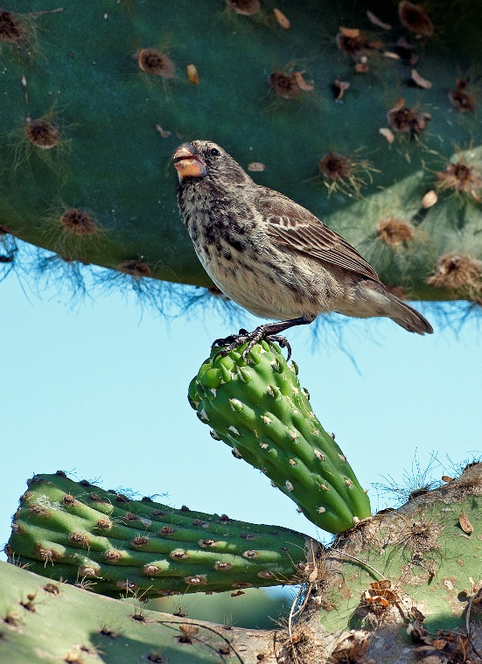
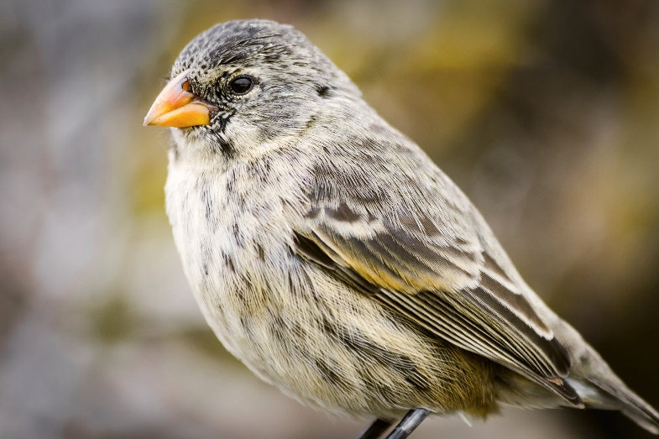
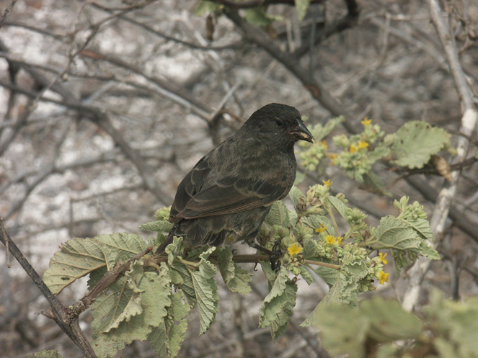
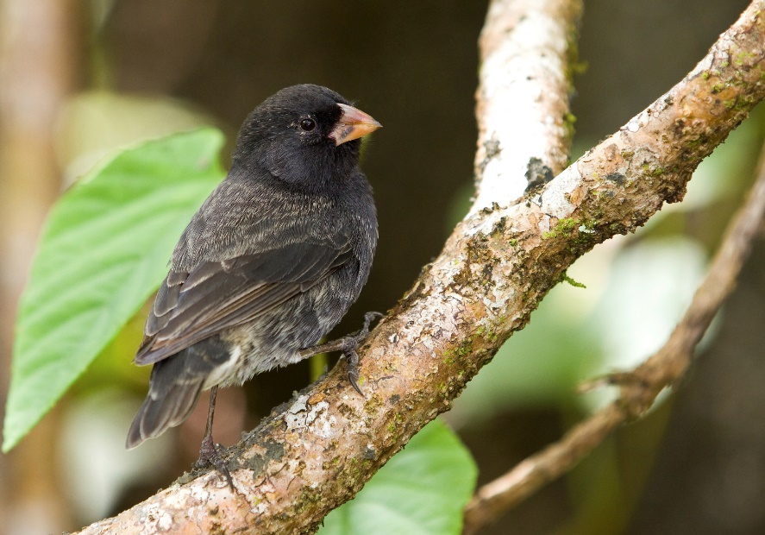
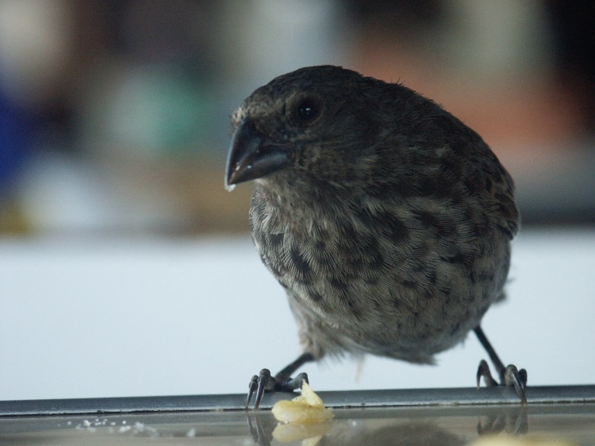
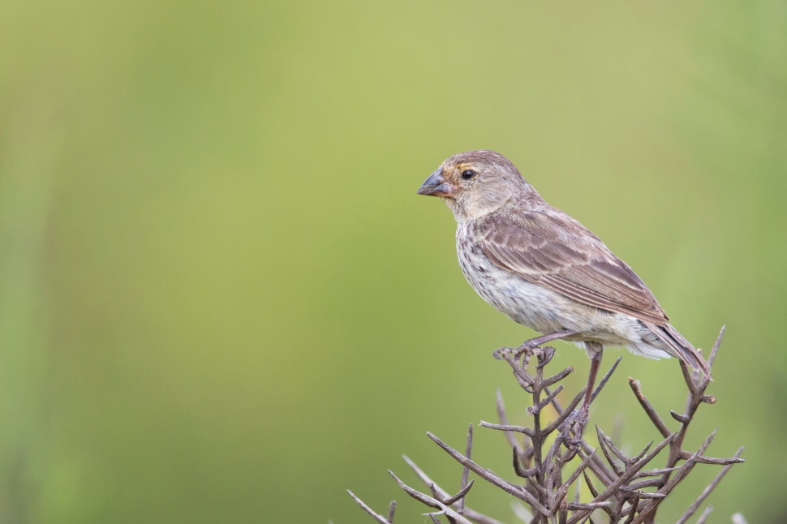
Galapagos Finches
Notes:
A famous example of how this process works involves the finches in the Galapagos Islands.

Slide 22

Variation in Finches
Small-beaked finches
Large-beaked finches
Notes:
Variation exists in the finch population. Some finches have small beaks, while others have large beaks.

Slide 23
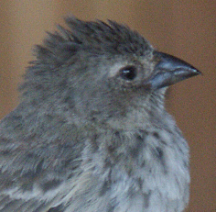
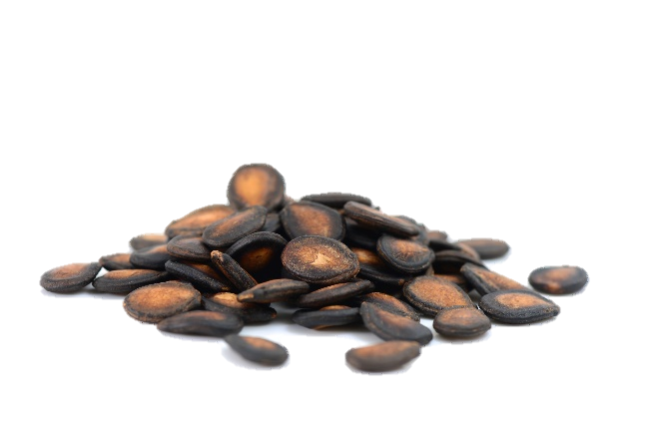
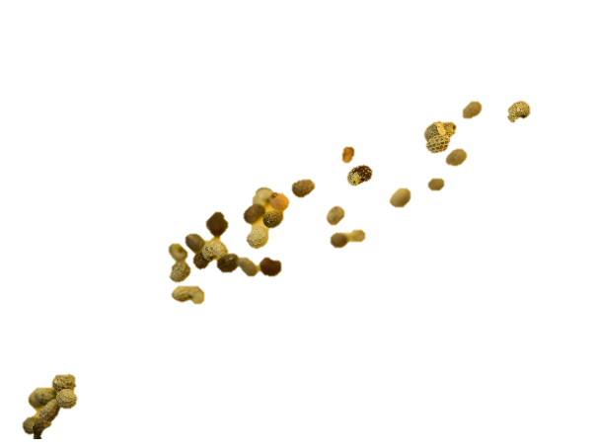
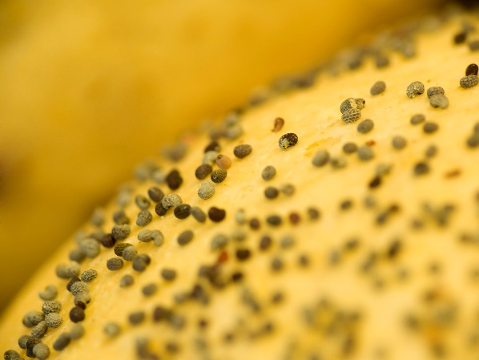
Variation in Finches
Small-beaked finches
Large-beaked finches
Eat smaller seeds
Eat larger seeds
Notes:
The finches with smaller beaks eat smaller seeds. / The finches with larger beaks eat larger seeds.

Slide 24
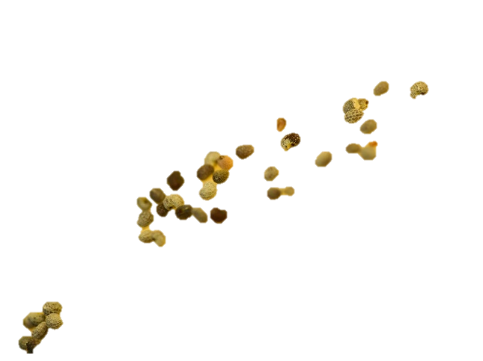
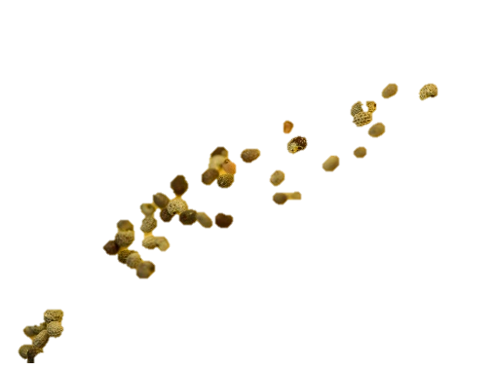
Drought
Small-beaked finches
Large-beaked finches
Eat smaller seeds
Plants with smaller seeds didn’t do well
Eat larger seeds
Notes:
One year, during drought conditions, / the plants with smaller seeds didn’t do well, / so there were fewer seeds available for the birds to eat. Most of the available seeds were large.

Slide 25
Drought
Small-beaked finches
Large-beaked finches
Eat smaller seeds
Eat larger seeds
Notes:
Because there was not enough food for all the small-beaked birds, / many of them did not survive.

Slide 26
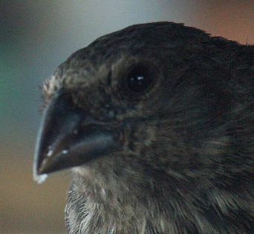
Drought
Small-beaked finches
Large-beaked finches
Eat smaller seeds
Eat larger seeds
Notes:
Since most of the available seeds were large, more large-beaked finches survived and had babies.

Slide 27
Drought
Small-beaked finches
Large-beaked finches
Eat smaller seeds
Eat larger seeds
Fewer genes for small beaks
Fewer babies
Lots of babies
More genes for large beaks
Notes:
Because fewer small-beaked finches were having babies, fewer genes that produce small beaks were passed on to the next generation. / Because most of the birds that were reproducing had large beaks, more of the genes that produce larger beaks were passed on to the next generation.

Slide 28
Change in Gene Frequency
Fewer genes in the population
Evolution
Notes:
In other words, / the frequency of genes that determine beak size had changed within the population of finches. / That change in gene frequency could be called evolution—

Slide 29
Change in Gene Frequency
Fewer genes in the population
Evolution--Microevolution
Notes:
…specifically microevolution

Slide 30
After the Drought
Small-beaked finches
Large-beaked finches
Eat smaller seeds
Eat larger seeds
Plants with small seeds grew better again
Notes:
Another year when there was a regular amount of rain, / the plants with small seeds grew better, which meant the small-beaked finches had plenty to eat. / More of them survived to have babies, which means there were more genes for small beaks in the population again.

Slide 31
Change in Gene Frequency
More genes in the population
Evolution--Microevolution
Notes:
Once again there was a change in the gene frequency in the finch population, / which would be an example of microevolution.

Slide 32
Heavy Rain Fall
Small-beaked finches
Large-beaked finches
Plants with large seeds didn’t survive as well.
Notes:
During a year with extra heavy rain fall, / the plants with larger seeds didn’t do as well. Without as much food available for birds with large beaks,

Slide 33
Change in Gene Frequency
Small-beaked finches
Large-beaked finches
Notes:
more of them died before reproducing. But the small-beaked finches, which still had plenty of food, survived and had babies—which meant there were more genes for small beaks within the finch population.

Slide 34
Change in Gene Frequency
Fewer genes in the population
Evolution--Microevolution
Notes:
Once again a change in gene frequency—or microevolution—had occurred in the finch population.

Slide 35


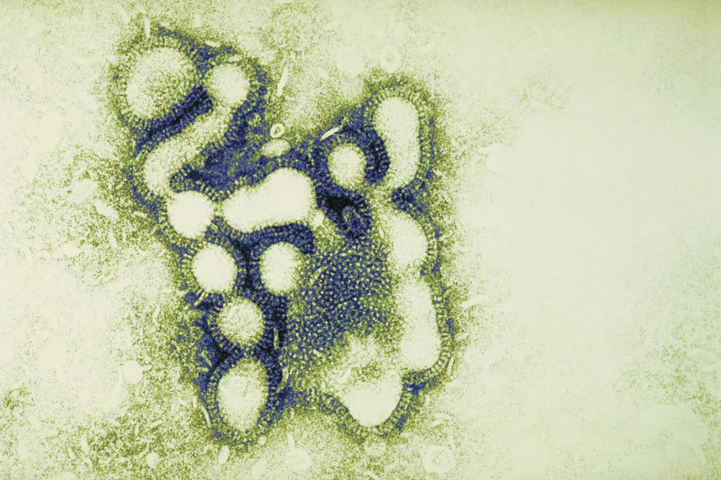
Microevolution
Flu virus
Notes:
There is a lot of evidence in nature for microevolution. Another example is a flu virus. The reason we need a different flu shot every year is because the virus has changed some since last year.

Slide 36
Microevolution
Small changes in living things are well documented
The fact of evolution = microevolution
Notes:
These small changes in living things are well documented. / When scientists talk about the fact of evolution, they are referring to these kinds of changes—in other words, to microevolution.

Slide 37

Micro
Macro
?
=
Microevolution is well documented
Macroevolution is not
?
Notes:
Although many scientists believe that lots of microevolution over millions of years is the same thing as macroevolution, / many other scientists believe microevolution does not add up to macroevolution, and that some other factor or factors must be involved.

Slide 38
Next: Natural Selection
Notes:
As Origins 101 continues, / we will learn about natural selection and the important part it plays in the theory of evolution.

Slide 39
Recorded at
Chattanooga Public RadioSM
Classical 90.5 WSMC

Slide 40
Images By
Images may appear on more than one slide. Citation is given on the first slide where each image appears.
[1] Slide design, Susan Landon
[5] DNA, Susan Landon
[7] Taller girl and shorter girl 126409038, Ron Chapple Stock, Thinkstock, Thinkstock Image Subscription Agreement
[8] Mixed Age Multi-Ethnic Group 166671155, LuminaStock, Thinkstock, Thinkstock Image Subscription Agreement
[9a] Baby with blue eyes 5016485, dolgachov, Getty Images (US), Inc. Subscription
[9b] Green eye 456008111, BetulTurhalDoganay, Thinkstock, Thinkstock Image Subscription Agreement
[9c] Young woman 79215090, Blend Images, Thinkstock, Thinkstock Image Subscription Agreement
[10] Ear 158681729, Oleksandra Voinova, Thinkstock, Thinkstock Image Subscription Agreement
[12] A smiling African American man and child 12894561, Feverpitched, Getty Images (US), Inc. Subscription
[13] Mother and daughter 105662898, amanaimagesRF, Thinkstock, Thinkstock Image Subscription Agreement
[17] Charles Darwin 16835919, picture, Getty Images (US), Inc. Subscription
[18] Herd of black lechwes running 57565409, Purestock, Thinkstock, Thinkstock Image Subscription Agreement

Slide 41
Images By
[19a] Macaw 453680067, sydeen, Thinkstock, Thinkstock Image Subscription Agreement
[19b] Atlantic salmon 182261618, AlexRaths, Thinkstock, Thinkstock Image Subscription Agreement
[19c] Coahuilan box turtle 93385233, amwu, Thinkstock, Thinkstock Image Subscription Agreement
[19d] Brown bear 13749720, GlobalP, Getty Images (US), Inc. Subscription
[21a] Sharp-beaked Ground Finch Geospiza difficilis, Tim Standish
[21b] Darwin’s Finch, Galapagos 24748928, mdmworks, Getty Images (US), Inc. Subscription
[21c] Galapagos Finch on cactus 61835574, pilesasmiles, Getty Images (US), Inc. Subscription
[21d] Finch of Galapagos 35513816, Roger De Marfa, Getty Images (US), Inc. Subscription
[21e] Medium Ground Finch Geospiza fortis 29426604, bephotographers, Getty Images (US), Inc. Subscription
[21f] Medium Ground Finch Geospiza fortis, Tim Standish, used with permission
[22a] Small Ground Finch Geospiza fuliginosa, Tim Standish, used with permission
[23c] Seeds 7103827, Jo De Vulder, Shutterstock standard license (overlay - Joaquin Hernandez)
[23d] Melon seeds 40447322 antpkr, Getty Images (US), Inc. Subscription
[34a] Flu virus 79997773, Fuse, Thinkstock, Thinkstock Image Subscription Agreement
[34b] Doctor with Flu Shot sign 58390148, nzphotonz, Getty Images (US), Inc. Subscription
[34c] Researching glass equipment in tiles 36187884, barbol88, Getty Images (US), Inc. Subscription

Slide 42
Special Thanks
Foundation for Adventist Education

Slide 43

© Origins Curriculum Resources 2015

Slide 44

© Southern Adventist University 2015

Slide 45

© Seventh-day Adventist North American Division 2015

Slide 46

© General Conference of Seventh-day Adventists 2015

Slide 47

© SCORE Southern Center for Origins Research & Education 2015

