Slide 1

Darwinism and Neo-Darwinism
Notes:
Origins 101—Darwinism and Neo-Darwinism
The purpose of this presentation is to describe the claims of Darwinism and how they have been modified through the years. Remember, though, that when we describe the theory, we aren’t presenting its claims as truth.

Slide 2
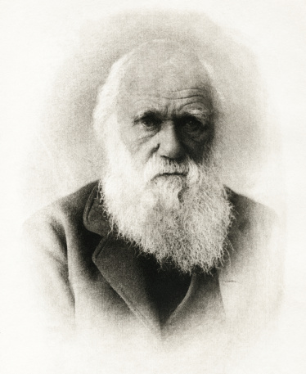
Charles Darwin
1859
On the Origin of Species by Means of Natural Selection (or the Preservation of Favoured Races in the Struggle for Life)
Notes:
In 1859 Charles Darwin published his book, On the Origin of Species by Means of Natural Selection. In time it became one of the most influential books ever written.

Slide 3
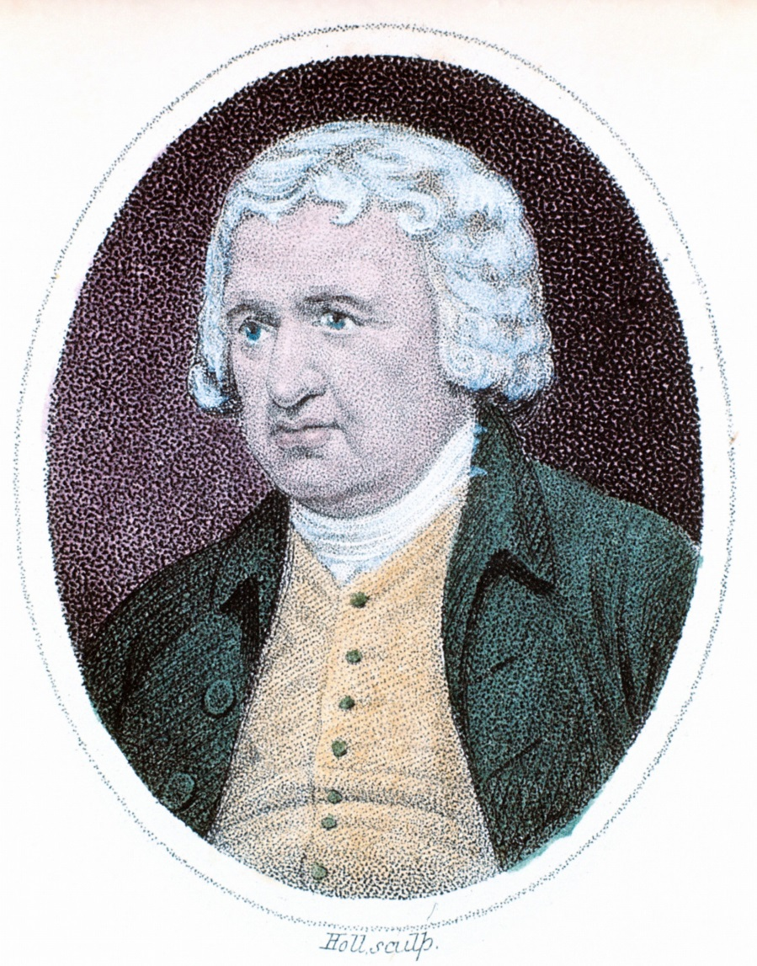
Darwinism
Many of the ideas in the book were not new
Influenced by many other scientists (including his grandfather, Erasmus Darwin), Charles organized ideas already present in the scientific community into a coherent theory.
Notes:
Many of the ideas in the book were not new. / Influenced by many other scientists, including his grandfather, Erasmus Darwin, Charles organized ideas already present in the scientific community into a coherent theory.

Slide 4
Darwinism
Darwin’s theory had two main claims:
  Theory of Universal Common Descent
  Natural Selection
Notes:
Darwin’s theory had two main claims: The Theory of Universal Common Descent and Natural Selection.

Slide 5
1. Theory of Universal Common Descent
    Every creature on Earth descended from a single-celled common ancestor somewhere in the distant past
Notes:
The theory of universal common descent states that every creature descended from a single-celled common ancestor somewhere in the distant past. Although the idea of common ancestry had been discussed by others before…

Slide 6
2. Natural Selection
Darwin’s contribution:
  suggesting the mechanism for change
Natural Selection
  Overproduction
    More creatures are born than can survive
  Variation
    Variation exists in any population
  Adaptation
    Some traits increase an organism’s fitness
  Natural selection
    Traits that increase fitness are passed on, replacing those that do not increase fitness and changing populations
Notes:
…Darwin was the first to put it together with a mechanism to explain the evolutionary process. The mechanism he suggested was natural selection, which included four parts:
Overproduction refers to the idea that more creatures are born than can survive on the available resources.
There is variation in any population of living creatures.
Some traits, or adaptations, increase an organism’s fitness (This means the traits enable an organism to survive and reproduce better than others.)
Traits that increase an organism’s fitness are passed on to their offspring, replacing traits that do not and changing populations over time.

Slide 7
Microevolution
Evolution is gradual—
  small changes
  acted on by natural selection
  accumulate over long periods (rate is not constant)
Natural selection happens to individuals
Evolutionary changes happen gradually to populations over time
Notes:
Essentially Darwin believed that evolution is gradual. Small changes, acted on by natural selection, accumulate over long periods of time.
It is important to realize that natural selection happens to individual creatures, / but evolution happens gradually to populations over time.

Slide 8
Claims of Darwinism
Small evolutionary changes within populations over millions of years add up to major change
Microevolution is capable of producing macroevolution
Microevolution = Macroevolution
Origins 101 explores why we disagree with this claim
Notes:
According to Darwinism, small evolutionary changes within populations over millions of years add up to major change. / In other words, the theory claims that lots of microevolution over lots of time equals macroevolution. / Throughout Origins 101, we will explore why we disagree with this claim.

Slide 9
Darwinism
Darwin’s two main claims:
  1. Theory of Universal Common Descent
  Within a couple decades, accepted by many scientists
  2. Natural Selection
1860s | 1870s | 1880s | 1890s | 1900s | 1910s | 1920s | 1930s | 1940s
Acceptance of common descent
Notes:
Within a couple decades after Darwin’s book was published, / most scientists had accepted the first of Darwin’s two claims--the idea of universal common descent.

Slide 10
Darwinism
Darwin’s two main claims:
  1. Theory of Universal Common Descent
  Within a couple decades, accepted by many scientists
  2. Natural Selection
  Not accepted for many decades
1860s | 1870s | 1880s | 1890s | 1900s | 1910s | 1920s | 1930s | 1940s
Acceptance of common descent |  | Non-acceptance of natural selection as the mechanism for evolution
Notes:
The second claim—natural selection—was not accepted for many decades.

Slide 11
Darwinism
At the time of Darwin, little or nothing was known about the inner workings of the cell
  Didn’t know about mutations so didn’t know how variation was generated
Notes:
Why? At the time of Darwin, little or nothing was known about the inner workings of the cell. / Scientists didn’t know about mutations, so they didn’t know how variation was generated.

Slide 12
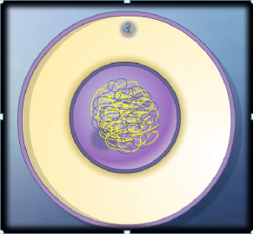


Darwinism
At the time of Darwin, little or nothing was known about the inner workings of the cell
  Didn’t know about genetics so didn’t know how traits were passed on to offspring
Notes:
They didn’t know about genetics, / so they didn’t understand how traits were passed on to offspring.

Slide 13
Darwinism
Age of the earth (as estimated at that time) wasn’t long enough
  15-20 million years
  Lord Kelvin
Notes:
In addition, a scientist named Lord Kelvin had recently estimated that the earth was 15-20 million years old. Scientists doubted that natural selection could have produced enough change in that amount of time to account for the diversity of life we see today.

Slide 14
Darwinism
1860s | 1870s | 1880s | 1890s | 1900s | 1910s | 1920s | 1930s | 1940s
Acceptance of common descent |  | Non-acceptance of natural selection as the mechanism for evolution |  |  |  |  |  | Natural Selection Accepted
The majority of biologists didn’t accept the main tenets of his theory until about 1940
Notes:
During this period of many decades—/ sometimes called the Eclipse of Darwin--scientists suggested other mechanisms to explain evolution. / It was not until about 1940 /that the majority of biologists accepted the main tenets of Darwinism.

Slide 15
Neo-Darwinism
Notes:
And this is where Neo-Darwinism comes in.

Slide 16
Neo-Darwinian Synthesis
1930s-1940s
Synthesized Darwin’s theory with new insights from molecular biology, genetics, population biology, mathematical biology, and paleontology
1860s | 1870s | 1880s | 1890s | 1900s | 1910s | 1920s | 1930s | 1940s
Acceptance of common descent |  | Non-acceptance of natural selection as the mechanism for evolution |  |  |  |  |  | Natural Selection Accepted
Notes:
In the 1930s and 40s, more than 70 years after the original publication of Darwin’s book, scientists synthesized the newest information from molecular biology and genetics with Darwin’s theory of evolution by natural selection. Using mutations to explain the source of variation, and using genetics to explain how traits were passed from one generation to the next, / many scientists became convinced of the validity of Darwin’s second main claim.

Slide 17
Neo-Darwinism
A modern version of evolutionary theory
  Neo-Darwinism
  Neo-Darwinian synthesis
  Modern synthesis
Current paradigm
Notes:
There are several different names for the modern version of evolutionary theory established by scientists in the 1930s and 40s. It is sometimes called Neo-Darwinism, the Neo-Darwinian synthesis, or the modern synthesis. / Although it took over 70 years to be accepted by the scientific community, it has been the reigning scientific paradigm for many decades since that time.

Slide 18
The Modern Synthesis
Two propositions:
  Gradual evolution results from small genetic changes that are acted upon by natural selection
  The origin of species as well as macroevolution can be explained in terms of natural selection acting on individuals (microevolution)
In other words, microevolution = macroevolution
Notes:
Neo-Darwinism, or the Modern Synthesis, is summarized by these two propositions: / Gradual evolution results from small genetic changes that are acted upon by natural selection. / The origin of species as well as macroevolution can be explained in terms of natural selection acting on individuals. / In other words, like Darwinism, it says that lots of small changes, accumulated over lots of time, amount to macroevolution.

Slide 19
Darwin’s Four Postulates Restated
Because of mutation and the recombination of alleles (genetic material) during reproduction, individuals in a population vary in traits.
Individuals pass their alleles on to their offspring.
In every generation, some individuals are more successful at surviving and reproducing than others.
The individuals that survive and reproduce most are the ones that have the best adaptations.
Notes:
Darwin’s four postulates were restated as follows:
Because of mutation and the recombination of alleles (genetic material) as reproduction takes place, individuals in a population vary in the traits they possess
Individuals pass their alleles on to their offspring.
In every generation, some individuals are more successful at surviving and reproducing than others.
The individuals that survive and reproduce most have the best adaptations. This idea has sometimes been called “survival of the fittest.”

Slide 20
Darwinism & Neo-Darwinism
Notes:
If Neo-Darwinism sounds a lot like Darwinism, that’s because it is! What makes Neo-Darwinism different is that, because of the advances in science since Darwin’s time, Neo-Darwinism is able to offer explanations for how variation occurs in populations and how organisms pass on their traits to the next generation.

Slide 21
Successful Theory?
Notes:
Even though it took many decades for scientists to accept all of Darwin’s theory, it turned out to be a very successful theory.

Slide 22
What makes a “successful” theory?
Organizes and explains groups of data
Suggests research to test explanations
Predicts the outcome of experiments
Notes:
A theory is considered to be successful / if it organizes and explains groups of data, / if it can suggest research to test those explanations, / and if it can predict the outcome of experiments. Darwin’s theory has been very successful at doing these things. It has been successful in organizing and explaining a broad range of biological data. It provides explanations and suggests ways to test them. In many cases the theory successfully predicts the outcome of experiments.

Slide 23
For these reasons, many scientists have great confidence in the theory
It is more widely believed by scientists today, after 150 years of research, than it was in Darwin’s lifetime
Notes:
For these reasons, many scientists have great confidence in the theory. / It is more widely believed by scientists today, after 150 years of research than it was in Darwin’s lifetime.

Slide 24
Darwinism Questioned
“…Leading figures in several subdisciplines of biology—cell biology, developmental biology, molecular biology, paleontology, and even evolutionary biology—now openly criticize key tenets of the modern version of Darwinian theory in the peer-reviewed technical literature.”
Stephen Meyer, Darwin’s Doubt, ix
Notes:
However, after being the reigning paradigm for several decades, Neo-Darwinism is again being questioned, even by some evolutionary scientists. / In his book Darwin’s Doubt, Stephen Meyer states that leading figures in several subdisciplines of biology…now openly criticize key tenets of the modern version of Darwinian theory in the peer-reviewed technical literature.

Slide 25
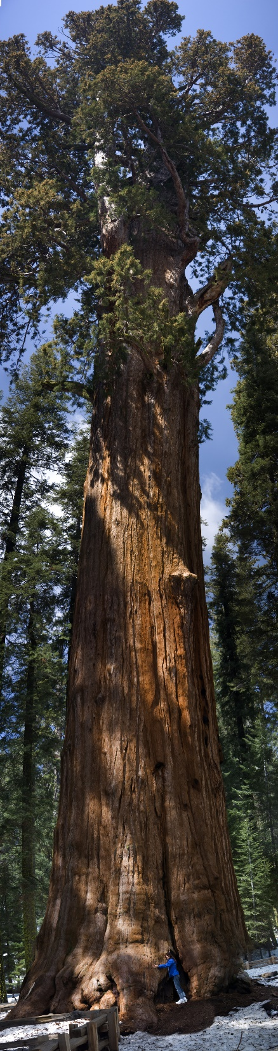


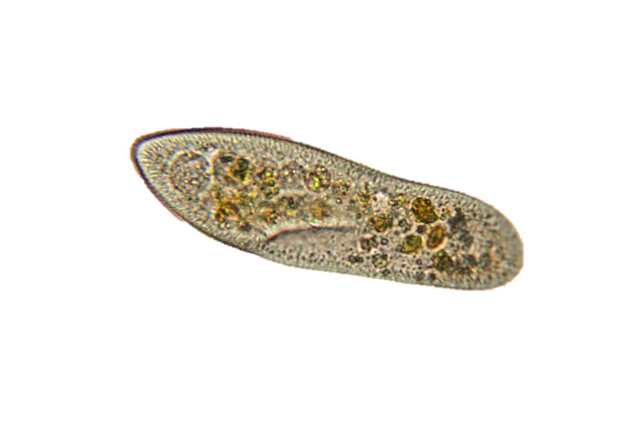
Darwin’s Two Main Claims
  Theory of Universal Common Descent
    Not abandoned
?
  2. Natural Selection
Notes:
Even though they may accept the theory of universal common descent, many scientists question whether natural selection acting on random mutations can explain the existence of organisms as diverse as a giant Sequoia, / microscopic Paramecium, / humans, / and snails/ /

Slide 26
“Altenberg 16”
    16 evolutionary scientists who met in Altenberg Austria in 2008 to discuss modifying the existing Modern Synthesis.
Modification necessary because they recognize that mutation and natural selection are inadequate to explain macroevolution.
Notes:
In 2008 a group of 16 evolutionary scientists met in Altenberg Austria to discuss modifying or extending the existing Modern Neo-Darwinian Synthesis. / The Altenberg 16, as they were called, believed modification was necessary because the recognized that mutation and natural selection are inadequate to explain macroevolution.

Slide 27
Neo-Darwinism Questioned
“As a host of distinguished biologists have explained in recent technical papers, small-scale, or ‘microevolutionary,’ change cannot be extrapolated to explain large-scale, or ‘macroevolutionary,’ innovation.”
Stephen Meyer, Darwin’s Doubt, x
Microevolution = Macroevolution
Notes:
According to Stephen Meyer, “a host of distinguished biologists have explained in recent technical papers that small scale, or ‘microevolutionary’ change cannot be extrapolated to explain macroevolutionary innovation.” / In other words, they recognize that lots of microevolutionary change over lots of time / does not equal macroevolution.

Slide 28
Summary
Both Darwinism and Neo-Darwinism include the idea of universal descent from a common ancestor.
Both also include the idea that the mechanism for evolution is natural selection.
Neo-Darwinism uses the advances in science since Darwin’s time, to explain variation and how individuals pass on their genes to their offspring.
In spite of doubts in the scientific community about natural selection as the mechanism for evolution, Neo-Darwinism remains the dominant explanation for the diversity of life we see around us.
Notes:
To summarize:
Both Darwinism and Neo-Darwinism include the idea of universal descent from a common ancestor.
Both also include the idea that the mechanism for evolution is natural selection.
Neo-Darwinism uses the advances in science since Darwin’s time, to explain variation and how individuals pass on their genes to their offspring.
In spite of doubts in the scientific community about natural selection as the mechanism for evolution, Neo-Darwinism remains the dominant explanation for the diversity of life we see around us. It is published without qualification in textbooks and is affirmed and disseminated freely by the media.

Slide 29
We do not accept:
Theory of universal common descent
Microevolution = macroevolution
Notes:
We have described the claims of Darwinism in this presentation, but we do not accept either the theory of universal common descent or the idea that lots of microevolution adds up to macroevolution. In later Origins 101 presentations, we will explore the evidence…

Slide 30
Misconceptions about Evolution
Notes:
…but first we will look at some common misconceptions that people have about the claims of evolution.

Slide 31
Recorded at
Chattanooga Public RadioSM
Classical 90.5 WSMC

Slide 32
Images By
Images may appear on more than one slide. Citation is given on the first slide where each image appears.
[1] Slide design, Susan Landon
[2] Charles Darwin 16835919, picture, Getty Images (US), Inc. Subscription
[3] Erasmus Darwin 92822643, photos.com, Thinkstock, Thinkstock Image Subscription Agreement
[5] Tree of Life, Ron Hight
[11a] Point mutation, Ron Hight
[11b] Frame shift deletion, Ron Hight
[11c] Gene inversion, Ron Hight
[12] Screenshots of Meiosis animation, purchased from Edumedia, https://www.edumedia-sciences.com/en/a418-meiosis
[25a] Friends 9672137 monkeybusinessimages, Getty Images (US), Inc. Subscription
[25b] Snail 3537039 tomonikon, Getty Images (US), Inc. Subscription
[25c] Paramecium caudatum 6046278 Nnehring, Getty Images (US), Inc. Subscription
[25d] Sequoia 000005648787, imagentix, Getty Images (US), Inc. Subscription

Slide 33
Special Thanks
Foundation for Adventist Education

Slide 34

© Origins Curriculum Resources 2015

Slide 35

© Southern Adventist University 2015

Slide 36

© Seventh-day Adventist North American Division 2015

Slide 37

© General Conference of Seventh-day Adventists 2015

Slide 38

© SCORE Southern Center for Origins Research & Education 2015

