Slide 1

Misconceptions About Evolution
Notes:
Origins 101: Misconceptions about evolution

Slide 2
Misconceptions about
Evolution
Notes:
A number of misconceptions exist about evolution. Many people who believe in creation don’t understand evolution, and even some people who believe in evolution are sometimes confused by these misconceptions. This presentation will explain three of them.

Slide 3
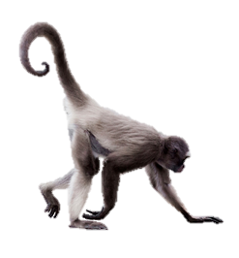

Misconception #1
Humans evolved from monkeys
Notes:
One common misconception is that the theory of evolution claims that humans evolved in a direct line from monkeys. But this is not really what evolutionists claim.

Slide 4
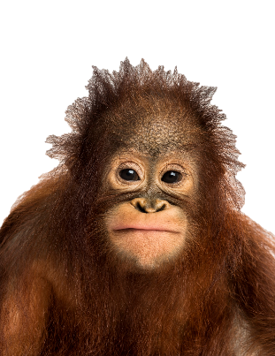
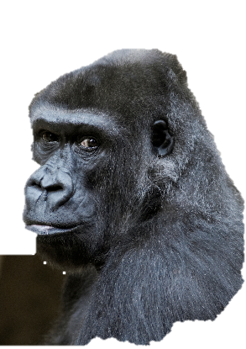


Evolution claims:
Apes and humans descended
from a common ancestor
Notes:
Instead, evolution claims that apes and humans descended from a common ancestor.

Slide 5
Cladogram
Phylogenetic Tree
Last Common Ancestor
Notes:
Here’s how it works according to evolutionary theory. / This graphic is called a cladogram or a phylogenetic tree, and its purpose is to show how closely related scientists believe these animals to be. / The yellow dot—sometimes called a node--represents the last common ancestor of apes and humans. / Each line going off to the left represents the branching off of a new kind of creature from the last common ancestor.

Slide 6
Cladogram
Phylogenetic Tree
Last Common Ancestor
Notes:
So, this would represent the last common ancestor of gorillas, chimps, and humans / and the branching off of the gorillas

Slide 7
Cladogram
Phylogenetic Tree
Last Common Ancestor
Notes:
And this would represent the last common ancestor of chimps and humans and the branching off of the chimps.

Slide 8

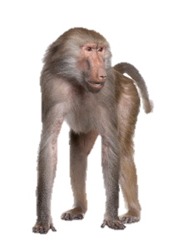
Humans
Gibbons
Gorillas
Orangutans
Chimps
Old world monkeys
New world monkeys
Notes:
Monkeys do appear on the cladogram but further back than the apes. According to evolution, both apes and humans shared a common ancestor with monkeys at some point in the distant past.

Slide 9
Notes:
But evolution doesn’t claim that these animals descended directly from one another—like grandparents, parents, and children

Slide 10
Humans
Gibbons
Gorillas
Orangutans
Chimps
Old world monkeys
New world monkeys
Notes:
In the evolutionary paradigm, they are more like cousins on the family tree.

Slide 11
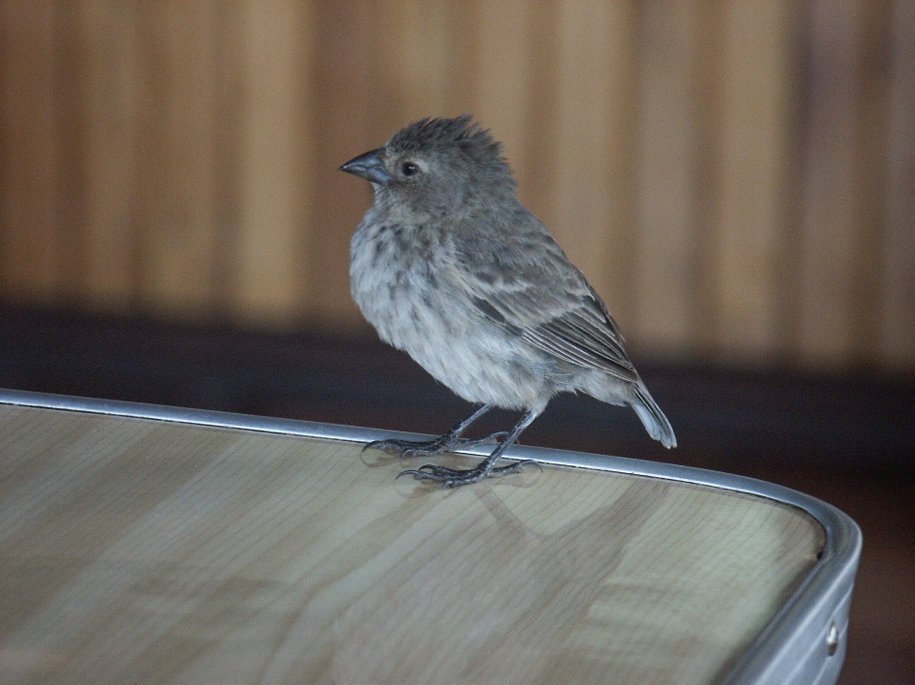
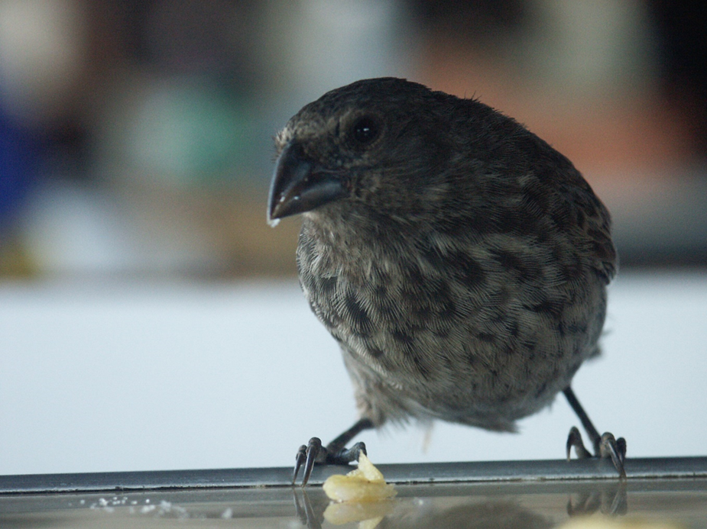


Misconception #2
Individual creatures can evolve a trait because they need or
want it
Notes:
Another misconception that some people have about the claims of evolution is that individual creatures can somehow evolve a trait because they need or want it. / That would be like saying that the beak size of an individual finch could get smaller if it needed to be able to eat smaller seeds / or get larger if it needed to be able to eat larger seeds.

Slide 12
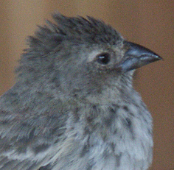
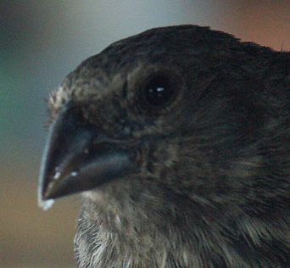
No individual beaks evolve
If there’s not enough food, some individual birds will die
Notes:
But evolution doesn’t make that claim, and we know that’s not what happens in nature. Birds can only eat whatever size seeds their beaks allow them to eat. / If there is a shortage of the right size seeds, no beaks grow or shrink to help individual birds survive. / If there’s not enough food, some individual birds will die.

Slide 13
Natural selection
happens to
individuals
Microevolution
happens to
populations over time
Notes:
Another way to say this is that natural selection happens to individuals.—they either survive or they don’t. And whether they survive or not is usually influenced by whether or not they have the most advantageous traits. Microevolution, on the other hand, only happens to populations over time as gene frequencies change.

Slide 14
Misconception #3
Evolution is somehow progressing purposefully toward “better” things
Notes:
The final misconception we will talk about is the idea that evolution is somehow progressing purposefully toward “better” things. Notice especially the words progressing and purposefully.

Slide 15
Evolution is an unguided process
NO purpose
NO direction
NO goal
Notes:
But instead of claiming that evolution is guided by some purpose and is moving in a certain direction toward some ultimate goal, / scientists with a naturalistic worldview actually claim that evolution is an unguided progress that happens naturally without any purpose or intelligence behind it.

Slide 16
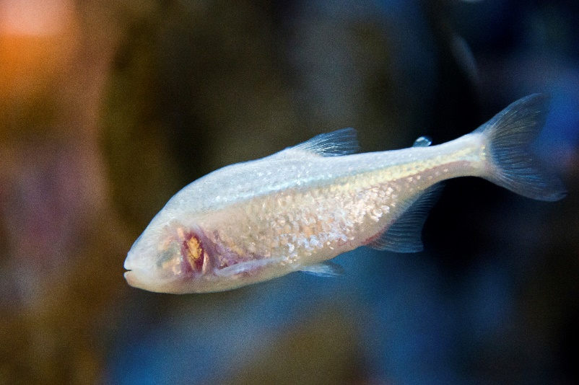
Evolution is an unguided process
Not all changes are progressive
Notes:
They also acknowledge that not all changes are progressive. / Sometimes traits can actually be lost—/ like eye sight or even eyes in cave-dwelling creatures like this fish.
Blind cave fish 49672106 antos777 (istock)

Slide 17
Misconceptions
Actual Claims
Humans evolved from monkeys
Creatures can evolve traits because they need or want them
Evolution is progressing toward a particular goal
Humans, apes, and monkeys evolved from a common ancestor
Natural selection happens to individuals. Microevolution happens to populations over time
Evolution is an unguided process
Notes:
We have looked at three common misconceptions about evolution: / that humans evolved from monkeys, / that creatures can evolve traits because they need or want them, / and that evolution is progressing toward a particular goal. And we have compared these misconceptions with the actual claims of evolution. Why is it important to understand these points correctly?

Slide 18
Why does it matter?
So we can compare the actual claims of evolution with the evidence
So we can represent the Creator/Christians/ creationists well
So we can discuss the issues accurately with others
Notes:
It is important to be able to compare the actual claims of evolution with the evidence. / We also want to represent our Creator well. When we are misinformed or careless in our thinking, we can damage the reputation of creationists, Christians, and even God Himself. / Finally, in order to be able to discuss the issues intelligently with other people, we need to understand the issues accurately.

Slide 19
Abiogenesis
Notes:
To learn about one of the toughest challenges to evolution, watch our next presentation.

Slide 20
Recorded at
Chattanooga Public RadioSM
Classical 90.5 WSMC

Slide 21
Images By
Images may appear on more than one slide. Citation is given on the first slide where each image appears.
[1] Slide design, Susan Landon
[3a] Spider monkey 53219362, JackF, Getty Images (US), Inc. Subscription
[3b] Man 38700968, Zurijeta, Getty Images (US), Inc. Subscription
[4a] Orangutan 34971082, GlobalP, Getty Images (US), Inc. Subscription
[4b] Gorilla 2015835, pixonaut, Getty Images (US), Inc. Subscription
[4c] Chimpanzee 9412019, GlobalP, Getty Images (US), Inc. Subscription
[8b] Baboon 9477313, GlobalP, Getty Images (US), Inc. Subscription
[8c] Gibbon 12613098, GlobalP, Getty Images (US), Inc. Subscription
[11a] Small Ground Finch Geospiza fuliginosa, Tim Standish, used with permission
[11b] Medium Ground Finch Geospiza fortis, Tim Standish, used with permission
[11c] Seeds 7103827, Jo De Vulder, Shutterstock standard license, (overlay - Joaquin Hernandez)
[11d] Jackfruit seeds 452415609, Moodboard, Thinkstock, Thinkstock Image Subscription Agreement
[12a] Small Ground Finch Geospiza fuliginosa, Tim Standish, used with permission
[12b] Medium Ground Finch Geospiza fortis, Tim Standish, used with permission
[16] Blind cave fish 49672106, antos777, Getty Images (US), Inc. Subscription

Slide 22
Special Thanks
Foundation for Adventist Education

Slide 23

© Origins Curriculum Resources 2015

Slide 24

© Southern Adventist University 2015

Slide 25

© Seventh-day Adventist North American Division 2015

Slide 26

© General Conference of Seventh-day Adventists 2015

Slide 27

© SCORE Southern Center for Origins Research & Education 2015

