Slide 1
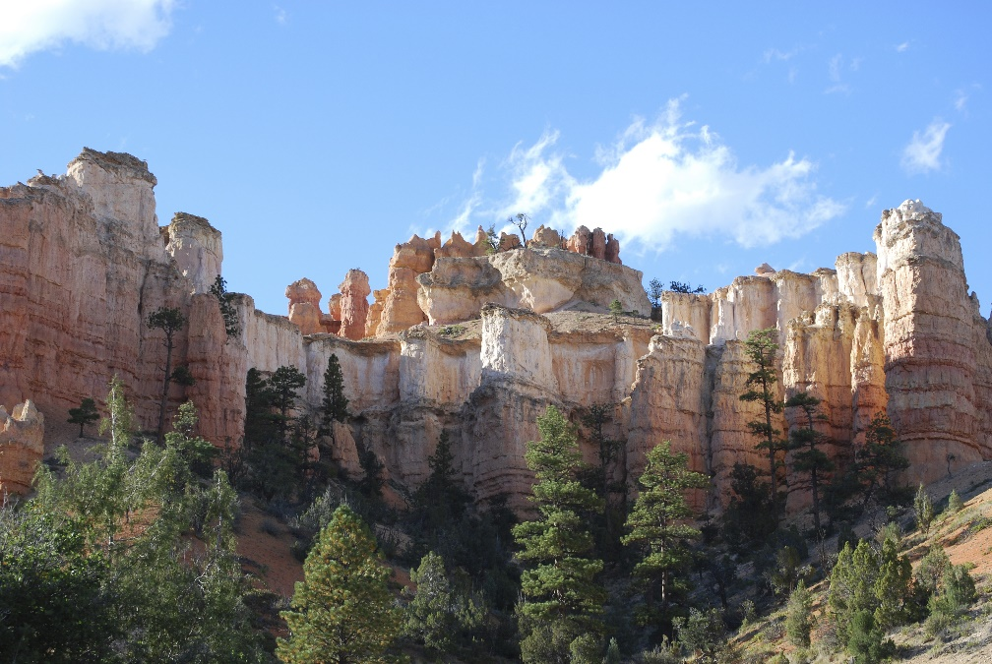
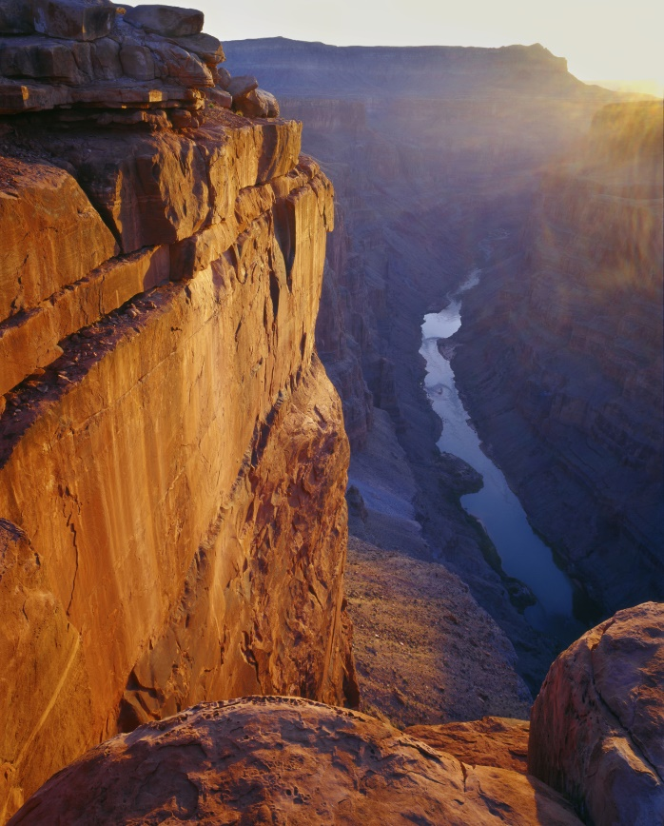
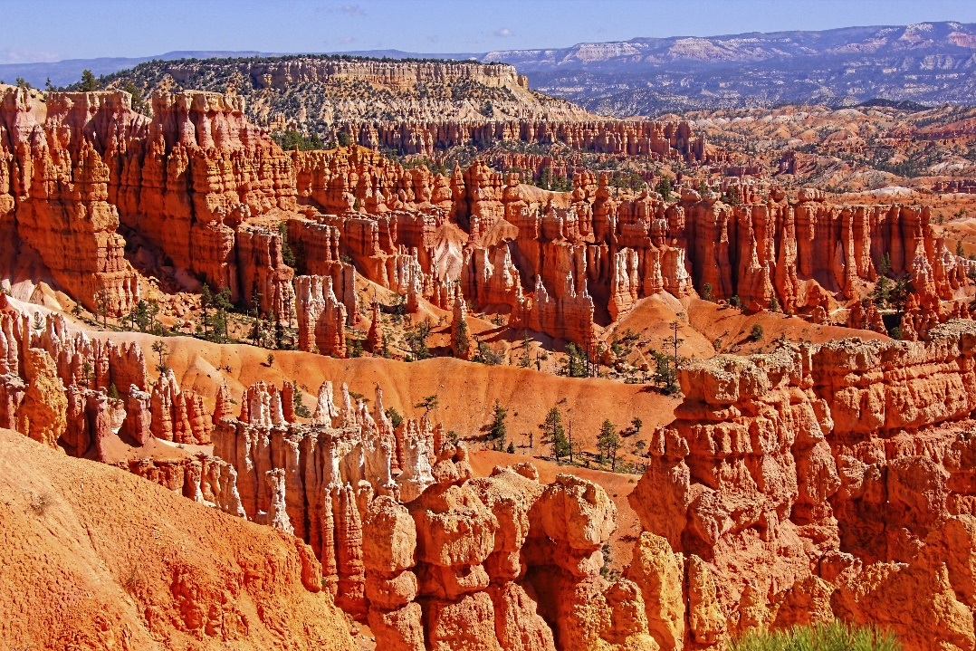
The Geologic Column (A1 Introduction)
Notes:
Introduction to the Geologic Column

Slide 2
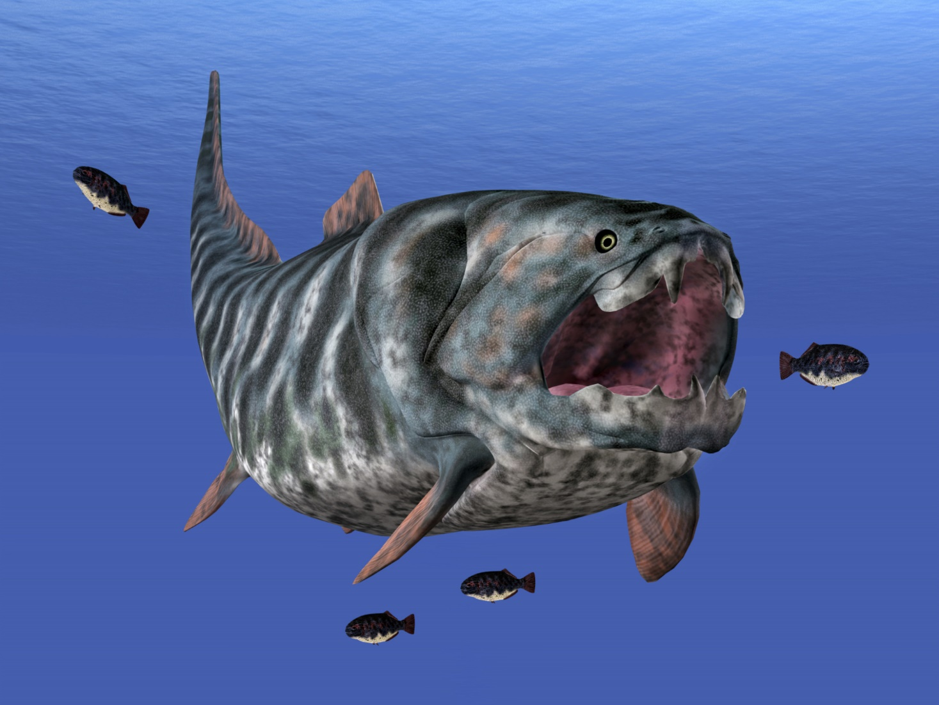
a 33-ft. Dunkleosteus
Notes:
Where can you find a 33-foot Dunkleosteus…

Slide 3
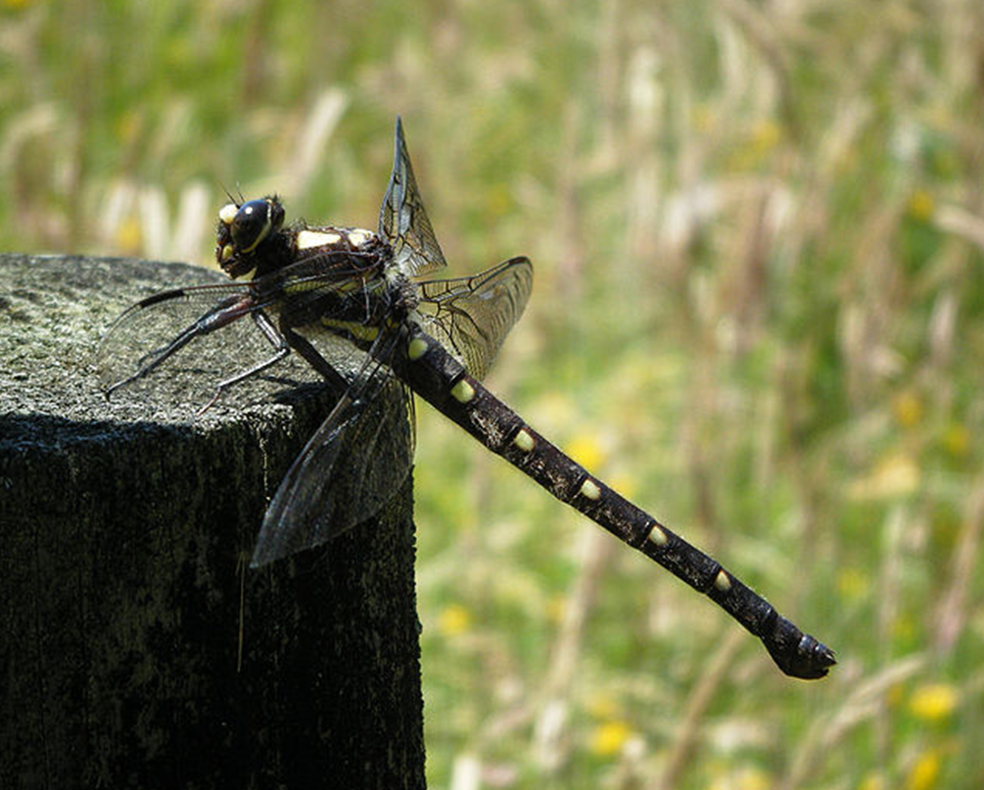
a dragonfly the size of a crow
Notes:
…a dragonfly the size of a crow…

Slide 4

Dinosaurs
Notes:
…dinosaurs…

Slide 5
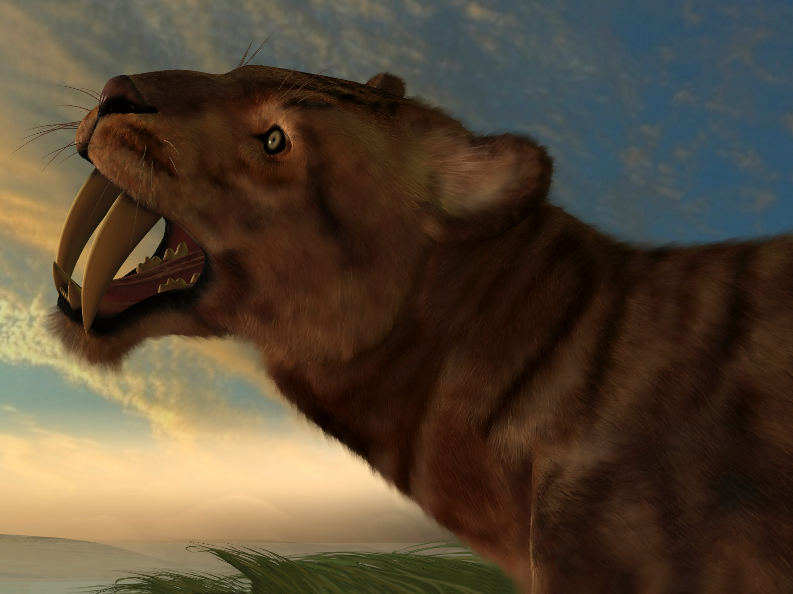
Saber Toothed Tigers
Notes:
…saber toothed tigers…

Slide 6

Wooly Mammoths
Notes:
…wooly mammoths…

Slide 7
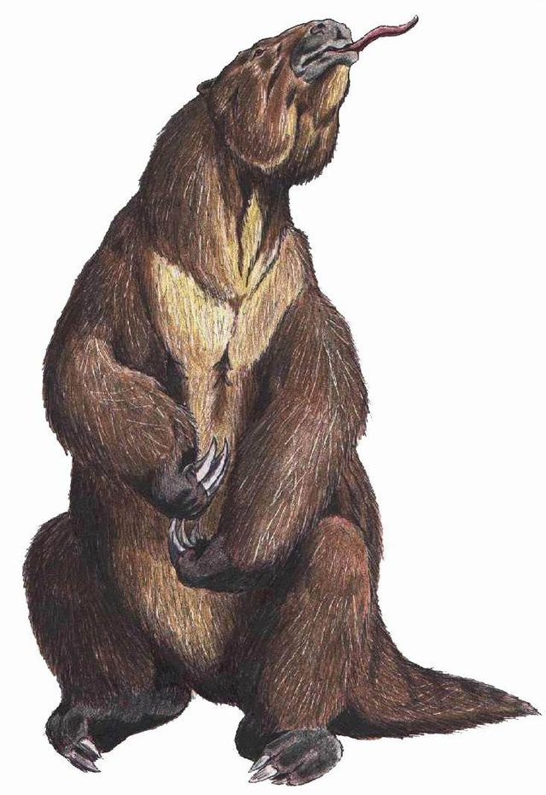
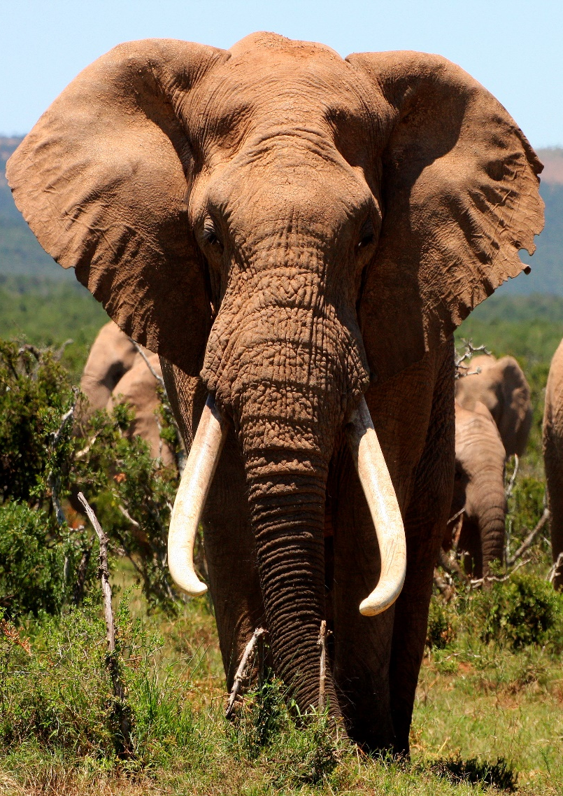
…and a sloth the size of an elephant?
Notes:
…and a sloth the size of an elephant?

Slide 8
In the Geologic Column!
Notes:
In the geologic column!

Slide 9
What is the Geologic Column?
Notes:
What exactly IS the geologic column? Where is it located? Why is it important? Let’s find out!

Slide 10
The Geologic Column
Notes:
All around the world there are really interesting layers of rock, / and when people use the words Geologic Column they are referring to all these layers. There are more layers than you can see in any one place, but if you travel a little you can see them all.

Slide 11
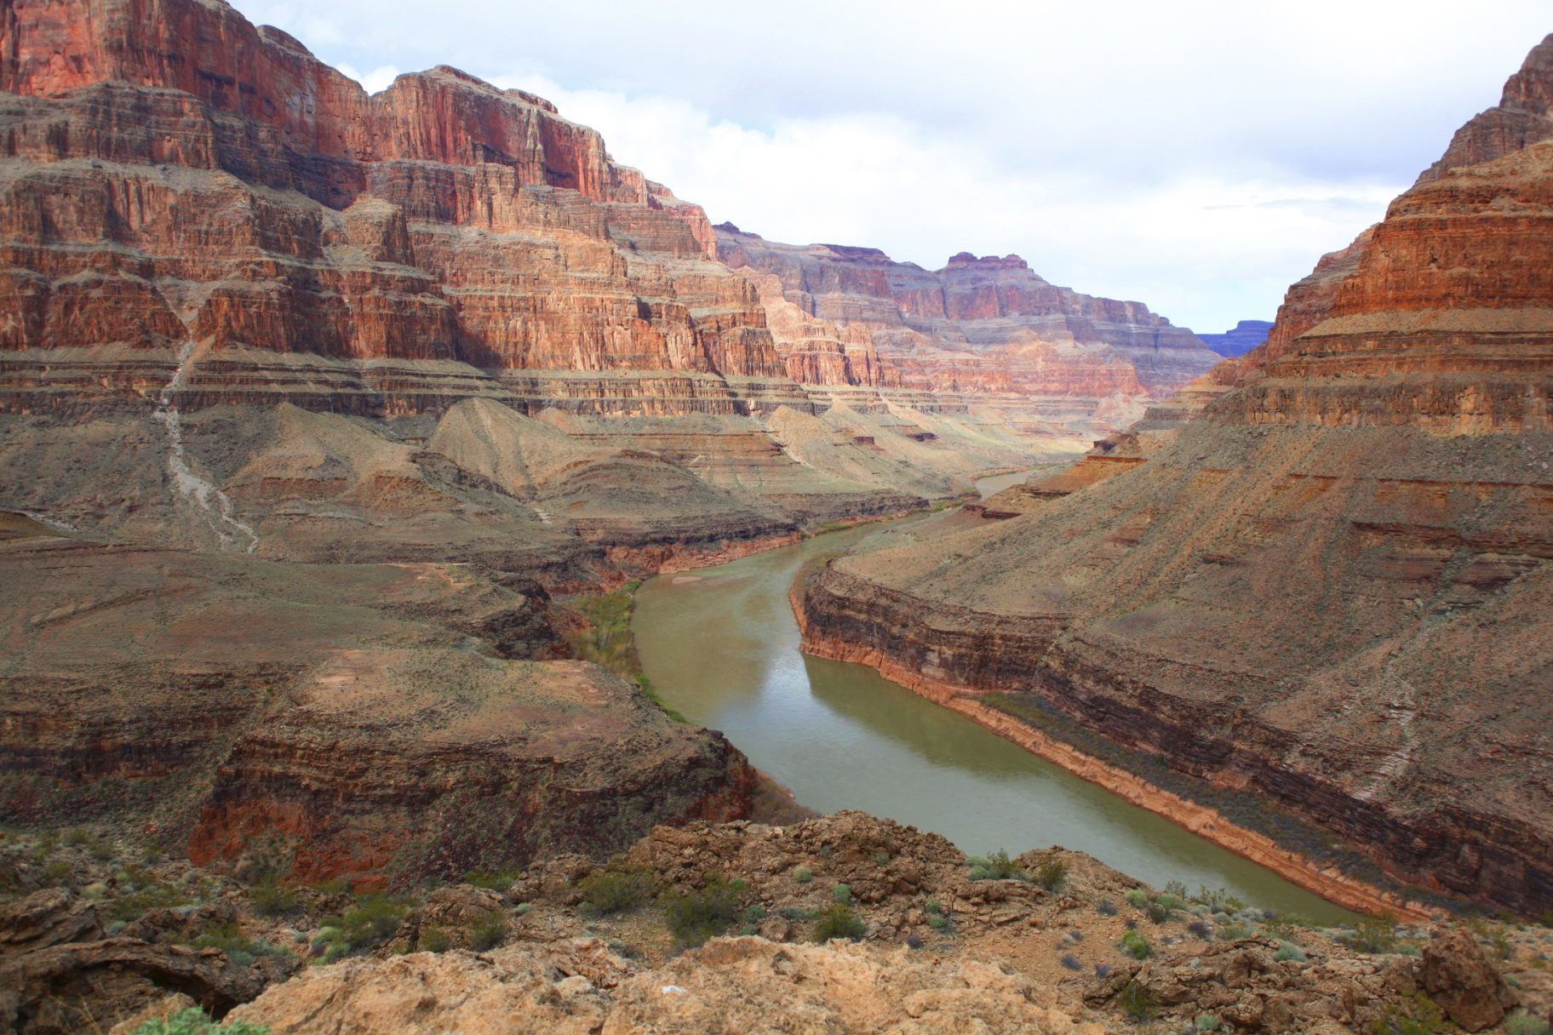
The Grand Canyon
Notes:
The bottom layers are visible in the grand Canyon in Arizona.

Slide 12
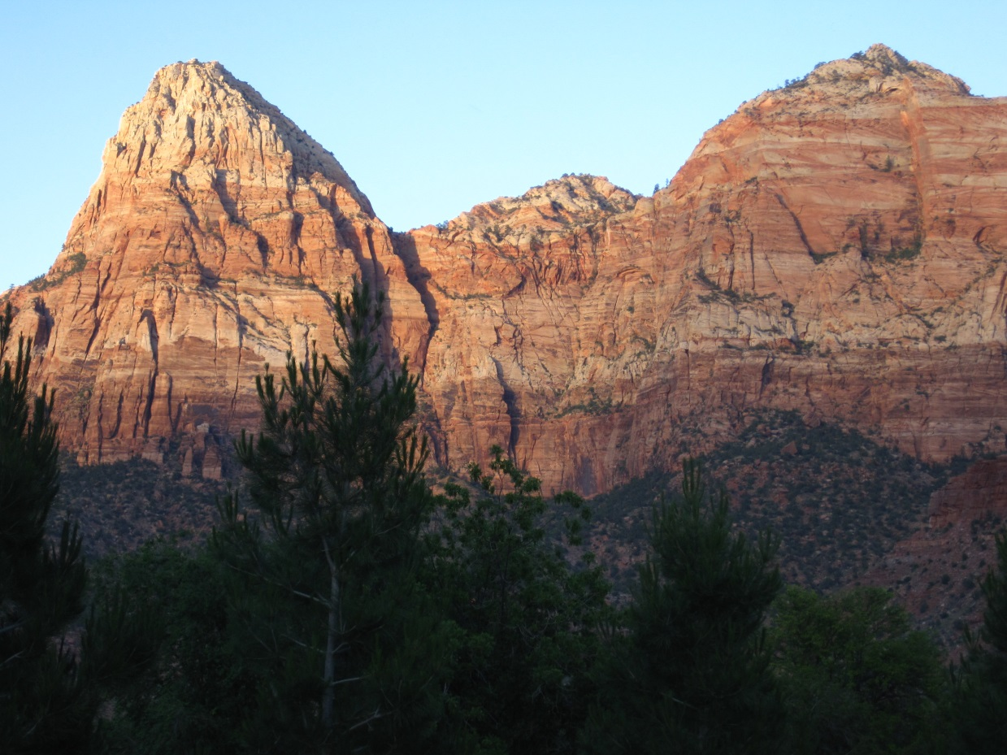
Zion National Park
Notes:
The middle layers are visible in Zion National Park in Utah.

Slide 13
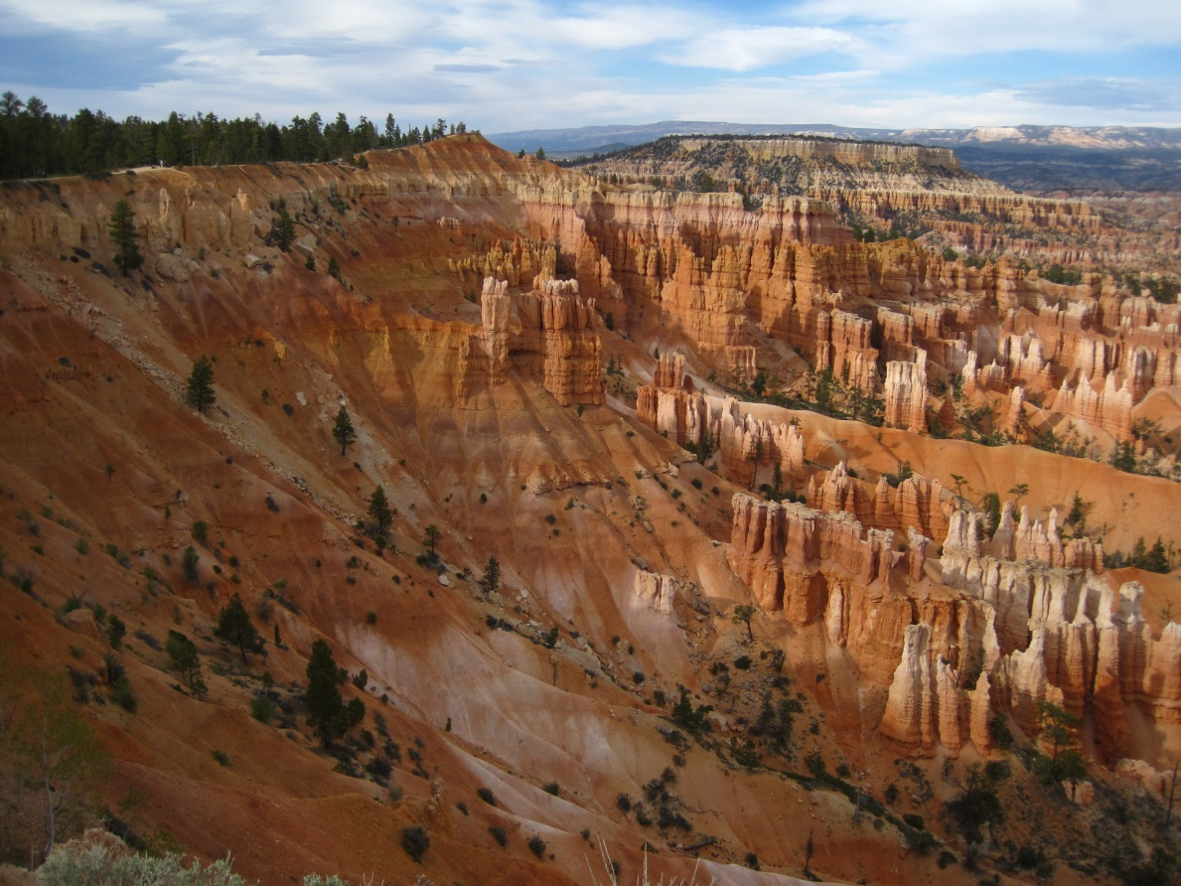
Bryce Canyon National Park
Notes:
The top layers are visible in Bryce Canyon National Park, which is also in Utah.

Slide 14
Quaternary
Cenozoic
Neogene
Paleogene
Cretaceous
Mesozoic
Jurassic
Triassic
Phanerozoic
Permian
Pennsylvanian
Mississippian
Paleozoic
Devonian
Silurian
Ordovician
Cambrian
Precambrian
Notes:
Geologists have named all those rock layers and organized them in a chart like this. All these names may seem really hard to learn, but it’s pretty easy if you break it into smaller chunks.

Slide 15
Precambrian
Notes:
The bottom section is called the Precambrian.

Slide 16
Phanerozoic
Precambrian
Notes:
On top of that is what we call the Phanerozoic.

Slide 17
Phanerozoic
Precambrian
Notes:
The Phanerozoic isn’t just one layer. It’s a special name for all the rest of the layers put together.

Slide 18
Phanerozoic
Precambrian
Notes:
The Phanerozoic is divided into 3 different parts, or sections.

Slide 19
Phanerozoic
Paleozoic
Precambrian
Notes:
On top of the Precambrian is the Paleozoic.

Slide 20
Mesozoic
Phanerozoic
Paleozoic
Precambrian
Notes:
On top of that is the Mesozoic.

Slide 21
Cenozoic
Mesozoic
Phanerozoic
Paleozoic
Precambrian
Notes:
And on top of that is the Cenozoic.

Slide 22
Cenozoic
Mesozoic
Phanerozoic
Paleozoic
Precambrian
Notes:
Those three parts are divided into smaller sections that you may want to learn some day.

Slide 23
Cenozoic
Mesozoic
Phanerozoic
Permian
Pennsylvanian
Mississippian
Paleozoic
Devonian
Silurian
Ordovician
Cambrian
Precambrian
Notes:
The Paleozoic has 7 sections.

Slide 24
Cenozoic
Cretaceous
Mesozoic
Jurassic
Triassic
Phanerozoic
Permian
Pennsylvanian
Mississippian
Paleozoic
Devonian
Silurian
Ordovician
Cambrian
Precambrian
Notes:
The Mesozoic has 3.

Slide 25
Quaternary
Cenozoic
Neogene
Paleogene
Cretaceous
Mesozoic
Jurassic
Triassic
Phanerozoic
Permian
Pennsylvanian
Mississippian
Paleozoic
Devonian
Silurian
Ordovician
Cambrian
Precambrian
Notes:
And the Cenozoic has 3.

Slide 26
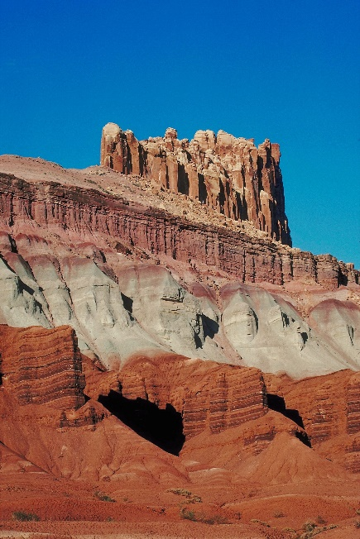
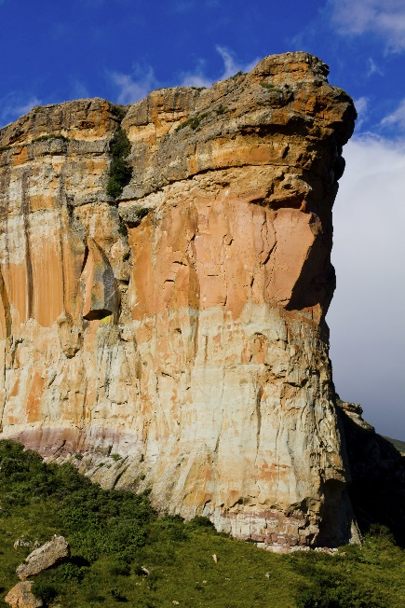
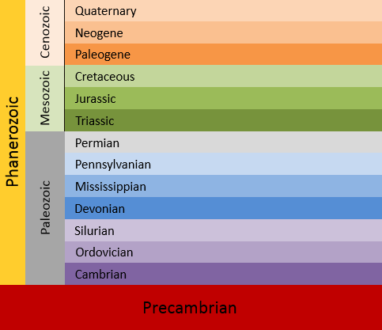
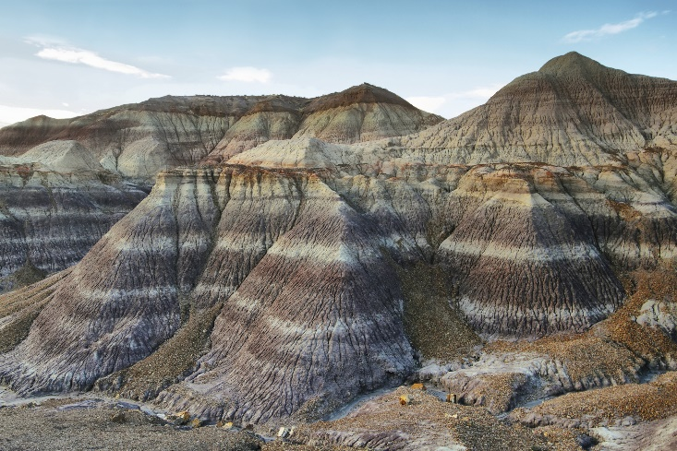
The Geologic Column
Notes:
All the layers of rock around the world that geologists have described in this chart make up what we call the Geologic Column.

Slide 27
The Geologic Column contains lots of interesting fossils.
Notes:
The Geologic Column contains lots of interesting fossils. Starting at the bottom, let’s see what kinds of fossils there are.

Slide 28
Is the bottom layer called the Precambrian
or the
Phanerozoic?
Notes:
Can you remember what the bottom section is called? Is it Precambrian or Phanaerozoic?

Slide 29
Is the bottom layer called the Precambrian
or the
Phanerozoic?
Notes:
If you said Precambrian, you’re right!

Slide 30
Phanerozoic
Precambrian
Notes:
Phanerozoic is the name for all the other layers put together.

Slide 31
Phanerozoic
Precambrian—almost NO fossils!
Notes:
The Precambrian has almost NO fossils at all,

Slide 32
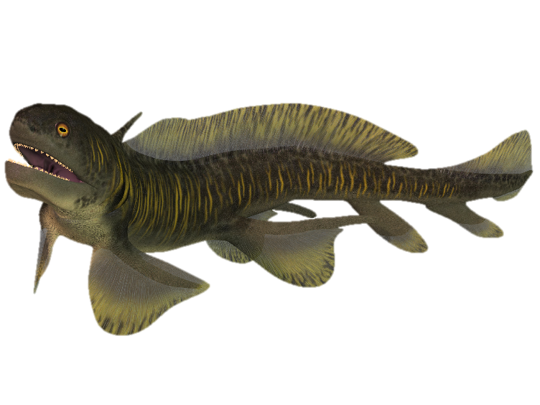
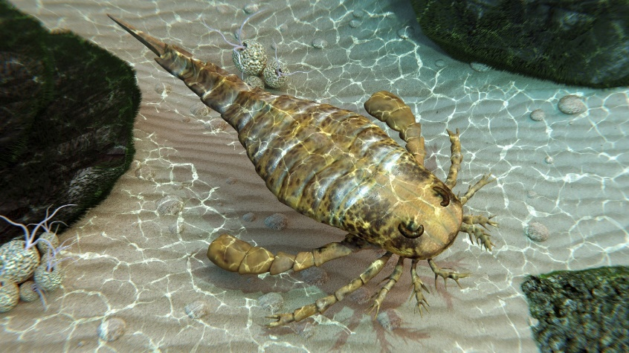
Phanerozoic
Paleozoic
Precambrian
Notes:
But the Paleozoic has all kinds of fossils including interesting fish and sea scorpions.

Slide 33

Phanerozoic
Paleozoic
Precambrian
Notes:
One of the most exciting Paleozoic fossils is the Dunkleosteus, which could grow to be 33 feet long!

Slide 34

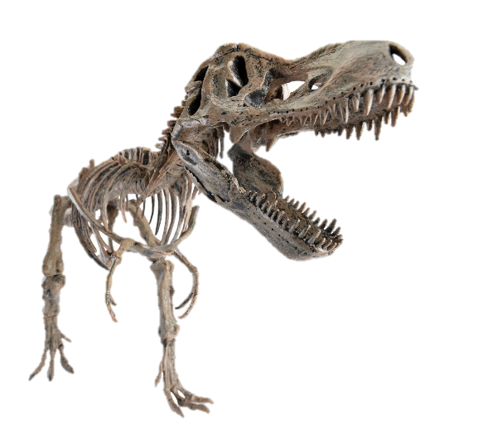
Mesozoic
Phanerozoic
Precambrian
Notes:
The Mesozoic layers contain a variety of fossils too, but the most well-known are the dinosaurs.

Slide 35

Cenozoic
Phanerozoic
Precambrian
Notes:
Remember the saber toothed tiger, the sloth the size of an elephant, and the woolly mammoth?

Slide 36
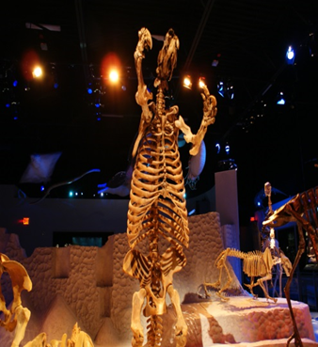
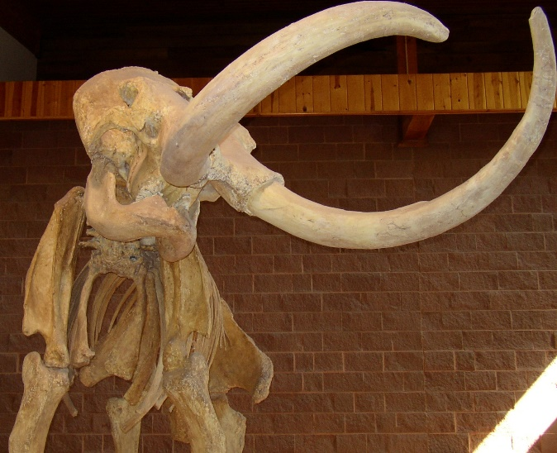
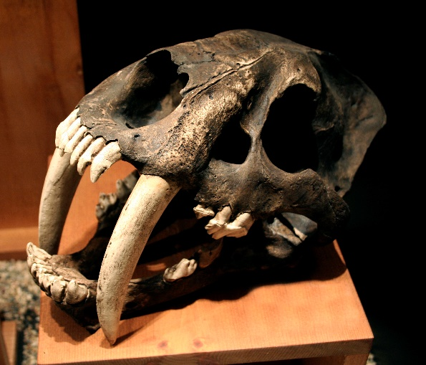
Cenozoic
Phanerozoic
Precambrian
Notes:
They are all found in the Cenozoic.

Slide 37



Notes:
The rock layers themselves / and the fossils found in them are fascinating to study.

Slide 38
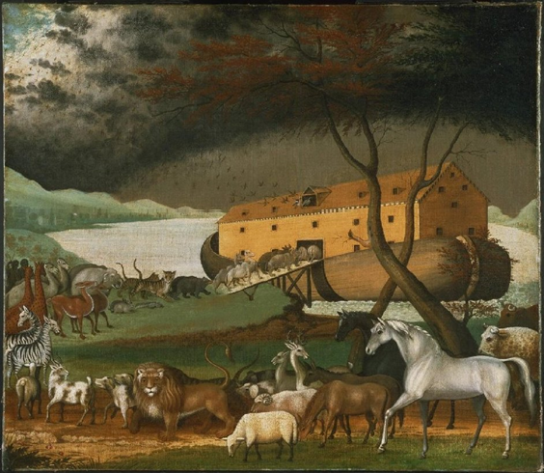
Evidence for Noah’s Flood
Notes:
We’ll be learning lots more about how they also provide important evidence for Noah’s Flood.

Slide 39
Recorded at
Chattanooga Public RadioSM
Classical 90.5 WSMC

Slide 40
Stock Images By
Images may appear on more than one slide. Citation is given on the first slide where each image appears.
[1a] Zion National Park 489588635, kaiborder, Thinkstock, Thinkstock Image Subscription Agreement
[1b] Grand Canyon – Toroweap Point 480297321, Scott_Walton, Thinkstock, Thinkstock Image Subscription Agreement
[1c] Bryce Canyon landscape 497280819, jenifoto, Thinkstock, Thinkstock Image Subscription Agreement
[2] Dunkleosteus 180176590, MR 1805, Thinkstock, Thinkstock Image Subscription Agreement
[3] Carovei Dragonfly, Ed Mitchell, http://commons.wikimedia.org/wiki/File:Uropetala_carovei_at_Punakaiki.JPG, CC-BY-3.0
[4] T-Rex 31496000, juanmonino, Getty Images (US), Inc. Subscription Agreement
[5] The Saber-Tooth Cat 22991262, CoreyFord, Getty Images (US), Inc. Subscription Agreement
[6] Mammoth illustration 54716814, nicolasprimola, Getty Images (US), Inc. Subscription Agreement
[7a] Megatherium, uploaded by Cropbot, http://en.wikipedia.org/wiki/Megatherium#mediaviewer/File:Megatherum_DB.jpg, public domain
[7b] Elephant 19971289, fishcat007, Getty Images (US), Inc. Subscription Agreement
[11] Grand Canyon 465264983, OlegBogdan, Thinkstock, Thinkstock Image Subscription Agreement
[12] Zion National Park, Keith Snyder
[13] Bryce Canyon National Park, Keith Snyder

Slide 41
Stock Images By
[26a] Golden Gate 487256769, marcelauret, Thinkstock, Thinkstock Subscription Agreement
[26b] Capitol Reef National Park 87614068, Jupiterimages, Thinkstock, Thinkstock Subscription Agreement
[26c] Blue Mesa 479232619, estivillml, Thinkstock, Thinkstock Subscription Agreement
[32a] Eurypterid Exploring Seafloor 504740193, Thinkstock, Thinkstock Subscription Agreement
[32b] Orthacanthus 26677829, CoreyFord, Getty Images (US), Inc. Subscription Agreement
[34b] Tyrannosaurus rex skeleton 23393902, LeventKonuk, Getty Images (US), Inc. Subscription Agreement
[36a] Giant Ground Sloth, Dallas Krentzel, http://www.flickr.com/photos/31867959@N04/3824332169, CC BY 2.0
[36b] Sabertooth Tiger Skull 825334, pixeldigits, Getty Images (US), Inc. Subscription Agreement
[36c] Mammoth skeleton 186043, Escaflowne, Getty Images (US), Inc. Subscription Agreement
[38] Noah’s Ark, http://commons.wikimedia.org/wiki/File:Noahs_Ark.jpg; Public domain

Slide 42
Special Thanks
Foundation for Adventist Education

Slide 43

© Southern Adventist University 2015

Slide 44

© Seventh-day Adventist North American Division 2015

Slide 45

© General Conference of Seventh-day Adventists 2015

Slide 46

© SCORE Southern Center for Origins Research & Education 2015

