Slide 1
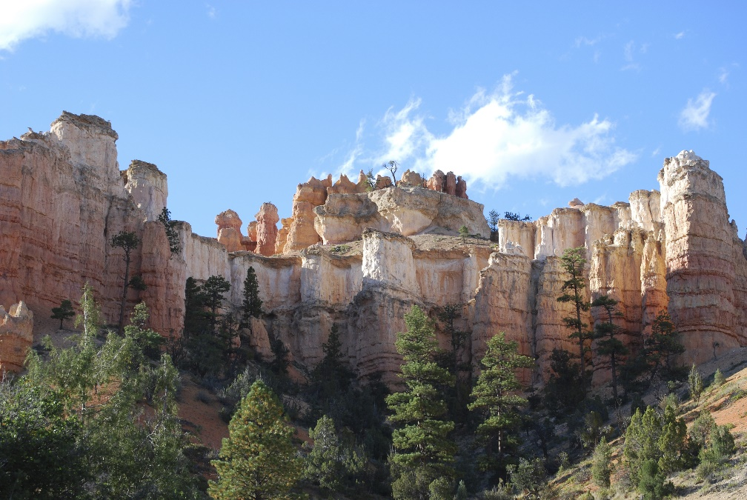
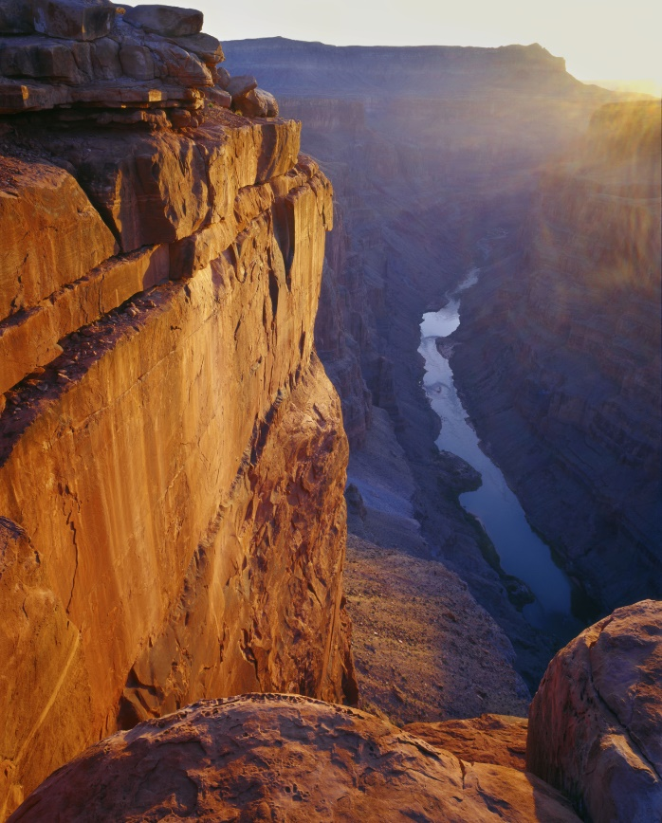
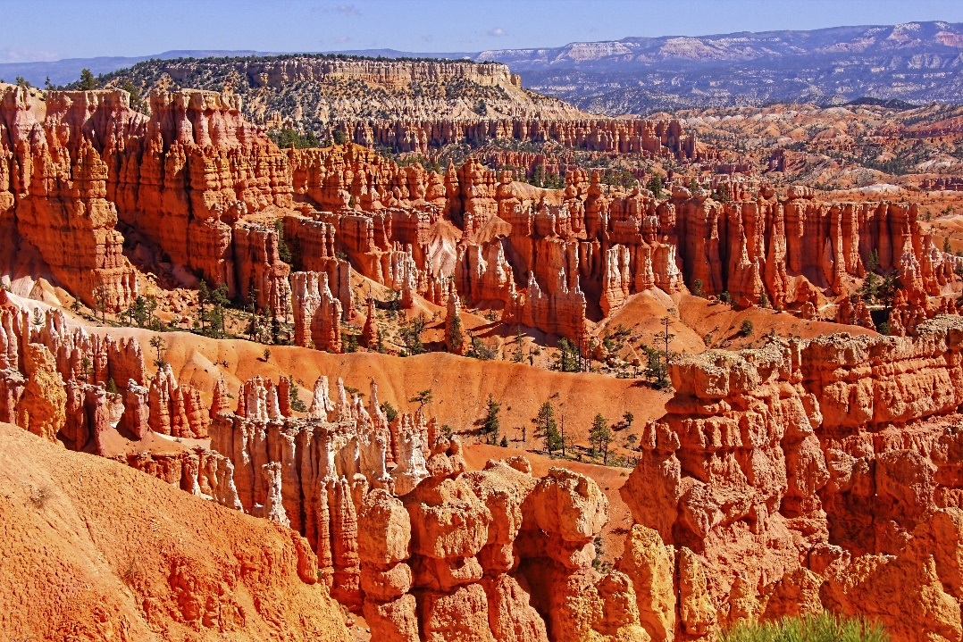
The
Geologic
Column
(A2 Some Definitions)
Notes:
The Geologic Column—Some Definitions

Slide 2



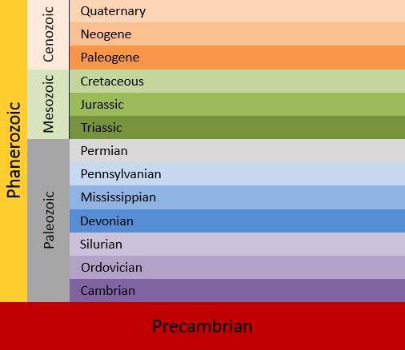

?
_______________ Column
Notes:
Can you remember the name for the rock layers all around the world that we represent using this chart?

Slide 3

Geologic
_______________ Column
Notes:
We call it the Geologic Column. Let’s think about what these words mean.

Slide 4
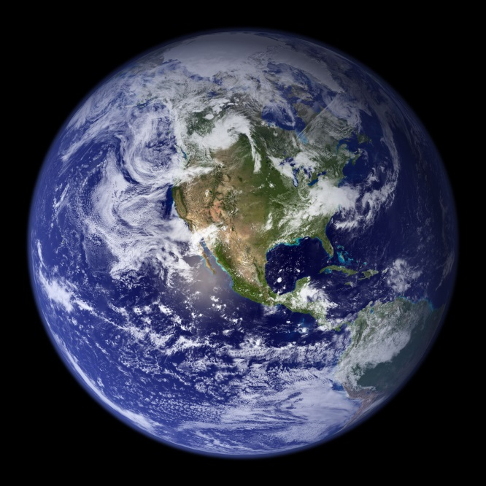

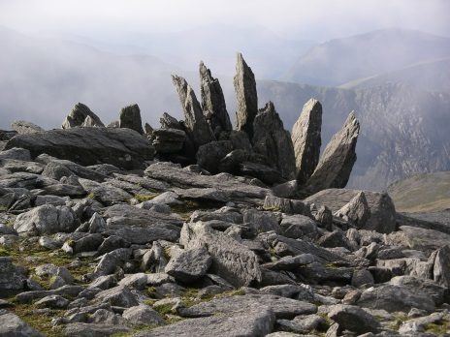
Ge-ology
Geo (earth)
logy (study of)
Geology is the study of the Earth (and the rocks that it is made of)
Notes:
Words are made up of small parts like prefixes and suffixes that give us clues to the meaning of the word. / The prefix “Geo” refers to the earth… including the rocks it is made of. / “ology” means “study of”/ So Ge-ology means the study of the earth and the rocks that it is made of.

Slide 5
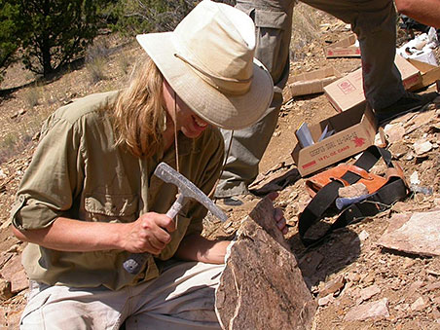
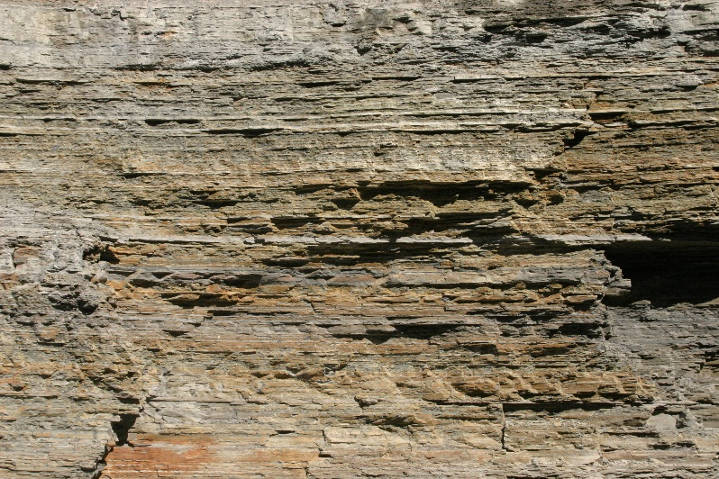
Geologist
Geologic
A geologist is someone who studies the earth and its rocks.
Geologic is an adjective that describes something to do with the earth and the rocks
Notes:
When you see “ist” at the end of a word, you know we’re talking about a person. / So a Geologist is a person who studies the earth and its rocks. / When you see “ic” at the end of a word, that tells you the word is an adjective to describe something. / So geologic is an adjective to describe something to do with the earth and its rocks.

Slide 6
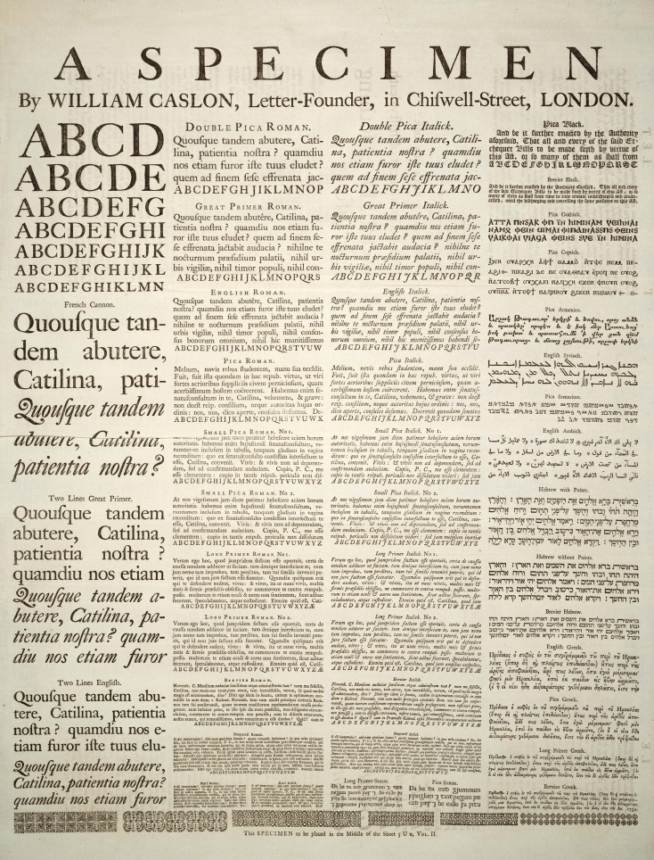

A column is a vertical (up and down) arrangement of something
Notes:
A column is a vertical (or up and down) arrangement of something / like a newspaper column or a column on a building.

Slide 7
Geologic
_______________ Column
Notes:
Now you know why we call this vertical arrangement of rock layers all around the world / the Geologic Column.

Slide 8
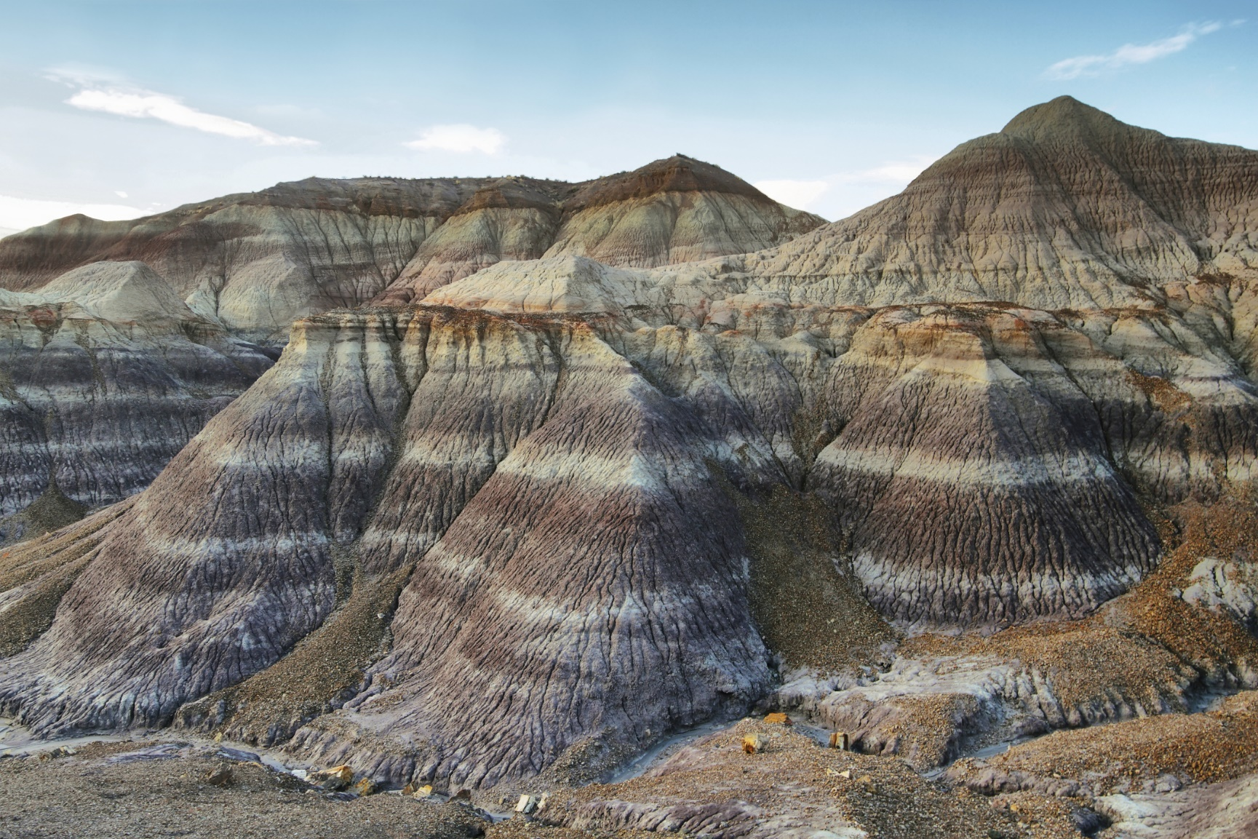
Rock Layers = Strata (plural)
Only one layer = Stratum (singular)
Notes:
The geologic column is made up of real layers of rock, which are called strata. / Stratum refers to just one layer.

Slide 9
Quaternary
Cenozoic
Neogene
Paleogene
Cretaceous
Mesozoic
Jurassic
Triassic
Phanerozoic
Permian
Pennsylvanian
Mississippian
Paleozoic
Devonian
Silurian
Ordovician
Cambrian
Precambrian
Notes:
If we want to talk about only certain parts of the geologic column, we can use specific terms to help us describe them accurately. As people studied the strata, they grouped certain layers together and named them. Each name in this chart represents not just one, but several different strata that have been grouped together in this way.

Slide 10
Phanerozoic
Eonothem
Phanerozoic Eonothem
Precambrian
Notes:
You already learned that the Phanerozoic is the name for all the layers above the Precambrian. / The word we use to describe this interval of the geologic column / is eonothem. So this interval is called the Phanerozoic eonothem.

Slide 11

Cenozoic
Mesozoic
Phanerozoic
Paleozoic
Precambrian
Notes:
You already learned that the Phanerozoic eonothem is divided into three smaller sections, /
the Paleozoic/ Mesozoic, / and Cenozoic. / The word we use to describe each of those sections / is erathem.

Slide 12
Cenozoic
Mesozoic
Phanerozoic
Paleozoic
Paleozoic erathem
Precambrian
Notes:
So these intervals would be called / the Paleozoic eratherm,

Slide 13
Cenozoic
Mesozoic
Mesozoic erathem
Phanerozoic
Paleozoic
Precambrian
Notes:
the Mesozoic erathem,

Slide 14
Cenozoic
Cenozoic erathem
Mesozoic
Phanerozoic
Paleozoic
Precambrian
Notes:
/ and the Cenozoic erathem.

Slide 15
Quaternary
Cenozoic
Neogene
Paleogene
Cretaceous
Mesozoic
Jurassic
Triassic
Phanerozoic
Systems
Permian
Pennsylvanian
Mississippian
Paleozoic
Devonian
Silurian
Ordovician
Cambrian
Precambrian
Notes:
Erathems are divided into even smaller intervals called systems

Slide 16

Quaternary
Cenozoic
Neogene
Paleogene
Cretaceous
Mesozoic
Jurassic
Triassic
Phanerozoic
Permian
Pennsylvanian
Mississippian
Paleozoic
Devonian
Silurian
Ordovician
Cambrian
Precambrian
Notes:
This would be the Cambrian system, / the Jurassic system, / and the Neogene system.

Slide 17
Notes:
Once you’re familiar with these words, it will be easier for you to learn lots more about the geologic column.

Slide 18
Recorded at
Chattanooga Public RadioSM
Classical 90.5 WSMC

Slide 19
Stock Images By
Images may appear on more than one slide. Citation is given on the first slide where each image appears.
[1a] Zion National Park 489588635, kaiborder, Thinkstock, Thinkstock Image Subscription Agreement
[1b] Grand Canyon – Toroweap Point 480297321, Scott_Walton, Thinkstock, Thinkstock Image Subscription Agreement
[1c] Bryce Canyon landscape 497280819, jenifoto, Thinkstock, Thinkstock Image Subscription Agreement
[2b] Question Marks on Blackboard 17861768, tumpikuja, Getty Images (US), Inc. Subscription Agreement
[4a] NASA Blue Marble of Eastern Hemisphere, NASA, http://commons.wikimedia.org/wiki/File:Earth_Eastern_Hemisphere.jpg, PD NASA.
[4b] Rock formations near the summit of Glyder Fawr in Snowdonia, Velela, http://commons.wikimedia.org/wiki/File:Glyder_Fawr_rocks.JPG, PD-self.
[4c] Cartoon illustration of a nerd boy 55082180, Bamztoon, Getty Images (US), Inc. Subscription Agreement
[5a] Paleontologist Matt Smith at work, John Day Fossil Beds National Monument. (NPS Photo), Trillman, http://commons.wikimedia.org/wiki/File:Joda_paleontologist.jpg, PD US NPS
[5b] Interesting rock strata from Western New York 799890, DavidHCoder, Getty Images (US), Inc. Subscription Agreement
[6a] A specimen sheet of typefaces and languages, by William Caslon I, letter founder; from the 1728, William Caslon, http://commons.wikimedia.org/wiki/File:Caslon-schriftmusterblatt.jpeg, CC-PD-Mark
[6b] Columns 9099568, twilightproductions, Getty Images (US), Inc. Subscription Agreement
[8] Blue Mesa Petrified Forest National Park 479232619, estivillml, Thinkstock, Thinkstock Image Subscription Agreement

Slide 20
Special Thanks
Foundation for Adventist Education

Slide 21

© Origins Curriculum Resources 2015

Slide 22

© Southern Adventist University 2015

Slide 23

© Seventh-day Adventist North American Division 2015

Slide 24

© General Conference of Seventh-day Adventists 2015

Slide 25

© SCORE Southern Center for Origins Research & Education 2015

