Slide 1
Before using this PowerPoint, consider doing activity 3 with the class.

Slide 2
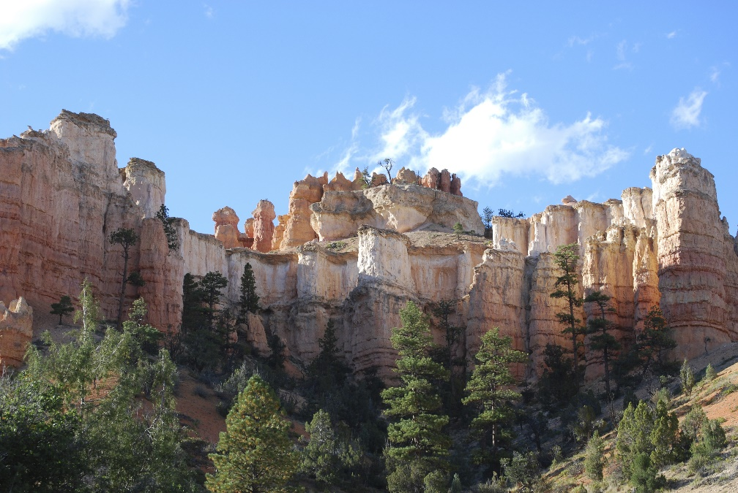
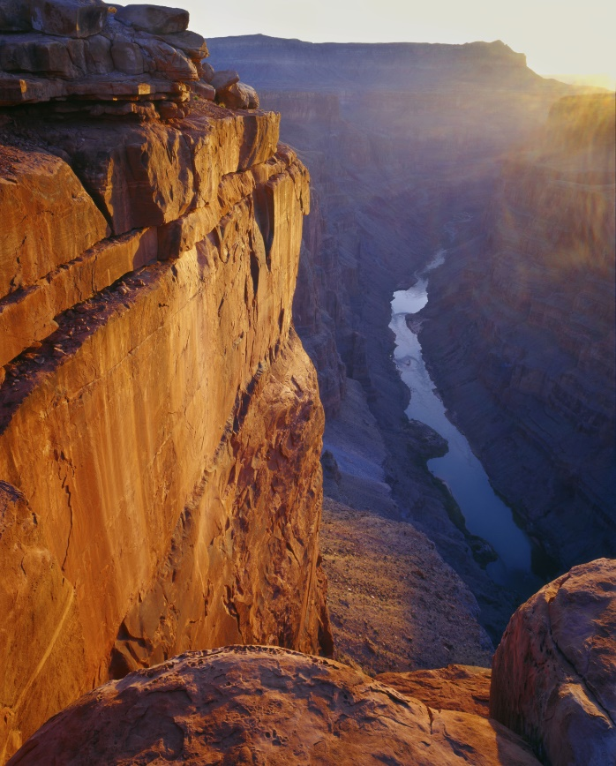
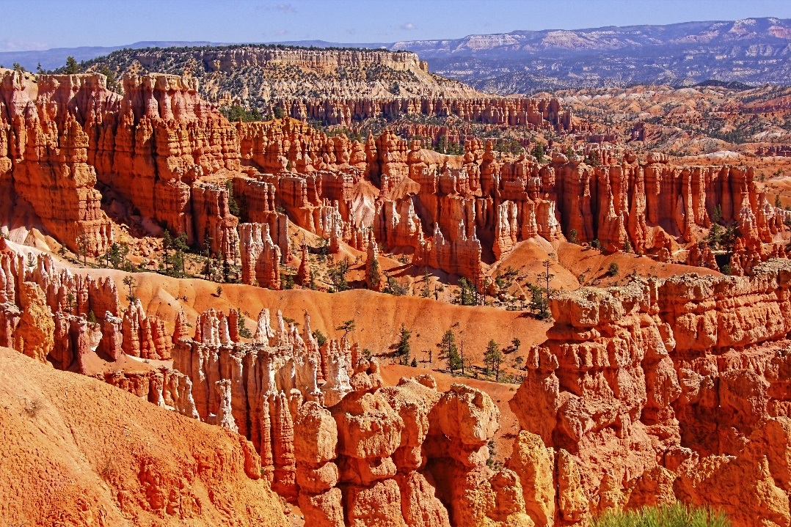
The
Geologic
Column
(A3 Relative Age)
Notes:
The Geologic Column--Relative Age

Slide 3
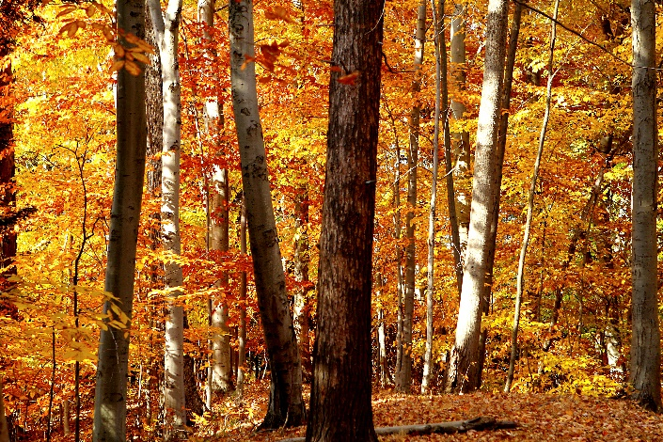




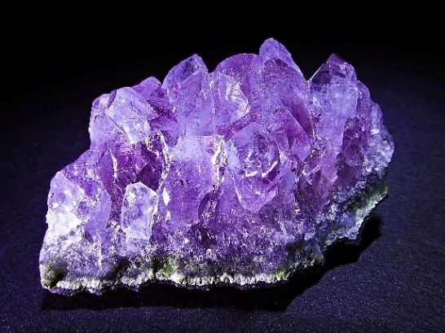
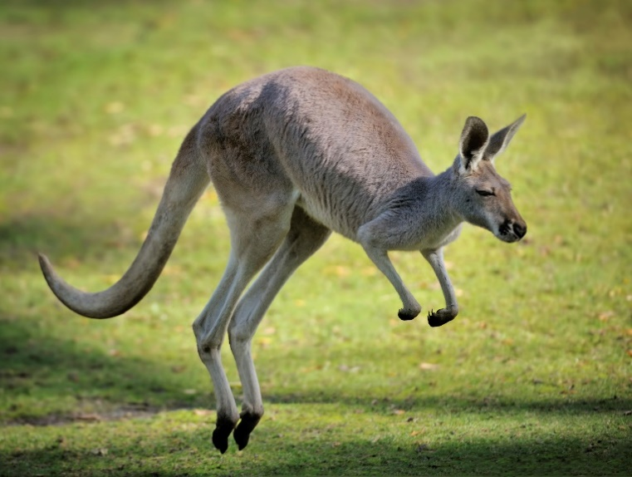


Notes:
Scientists study all kinds of things.

Slide 4
Scientific Inquiry
1.
Collect
Data
2.
Interpret
Data
Notes:
In the process of scientific inquiry scientists do two things:
First they collect data, / and then they interpret data.

Slide 5


Scientific Inquiry
Data
Facts
Information
Notes:
Data are facts, or pieces of information, that we gather by observing, measuring, or analyzing something.

Slide 6


Data
Color
Notes:
We can observe the color of flowers

Slide 7

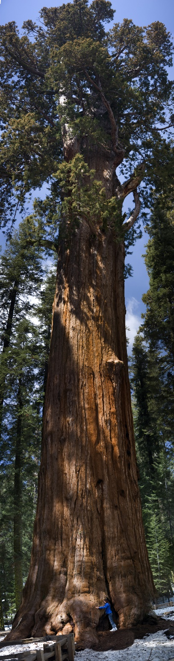

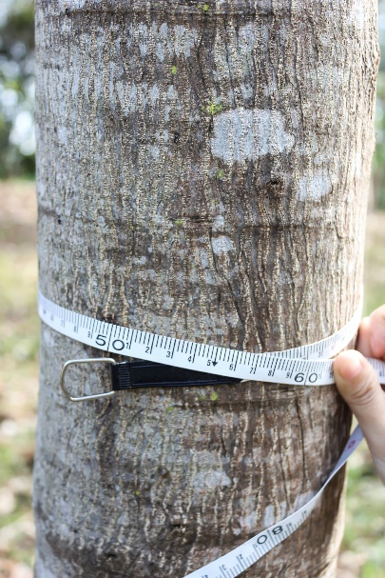
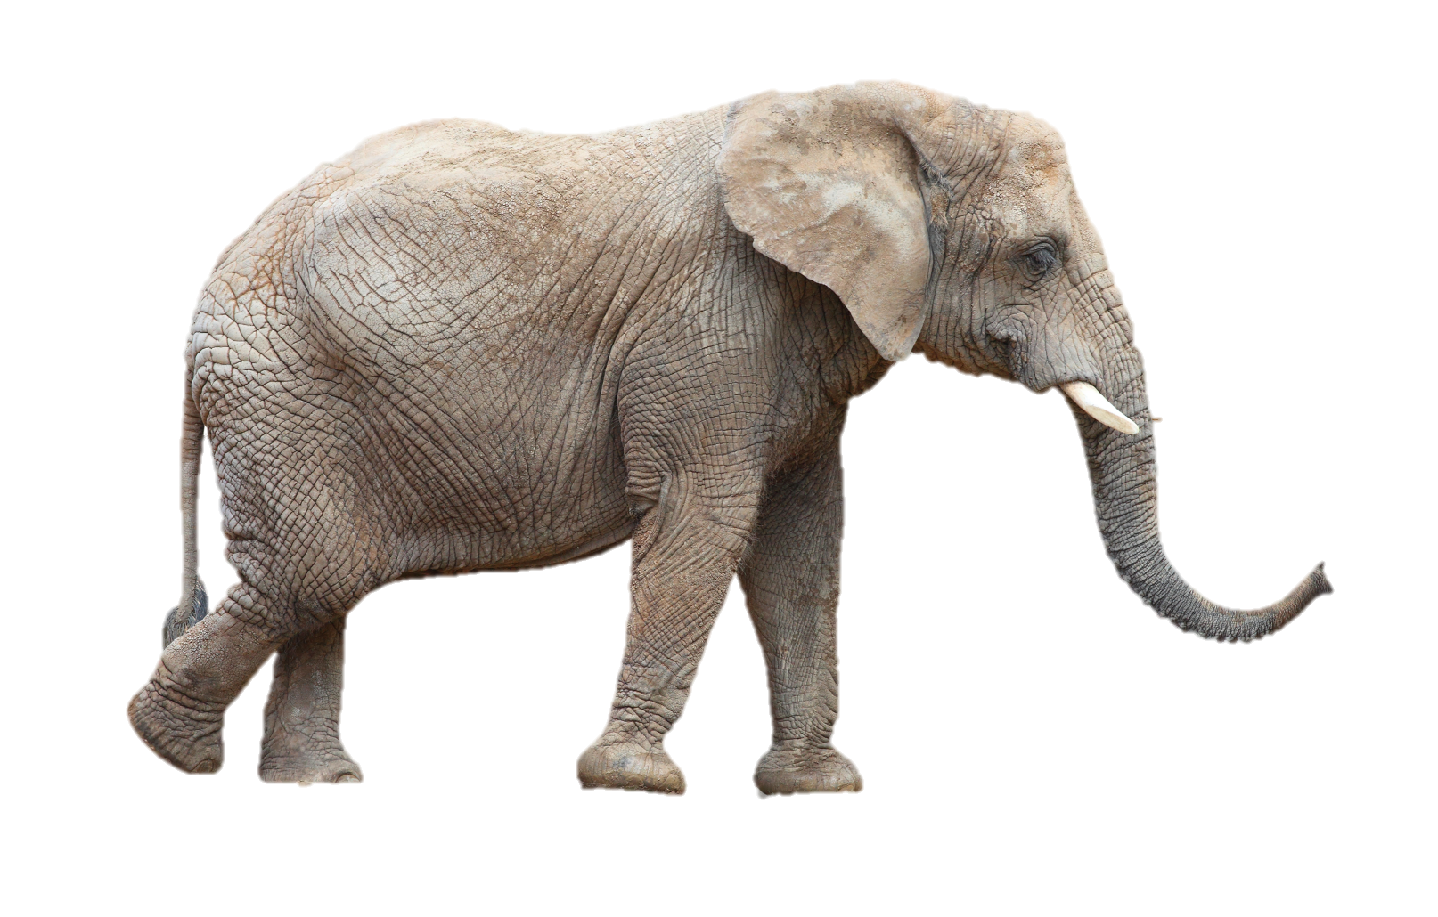
Data
Measurements
Notes:
We can find the weight of a kitten, or an elephant and measure the circumference or height of a tree.

Slide 8
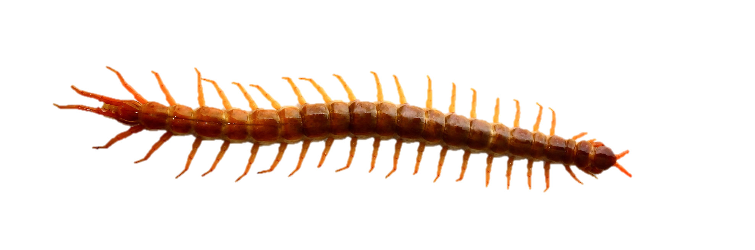
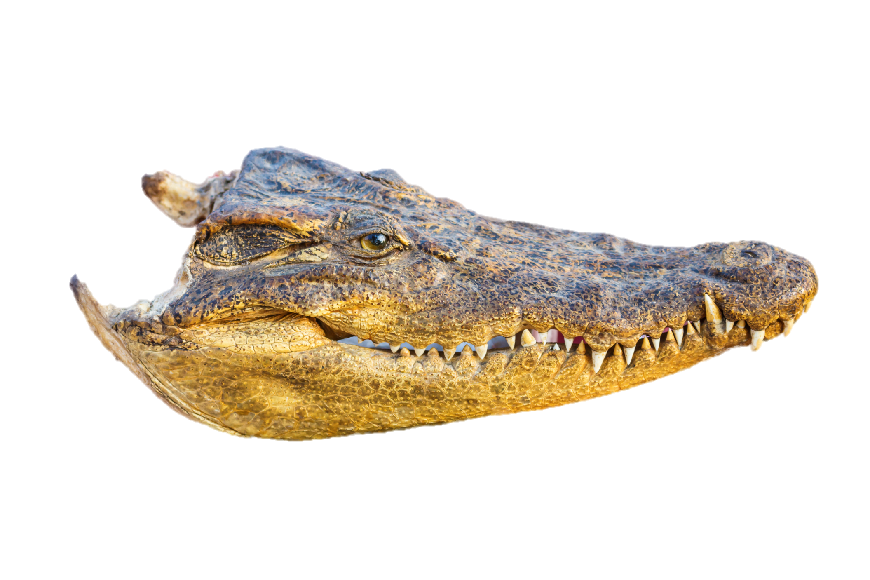
Data
1, 2, 3, …
Notes:
We can count a crocodile’s teeth / or the legs on a centipede.

Slide 9


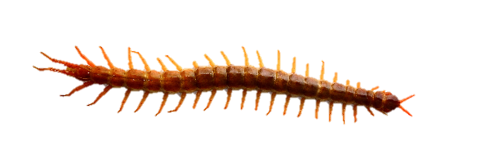
Scientific Inquiry
Data
Color
Facts
1, 2, 3, …
Measurements
Notes:
All these pieces of information are facts—or data.

Slide 10

Scientific Inquiry
Data
Facts
Explanations
Notes:
The ideas scientists come up with to explain the data…
… are called interpretations.

Slide 11



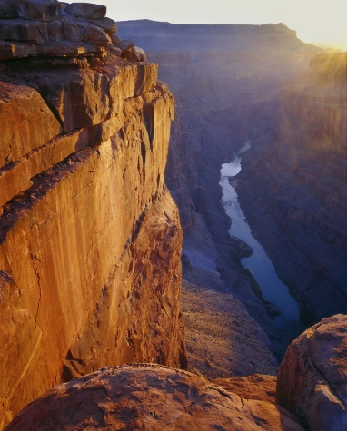
Geologic Column
Data
Notes:
The rocks in the geologic column are a source of lots of interesting data.

Slide 12
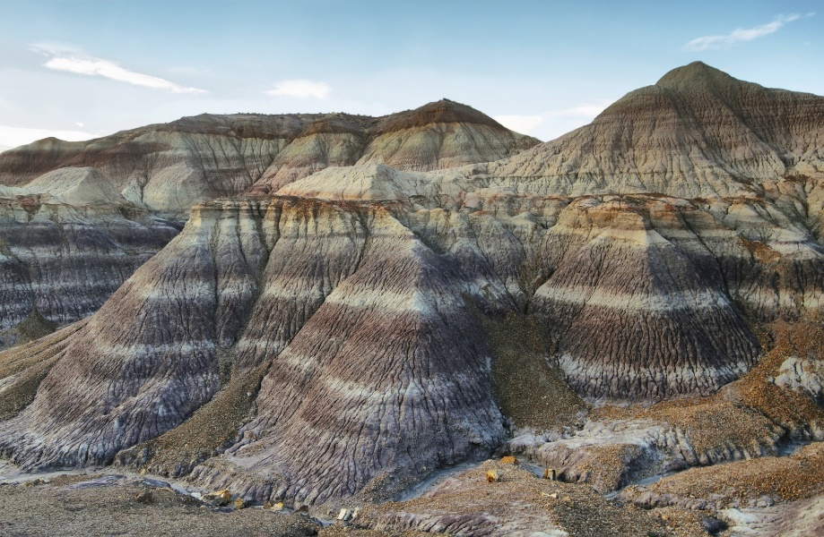
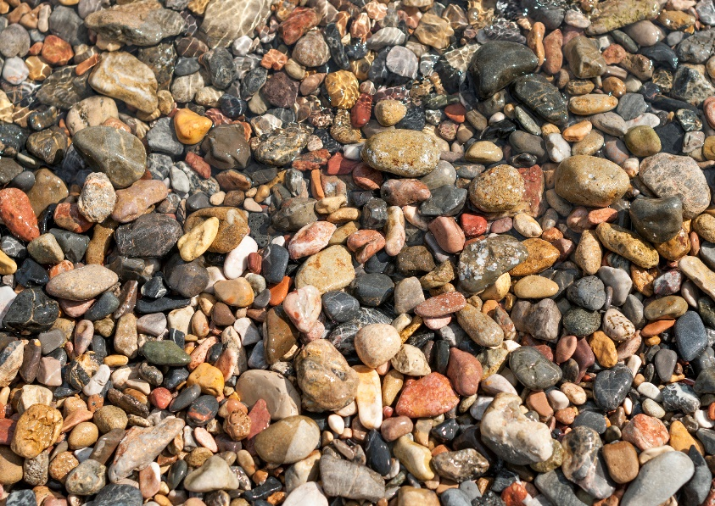
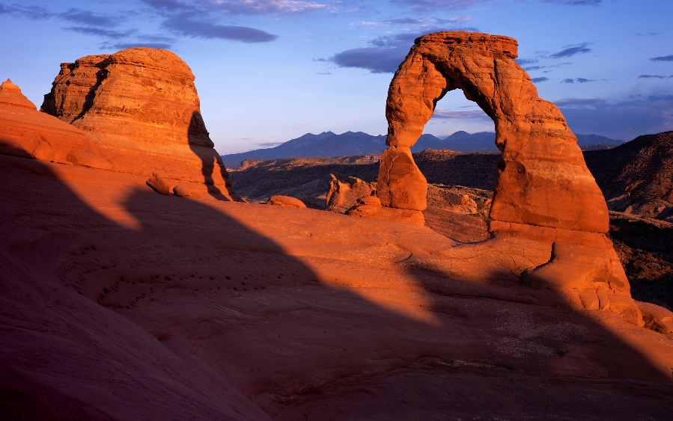
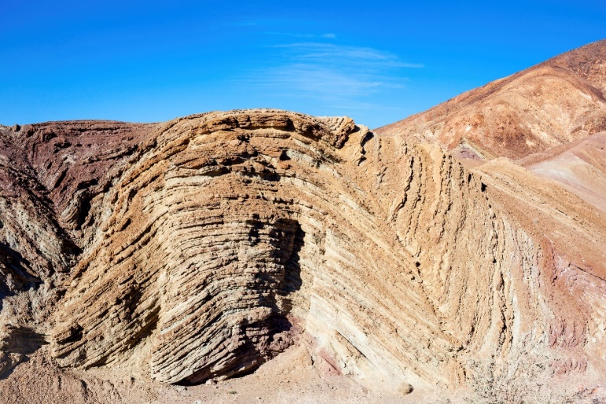
Facts--Data
Notes:
For example, the color and shape of rocks are facts—/ things that can be observed by anyone who looks at the rocks. / These facts are data. / Measurements of things—like the size of a pebble or the depth of a rock layer are data also.

Slide 13
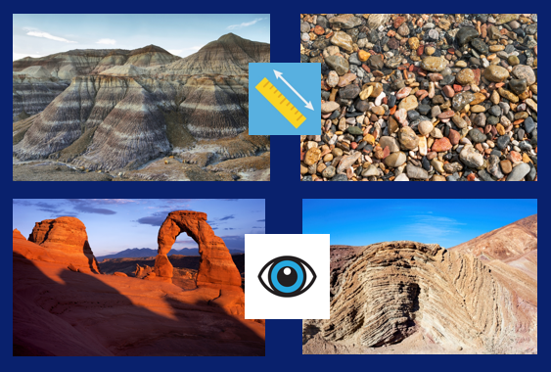
Scientific Inquiry
Data
Why?
How?
Notes:
As scientists analyze the data from the geologic column, they look for explanations for why rocks are a certain color or shape or how they came to be layered or folded? / These are called interpretations.

Slide 14

Data & Interpretation
Notes:
As scientists look at the sequence of layers in the geologic column, one thing they draw conclusions about is the relative age of the layers.

Slide 15

Notes:
To understand relative age, look at the floor in this picture. Which do you think was laid down first? The carpet or the hard wood floor? You couldn’t very well put down carpet and THEN put a hard wood floor underneath, so we know the hard wood had to be laid down first. Then, sometime later, the carpet was laid down on top.

Slide 16
“Older”
Been there longer
Notes:
We could say that the hard wood is “older” and by that we mean that it was laid down earlier. It has been in place longer.

Slide 17


“Younger”
Been there less time
Notes:
We could say the carpet is “younger” and by that we mean that it was laid down later. It has not been in place as long.

Slide 18
2 days?
20 years?
How much time?
Notes:
But can we tell how much time there was between when the wood was laid down and when the carpet was laid down on top of it? Just by looking at it, we cannot tell whether the wood floor was put in on Monday and the carpet laid the following Wednesday / or whether the floor was there for 20 years before the room was carpeted.

Slide 19

Which layer is “older?”
Notes:
Now let’s look at the rock layers again. Which layer is older?
This one? Or this one?

Slide 20
Older
Which layer is “older?”
Notes:
The lower one is “older.” Remember that just means it was laid down sooner than the ones higher up. We can’t tell by looking exactly how much time went by between the time the older one was laid down and the younger one was laid down.

Slide 21
Cenozoic
Mesozoic
Phanerozoic
Paleozoic
Precambrian
Notes:
Just like with the real rock layers, we can tell the relative age of the intervals in our chart.

Slide 22
Youngest
Oldest
Notes:
The interval on the bottom is the oldest and the one on top is the newest, or youngest. Let’s practice…

Slide 23

Cenozoic
Mesozoic
Phanerozoic
Paleozoic
Precambrian
Notes:
Is the Mesozoic or the Precambrian older?

Slide 24
Cenozoic
Mesozoic
Phanerozoic
Paleozoic
Precambrian
Notes:
The Precambrian is older because it’s on the bottom

Slide 25
Cenozoic
Mesozoic
Phanerozoic
Paleozoic
Precambrian
Notes:
Is the Cenozoic or the Paleozoic older?

Slide 26
Cenozoic
Mesozoic
Phanerozoic
Paleozoic
Precambrian
Notes:
The Paleozoic is older because it’s lower.

Slide 27
Cenozoic
Mesozoic
Phanerozoic
Paleozoic
Precambrian
Notes:
Which is younger or more recent--the Mesozoic or the Paleozoic?

Slide 28
Cenozoic
Mesozoic
Phanerozoic
Paleozoic
Precambrian
Notes:
The Mesozoic is younger because it’s higher.

Slide 29
Cenozoic
Mesozoic
Phanerozoic
Paleozoic
Precambrian
Notes:
The idea that older layers are below the younger layers is reflected in the names of these strata.

Slide 30
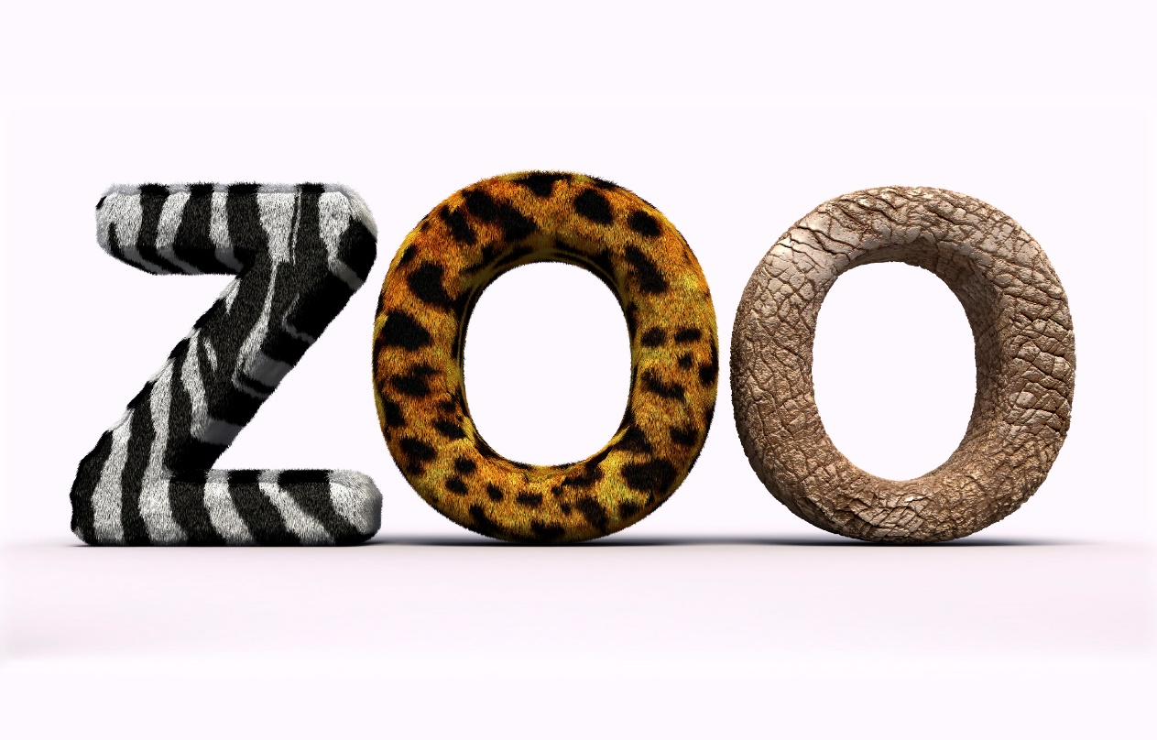
Think “zoo”
(Place where animals live)
Notes:
To understand what the names mean, think about the letters in the word “zoo”

Slide 31
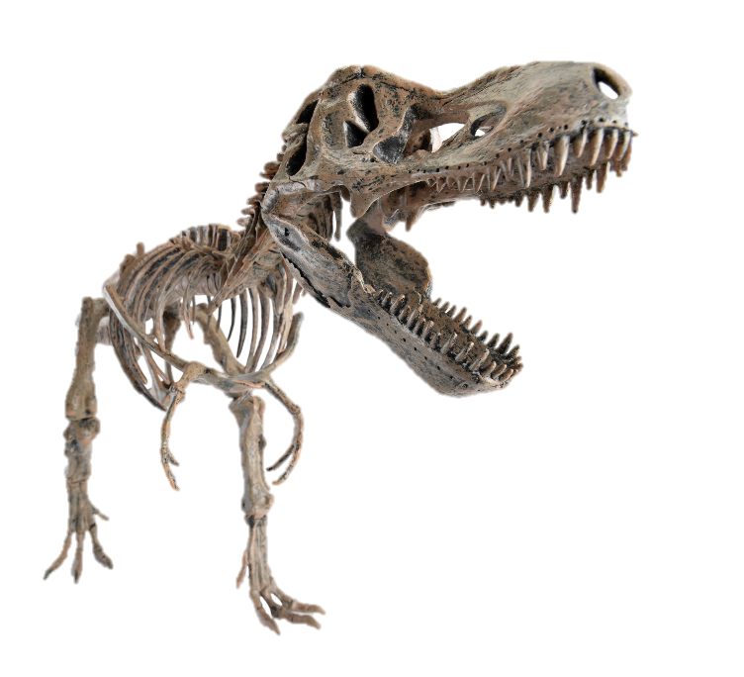

Ceno zoic
Meso zoic
Phanero zoic
Paleo zoic
Precambrian
Notes:
Notice the letters “zo” (as in zoo) in each of these names, and because zoos are where animals live, think “animal life.” But in this case we aren’t talking about live animals. / We are talking about the fossilized remains of animals that used to be alive.

Slide 32
Paleo
zoic
Old
Animal life
Notes:
Paleo means old, and when you see “zoic”, think animal life.

Slide 33
Paleozoic
“Old animal life”
Notes:
So Paleozoic means “old animal life”

Slide 34
Meso
zoic
Middle
Animal life
Notes:
Meso means middle, and zoic means animal life.

Slide 35
Mesozoic
“Middle animal life”
Notes:
So Mesozoic means middle animal life.

Slide 36
Ceno
zoic
Recent
Animal life
Notes:
Ceno means recent, and zoic means animal life.

Slide 37
Cenozoic
“Recent animal life”
Notes:
So Cenozoic means recent animal life

Slide 38
Recent
Middle
Old
Notes:
The prefixes at the beginning of the names mean old, middle, and recent.

Slide 39
Animal Life
Notes:
The rest of each word means animal life.

Slide 40
Cenozoic
Mesozoic
Paleozoic
Notes:
The names of these intervals reflect the idea that the lower layers (and the fossils in them) are older than the ones above.

Slide 41
Relative Age
Notes:
In other words, they reflect the idea of relative age.

Slide 42
Youngest
How much?
Oldest
Notes:
Remember, though, that we can’t tell just by looking how much older or younger the layers are.

Slide 43
Phanerozoic
Precambrian
Notes:
What about the Precambrian and the Phanerozoic?

Slide 44
Hardly any fossils found here
Notes:
Since we hardly find any fossils at all in the Precambrian, there’s nothing about animal life in the name.

Slide 45
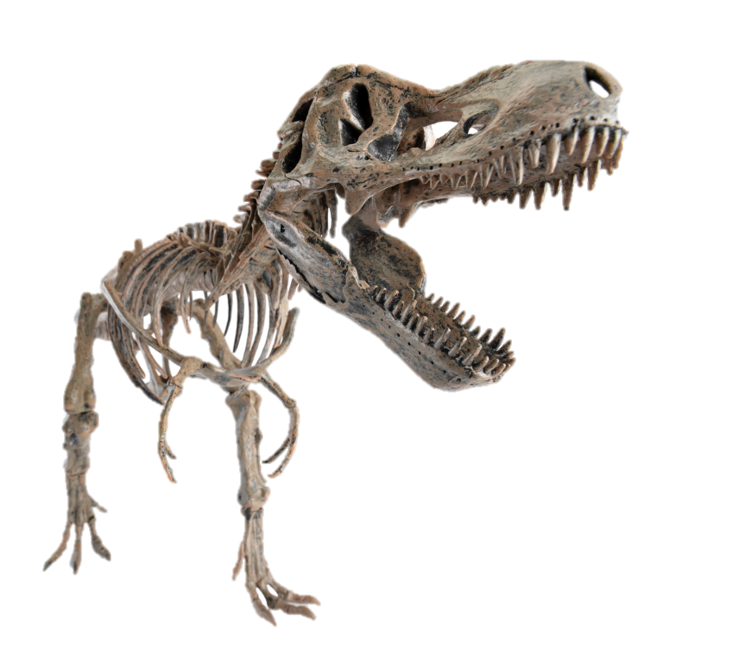
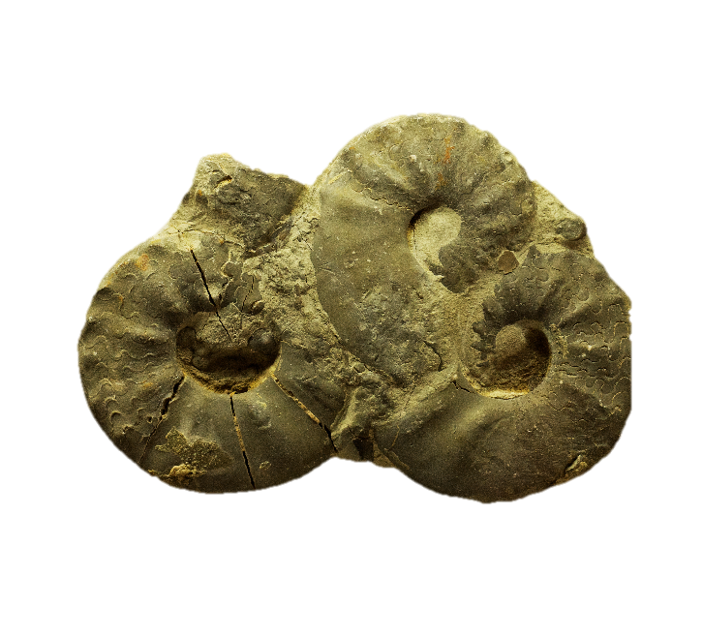
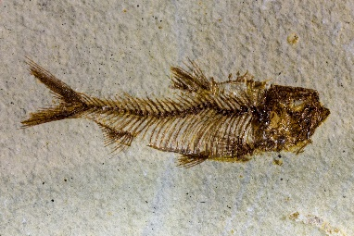
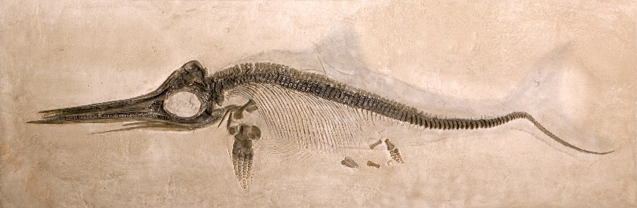
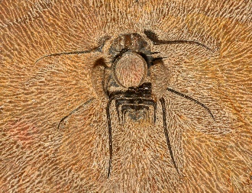
Phanerozoic means
Visible
Animal Life
Notes:
Phanerozoic means visible animal life, / which makes sense because we find SO many different fossils in those layers.

Slide 46
Relative Age Summary
We can’t tell just by looking how long the different layers have been there.
Notes:
Let’s summarize: We can’t tell just by looking how long the different layers have been there, but certain clues that we’ll be learning more about, indicate that it probably didn’t take long at all for the layers to be laid down.

Slide 47
Relative Age Summary
We can’t tell just by looking how long the different layers have been there.
We do know that younger ones are on top of older ones.
Notes:
And unless the layers have been disturbed, we know that younger layers are always on top of older ones.

Slide 48
Recorded at
Chattanooga Public RadioSM
Classical 90.5 WSMC

Slide 49
IMAGES BY
Images may appear on more than one slide. Citation is given on the first slide where each image appears.
[2a] Zion National Park 489588635, kaiborder, Thinkstock, Thinkstock Image Subscription Agreement
[2b] Grand Canyon – Toroweap Point 480297321, Scott_Walton, Thinkstock, Thinkstock Image Subscription Agreement
[2c] Bryce Canyon landscape 497280819, jenifoto, Thinkstock, Thinkstock Image Subscription Agreement
[3a] Forest brilliance 4250904, emptyclouds, Getty Images (US), Inc. Subscription Agreement
[3b] Blue cells under microscope 12229229, Henrik5000, Getty Images (US), Inc. Subscription Agreement
[3c] Giant Pandas 17308910, fototrav, Getty Images (US), Inc. Subscription Agreement
[3d] Spiral Galaxy Milky Way 30198432, alex-mit, Getty Images (US), Inc. Subscription Agreement
[3e] Family 36504990, CEFutcher, Getty Images (US), Inc. Subscription Agreement
[3f] Amethyst 25568315, Dariildo, Getty Images (US), Inc. Subscription Agreement
[3g] Red kangaroo jumping 22066177, Freder, Getty Images (US), Inc. Subscription Agreement
[3h] Daisies 16883788, sankai, Getty Images (US), Inc. Subscription Agreement
[3i] Coral reef 17794310, Iborisoff, Getty Images (US), Inc. Subscription Agreement
[5a] Eye icon, 39171676, dyeekc, Getty Images (US), Inc. Subscription Agreement
[5b] Ruler 36430812, Jane_Kelly, Getty Images (US), Inc. Subscription Agreement
[6a] Red rose 20105231, VIDOK, Getty Images (US), Inc. Subscription Agreement
[6b] Daisy 13561534, Dimitris66, Getty Images (US), Inc. Subscription Agreement

Slide 50
IMAGES BY
[7a] Kitten on scales 4775409, DigitalZombie, Getty Images (US), Inc. Subscription Agreement
[7b] Elephant 27059762, abadonian, Getty Images (US), Inc. Subscription Agreement
[7c] Measuring tape around tree 40780366, Thawatchai1991, Getty Images (US), Inc. Subscription Agreement
[7d] Sequoyah 5648787, imagentix, Getty Images (US), Inc. Subscription Agreement
[8a] Crocodile skull 54529804, jedsadabodin, Getty Images (US), Inc. Subscription Agreement
[8b] Centipede 45429746, pixbox77, Getty Images (US), Inc. Subscription Agreement
[12a] Blue Mesa Petrified Forest National Park, 479232619 estivillml, Thinkstock Image Subscription Agreement
[12b] Pebbles 48802570, Nirian, Getty Images (US), Inc. Subscription Agreement
[12c] Arch 11811315, Kjschoen, Getty Images (US), Inc. Subscription Agreement
[12d] Folded rock layers 33954188, hlnicaise, Getty Images (US), Inc. Subscription Agreement
[15] Luxury house interior 38622004, irina88w, Getty Images (US), Inc. Subscription Agreement
[30] Word zoo, 25142385, look_around, Getty Images (US), Inc. Subscription Agreement
[31] Tyrannosaurus rex skeleton 23393902, LeventKonuk, Getty Images (US), Inc. Subscription Agreement
[45a] Ammonite fossils 54540080, Wlad74, Getty Images (US), Inc. Subscription Agreement
[45b] Fish fossil 36471134, gsaielli, Getty Images (US), Inc. Subscription Agreement
[45c] Ichthyosaur fossil 5364039, Tyrannosaur, Getty Images (US), Inc. Subscription Agreement
[45d] Trilobite fossil 24476579, demarfa, Getty Images (US), Inc. Subscription Agreement

Slide 51
Special Thanks
Foundation for Adventist Education

Slide 52

© Origins Curriculum Resources 2015

Slide 53

© Southern Adventist University 2015

Slide 54

© Seventh-day Adventist North American Division 2015

Slide 55

© General Conference of Seventh-day Adventists 2015

Slide 56

© SCORE Southern Center for Origins Research & Education 2015

