Slide 1
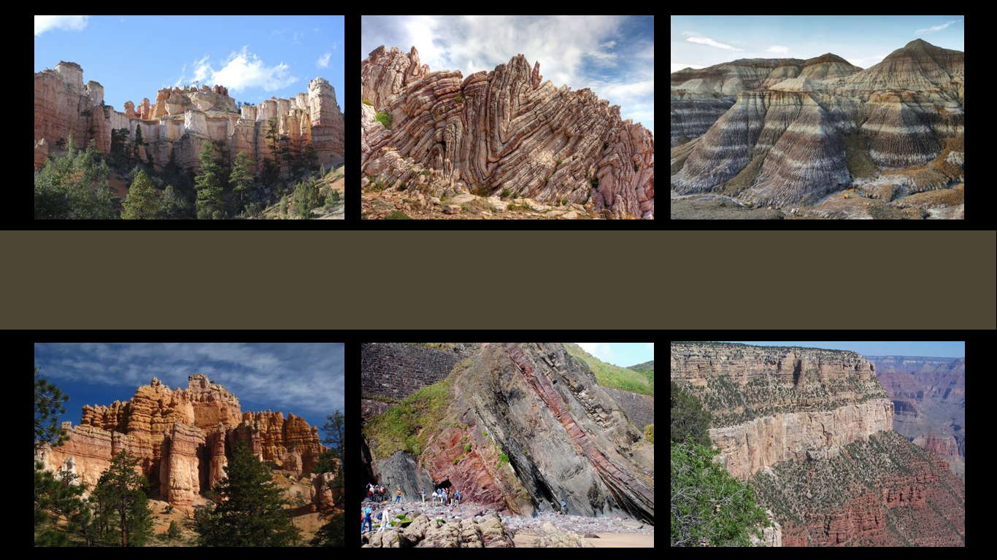
The Geologic Column
Introduction
Notes:
Introduction to the Geologic Column

Slide 2

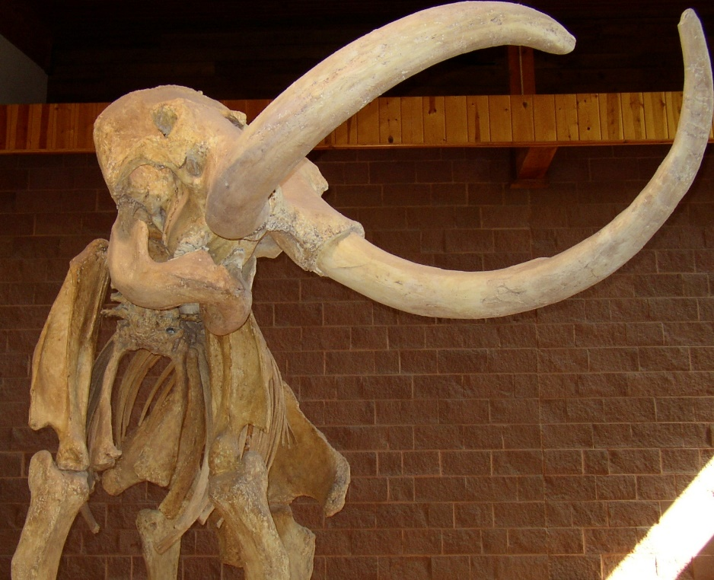
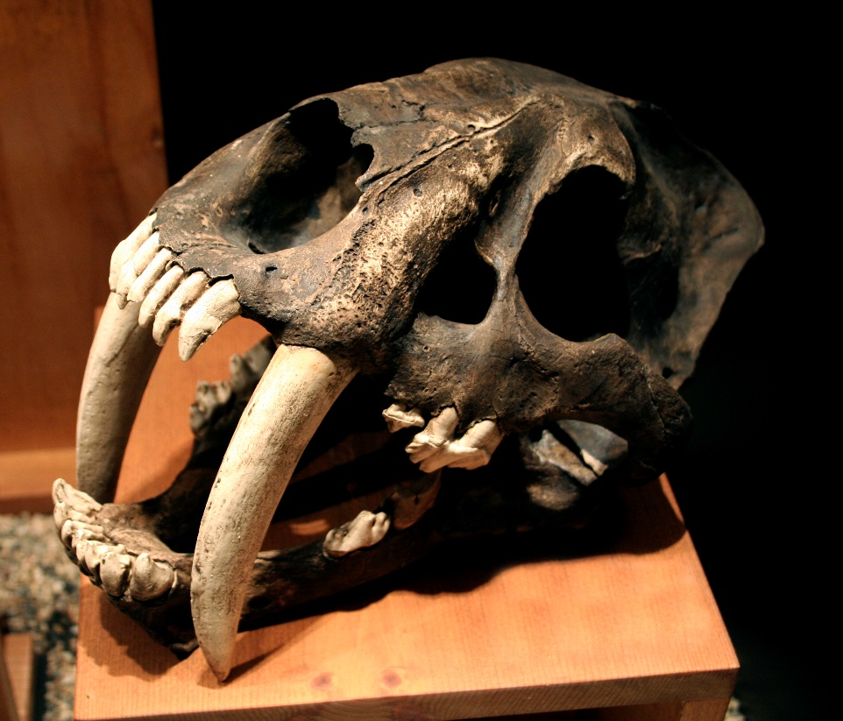

Notes:
The Geologic Column is filled with fascinating evidence of creatures that used to live on earth. In it we find bones…

Slide 3
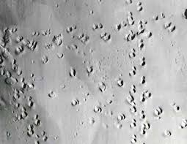
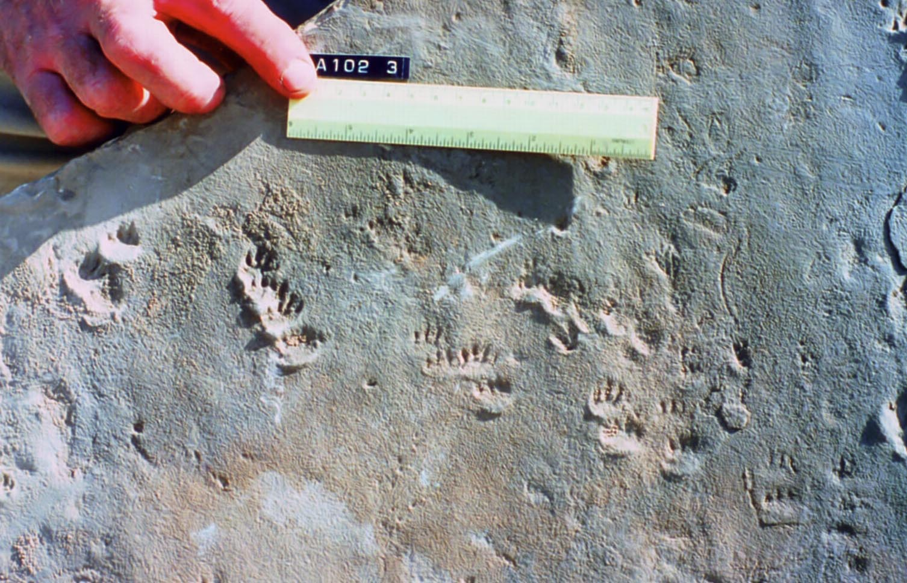
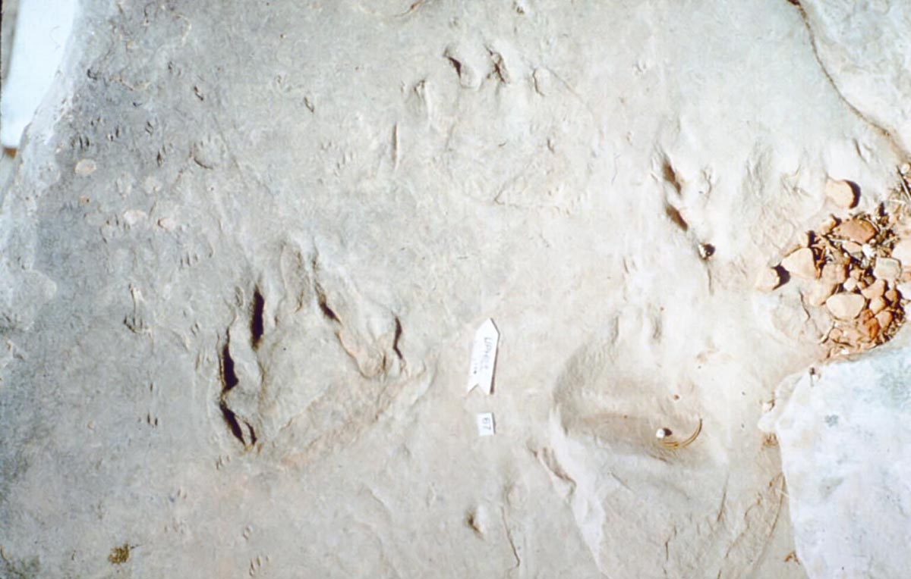
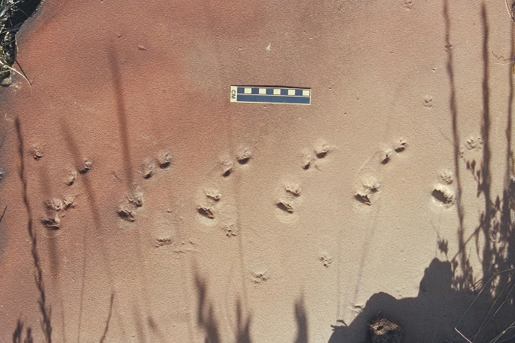
Notes:
…tracks…

Slide 4
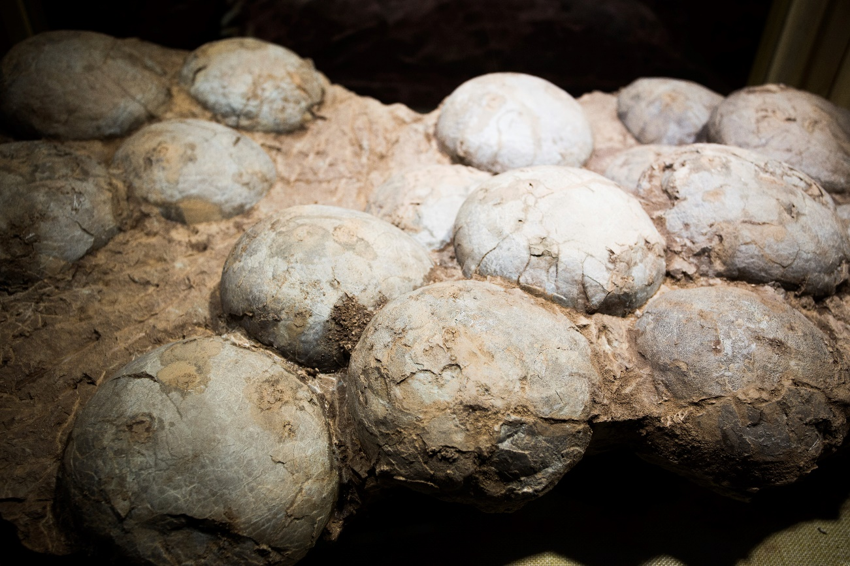
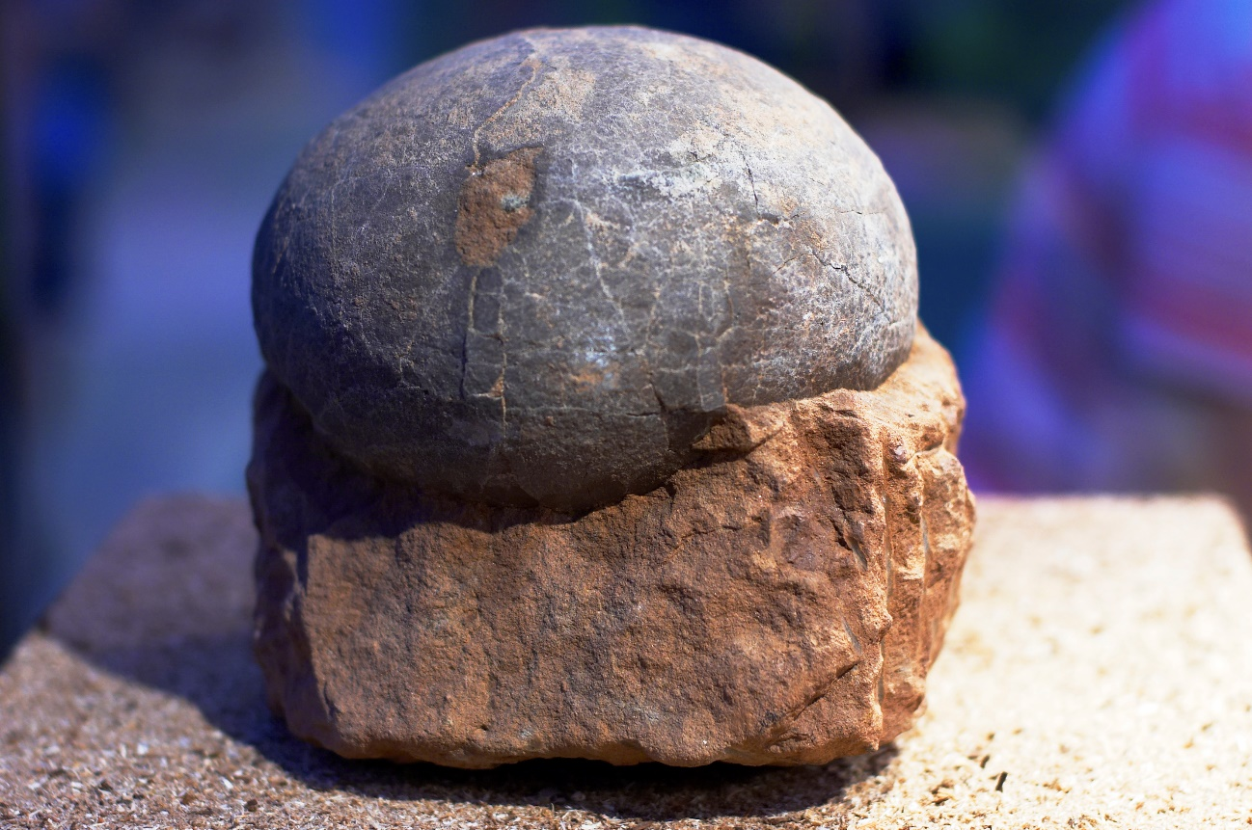
Notes:
…eggs…

Slide 5
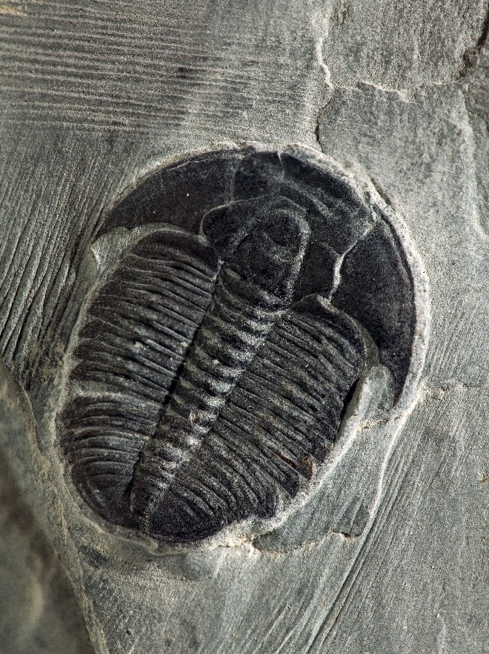
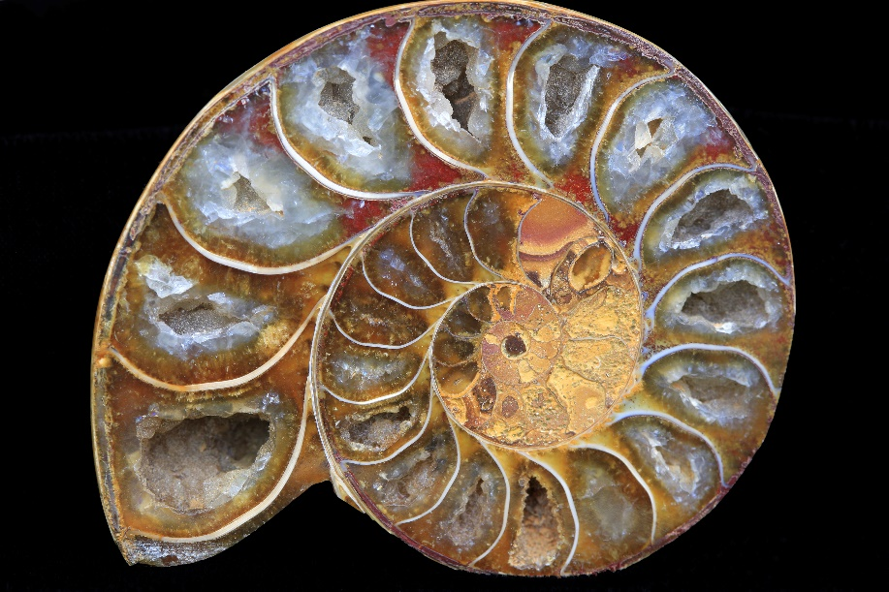
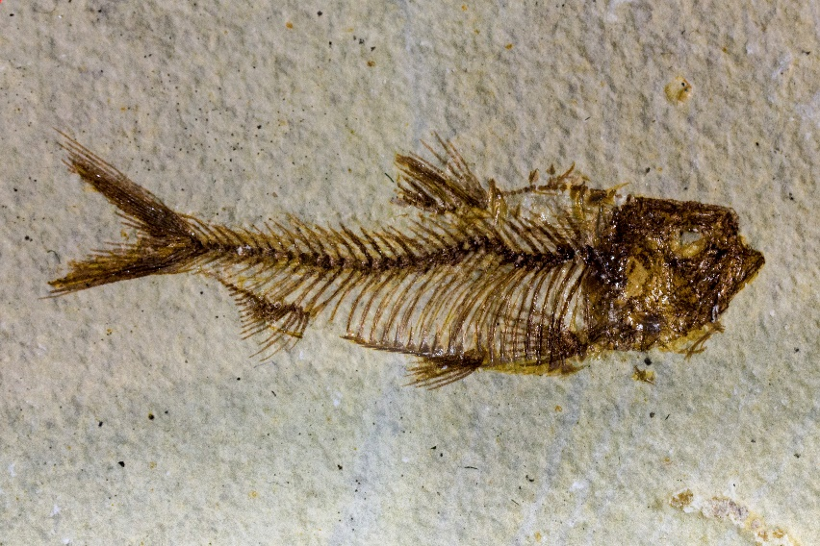
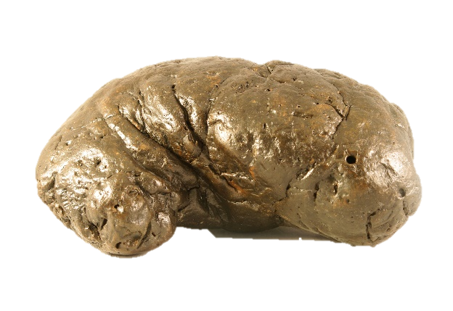
Notes:
…and other evidence of creatures—most of which are now extinct.

Slide 6
Geologic Column
Terms
Fossils
Ideas
Evidence
Notes:
In this presentation, we will learn what the geologic column is. Then throughout this series we will learn some of the of the terms used to describe the geologic column; we’ll learn about the fossils preserved in it; some ideas about how the geologic column came to be; and some of the evidence used to support those ideas,

Slide 7
What is the Geologic Column?
Notes:
So what exactly IS the geologic column?

Slide 8
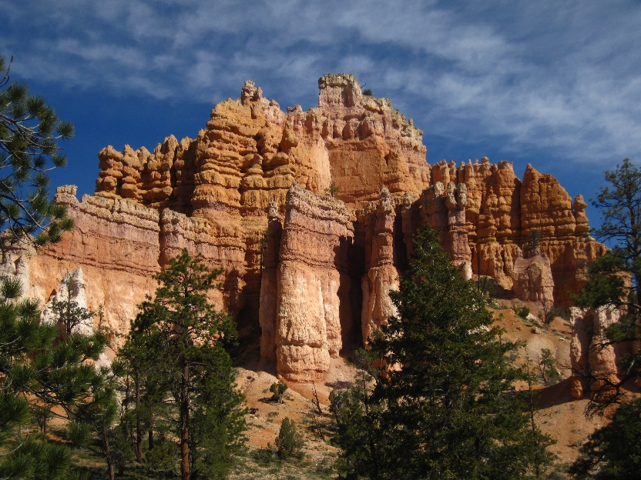
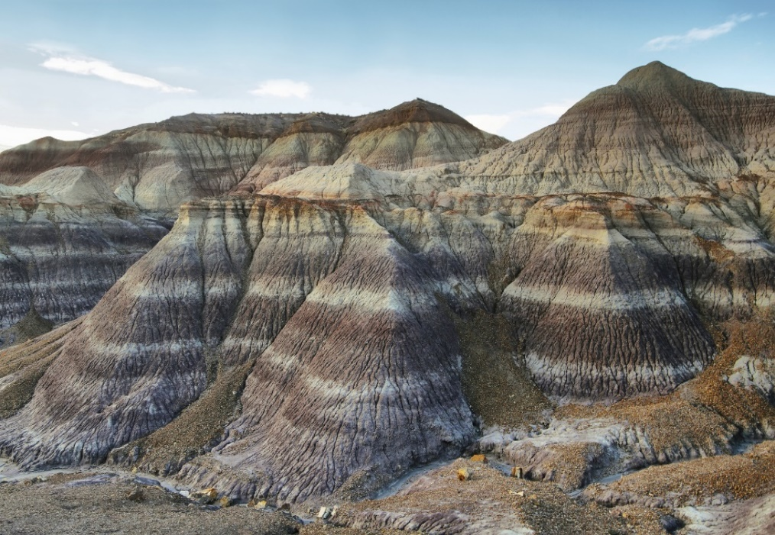
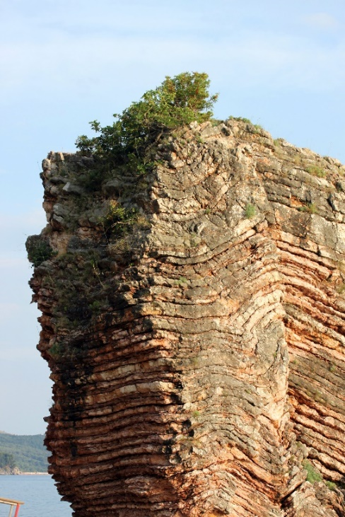
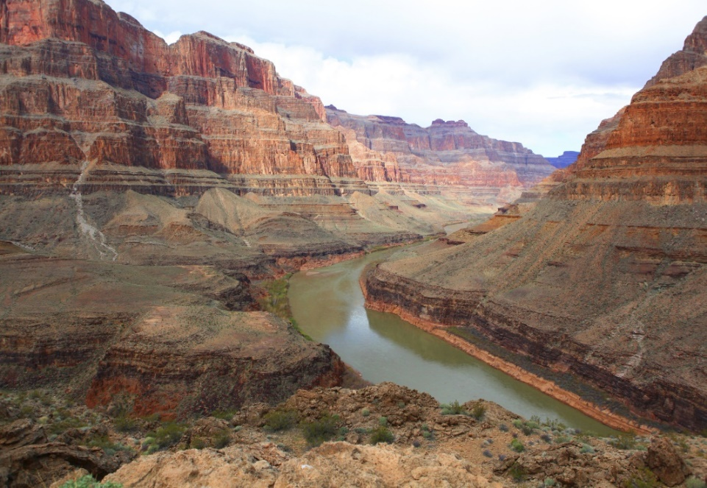
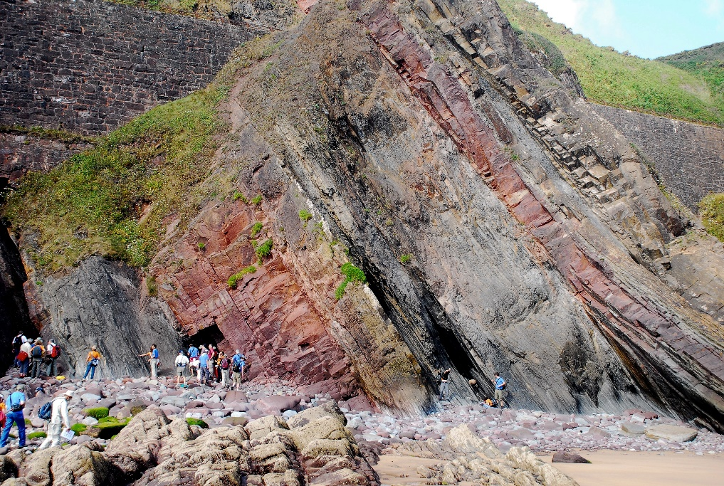
Notes:
The Geologic Column refers to layers of rock all over the world.

Slide 9
Layers = Strata
(plural)
Notes:
Another word for the layers…

Slide 10
Layers = Strata
(plural)
Notes:
…is strata.

Slide 11
Layers = Strata
(plural)
Layer = Stratum (singular)
Notes:
The singular form is stratum.

Slide 12
Notes:
Much of the Geologic Column is buried underground, but there are places where parts of it lie exposed for us to see and study.

Slide 13
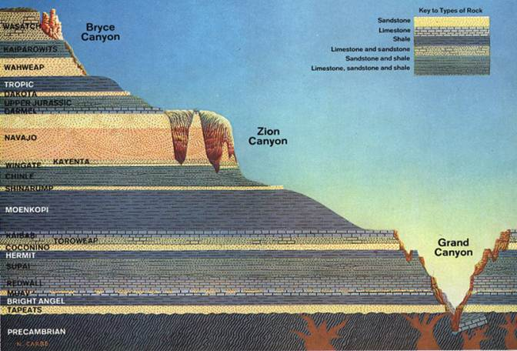
Grand Staircase
Notes:
There is no one place in the world where all the sedimentary rock strata are visible. But a really great place to see most of the layers is in the Western United States in a place called the Grand Staircase.

Slide 14
Grand Staircase
Notes:
Starting in the Grand Canyon in Arizona…

Slide 15
Grand Staircase
Notes:
….and going north through Zion National Park in Utah…

Slide 16
Grand Staircase
Notes:
…and Bryce Canyon National Park in Utah, the Grand Staircase includes hundreds of square miles of exposed rock layers.

Slide 17
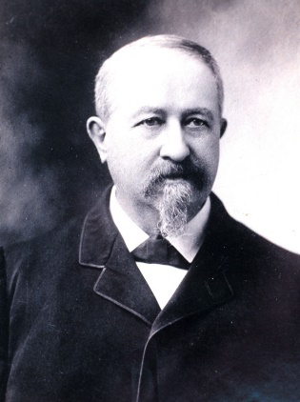
Clarence Dutton
Notes:
A geologist named Clarence Dutton first thought of them as a huge staircase in the 1870s and grouped the strata into five steps based on their colors:

Slide 18
Grand Staircase
Chocolate Cliffs
Notes:
…Chocolate…

Slide 19
Grand Staircase
Vermilion Cliffs
Notes:
…Vermilion (which means bright scarlet red)…

Slide 20
Grand Staircase
White Cliffs
Notes:
…White…

Slide 21
Grand Staircase
F = Gray Hills
Notes:
…Gray…

Slide 22
Grand Staircase
Pink Cliffs
Notes:
…and pink.

Slide 23
Quaternary
Cenozoic
Neogene
Paleogene
Cretaceous
Mesozoic
Jurassic
Triassic
Phanerozoic
Permian
Pennsylvanian
Mississippian
Paleozoic
Devonian
Silurian
Ordovician
Cambrian
Precambrian
Notes:
Geologists have named the rock layers—not just those in the Grand Staircase, but the strata all around the world--and organized them in a chart like this. In order to be able to learn about them it’s helpful to know their names.

Slide 24
Precambrian
Notes:
An interval that includes several layers at the bottom is called the Precambrian.

Slide 25
Phanerozoic
Quaternary
Cenozoic
Neogene
Paleogene
Cretaceous
Mesozoic
Jurassic
Triassic
Phanerozoic
Permian
Pennsylvanian
Mississippian
Paleozoic
Devonian
Silurian
Ordovician
Cambrian
Precambrian
Notes:
All the layers above the Precambrian can be grouped together into an interval we call the Phanerozoic.

Slide 26
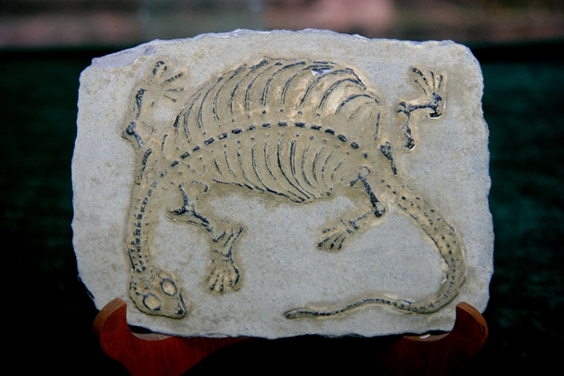
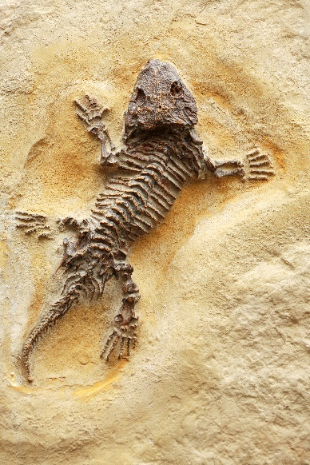
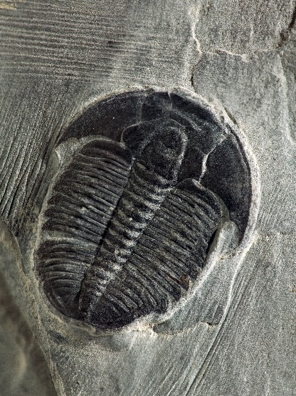
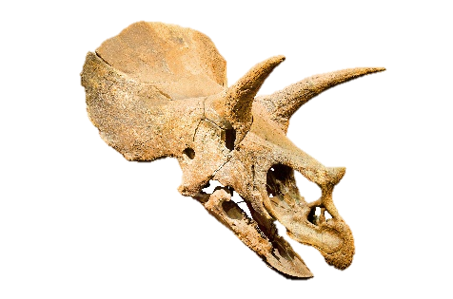
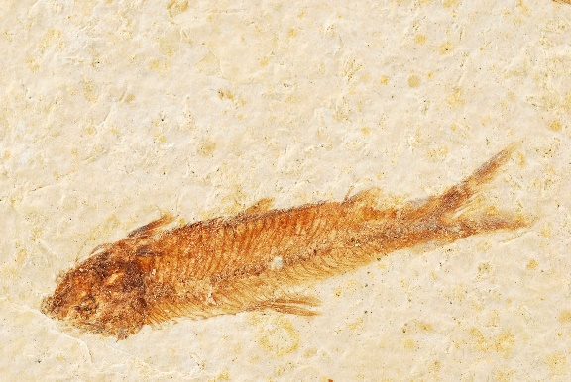
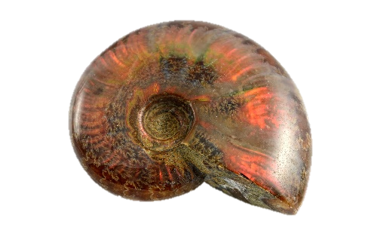
Phanerozoic
Precambrian—almost no fossils
Notes:
The main difference between the Precambrian and the Phanerozoic is that the Precambrian has almost no fossils at all, but the Phanerozoic has lots…

Slide 27
Erathems
Phanerozoic
Precambrian
Notes:
The Phanerozoic is divided into 3 different intervals called “erathems.”

Slide 28
Phanerozoic
Paleozoic
Precambrian
Notes:
Just above the Precambrian is the Paleozoic erathem.

Slide 29
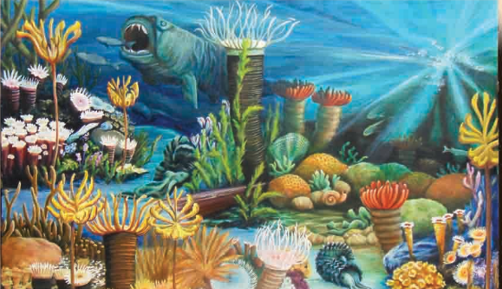
Phanerozoic
Precambrian
Notes:
Most of the fossils found in the Paleozoic layers are marine animals, or animals that lived in or around the water.

Slide 30
Cenozoic
Mesozoic
Phanerozoic
Permian
Pennsylvanian
7
Mississippian
Paleozoic
Devonian
Silurian
Ordovician
Cambrian
Precambrian
Notes:
It is divided into 7 different sections called systems.

Slide 31
Mesozoic
Phanerozoic
Paleozoic
Precambrian
Notes:
On top of the Paleozoic is the Mesozoic erathem.

Slide 32

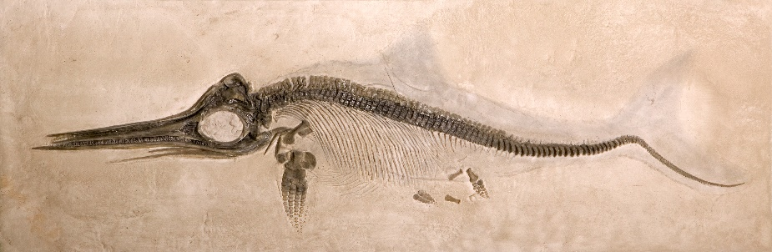
Phanerozoic
Precambrian
Notes:
The Mesozoic layers are filled with a mixture of marine and land creatures, the most famous of which are the dinosaurs.

Slide 33
Cenozoic
3
Cretaceous
Mesozoic
Jurassic
Triassic
Phanerozoic
Paleozoic
Precambrian
Notes:
It is divided into three systems.

Slide 34
Cenozoic
Mesozoic
Phanerozoic
Paleozoic
Precambrian
Notes:
On top of the Mesozoic is the Cenozoic erathem.

Slide 35


Phanerozoic
Precambrian
Notes:
The Cenozoic layers contain a variety of creatures, but they are best known for the fossils of land mammals found there.

Slide 36
Quaternary
3
Cenozoic
Neogene
Paleogene
Mesozoic
Phanerozoic
Paleozoic
Precambrian
Notes:
The Cenozoic is divided into 3 systems.

Slide 37
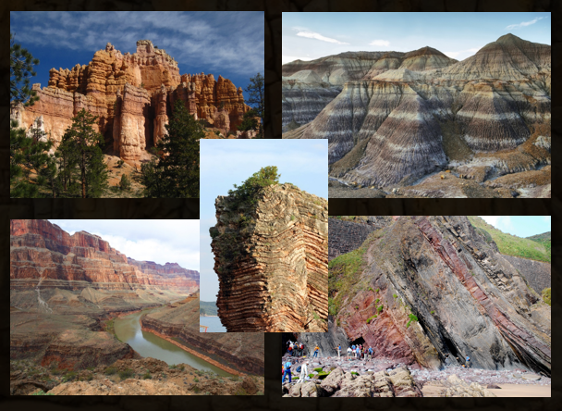
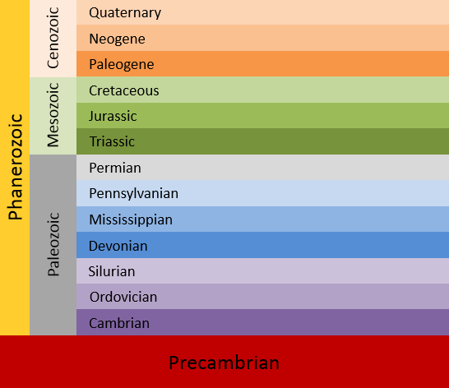
The Geologic Column
Notes:
All the rock strata around the world that geologists have described in this chart make up what we call the Geologic Column.

Slide 38
The Geologic Column
Data
Notes:
These rock layers, their position in relation to each other, and the fossils found in them provide us with lots of observable data.

Slide 39
Erathems
Systems
Eonothem
Notes:
As scientists study the data in the geologic column, they use some very specific terminology.

Slide 40
Era
Erathems
Periods
Systems
Eon
Eonothem
Notes:
In fact, there are two different sets of terminology.

Slide 41
The Geologic Column
Important Terminology
Notes:
Our next presentation will explain the difference between the two sets of words and why it’s important to understand and be able to use both.

Slide 42
Recorded at
Chattanooga Public RadioSM
Classical 90.5 WSMC

Slide 43
Images By
Images may appear on more than one slide. Citation is given on the first slide where each image appears.
[1a] Zion National Park 489588635, kaiborder, Thinkstock, Thinkstock Image Subscription Agreement
[1b] Folded rocks 24286621 Matauw, Getty Images (US), Inc. Subscription Agreement
[1c] Blue Mesa Petrified Forest National Park 479232619, estivillml, Thinkstock, Thinkstock Image Subscription Agreement
[1d] Bryce Canyon National Park, Keith Snyder
[1e] Folded rocks, Raul Esperante, used with permission
[1f] Grand Canyon, taken by Ed Chatelain, used with permission
[2a] Mammoth skeleton 186043, Escaflowne, Getty Images (US), Inc. Subscription
[2b] Tyrannosaurus Rex skeleton, 23393902 LeventKonuk, Getty Images (US), Inc. Subscription
[2c] Saber-toothed cat skull 825334, pixeldigits, Getty Images (US), Inc. Subscription

Slide 44
Images By
[3a] Seligman tracks, Leonard Brand, used with permission
[3b] Fossil tracks, Leonard Brand, used with permission
[3c] Large Coconino fossil tracks, Leonard Brand, used with permission
[3d] Fossil tracks, Leonard Brand, used with permission
[4a] Fossilized eggs of a Hadrosaur dinosaur 55805314, xijian, Getty Images (US), Inc. Subscription
[4b] Dinosaur egg 734309, samkee, Getty Images (US), Inc. Subscription
[5a] Ammonite macro 5175661, ManoAfrica, Getty Images (US), Inc. Subscription
[5b] Elrathia kingii Trilobite 4974845, Tyrannosaur, Getty Images (US), Inc. Subscription
[5c] Fossil fish 36471134 gsaielli, Getty Images (US), Inc. Subscription
[5d] Coprolite 177443097, Gfrandsen, Thinkstock, Thinkstock Image Subscription Agreement
[8c] Cliff 105813791, Dejan Nikolic, Thinkstock, Thinkstock Image Subscription Agreement
[8d] Colorado River in the Grand Canyon 33169492, OlegBogdan, Getty Images (US), Inc. Subscription

Slide 45
Images By
[13] Grand Stair Case, Ron Hight
[17] Clarence Dutton, http://commons.wikimedia.org/wiki/File:Clarence_Dutton_NOAA.jpg, public domain
[26a] Ancient Lizard Fossil 21484571, kvkirillov, Getty Images (US), Inc. Subscription
[26b] Fossil 125989606, Top Photo Corporation, Thinkstock, Thinkstock Image Subscription Agreement
[26c] Elrathia kingii Trilobite 4974845, Tyrannosaur, Getty Images (US), Inc. Subscription
[26d] Triceratops fossil skull 43436804, herraez, Getty Images (US), Inc. Subscription [26e] Fish fossil background 91825184, Chris Crowley, Thinkstock, Thinkstock Image Subscription Agreement
[26f] Fossil opal ammonite 23873239, hsvrs,, Getty Images (US), Inc. Subscription
[29] Paleozoic community painting, Katherine Holder
[32b] Ichthyosaur 5364039 Tyrannosaur, Getty Images (US), Inc. Subscription

Slide 46
Special Thanks
Foundation for Adventist Education

Slide 47

© Origins Curriculum Resources 2015

Slide 48

© Southern Adventist University 2015

Slide 49

© Seventh-day Adventist North American Division 2015

Slide 50

© General Conference of Seventh-day Adventists 2015

Slide 51

© SCORE Southern Center for Origins Research & Education 2015

