Slide 1
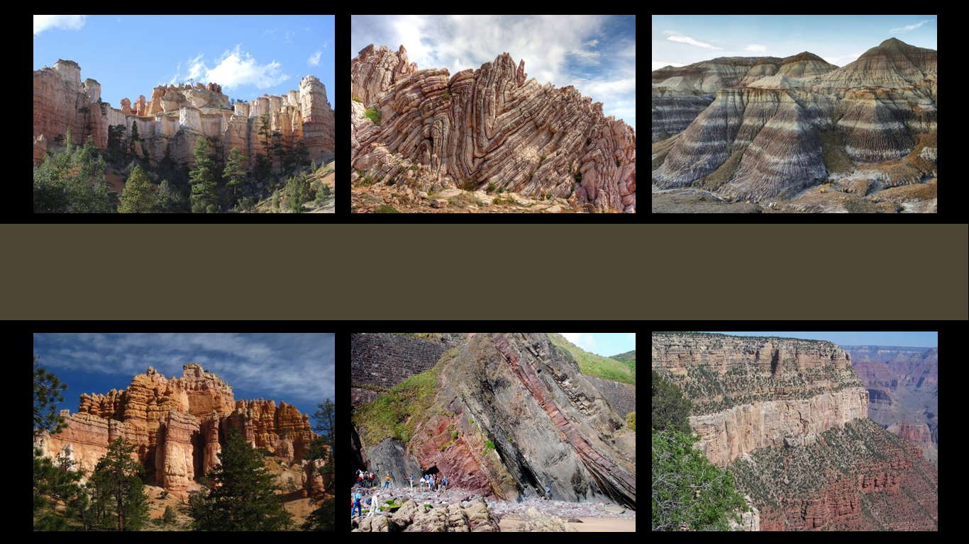
The Geologic Column
Biome Succession
Notes:
Biome Succession

Slide 2

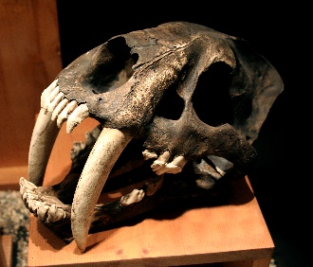
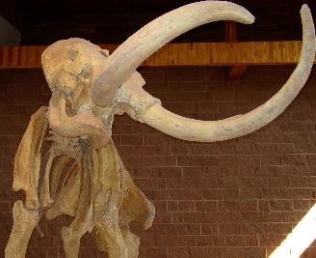
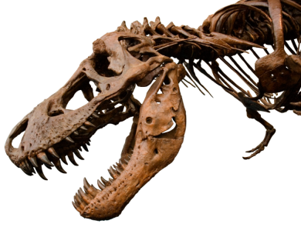
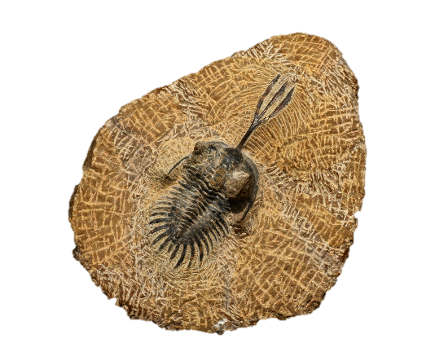
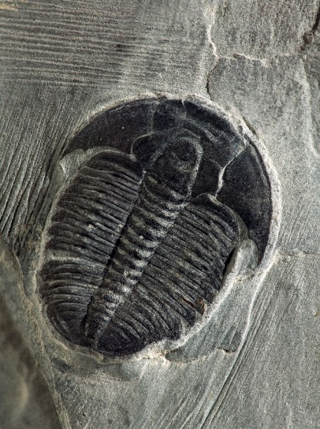
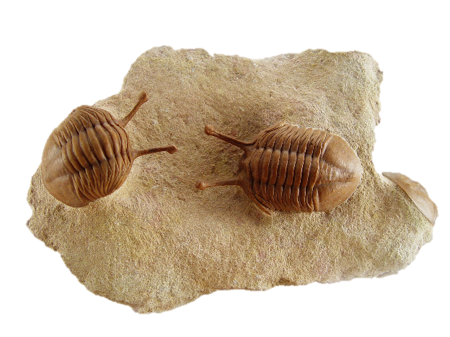
Quaternary
Cenozoic
Neogene
Paleogene
Cretaceous
Mesozoic
Jurassic
Triassic
Permian
Phanerozoic
Pennsylvanian
Mississippian
Paleozoic
Devonian
Silurian
Ordovician
Cambrian
Precambrian
Notes:
We have learned that there is a real, consistent order in the fossil record all around the world. This is observable data and it provides important evidence about Earth’s history.

Slide 3
Quaternary
Cenozoic
Neogene
Few “transitions”
Paleogene
Cretaceous
Mesozoic
Jurassic
Complexity throughout
Triassic
Permian
Phanerozoic
Abrupt disappearance
Stasis
Abrupt appearance
Pennsylvanian
Mississippian
Paleozoic
Devonian
Silurian
Ordovician
Cambrian Explosion
Cambrian
Precambrian
Notes:
We have also learned that the fossil record is not adequately explained by the theory of evolution. / Instead of new body plans appearing gradually throughout the rock layers, we find most major body plans right at the base of the Phanerozoic layers. Instead of a simple-to-complex sequence of fossils, we find complexity from the beginning. Instead of an obvious, gradual sequence of creatures evolving, we find the abrupt appearance of new fossils, little or no change, and then the abrupt disappearance of the fossils from the record. Instead of the many transitional fossils we would expect, we find few, if any, real “missing links.”

Slide 4
?
Notes:
Is there another explanation that fits the data better?

Slide 5

Biome Succession
Notes:
This presentation will explain a hypothesis called biome succession that combines evidence from biology and geology to suggest an explanation for how the geologic column was deposited.

Slide 6
Biome
A complex community
Plants
Animals
Specific environmental conditions
Notes:
Before we explain the idea of biome succession, we need to understand what biomes are. A biome is a complex community of distinctive plants and animals living under specific environmental conditions.

Slide 7
Biome
A complex community
Plants
Grass, shrubs, or trees
Animals
Well suited to these conditions
Specific environmental conditions
Latitude, elevation, moisture
Notes:
Land biomes are defined by what sorts of grass, shrubs, or trees are found there as well as their latitude, elevation, and moisture. In each of these places, specific animals well suited to those conditions complete the community.

Slide 8
Biome
Land biomes
Tundra
Forest
Grassland
Desert
Aquatic biomes
Coral reefs
Freshwater wetlands
Notes:
Some familiar land biomes include tundra, forest, grassland, and desert. Some familiar aquatic biomes include coral reefs and freshwater wetlands.

Slide 9
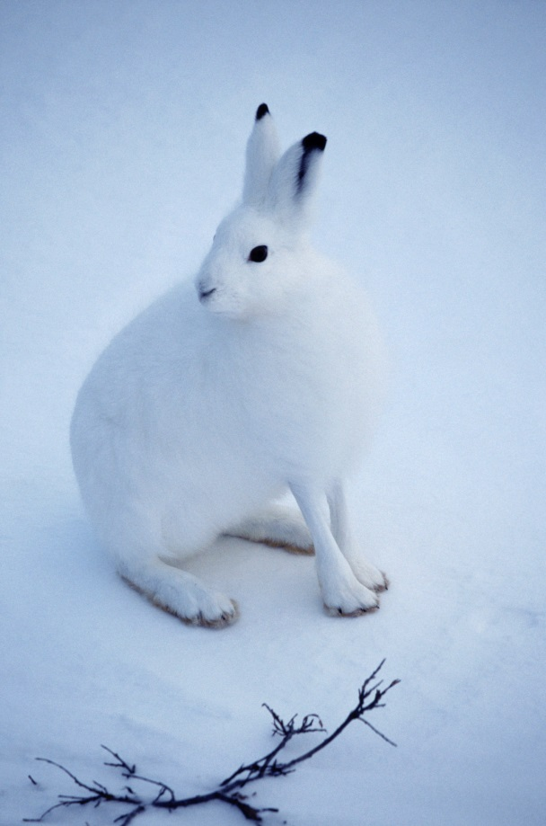
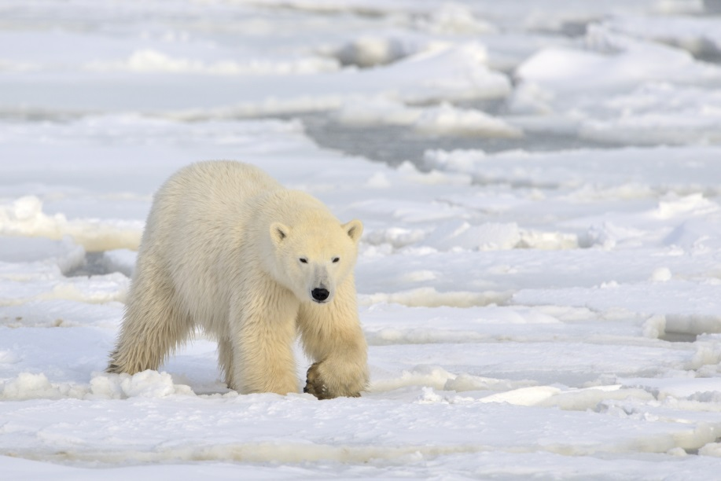

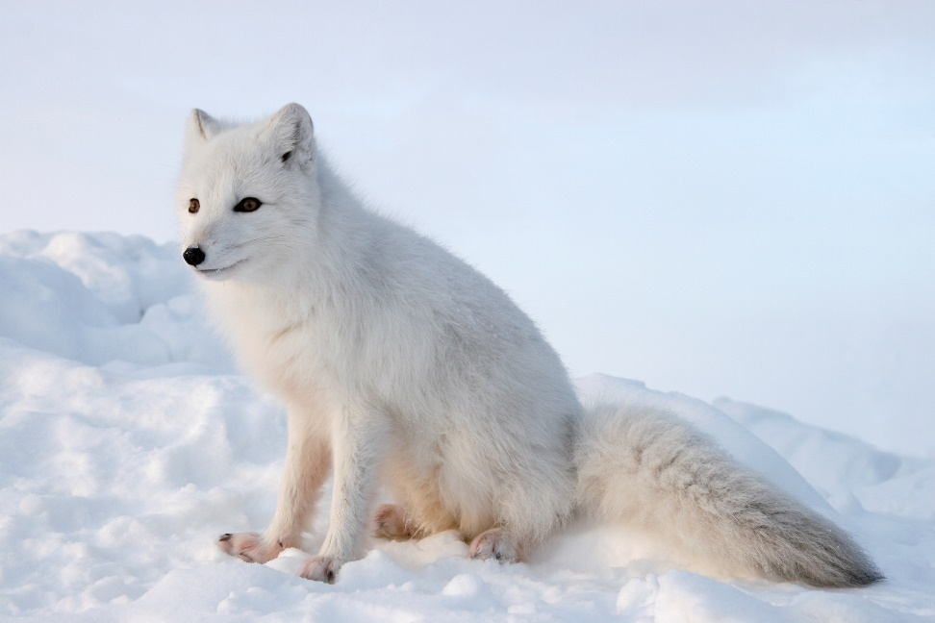
Tundra
Notes:
In the frigid tundra biome, there are no trees, no shrubs, and very few plants. It is home to very specific animals like the Arctic hare, Polar bear, Arctic fox, and the snowy owl.

Slide 10
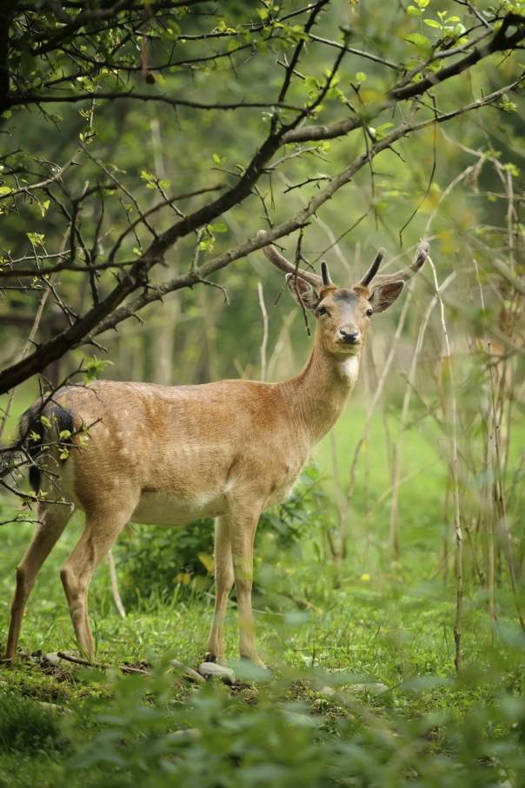
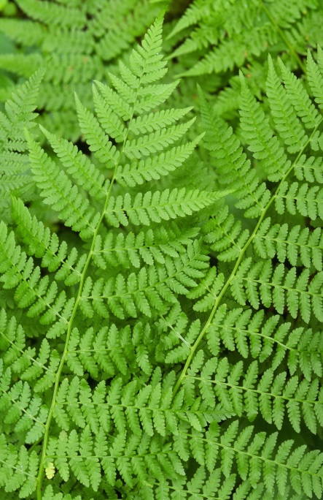
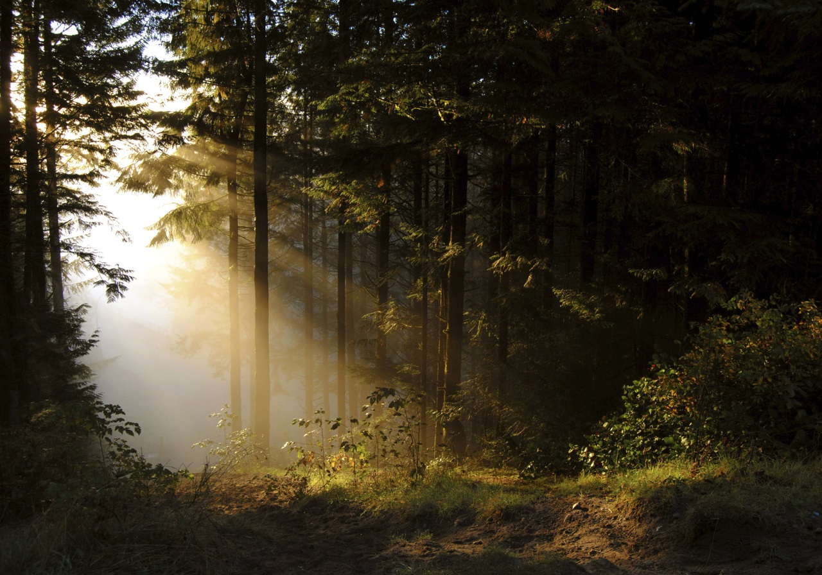
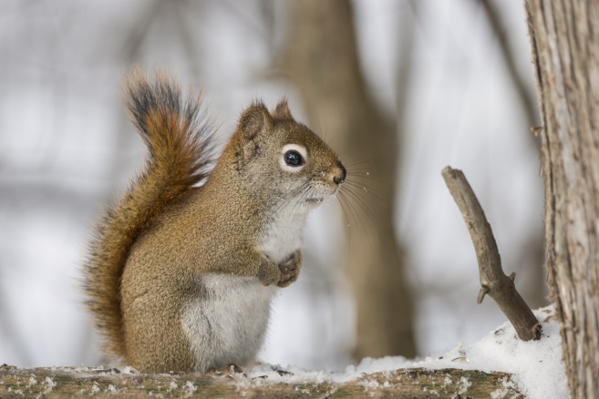
Forest
Notes:
In forest biomes we find Pine trees, ferns, and familiar animals like deer, squirrels, and bears.

Slide 11
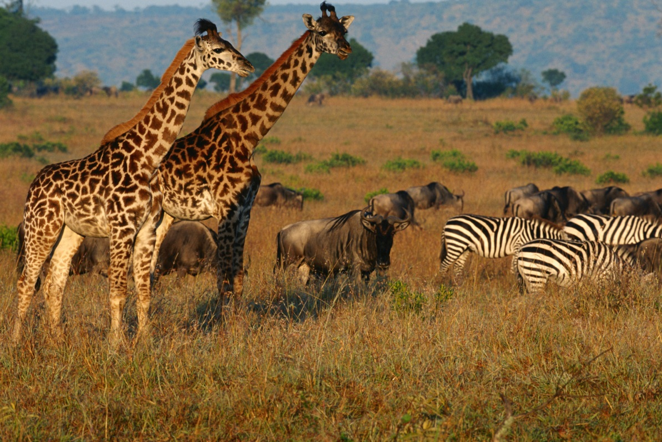
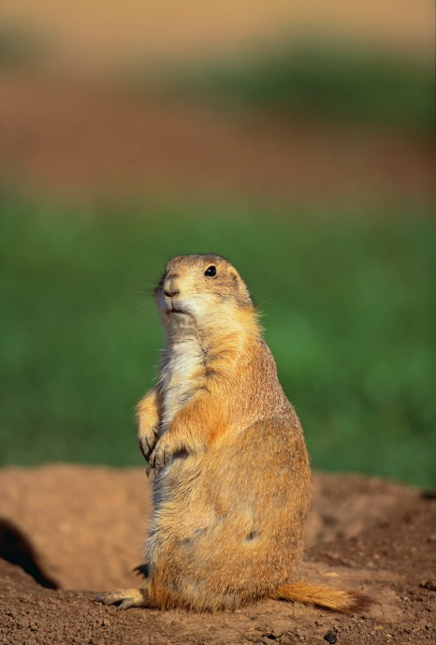
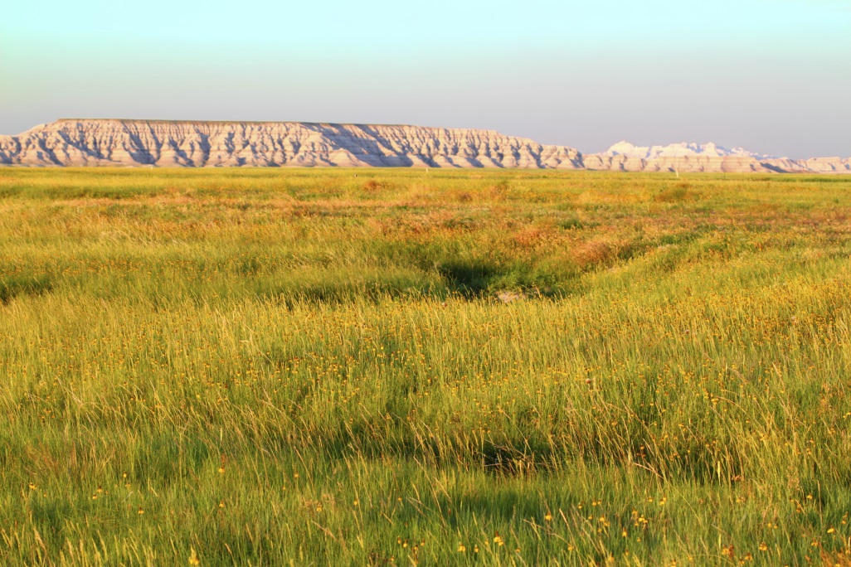
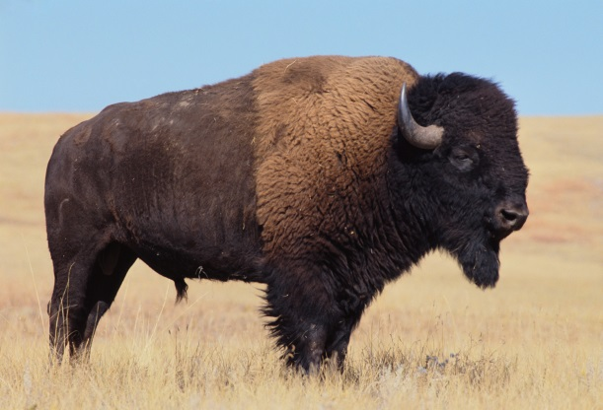
Grassland
Notes:
As the name implies grasslands have very few trees and lots of grass. Animals like Zebras, giraffes, prairie dogs, and bison live there.

Slide 12
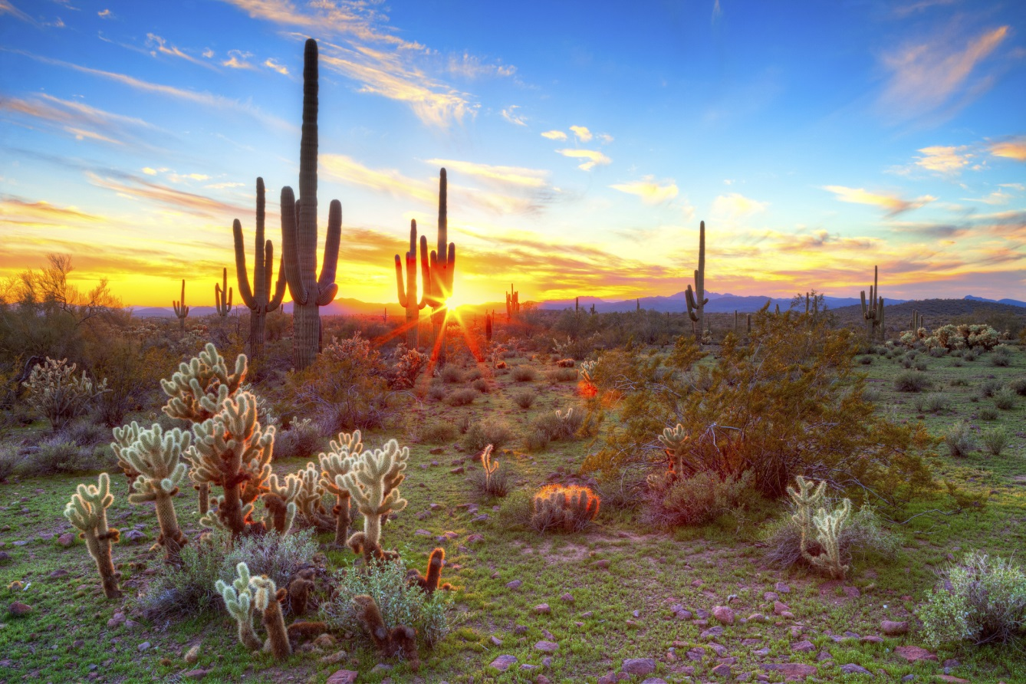
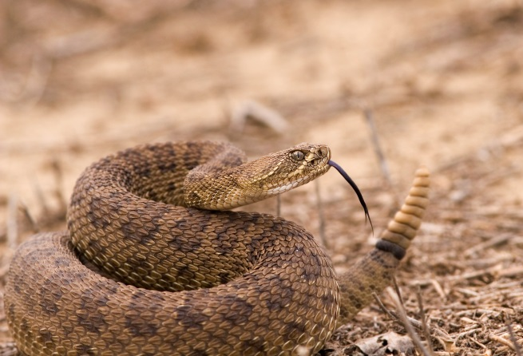
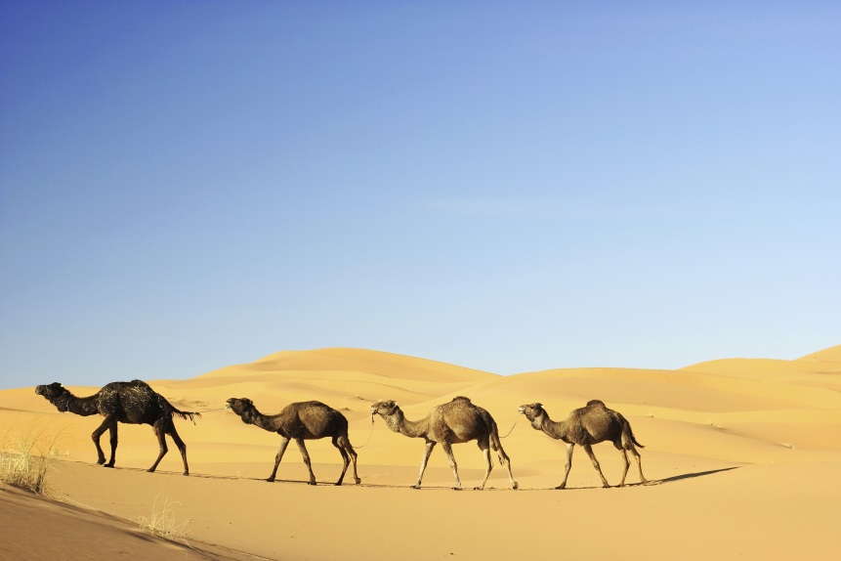
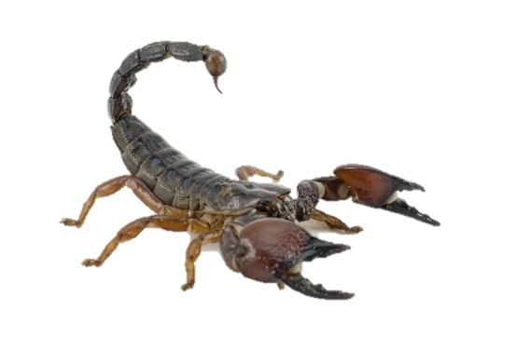
Desert
Notes:
Desert biomes are home to specialized plants such as cactus, and animals such as snakes, scorpions, lizards, and camels.

Slide 13
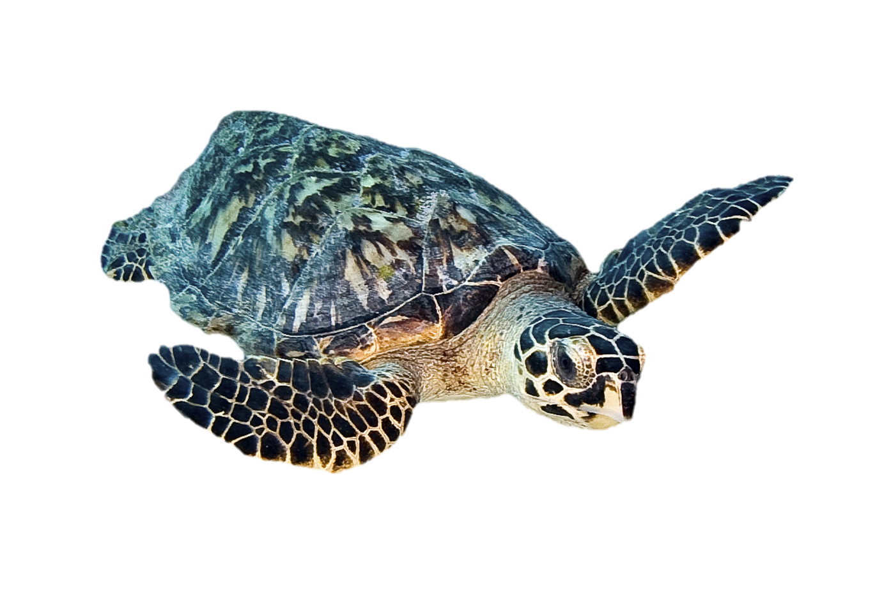
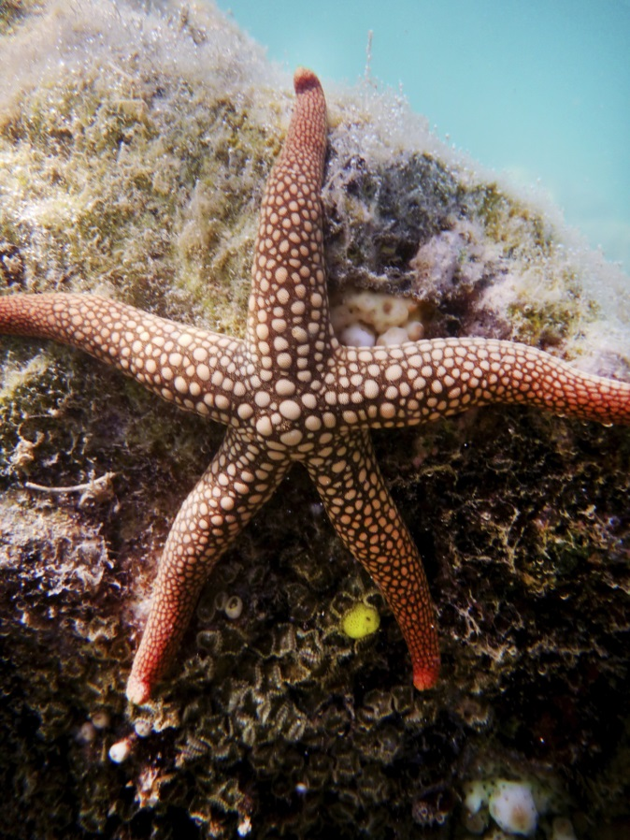
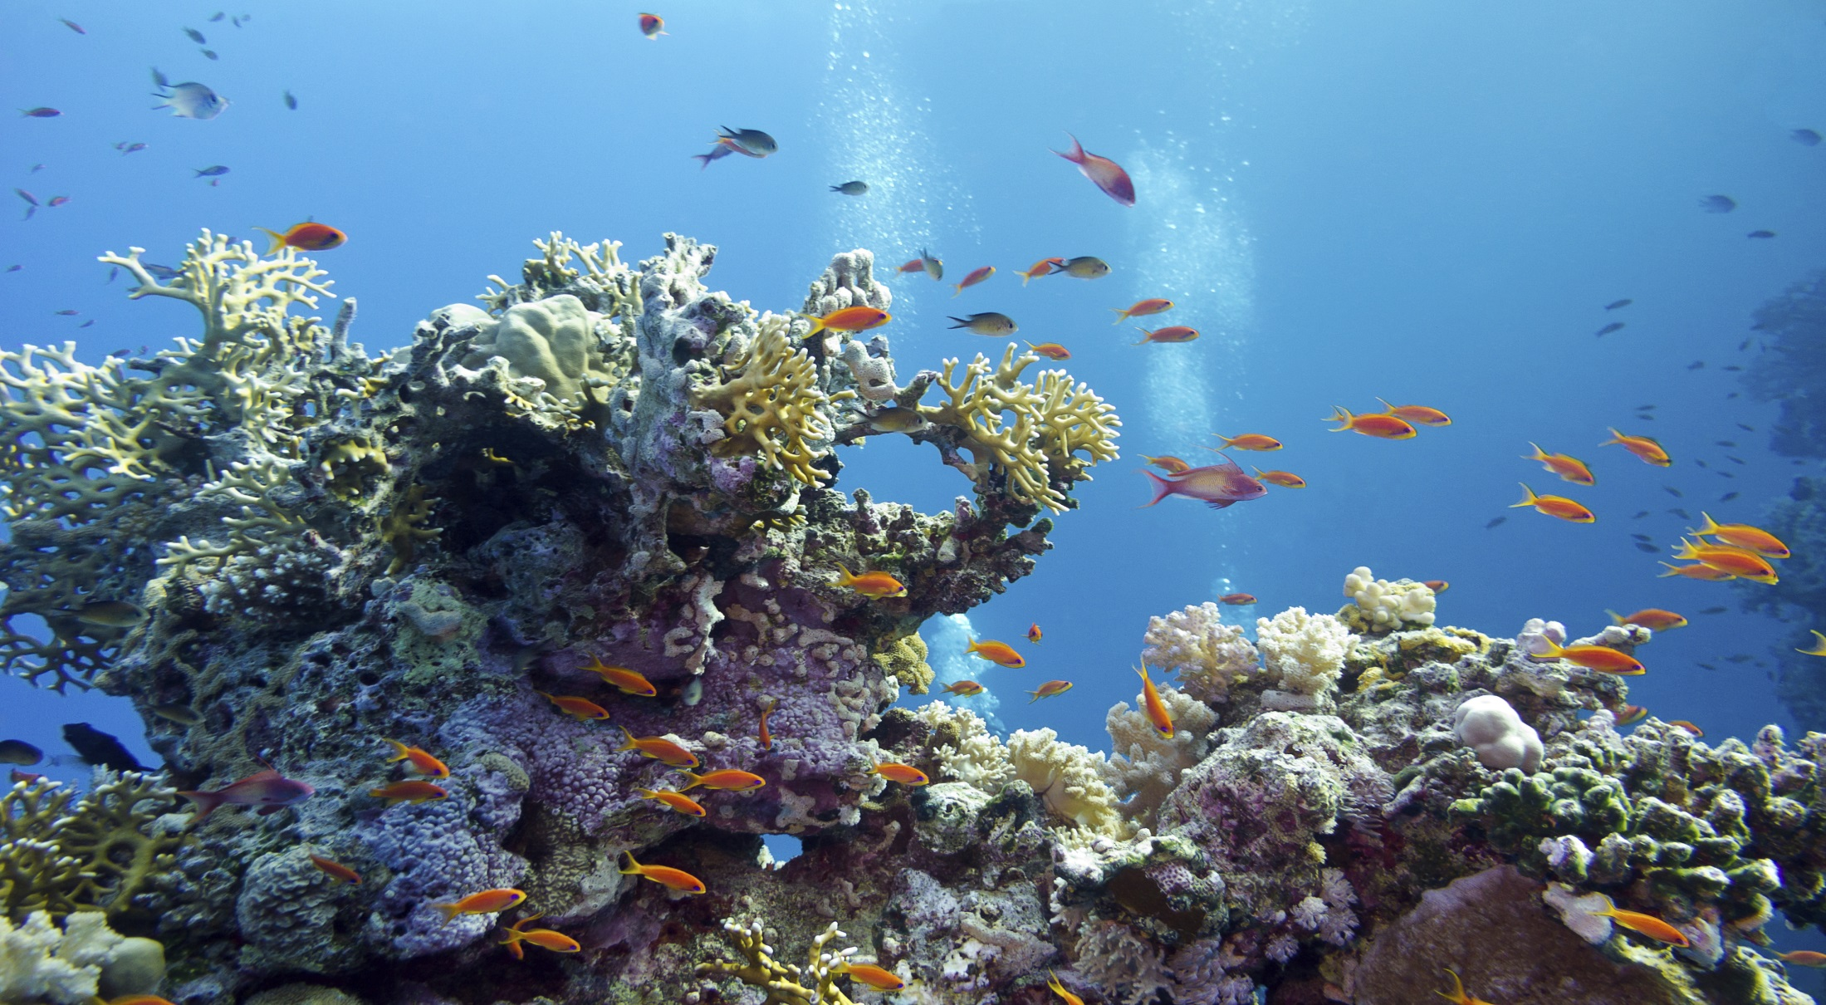
Coral Reef
Notes:
Coral reef biomes support their own very distinctive plants and animals…

Slide 14
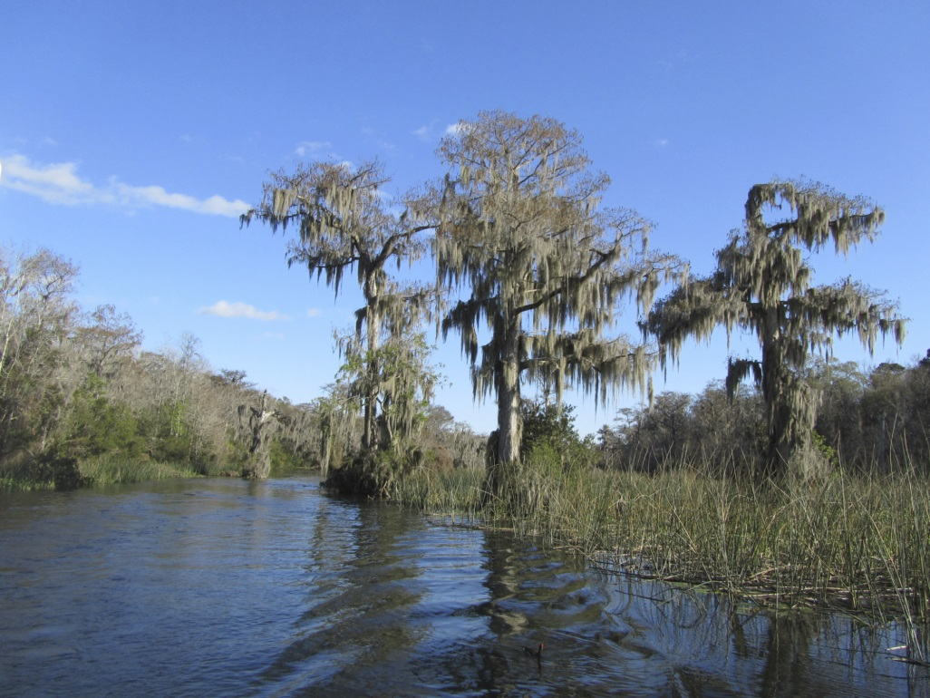
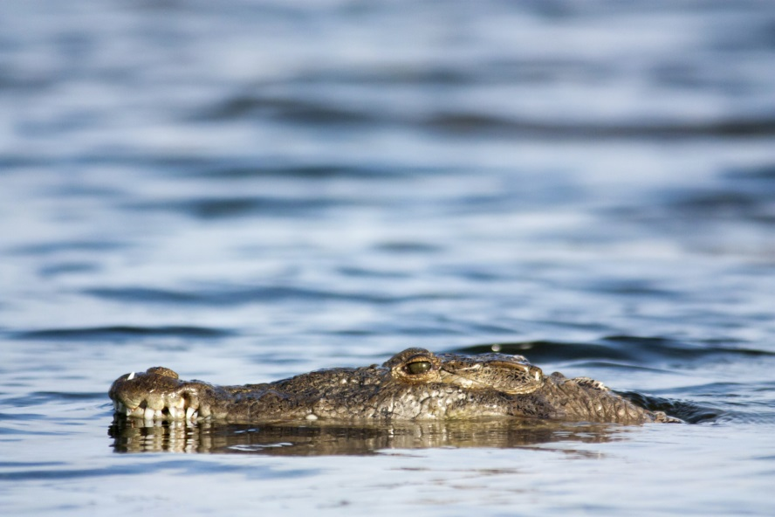
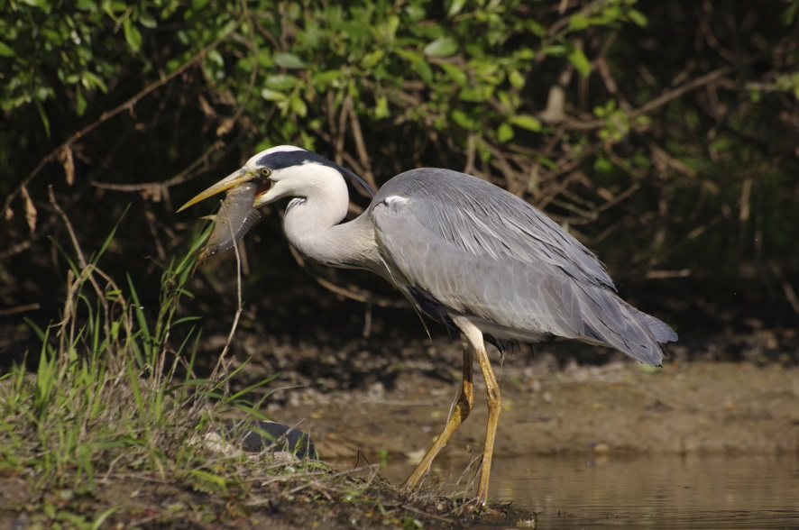
Freshwater Wetlands
Notes:
…which are different from the plants and animals found in freshwater wetlands.

Slide 15
Biomes = Life Zones
Notes:
Sometimes biomes are called life zones.

Slide 16




Notes:
The general biomes we have mentioned so far are dramatically different from each other. Each of these major biomes can be subdivided into smaller units--each with their own distinct plants and animals.

Slide 17
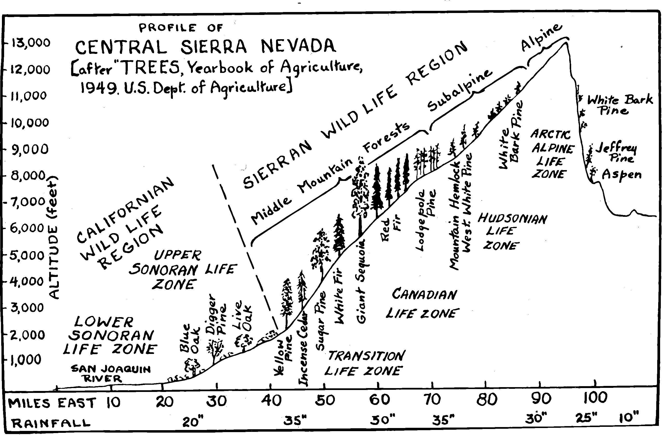
Notes:
This diagram illustrates some very specific biomes at different altitudes in the Sierra Nevada mountain range in California:

Slide 18
Notes:
The lower Sonoran at the bottom

Slide 19
Notes:
The upper Sonoran…

Slide 20
Notes:
Transition

Slide 21
Notes:
Canadian

Slide 22
Notes:
Hudsonian

Slide 23
Notes:
And the Arctic Alpine life zone.

Slide 24

Few
Trees
Notes:
The lower Sonoran Life Zone has a warm, arid climate with only a few small trees

Slide 25
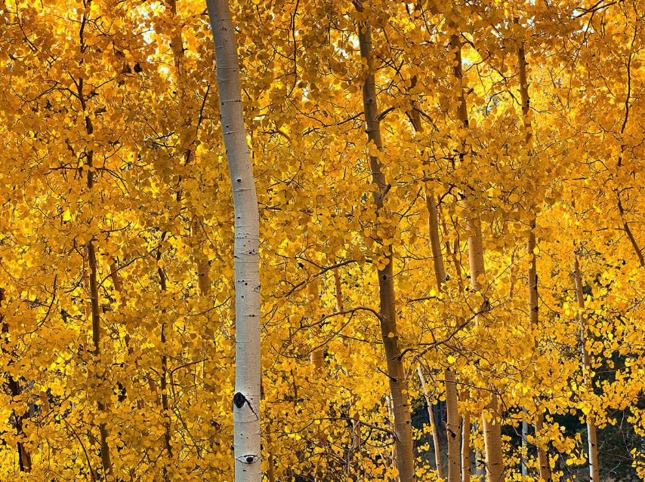
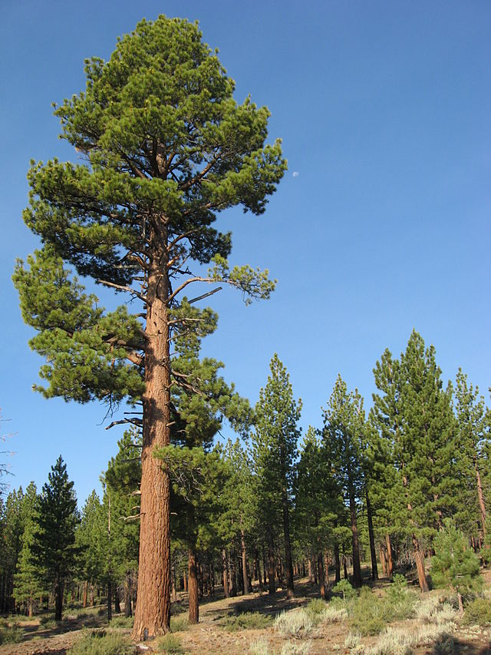
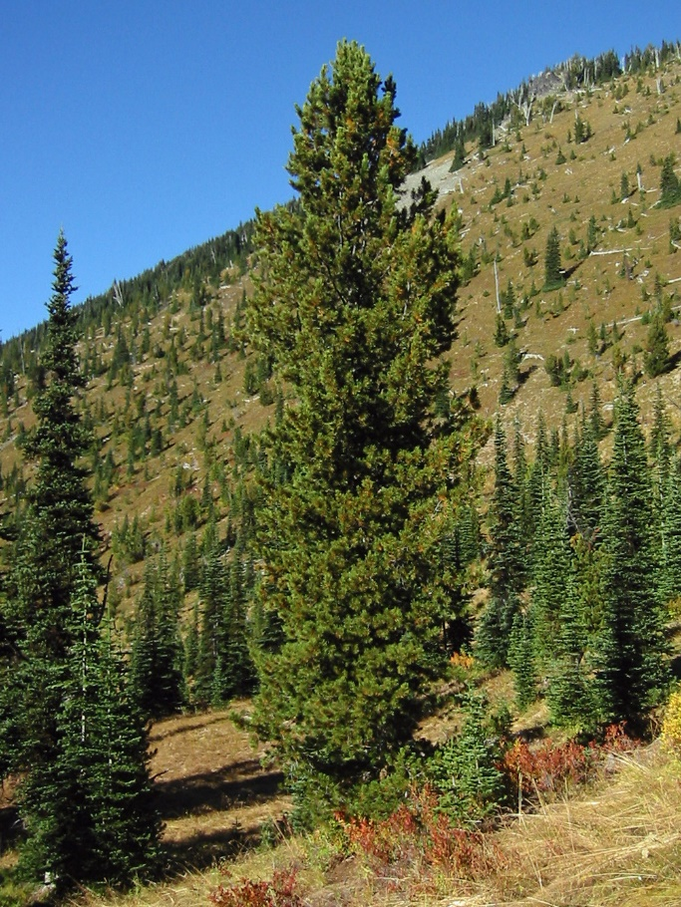
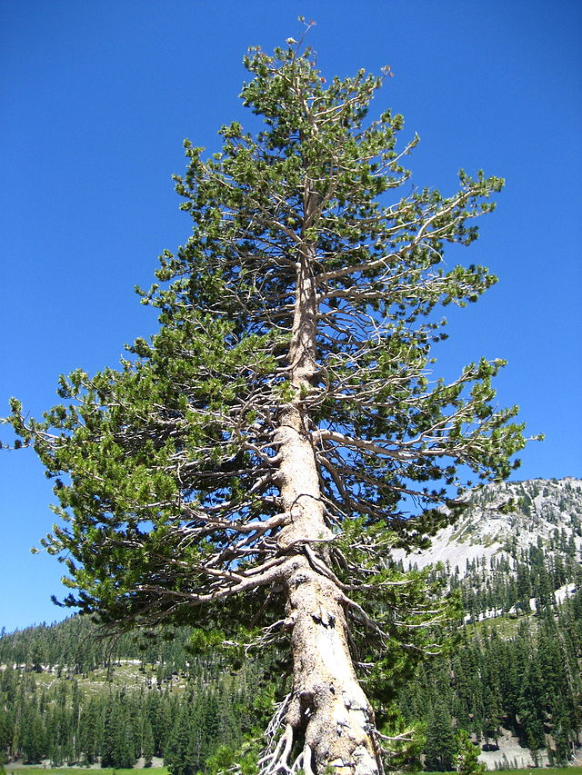
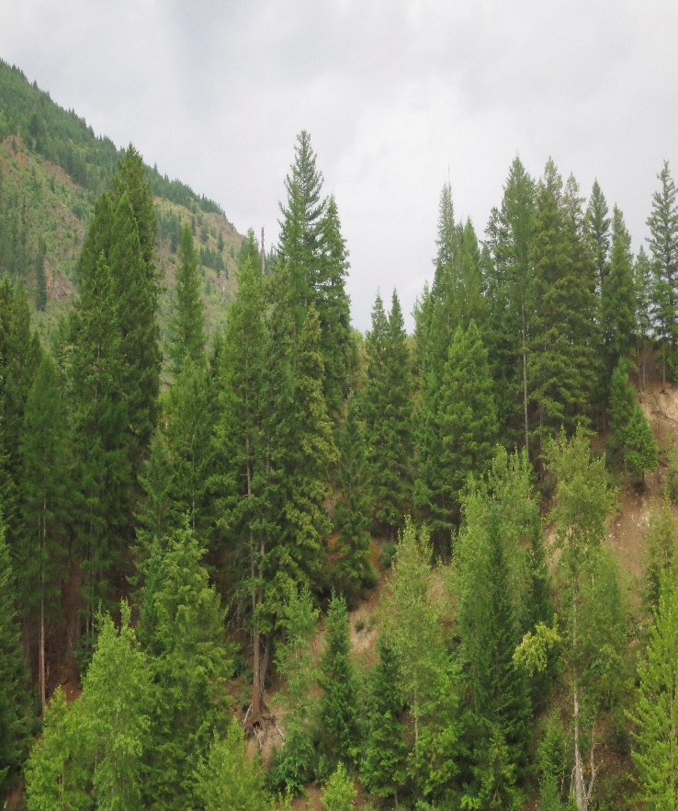
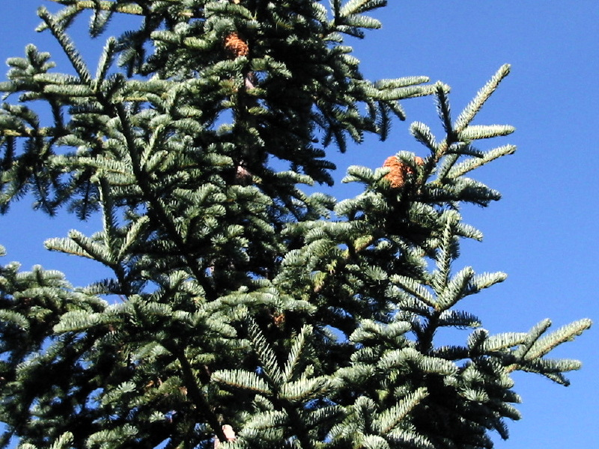
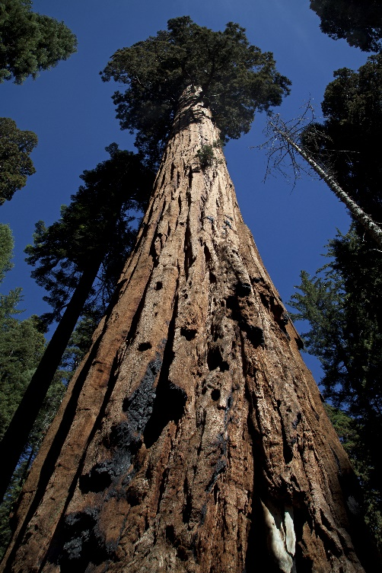
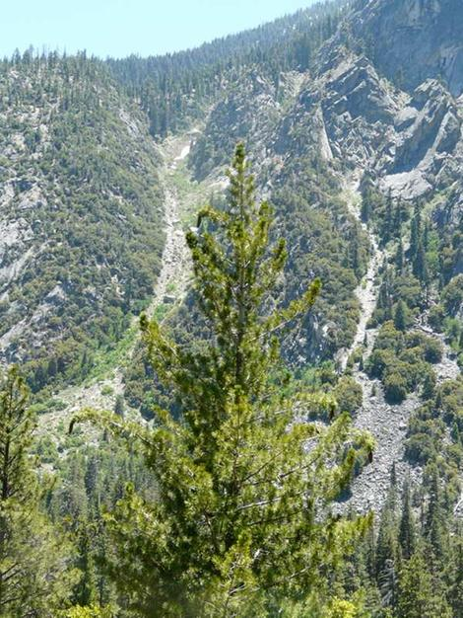
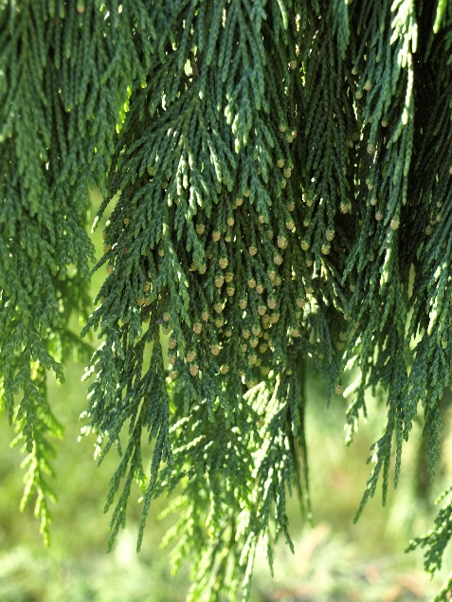
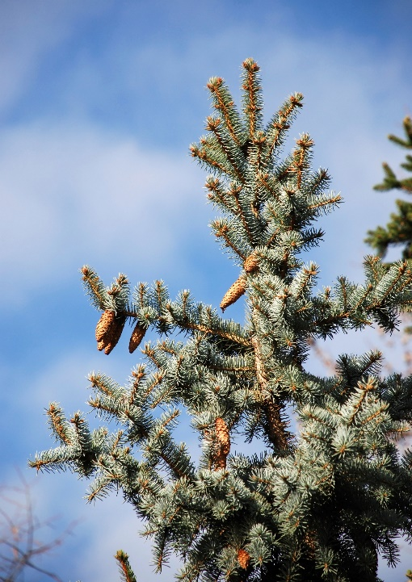
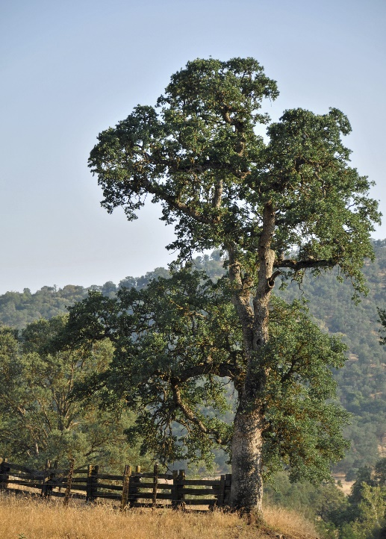
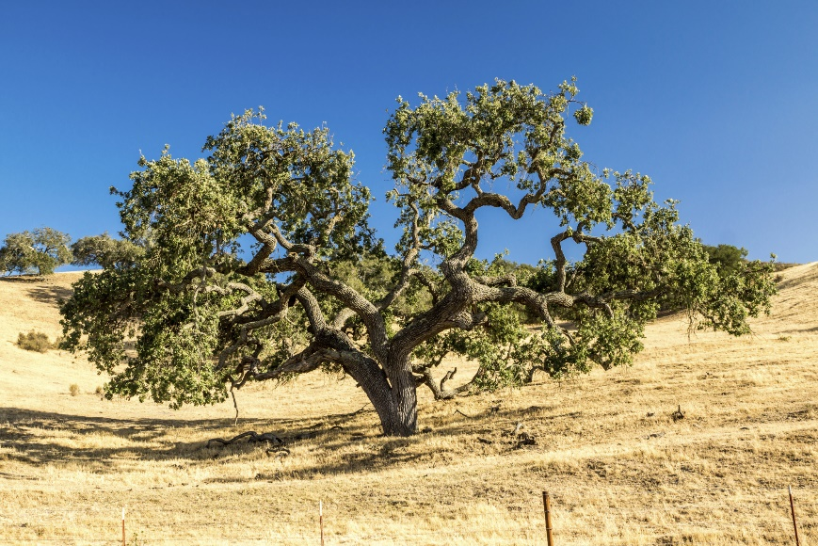
Notes:
Beginning in the warm, semiarid Upper Sonoran, we find oak trees and pine trees. In each successive life zone, we find different species of trees.
(not in script: Bottom up: blue oak, digger pine, live oak, incense cedar, sugar pine, giant sequoia, red fir, lodgepole pine, mountain hemlock, white bark pine, Jeffrey pine, aspen)

Slide 26
Arctic Alpine
Hudsonian
Canadian
Transition
Upper Sonoran
Lower Sonoran
 | A | B | C | D | E | F | G | H | I
 | Species of Shrews |  |  |  | Species of Squirrels
Notes:
The same is true of the mammals found in these life zones. / This chart shows the life zones from the Sierra Nevada mountain range. Along the bottom, we will use these letters to represent various species of mammals. / We will use shrews and squirrels, but the same pattern exists with chipmunks, gophers, moles, mice, foxes, and many other mammals.

Slide 27
Arctic Alpine
Hudsonian
Canadian
Transition
Upper Sonoran
Lower Sonoran
 | A | B | C | D | E | F | G | H | I
 | Species of Shrews |  |  |  | Species of Squirrels
Notes:
This bar represents a species of shrew we will call species A, which is found only in the Lower Sonoran life zone.

Slide 28
Arctic Alpine
Hudsonian
Canadian
Transition
Upper Sonoran
Lower Sonoran
 | A | B | C | D | E | F | G | H | I
 | Species of Shrews |  |  |  | Species of Squirrels
Notes:
This one represents species B that lives in both the Lower and Upper Sonoran life zones

Slide 29
Arctic Alpine
Hudsonian
Canadian
Transition
Upper Sonoran
Lower Sonoran
 | A | B | C | D | E | F | G | H | I
 | Species of Shrews |  |  |  | Species of Squirrels
Notes:
Species C is found in three successive life zones, while species D lives only in the Canadian.

Slide 30
Arctic Alpine
Hudsonian
Canadian
Transition
Upper Sonoran
Lower Sonoran
 | A | B | C | D | E | F | G | H | I
 | Species of Shrews |  |  |  | Species of Squirrels
Notes:
These bars represent five different species of squirrels found in different life zones.

Slide 31
Arctic Alpine
Hudsonian
Canadian
Transition
Upper Sonoran
Lower Sonoran
 | A | B | C | D | E | F | G | H | I
 | Species of Shrews |  |  |  | Species of Squirrels
Notes:
So far we have noticed the vertical bars, / which represent the biomes where individual species live.

Slide 32
Arctic Alpine
Hudsonian
Canadian
Transition
Upper Sonoran
Lower Sonoran
 | A | B | C | D | E | F | G | H | I
 | Species of Shrews |  |  |  | Species of Squirrels
Notes:
Next, let’s look horizontally at the different communities of mammals found in the same biome.

Slide 33
Arctic Alpine
Hudsonian
Canadian
Transition
Upper Sonoran
Lower Sonoran
 | A | B | C | D | E | F | G | H | I
 | Species of Shrews |  |  |  | Species of Squirrels
Notes:
Notice that the Lower Sonoran life zone has a couple different species of shrews, / and couple different species of squirrels, and of course many other kinds of mammals besides ones shown on this chart.

Slide 34
Arctic Alpine
Hudsonian
Canadian
Transition
Upper Sonoran
Lower Sonoran
 | A | B | C | D | E | F | G | H | I
 | Species of Shrews |  |  |  | Species of Squirrels
Notes:
The Upper Sonoran has some of the same species as well as some different ones

Slide 35
Arctic Alpine
Hudsonian
Canadian
Transition
Upper Sonoran
Lower Sonoran
 | A | B | C | D | E | F | G | H | I
 | Species of Shrews |  |  |  | Species of Squirrels
Notes:
Each life zone or biome is a combination of specific creatures that is similar to, yet distinct from the ones in the biomes above and below.

Slide 36
Arctic Alpine
Hudsonian
Canadian
Transition
Upper Sonoran
Lower Sonoran
 | A | B | C | D | E | F | G | H | I
 | Species of Shrews |  |  |  | Species of Squirrels
Notes:
In other words, each biome contains a specific community of both plants and animals.

Slide 37
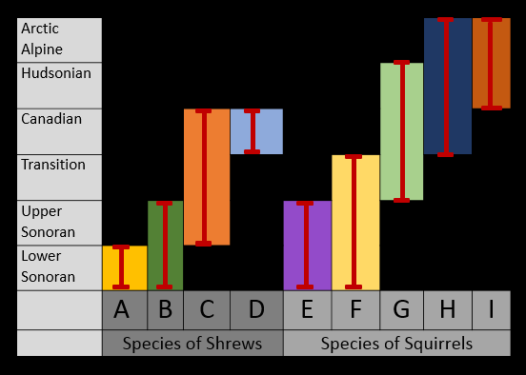
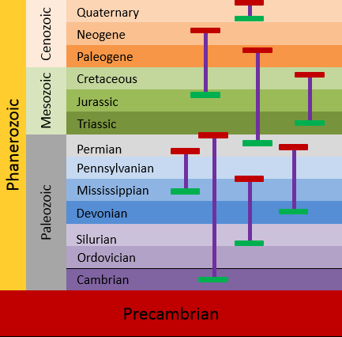
In Biomes Today
In Fossil Record
Notes:
This detailed order of individual species in specific biomes corresponds to the pattern we find in the fossil record as well.

Slide 38
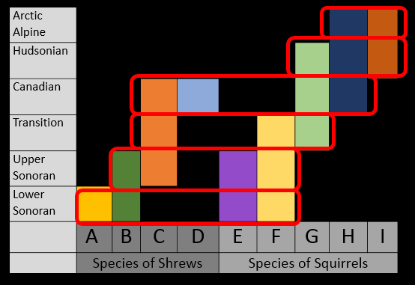
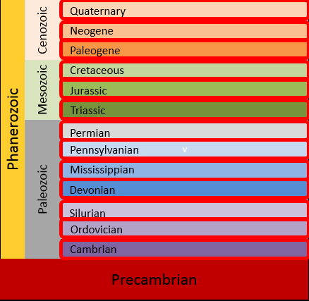
In Biomes Today
In Fossil Record
Notes:
Biome succession puts what we know about specific creatures living in communities in different biomes in nature today with the succession of fossil communities we find in the geologic column…

Slide 39
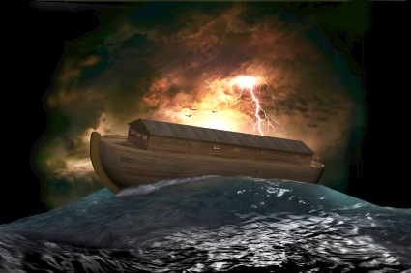
Worldwide Flood
Notes:
And suggests that the order in the fossil record could have been created by the worldwide flood described in the Bible.

Slide 40

Genesis 7:11
All the fountains of the great deep burst open, and the floodgates of the sky were opened.
Notes:
It’s important to remember that the Genesis flood was much more than 40 days of rain. The Bible tells us that all the fountains of the great deep burst open, and the floodgates of the sky were opened.

Slide 41
Genesis 8:2
The fountains of the great deep and the floodgates of the sky were closed, and the rain stopped.
Notes:
And they were not closed again for five months.

Slide 42
Worldwide Flood
“Fountains of the great deep” burst open
Moving tectonic plates
Volcanoes
Earthquakes
Tsunamis
40 days of rain
Notes:
It is likely that the flood involved moving tectonic plates, volcanoes, earthquakes, and tsunamis in addition to the 40 days and nights of rain.

Slide 43
Biome Succession
Notes:
If a worldwide Flood like that were to happen today, we would expect a succession of biomes to be buried in a predictable order as the flood waters rose. / The succession of fossil communities in the geologic column is consistent with what could have happened during the flood.

Slide 44
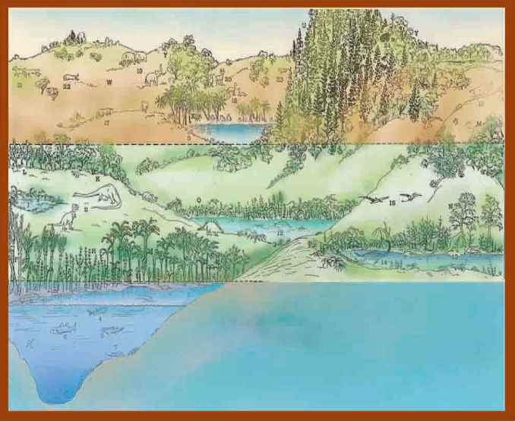
Notes:
The first biomes to be buried in a flood model would be deep marine biomes, followed by shallower marine biomes…

Slide 45
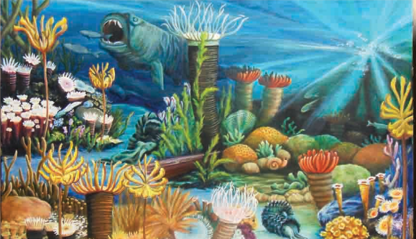
Quaternary
Cenozoic
Neogene
Paleogene
Cretaceous
Mesozoic
Jurassic
Triassic
Marine Communities
Phanerozoic
Permian
Pennsylvanian
Mississippian
Paleozoic
Devonian
Silurian
Ordovician
Cambrian
Precambrian
Notes:
which is exactly what we find at the bottom of the geologic column

Slide 46
Notes:
On land, cold-blooded animals like amphibians and reptiles need to live in warmer climates, which are at lower elevations. / Warm-blooded animals like mammals and birds need to live in cooler climates, which are at higher elevations.

Slide 47
Quaternary
Cenozoic
Neogene
Mammal Communities
Paleogene
Cretaceous
Mesozoic
Jurassic
Reptile & Dinosaur
Communities
Triassic
Phanerozoic
Permian
Pennsylvanian
Mississippian
Paleozoic
Devonian
Silurian
Ordovician
Cambrian
Precambrian
Notes:
As the flood waters continued to rise, we would expect them to bury reptiles and dinosaurs living in the lower, warmer land biomes, followed by mammals living in the higher, cooler biomes. This is what we find in the geologic column.

Slide 48
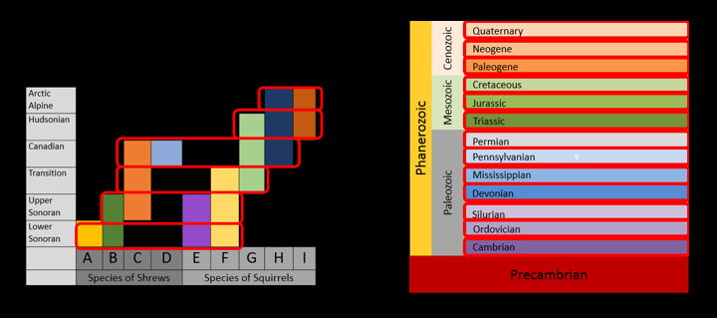
Biome Succession
Notes:
To summarize, biome succession suggests that the geologic column was formed as a series of biomes were destroyed successively by the flood.

Slide 49
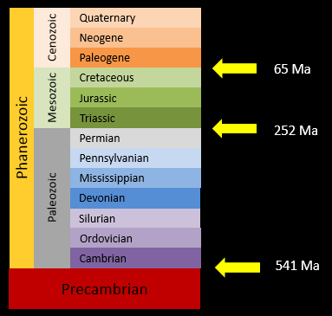
Millions of Years
Biome
Succession
Notes:
Scientists who are exploring biome succession believe this hypothesis is a better overall explanation for the geologic column / than the idea that it formed slowly over millions of years.

Slide 50

Notes:
Our next presentation summarizes the DVD Evidences from the Geoscience Research Institute, which explains additional evidence from the geologic column that is more consistent with a worldwide flood than it is with formation over millions of years.

Slide 51
Recorded at
Chattanooga Public RadioSM
Classical 90.5 WSMC

Slide 52
Images By
Images may appear on more than one slide. Citation is given on the first slide where each image appears.
[1a] Zion National Park 489588635, kaiborder, Thinkstock, Thinkstock Image Subscription Agreement
[1b] Folded rocks 24286621 Matauw, Getty Images (US), Inc. Subscription Agreement
[1c] Blue Mesa Petrified Forest National Park 479232619, estivillml, Thinkstock, Thinkstock Image Subscription Agreement
[1d] Bryce Canyon National Park, Keith Snyder
[1e] Folded rocks, Raul Esperante, used with permission
[1f] Grand Canyon, taken by Ed Chatelain, used with permission
[2a] Saber-toothed cat skull 825334, pixeldigits, Getty Images (US), Inc. Subscription Agreement
[2b] Mammoth skeleton 186043, Escaflowne, Getty Images (US), Inc. Subscription Agreement
[2c] Dinosaur skeleton 465562669, herraez, Thinkstock, Thinkstock Image Subscription Agreement
[2d] Trilobite 35519138, demarfa, Getty Images (US), Inc. Subscription Agreement
[2e] Elrathia kingii Trilobite 144970604, Russell Shively, Thinkstock, Thinkstock Image Subscription Agreement
[2f] Trilobites Russian 596507, bobainsworth, Getty Images (US), Inc. Subscription Agreement
[9a] Arctic hare 71260802, Purestock, Thinkstock, Thinkstock Image Subscription Agreement

Slide 53
Images By
[9b] Polar bear 26746428, AndreAnita, Getty Images (US), Inc. Subscription Agreement
[9c] Arctic fox 5311341, DmitryND, Getty Images (US), Inc. Subscription Agreement
[9d] Snowy owl 186225855, JackF, Thinkstock, Thinkstock Image Subscription Agreement
[10a] Deer 466201549, Byrdyak, Thinkstock, Thinkstock Image Subscription Agreement
[10b] Ferns 450746917, Ralph A. Clevenger/Fuse, Thinkstock, Thinkstock Image Subscription Agreement
[10c] Squirrel in winter 478458723, mpr2003, Thinkstock, Thinkstock Image Subscription Agreement
[10d] Magic forest 458859955, Drazen, Thinkstock, Thinkstock Image Subscription Agreement
[11a] Giraffe and zebra 200207232-001, Anup Shah, Thinkstock, Thinkstock Image Subscription Agreement
[11b] Prairie dog 78781575, Fuse, Thinkstock, Thinkstock Image Subscription Agreement
[11c] Buffalo 78748662, Fuse, Thinkstock, Thinkstock Image Subscription Agreement
[11d] Buffalo Gap National Grassland 470864887, Wirepec, Thinkstock, Thinkstock Image Subscription Agreement
[12a] Sunset 462779973, tonda, Thinkstock, Thinkstock Image Subscription Agreement
[12b] Rattlesnake 139907077, Steve Mcsweeny, Thinkstock, Thinkstock Image Subscription Agreement
[12c] Scorpion 180116068, piyathep, Thinkstock, Thinkstock Image Subscription Agreement
[12d] Camels in the desert 464888569, Lenar Musin, Thinkstock, Thinkstock Image Subscription Agreement

Slide 54
Images By
[13a] Turtle swimming 478114955, burnsboxco, Thinkstock, Thinkstock Image Subscription Agreement
[13b] Sea Star 468443257, TinkerJulie, Thinkstock, Thinkstock Image Subscription Agreement
[13c] Coral reef 466061973, mychadre77, Thinkstock, Thinkstock Image Subscription Agreement
[14a] Wakulla Springs State Park, Florida 467243631, 1001Love, Thinkstock, Thinkstock Image Subscription Agreement
[14b] American crocodile 477645817, Hoatzinexp, Thinkstock, Thinkstock Image Subscription Agreement
[14c] Grey heron 451992639, gabylegeai, Thinkstock, Thinkstock Image Subscription Agreement
[17] Central Sierra Nevada biomes and trees, Harold Clark
[25a] Snowbowl Aspens, Doug Dolde, http://en.wikipedia.org/wiki/File:Snowbowlaspens.jpg, public domain
[25b] Mature Jeffrey Pine, Jhodlof, http://commons.wikimedia.org/wiki/File:Mature_Jeffrey_Pine.JPG, public domain
[25c] Coniferous Trees 4484782, jdwfoto, Getty Images (US), Inc. Subscription Agreement
[25d] Pinus contorta, Walter Siegmund, http://commons.wikimedia.org/wiki/File:Pinus_contorta_28263.JPG, CC Generic
[25e] Tsuga mertensiana 0261, Walter Siegmund, http://commons.wikimedia.org/wiki/File:Tsuga_mertensiana_0261.JPG, CC Generic
[25f] Abies magnifica: Cones stand upright on branches, Walter Siegmund, http://commons.wikimedia.org/wiki/File:Abies_magnifica_8016t.jpg, CC BY 2.5

Slide 55
Images By
[25g] Abies magnifica, Walter Siegmund, http://commons.wikimedia.org/wiki/File:Abies_magnifica_8016t.jpg, public domain
[25h] Giant Sequioia close up 506157415, Robert Miramontes, Thinkstock, Thinkstock Image Subscription Agreement
[25i] Sugar Pine, Willmcw, http://commons.wikimedia.org/wiki/File:Sugar_Pine.jpg, Public Domain
[25j]Cypress branch 8249878, Ericlefrancais, Getty Images (US), Inc. Subscription Agreement
[25k] Pine tree 92187521, Majoros Laszlo, Thinkstock, Thinkstock Image Subscription Agreement
[25l] Pine tree branches with cones 4691358, majorosl, Getty Images (US), Inc. Subscription Agreement
[25m] Blue Sky – Blue Oak 7197946, John Seiler, Getty Images (US), Inc. Subscription Agreement
[39] Noah's Ark 12550737, jgroup, Getty Images (US), Inc. Subscription Agreement
[40] Vintage old book 95272278, Sharon Bronte, Thinkstock, Thinkstock Image Subscription Agreement
[44] Biomes, Ron Hight
[45] Paleozoic Community, Katherine Holder
[50] Photo of Evidences DVD, Carol Raney

Slide 56
Special Thanks
Lee Spencer, PhD
Research Professor, Southern Adventist University
and the
Foundation for Adventist Education

Slide 57

© Origins Curriculum Resources 2015

Slide 58

© Southern Adventist University 2015

Slide 59

© Seventh-day Adventist North American Division 2015

Slide 60

© General Conference of Seventh-day Adventists 2015

Slide 61

© SCORE Southern Center for Origins Research & Education 2015

