Slide 1
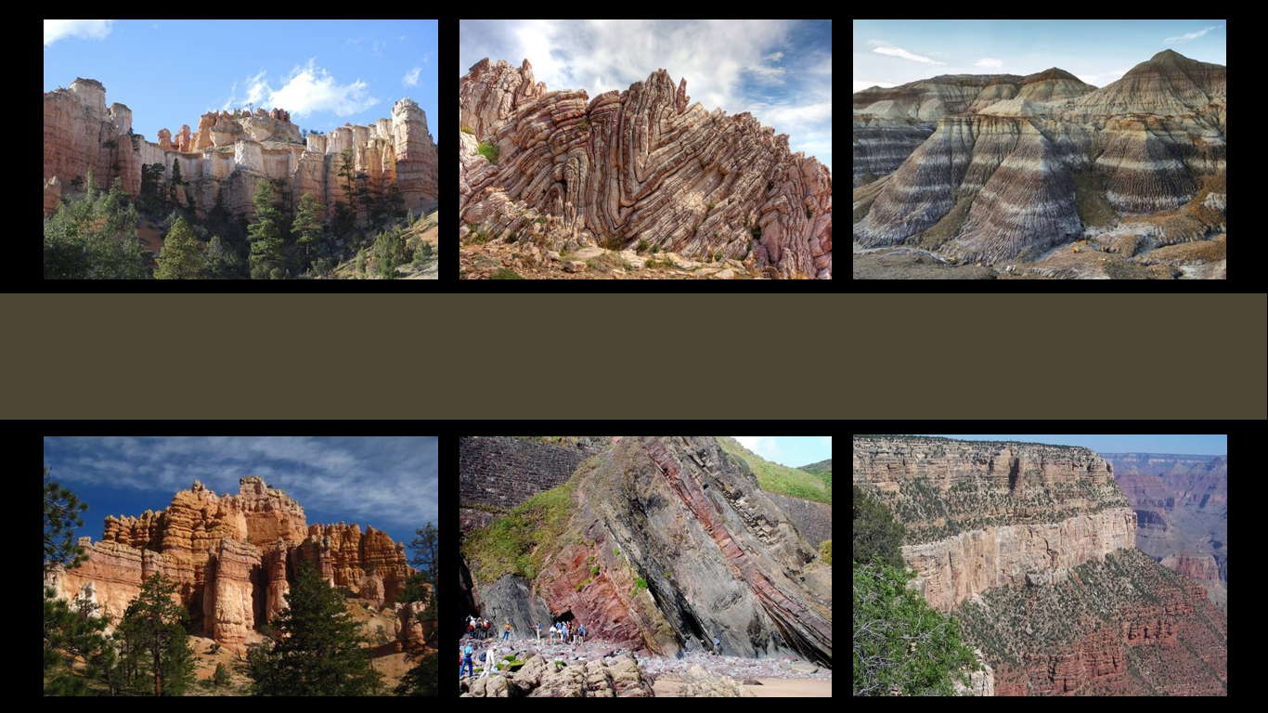
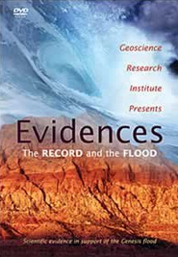
Evidences:
The Record and the Flood
Notes:
Evidences: The Record and the Flood

Slide 2

Tips for Classroom Use
Geoscience Research Institute (1990)
Scientific evidence in support of the Genesis flood
Notes:
Evidences is a 45-minute video produced by the Geoscience Research Institute in 1990. For those with access to the Evidences DVD, this presentation offers a summary with tips for choosing the most helpful sections for use in an elementary or middle school classroom. For those without access to the entire DVD, four individual clips from this DVD are available in separate presentations.

Slide 3

Tips for Classroom Use
Ch 10
6th
8th
Notes:
The Evidences DVD would be especially valuable for use during chapter 10 of either the 6th or 8th grade By Design textbooks. We recommend showing the video in smaller chunks that correspond to certain sections in the textbook.

Slide 4
By Design Science Textbook Grade 6, Chapter 10 |  | Evidences DVD
Flood Evidence | Pages | DVD Sections
1--Burial and Preservation of Remains | 335
2--Widespread Sedimentary Deposits | 335-336 | Segment 2 Widespread Deposits
3--Flat Gaps | 337-338 | Segment 4 Lack of Erosion
4--Turbidites | 337 | Segment 3 Turbidity Currents
5--Ocean Sediments on the Continents | 337 | Segment 1 Marine Deposits on Land
6--Continental-Scale Currents | 338
7--Incomplete Ecological Systems | 338
Notes:
Chapter 10 of the 6th grade textbook describes seven different kinds of flood evidence.

Slide 5
By Design Science Textbook Grade 6, Chapter 10 |  | Evidences DVD
Flood Evidence | Pages | DVD Sections
1--Burial and Preservation of Remains | 335
2--Widespread Sedimentary Deposits | 335-336 | Segment 2 Widespread Deposits
3--Flat Gaps | 337-338 | Segment 4 Lack of Erosion
4--Turbidites | 337 | Segment 3 Turbidity Currents
5--Ocean Sediments on the Continents | 337 | Segment 1 Marine Deposits on Land
6--Continental-Scale Currents | 338
7--Incomplete Ecological Systems | 338
Notes:
Four of them correspond with four segments of the Evidences DVD.

Slide 6
By Design Science Textbook Grade 6, Chapter 10 |  | Evidences DVD
Flood Evidence | Pages | DVD Sections
1--Burial and Preservation of Remains | 335
2--Widespread Sedimentary Deposits | 335-336 | Segment 2 Widespread Deposits
3--Flat Gaps | 337-338 | Segment 4 Lack of Erosion
4--Turbidites | 337 | Segment 3 Turbidity Currents
5--Ocean Sediments on the Continents | 337 | Segment 1 Marine Deposits on Land
6--Continental-Scale Currents | 338
7--Incomplete Ecological Systems | 338
17:05-21:50
21:52-29:26
29:28-35:50
12:59-17:00
Notes:
Here’s where to find each of the four segments. / But there may be other parts of the DVD you may want to consider showing as well.

Slide 7
Notes:
The four video segments correspond with four of the flood evidences listed on page 377 of the 8th grade textbook as well.

Slide 8
Summary & Suggestions
Select the portions that meet the needs of your class
Notes:
What follows is a summary of the various sections of the DVD so that you can select the parts that will be most helpful for your students.

Slide 9
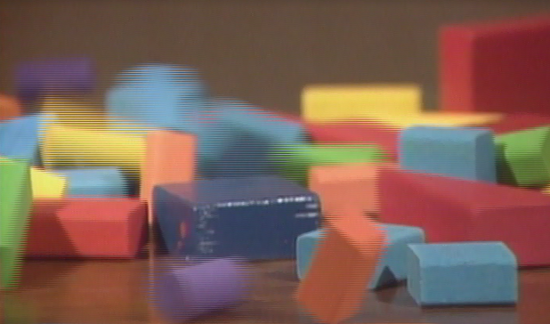
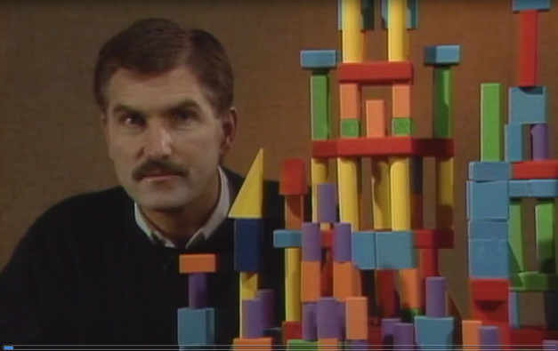
Introduction
00:00-1:23
Notes:
The introduction uses tower made of blocks to illustrate how some blocks are more foundational than others. Some blocks can be removed without consequence. / But if one of the bottom blocks is removed, the tower crumbles. The flood is compared to a foundational block in our belief system. If the flood didn’t happen, our tower is in trouble. This video contains scientific evidence that is consistent with the flood and shows that our tower is built on a solid foundation.

Slide 10
Introduction
1:25-2:17
Interviews with people on the street
2:18-2:50
Flood stories from other cultures
2:50-2:58
Written accounts can’t prove it happened. We need more concrete evidence--from the rocks
Notes:
The introductory section also includes interviews with people on the street asking whether they believe the biblical flood really happened. / Flood stories from other cultures are mentioned, but no specific examples are given. / And the point is made that written accounts can’t prove the happened. We need more concrete evidence, like the kind of evidence we find in the rocks.

Slide 11
Introduction
3:00-5:00
Sedimentary rocks/strata
Explanation of how sandstone and shale are formed
Layers=story/history
No way a flood could have happened without leaving evidence in the rocks
Notes:
Before showing the four sections that correspond with portions of the textbook, we recommend that you show this two-minute segment, which gives a general introduction about how rock layers form, introduces some terms, / and suggests that there’s no way a flood could have happened without leaving evidence in the rocks.

Slide 12
Introduction
5:00-7:10
Strata formation
Illustration of muddy water in a cup—eventually sediment settles out
Animation of layers being deposited and then eroded
What happened in the past is preserved in the layers
Notes:
This section would also be beneficial. It describes and illustrates in more detail how rocks are formed. / The animation of layers being deposited and eroded is especially helpful.

Slide 13
Introduction
7:09-12:05
On location at the Grand Canyon
Model of Colorado Plateau (Grand Staircase)
Ariel Roth—describes formation
Animation of formation
Evidence for flood
Notes:
The next section focuses specifically on the Grand Canyon, including some great photography and more animations illustrating the formation of the Colorado Plateau.

Slide 14
Transition
12:09-12:49
Dated sequence of kids finding what doesn’t fit
12:49
For scientists, finding something that doesn’t fit can be useful
Notes:
The transition to evidence 1 appears quite dated. The point being made is that when scientists find something that doesn’t seem to fit, it can encourage questions and research. This prepares the way for evidence 1—which is the presence of marine fossils where we might not expect to find them—on land. You may want to consider skipping this portion of the DVD and explaining this point to your students yourself.

Slide 15
Evidence 1: Marine Deposits
Corresponds to Ocean Sediments on the Continents
12:59-17:00
Puzzle in geology—ocean sediments on continents
  In the US
  On location in the Alps
Ariel Roth describes shells buried in a formation the size of Utah but 800 miles from the nearest ocean
Animation
Summary statement—at some time, oceans covered the land
p 337
Notes:
We definitely recommend showing the next four segments to your class. / This one corresponds with the section about ocean sediments on the continents on page 337. / Veteran Adventist scientist, Ariel Roth, describes shells buried in a formation the size of Utah but 800 miles from nearest ocean / and concludes that at some time in the past, it appears that the oceans covered the land

Slide 16
Evidence 2: Widespread Deposits
Corresponds to Widespread Sedimentary Deposits
17:05—21:50
Unusually widespread, thin rock formations
Helpful maps
Description by Ariel Roth of how it was deposited
Animations
Evidence of deposition on a larger scale than we see today
335-336
Notes:
Evidence 2 corresponds to the section about widespread sedimentary deposits on pages 335-336 of the textbook. Ariel Roth uses helpful maps to describe four huge rock formations that each cover multiple states in the American Midwest. / These formations provide evidence of deposition on a much larger scale than we see happening today.

Slide 17
Evidence 3: Turbidity Currents
Corresponds to Turbidites
21:52-29:26
Earthquake that broke transatlantic cables
Explanation and animation of turbidity current
Lab experiment showing turbidity current
On site with Ariel Roth examining turbidites
Rapid deposition underwater
p 337
Notes:
Evidence 3 is an especially interesting segment that corresponds to the section about turbidites on page 337. / Using the story of a relatively modern earthquake, / it explains what turbidity currents are and how turbidites form under water. / Ariel Roth examines turbidites found on the continents, / which provides more evidence that the land was once covered with water.

Slide 18
Evidence 4: Lack of Erosion
Corresponds to Flat Gaps
29:28-35:50
Supposed gaps of time in rock layers
Animation
On location with Ariel Roth to see flat contact
Conventional explanations and alternate view of rapid deposition during worldwide flood
337-338
Notes:
After a brief introduction where the host makes a handkerchief disappear, this section does a good job of demonstrating the lack of erosion described in the section called flat gaps on pages 337-338. / Ariel Roth suggests that rapid deposition during the worldwide flood as the explanation for the lack of erosion between these flat layers.

Slide 19
Summary
35:55-36:31
Marine deposits on land
Widespread deposits
Turbidity currents
Lack of erosion
Fairly compelling evidence that these were laid down during a worldwide catastrophe like the flood in Genesis
Notes:
This short segment is a great summary of the four kinds of evidence just described. This summary ends the part of the DVD that specifically corresponds to sections in chapter 10 of the 6th and 8th grade books

Slide 20
The Model
36:32-43:20
Scientific model defined
Reconstruct the past (guesses)
Noah’s flood model—not just a rain storm
Pre-flood similarities
Animations
Notes:
The final section of the DVD describes a specific model for Noah’s flood and would be a great supplement for anyone who wants to explore the topic beyond what is presented in the textbook. The introductory portion using remote control airplanes may seem a bit dated, but it helps to explain the idea of a model. Then the flood is described as more than just a rain storm.

Slide 21
The Model
Animations
43:20
43:22
Ideas build on what has gone before
Build faith on the Bible—one tower that’s never going to fall
Notes:
The model is demonstrated with some interesting animations, / and then the DVD ends by returning to the illustration of the block tower and how if we build our faith on the Bible, that’s one tower that’s never going to fall.

Slide 22

Geoscience Research Institute
Featured in
5th Grade By Design
Chapter 1
Page 45
grisda.org
Notes:
The Geoscience Research Institute is an official research institute of the Seventh-day Adventist Church. It was founded in 1958 to advise the church on issues relating to science and faith. / It is featured in the 5th grade By Design textbook in the science and Technology section at the end of chapter 1 (page 45). / Visit their website to see what other resources are available.

Slide 23
Recorded at
Chattanooga Public RadioSM
Classical 90.5 WSMC

Slide 24
Images By
Images may appear on more than one slide. Citation is given on the first slide where each image appears.
[1a] Zion National Park 489588635, kaiborder, Thinkstock, Thinkstock Image Subscription Agreement
[1b] Folded rocks 24286621 Matauw, Getty Images (US), Inc. Subscription Agreement
[1c] Blue Mesa Petrified Forest National Park 479232619, estivillml, Thinkstock, Thinkstock Image Subscription Agreement
[1d] Bryce Canyon National Park, Keith Snyder
[1e] Folded rocks, Raul Esperante, used with permission
[1f] Grand Canyon, taken by Ed Chatelain, used with permission
[1g] Picture of Evidences DVD, Carol Raney
[3a-b] Pictures of By Design Textbooks, Carol Raney
[9a-b] Screenshots from Evidences DVD, Geoscience Research Institute, used with permission

Slide 25
Special Thanks
Foundation for Adventist Education

Slide 26

© Origins Curriculum Resources 2015

Slide 27

© Southern Adventist University 2015

Slide 28

© Seventh-day Adventist North American Division 2015

Slide 29

© General Conference of Seventh-day Adventists 2015

Slide 30

© SCORE Southern Center for Origins Research & Education 2015

