Slide 1
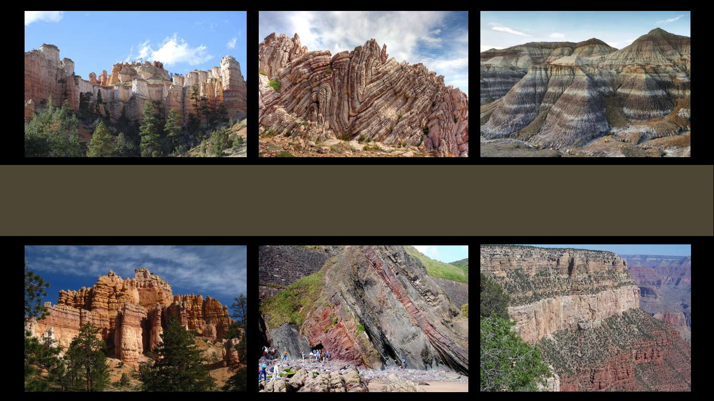
The Geologic Column
Important Terminology
Notes:
The Geologic Column—Important Terminology

Slide 2

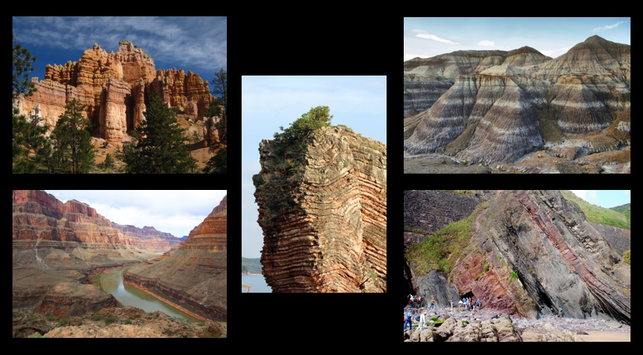
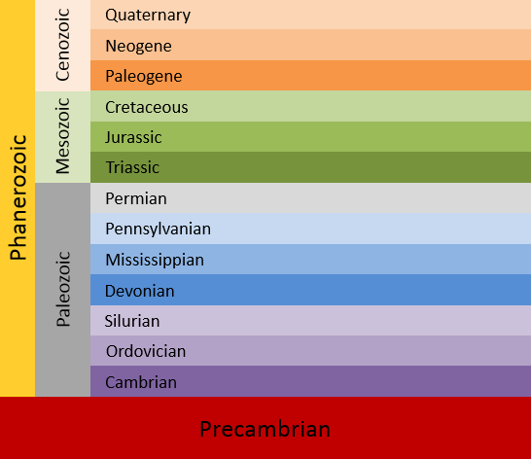
The Geologic Column
Notes:
Recall that all the rock strata around the world make up what we call the Geologic Column.

Slide 3

Erathems
Systems
Eonothem
Notes:
As scientists study the data in the geologic column, they use some very specific terminology.

Slide 4
Era
Erathems
Periods
Systems
Eon
Eonothem
Notes:
In this presentation, we will learn about two different sets of words that we can use to describe the geologic column and why it matters which words we use.

Slide 5

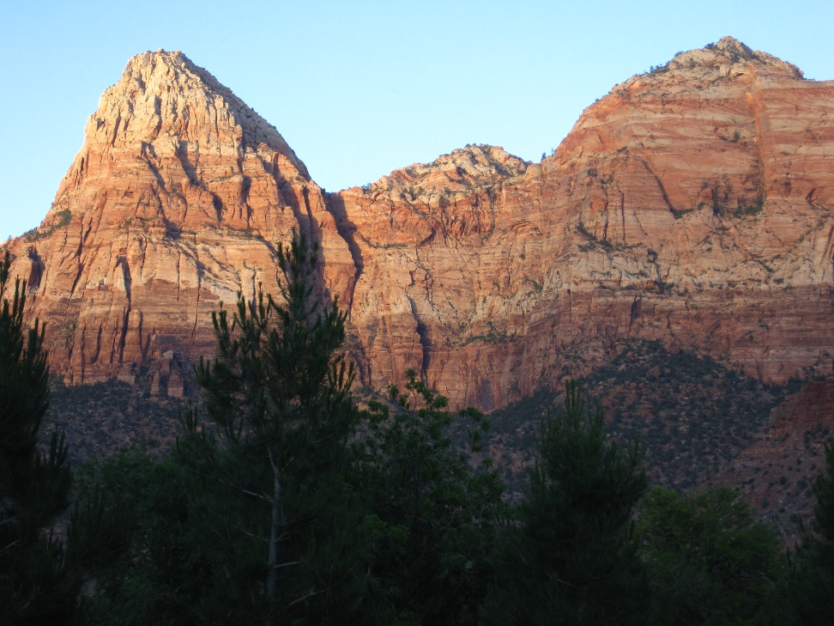
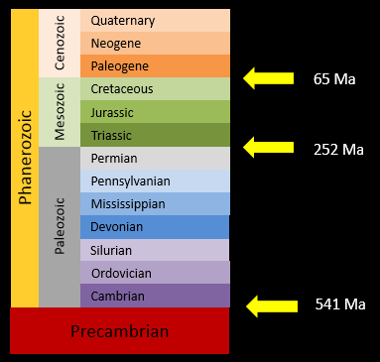
Two Sets of Terminology
Chronostratigraphic
Geochronologic
Notes:
One set of words refers just to the rock layers themselves, / and the other refers to the rock layers and the millions of years of time that have come to be associated with them. Knowing both sets of words allows us to be more precise as we talk about the geologic column.
(Picture from Keith)

Slide 6
Phanerozoic
Eonothem
Precambrian
Notes:
You may have heard the Phanerozoic section of the geologic column referred to as an eonothem…

Slide 7
Phanerozoic
Phanerozoic eonothem
Precambrian
Notes:
…the Phanerozoic eonothem

Slide 8
Cenozoic
Mesozoic
Erathems
Phanerozoic
Paleozoic
Precambrian
Notes:
We have also referred to the Paleozoic, Mesozoic, and Cenozoic sections as erathems

Slide 9
Cenozoic
Mesozoic
Phanerozoic
Paleozoic
Paleozoic erathem
Precambrian

Slide 10
Cenozoic
Mesozoic
Mesozoic erathem
Phanerozoic
Paleozoic
Precambrian
Notes:
Mesozoic erathem…

Slide 11
Cenozoic
Cenozoic erathem
Mesozoic
Phanerozoic
Paleozoic
Precambrian
Notes:
…and the Cenozoic erathem

Slide 12
Quaternary
Cenozoic
Neogene
Paleogene
Cretaceous
Cretaceous
Mesozoic
Jurassic
Triassic
Systems
Phanerozoic
Permian
Pennsylvanian
Mississippian
Paleozoic
Devonian
Silurian
Ordovician
Cambrian
Precambrian
Notes:
Each erathem is further divided into sections we refer to as systems

Slide 13
Quaternary
Cenozoic
Neogene
Paleogene
Cretaceous
Cretaceous
Mesozoic
Jurassic
Triassic
Phanerozoic
Permian
Pennsylvanian
Mississippian
Paleozoic
Devonian
Silurian
Ordovician
Cambrian
Precambrian
Notes:
Like the Cambrian system…

Slide 14
Quaternary
Cenozoic
Neogene
Paleogene
Cretaceous
Cretaceous
Mesozoic
Jurassic
Triassic
Phanerozoic
Permian
Pennsylvanian
Mississippian
Paleozoic
Devonian
Silurian
Ordovician
Cambrian
Precambrian
Notes:
The Jurassic system…

Slide 15
Quaternary
Cenozoic
Neogene
Paleogene
Cretaceous
Cretaceous
Mesozoic
Jurassic
Triassic
Phanerozoic
Permian
Pennsylvanian
Mississippian
Paleozoic
Devonian
Silurian
Ordovician
Cambrian
Precambrian
Notes:
…and the Neogene system.

Slide 16
Important Terminology
Chronostratigraphic
Notes:
All of these terms we have used so far are chronostratigraphic names.

Slide 17
Important Terminology
Chronostratigraphic
  Strata = layers
  Stratigraphy = study of the rock layers
Notes:
Notice the part of the word in yellow. The word strata means layers and stratigraphy is the term for the study of the rock layers.

Slide 18
Important Terminology
Chronostratigraphic
  The layers themselves
  Their placement in relation to each other
  No ages or dates inferred
Notes:
Chrono (as in the word chronology) refers to a sequence in a certain order. / So the chronostratigraphic names we have been using refer to the layers themselves and their placement in a certain order. / There are no ages or dates inferred when we use these terms.

Slide 19
Important Terminology
Chronostratigraphic
  The layers themselves
  Their placement in relation to each other
  No ages or dates inferred
Geochronologic
Layers +
Time inference (millions of years)
Notes:
Another set of terms refers to the same rock layers / but also includes the inference of time. These are called geochronologic terms

Slide 20
Phanerozoic
Phanerozoic eonothem
Precambrian
Notes:
Instead of the term eonothem (which refers simply to the layers themselves)…

Slide 21
Phanerozoic
Phanerozoic eon
Precambrian
Notes:
The term eon refers to the layers as well as the time associated with them.

Slide 22
Cenozoic
Mesozoic
Erathem
Phanerozoic
Paleozoic
Precambrian
Notes:
While the word erathem refers to the layers…

Slide 23
Cenozoic
Cenozoic era
Mesozoic
Mesozoic era
Phanerozoic
Paleozoic
Paleozoic era
Precambrian
Notes:
The word era carries with it the connotation of inferred time

Slide 24
Quaternary
Cenozoic
Neogene
Paleogene
Cretaceous
Cretaceous
Mesozoic
Systems
Jurassic
Triassic
Phanerozoic
Permian
Pennsylvanian
Mississippian
Paleozoic
Devonian
Silurian
Ordovician
Cambrian
Precambrian
Notes:
Instead of system—which refers to the placement of the layers themselves

Slide 25
Quaternary
Cenozoic
Neogene
Paleogene
Cretaceous
Cretaceous
Mesozoic
Systems
Periods
Jurassic
Triassic
Phanerozoic
Permian
Pennsylvanian
Mississippian
Paleozoic
Devonian
Silurian
Ordovician
Cambrian
Precambrian
Notes:
The word period includes the time connotations associated with the layers

Slide 26
Important Terminology
Chronostratigraphic (layers)
  Eonothem
  Erathem
  System
  Series
  Stage
Geochronologic (time)
  Eon
  Era
  Period
  Epoch
  Age
Notes:
Compare the chronostratigraphic terms in the left column / with the geochronologic terms in the right column.

Slide 27
Important Terminology
Chronostratigraphic (layers)
  Eonothem
  Erathem
  System
  Series
  Stage
Geochronologic (time)
  Eon
  Era
  Period
  Epoch
  Age
Notes:
Notice how similar the words eonothem and eon are.

Slide 28
Important Terminology
Chronostratigraphic (layers)
  Eonothem
  Erathem
  System
  Series
  Stage
Geochronologic (time)
  Eon
  Era
  Period
  Epoch
  Age
Notes:
And how similar erathem and era are.

Slide 29
Important Terminology
Chronostratigraphic (layers)
  Eonothem
  Erathem
  System
  Series
  Stage
Geochronologic (time)
  Eon
  Era
  Period
  Epoch
  Age
Notes:
Notice how all the words in the geochronologic column are related to time.

Slide 30
Millions of years ago
Ma = millions of years ago
Mya = millions of years ago
Notes:
Geologic time scale charts usually contain the abbreviation Ma—which means millions of years ago. Sometimes you will see Mya, but the most current abbreviation is Ma.

Slide 31
Quaternary
Cenozoic
Neogene
Paleogene
65 Ma
Cretaceous
Mesozoic
Jurassic
Triassic
252 Ma
Phanerozoic
Permian
Pennsylvanian
Mississippian
Paleozoic
Devonian
Silurian
Ordovician
Cambrian
541 Ma
Precambrian
Notes:
Sometimes suggested numbers correspond with boundaries between sections. While numbers sometimes vary from chart to chart, / 541 ma is the standard suggestion for the boundary between the Precambrian and the Cambrian. / 252 Ma is suggested for the boundary between the Permian and Triassic periods. / 65 Ma is the consensus for the boundary between the Cretaceous and Paleogene periods.

Slide 32
Quaternary
Cenozoic
Neogene
Paleogene
Cretaceous
Mesozoic
Jurassic
Triassic
Phanerozoic
Permian
Pennsylvanian
Mississippian
Paleozoic
Devonian
Silurian
Ordovician
Cambrian
54 million years
Precambrian
Notes:
Other times the numbers on geologic column charts suggest the length of time scientists think a particular period—like the Cambrian--lasted.

Slide 33
Two Sets of Terminology
Chronostratigraphic
Geochronologic
Notes:
To summarize, there are two sets of terminology used to describe the geologic column. / Chronostratigraphic terms refer just to the rock layers themselves, / while geochronologic terms refer to the rock layers and the millions of years associated with them.

Slide 34

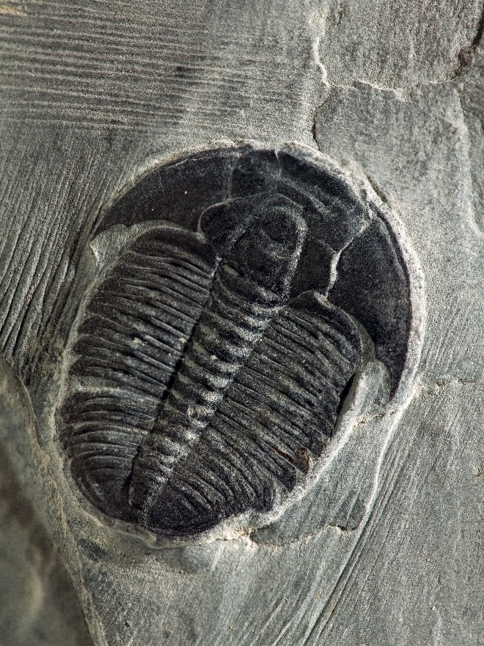
Quaternary
Cenozoic
Neogene
Paleogene
Cretaceous
Mesozoic
Jurassic
Triassic
Phanerozoic
Data
Permian
Pennsylvanian
Mississippian
Paleozoic
Devonian
Silurian
Ordovician
Cambrian
Precambrian
Notes:
Observations that we make about the rocks and fossils in the geologic column are data. These data can be verified by others who study or measure them as well.

Slide 35
Quaternary
Cenozoic
Neogene
Paleogene
65 Ma
Cretaceous
Mesozoic
Jurassic
Triassic
252 Ma
Phanerozoic
Permian
Pennsylvanian
Mississippian
Interpretation
Paleozoic
Devonian
Silurian
Ordovician
Cambrian
541 Ma
Precambrian
Notes:
The millions of years of inferred time / is an interpretation of that data from a particular worldview.

Slide 36
Important Terminology
Chronostratigraphic (layers)
  Eonothem
  Erathem
  System
  Series
  Stage
Geochronologic (time)
  Eon
  Era
  Period
  Epoch
  Age
Notes:
It’s important to understand both sets of terminology. / Because geochronologic terms are used most often by scientists, we should know and be able to use them accurately even if we do not accept the millions of years associated with them. / We also have the option of using chronostratigraphic terms when we want to refer just to the placement of the rock layers in the geologic column.

Slide 37
The Geologic Column
How did the layers form?

Slide 38
Recorded at
Chattanooga Public RadioSM
Classical 90.5 WSMC

Slide 39
Images By
Images may appear on more than one slide. Citation is given on the first slide where each image appears.
[1a] Zion National Park 489588635, kaiborder, Thinkstock, Thinkstock Image Subscription Agreement
[1b] Folded rocks 24286621 Matauw, Getty Images (US), Inc. Subscription Agreement
[1c] Blue Mesa Petrified Forest National Park 479232619, estivillml, Thinkstock, Thinkstock Image Subscription Agreement
[1d] Bryce Canyon National Park, Keith Snyder
[1e] Folded rocks, Raul Esperante, used with permission
[1f] Grand Canyon, taken by Ed Chatelain, used with permission
[2c] Cliff 105813791, Dejan Nikolic, Thinkstock, Thinkstock Image Subscription Agreement
[2d] Colorado River in the Grand Canyon 33169492, OlegBogdan, Getty Images (US), Inc. Subscription
[5] Zion National Park, Keith Snyder, used with permission
[34b] Elrathia kingii Trilobite 4974845, Tyrannosaur, Getty Images (US), Inc. Subscription

Slide 40
Special Thanks
Foundation for Adventist Education

Slide 41

© Origins Curriculum Resources 2015

Slide 42

© Southern Adventist University 2015

Slide 43

© Seventh-day Adventist North American Division 2015

Slide 44


© General Conference of Seventh-day Adventists 2015

Slide 45

© SCORE Southern Center for Origins Research & Education 2015

