Slide 1
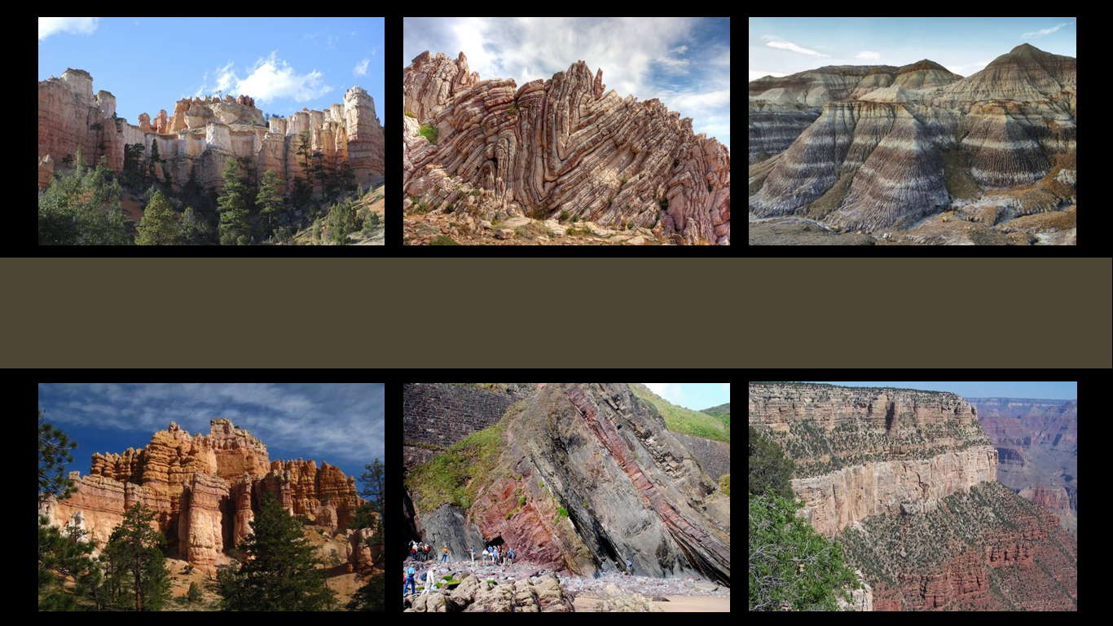
The Geologic Column
Relative Age
Notes:
The Geologic Column—Relative Age

Slide 2

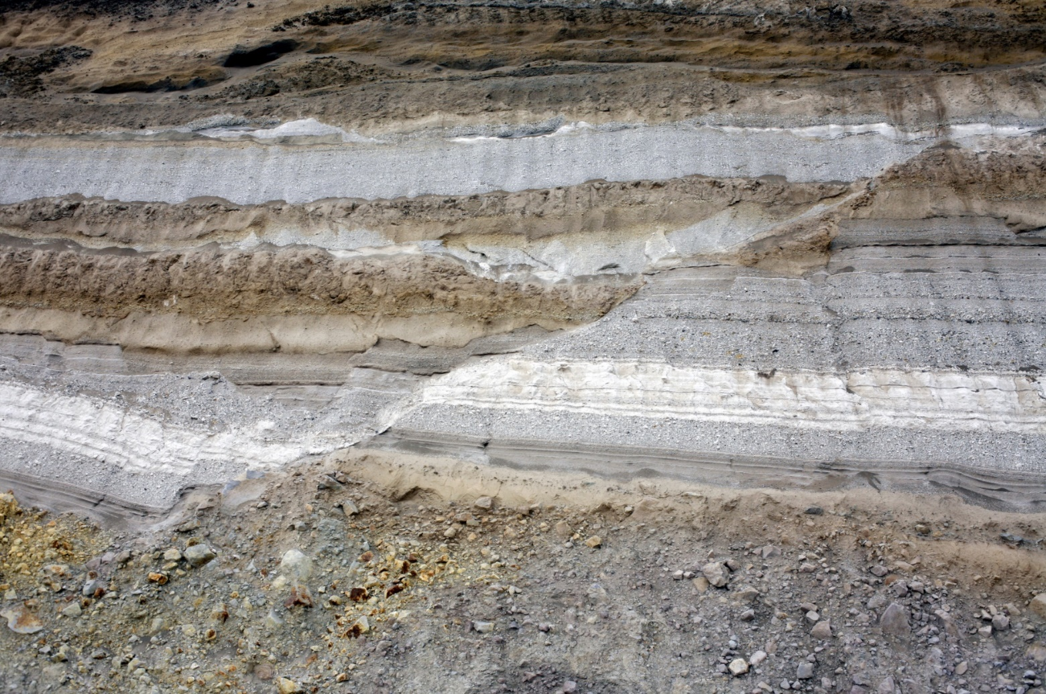
Just a Rock?
History of Events – Relative Age
Story
Notes:
At first glance, many people might look at this and see—well, just a rock. / But actually the various layers shown here tell a very specific story. And when scientists look at these sedimentary layers, they try to decipher the exact sequence of events that created this unique formation. / When we talk about relative age, we are trying to figure out the history of the rock.

Slide 3
Principles
  Original horizontality
    Layers are deposited horizontally.
  Superposition
  Younger layers are on top of older ones.
  3. Cross-cutting relationships
  Faults and intrusions are younger than the layers they cut across.
Notes:
Remember that 1. Sedimentary rock layers are deposited horizontally. 2. Younger layers are deposited on top of older ones. 3. Earthquake faults and magma intrusions are younger than the layers of rock they cut across.

Slide 4
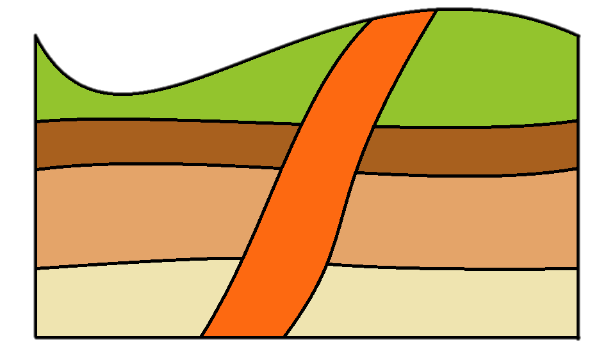
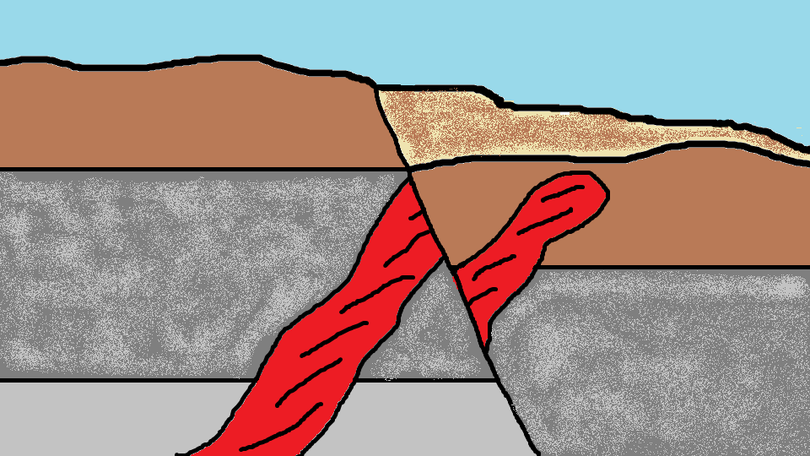
Order of Events?
Notes:
Using these principles, let’s see if we can figure out the order of the events that created two specific rock formations.

Slide 5
What order?
A
B
C
D
E
Notes:
In this illustration, A, B, D, and E represent different rock strata. C represents an intrusion of magma up through cracks in the rock layers. You may wish to pause the video while you try to decipher the relative age of these features.

Slide 6
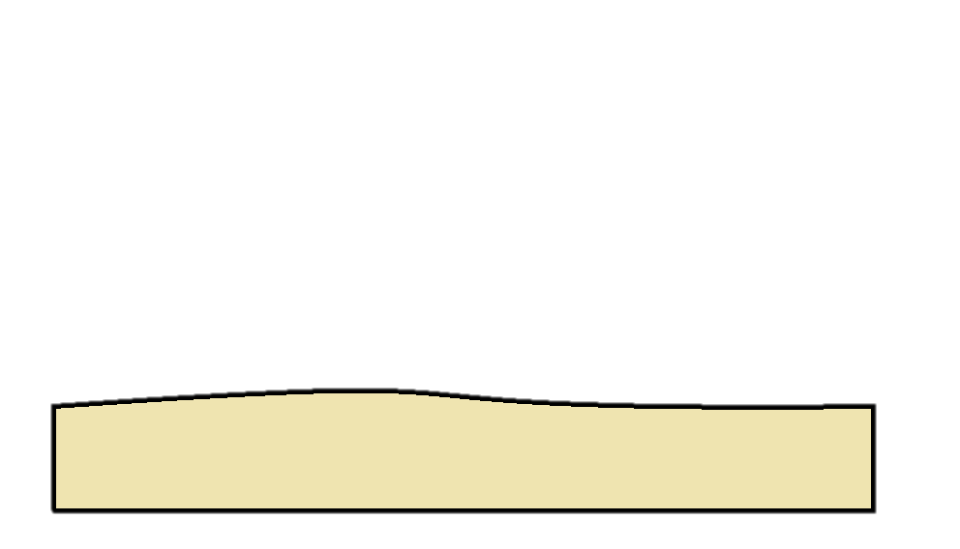
What order?
1
Notes:
We know from the principle of superposition that the first layer to be deposited was the bottom layer.

Slide 7
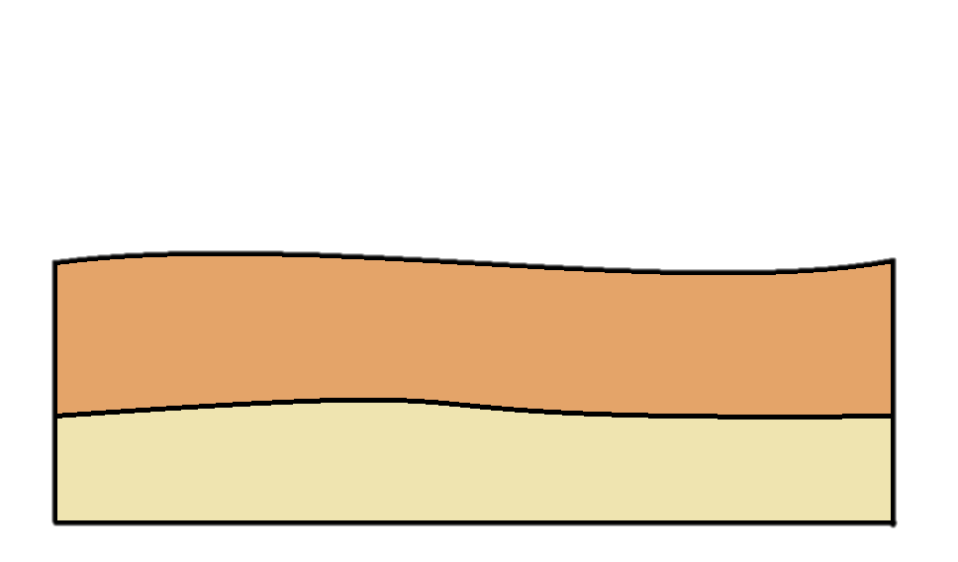
What order?
2
1
Notes:
Then layer 2 was deposited on top.

Slide 8
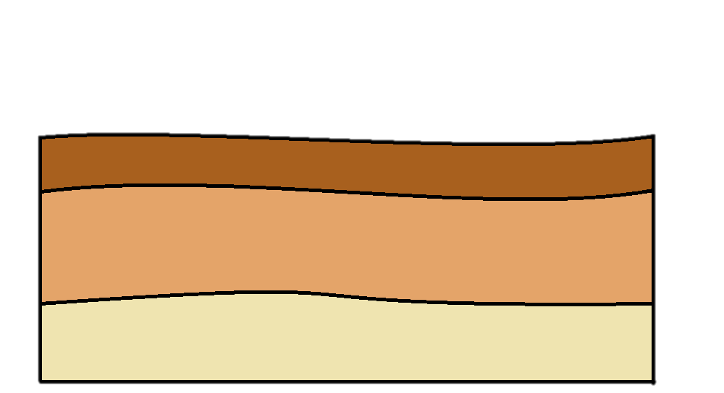
What order?
3
2
1
Notes:
The third layer came next…

Slide 9
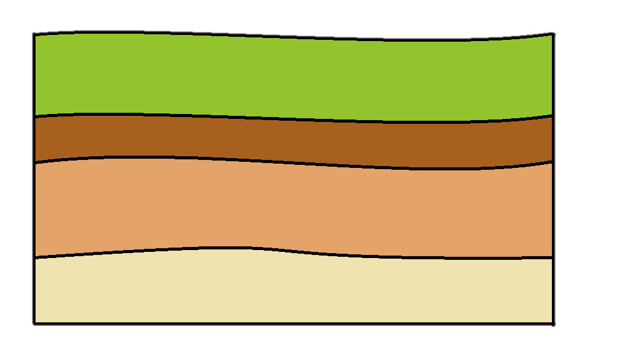
What order?
4
3
2
1
Notes:
…followed by the top layer.

Slide 10
What order?
4
youngest
3
2
1
oldest
Notes:
So far, this seems pretty easy.

Slide 11
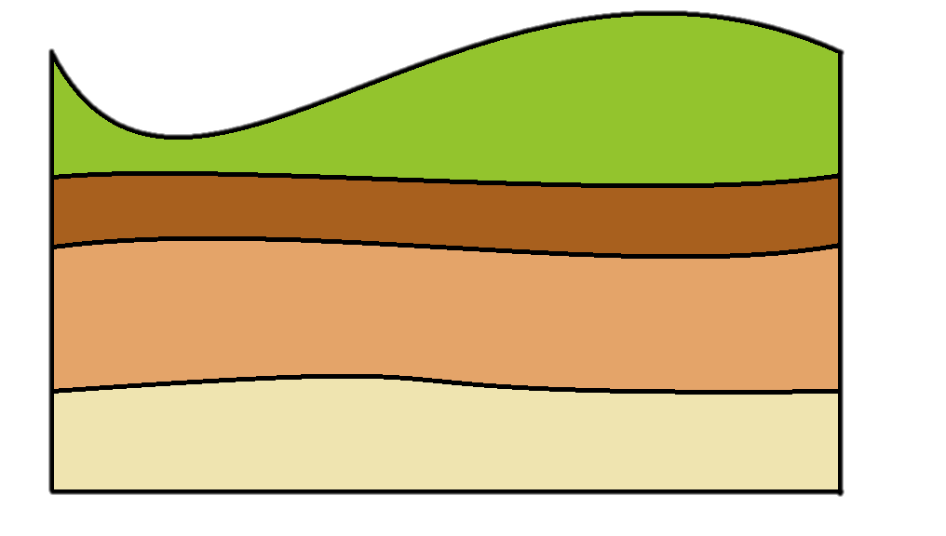
What order?
4
3
2
1
Notes:
Some time later, the green layer experienced some erosion, creating this dip.

Slide 12
What order?
4
3
2
1
Notes:
And at some point, an intrusion of magma came up through cracks in all four layers of rock.

Slide 13
What order?
?
4
3
?
2
1
Notes:
What we can’t be sure of, just by looking at this diagram, is which one of those happened first.

Slide 14


1
2
3
1
2
3
Notes:
Did the erosion happen first / and then the intrusion / or / did the intrusion happen before the erosion?

Slide 15
youngest
oldest
Notes:
Unlike our diagram, real rocks would probably contain other clues that would help geologists figure out which happened first. If we assume the erosion happened first, / that would make the magma intrusion the youngest or most recent of all the features in this formation.

Slide 16
Notes:
Let’s try another one. Here we see several layers, two different sections of a magma intrusion, and an earthquake fault. Can you describe the events that would have created this rock formation? Which do you think happened first—the earthquake or the magma intrusion? You may want to pause the video while you think about it.

Slide 17

Notes:
Here’s the order of events that would have created this formation: the bottom sedimentary layer was deposited…

Slide 18

Notes:
Then the second layer was deposited on top.

Slide 19
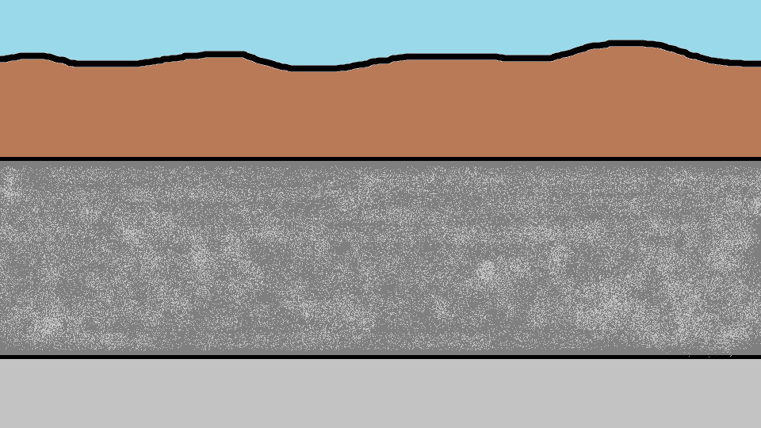
Notes:
And the third layer was deposited on top of that

Slide 20
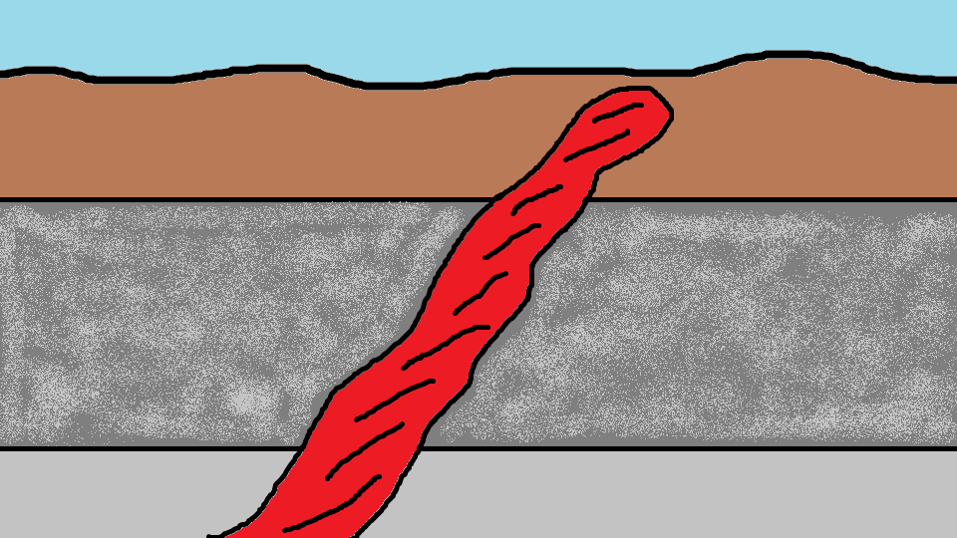
Notes:
Then magma pushed its way up through cracks in all three layers of rock

Slide 21
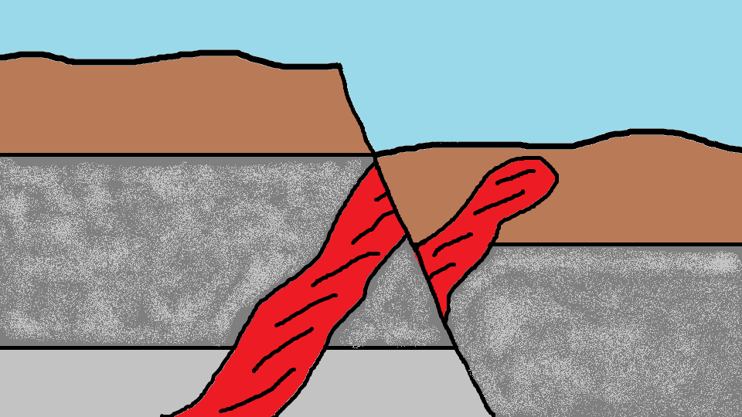
Notes:
Next, an earthquake happened, creating a fault line through all the layers, and through the magma intrusion as well, causing everything to the right of the fault to drop.

Slide 22
Notes:
Eventually the empty space created by the drop began to be filled in with new sediment.

Slide 23

Relative Age
  1. Original horizontality
  2. Superposition
  3. Cross-cutting relationships
History
Notes:
By applying these principles to the clues found in the rocks, we can figure out a lot about the history of specific rock formations.

Slide 24
The Geologic Column
Discovery and Contents of the Paleozoic
Notes:
In the next presentation, we will learn about the discovery and contents of the Paleozoic layers

Slide 25
Recorded at
Chattanooga Public RadioSM
Classical 90.5 WSMC

Slide 26
Original Graphics by
Thomas Bartlett

Slide 27
Images By
Images may appear on more than one slide. Citation is given on the first slide where each image appears.
[1a] Zion National Park 489588635, kaiborder, Thinkstock, Thinkstock Image Subscription Agreement
[1b] Folded rocks 24286621 Matauw, Getty Images (US), Inc. Subscription Agreement
[1c] Blue Mesa Petrified Forest National Park 479232619, estivillml, Thinkstock, Thinkstock Image Subscription Agreement
[1d] Bryce Canyon National Park, Keith Snyder
[1e] Folded rocks, Raul Esperante, used with permission
[1f] Grand Canyon, taken by Ed Chatelain, used with permission
[2] Geological fault in strata of volcanic ash 145055059, Morley Read, Thinkstock, Thinkstock Image Subscription Agreement
[4a] Rock formation A, Thomas Bartlett
[4b] Rock formation B, Thomas Bartlett

Slide 28
Special Thanks
Foundation for Adventist Education

Slide 29

© Origins Curriculum Resources 2015

Slide 30

© Southern Adventist University 2015

Slide 31

© Seventh-day Adventist North American Division 2015

Slide 32

© General Conference of Seventh-day Adventists 2015

Slide 33

© SCORE Southern Center for Origins Research & Education 2015

