Slide 1
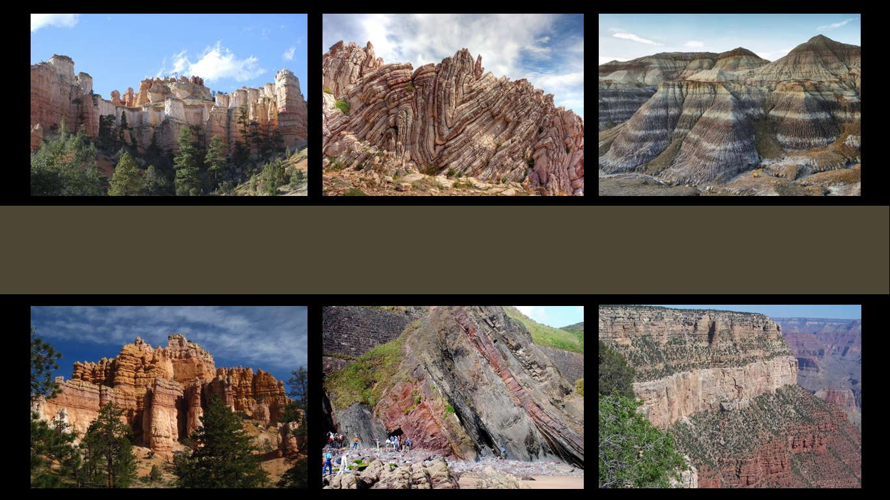
The Geologic Column
Discovery and Content of the Mesozoic
Notes:
The Geologic Column—the Discovery and Content of the Mesozoic

Slide 2

Cenozoic
Mesozoic
Mesozoic
Phanerozoic
Paleozoic
Precambrian
Notes:
In this presentation we will explore the Mesozoic erathem--learning how its layers were first discovered and what kinds of fossils are found in them.

Slide 3
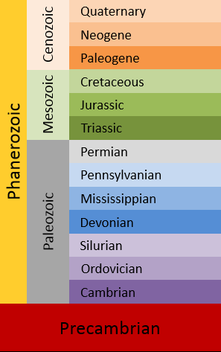


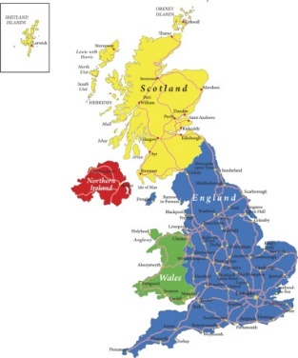
Carboniferous
Notes:
In the same way that most of the various systems of the Paleozoic erathem are named after places where the fossils were first studied..

Slide 4
Notes:
The Mesozoic systems got their names in similar ways.
And just like the Paleozoic layers were studied and named by people who believed in the Bible, the Mesozoic layers were too.

Slide 5
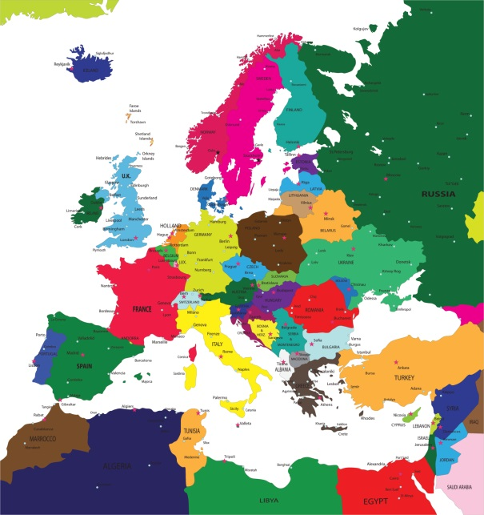

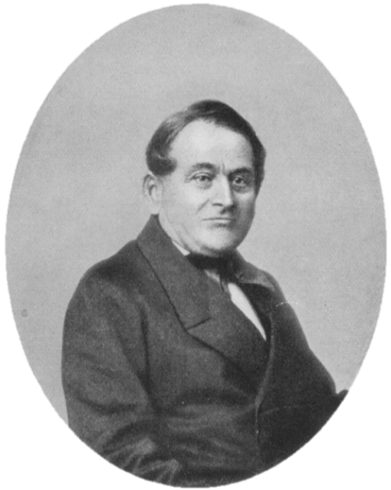
Friedrich
von Alberti
1834
Tri = 3
Black Shales
Chalk
Red Beds
Notes:
The Triassic was named in 1834 by Friedrich Von Alberti because of the three distinct rock layers that are found throughout Germany and northwest Europe. / The three layers included red beds, / capped by chalk, / followed by black shales.
(Alberti picture is from wiki; licensed for reuse)
(Europe map is probably thinkstock; Germany is iStock—17772671 teekid)

Slide 6
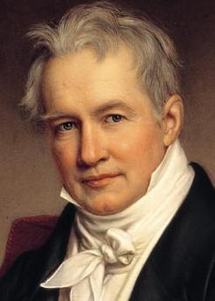


“Jurakalk”
1795
Swiss Jura Mountains
Alexander
von Humbolt
Notes:
The term “Jurassic” is directly linked to the Swiss Jura Mountains. /Alexander von Humbolt recognized the limestone dominated rocks of the Swiss Jura Mountains as a separate formation and named it “Jurakalk” in 1795.

Slide 7

Cretaceous is Latin for “chalky”
Western Europe
Notes:
Cretaceous is Latin for “chalky” / and describes layers of chalky rocks in western Europe.

Slide 8
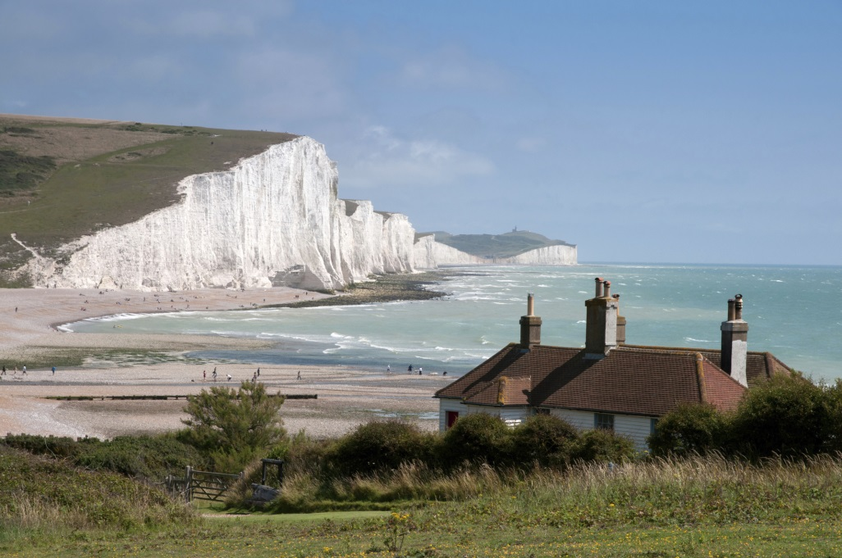
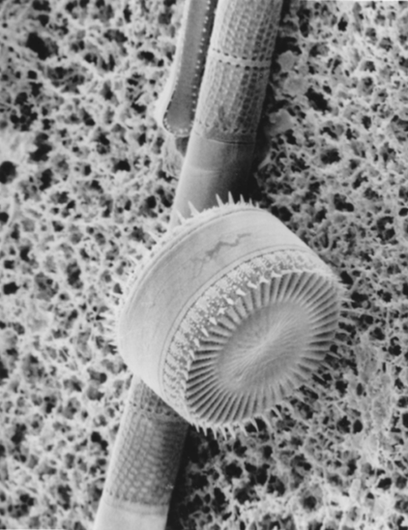
White Cliffs of Dover
Notes:
The famous White Cliffs of Dover, are typical of this rock formation. /The chalk itself is formed from the calcium carbonate deposited by the shells of countless tiny marine organisms like plankton

Slide 9
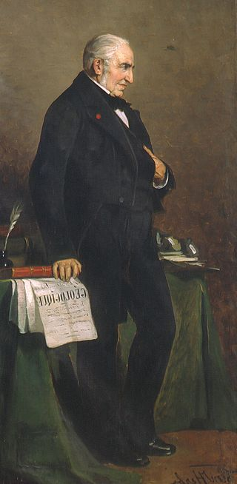


Terrain Cretace
Jean d’Omalius
de’Halloy
1822
Notes:
In 1822 a Belgian geologist named the chalky rock layers Terrain Cretace. / This system eventually came to be called the Cretaceous.
(picture of Halloy from wiki, licensed for reuse)

Slide 10
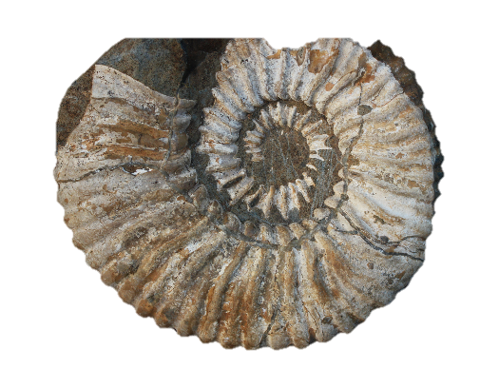
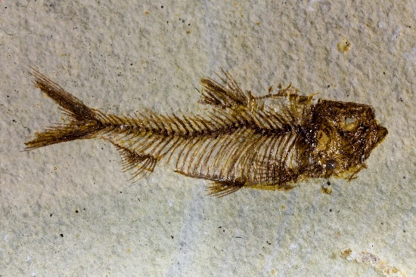
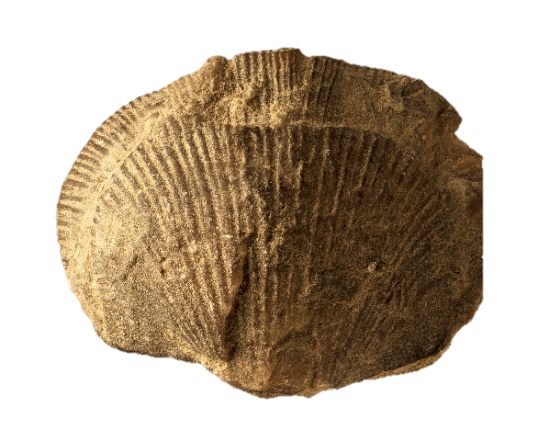
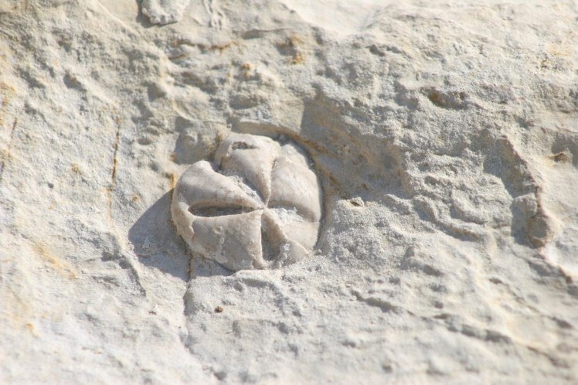
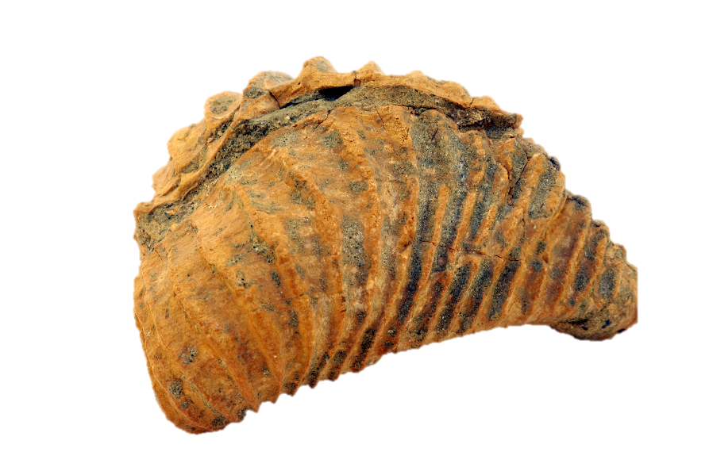
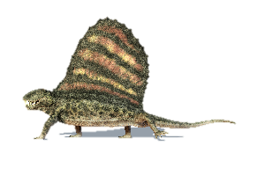
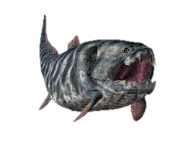
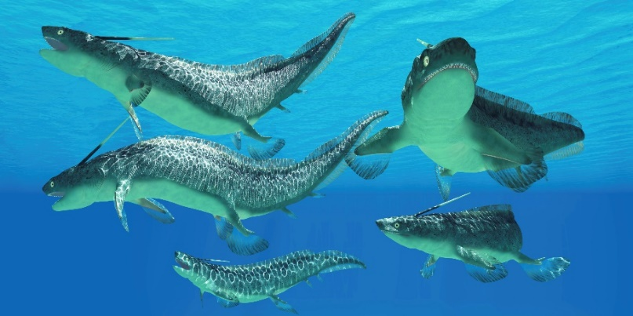
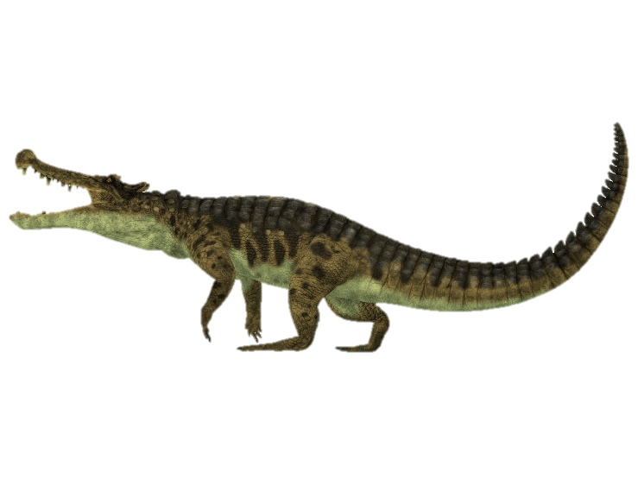
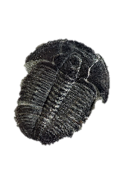
Notes:
Just like there are communities of slightly different creatures in the Paleozoic erathem, / the Mesozoic erathem contains changing communities of creatures as well. Similar kinds of marine creatures as those found in lower layers continue to appear in the Mesozoic—/ like shells, / fish, / and sea urchins.
(Left to right: fish from istock; clam from istock; sea urchins from istock; ammonite either istock or thinkstock; Pleurotrigonia from istock)
In addition to different kinds of insects—like flies, mosquitos, wasps, and bees—/ there were crocodiles, lizards, / sharks, birds, and small, rodent-sized mammals.
(Kaprosuchus from istock (crocodile); Xenocanthus from iStock (shark)

Slide 11
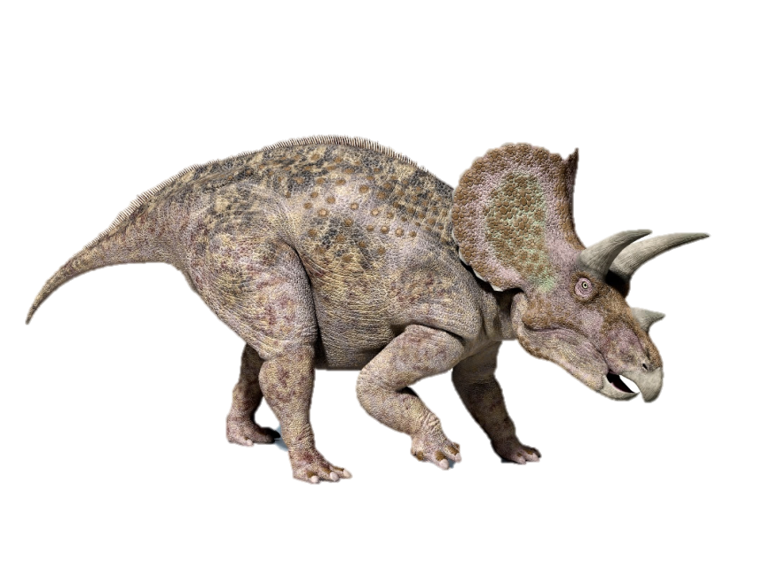

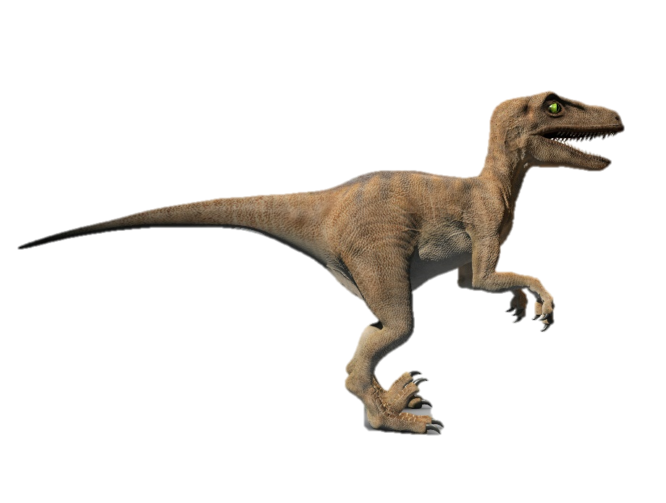
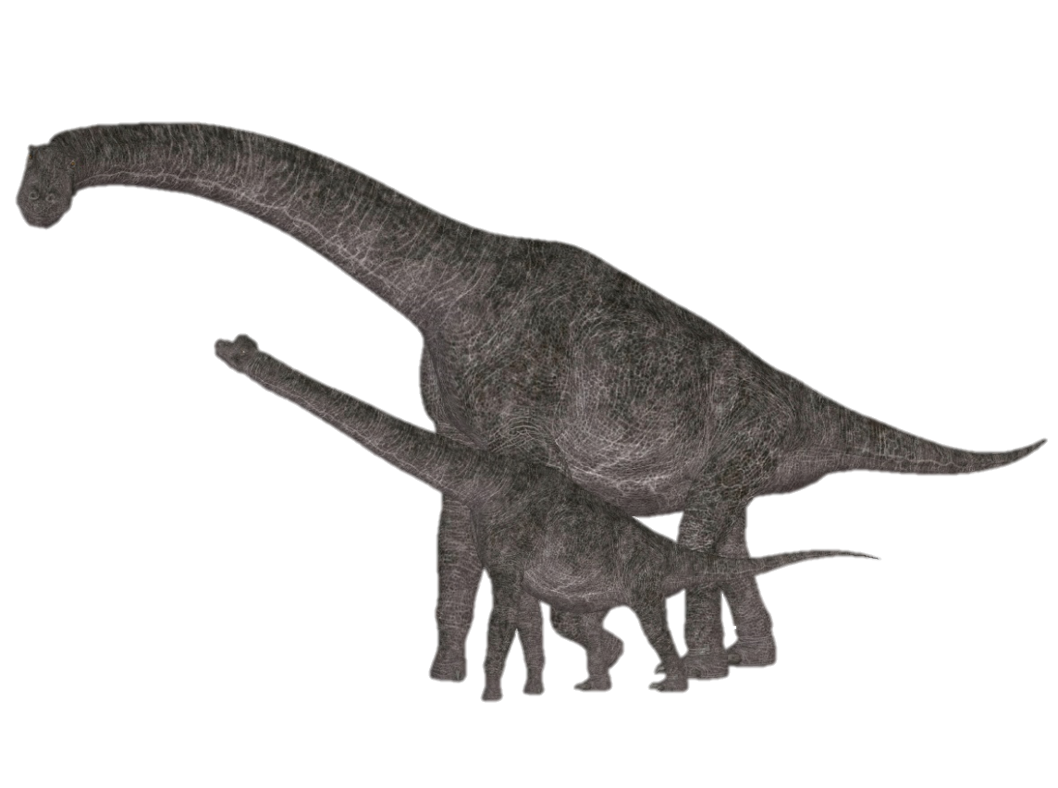
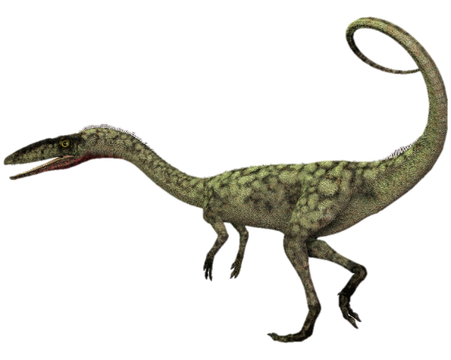
Notes:
The most well-known fossils in the Mesozoic layers are dinosaurs. And some other creatures that are often mistakenly identified as dinosaurs
(All dinosaurs from iStock: top left Triceratops; top right Tyrannosaurus; middle left Velociraptor; lower left Coelophysis; lower right Sauropods)

Slide 12
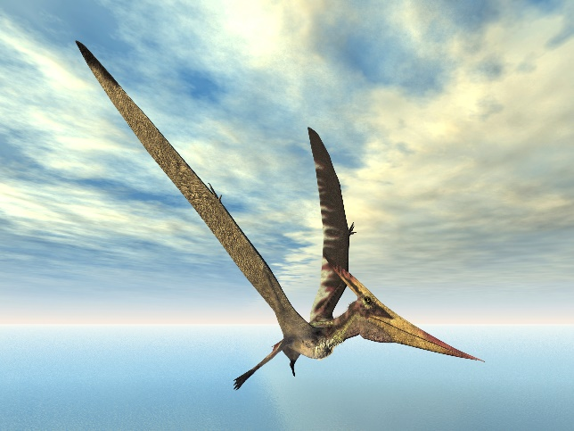
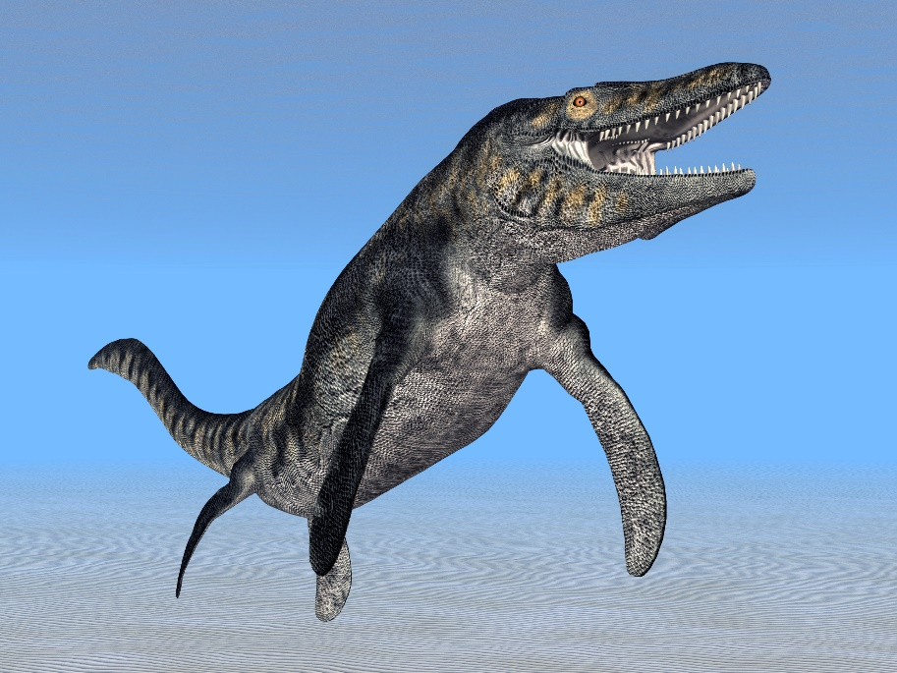
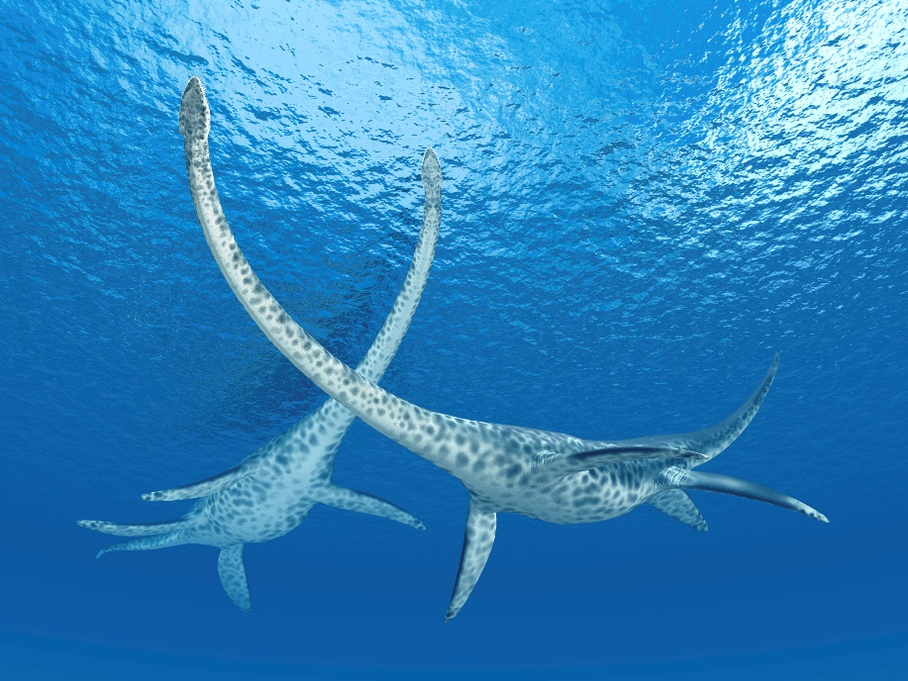
Notes:
—like the plesiosaur, mosasaur, and pterosaur
(From iStock: top to bottom: pterosaur, mosasaur, plesiosaur)

Slide 13
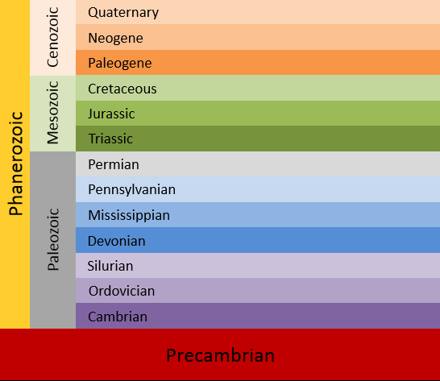
Notes:
The Mesozoic rock layers themselves…

Slide 14

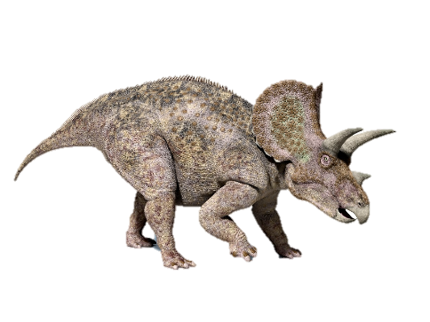
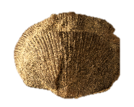
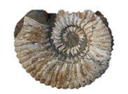
Notes:
…and the fossils found in them provide us with observable data.

Slide 15
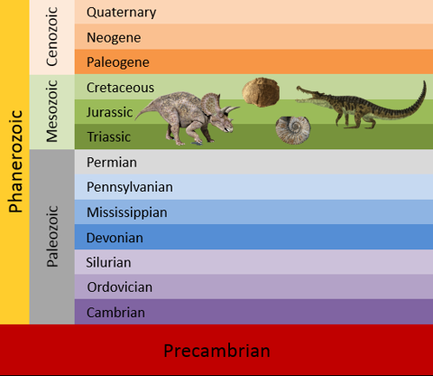
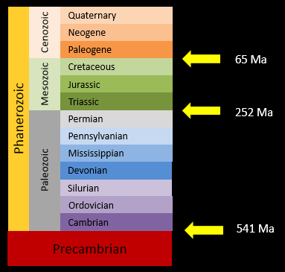
Data
Interpretation
Notes:
The idea that these layers were deposited during millions of years of evolution is an interpretation of the data that conflicts with what the Bible teaches as well as with certain scientific data.

Slide 16
The Geologic Column
Discovery and Contents of the Cenozoic
Notes:
We will explore this further in a later presentation, but first we’ll explore the discovery and contents of the Cenozoic.

Slide 17
Recorded at
Chattanooga Public RadioSM
Classical 90.5 WSMC

Slide 18
Images By
Images may appear on more than one slide. Citation is given on the first slide where each image appears.
[1a] Zion National Park 489588635, kaiborder, Thinkstock, Thinkstock Image Subscription Agreement
[1b] Folded rocks 24286621 Matauw, Getty Images (US), Inc. Subscription Agreement
[1c] Blue Mesa Petrified Forest National Park 479232619, estivillml, Thinkstock, Thinkstock Image Subscription Agreement
[1d] Bryce Canyon National Park, Keith Snyder
[1e] Folded rocks, Raul Esperante, used with permission
[1f] Grand Canyon, taken by Ed Chatelain, used with permission
[3a] World Map 164786370, bogdanserban, Thinkstock, Thinkstock Image Subscription Agreement
[3b] Black coal 476094129, multik7, Thinkstock, Thinkstock Image Subscription Agreement
[5a] Friedrich von Alberti, Friedrich Brandseph, http://commons.wikimedia.org/wiki/File:Friedrich_von_Alberti.jpg, public domain
[5b] Political map of Europe 164568338, Serban Bogdan, Thinkstock, Thinkstock Image Subscription Agreement
[5c] Germany 17772671, teekid, Getty Images (US), Inc. Subscription Agreement

Slide 19
Images By
[6b] Switzerland map 44336300, FabianCode, Getty Images (US), Inc. Subscription Agreement
[6c] Alexander von Humboldt, Karl Joseph Stieler, http://commons.wikimedia.org/wiki/File:Stieler,_Joseph_Karl_-_Alexander_von_Humboldt_-_1843.jpg, public domain
[7a] Chalk 490850561, VvoeVale, Thinkstock, Thinkstock Image Subscription Agreement
[8a] White cliffs of Southern England 123161350, krzych-34, Thinkstock, Thinkstock Image Subscription Agreement
[8b] Plankton, Keith Snyder
[9a] Jean d’Omaliusde’Halloy, unknown painter, http://commons.wikimedia.org/wiki/File:Omalius_d%27Halloy.jpg, public domain
[10a] Dimetrodon 178583890, Leonello, Thinkstock, Thinkstock Image Subscription Agreement
[10b] Dunkleosteus 180176590, MR 1850, Thinkstock, Thinkstock Image Subscription Agreement
[10c] Trilobite 35519138, demarfa, Thinkstock, Thinkstock Image Subscription Agreement
[10d] Fish 36471134, gsaielli, Getty Images (US), Inc. Subscription Agreement
[10e] Nautilus 2 101401226, Andrey Davidenko, Thinkstock, Thinkstock Image Subscription Agreement

Slide 20
Images By
[10f] Shell clam 19082589, ElementalImaging, Getty Images (US), Inc. Subscription Agreement
[10g] Sea urchin 42455968, shadow_hawk, Getty Images (US), Inc. Subscription Agreement
[10h] Pleurotrigonia 04250465, asterix0597, Getty Images (US), Inc. Subscription Agreement
[10i] Xenacanthus 35638390, CoreyFord, Getty Images (US), Inc. Subscription Agreement
[10j] Kaprosuchus 27628806, CoreyFord, Getty Images (US), Inc. Subscription Agreement
[11a] Triceratops 25024717, leonello, Getty Images (US), Inc. Subscription Agreement
[11b] Tyrannosaurus 23281408, LeventKonuk, Getty Images (US), Inc. Subscription Agreement
[11c] Velociraptor 36725022, 3dalia, Getty Images (US), Inc. Subscription Agreement
[11d] Coelophysis 41872176, CoreyFord, Getty Images (US), Inc. Subscription Agreement
[11e] Sauropods 42666354, XiaImages, Getty Images (US), Inc. Subscription Agreement
[12a] Pterosaur 27946920, MR1805, Getty Images (US), Inc. Subscription Agreement
[12b] Mosasaur 57164690, MR1805, Getty Images (US), Inc. Subscription Agreement
[12c] Plesiosaurus 42703490, MR1805, Getty Images (US), Inc. Subscription Agreement

Slide 21
Special Thanks
Foundation for Adventist Education

Slide 22

© Origins Curriculum Resources 2015

Slide 23

© Southern Adventist University 2015

Slide 24

© Seventh-day Adventist North American Division 2015

Slide 25

© General Conference of Seventh-day Adventists 2015

Slide 26

© SCORE Southern Center for Origins Research & Education 2015

