Slide 1
Critical Thinking: Teaching and Assessment
Daniel Fasko, Jr., Ph.D.

Slide 2
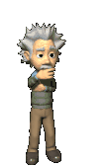
Overview
Definition of Critical Thinking
Critical Thinking Skills
Critical Thinking Dispositions
Instructional Strategies
Assessment Techniques
Review of Samples of Syllabi

Slide 3
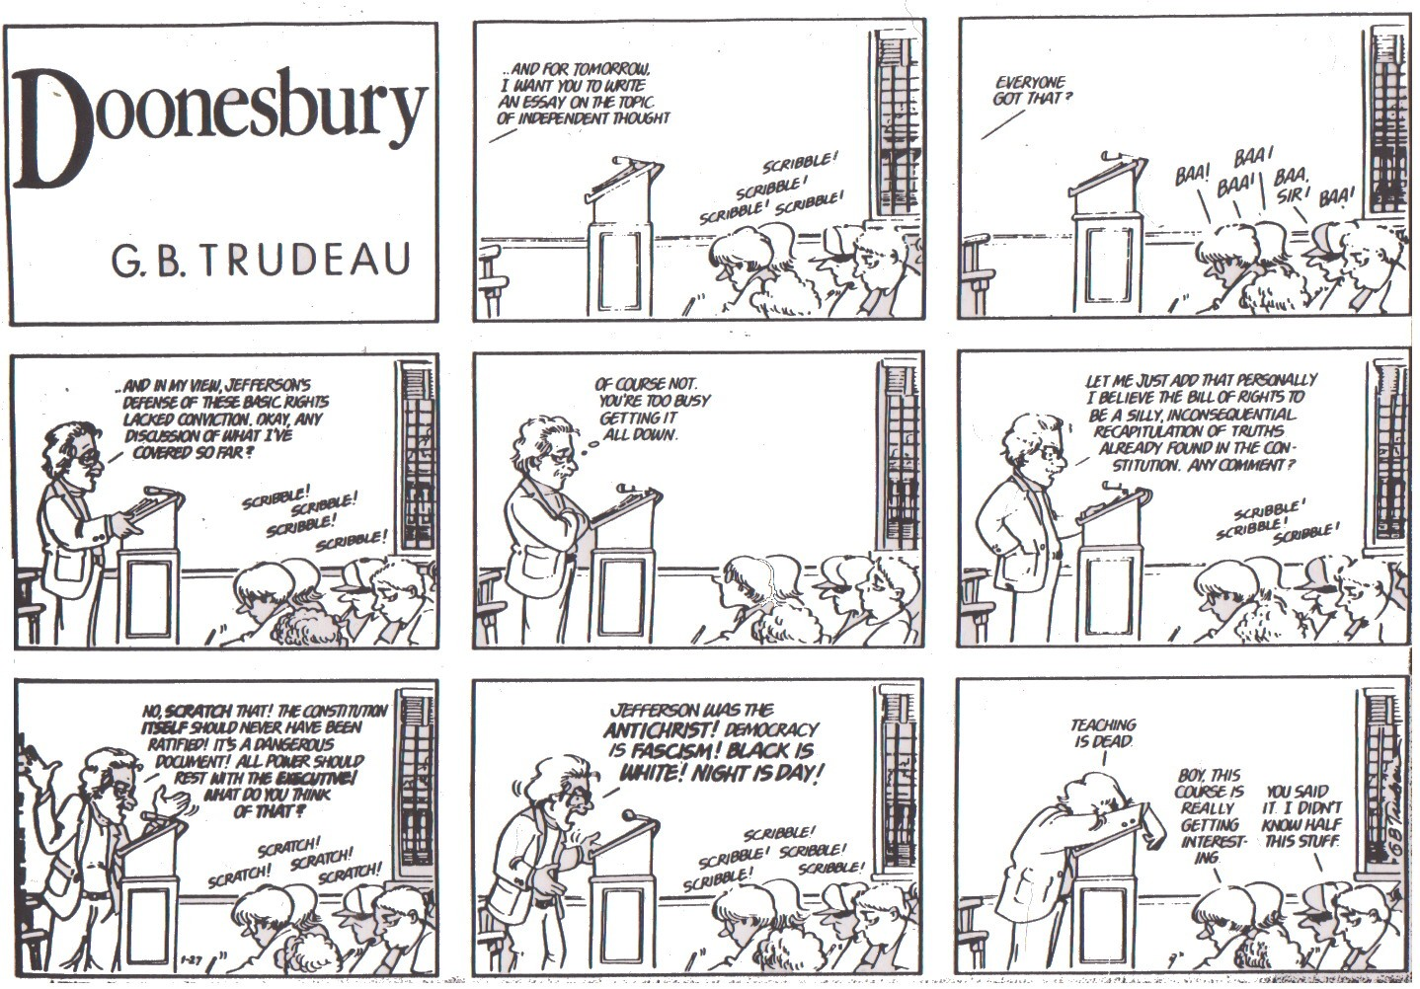

Slide 4
Definition of Critical Thinking
Refers to the skills of reflective intelligence used in making decisions about what to believe and what to do. (R. Ennis, 1996)
This is the definition I will use for this colloquia.
There are many other definitions too numerous to discuss today. (See Fasko, 2003.)

Slide 5

Critical Thinking Characteristics
Optimism
Confidence
Acceptance of Ambiguity & Uncertainty
Wide Range of Interests
Flexibility
Tolerance of Complexity
Curiosity
Persistence (but not stubborn persistence)
Independence

Slide 6
Critical Thinking Skills
Distinguishing Fact from Opinion
Determining the Reliability of Sources
Clarifying
Evaluating
Comparing and Contrasting
Sequencing
Noting Similarities & Differences

Slide 7

CT Skills (cont.)
Distinguishing Relevant from Irrelevant Facts
Making Predictions
Recognizing Contradictions
Exploring Implications
Recognizing Statements that are Provable
(Brookfield, 1987)
Self-Regulation

Slide 8
Critical Thinking Dispositions/Attitudes
Seeking a Clear Statement of the Thesis or Question
Seeking Reasons
Being Well Informed
Using and Noting Credible Sources
Considering the Total Situation
Remaining Relevant to the Main Point
Keeping in Mind the Original or Basic Concern
Curiosity
Self-Confidence

Slide 9
CT Dispositions/Attitudes (cont.)
Look for Alternatives
Being Open-minded*
Taking and/or Changing a Position when the Evidence is Sufficient to do so
Seeking Precision
Dealing in an Orderly Manner with the Parts of a Complex Whole
Being Sensitive to the Feelings, Levels of Knowledge, and Degree of Sophistication of Others

Slide 10
Instructional Strategies
Ensure that students process information.
Ask broad, open, and higher-order
(How & Why) questions. (Use Socratic Method.)
After asking questions wait at least 4-5 seconds before calling on students.
Probe student responses by asking for: clarification, elaboration, evidence.*
Use arguments.
“Fishbowling”

Slide 11
Instructional Strategies (cont.)
Have a clear purpose for and plan of activities (active learning) to accomplish it.
Model problem solving and thinking processes.
Encourage students to ask questions of their own.
Promote open discussion in groups.
Play “Devil’s advocate”.
Course topics should refer to practical situations that students can relate to
Use a consistent thinking skills vocabulary.

Slide 12
Critical Thinking Vocabulary
Infer
Conclude
Criteria
Point of view
Relevance
Issue
Contradiction
Credibility
Evidence*
Prioritize
Distinguish
Elaborate
Justify
Perspective
Interpret
Analyze
Synthesize
Explain
Compare
Summarize

Slide 13
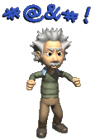
CT Vocabulary (cont.)
Hypothesize
Relate
Problem solve
Make decisions
Main idea
Predict
Derive
Classify
Evaluate

Slide 14
Guidelines for Students to Thinking Critically
Ask questions; be willing to wonder.
Define the problem.
Examine the evidence.*
Analyze biases and assumptions.
Avoid emotional reasoning.
Do not oversimplify.
Consider other interpretations.
Tolerate uncertainty. (C. Wade & C. Tavris, 1990).

Slide 15

Use of Reasoning
Involves inferring specific conclusions based on a general premise.
Errors typically are due to erroneous premises and faulty logic.
Involves inferring a general conclusion based on specific instances.
Errors are usually the result of overgeneralizing from biased, insufficient, or inappropriate observation.
(D.A. Levy, 1997).
Deductive
Inductive

Slide 16
Assisting Students with their Reasoning
Help them to differentiate between Deductive and Inductive reasoning, (use examples).
Help them recognize that different types of problems, tasks, and goals call for different reasoning strategies.
Remind them that when using deductive reasoning, that they should be sure that their initial assumptions are correct and that their logic is sound.
Remind them that when using inductive reasoning, that they should be careful not to hastily overgeneralize from an unrepresentative, inadequate, or otherwise flawed initial data base. (D.A. Levy, 1997)

Slide 17

Critical Thinking Assessment
Authentic assessment – ask students to apply skills and abilities as they would in real life situations
(Woolfolk, 2010).
Performance assessments –
Portfolios
Exhibitions
Commercial tests of Critical Thinking (see readings)
Non-Commercial tests of Critical Thinking (see readings)

Slide 18
Using a Rubric to Assess Critical Thinking
Rubric: A set of scoring guidelines for assessing student performance
An Assessment Method Should:
Link Assessment Results to Student Learning
Provide Students with Useful Feedback by Pointing to Ways they can Improve

Slide 19

Critical Thinking Web Sites
http://www.scientificmethod.com/index.html
http://austhink.com/critical/index.htm
www.wadsworth.com/colsuccess_d/special.../critical_thinking.rtf
www.indiana.edu/~reading/ieo/bibs/crit-elesec.html
http://trc.ucdavis.edu/wp-content/uploads/2008/12/activelearningtacucd.pdf
http://www.crlt.umich.edu/tstrategies/tsal.php
http://www.insightassessment.com/pdf_files/Exernalizing%20CT_%20Nsg%20Otlk%201996.PDF
www.criticalthinking.org

Slide 20
Identify Learning Outcomes for Critical Thinking
List words/phrases that describe the critical thinking outcomes you would like your students to achieve

Slide 21
Identify Types of Assessment for Critical Thinking
List types of Critical Thinking assessment for your subject matter
- Describe how each assessment will demonstrate your Learning Outcomes
- Learning Outcomes may include:
Verbal Information
Intellectual Skills (e.g., demonstration of a rule)
Cognitive Strategies (e.g., concept maps)
Attitudes
Psychomotor Skills (R. Gagne, 1985)

Slide 22
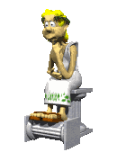
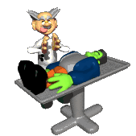
Is “It” Finished?
Looking-back
RAR – Revise As Required!

