Slide 1

Southern
Adventist
University
Faculty
Session
Part 1
28 August 2012
Starting Your College Journey
with a Sense of Purpose
Dr. Bill Millard
Terry T. Munday Endowed Chair of Life Calling
Professor of Leadership Studies
School of Life Calling and Integrative Learning
Senior Scholar
Life Calling Research Institute
INDIANA WESLEYAN UNIVERSITY

Slide 2
Southern
Adventist
University
Faculty
Session
Part 1
28 August 2012
Starting Your College Journey
with a Sense of Purpose
Dr. Bill Millard
is a galactic traveler who explores the life of the body, mind, soul and spirit across the universe of ideas, welcoming, inspiring, and equipping others to join the journey in search of big questions and worthy dreams.

Slide 3



Slide 4
EXPLORER’S
GUIDE
A sad thing happens to people on the road from childhood into their teen and college years and then life beyond. Somewhere along that road, they lose their ability to dream. When they were young they would imagine all sorts of things and pretend they were great people. Then somewhere or sometime they were told that such dreams were foolish and that they could never achieve anything like that. But that’s not the saddest part to this story. The saddest part is that they began to believe what they were told and gave up dreaming and turned their backs on the passions they once had.
They started following paths somebody else outlined for them
  and entered careers somebody else recommended.
In those careers they performed tasks somebody else gave them
  and were evaluated by somebody else’s opinion.
And at the end of their lives, they look back with some level of remorse because they
realize they gave up on their dreams and abandoned their passion and …
instead lived somebody else’s life.
In other words they ended up only impersonating themselves rather than living out their
own true lives.

Slide 5


People in almost
all cultures and
countries aspire
to have a sense of:
Meaning
Significance
Hope
Universal Aspiration

Slide 6
People in almost
all cultures and
countries aspire
to have a sense of:
Meaning
Significance
Hope
Universal Aspiration

Slide 7
People in almost
all cultures and
countries aspire
to have a sense of:
Meaning
Significance
Hope
Universal Aspiration

Slide 8
People in almost
all cultures and
countries aspire
to have a sense of:
Meaning
Significance
Hope
Universal Aspiration

Slide 9
People in almost
all cultures and
countries aspire
to have a sense of:
Meaning
Significance
Hope
Universal Aspiration

Slide 10
People in almost
all cultures and
countries aspire
to have a sense of:
Meaning
Significance
Hope
Universal Aspiration

Slide 11
People in almost
all cultures and
countries aspire
to have a sense of:
Meaning
Significance
Hope
Universal Aspiration

Slide 12
People in almost
all cultures and
countries aspire
to have a sense of:
Meaning
Significance
Hope
Universal Aspiration

Slide 13

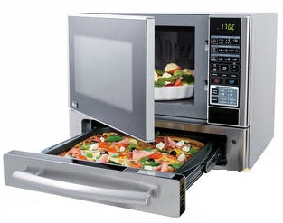
Quick Fix
Enhanced Narcissism
Universal Aspiration

Slide 14



Meaning
People in almost
all cultures and
countries aspire
to have a sense of:
Meaning
Significance
Hope
Hope
Significance
Universal Aspiration

Slide 15

Typical College/Career Development Model
Uncertainty & Discontent
Incentives:
- job security
- promotions
- higher pay
Self-centered Paradigm
Concerns
centered on:
- amount of salary
- job availability
- job growth
Experience
Job
Career
Interests often based on very limited life experience
Concerns
Interests
Pressure
Major
Sources of pressure:
- family, peers,
society, trends

Slide 16
3
Value
Dream
Priorities
IMPORTANT ISSUES
that can produce a better approach

Slide 17
3
Value
Dream
Priorities
IMPORTANT ISSUES
that can produce a better approach

Slide 18
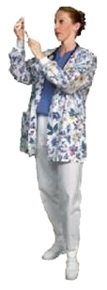
Paradigm shift in college education in the USA over the last five decades
Increased emphasis on the growth of pre-professional majors
Decreased emphasis on learning for the sake of learning

Slide 19
Colleges & Universities
$ Job Training Centers $

Slide 20
How well is this paradigm shift working?
Colleges & Universities
$ Job Training Centers $

Slide 21
How well is this paradigm shift working?
25 percent of college graduates end up working
in careers unrelated to their college major
one year after graduation.
40 percent of college graduates end up working
in careers unrelated to their college major
four years after graduation.
70 percent of college graduates end up working
in careers unrelated to their college major
ten years after graduation.
Source:
McCormick, A.C. and Horn, L.J. “A Descriptive Summary of 1992-1993 Bachelor’s Degree Recipients: 1 Year Later,” Statistical Analysis Report, August 1996. Washington D.C.
National Center for Education Statistics U.S. Department of Education, (1996). McCormick, A.C., Nuñez. A.M., Shah, V. and Choy, S.P. “Life After College: A Descriptive Summary of 1992-93 Bachelor’s Degree Recipients in 1997,” Statistical Analysis Report, July 1999. Washington, D.C. National Center for Education Statistics U.S. Department of Education, 1999.
NLS-72. “The National Longitudinal Study of the High School Class of 1972 (NLS-72), a U.S. Department of Education survey of high school seniors in 1972 with follow-ups in 1976 and 1986,” Washington, D.C. National Center for Education Statistics U.S. Department of Education, 1986.
Value of
Diminished
Liberal Learning

Slide 22
OBLIVION
OBLIVION
misdirection
confusion
misdirected survival
confused self-promotion
COLLEGE FACTORY
no sense of purpose
no sense of purpose

Slide 23
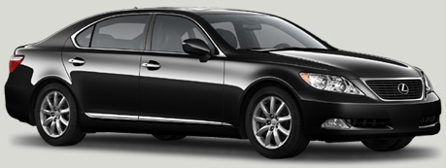
$93,065
Notes:
Bring this slide up when I say something like “dream with me for a minute”
Bring up the first animation when I say “let’s dream about a Lexus”
Bring up each car separately as I introduce them.
Then bring up each price as I call for them.
Finally bring up the 50% statement when I say something like “Would you buy any of these if you knew this…”

Slide 24

$103,232
$93,065
Notes:
Bring this slide up when I say something like “dream with me for a minute”
Bring up the first animation when I say “let’s dream about a Lexus”
Bring up each car separately as I introduce them.
Then bring up each price as I call for them.
Finally bring up the 50% statement when I say something like “Would you buy any of these if you knew this…”

Slide 25

$103,232
$93,065
$10,167
Notes:
Bring this slide up when I say something like “dream with me for a minute”
Bring up the first animation when I say “let’s dream about a Lexus”
Bring up each car separately as I introduce them.
Then bring up each price as I call for them.
Finally bring up the 50% statement when I say something like “Would you buy any of these if you knew this…”

Slide 26

40% chance it won’t work
in 4 years!
$103,232
$93,065
$10,167
Notes:
Bring this slide up when I say something like “dream with me for a minute”
Bring up the first animation when I say “let’s dream about a Lexus”
Bring up each car separately as I introduce them.
Then bring up each price as I call for them.
Finally bring up the 50% statement when I say something like “Would you buy any of these if you knew this…”

Slide 27

Christian University
The college experience needs to have
value added that is more than just
preparing for a job.

Slide 28
3
Value
Dream
Priorities
IMPORTANT ISSUES
that can produce a better approach

Slide 29

Students see college as a huge mountain to climb
Old self-centered paradigm too weak to motivate some

Slide 30
What drives a person to climb a mountain with all
of its perils?

Slide 31

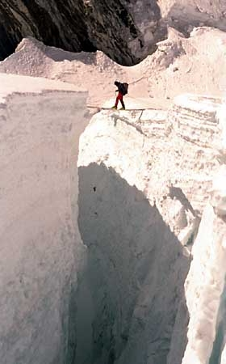


Slide 33


DREAM
must be greater than the
CHALLENGE

Slide 34
3
Value
Dream
Priorities
IMPORTANT ISSUES
that can produce a better approach

Slide 35
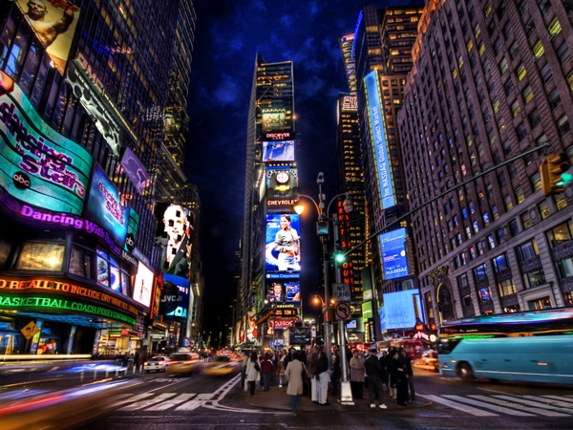
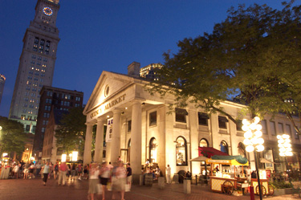

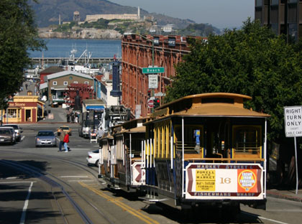
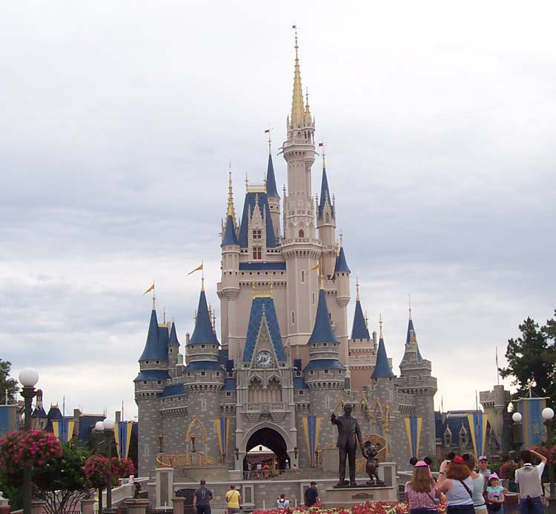
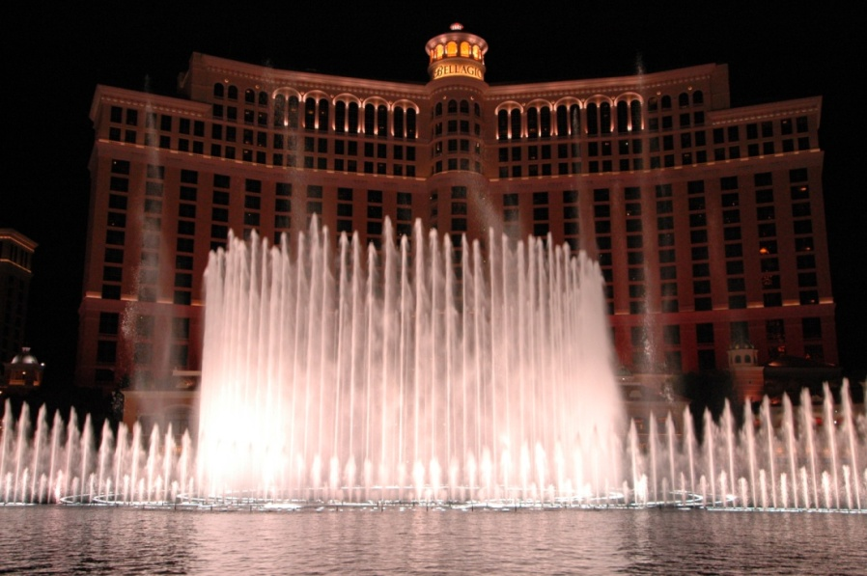

Vacation
Notes:
Bring this slide up when I say something like “Let’s consider the Family Vacation.”
The pictures will come up automatically.

Slide 36



Is Your First Important Question…
What kind of car should we drive to get there?
Nissan Leaf
Total Electric Sedan
Porsche Carrera
Ford C-Max
Pure Top-down Gas-Guzzling Sports Car Thrills
Hybrid SUV
Notes:
Bring this slide up when I say something like “dream with me for a minute”
Bring up the first animation when I say “let’s dream about a Lexus”
Bring up each car separately as I introduce them.
Then bring up each price as I call for them.
Finally bring up the 50% statement when I say something like “Would you buy any of these if you knew this…”

Slide 37

How do you know how to get there...
if you don't know where you're going?
Vacation
Notes:
Bring this slide up when I say something like “Let’s consider the Family Vacation.”
The pictures will come up automatically.

Slide 38
Typical College/Career Development Model
Uncertainty & Discontent
Incentives:
- job security
- promotions
- higher pay
self-centered
Concerns
centered on:
- amount of salary
- job availability
- job growth
Job
Career
Interests often based on very limited life experience
Major
Sources of pressure:
- family, peers,
society, trends

Slide 39

Meaning…
Significance…
Hope
in Career and Life
Christ-Centered
Aspirational Model
Stewardship Paradigm
Life Calling
Major & Career
Discovery Tools

Slide 40
Purpose

Slide 41

Kingdom of Heaven
Kingdom of This World
Purpose
Biblical-spiritual
Pop-culture

Slide 42
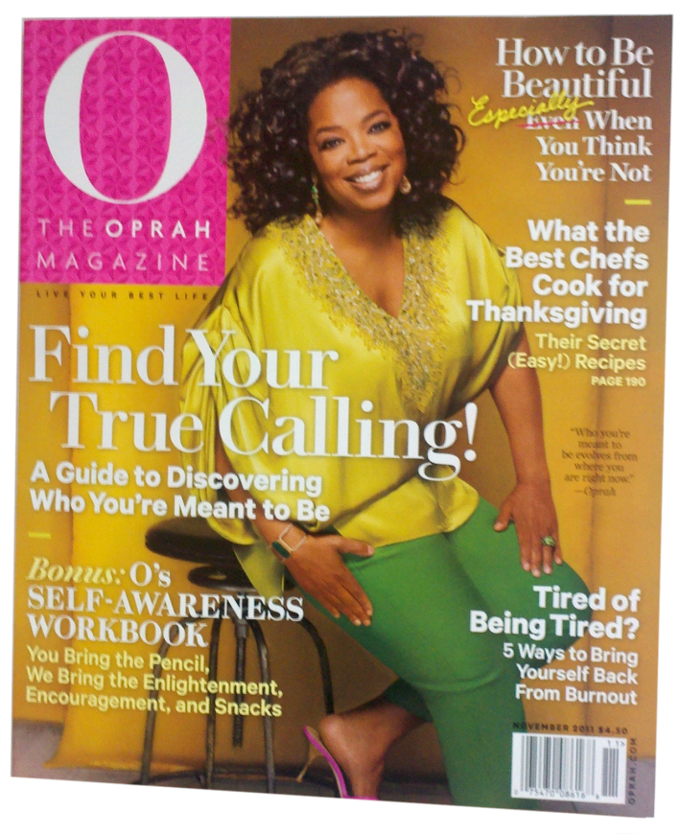

Kingdom of Heaven
Kingdom of This World
Purpose
Biblical-spiritual
Pop-culture

Slide 43
Kingdom of Heaven
Kingdom of This World
Lose their life for Jesus and find it
Deny themselves, take up their cross, and follow Jesus
Save their life and in the end lose it
Gain the whole world, yet forfeit their soul
Purpose
Biblical-spiritual
Pop-culture

Slide 44
Kingdom of Heaven
Lose their life for Jesus and find it
Deny themselves, take up their cross, and follow Jesus
Purpose
Life Calling

Slide 45


Slide 46
Educational Path
8
Organizational Leadership
7
Geology
G
R
A
D
U
A
T
E
6
Secondary Education
5
Dentistry
4
Public Health
3
Seminary
2
History/Pre-Law
C
O
L
L
E
G
E
1
Theology

Slide 47
Life Calling
Vocation
a higher purpose that draws and guides in all aspects of life
a particular field of work or profession
Career
Job
a person's general progression of work through life
a post of employment

Slide 48
Life Calling
Vocation
More than…
Career
Job

Slide 49
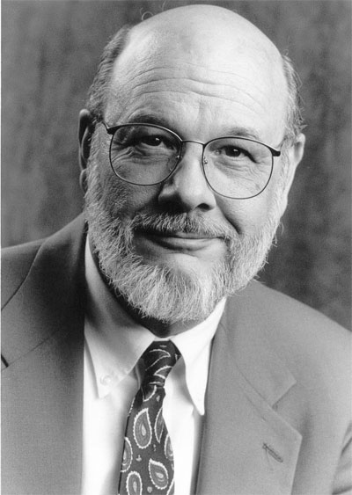

James fowler
“Vocation…is larger than one’s job or occupation, deeper than a profession or life’s work. It means finding a purpose for one’s life that is part of the purposes of God.
─ Becoming Adult, Becoming Christian (2000)

Slide 50
James fowler
“In what pursuits, attainments,
or investments will human beings find deepest fulfillment? In what modes of living, of spending, and being spent will humans realize their full potential and contributions?”
─ Becoming Adult, Becoming Christian (2000)

Slide 51
What is Life Calling?
finding a meaning, design and plan for your life that are part of
God’s higher purposes
… and then living your life consistent with that purpose.

Slide 52
What isn’t Life Calling?

Not a forecast about what will happen in your life

Slide 53
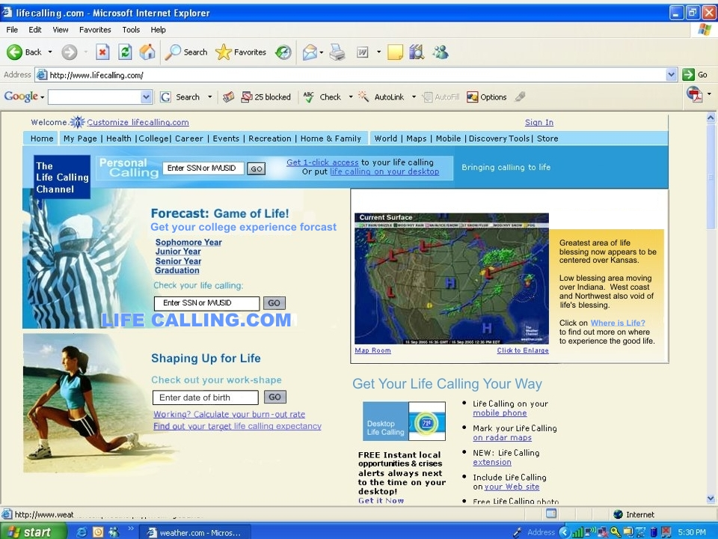
LIFE CALLING CENTER
August 28, 2012
Life Calling is not the same as logging onto LifeCalling.com for a quick prediction.

Slide 54
What isn’t Life Calling?

Not a forecast about what will happen in your life

Not a prophecy of what you should become in life

Slide 55
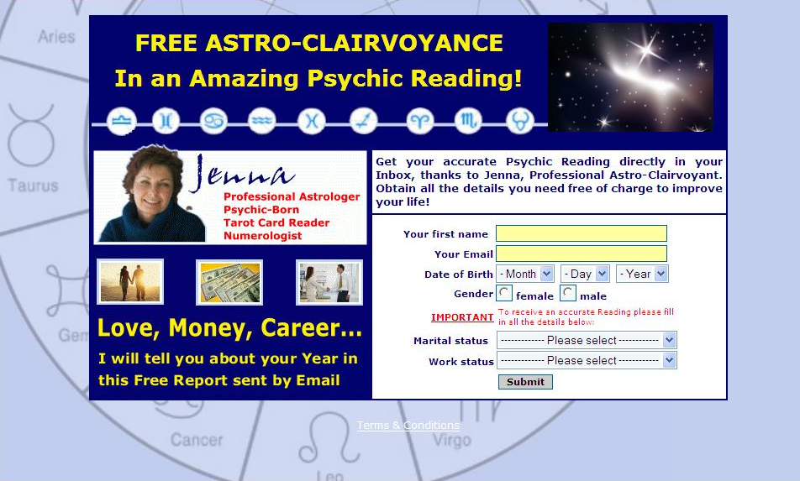
An Amazing Psychic Calling!
Get your accurate Psychic Calling directly in your Inbox, thanks to Jenna, Professional Astro-Clairvoyant. Obtain all the details you need free of charge to know your life calling!
I will tell you about your Call in
This Free Report sent by Email
Life Calling is not the same as gazing into a crystal
ball or reading horoscopes.

Slide 56
What isn’t Life Calling?

Not a forecast about what will happen in your life

Not a prophecy of what you should become in life

Not a determination of the perfect match for your life

Slide 57

eHarmony
®
Love
Begins Here
™
Get Matched for Free!
First Name:
I’m a:
Student

Seeking
Career

Zip Code:
Country:
United States

How did you
hear about us?
Please Select…

Find My Matches
It is not the Life Calling
version of eHarmony.

Slide 58

eHarmony
®
Life
Begins Here
™
Get Matched for Free!
First Name:
I’m a:
Student

Seeking
Career

Zip Code:
Country:
United States

How did you
hear about us?
Please Select…

Find My Matches
It is not the Life Calling
version of eHarmony.

Slide 59
What isn’t Life Calling?

Not a forecast about what will happen in your life

Not a prophecy of what you should become in life

Not a determination of the perfect match for your life

Not a map of the one thing you should do in your life

Slide 60

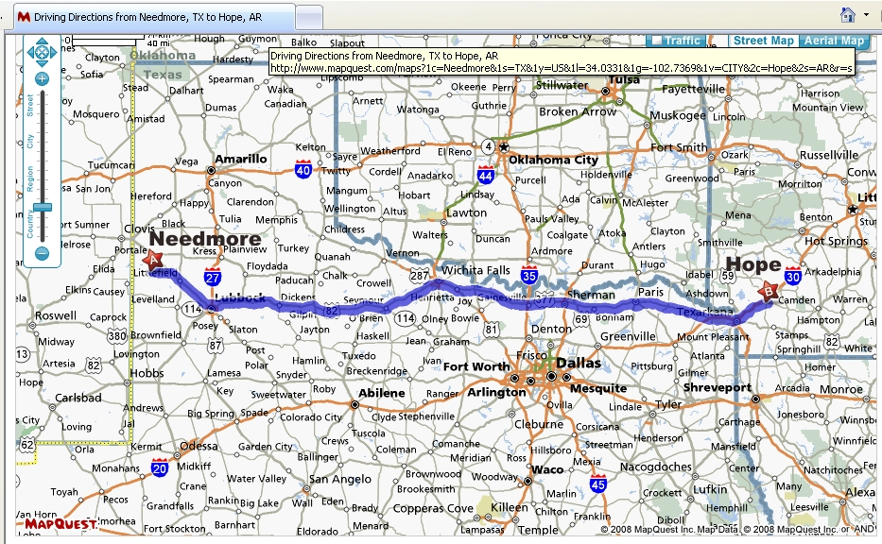

Slide 61

The will of God is not a system of rules established from the outset. It is something new and different in each different situation in life. And for this reason a man must forever reexamine what the will of God may be. The will of God may lie deeply concealed beneath a great number of possibilities.
Dietrich Bonhoeffer
Life Calling is not making sure you are on the one right track.

Slide 62
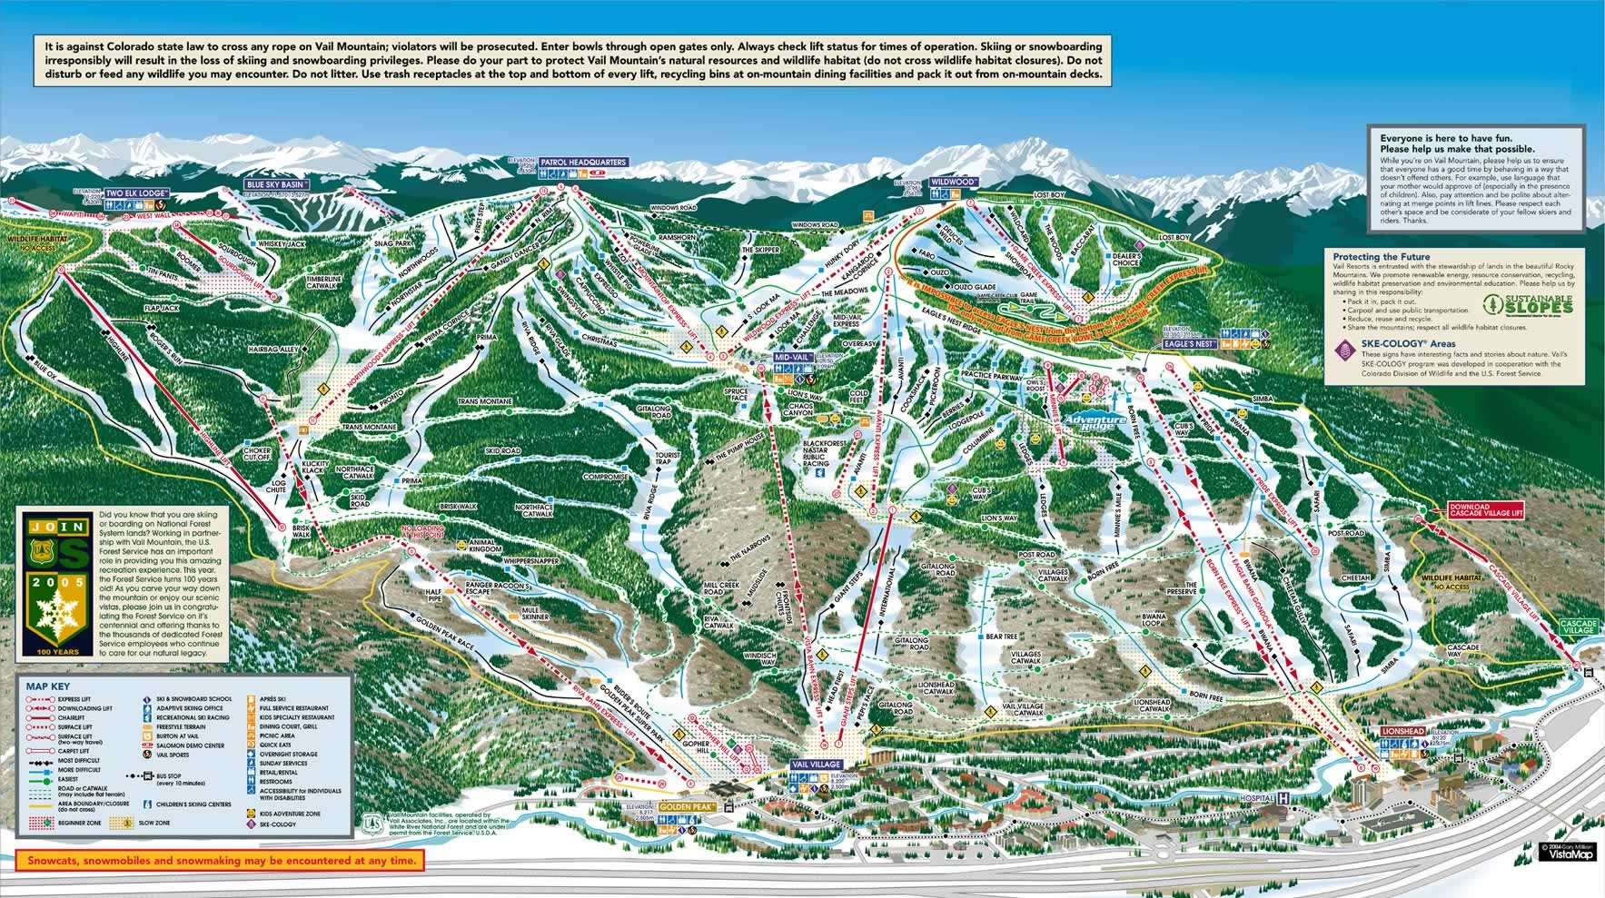

Slide 63
What is Life Calling?
finding a meaning, design and plan for your life that are part of
God’s higher purposes
… and then living your life consistent with that purpose.
Less about
right decisions
More about
right living
Less about
right decisions

Slide 64
What is Life Calling?

Slide 65
What is Life Calling?

Slide 66
LIFE Calling MODEL
Life Calling is easier to understand when it is looked at through the
Life Calling Model
Why?
A model provides a visual representation of an idea that:
accounts for and describes its parts and properties (analysis)
explains how these parts and properties work together (synthesis)

Slide 67
LIFE Calling MODEL
Life Calling is easier to understand when it is looked at through the
Life Calling Model
Concept

Slide 68
LIFE Calling MODEL
The model shows that discovery of a Life Calling emerges when
3 important components are recognized and interact with each other.
(analysis) (synthesis)
Life Calling Model

Slide 69
d
a
t
i
o
n
a
l
V
a
u
n
l
u
F
o
e
s
Component 1: There exists at the core of our lives a set of foundational values that form the way we think about reality, ourselves, and others.
Life Calling Model
B

Slide 70
d
a
t
i
o
n
a
l
V
a
u
n
l
u
F
o
e
s
g
n
s
i
D
e
n
i
q
u
e
U
Component 2: Our Life Calling appears differently in each of us because our foundational values are conveyed through our unique design that gives us individuality as a person
Life Calling Model
B

Slide 71
d
a
t
i
o
n
a
l
V
a
u
n
l
u
F
o
e
s
P
P
e
r
e
n
s
r
g
o
s
i
n
s
o
a
e
n
l
D
a
L
l
e
e
a
M
d
p
u
i
e
i
q
r
h
s
s
s
n
i
i
o
n
U
Component 3: Our universal foundational values and our individual unique design set the stage that enables us to discover how to implement our Life Calling through personal leadership.
Life Calling Model
B

Slide 72
d
a
t
i
o
n
a
l
V
a
u
n
l
u
F
o
e
s
P
e
r
n
s
g
o
i
n
s
a
e
l
L
D
e
e
a
u
d
e
p
r
i
q
s
h
U
n
i
Life Calling Model

Slide 73
d
a
t
i
o
n
a
l
V
a
u
n
l
u
F
o
e
s
P
e
r
n
s
g
o
i
n
s
a
e
l
L
D
e
e
a
u
d
e
p
r
i
q
s
h
U
n
i
The 3 Components are not independent of each other.
They draw from and reinforce each other.
Life Calling Model

Slide 74
Clarity = white zone where all colors blend
d
a
t
i
o
n
a
l
V
a
u
n
l
u
F
o
e
s
Confidence in an
for my life
Higher
Purpose
Life
Calling
P
e
r
n
s
g
o
i
n
s
a
e
l
L
D
e
e
a
u
d
e
p
r
i
q
s
h
U
n
i
Discovery of a Life Calling emerges when
all 3 Components are interacting with each other.
Life Calling Model

Slide 75
d
a
t
i
o
n
a
l
V
a
u
n
l
u
F
o
e
s
P
e
r
n
s
o
g
n
s
i
a
l
D
e
L
e
a
u
e
d
e
r
s
h
i
p
U
n
i
q
Component 1: There exists at the core of our lives a set of foundational values that form the way we think about…
reality, ourselves, and others.
Life Calling Model

Slide 76
d
a
t
i
o
n
a
l
V
a
u
n
l
u
F
o
e
s
P
Foundational = the basis or groundwork for all other components and elements necessary for an understanding
Values = those things considered worthwhile, excellent, useful, and important in creating a groundwork for an understanding of the world and universe
e
r
n
s
o
g
n
s
i
a
l
D
e
L
e
a
u
e
d
e
r
s
h
i
p
U
n
i
q
Life Calling Model

Slide 77
d
a
t
i
o
n
a
l
V
a
u
n
l
u
F
o
e
s
character
faith
service
P
e
r
n
s
o
g
n
s
i
a
l
D
e
L
e
a
u
e
d
e
r
s
h
i
p
U
n
i
q
Our foundational values are formed from 3 key elements that
emerge out of 3 Universal Calls from God.
Life Calling Model

Slide 78

d
a
t
i
o
n
a
l
V
a
u
n
l
u
F
o
e
s
character
faith
service
MODEL
P
e
r
n
s
o
g
n
s
i
a
l
D
e
L
e
a
u
e
d
e
r
s
h
i
p
U
n
i
q
2
Why?
Life Calling Model

Slide 79
d
a
t
i
o
n
a
l
V
a
u
n
l
u
F
o
e
s
character
faith
service
Matthew 28:18-20
Matthew 25:14-30
motivation
stewardship
Life
Calling
MODEL
from God
P
e
r
n
s
g
o
i
n
s
a
e
l
L
D
e
e
a
u
d
e
p
r
i
q
2
s
h
U
n
i
Why?
Life Calling Model

Slide 80
d
a
t
i
o
n
a
l
V
a
u
n
l
u
o
e
narcissism
F
character
s
faith
service
Life
Calling
P
e
r
n
s
g
o
i
n
s
a
e
l
L
D
e
e
a
u
d
e
p
r
i
q
s
h
U
n
i
Life Calling Model

Slide 81
d
a
t
i
o
n
a
l
V
a
u
n
l
u
F
o
e
s
character
faith
service
Faith = Our Life Premises ⇨our mindset about reality.
Is there an intelligent design and Designer to the universe?
Am I an intentional part of that design?
(noun faith)
Faith is also a verb describing the process of
our ongoing search for these answers.
P
e
r
n
s
o
g
n
s
i
a
l
D
e
L
e
a
u
e
d
e
r
s
h
i
p
U
n
i
q
FOUNDATIONAL VALUES
3 universal calls from God
Faith: The universal call to everyone to trust God as their Caller
Life Calling Model

Slide 82

In the beginning was the Word, and the Word was with God, and the Word was God. He was with God in the beginning. Through him all things were made; without him nothing was made that has been made.
John 1:1-3

Slide 83

Called
Calling
Caller

Slide 84

Become
your…
d
a
t
i
o
n
a
l
V
a
u
n
l
u
F
o
e
s
Worldview
Foundational = the basis or groundwork for all other components and elements necessary for an understanding
Values = those things considered worthwhile, excellent, useful, and important in creating a groundwork for an understanding of the world and universe
Life Calling Model

Slide 85

A worldview
is a set of presuppositions which we hold about the basic makeup of our world.
James Sire
The Universe Next Door

Slide 86
Naturalism
Worldview formed around the belief that nature contains all there is, and all basic truths are truths of nature
Supernaturalism
Worldview formed around the belief that there is an order of existence beyond the scientifically visible universe

Slide 87
Supernaturalist |  | Naturalist
\ God |  | God
Intentional creation | Origins➢ | Random chance
Deliberate design | Blueprint➢ | Accidental pattern
Unique purpose | Guidance➢ | Chaotic possibilities
Permanent place | Results➢ | Temporary niche
Life Calling | Choices➢ | Best guess

Slide 88


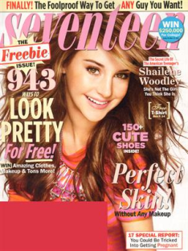
Supernaturalist |  | Naturalist
\ God |  | God
 | Beauty➢
 | Smart➢
 | Success➢
 | Fame➢
 | Fun➢
 | Glory➢
 | Hope➢

Slide 89
d
a
t
i
o
n
a
l
V
a
u
n
l
u
F
o
e
s
character
faith
service
Faith = Our Life Premises ⇨our mindset about reality.
Is there an intelligent design and Designer to the universe?
Am I an intentional part of that design?
(noun faith)
Faith is also a verb describing the process of
our ongoing search for these answers.
P
e
r
n
s
o
g
n
s
i
a
l
D
e
L
e
a
u
e
d
e
r
s
h
i
p
U
n
i
q
Faith is not simply a set of beliefs that religious people have.
It is something that all human beings do.
- Sharon Daloz Parks
Life Calling Model

Slide 90
HEARING
Consequently, faith comes from hearing the message, and the message is heard through the word about Christ.
Roman 10:17
PRACTICING
REFLECTING
LEARNING
Building Your Faith

Slide 91
FAITH
Everybody has it…
It’s just a matter of who or what it is in.

Slide 92
d
a
t
i
o
n
a
l
V
a
u
n
l
u
F
o
e
s
character
faith
service
P
e
r
n
s
o
g
n
s
i
a
l
D
e
L
e
a
u
e
d
e
r
s
h
i
p
U
n
i
q
Answers about faith naturally lead to questions
about character.
Life Calling Model

Slide 93
d
a
t
i
o
n
a
l
V
a
u
n
l
u
F
o
e
s
character
faith
service
Character = Life Congruence ⇨ How we live out our faith.
Character starts with our capacity to determine how our faith should be applied to our life values, goals, and actions.
Character is fully realized when we actually live this out
in all aspects of our life.
P
e
r
n
s
o
g
n
s
i
a
l
D
e
L
e
a
u
e
d
e
r
s
h
i
p
U
n
i
q
FOUNDATIONAL VALUES
2nd of 3 universal calls from God
Character: The universal call to everyone to live holy lives
Life Calling Model

Slide 94
d
a
t
i
o
n
a
l
V
a
Denial
u
n
l
u
F
o
e
s
Isolation
character
faith
service
Character = Life Congruence ⇨ How we live out our faith.
Character starts with our capacity to determine how our faith should be applied to our life values, goals, and actions.
Character is fully realized when we actually live this out
in all aspects of our life.
P
e
r
n
s
o
g
n
s
i
a
l
D
e
L
e
a
u
e
d
e
r
s
h
i
p
U
n
i
q
FOUNDATIONAL VALUES
2nd of 3 universal calls from God
Character: The universal call to everyone to live holy lives
Life Calling Model

Slide 95

Faith
Life
An example of incongruent faith that is not consistent
Moral Silos

Slide 96

Faith
Moral Silos

Slide 97

Faith
Moral Silos

Slide 98
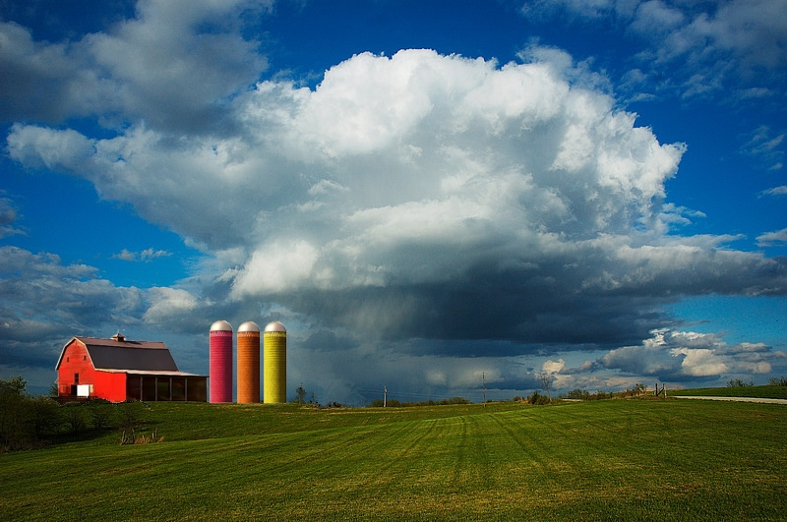
Faith
Moral Silos

Slide 99

Faith
Moral Silos

Slide 100

Faith
Moral Silos

Slide 101

Faith
Sex
School
Money
Religion
Work
Driving
Moral Silos

Slide 102

Faith
Sex
School
Money
Religion
Work
Driving
Moral Silos

Slide 103
Faith
Sex
School
Money
Religion
Work
Driving
Moral Silos

Slide 104

Faith
Sex
School
Money
Calling
Religion
Work
Driving
Moral Silos

Slide 105

Faith
Sex
School
Money
Calling
Religion
Work
Driving
Moral Silos

Slide 106
Faith
Sex
School
Money
Calling
Religion
Work
Driving
Moral Silos

Slide 107
d
a
t
i
o
n
a
l
V
a
PURPOSE
CONFUSION
Denial
u
n
l
u
F
o
e
s
Isolation
character
faith
service
Character = Life Congruence ⇨ How we live out our faith.
Character starts with our capacity to determine how our faith should be applied to our life values, goals, and actions.
Character is fully realized when we actually live this out
in all aspects of our life.
P
e
r
n
s
o
g
n
s
i
a
l
D
e
L
e
a
u
e
d
e
r
s
h
i
p
U
n
i
q
FOUNDATIONAL VALUES
2nd of 3 universal calls from God
Character: The universal call to everyone to live holy lives
Life Calling Model

Slide 108
d
a
t
i
o
n
a
l
V
a
u
n
l
u
F
o
e
s
character
faith
service
P
e
r
n
s
o
g
n
s
i
a
l
D
e
L
e
a
u
e
d
e
r
s
h
i
p
U
n
i
q
Issues of faith and character lead to the questions of how then will
we relate toward others in response to our faith and character?
Life Calling Model

Slide 109
d
a
t
i
o
n
a
l
V
a
u
n
l
u
F
o
e
s
character
faith
service
Service = Life Connection—my attitude about others.
Service starts with my capacity to respect others in a spirit of community.
Service is fully realized when I actually take actions of character that are carried out with a sense of concern and responsibility for others.
P
e
r
n
s
o
g
n
s
i
a
l
D
e
L
e
a
u
e
d
e
r
s
h
i
p
U
n
i
q
FOUNDATIONAL VALUES
3rd of 3 universal calls from God
Service: The universal call to everyone to serve others
Life Calling Model

Slide 110
t
i
o
n
a
l
Respect
Community
Concern
Responsibility
Action
n
d
a
V
a
l
o
u
u
e
F
character
s
faith
service
Service = Life Connection—my attitude about others.
Service starts with my capacity to respect others in a spirit of community.
Service is fully realized when I actually take actions of character that are carried out with a sense of concern and responsibility for others.
P
e
r
n
s
o
g
n
s
i
a
l
D
e
L
e
a
u
e
d
e
r
s
h
i
p
U
n
i
q
FOUNDATIONAL VALUES
3rd of 3 universal calls from God
Service: The universal call to everyone to serve others
Life Calling Model

Slide 111
I honor rather than demean
I am a part—not apart
I see the people and their need, not the dirt
I am the “me” in “somebody will take care of it”
I move beyond feelings to acting
Respect
Community
Concern
Responsibility
Action
Two areas of college that can help develop these attitudes:
Civic Engagement
General Education
Civic Engagement
FOUNDATIONAL VALUES
3rd of 3 universal calls from God
Service: The universal call to everyone to serve others
Life Calling Model

Slide 112
I honor rather than demean
I am a part—not apart
I see the people and their need, not the dirt
I am the “me” in “somebody will take care of it”
I move beyond feelings to acting
Respect
Community
Concern
Responsibility
Action
Life Calling cannot be discovered
if we are unwilling to serve others.
If this is true…
…then this is true
FOUNDATIONAL VALUES
3rd of 3 universal calls from God
Service: The universal call to everyone to serve others
Life Calling Model

Slide 113
d
a
t
i
o
n
a
l
V
a
u
n
l
u
F
o
e
s
character
faith
service
P
All men are caught in an inescapable network of mutuality, tied in a single
garment of destiny…I can never be what I ought to be until you are
what you ought to be, and you can never be what you ought to be until
I am what I ought to be. This is the inter-related structure of reality.
- Martin Luther King, Jr.
e
r
n
s
o
g
n
s
i
a
l
D
e
L
e
a
u
e
d
e
r
s
h
i
p
U
n
i
q
FOUNDATIONAL VALUES
3rd of 3 universal calls from God
Service: The universal call to everyone to serve others
Life Calling Model

Slide 114
Meaning
t
i
o
n
a
l
n
d
a
V
a
l
o
u
u
e
F
s
Hope
Significance
Universal Aspiration

Slide 115
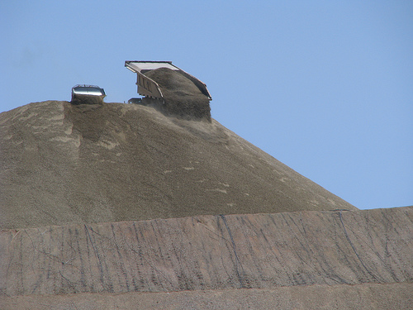

Slide 116
Notes:
This is a blackout slide you can use to close while you shut down.

