Slide 1

Southern
Adventist
University
Faculty
Session
Part 2
28 August 2012
Starting Your College Journey
with a Sense of Purpose
Dr. Bill Millard
Terry T. Munday Endowed Chair of Life Calling
Professor of Leadership Studies
School of Life Calling and Integrative Learning
Senior Scholar
CLCL Life Calling Research Institute
INDIANA WESLEYAN UNIVERSITY

Slide 2



One of the more difficult things for people to do is to discover their own uniqueness and to accept it. We live in a society that gives a lot more emphasis to conformity than to uniqueness. You don't have to see very many advertisements to realize conformity is the main goal. Education is no different. The loftiest goals of education should be to help people discover their uniqueness and then develop that uniqueness to its fullest potential in whatever direction it goes. Instead, our educational systems are more like assembly lines turning out plastic widgets, trying to make each widget like the others. Businesses and organizations exhibit the same pattern. They fit people to their plans, requiring them to conform, rather than adapting their plans to their people by making full use of the talents and skills the people have to offer. Unfortunately, churches tend to follow this same pattern. A certain type of person in the church is identified as “good” and everybody else is encouraged, if not expected, to conform to this “good” type.
The frustrating thing about these situations is this is not the way we are created. We are each very much unique individuals, and each of us has very distinct characteristics that combine to make us who we are.

Slide 3
What is Life Calling?
finding a meaning, design and plan for your life that are part of
God’s higher purposes
… and then living your life consistent with that purpose.

Slide 4
d
a
t
i
o
n
a
l
V
a
u
n
l
u
F
o
e
s
character
faith
service
Life
Calling
P
e
r
n
s
o
g
n
s
i
a
l
D
e
L
e
a
u
e
d
e
r
s
h
i
p
U
n
i
q
Life Calling Model built around 3 main components
Life Calling Model

Slide 5
d
a
t
i
o
n
a
l
V
a
u
n
l
u
F
o
e
s
character
faith
service
P
e
r
n
s
o
g
n
s
i
a
l
D
e
L
e
a
u
e
d
e
r
s
h
i
p
U
n
i
q
Component 1: There exists at the core of our lives a set of foundational values that form the way we think about…
reality, ourselves, and others.
Life Calling Model

Slide 6



Slide 7
d
a
t
i
o
n
a
l
V
a
u
n
l
u
F
o
e
s
strengths
passions
P
e
experiences
r
n
s
o
g
n
s
i
a
l
D
e
L
e
a
u
e
d
e
r
s
h
i
p
U
n
i
q
Component 2: Our Life Calling appears differently in each of us because our foundational values are conveyed through our unique design that gives us individuality as a person
Life Calling Model

Slide 8
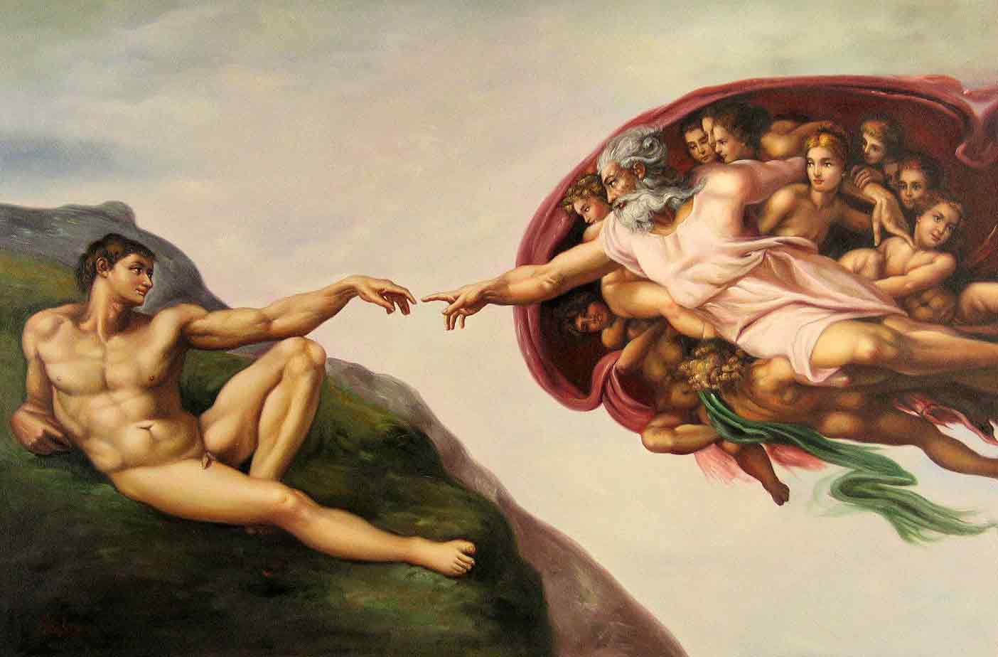
“For you created my inmost being; you knit me together in my mother’s womb. I praise you because I am fearfully and wonderfully made; your works are wonderful, I know that full well.”
Psalm 139:13&14

Slide 9
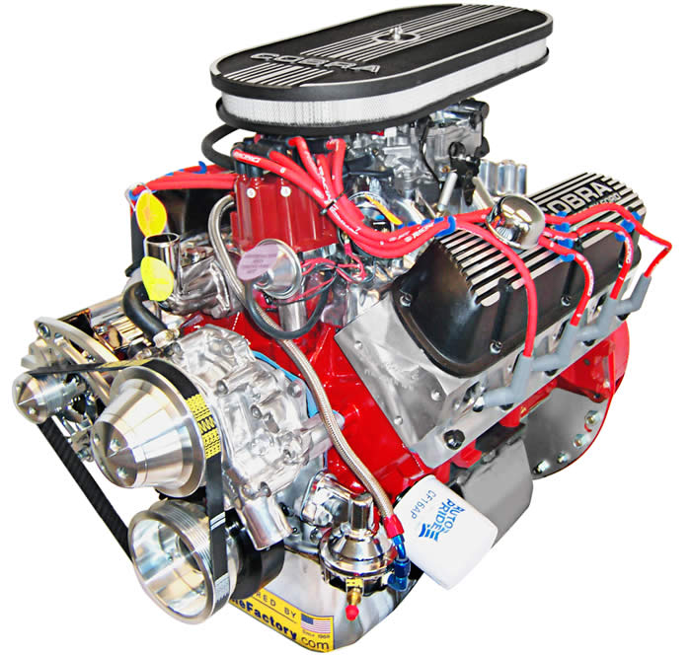
d
a
t
i
o
n
a
l
V
a
u
n
l
u
F
o
e
s
strengths
passions
P
e
experiences
r
n
s
o
g
n
s
i
a
l
D
e
L
e
a
u
e
d
e
r
s
h
i
p
U
n
i
q
Why?
Life Calling Model

Slide 10
d
a
t
i
o
n
a
l
V
a
u
n
l
u
F
o
e
s
Matthew 5:14-16
expression
Life
Calling
strengths
passions
P
focus
e
experiences
r
n
s
o
g
n
s
i
a
l
D
e
L
e
a
u
e
d
e
r
s
h
i
p
U
n
i
q
1 Peter 4:10&11
Why?
Life Calling Model

Slide 11
d
a
t
i
o
n
a
l
V
a
u
n
l
u
F
o
e
s
Life
Calling
delinquency
P
e
r
g
n
s
o
s
i
n
a
D
e
l
M
i
q
u
e
s
s
i
o
n
U
n
i
Life Calling Model

Slide 12
d
a
t
i
o
n
a
l
V
a
u
n
l
u
F
o
e
s
strengths
passions
P
e
experiences
r
n
s
o
g
n
s
i
a
l
D
e
L
e
a
u
e
d
e
r
s
h
i
p
U
n
i
q
Component 2: Our Life Calling appears differently in each of us because our foundational values are conveyed through our unique design that gives us individuality as a person
Life Calling Model

Slide 13
d
a
t
i
o
n
a
l
V
a
u
n
l
u
STRENGTHS
o
e
F
s
An assets-based approach to your life that looks at your whole life and offers the greatest potential for success.
strengths
passions
P
e
experiences
r
n
s
o
g
n
s
i
a
l
D
e
L
e
a
u
e
d
e
r
s
h
i
p
U
n
i
q
Component 2: Our Life Calling appears differently in each of us because our foundational values are conveyed through our unique design that gives us individuality as a person
Life Calling Model

Slide 14
d
a
t
i
o
n
a
l
V
a
u
n
l
u
STRENGTHS
o
e
F
s
An assets-based approach to your life that looks at your whole life and offers the greatest potential for success.
strengths
passions
P
e
experiences
r
n
s
o
g
n
s
i
a
l
D
e
L
e
a
u
e
d
e
r
s
h
i
p
U
n
i
q
Component 2: Our Life Calling appears differently in each of us because our foundational values are conveyed through our unique design that gives us individuality as a person
School – Career – Relationships – Service – Recreation – and most other areas of your life
Life Calling Model

Slide 15
BREAK RULES…
…CHANGE PARADIGMS
Our effectiveness is…
DETERMINED BY
OUR LIMITATIONS
old rule

Slide 16
BREAK RULES…
…CHANGE PARADIGMS
Our effectiveness is…
DETERMINED BY
OUR LIMITATIONS
old rule

Slide 17
BREAK RULES…
…CHANGE PARADIGMS
Our effectiveness is…
DETERMINED BY OUR
STRENGTHS
STRENGTHS

Slide 18
BREAK RULES…
…CHANGE PARADIGMS
Success comes from…
CORRECTING
WEAKNESSES
old rule

Slide 19
BREAK RULES…
…CHANGE PARADIGMS
Success comes from…
CORRECTING
WEAKNESSES
old rule

Slide 20
BREAK RULES…
…CHANGE PARADIGMS
Success comes from…
MAXIMIZING
STRENGTHS!
STRENGTHS!

Slide 21


All you can get from correcting weaknesses…
okay, but not great
Weaknesses
Strengths
M
E
D
I
O
C
R
I
T
Y
FAILURE
SUCCESS

Slide 22
We move from okay to great when we go beyond
mediocrity and follow our strengths to success!
Weaknesses
Strengths
M
E
D
I
O
C
R
I
T
Y
FAILURE
SUCCESS

Slide 23
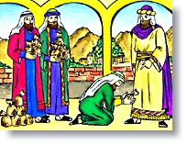
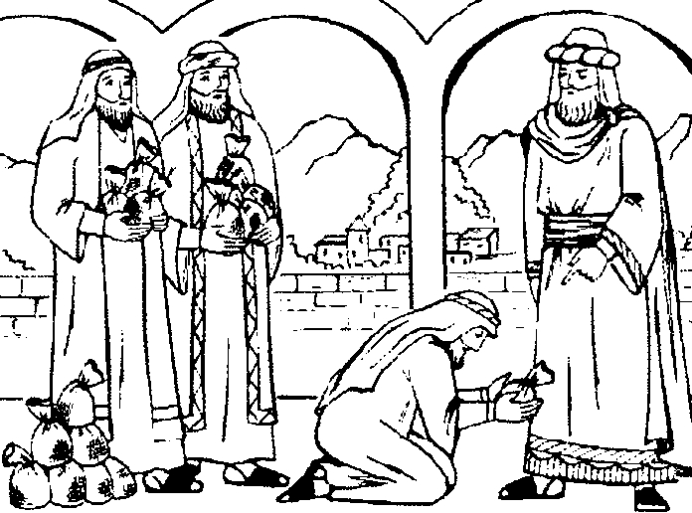
6 Lessons from the Parable of the Talents
Matthew 25:14-30

Slide 24

6 Lessons from the Parable of the Talents
Master heads out on long journey.
Leaves his property with three servants.
One servant gets five talents of gold (around
$3 million).
Another servant gets two talents of gold (around $1.2 million).
The third servant gets one talent of gold (around $600,000).
The first and second servant invest their gold and double their value. The master is happy and rewards them equally.
The third servant buries his gold, makes no interest, and gets into big trouble with the master.
Matthew 25:14-30

Slide 25
6 Lessons from the Parable of the Talents
All your gifts are ultimately from God.
Everyone has received gifts from
God, and they are abundant.
Matthew 25:14-30

Slide 26
Strengths
MATRIX
®
Body
Heart
Bible challenge to love God…
Mind
DOMAINS
Soul
Spirit
® Registered Trademark and Copyright © 2004. Bill Millard. Life Discovery, Inc. Used by permission.

Slide 27
Strengths
MATRIX
®
Strength in your life that gives your body distinct features and enables you to perform actions with your body.
Body
Physical
Heart
Mind
DOMAINS
Soul
Spirit

Slide 28
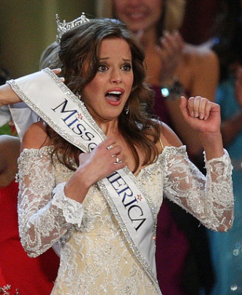
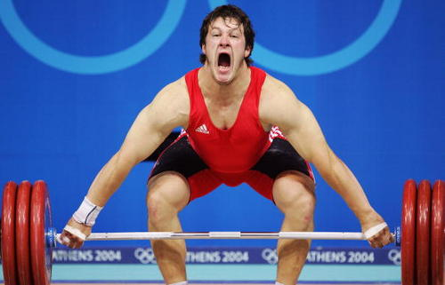
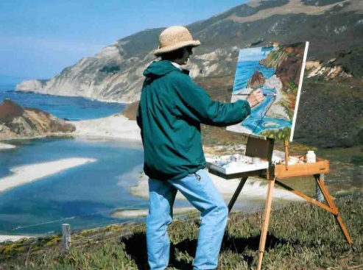
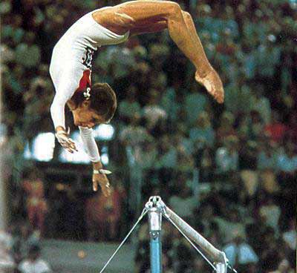
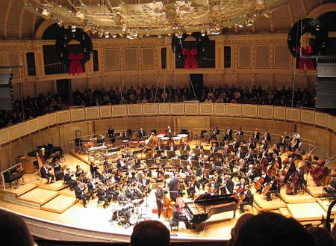
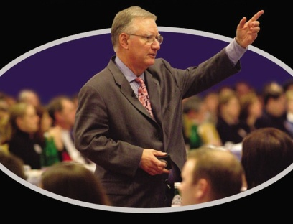
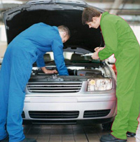
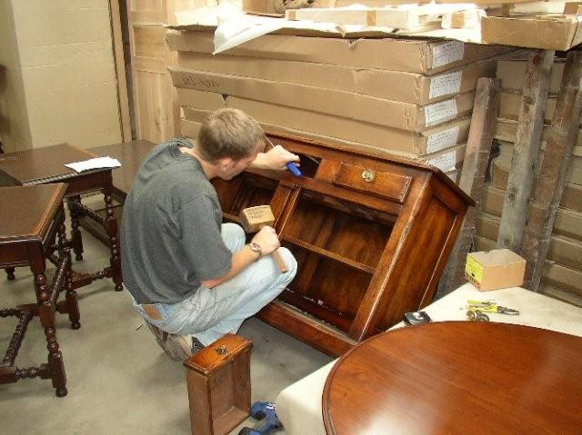
Brute Force
Appearance
Artistry
Kinesthetics
Physical Strengths
Music
Oratory
Mechanics
Craftsmanship

Slide 29
Strengths
MATRIX
®
Body
Physical
Strength in your life that enables you to correctly experience and employ feelings and sensibility.
Heart
Emotional
Mind
DOMAINS
Soul
Spirit

Slide 30


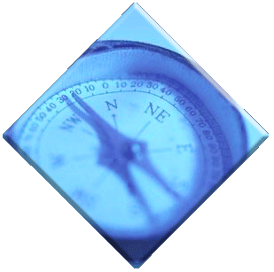

A Blueprint for Emotions
1
1
2
What emotions are you, and others, experiencing?
How are these emotions
directing and impacting thinking?
Identify
4
2
Manage
Use
understand
4
3
How do you manage your emotions and other’s emotions?
3
What caused these emotions? How might these emotions change?

Slide 31
Strengths
MATRIX
®
Body
Physical
Strength in your life that
enables you to effectively process
and deal with cognitive complexity
Heart
Emotional
Mind
Intellectual
DOMAINS
Soul
Spirit

Slide 32
Comprehend our surroundings
Acquire information
Catch on to what is acquired
Make sense of information
Figure out what to do
Capacity

Slide 33
Learning Styles
t
h
e
t
i
c
/
T
e
s
a
n
c
t
i
i
l
K
e
hands-on
images
words
y
r
o
V
i
s
u
a
l
t
i
d
u
A

Slide 34
Learning Atmosphere
Environmental
Emotional
Sociological
Physical
Psychological

Slide 35
Intellectual Disciplines
Patience
Courage
Critical
Thinking
Systematic
Thinking
Process
Application
Humility
Integrity
Advancement
Discovery
Curiosity
Persistence
Teachable
Spirit

Slide 36
Strengths
MATRIX
®
Body
Physical
Heart
Emotional
Mind
Intellectual
Strength in your life that enables you to exercise your will to decide upon courses of action for your life.
DOMAINS
Soul
Psychological
Spirit

Slide 37

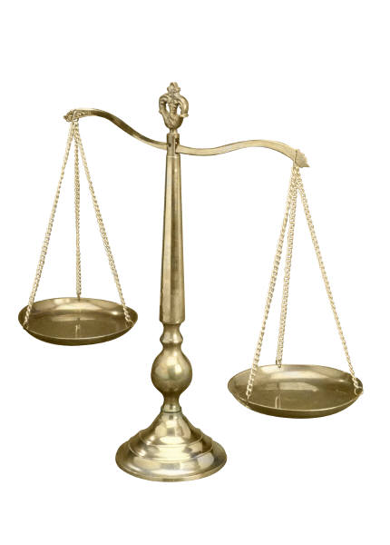
What is the soul?
The higher nature
in human beings which enables them to reason critically and make moral judgments

Slide 38

Decision
Making
1
How do you take in information?
Do you conduct this process
externally or internally?
Which part
of the process
do you focus on?
3
4
What do you
use as a basis for making decisions?
2
Notes:
This slide introduces the four components of psychological type all related to how we gather information and make decisions based on the information we gather.
The vertical axis contains the two primary components in Psychological type. They are
Perceptional intake: There are two primary ways in which we gather information—through our senses, or through our intuition
Decisional Paradigm: There are two primary ways we make decisions or come to conclusions about the information we gather—through a logical thinking process based on rational analysis, or through a interrelational feeling process based on how worthwhile the decision will be in enhancing relationships
The horizontal axis contains the two supporting components in Psychological type. They are
Process focus: We tend to prefer operating in one of the activities of gather information or making decisions about the information
Process energy: We tend to gain energy in the decision-making process from one of two opposite sources—the external world of people, experience, and activity, or the internal world of ideas, memories, and emotions.

Slide 39
Strengths
MATRIX
®
Body
Physical
Heart
Emotional
Mind
Intellectual
DOMAINS
Soul
Psychological
Strength in your life that
enables you to discern and respond
in service to the supernatural
inner leading of God.
Spirit
Spiritual

Slide 40
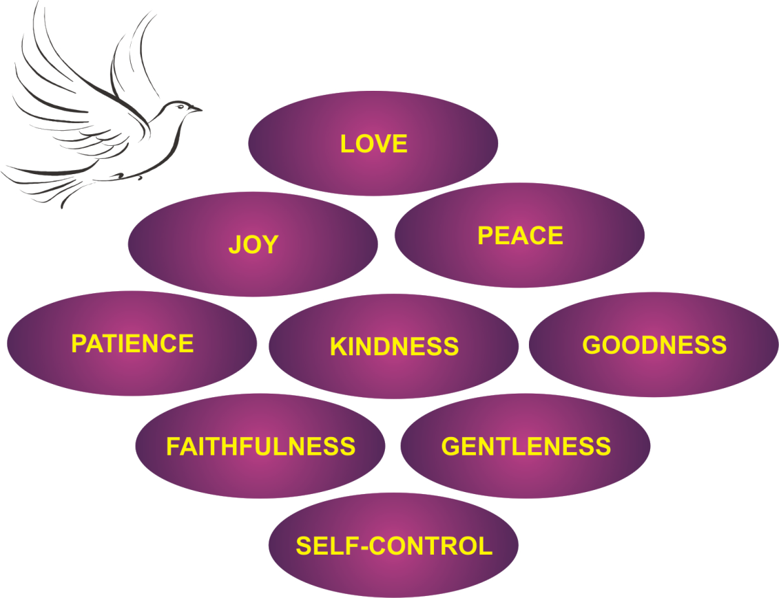
Spiritual Fruit

Slide 41
Service
Worship
Fellowship
Spiritual
Discipline
Confession
Prayer
Bible Study
Simplicity
Solitude

Slide 42
Spiritual Gifts
ΧΑΡΙΣΜΑΤΩΝ
ΕΝΕΡΓΗΜΑΤΩΝ
ΔΙΑΚΟΝΙΩΝ
Motivational Gifts of Grace
Romans 12:3-9
Ministries to Prepare God’s People for Works of Service
Ephesians 4:11-13
Appointed Positions of Service in the Church
1 Corinthians 12:28
Manifestations of the Spirit
1 Corinthians 12:7-11

Slide 43
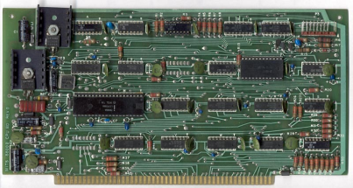
Strengths
D I M E N S I O N S
MATRIX
®
Gifts
Body
Physical
Capabilities and features in a
strength domain that
came into your life
without your own doing.
Heart
Emotional
Mind
Intellectual
DOMAINS
Soul
Psychological
Spirit
Spiritual

Slide 44
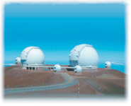
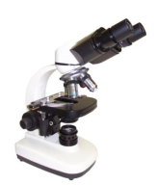
Strengths
D I M E N S I O N S
MATRIX
®
Gifts
Knowledge
Body
Physical
Information and understanding
you gain by learning
about a strength domain and
how to incorporate it into your life.
Heart
Emotional
Mind
Intellectual
DOMAINS
Soul
Psychological
Spirit
Spiritual

Slide 45
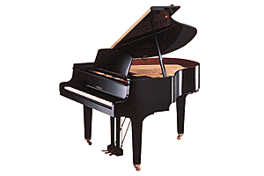
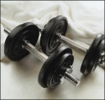
Strengths
D I M E N S I O N S
MATRIX
®
Gifts
Knowledge
Skills
Body
Physical
Abilities you develop in a strength
domain by repeated practice of
the disciplines and actions
associated with the dimension.
Heart
Emotional
Mind
Intellectual
DOMAINS
Soul
Psychological
Spirit
Spiritual

Slide 46
Strengths
D I M E N S I O N S
MATRIX
®
Gifts
Knowledge
Skills
Attitude
Body
Physical
Frame of mind that you develop and adopt reflecting your beliefs and values concerning a strength domain.
Heart
Emotional
Mind
Intellectual
DOMAINS
Soul
Psychological
Spirit
Spiritual

Slide 47
Strengths
D I M E N S I O N S
TOTAL
MATRIX
®
Gifts
Knowledge
Skills
Attitude
Body
Physical
Your overall strength in a domain
is determined by the synergistic
combination of all four dimensions.
Heart
Emotional
Mind
Intellectual
DOMAINS
Soul
Psychological
Spirit
Spiritual

Slide 48




Strengths
D I M E N S I O N S
TOTAL
MATRIX
®
Gifts
Knowledge
Skills
Attitude
Body
Physical
Heart
Emotional
Where the world tends
to place its focus
Mind
Intellectual
DOMAINS
NOBEL PRIZE
Soul
Psychological
Spirit
Spiritual

Slide 49
Strengths
D I M E N S I O N S
TOTAL
MATRIX
®
Gifts
Knowledge
Skills
Attitude
Body
Physical
Heart
Emotional
Mind
Intellectual
Life Calling
DOMAINS
Soul
Psychological
Holistic
Spirit
Spiritual
Your Life Calling will be impacted
by all 5 domains in all 4 dimensions

Slide 50
Strengths
D I M E N S I O N S
TOTAL
MATRIX
®
Gifts
Knowledge
Skills
Attitude
Body
Physical
Heart
Emotional
Mind
Intellectual
mid
hi
hi
hi
hi
DOMAINS
Soul
Psychological
Spirit
Spiritual
hi
mid
lo
lo
lo

Slide 51
Strengths
D I M E N S I O N S
TOTAL
MATRIX
®
Gifts
Knowledge
Skills
Attitude
Body
Physical
Heart
Emotional
Mind
Intellectual
mid
hi
hi
hi
hi
DOMAINS
Soul
Psychological
Spirit
Spiritual
hi
mid
lo
lo
lo

Slide 52
Strengths
D I M E N S I O N S
TOTAL
MATRIX
®
Gifts
Knowledge
Skills
Attitude
Body
Physical
Heart
Emotional
When giftedness is high yet the overall score is low, the person has undeveloped or underdeveloped strength.
Mind
Intellectual
mid
hi
hi
hi
hi
DOMAINS
Soul
Psychological
Spirit
Spiritual
hi
mid
lo
lo
lo

Slide 53
Strengths
D I M E N S I O N S
TOTAL
MATRIX
®
Gifts
Knowledge
Skills
Attitude
Body
Physical
Heart
Emotional
Learning more about this strength and understanding what is learned would help increase the knowledge dimension score and increase the overall TOTAL.
Mind
Intellectual
mid
hi
hi
hi
hi
DOMAINS
Soul
Psychological
Spirit
Spiritual
hi
mid
lo
lo
lo

Slide 54
Strengths
D I M E N S I O N S
TOTAL
MATRIX
®
Gifts
Knowledge
Skills
Attitude
Body
Physical
Heart
Emotional
Practicing and developing the skills associated with this strength would increased the dimension and increase the overall TOTAL score.
Mind
Intellectual
mid
hi
hi
hi
hi
DOMAINS
Soul
Psychological
Spirit
Spiritual
hi
mid
lo
lo
lo

Slide 55
Strengths
D I M E N S I O N S
TOTAL
MATRIX
®
Gifts
Knowledge
Skills
Attitude
Body
Physical
Heart
Emotional
Something in the person’s life has led to a negative attitude toward this strength. Positive input needs to be infused.
Mind
Intellectual
mid
hi
hi
hi
hi
DOMAINS
Soul
Psychological
Spirit
Spiritual
hi
mid
lo
lo
lo

Slide 56
StrengthsMatrix 360
Parents
Teachers
Youth Pastor
STRENGTHS
Peers
Friends
Younger Siblings or Relatives

Slide 57
6 Lessons from the Parable of the Talents
All your gifts are ultimately from God.
Everyone has received gifts from
God, and they are abundant.
Everyone does not receive identical gifts. God determines what is your capacity.
Matthew 25:14-30

Slide 58
d
a
t
i
o
n
a
l
V
a
u
n
l
u
STRENGTHS
o
e
F
s
An assets-based approach to your life that looks at your whole life and offers the greatest potential for success.
strengths
passions
P
e
experiences
r
n
s
o
g
n
s
i
a
l
D
e
L
e
a
u
e
d
e
r
s
h
i
p
U
n
i
q
School – Career – Relationships – Service – Recreation – and most other areas of your life
I don’t want to come to the end of my life and find that I only impersonated myself.
- Parker Palmer

Slide 59
d
a
t
i
o
n
a
l
V
a
u
n
l
u
PASSIONS
F
o
e
s
My passions arise from those things I desire intensely. More than just interests,
they burn within my heart
and often drive the actions
or paths I take.
strengths
passions
P
e
experiences
r
n
s
o
g
n
s
i
a
l
D
e
L
e
a
u
e
d
e
r
s
h
i
p
U
n
i
q
Component 2: Our Life Calling appears differently in each of us because our foundational values are conveyed through our unique design that gives us individuality as a person
Life Calling Model

Slide 60

Trust in the LORD and do good; dwell in the land and enjoy safe pasture. Take delight in the LORD and he will give you the desires of your heart.
Psalm 37:3&4

Slide 61
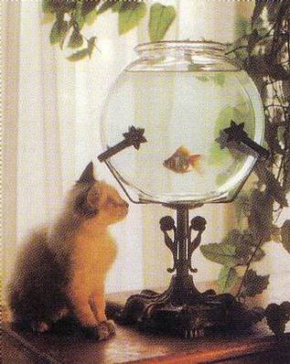
3 Levels of Passion
Interests
Level 1: Options in life that attract your curiosity.

Slide 62

3 Levels of Passion
Desires
Interests
Level 2: Your interests you would definitely pursue
if you had no limitations

Slide 63
3 Levels of Passion
Sacrifice
Desires
Interests
Level 3: The desires you care about enough that you would be
willing to set aside other interests or desires and dedicate
(in some cases even risk) your life for these passions

Slide 64
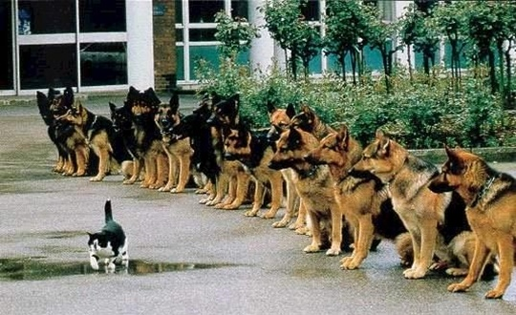
3 Levels of Passion
Sacrifice
Desires
Interests
Level 3: The desires you care about enough that you would be
willing to set aside other interests or desires and dedicate
(in some cases even risk) your life for these passions

Slide 65
Sacrifice

Slide 66
3 Levels of Passion
Very Few
Sacrifice
Many
Desires
Very Many
Interests
Level 3: The desires you care about enough that you would be
willing to set aside other interests or desires and dedicate
(in some cases even risk) your life for these passions

Slide 67

PASSIONS
If you have men who will only come if they know there is a good road, I don't want them. I want men who will come if there is no road at all.
- David Livingston

Slide 68
d
a
t
i
o
n
a
l
V
a
n
l
EXPERIENCES
o
u
u
e
F
s
My strengths and passions are developed and shaped in a distinct pattern based upon
my unique experiences.
strengths
passions
P
e
experiences
r
n
s
o
g
n
s
i
a
l
D
e
L
e
a
u
e
d
e
r
s
h
i
p
U
n
i
q
Component 2: Our Life Calling appears differently in each of us because our foundational values are conveyed through our unique design that gives us individuality as a person
Life Calling Model

Slide 69
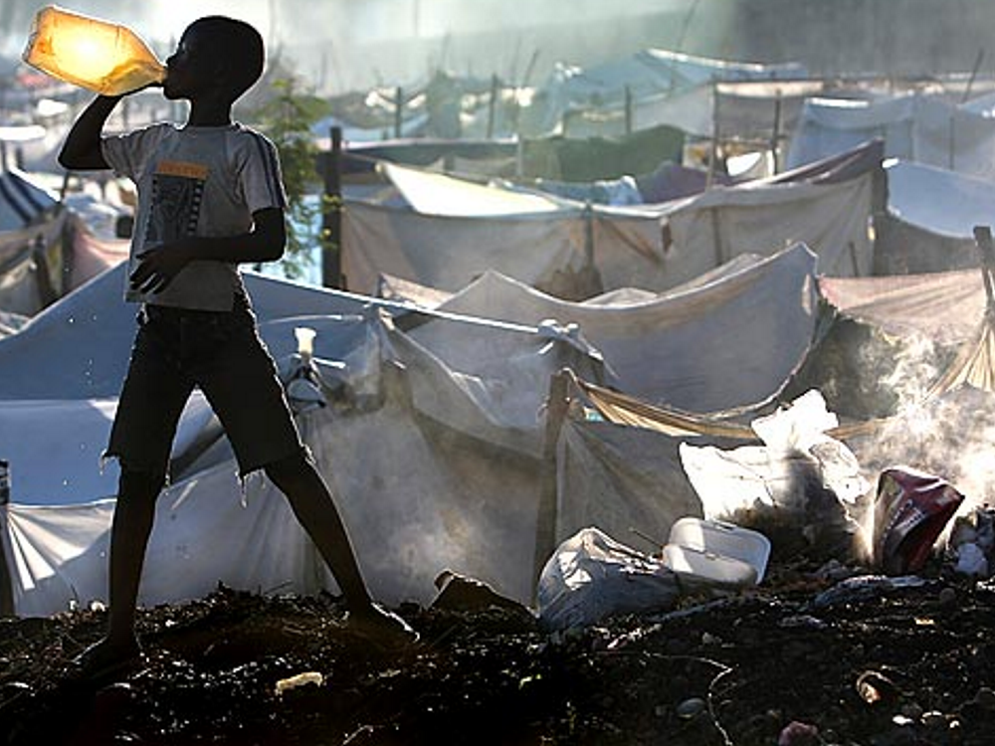
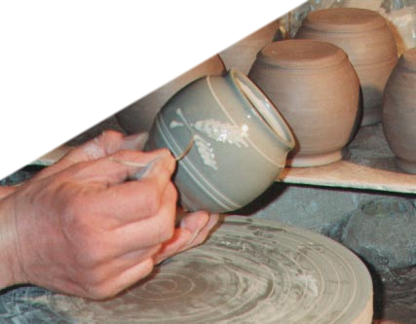
And we know that in all things God works for the good of those who love him, who have been called according to his purpose.
Romans 8:28
But who are you, a mere human being, to talk back to God? "Shall what is formed say to the one who formed it, 'Why did you make me like this?' " Does not the potter have the right to make out of the same lump of clay some pottery for noble purposes and some for disposal of refuse?
Romans 9:20&21

Slide 70
Circumstances: The quality of the elements that impact its life experience.
The Carbon Atom
Life Experience
carbon atom
Time: The point of time in its life in which this experience occurred, and/or the length of time it lasted.
Intensity: The strength of influence this experience had on its life

Slide 71
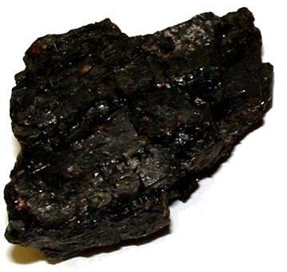
The Carbon Atom
Life Experience
coal
carbon atoms packed in loose layers
Circumstances: | Moderately shallow burial
Intensity: | Minimal heat and pressure
Time: | Relatively long period of increased burial

Slide 72
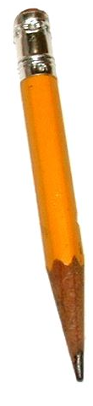
The Carbon Atom
Life Experience
graphite
carbon atoms packed in tighter layers
Circumstances: | Deep burial
Intensity: | High heat and pressure
Time: | Long period of metamorphic influence

Slide 73
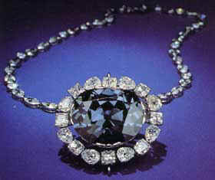
The Carbon Atom
Life Experience
diamond
carbon atoms tightly packed in tetrahedrons
Circumstances: | Deep melting formation
Intensity: | Violent eruption
Time: | Rapid eruption

Slide 74
The Carbon Atom
Life Experience
coal
(All elemental carbon;
made different by “experiences”.)
What a difference
experiences can make!
graphite
diamond

Slide 75
LIFE MAPPING

Slide 76

Iconographic Life Map
10
9
8
7
6
5
4
3
2
1
0
1985 1990 1995 2000 2005 2010

Slide 77
d
a
t
i
o
n
a
l
V
a
n
l
EXPERIENCES
o
u
u
e
F
s
My strengths and passions are developed and shaped in a distinct pattern based upon
my unique experiences.
strengths
passions
P
e
experiences
r
n
s
o
g
n
s
i
a
l
D
e
L
e
a
u
e
d
e
r
s
h
i
p
U
n
i
q
Two roads diverged in a wood and I — I took the one less traveled by,
and that has made all the difference.
- Robert Frost

Slide 78

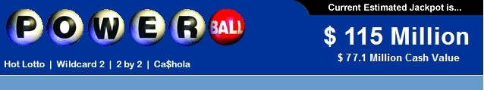
Meaning
t
i
o
n
a
l
n
d
a
V
a
l
o
u
u
e
F
s
Hope
n
g
Significance
s
i
D
e
n
i
q
u
e
U
Universal Aspiration

Slide 79
d
a
t
i
o
n
a
l
V
a
u
n
l
u
F
o
e
s
character
faith
service
Life
Calling
strengths
passions
P
e
experiences
r
n
s
g
o
s
i
n
a
e
l
L
D
e
e
a
u
d
e
p
q
r
i
i
s
h
U
n
Life Calling Model

Slide 80

d
a
t
i
o
n
a
l
V
a
u
n
l
u
F
o
e
s
P
e
r
n
s
g
o
i
n
s
a
e
l
L
D
e
e
a
u
d
e
p
r
i
q
s
h
U
n
i
Why?
Life Calling Model
B

Slide 81
d
a
t
i
o
n
a
l
V
a
u
n
l
u
F
o
e
s
2 Timothy 4:7&8
fulfillment
Life
Calling
from God
P
evidence
e
r
n
s
g
o
i
n
s
a
e
l
L
D
e
e
a
u
d
e
p
r
i
q
s
h
U
n
i
Romans 12:3-8
Why?
Life Calling Model

Slide 82
d
a
t
i
o
n
a
l
V
a
u
n
l
u
F
o
e
s
Life
Calling
no
accountability
P
e
r
n
s
g
o
i
n
s
a
e
l
L
D
e
e
a
u
d
e
p
r
i
q
s
h
U
n
i
Life Calling Model

Slide 83
d
a
t
i
o
n
a
l
V
a
u
n
l
u
You are the light of the world…let your light shine before others, that they may see your good deeds and glorify your Father in heaven.
Matthew 5:14 &16
F
o
e
s
character
faith
service
Be a difference
strengths
Make a
difference
passions
P
e
experiences
r
n
s
g
o
s
i
Go and make disciples of all nations….
Matthew 28:19
n
a
e
l
L
D
e
e
a
u
d
e
p
q
r
i
i
s
h
U
n
As a result of how we live out our Foundational Values and our
Unique Design, there should be a difference in the world.
Life Calling Model

Slide 84
LEADERSHIP
3
Formal
Positional
Leadership
Levels
Informal
Positional
Leadership
Personal
Leadership
Taking action to bring about change by mobilizing
others to accomplish a shared vision.

Slide 85
LEADERSHIP
Formal
Positional
Leadership
Informal
Positional
Leadership
Organizational Sea
Personal
Leadership
Taking action to bring about change by mobilizing
others to accomplish a shared vision.

Slide 86
LEADERSHIP
Formal
Positional
Leadership
Informal
Positional
Leadership
Organizational Sea
Personal
Leadership
…Taking action in
a formal position to bring about change by mobilizing those under your authority to accomplish a shared vision

Slide 87
LEADERSHIP
1
Formal
Positional
Leadership
Level
Informal
Positional
Leadership
Personal
Leadership
Taking action to bring about change in your
everyday situation by mobilizing resources
around you to accomplish a shared vision.

Slide 88
Leadership Paradigms
Servant
Patronizing
Self-centered
Leader as
Steward
Mindset centered
on others
Putting the
needs of the
led first
Treating others
as your partners
Leader as
Parent
Mindset centered
on position
Presuming that the needs of those led are best known and determined by you
Treating others
as your children
Leader as
Dictator
Mindset centered
on self
Putting your
needs as the
leader first
Treating others
as your servants

Slide 89
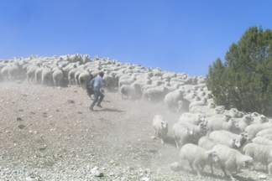
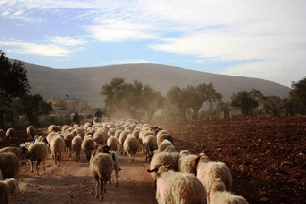
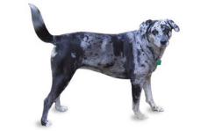
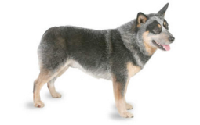
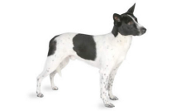
Western vs. Eastern Shepherd

Slide 90

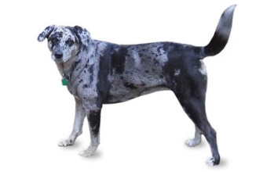
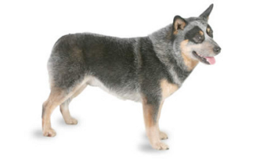
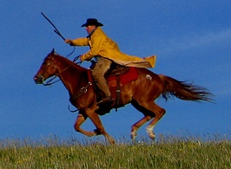
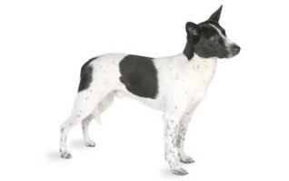
Western Shepherd
Green Pastures
Vision
DANGER
FEAR
Motivation
SHEEP
Dogs
Dogs
Path
Position
Shepherd

Slide 91
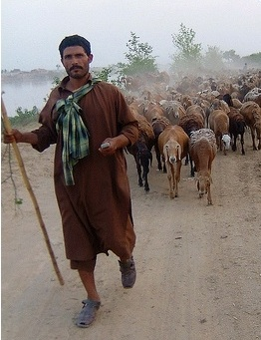
Eastern Shepherd
John 10:2-5
The one who enters by the gate is the shepherd of the sheep. The gatekeeper opens the gate for him, and the sheep listen to his voice. He calls his own sheep by name and leads them out. When he has
brought out all his own, he goes on ahead of them, and his sheep follow him because they know his voice.

Slide 92
Eastern Shepherd
Green Pastures
Vision
DANGER
TRUST
Shepherd
Motivation
SHEEP
Path
Position

Slide 93
d
a
t
i
o
n
a
l
V
a
u
n
l
u
F
o
e
s
mission
vision
P
P
e
action
r
e
n
s
r
g
o
s
i
n
s
o
a
e
n
l
D
a
L
l
e
e
a
M
d
p
u
i
e
i
q
r
h
s
s
s
n
i
i
o
n
U
Component 3: Our universal foundational values and our individual unique design set the stage that enables us to discover how to implement our Life Calling through personal leadership.
Life Calling Model
B

Slide 94
d
a
t
i
o
n
a
l
V
a
u
n
l
u
F
o
e
s
mission
vision
P
P
e
action
r
e
n
s
r
g
o
s
i
n
s
o
a
e
n
l
D
a
L
l
e
e
a
M
d
p
u
i
e
i
q
r
h
s
s
s
n
i
i
o
n
U
Component 3: Our universal foundational values and our individual unique design set the stage that enables us to discover how to implement our Life Calling through personal leadership.
Life Calling Model
B

Slide 95
d
a
t
i
o
n
a
l
V
a
u
n
l
u
MISSION
F
o
e
s
Personal Leadership is empowered by a sense of mission that emerges as we are drawn to different situations in the world.
mission
vision
P
This is impacted by our:
Foundational Values
Unique Design
P
e
action
r
e
n
s
r
g
o
s
i
n
s
o
a
e
n
l
D
a
L
l
e
e
a
M
d
p
u
i
e
i
q
r
h
s
s
s
n
i
i
o
n
U
Component 3: Our universal foundational values and our individual unique design set the stage that enables us to discover how to implement our Life Calling through personal leadership.
Life Calling Model
B

Slide 96
d
a
t
i
o
n
a
l
V
a
u
n
l
u
MISSION
F
o
e
s
Personal Leadership is empowered by a sense of mission that emerges as we are drawn to different situations in the world.
mission
vision
P
This is impacted by our:
Foundational Values
Unique Design
P
e
action
r
e
n
s
r
g
o
s
i
n
s
o
a
e
n
l
D
a
L
l
e
e
a
M
d
p
u
i
e
i
q
r
h
s
s
s
n
i
i
o
n
U
The kind of work God usually calls you to is the kind of work that you need most to do and that the world most needs to have done...The place God calls you to is the place where your deep gladness and the world's deep hunger meet.
- Frederick Buechner
Life Calling Model
B

Slide 97
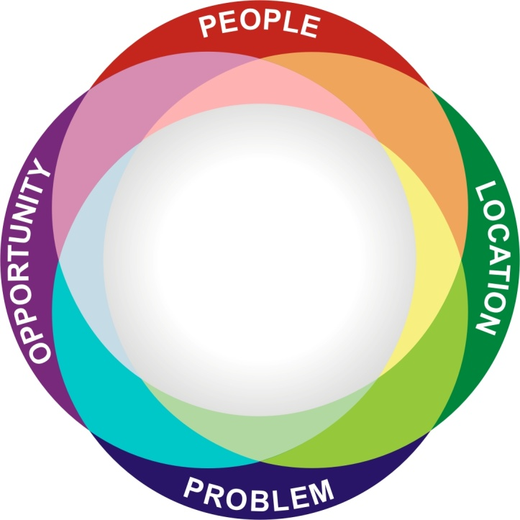
If you are not sure what’s drawing you, then examine what you find yourself most often encountering.
This is okay!
You can’t be everything
to everybody!
What different types of people, locations, opportunities, or
problems within the world are drawing you to them?

Slide 98
d
a
t
i
o
n
a
l
V
a
u
n
l
u
VISION
F
o
e
s
Our personal mission becomes clearer as we begin to formulate a vision for a better future in response to the situations to which we are drawn.
mission
vision
P
e
action
r
n
s
g
o
i
n
s
a
e
l
L
D
e
e
a
u
d
e
p
r
i
q
s
h
U
n
i
Component 3: Our universal foundational values and our individual unique design set the stage that enables us to discover how to implement our Life Calling through personal leadership.
Life Calling Model
B

Slide 99
Vision = Picture
What kind of picture of a better place do you envision in your mind in response to the situations to which you are drawn?

Slide 100




Slide 101
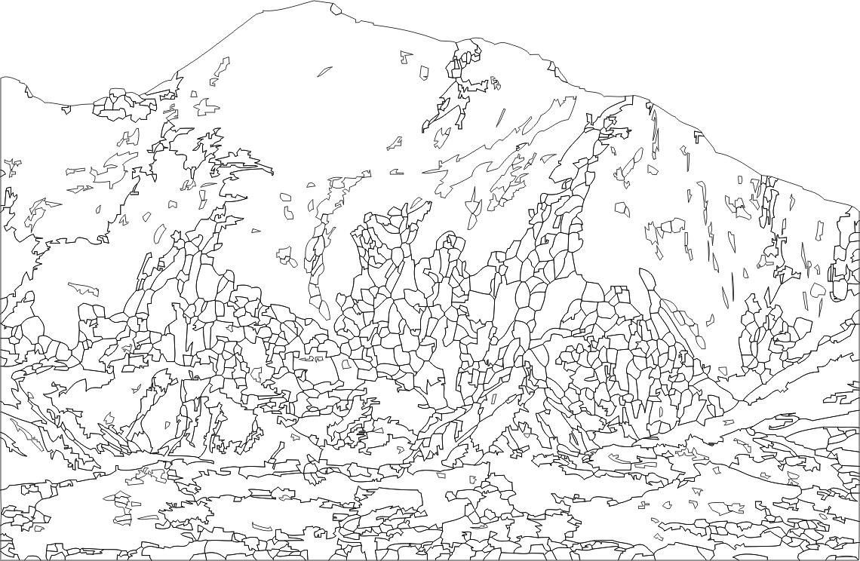
Students see college as a huge mountain to climb.
What can inspire them to make the climb?

Slide 102
What drives a person to climb a mountain with all
of its perils?

Slide 103

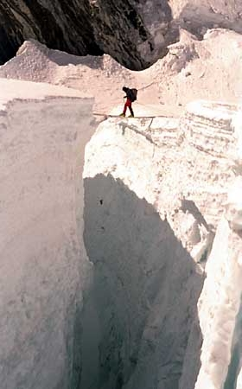
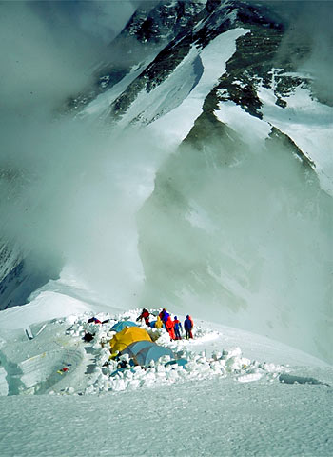

Slide 105


DREAM
must be greater than the
CHALLENGE

Slide 106

All these people were still living by faith when they died. They did not receive the things promised; they only saw them and welcomed them from a distance, admitting that they were foreigners and strangers on earth.
Hebrews 11:13
Bible
Calling
on

Slide 107
d
a
t
i
o
n
a
l
V
a
u
n
l
u
ACTION
F
o
e
s
Personal mission is realized as our vision becomes clear and we take steps to carry out the vision in Personal Leadership.
mission
vision
P
P
e
action
r
e
n
s
r
g
o
s
i
n
s
o
a
e
n
l
D
a
L
l
e
e
a
M
d
p
u
i
e
i
q
r
h
s
s
s
n
i
i
o
n
U
Component 3: Our universal foundational values and our individual unique design set the stage that enables us to discover how to implement our Life Calling through personal leadership.
Life Calling Model
B

Slide 108
FOUR STEPS LEADING FROM VISION TO ACTION
Directions
Goals
Strategies
Action
A
B

Slide 109

FOUR STEPS LEADING FROM VISION TO ACTION
1. Directions > 2. Goals > 3. Strategies > 4. Action
1. Visualize your shot
2. Address the ball with
proper alignment
3. The backswing is as important as the
forward swing
4. Follow through—you ultimately have to swing if
you plan to hit the ball!

Slide 110
Meaning
t
i
o
n
a
l
n
d
a
V
a
l
o
u
u
e
F
s
Hope
P
e
r
n
s
g
Significance
o
i
n
s
a
e
l
L
D
e
e
a
u
d
e
p
r
i
q
s
h
U
n
i
Universal Aspiration

Slide 111

Meaning
t
i
o
n
a
l
n
d
a
V
a
l
o
u
u
e
F
s
Life
Calling
Hope
P
e
r
n
s
g
Significance
o
i
n
s
a
e
l
L
D
e
e
a
u
d
e
p
r
i
q
s
h
U
n
i
Universal Aspiration

Slide 112
6 Lessons from the Parable of the Talents
All your gifts are ultimately from God.
Everyone has received gifts from
God, and they are abundant.
Everyone does not receive identical gifts. God determines what is your capacity.
God expects you to do something with what you have been given.
God’s blessing on your life calling comes based on what you do with what you have.
Ignoring and doing nothing with what God has given you makes it difficult to discern your life calling or to be blessed by God in pursuit of your life purpose.
Matthew 25:14-30

Slide 113
d
a
t
i
o
n
a
l
V
a
u
n
l
u
F
o
e
s
character
faith
service
motivation
stewardship
fulfillment
expression
Life
Calling
mission
strengths
vision
passions
P
focus
e
action
experiences
r
n
s
evidence
g
o
s
i
n
a
e
l
L
D
e
e
a
u
d
e
p
q
r
i
i
s
h
U
n
Lifelong continuous discovery process
Life Calling Model

Slide 114
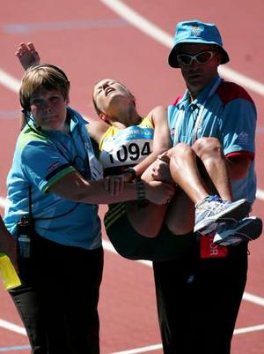
End of a marathon
Notes:
This is a blackout slide you can use to close while you shut down.

