Slide 1

Southern
Adventist
University
First –Year
Experience
Seminar
28 August 2012
Starting Your College Journey
with a Sense of Purpose
Dr. Bill Millard
Terry T. Munday Endowed Chair of Life Calling
Professor of Leadership Studies
School of Life Calling and Integrative Learning
Senior Scholar
CLCL Life Calling Research Institute
INDIANA WESLEYAN UNIVERSITY

Slide 2
LIFE CALLING MODELS
1. Conceptual Model
2. Discovery Model
3. Developmental Model
4. Institutional Model

Slide 3
Pre
1st Year
2nd Year
3rd Year
4th Year
Graduation
Post
Transition
Exploration
Connection
Interaction
Anticipation
Transition
Implementation
3. Developmental Model
Stage-Appropriate Life Calling Developmental Model

Slide 4
Pre
1st Year
2nd Year
3rd Year
4th Year
Graduation
Post
Transition
Exploration
Connection
Interaction
Anticipation
Transition
Implementation
HIGH
LOW
Self-Directedness Scale
Stage-Appropriate Life Calling Developmental Model

Slide 5
Pre
1st Year
2nd Year
3rd Year
4th Year
Graduation
Post
Transition
Exploration
Connection
Interaction
Anticipation
Transition
Implementation
HIGH
LOW
Self-Directedness Scale
Differentiation
Personal
Awareness
Relational
Dynamics
Community
Service
Career Skills
Enhancement
Closure
Advanced Level
of Previous
Life Coaching Issues
Capabilities
Assessment
Academic
Skills
Major Selection/
Entrance
Experiential
Learning
Degree
Completion/
Life Readiness
Graduate Education
Preparation
Credentialing
Academic Advising Issues
Placement
Liberal Arts
Gateway
Courses
Service
Learning
Capstone
Experience
Graduation
Lifelong
Learning
Academic Curriculum Issues
Readiness
Assessment
Strengths
Analysis
Job
Scoping
Internships
Job Search/
Self-Placement
Finalization
Continuous
Improvement
Career Development Issues
MENTOR
explain to
me what mentoring is
mentee
seeking mentor
peer mentors
seeking
each other
mentors
seeking
mentees
mentees
seeking
career mentors
mentor/
mentee
celebration
individuals seeking
mentor, mentee, and peer
relationships
PEER
?
MENTEE
Primary Mentoring Orientation
Stage-Appropriate Life Calling Developmental Model

Slide 6
Pre
1st Year
2nd Year
3rd Year
4th Year
Graduation
Post
Transition
Exploration
Connection
Interaction
Anticipation
Transition
Implementation
HIGH
LOW
Self-Directedness Scale
Personal
Awareness
Relational
Dynamics
Community
Service
Career Skills
Enhancement
Purpose-guided emphasis in first year residence life
Differentiation
Closure
Advanced Level
of Previous
Life Coaching Issues
Capabilities
Assessment
Academic
Skills
Major Selection/
Entrance
Experiential
Learning
Degree
Completion/
Life Readiness
Purpose-guided Life Calling course for all first year students
Credentialing
Graduate Education
Preparation
Academic Advising Issues
Gateway
Courses
Service
Learning
Purpose-guided curriculum in introductory courses in majors
Placement
Liberal Arts
Capstone
Experience
Graduation
Lifelong
Learning
Academic Curriculum Issues
Purpose-guided strengths assessment for all first year students
Readiness
Assessment
Strengths
Analysis
Job
Scoping
Internships
Job Search/
Placement
Finalization
Continuous
Improvement
Career Development Issues
MENTOR
Purpose-guided first year mentoring
explain to
me what mentoring is
mentee
seeking mentor
peer mentors
seeking
each other
mentors
seeking
mentees
mentees
seeking
career mentors
mentor/
mentee
celebration
individuals seeking
mentor, mentee, and peer
relationships
PEER
?
MENTEE
Primary Mentoring Orientation
Stage-Appropriate Life Calling Developmental Model

Slide 7
Pre
1st Year
2nd Year
3rd Year
4th Year
Graduation
Post
Transition
Exploration
Connection
Interaction
Anticipation
Transition
Implementation
HIGH
LOW
Self-Directedness Scale
Differentiation
Personal
Awareness
Relational
Dynamics
Community
Service
Career Skills
Enhancement
Closure
Advanced Level
of Previous
Life Coaching Issues
Capabilities
Assessment
Academic
Skills
Major Selection/
Entrance
Experiential
Learning
Degree
Completion/
Life Readiness
Graduate Education
Preparation
Credentialing
Academic Advising Issues
Placement
Liberal Arts
Gateway
Courses
Service
Learning
Capstone
Experience
Graduation
Lifelong
Learning
Academic Curriculum Issues
Readiness
Assessment
Strengths
Analysis
Job
Scoping
Internships
Job Search/
Self-Placement
Finalization
Continuous
Improvement
Career Development Issues
MENTOR
explain to
me what mentoring is
mentee
seeking mentor
peer mentors
seeking
each other
mentors
seeking
mentees
mentees
seeking
career mentors
mentor/
mentee
celebration
individuals seeking
mentor, mentee, and peer
relationships
PEER
?
MENTEE
Primary Mentoring Orientation
Stage-Appropriate Life Calling Developmental Model

Slide 8
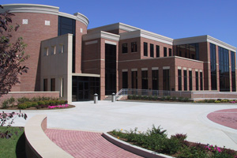
Indiana Wesleyan University
Between 20 and 30
percent of first-year
students who enter IWU’s College of Arts and Science are still exploring for a major among the 60+ offered.
This is typical of tertiary education as a whole in the United States of America.

Slide 9

Center for
Life Calling & Leadership
Indiana Wesleyan University
!
National studies show this group of students to be at risk for retention and persistence to graduation.
Students who are still exploring which major to pursue in college are placed into the Pre-declared academic program under the direction of Center for Life Calling and Leadership.

Slide 10
Pre
1st Year
2nd Year
3rd Year
4th Year
Graduation
Post
Transition
Exploration
Connection
Interaction
Anticipation
Transition
Implementation
HIGH
LOW
Self-Directedness Scale
Differentiation
Personal
Awareness
Relational
Dynamics
Community
Service
Career Skills
Enhancement
Closure
Advanced Level
of Previous
Life Coaching Issues
Capabilities
Assessment
Academic
Skills
Major Selection/
Entrance
Experiential
Learning
Degree
Completion/
Life Readiness
Graduate Education
Preparation
Credentialing
Academic Advising Issues
Placement
Liberal Arts
Gateway
Courses
Service
Learning
Capstone
Experience
Graduation
Lifelong
Learning
Academic Curriculum Issues
Readiness
Assessment
Strengths
Analysis
Job
Scoping
Internships
Job Search/
Placement
Finalization
Continuous
Improvement
Career Development Issues
MENTOR
explain to
me what mentoring is
mentee
seeking mentor
peer mentors
seeking
each other
mentors
seeking
mentees
mentees
seeking
career mentors
mentor/
mentee
celebration
individuals seeking
mentor, mentee, and peer
relationships
PEER
?
MENTEE
Primary Mentoring Orientation
Stage-Appropriate Life Calling Developmental Model

Slide 11
Pre
1st Year
2nd Year
3rd Year
4th Year
Graduation
Post
Transition
Exploration
Connection
Interaction
Anticipation
Transition
Implementation
HIGH
LOW
Self-Directedness Scale
Differentiation
Personal
Awareness
Relational
Dynamics
Community
Service
Career Skills
Enhancement
Closure
Advanced Level
of Previous
Life Coaching Issues
Capabilities
Assessment
Academic
Skills
Major Selection/
Entrance
Experiential
Learning
Degree
Completion/
Life Readiness
Graduate Education
Preparation
Credentialing
Pre-declared
Advisors
Academic Advising Issues
Needed an efficient delivery system for large number of students
Developed a 3-credit class to accomplish this
Stage-Appropriate Life Calling Developmental Model

Slide 12
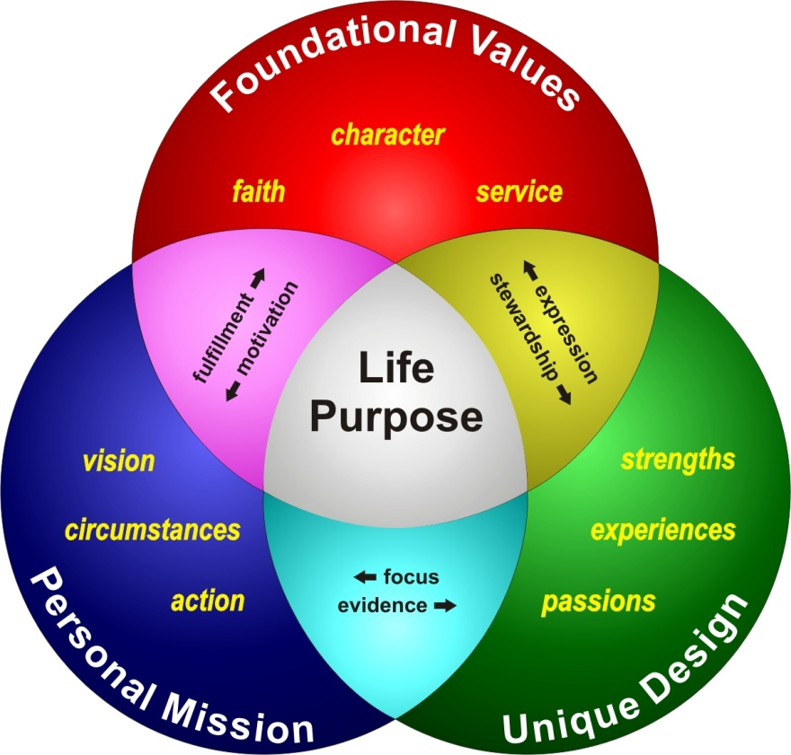
LDR 150: Introduction to Life Calling
This course introduces students to a framework for understanding their lives through the concept of purpose and calling. They
begin to develop tools that will help them make
decisions in life consistent with this life
calling and purpose.
This is a far more effective approach to
choosing majors and making other
decisions in college.
We have created this into an
academic course so that students
gain credits toward graduation while
benefiting from this learning experience.

Slide 13
LDR 150: Introduction to Life Calling
Our Center faculty become:
Instructor
Life Coach
Academic Advisor

Slide 14
Pre
1st Year
2nd Year
3rd Year
4th Year
Graduation
Post
Transition
Exploration
Connection
Interaction
Anticipation
Transition
Implementation
HIGH
LOW
Self-Directedness Scale
Center’s Impact on retention:
27% enrollment increase
117% undeclared
enrollment increase
373% increase in
sophomore undeclared
majors
Differentiation
Personal
Awareness
Relational
Dynamics
Community
Service
Career Skills
Enhancement
Closure
Advanced Level
of Previous
Life Coaching Issues
Capabilities
Assessment
Academic
Skills
Major Selection/
Entrance
Experiential
Learning
Degree
Completion/
Life Readiness
Graduate Education
Preparation
Credentialing
Instructor
Life Coach
Academic
Advisor
Academic Advising Issues
LDR 150: Introduction to Life Calling
Stage-Appropriate Life Calling Developmental Model

Slide 15
LDR 150: Introduction to Life Calling
Research conducted by Indiana University as part of the Indiana Project on Academic Success (IPAS)
Students that took the class were more likely to persist to the next year than students who did not take the class
(odds ratio of 3:1)
Students who took the class were significantly more likely to have earned a degree then those students who did not take the class
(odds ratio of 6:1)
LDR 150: Introduction to Life Calling
Source: Reynolds, P., Gross, J., & Millard, B., and Pattengale, J. “Discovering Life Purpose:
Retaining Undeclared students.” Paper presented at 46th Annual Forum of the Association for
Institutional Research, Chicago. May, 2006.

Slide 16
Pre
1st Year
2nd Year
3rd Year
4th Year
Graduation
Post
Transition
Exploration
Connection
Interaction
Anticipation
Transition
Implementation
HIGH
LOW
Self-Directedness Scale
Personal
Awareness
Relational
Dynamics
Community
Service
Career Skills
Enhancement
What makes
the difference?
Differentiation
Closure
Advanced Level
of Previous
Life Coaching Issues
Capabilities
Assessment
Academic
Skills
Major Selection/
Entrance
Experiential
Learning
Degree
Completion/
Life Readiness
Graduate Education
Preparation
Credentialing
Instructor
Life Coach
Academic
Advisor
Academic Advising Issues
LDR 150: Introduction to Life Calling
Sense of purpose larger
than majors or careers
Purpose
Advocacy
2. Tools for making life decisions
congruent with purpose
3. Advocates students can count on
during the time they are deciding on a major
Stage-Appropriate Life Calling Developmental Model

Slide 17
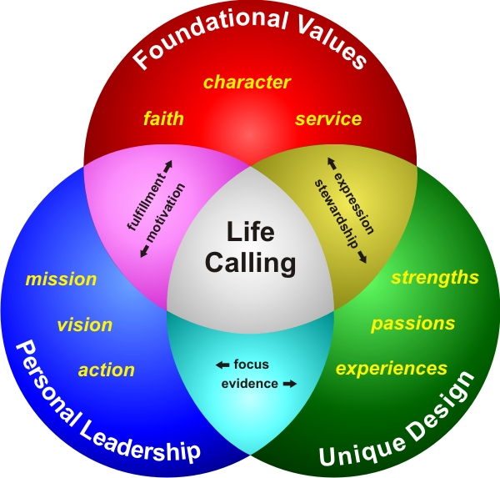
LDR 150: Introduction to Life Calling
Team of 33 LDR 150 faculty will be:
Instructor
Life Coach
Academic Advisor
2012

Slide 18
Pre
1st Year
2nd Year
3rd Year
4th Year
Graduation
Post
Transition
Exploration
Connection
Interaction
Anticipation
Transition
Implementation
Model first developed around years in college
Now see it as tied to stages more than precise years
Stage-Appropriate Life Calling Developmental Model

Slide 19
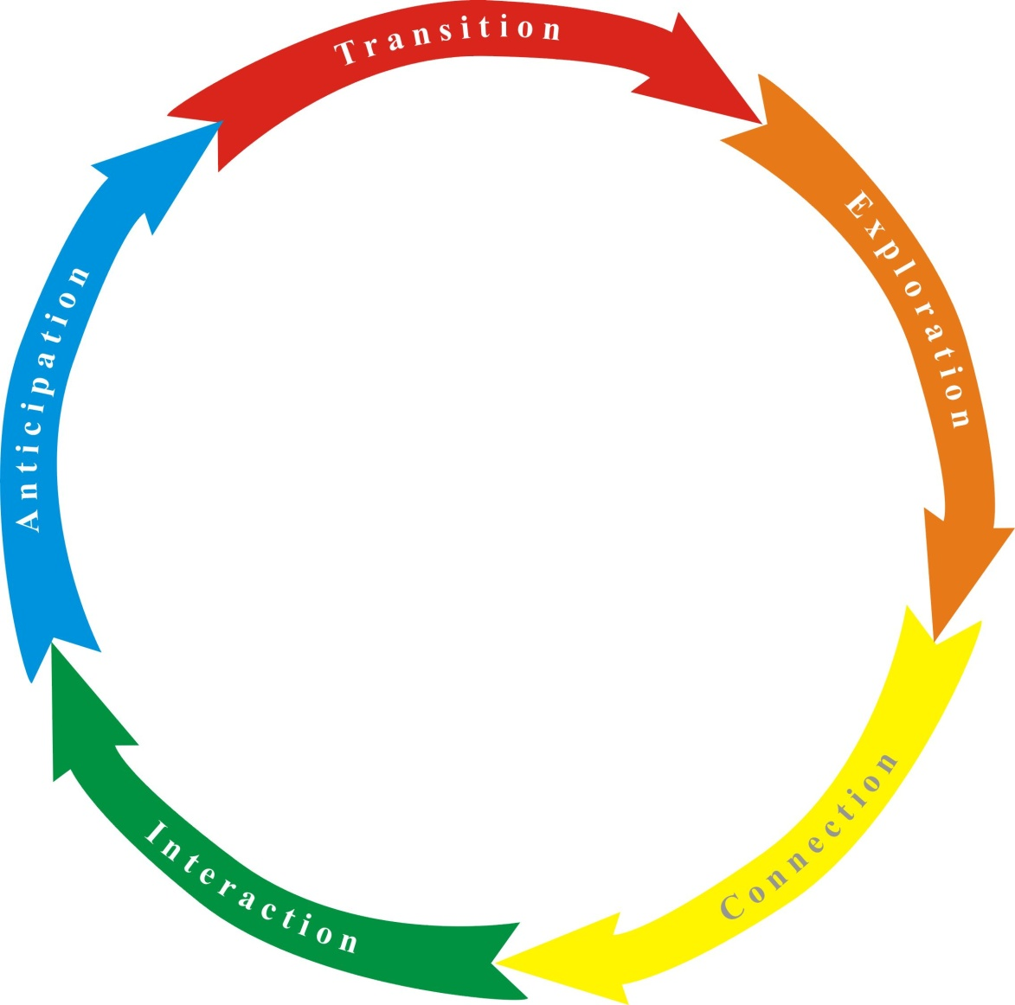
Pre
1st Stage
2nd Stage
3rd Stage
4th Stage
Graduation
Post
Transition
Exploration
Connection
Interaction
Anticipation
Transition
Implementation
TOOLS
Discover and develop a sense
of purpose…a Life Calling
Stage-Appropriate Life Calling Developmental Model

Slide 20
LIFE CALLING MODELS
1. Conceptual Model
2. Discovery Model
3. Developmental Model
4. Institutional Model
Next Section

Slide 21
LIFE CALLING INITIATIVE
Lilly Endowment Programs for the Theological Exploration of Vocation
Creating a Model for a Life-Calling Discovery Process and Culture on the IWU Campus

Slide 22
Integrating Life Calling across the life of an institution begins by creating a Life Calling atmosphere. The first step in creating such an atmosphere is a conceptual model.

Slide 23
d
a
t
i
o
n
a
l
V
a
u
n
l
u
F
o
e
s
character
faith
service
motivation
stewardship
fulfillment
expression
Life
Calling
mission
strengths
vision
passions
P
focus
e
action
experiences
r
n
s
evidence
g
o
s
i
n
a
e
l
L
D
e
e
a
u
d
e
p
q
r
i
i
s
h
U
n
Life Calling Model built around 3 main components made up of 9 key elements

Slide 24

Foundational Values
A Life Calling discovery atmosphere first emerges by creating broad and deep opportunities for students to explore the core Foundational Values that they hold about reality, themselves, and others.

Slide 25

Foundational Values
Unique Design
The second layer of a Life Calling discovery atmosphere emerges by creating opportunities for students to explore their Unique Design found in the distinct strengths that combine to make students who they are, the passions that internally drive students, and how all of these are shaped by experiences the students encounter throughout their lives.

Slide 26

Personal Leadership
Foundational Values
Unique Design
The third layer of a Life Calling discovery atmosphere forms by creating opportunities for students to explore how they can begin to incorporate their Foundational Values and Unique Design into a plan of action that can be carried out through Personal Leadership as they begin to intersect the people and needs of the world.

Slide 27
Intention
Personal Leadership
Foundational Values
Unique Design
Infusion
Integration
3 KEY DEVELOPMENTAL QUALITIES
Intention = seriousness and strategy
Integration = comprehensiveness, collaboration and synergy
Infusion = depth, assessment and accountability

Slide 28
Intention
Personal Mission
Foundational Values
AA
Unique Design
Infusion
Integration
There are four major arenas on our campus that are crucial to supporting the students’ discovery process and intentionally integrating and infusing Life Calling throughout the institution.
Academic Affairs

Slide 29
First Year Course
Learning
Faculty Training
Bookend Courses
Exploration Academic Department for Pre-declared Students
Life Calling Integration/Infusion Model
Academic Affairs

Slide 30
Intention
Personal Mission
Foundational Values
AA
S
D
Unique Design
Infusion
Integration
There are four major arenas on our campus that are crucial to supporting the students’ discovery process and intentionally integrating and infusing Life Calling throughout the institution.
Student Development

Slide 31
New Student Orientation
Mentoring
Co-curricular
Programs
Residence Life
Student Leadership Roles
Life Calling Operational Model
Student Development

Slide 32
Intention
Personal Mission
Foundational Values
AA
S
S
F
D
Unique Design
Infusion
Integration
There are four major arenas on our campus that are crucial to supporting the students’ discovery process and intentionally integrating and infusing Life Calling throughout the institution.
Spiritual Formation

Slide 33
Residence Life
Spiritual Values Development
Chapel
Faculty Hiring
Compassion & Community Service
Life Calling Values Model
Spiritual Formation

Slide 34
Intention
Personal Mission
Foundational Values
AA
S
Exemplars
S
F
D
F S
Mentors
Unique Design
Infusion
Integration
There are four major arenas on our campus that are crucial to supporting the students’ discovery process and intentionally integrating and infusing Life Calling throughout the institution.
Faculty / Staff

Slide 35
Intention
Personal Mission
Foundational Values
AA
S
S
F
C
L
C
L
D
F S
Unique Design
Infusion
Integration
IWU has gone to the level of establishing a comprehensive center for coordinating and supporting the efforts of the four arenas in the institutionalization of Life Calling.
Center for Life Calling & Leadership

Slide 36
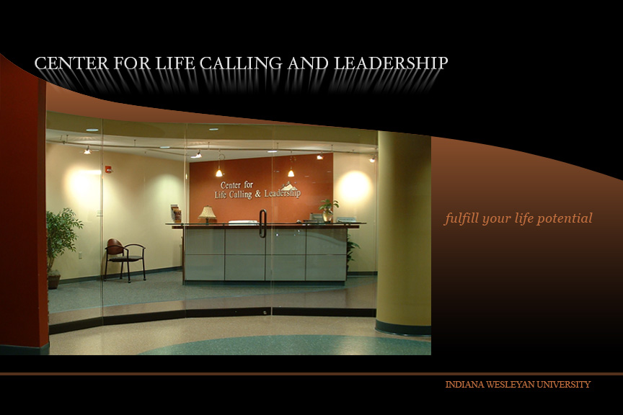
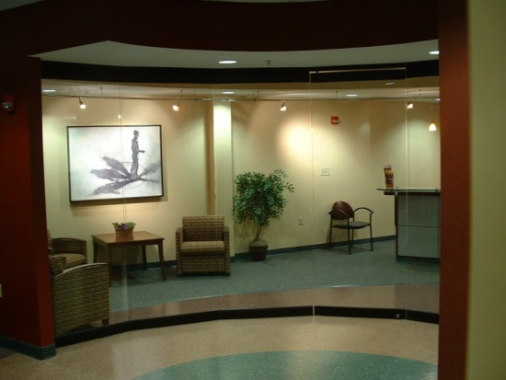
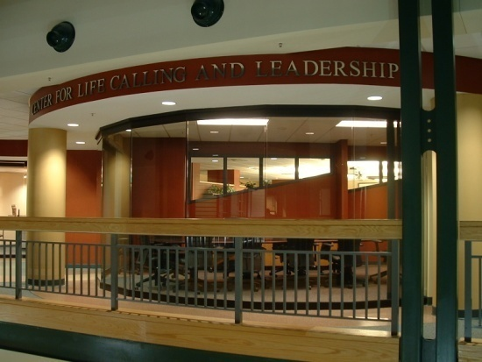
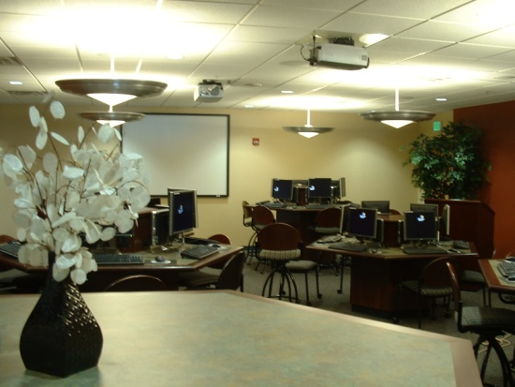
Center for Life Calling & Leadership

Slide 37
Center for Life Calling & Leadership
Structurally in Academic Affairs/Physically in Student Development

Slide 38
Intention
Personal Mission
Foundational Values
AA
S
S
F
C
L
C
L
D
F S
Unique Design
Infusion
Integration
IWU has now gone even further in the institutionalization of Life Calling by establishing a School of Life Calling and Integrative Learning for all incoming students.
School of Life Calling & Integrative Learning

Slide 39
Intention
Personal Leadership
Foundational Values
AA
S
S
F
C
L
C
L
D
F S
Unique Design
Infusion
Integration
Integrating Life Calling across the life of our institution
IWU

