Slide 1
MAP-Works
Southern Adventist University
Faculty In-Service Program
August 25, 2009
Diana McGregor Fulkerson
Director of Client Services

Slide 2

MAP-Works History
Original Developers of MAP
First-year students arrived with unrealistic expectations
Retention rates were not as high as desired
Mid-terms was too late to intervene
Better data about incoming students was needed
Fall 2009, 80+ schools will use MAP-Works!
Fall 2008, 40 schools used MAP-Works during the first year of the national roll-out
1989-2004, Ball State used MAP in-house
2005, Ball State partnered with EBI to create MAP-Works.
1988, Ball State developed concept

Slide 3

Foci MAP-Works
Academic & Socio-Emotional Success
  Improve students' ability to succeed academically by realigning behavior with grade expectations and focusing on elements of academic success
  Address socio-emotional transition issue
Retention
  Minimize percentage of capable students who leave due to issues that could have been addressed by self-awareness or timely intervention

Slide 4
MAP-Works Surveys

Slide 5
MAP-Works Surveys
Types of Surveys
  Transition Survey (administration at Southern Adventist will begin on Sept. 14)
  Check-Up Survey (may be administered multiple times during the academic year)

Slide 6
Why does this matter?

Slide 7
Southern Adventist
Persistence
Progression
First-term GPA
Retention
Retention – 69%
Graduation
Graduation (6 yr) – 58%
Fall to Winter – 89%
~59 students will leave
> 3.67 – 18%
2.67 – 3.67 – 45%
2.00 – 2.66 – 18%
< 2.00 – 19%
~226 students will not graduate
~167 students will not be back at this time next year

Slide 8
How can MAP-Works help?

Slide 9
Information/Data Collected
Profile Information
  Gender and race/ethnicity
  Entrance exam scores
  # credit hours enrolled
  Cumulative GPA
  Credit Hours Earned
Academic Integration
  Academic Self-Efficacy
  Basic Academic Behaviors
  Advanced Academic Behaviors
  Commitment to Education
Self-Assessment
  Communication Skills
  Analytical Skills
  Self-Discipline
  Time Management
  Health and Wellness
  Financial Issues
Social Integration
  Homesickness
  Peer Connections
  Living Environment (on/off campus)
  Roommate Relationships
  Campus Involvement

Slide 10



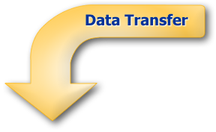
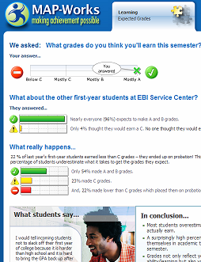


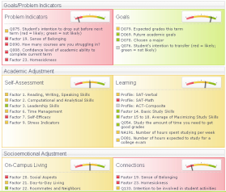
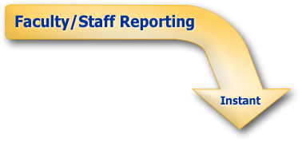




MAP-Works Process
Expectations
Behaviors
Student Profile
Institution Profile
Campus Resources
Social Norming
Expectations
Campus
Resources
Student Summary
Sort Students
Coordinate
Efforts

Slide 11





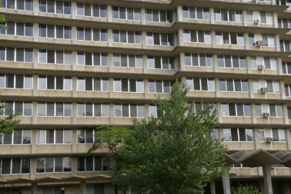


MAP-Works Direct-Connects
Athletics
International or Minority Student Office
First-Year Seminar Instructors
Residence Hall Staff
Advisors

Slide 12
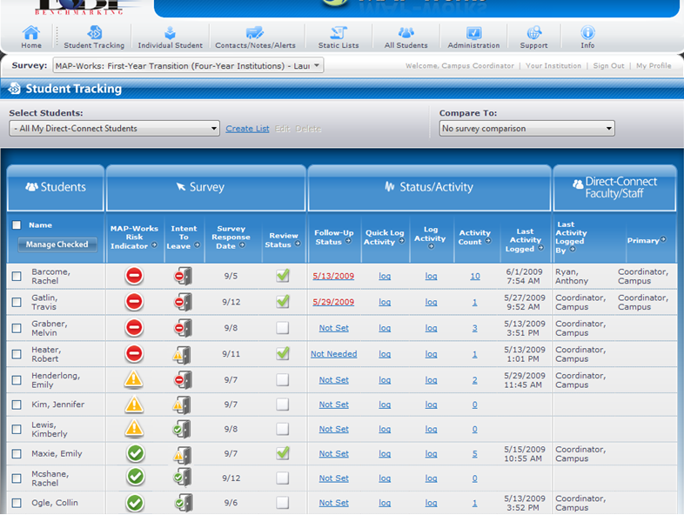
Student Tracking Page
Students: List of your Direct-Connect students
MAP-Works Risk Indicator: Identifies a student who may be a retention risk or academically at risk
Status/Activity: Indicate when to follow-up; log a quick activity or log an activity and enter details in “log activity;” view count of all activities logged by all users and when the last activity was logged
Intent to Leave: Students self-reported intention regarding enrollment next term
Review Status: From the individual student dashboard, click if you have reviewed student’s information
Direct-Connect Faculty /Staff: View who last logged an activity and who is the student’s Primary Direct-Connect
Survey Response Date: Date the student completed the survey

Slide 13
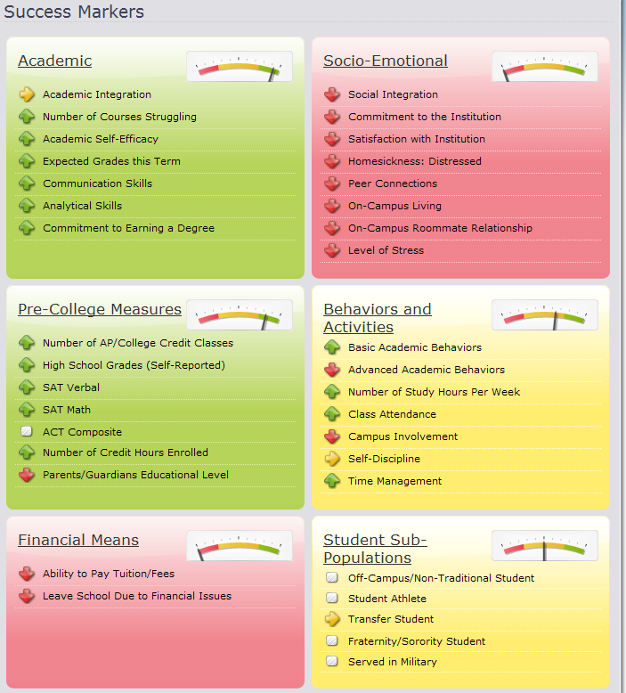
Reading the Individual Student Dashboard
Socio-Emotional: Social integration markers measured from survey
Academic: Academic integration markers measured from survey
Pre-College Measures: Student academic characteristics based on profile and survey
Behaviors and Activities: Based on survey items
Financial Means: Indicators of financial issues based on survey
Student Sub-Populations: Targeted survey items based on sub-population

Slide 14
Questions/Discussion

