Slide 1
MAP-Works Training Southern Adventist University August 25, 2009 Diana McGregor Fulkerson, Director of Client Services
© 2009 Educational Benchmarking, Inc. All Rights Reserved. These materials constitute confidential and propriety information of Educational Benchmarking, Inc. ("EBI") and may not be copied, reproduced, modified, excerpted, published, shared, distributed, or publicly displayed, in whole or in part without the express written consent of EBI.

Slide 2
Educational Benchmarking Inc. (EBI)
Founded in 1994
EBI Assessment Participants
Nearly 1500 Colleges and Universities worldwide
Surveyed nearly 15 million people
Assessments to Date
Currently offer 93 national/international assessments in 25 areas of study
Over 600 custom assessments conducted for 87 institutions
Reporting
Produced over 18,000 customized reports
Created a state-of-the-art online data collection, reporting, and distribution system

Slide 3







EBI’s Professional Partnerships
Housing/
Residence Life
Union
Student Center
Fraternity/Sorority
Policy Center on the First Year of College
Nursing Education
Military Housing
MAP-Works

Slide 4
MAP-Works

Slide 5

MAP-Works History
Original Developers of MAP
First-year students arrived with unrealistic expectations
Retention rates were not as high as desired
Mid-terms was too late to intervene
Better data about incoming students was needed
Fall 2009, 80+ schools will use MAP-Works!
Fall 2008, 40 schools used MAP-Works during the first year of the national roll-out
1989-2004, Ball State used MAP in-house
2005, Ball State partnered with EBI to create MAP-Works.
1988, Ball State developed concept

Slide 6

MAP-Works Focus
Retention
Minimize percentage of capable students who leave due to issues that could have been addressed by self-awareness or timely intervention
Academic & Socio-Emotional Success
Improve students' ability to succeed academically by realigning behavior with grade expectations and focusing on elements of academic success. Address socio-emotional transition issues.

Slide 7
Information/Data Collected
Profile Information
Gender and race/ethnicity
Entrance exam scores
# credit hours enrolled
Cumulative GPA
Credit Hours Earned
Academic Integration
Academic Self-Efficacy
Basic Academic Behaviors
Advanced Academic Behaviors
Commitment to Education
Self-Assessment
Communication Skills
Analytical Skills
Self-Discipline
Time Management
Health and Wellness
Financial Issues
Social Integration
Homesickness
Peer Connections
Living Environment (on/off campus)
Roommate Relationships
Campus Involvement

Slide 8



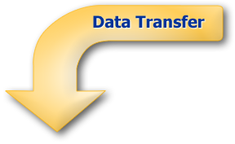
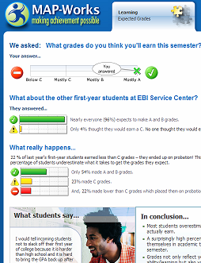


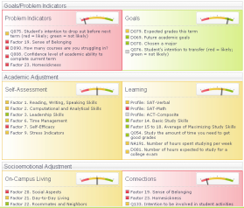
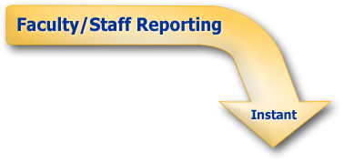




MAP-Works Process
Expectations
Behaviors
Student Profile
Institution Profile
Campus Resources
Social Norming
Expectations
Campus
Resources
Student Summary
Sort Students
Coordinate
Efforts

Slide 9





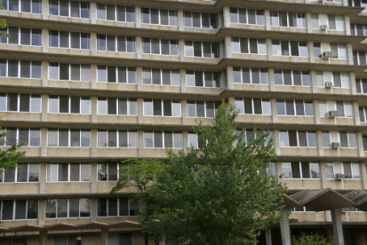


MAP-Works Direct-Connects
Athletics
International or Minority Student Office
First-Year Seminar Instructors
Residence Hall Staff
Advisors

Slide 10
MAP-Works: Surveys and Risk Indicator

Slide 11
MAP-Works Surveys
Types of Surveys
Transition Survey (administration at Southern Adventist will begin on Sept. 14)
Check-Up Survey (may be administered multiple times during the academic year)
Understanding the MAP-Works Risk-Indicator
“Needle Hunting in Action”--- Identifying Risk
“Non-Respondents”--- Inherently At Risk

Slide 12
Theoretical Foundation of MAP-Works

Slide 13
Early Adjustment to College
Research
Success of first-year students is determined largely by pre-enrollment variables, institutional characteristics, and institutional climate
Emphasized the importance of interaction with peers – especially during first month of enrollment
MAP-Works
Focuses on the early adjustment of first-year students
Includes important measures such as Peer Interactions and Sense of Belonging
“Overwhelming evidence that students’ success is, in large part, determined by their experiences during the freshman year”
Ref: Upcraft, Gardner, & Associates (1989)
Emphasizes both academic and socio-emotional adjustment
Data collection and intervention occur during the first month
Ref: Upcraft, M. L., Gardner, J. N., & Associates (1989). The Freshman Year Experience. San Francisco: Jossey-Bass.

Slide 14
Astin’s Theory of Involvement
Research
Alexander Astin defined college student involvement as the investment of energy
MAP-Works
Focuses on the quantity and quality of involvement in a variety of domains (e.g. academic, co-curricular, residence life, social, etc.)
Emphasized both quantitative (amount of effort) and qualitative (type of effort)
Related involvement to learning and development
Ref: Skipper, T. L. (2005). Student Development in the First College Year: A Primer for College Educators. Columbia, SC: University of South Carolina, National Resource Center for the First-Year Experience and Students in Transition.

Slide 15
Tinto’s Theory of Attrition
Research
Tinto’s theory describes the interaction between a student and the academic and social systems of the college environment
MAP-Works
Not only asks about every area in Tinto’s theory, the reporting is structured around most of these concepts
Interdependent nature of experiences and interactions as factors that affect commitment to the institution and educational goals
Five Areas: Pre-Entry Characteristics; Goals and Commitments; Institutional Experiences; Integration; and the Departure Decision
Ref: Tinto, V. (1993). Leaving college: Rethinking the Causes and Cures of Student Attrition (2nd ed.). Chicago: University of Chicago Press.

Slide 16
Self-Efficacy and Institutional Commitment
Research
Importance of self-efficacy and the development of positive coping strategies leads to better student outcomes
MAP-Works
Focuses on self-efficacy and institutional commitment
Gives students information to promote positive behaviors
Encourages students to build self-efficacy by promoting self-reflection and successful behaviors
Importance of initial institutional commitment for residential students – impact on student perceptions and behaviors (and thus retention).
Self-efficacy linked to situations people choose, behaviors, effort, persistence, resiliency, thought patterns, stress levels, outcomes.
Ref: Bean, J. P., & Eaton, S. B. (2000). A Psychological Model of Student Retention. In J. M. Braxton (Ed.), Reworking the Student Departure Puzzle (pp.48-61). Nashville, TN: Vanderbilt University Press.
Ref: Braxton, J. M., Hirschy, A.S, & McClendon, S. A. (2004). Understanding and Reducing College Student Departure. San Francisco: Jossey-Bass. (ASHE-ERIC Higher Education Report No. 30.3).
Ref: Bandura, A. (1997). Self-Efficacy: The Exercise of Control. New York: W. H. Freeman and Company.

Slide 17
Engagement and Effort
Research
Pascarella’s model emphasizes the interaction with socializing agents (faculty and peers) and the quality of student effort as important predictors of student learning and development.
MAP-Works
Focuses on academic, social, emotional, and developmental domains
Weidman’s model of undergraduate socialization discusses the normative contexts, socialization processes, and socialization outcomes
Ref: Pascarella, E. (1985). College Environmental Influence on learning and Cognitive Development: A Critical Review and Synthesis. In J. Smart (Ed.), Higher education: Handbook of Theory and Research (Vol. 1). New York: Agathon
Ref: Weidman, J. (1989). Undergraduate socialization: A Conceptual Approach. In J. Smart (Ed.). Higher Education: Handbook of Theory and Research (Vol. 5). New York: Agathon.

Slide 18
Student Expectations
Research
Expectations serve as a filter through which students evaluate their experiences. Can also serve as a psychological catalyst or deterrent to certain types of behaviors
MAP-Works
Addresses student expectations through survey items and reporting
Provides information to students on campus resources
The transition to college can set the tone for what students expect, how much they get involved and their experience
Need to promote reasonable expectations of college
Ref: Kuh, G. D., Kinzie, J., Schuh, J. H., Whitt, E. J, & Associates (2005). Student Success in College: Creating Conditions that Matter. San Francisco: Jossey-Bass.
Ref: Pascarella, E. T. & Terenzini, P. T. (1991). How College Affects Students. San Francisco: Jossey-Bass
Ref: Miller, T. E., Bender, B. E., Schuh, J. H., & Associates (2005). Promoting Reasonable Expectations: Aligning Student and Institutional Views of the College Experience. San Francisco: Jossey-Bass

Slide 19
Student Development
Research
Chickering’s seven vectors of college development
MAP-Works
Includes items about self-perceptions of confidence and skills, initial social relationships, and educational goals.
Feedback to students emphasizes personal responsibility and development, and building connections for long-term success.
(1) developing competence, (2) managing emotions, (3) moving through autonomy toward interdependence, (4) developing mature interpersonal relationships, (5) establishing identity, (6) developing purpose, and (7) developing integrity.
Ref: Chickering, A. W., & Reisser, L. (1993). Education and Identity (2nd ed.). San Francisco: Jossey-Bass.

Slide 20
Navigating MAP-Works
© 2009 Educational Benchmarking, Inc. All Rights Reserved. These materials constitute confidential and propriety information of Educational Benchmarking, Inc. ("EBI") and may not be copied, reproduced, modified, excerpted, published, shared, distributed, or publicly displayed, in whole or in part without the express written consent of EBI.

Slide 21
Topics
Logging Into MAP-Works
Home Page
Student Tracking Page
Lists---Real time and Static
Individual Student Reporting/Dashboards
Logging Contact, Notes, and Alerts
All Student Reporting/Advanced Filters
MAP-Works Student Report/Portal

Slide 22
Logging into MAP-Works

Slide 23
Southern Adventist “Demo” Account
http://demo.map-works.com
Username:
southern2010@map-works.com
Password: southern1783

Slide 24
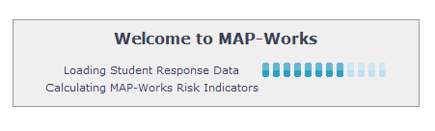
Logging into "Real" MAP-Works Account
Visit Southern Adventist University’s URL
https://southern.map-works.com
Building Data
Each time faculty/staff enter the MAP-Works site, the data is built to populate the reporting. Faculty/staff receive a screen that indicates the data is being built. The process may take a few moments.

Slide 25
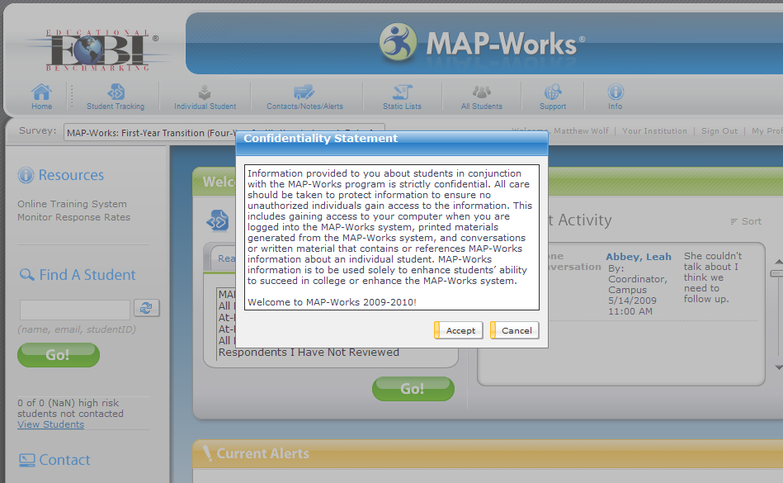
Logging in to MAP-Works
Confidentiality Statement
The first time each term faculty/staff enter MAP-Works, they must accept a confidentiality statement and view a brief video on navigation

Slide 26
Home Page

Slide 27
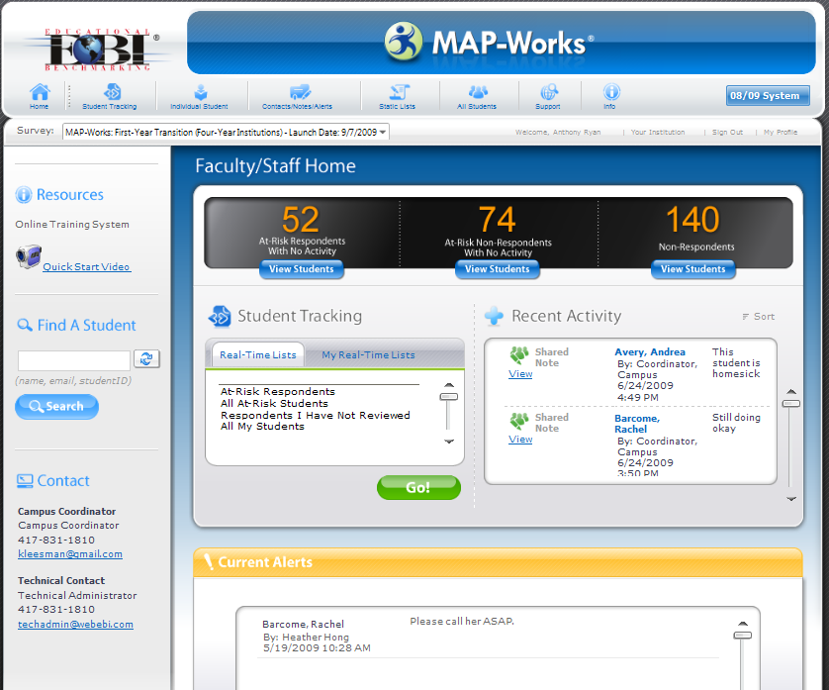
Home Page
Quickly access your students (respondents and non-respondents) who are at-risk and have had no activity logged by any of their Direct-Connect faculty/staff
Quickly access a list of your students who have yet to respond to the survey.
Student Tracking: Quickly access your Direct-Connect students. Choose from a “Real-Time List” or your “My Real-Time Lists”
Recent Activity: View all recent activities (notes, contacts, or alerts) that have been posted for your students
Current Alerts: A list of your Direct-Connects who have an open alert

Slide 28
Home Page
Survey: If your institution also launches a Check-Up or Sophomore Survey, you can choose the survey to view
Resources: Online training system and quick start videos
Find A Student: Locate a specific student quickly by typing in name, email or student ID
Contact: Contact information for your institution’s Campus Coordinator and Technical Administrator

Slide 29
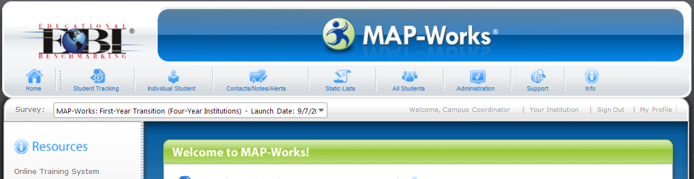
Home Page
Individual Student: Search for a student
Static Lists: Create a constant student list; will not automatically update based on survey or profile data changes
Support: Provides your campus’s MAP-Works contact info, listserv info, and other support documents
Home: Return to the Home Page
Contacts/Notes/ Alerts: View all contacts, notes, and alerts that been recorded for your Direct-Connect students
All Students: Provides a variety of report options to view survey and profile data of all your Direct-Connect students
Info: Access faculty/staff report, survey info, a sample student report, etc.
Student Tracking: Go to Student Tracking (an overview of your work with students)
Administration: Provides access to the Administration site (available only for Campus Coordinator and Technical Administrator)

Slide 30
Student Tracking Page

Slide 31
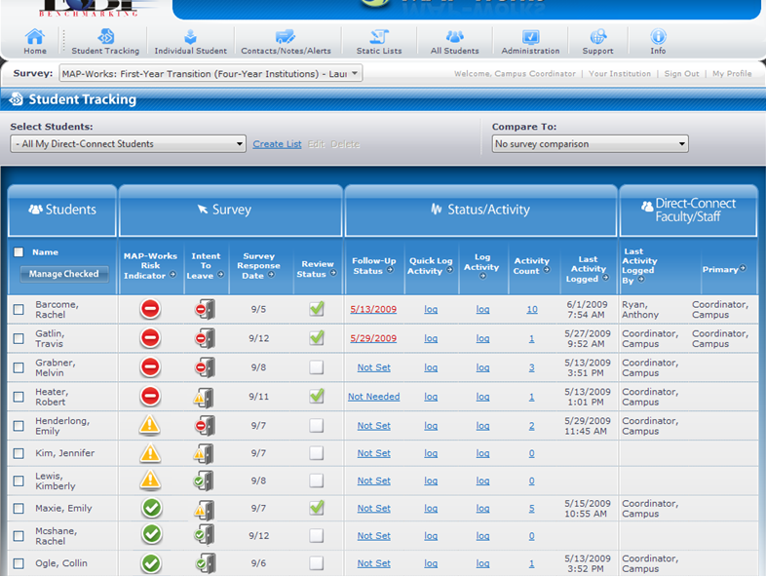
Student Tracking Page
Students: List of your Direct-Connect students
MAP-Works Risk Indicator: Identifies a student who may be a retention risk or academically at risk
Status/Activity: Indicate when to follow-up; log a quick activity or log an activity and enter details in “log activity;” view count of all activities logged by all users and when the last activity was logged
Intent to Leave: Students self-reported intention regarding enrollment next term
Review Status: From the individual student dashboard, click if you have reviewed student’s information
Direct-Connect Faculty /Staff: View who last logged an activity and who is the student’s Primary Direct-Connect
Survey Response Date: Date the student completed the survey

Slide 32
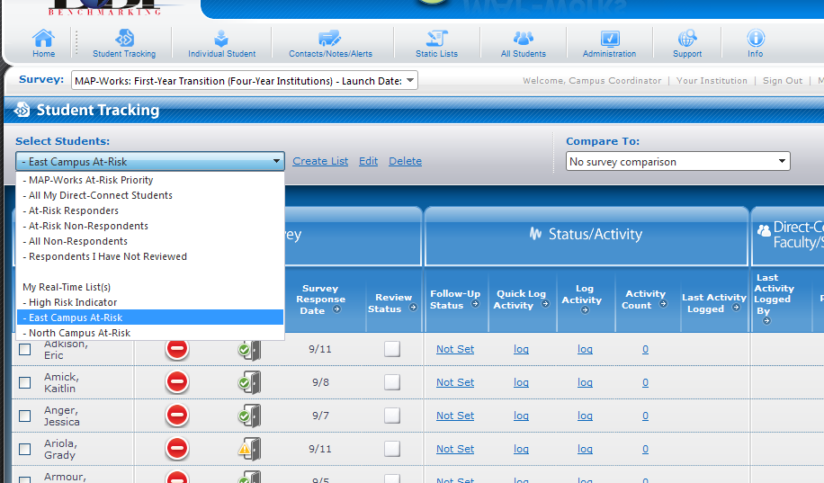
Student Tracking Page
Create, edit, or delete “My Real-Time List.” May be created and save based upon selected criteria. Real-Time Lists are updated based on survey and profile date changes.
Once your institution launches a Check-Up Survey, you may compare the Transition Survey results to the Check-Up results to determine students whose situation has improved, stayed the same, or declined
Select Students: Drop-down of all the “Real-Time Lists” and “My Real-Time Lists” Use this to filter your list to students you would like to view

Slide 33
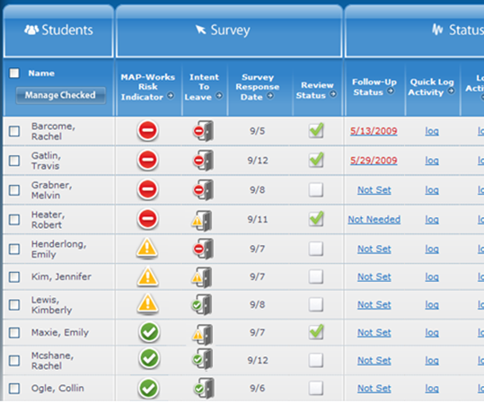
Student Tracking Page - Responders
Red MAP-Works Risk Indicator: Student is potentially at risk for leaving the institution or having poor academic performance
Red Intent to Leave: Student self-reported he/she is seriously considering not returning next term
Yellow Intent to Leave: Student self-reported he/she is not firmly committed to returning next term
Yellow MAP-Works Risk Indicator: Student is moderately at risk for leaving the institution or having poor academic performance
Green Intent to Leave: Student self-reported he/she is committed to returning next term
Green MAP-Works Risk Indicator: Student is at low risk for leaving the institution or having poor academic performance

Slide 34
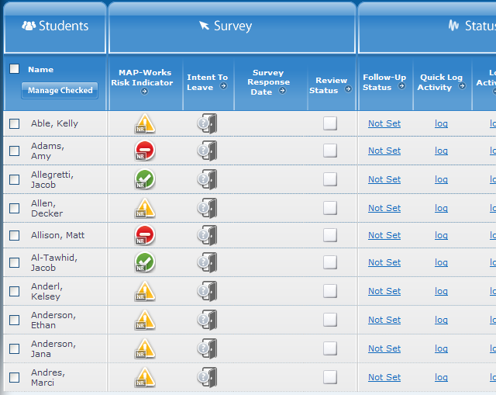
Student Tracking Page – Non-Responders
Red MAP-Works Risk Indicator (NR): Student did not complete the survey, but is potentially at risk for leaving the institution or having poor academic performance
Intent to Leave: Student did not indicate if he/she is planning to return next term.
Yellow MAP-Works Risk Indicator (NR): Student did not complete the survey, but is moderately at risk for leaving the institution or having poor academic performance
Green MAP-Works Risk Indicator (NR): Student did not complete the survey, but is at low risk for leaving the institution or having poor academic performance

Slide 35
Lists

Slide 36
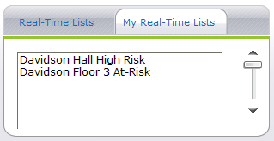
Real-Time Lists
Real-Time Lists: A set of Real-Time Lists generated by MAP-Works. Real-Time Lists are updated based on changes in students’ profile or survey response
My Real-Time Lists: A set of Real-Time Lists you create based on selected students profile or survey response criteria. Examples might be students in a residence hall or first-year seminar section

Slide 37
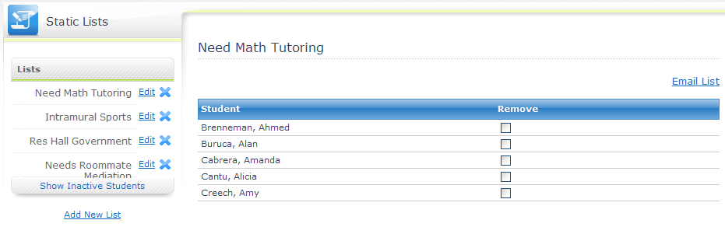
Static Lists
Static Lists: Create a constant list of students to monitor progress; will not automatically update based on survey or profile data changes

Slide 38
Individual Student Report

Slide 39
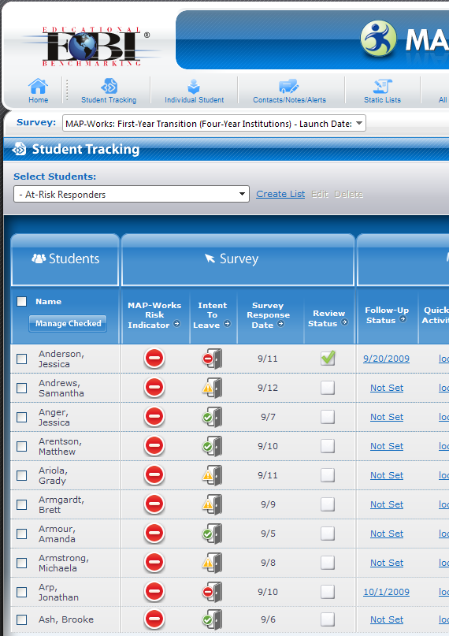
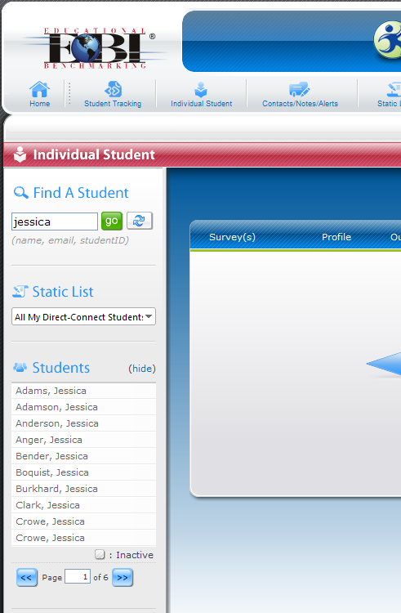
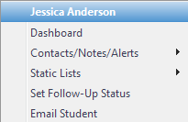
Accessing the Individual Student Dashboard
OR
Individual Student: Click on the icon at the top and search for the student
Student Tracking: Click on a student’s name (ex: Jessica Anderson). A hover down-down menu shows
Click on student’s name to view her “Dashboard”
Click on “Dashboard” to view her report

Slide 40
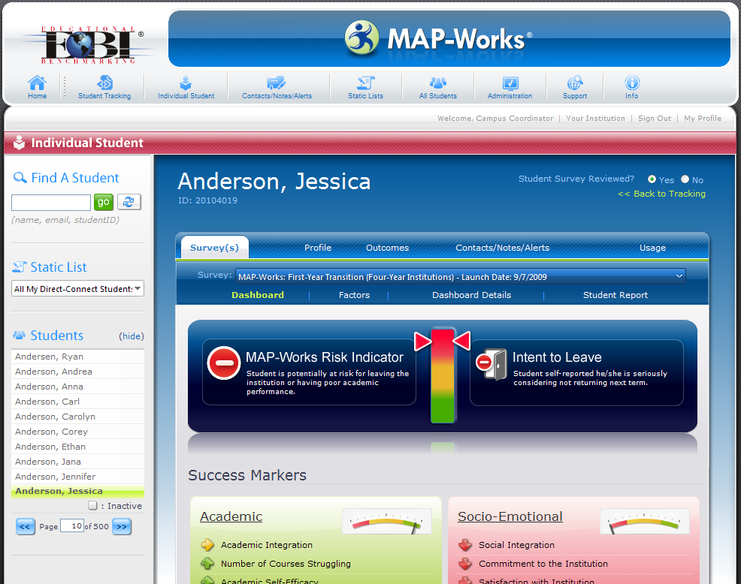
Reading the Individual Student Dashboard
If red, student is potentially at risk for leaving the institution or having poor academic performance
If red, student self-reported he/she is seriously considering not returning next term
MAP-Works Risk Indicator: The same indicator seen on the Student Tracking screen
Intent to Leave: The same indicator seen in the Student Tracking screen
If yellow, student is moderately at risk for leaving the institution or having poor academic performance
If yellow, student self-reported he/she is not firmly committed to returning next term
If green, student is at low risk for leaving the institution or having poor academic performance
If green, student self-reported he/she is committed to returning next term

Slide 41
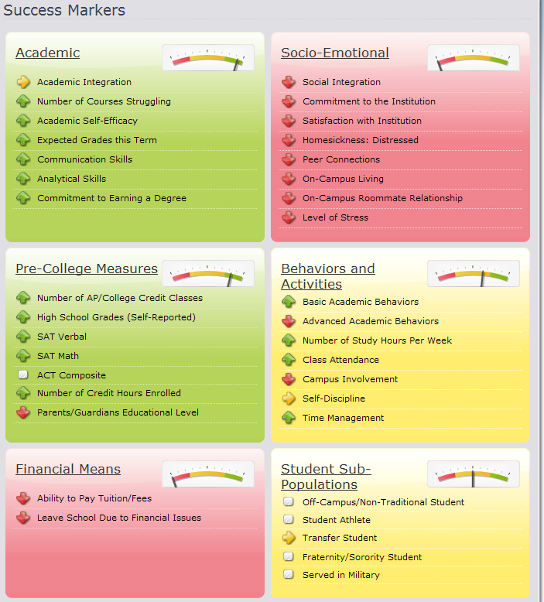
Reading the Individual Student Dashboard
Socio-Emotional: Social integration markers measured from survey
Academic: Academic integration markers measured from survey
Pre-College Measures: Student academic characteristics based on profile and survey
Behaviors and Activities: Based on survey items
Financial Means: Indicators of financial issues based on survey
Student Sub-Populations: Targeted survey items based on sub-population

Slide 42
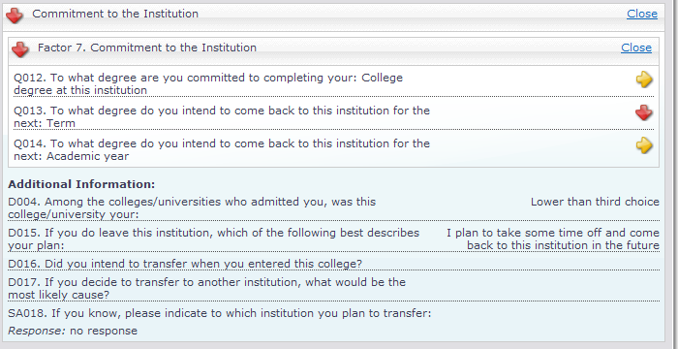
Drilling Down from the Dashboard
Click on header or any factor to view survey and/or profile information
Some questions that compose the marker…
… some questions are additional information to help guide your conversations and interventions

Slide 43
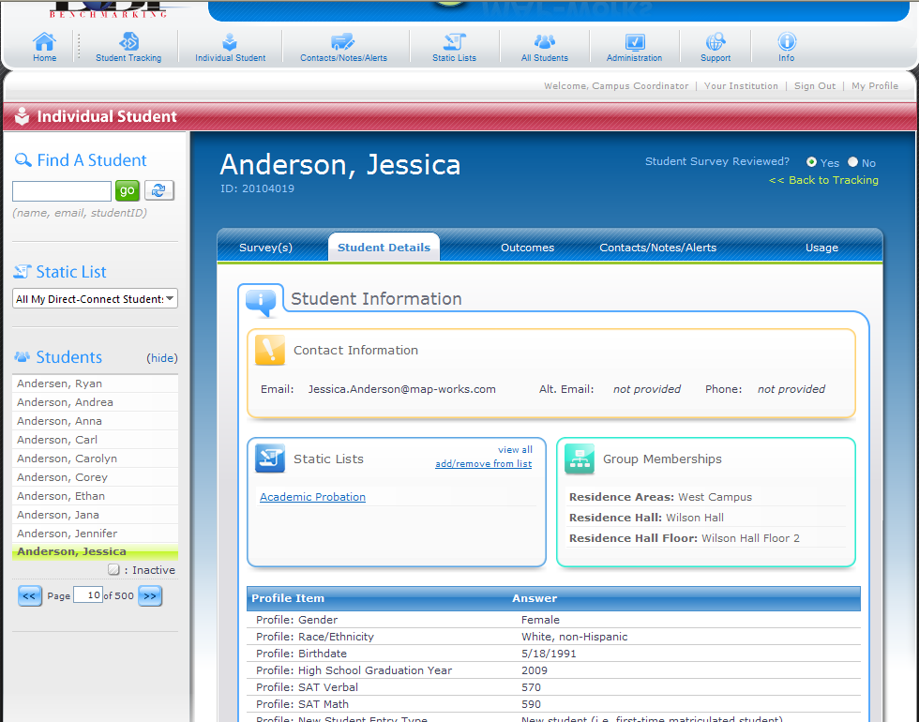
Accessing More Student Information
Click on the Student Details tab to find contact information, static lists you’ve placed student on, groups student is linked to, and the list of Direct-Connect faculty/staff connect to the student
Student contact info
Static Lists and Group Memberships
Profile information provided by institution

Slide 44
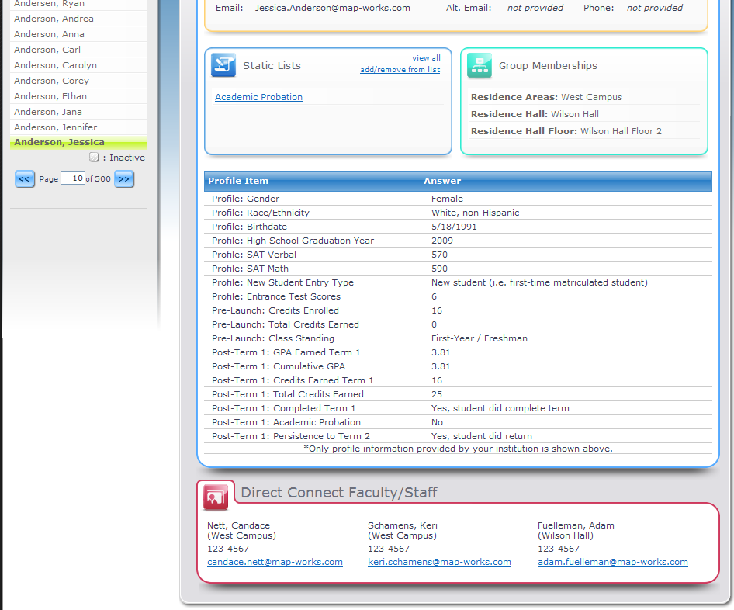
Accessing More Student Information
Scrolling down the screen, you’ll see more Student Details information…
View a list of all Direct-Connect Faculty/Staff

Slide 45
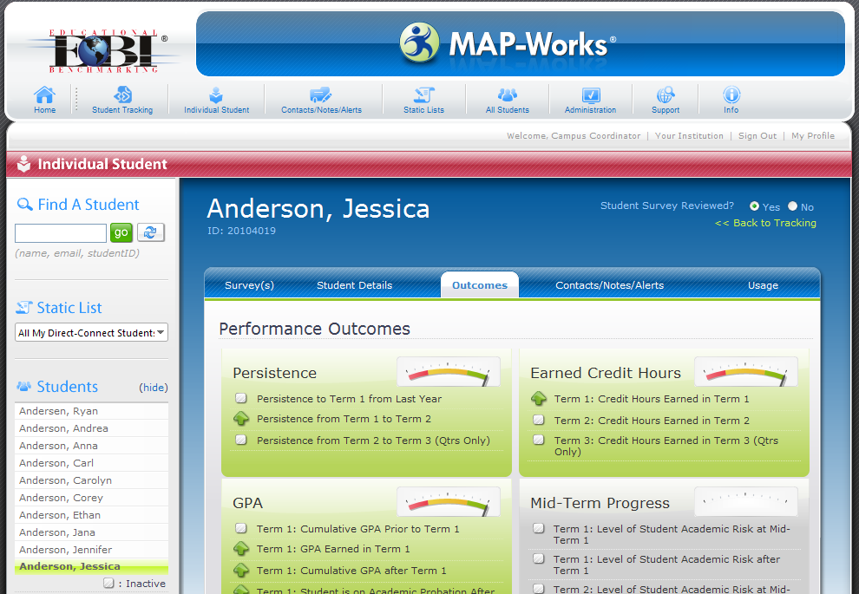
Accessing More Student Information
Click on the Outcomes tab to view the mid-term and post-term information provided by institution. Items may include GPA and credit hours earned

Slide 46
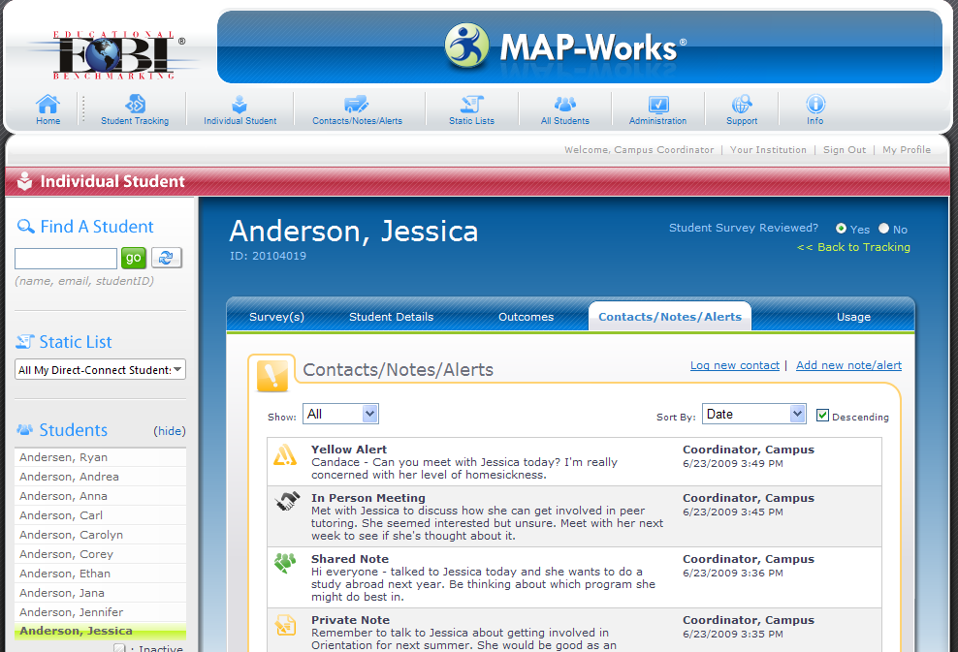
Accessing More Student Information
Click on the Contacts/Notes/Alerts tab to find all activity that’s been logged by you or her other Direct-Connect faculty/staff

Slide 47
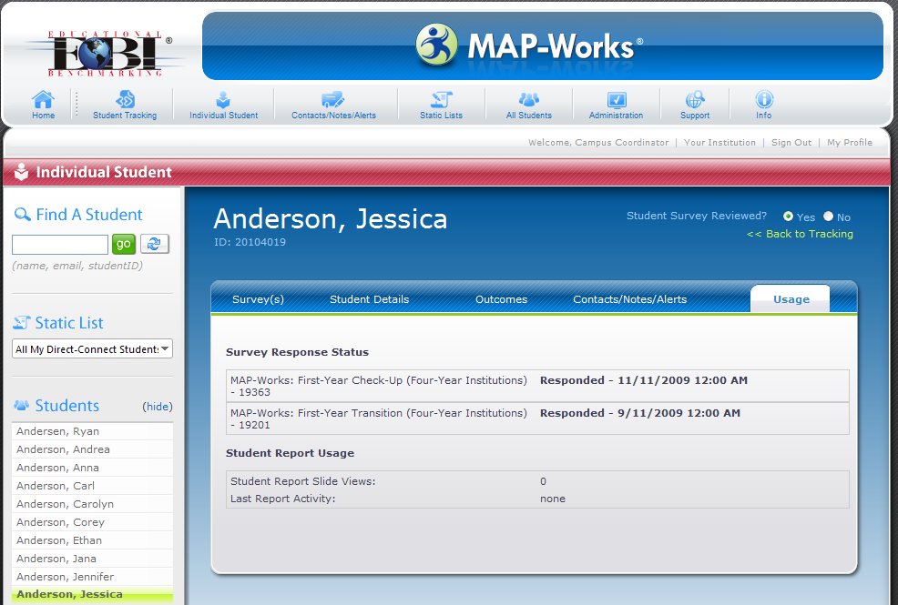
Accessing More Student Information
Click on the Usage tab to see when student responded to the survey and whether she read her report

Slide 48
Logging Information

Slide 49
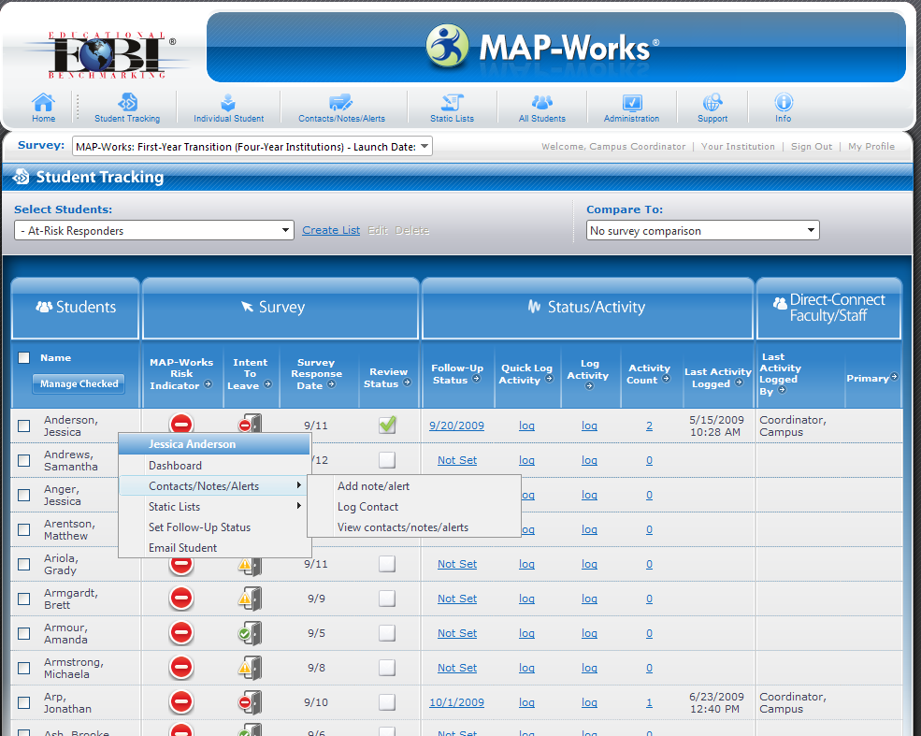
Accessing Contacts/Notes/Alerts
Click on a student’s name and a hover drop-down menu appears
Click on Contacts/Notes/Alerts and a secondary menu appears
Select add note/alert or log contact. Or view a list of contacts/notes/alerts logged for the student
NOTE: Any time a student’s name is listed inside MAP-Works, you can access this drop-down menu!

Slide 50
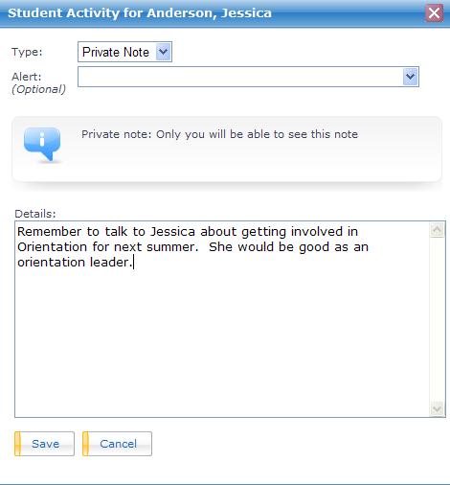
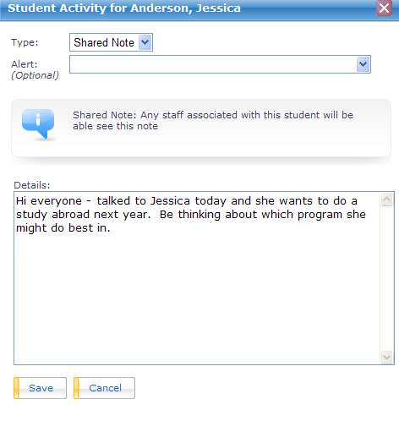
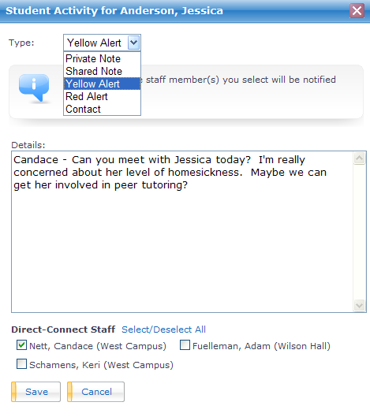
Accessing Contacts/Notes/Alerts

Slide 51
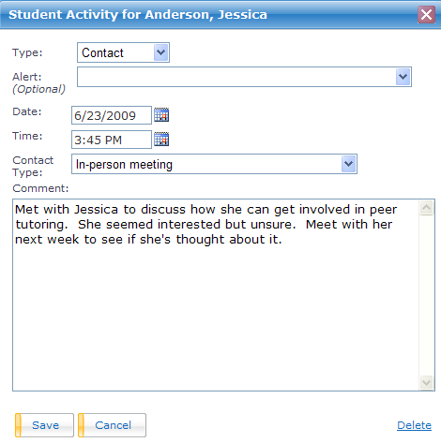
Accessing Contacts/Notes/Alerts

Slide 52
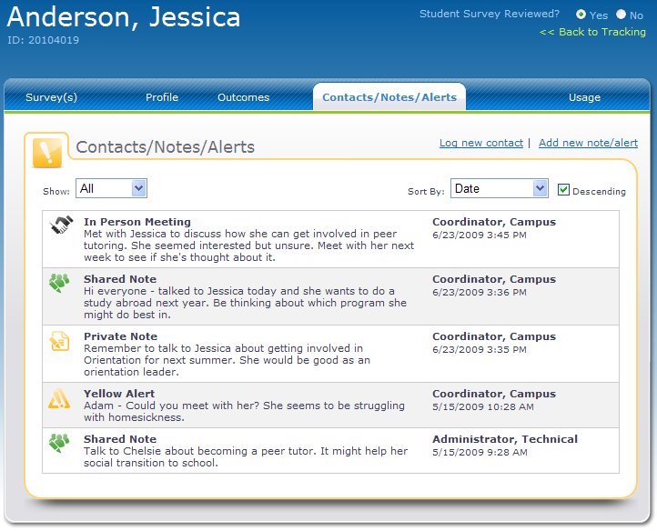
Accessing Contacts/Notes/Alerts

Slide 53
All Students Reporting

Slide 54
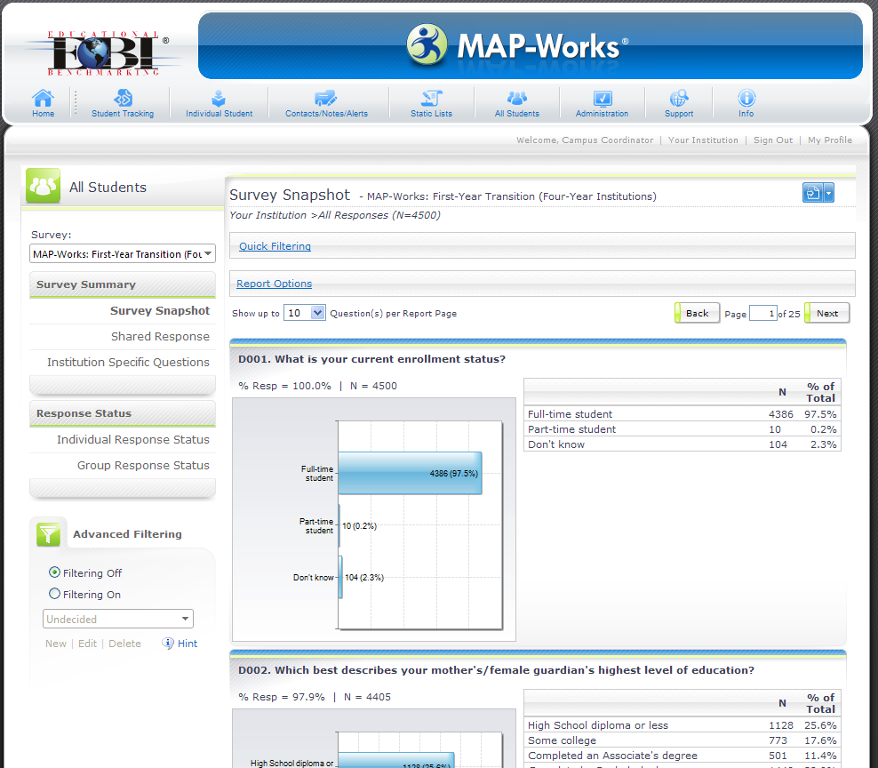
Accessing All Student Reporting
All Students: Click on the “All Students” icon to access the aggregate reporting for your Direct-Connect students
Survey Snapshot: Frequency distribution of every survey question to which you have access
Shared Response: Select an item (survey or profile) and find students who answered the item similarly
Institution Specific Questions (ISQ): Frequency distribution of the ISQs to which you have been given access
Individual Response Status: View a list of your students & date completed survey
Group Response Status: View the aggregate response rate for groups (i.e. halls, courses, etc.) to which have been given access
Quick and Advanced Filtering: Select students based on similar criteria to view responses

Slide 55
MAP-Works Student Report

Slide 56
MAP-Works Student Portal
NEW! A “home page” for students to view and revisit
Transition Student Report
Printable Student Report
Campus Resources
Contact information for their Direct-Connect faculty/staff
Access to Transition or Check-Up Surveys that are available

Slide 57
Student Examples

Slide 58
Student Example #1
Jessica Anderson
CampusID - 20104019

Slide 59
Student Example #2
Adriana Tubbs
CampusID - 20103972

Slide 60
Student Example #3
Amber Rumpza
CampusID - 20103510

Slide 61
Student Example #4
Timothy Williams
CampusID - 20103622

Slide 62
Review
Logging Into MAP-Works
Home Page
Student Tracking Page
Lists---Real time and Static
Individual Student Reporting/Dashboards
Logging Contact, Notes, and Alerts
All Student Reporting/Advanced Filters
MAP-Works Student Report/Portal

Slide 63
Questions/Discussion

