Slide 1
Student Success Factors
Faculty In-Service Program
Tuesday, August 25

Slide 2
The Mission
Southern Adventist University as a learning community nurtures Christ-likeness and encourages the pursuit of truth, wholeness, and a life of service.

Slide 3
The Vision
Southern Adventist University, responsive to its diverse constituencies, will provide high quality educational benefit, lead in the integration of faith and learning, and model academic and professional excellence. The institution will graduate servant leaders guided by faith and integrity, and committed to living balanced lives.

Slide 4
Institutional Goals
Southern Adventist University will
  • Learning Community
nurture campus learning communities that engage students with ideas that mark educated persons, global and multicultural perspectives, and advanced technology to develop both ethical principles and intellectual flexibility.
  • Faculty and Staff
hire and develop a competent and diverse faculty and staff who model balanced ethical lives, integrate faith and learning, demonstrate scholarship through teaching, research, and other scholarly and creative activities, and celebrate and energize the student spirit as they respect and support the different ways students develop their minds, their persons, and their citizenship.
  • Students
recruit, retain, and support a capable, diverse student body.
  • Campus Environment
provide a safe, nurturing learning community of faith for students, faculty, and staff.

Slide 5
Institutional Goals
  • Student Service
enable every student to participate in local service and/or mission service activities.
  • Partnerships
pursue and nurture partnerships with alumni, church, community, business and industry, civic organizations, and government in order to analyze, project, and respond to changing needs to help ensure that graduates are prepared for a life of service.
  • Stewardship
steward resources entrusted to the university through effective fiscal management to fulfill its mission, vision and goals.

Slide 6
The Academic Master Plan
3 Themes, 9 Goals, and Actions
Theme #1: Engaging Instruction:
  Goal #1: Support quality undergraduate academic programs through regular assessment and review.
  Goal #2: Enable high levels of student engagement in learning.
  Goal #3: Promote high academic achievement levels by students
  1. Critical thinking
  2. Core general education curriculum
  3. Active learning
  4. Service learning
  5. Enrollment of qualified students

Slide 7
Six Conditions that Matter to Student Success
(Kuh et al. 2005)
“Living” Mission and “Lived” Educational Philosophy
Unshakeable Focus on Student Learning
Environments Adapted for Educational Enrichment
Clear Pathways to Student Success
Improvement-Oriented Ethos
Shared Responsibility for Educational Quality and Student Success
Notes:
A “Living” Mission and “Lived” Educational Philosophy
“ Mission” refers to the overarching purposes of the institution – what it is, what it stands for, and what it aspires to be. An institution’s philosophy is composed of tacit understandings about how institutional values guide policy and decision making.
II. Unshakeable Focus on Student Learning
At high performing institutions, student learning is the raison d’etre for institutional policies, programs, practices, and the rationale for daily activities as well as broad institutional directions.
III. Environments Adapted for Educational Enrichment
Learning environments include all the physical and psychological spaces in which students, faculty, and staff live, work, and play.
IV. Clearly Marked Pathways to Student Success
To encourage students to devote time and energy to the right activities, (1) teach students what the institution values, what successful students do, and how to take advantage of institutional resources for learning and (2) make sure resources are available to all their students.
V. Improvement-Oriented Ethos
“positively restless.” Strive to monitor themselves and improve continually, in both formal and informal ways: their current level of performance and whether they are making progress toward desired goals and objectives.
VI. Shared Responsibility for Educational Quality and Student Success
Faculty, staff, and students see themselves as educators. Student learning is widely accepted as everyone’s responsibility (Kinzie & Kuh, 2004).

Slide 8
Clear Pathways to Student Success
(Support with challenge)
Student success is no accident. Students who thrive in college typically engage in a variety of educationally purposeful activities and use the educational resources of the campus. To increase the odds that students will invest the time and right activities some colleges do two things very well.
(Kuh 2006)

Slide 9
Clear Pathways to Student Success
(Support with Challenge)
Teach students what the institution values, what successful students do, and how to take advantage of institutional resources for learning.
Provide redundant early warning systems, safety nets, and ongoing assessment and feedback.
Notes:
IV. Clearly Marked Pathways to Student Success
To encourage students to devote time and energy to the right activities, DEEP schools (1) teach students what the institution values, what successful students do, and how to take advantage of institutional resources for learning and (2) provide redundant early warning systems, safety nets, and ongoing assessment and feedback!
What does the institution do to communicate the expectation that students assume a fair share of responsibility for their learning, prior to and after students start college?
What symbols and actions communicate to newcomers the importance of students and their learning and success?
To what extent are resources ‘front-loaded’ to foster students’ academic and social success?
Do all students have equal access to institutional resources?
Is the amount of challenge and support consistent with the needs of students and with the institution’s educational priorities?
Do students who need extra support receive it?
What policies and practices identify students at risk? What early warning systems are in place at your institution? To what extent are they used, in what ways, and by whom?
Do faculty members know where or to whom to refer students experiencing difficulties?
Would a complex, comprehensive support program make sense at your institution? If so, what steps would be necessary to put such a system in place?

Slide 10
What we Know About Student Feedback at Southern
The Noel-Levitz Student Satisfaction Inventory (SSI)
  Performance gaps on the question: “Faculty provide timely feedback about student progress in a course.” are consistently higher than other 4-year private institutions. This performance gap is statistically significant at p<.001 in most years.
2000 |  | 2002 |  | 2004 |  | 2006 |  | 2008
SAU | 4-Yr Pvt | SAU | 4-Yr Pvt | SAU | 4-Yr Pvt | SAU | 4-Yr Pvt | SAU | 4-Yr Pvt
1.44 | 1.24 | 1.75 | 1.18 | 1.28 | 1.17 | 1.61 | 1.21 | 1.66 | 1.17
Notes:
Performance Gap is the difference between student perceived importance (not important at all to very important) and student satisfaction (not satisfied at all to very satisfied) on a seven point scale for each dimension.
Higher gaps indicate a broader spread between student perception of importance and student satisfaction. Narrower gaps indicate closer alignment between the dimensions and therefore lower significance to institutional improvement efforts.

Slide 11
What we Know About Student Feedback at Southern
National Survey of Student Engagement (NSSE)
  Mean response to: “Received prompt written or oral feedback from faculty on your academic performance.” is consistently lower than SAU’s selected peer group and Carnegie Class. This performance differential is statistically significant at p<.001 in most years for first-year students and seniors.
 | 2007 |  |  | 2008 |  |  | 2009
 | SAU | Peer | CC | SAU | Peer | CC | SAU | Peer | CC
FY | 2.53 | 2.75*** | 2.64 | 2.44 | 2.79*** | 2.75*** | 2.54 | 2.75*** | 2.69***
SR | 2.68 | 2.93*** | 2.87** | 2.61 | 2.95*** | 2.91*** | 2.80 | 2.97** | 2.91*
Notes:
See Word table for frequencies behind these mean scores.
The scale here was: (1) Never, (2) Sometimes, (3) Often, (4) Very Often
*** = <.001
** = <.01
* = <.1

Slide 12
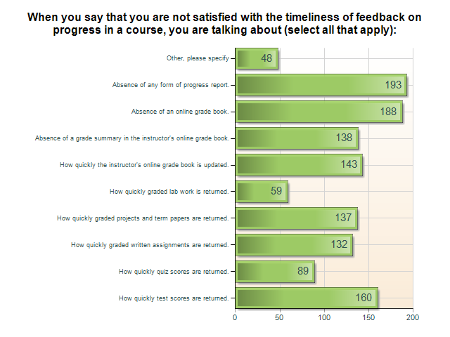
What Does it Mean?
Notes:
Zoomerang sent out May 2008
348 responses

Slide 13
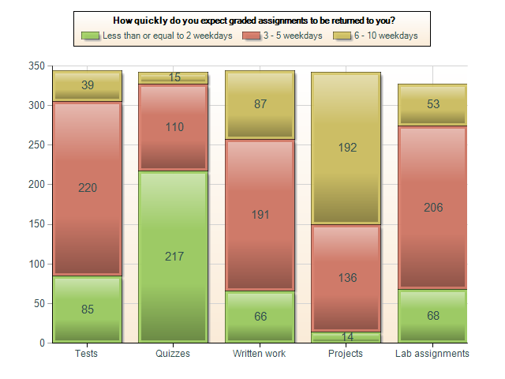
What Does it Mean?

Slide 14
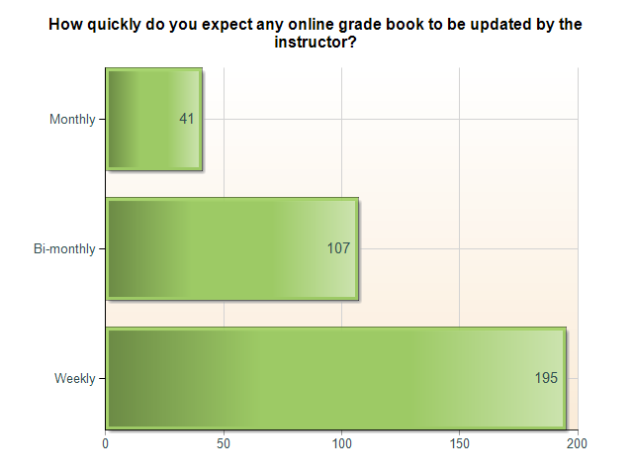
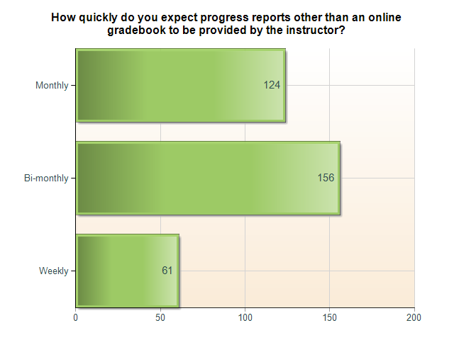
What Does it Mean?

Slide 15
Where Do We Go From Here?

Slide 16
References
Kuh, George. D., Kinzie, Jillian., Schuh, J.H., Whitt, E.J., & Associates (2005). Student success in college: Creating conditions that matter. San Francisco: Jossey-Bass.
Kuh, G., Kinzie, J., Schuh, J.H., Whitt, E.J. (2006, January 19). Student success in college: Why it matters and what institutions can do about it. First-Year Assessment Listserv. http://www.sc.edu/fye/resources/assessment/essays/Kuh-1.19.06.html

