Slide 1


Using Strengths
Using Your Strengths to Build Emotional
Intelligence in Higher Education

Slide 2

Using Strengths
Worship Thought….

Slide 3

Clifton’s Strength and Emotions
What do things look like now?
EI and Clifton’s Strengths
Sensitivity regarding EI scores
Privacy
4 seminars (Perceiving, Using, Understanding and Managing) While Focusing on Your Strengths
Set up coaching sessions

Slide 4

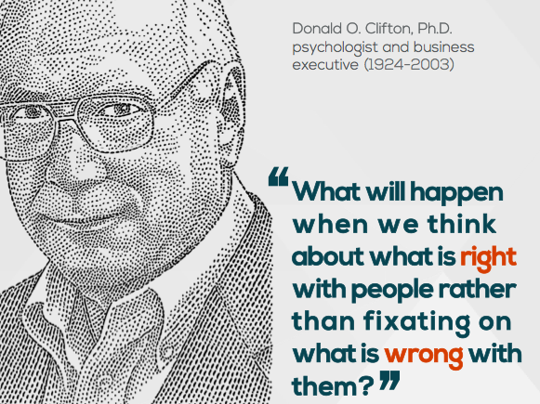
Sample 3
Think About What is Right!
As a leader, KNOW your TEAM’s Strengths!
Clifton’s Strengths
“From this point of view, to avoid your strengths and to focus on your weaknesses isn't a sign of diligent humility. It is almost irresponsible. By contrast the most responsible, the most challenging, and, in the sense of being true to yourself, the most honorable thing to do is face up to the strength potential inherent in your talents and then find ways to realize it.”
(Baehr, 2017)

Slide 5
Clifton’s Strength and Emotions
By concentrating on your talents while growing
your emotional intelligence, you will be able to see an honest picture of who God made you to be…
-R. Overstreet

Slide 6
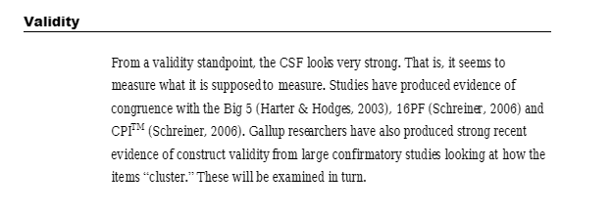
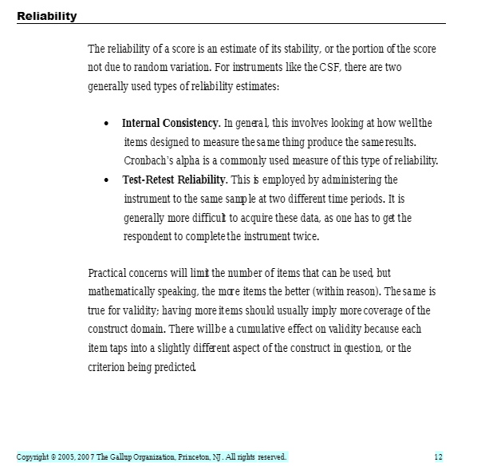
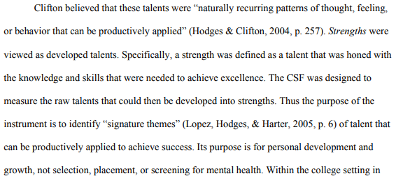


Slide 7
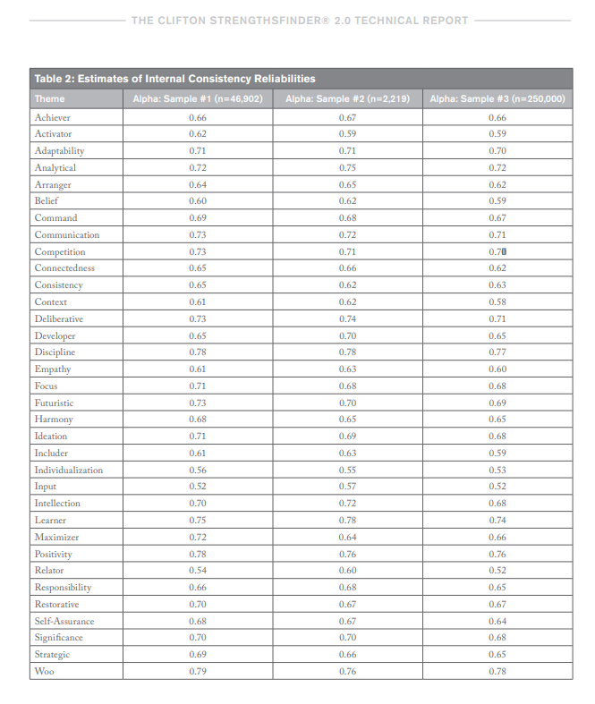



Slide 8
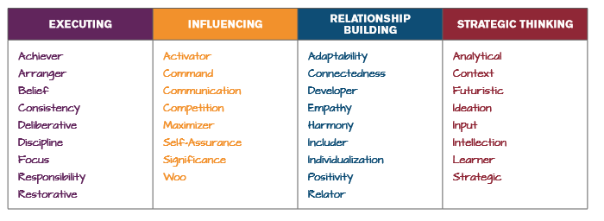
Clifton’s Strength and Emotions What Domains Do You Fall In?

Slide 9
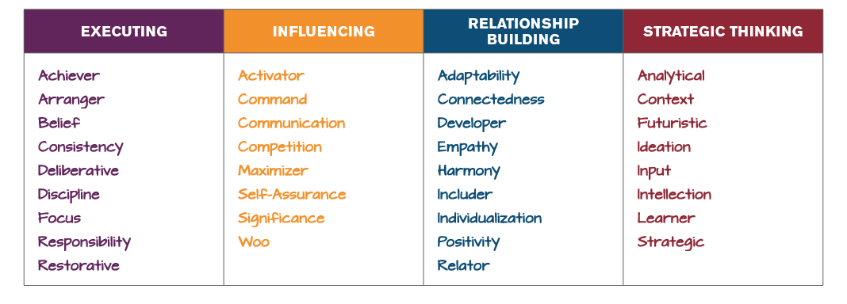
My Top 5 = 2 Domains

Slide 10
Do Your Strengths Affect Your Emotions?

Slide 11
Top 34 Strengths? Always….Sometimes…Hardly Ever

Slide 12
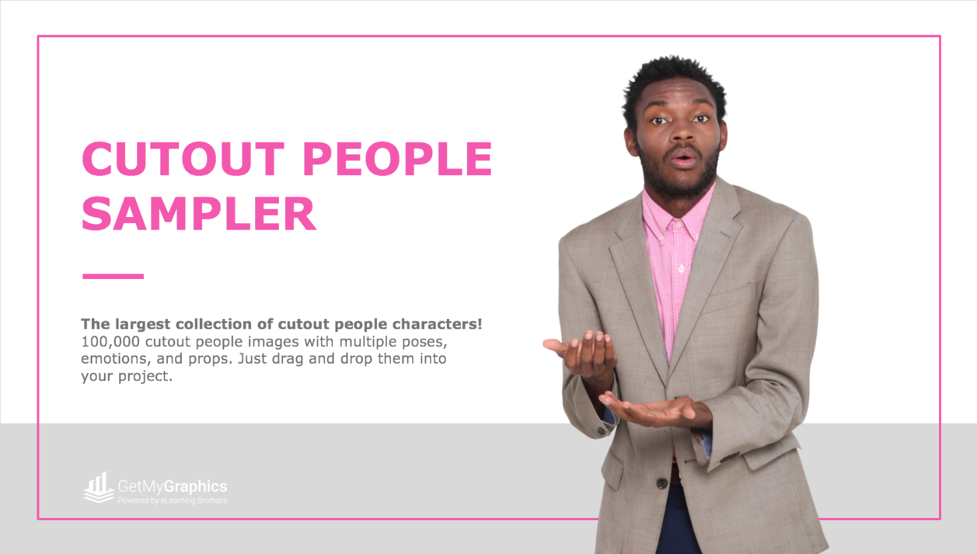
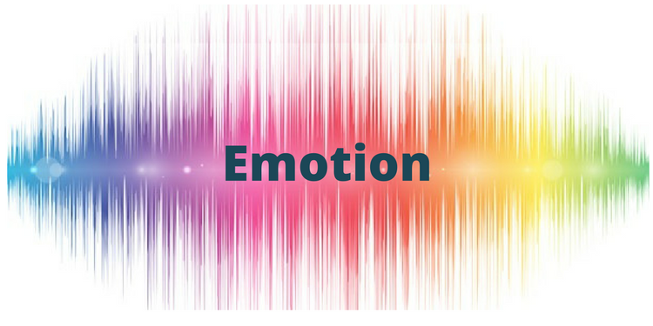



Slide Title Page
The single most important factor in job performance and advancement is emotional intelligence
(Goleman 2006)
“All learning has an emotional base.”
-Plato
Far from interfering with rationality, the absence of emotion and feeling can break down rationality and make wise decision making almost impossible
Damasio, 2018

Slide 13
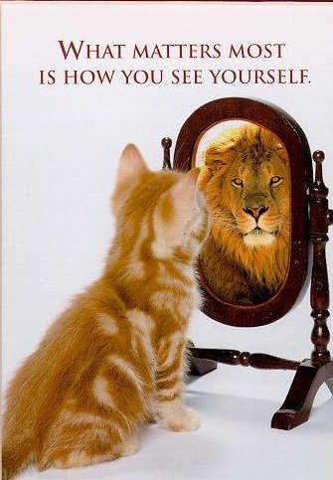
How Well Do YOU Know YOU?
Self-Awareness – People with high emotional intelligence and know their strengths are usually very self-aware. They understand their emotions, and because of this, they don't let their feelings rule them. They're confident – because they trust their intuition and don't let their emotions get out of control.
What are your “Strengths” according to Clifton’s Strengths Finder?
Do you know your EI scores?

Slide 14
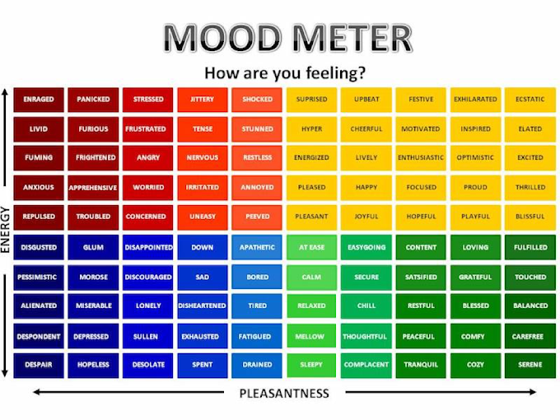
Understanding Emotions

Slide 15
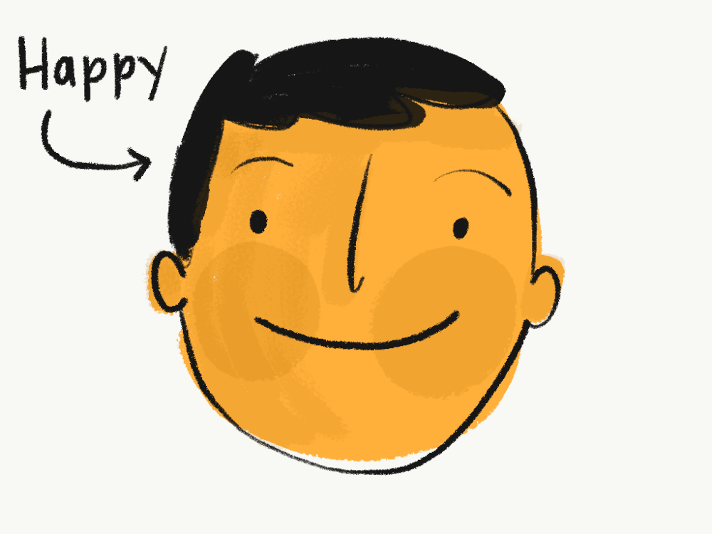
Sample 3
EI predicts 90% of success
Emotional Intelligence
Emotions are essential and help us think – A FORM OF DATA characters.
“THE CAPACITY FOR RECOGNIZING OUR OWN FEELINGS AND THOSE OF OTHERS, FOR MOTIVATING OURSELVES, AND FOR MANAGING EMOTIONS WELL IN OURSELVES AND IN OUR RELATIONSHIPS.

Slide 16

Why Should Professors/Educators Focus on Emotional Intelligence in Education?
Our ability to learn has deep roots in relationships… Our learning performance may be deeply affected by the emotional environment in which the learning takes place (Medina, 2008)
Foster relationships - Successful teaching and learning therefore depends on the establishment of close bonds with students and on creating teaching conditions that make emotional understanding possible. (Hargreaves, 2001)

Slide 17

Sample 4
Teacher Effectiveness in Relation to Emotional Intelligence.The study revealed a positive correlation between EI and teacher effectiveness, both self-reported and students rated.
Indoo Singh, Ajeya Jha. (2014).
WHAT EI PREDICTS
More Pro-social Behavior
Better quality relationships
Greater sensitivity and empathy
Create More positive work environment
Teams that are higher in EI
Have faster cohesion
Perform more effectively in a short amt of time
Clearer vision

Slide 18
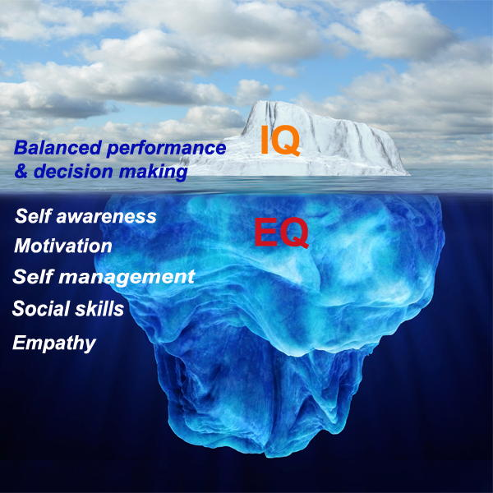
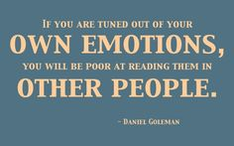
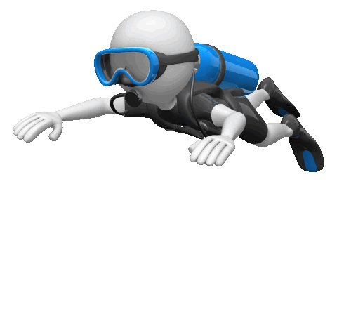
got you the job?
helps you keep the job?

Slide 19

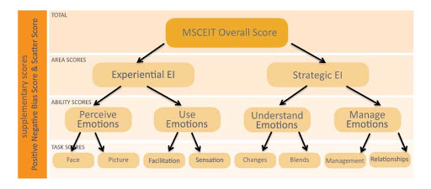
What is the MSCEIT
Relating to the identification of long-term or overall aims and interests and the means of achieving them.
involving or based on experience and observation

Slide 20
Ability Based EI: Measurement
MSCEIT: Mayer-Salovey-Caruso Emotional Intelligence Test
Based on a series of emotion-based problem-solving items
Tests individual’s abilities on each of the four branches of emotional intelligence
Scores generated for each of the four branches as well as a total score
**

Slide 21
Ability Based EI: Measurement
MSCEIT: Scoring
Individual’s responses compared to those provided by worldwide sample of respondents
With higher scores indicating higher overlap between individual and comparison group
Unlike IQ test, items on MSCEIT do not have objectively correct responses
Difficult to regard as a genuine intelligence

Slide 22
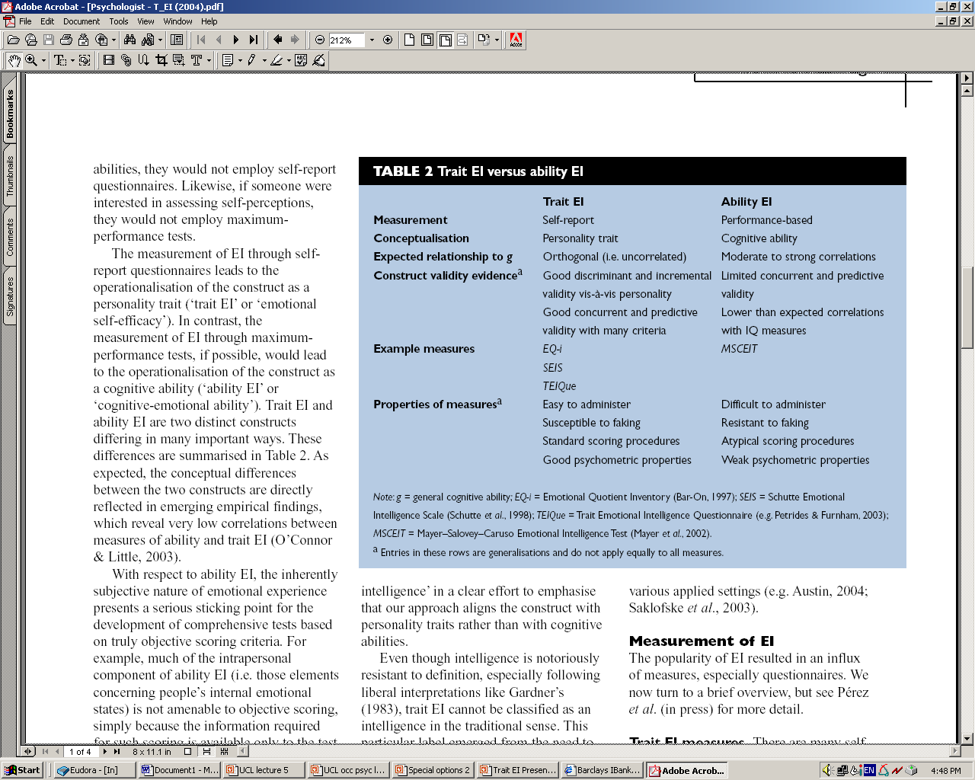
Trait EI vs ability EI
October 2009, NTU Taipei

Slide 23
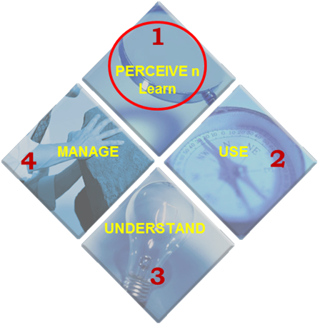
Ability Model of EI - MSCEIT
Perceiving Emotions | Emotion contains information about ourselves, other people and the world around us. Emotions are data.
Using Emotions to Facilitate Thought | Our emotions influence both what we think about, and how we think.
Understanding Emotions | Understand causes of emotions, predict emotional changes, label emotions to communicate.
Managing Emotions | Enhance, reduce, create or prevent emotions to achieve positive outcomes.
Within each branch, skills can be identified that are early-developing (e.g., in childhood), and skills that await greater maturity. Caruso (2012)

Slide 24
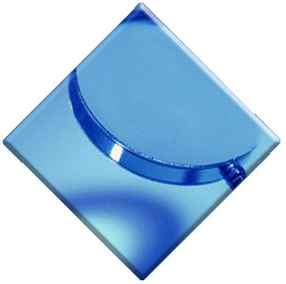


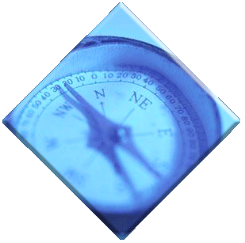


Perceiving Emotions
“How you and those around you are feeling”
Pay Attention to emotional signals
Perceive and express emotions and your role
Pick up on cues Look!!!
1
PERCEIVE
MANAGE
USE
4
2
UNDERSTAND
3

Slide 25
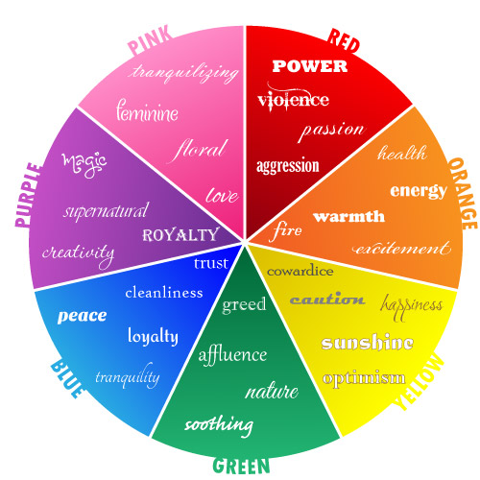
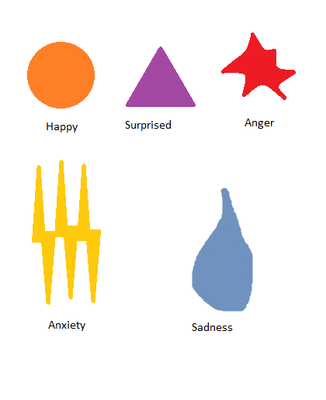
Perceiving Color and Shapes

Slide 26
Person Perception
Person Perception can be a very subjective process that can be impacted by a number of variables. Factors that can influence the impressions you form of other people include the
Characteristics of the person you are observing
The context of the situation
Own personal traits and your past experiences.
Nisbett, R. E. (2003). The geography of thought. New York, NY: Simon & Schuster Inc.
Do You Know Your Preconceptions?

Slide 27
Perceive - Picking up on Cues
Facial Expressions - Why they matter: Facial expressions can be the most obvious social cues. It’s hard to hide an emotion when it’s “written all over your face.”
http://www.artofcommunicating.com.au/public_speaking%20tips/body_language_expression.html

Slide 28
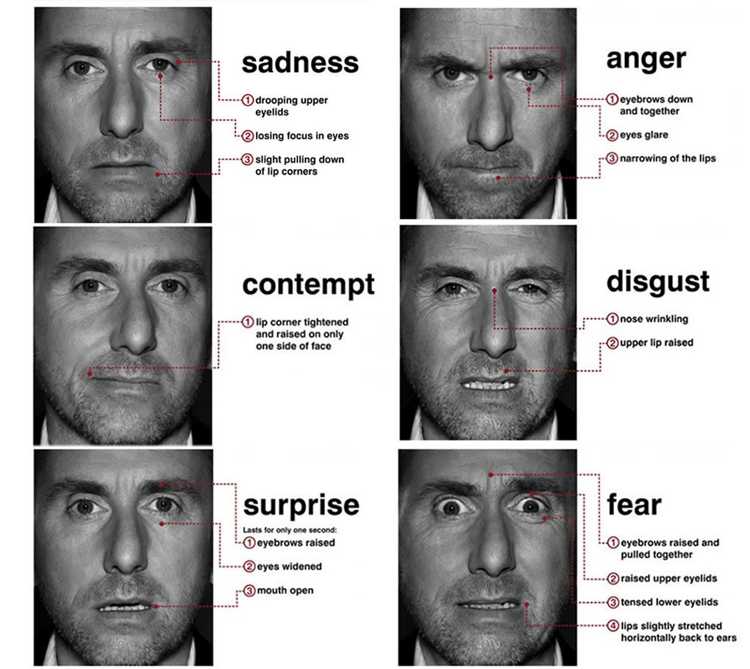
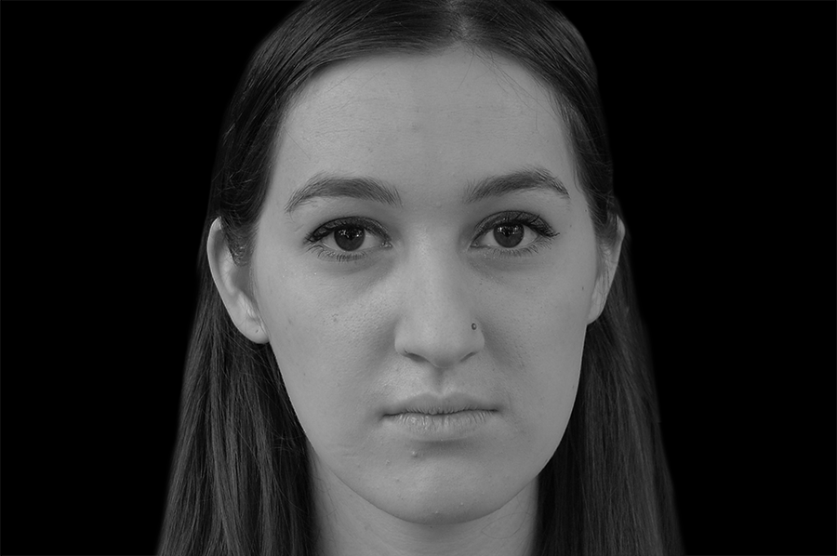

Perceive - Picking up on Cues
Unlike regular, pro-longed facial expressions, it is difficult to fake a microexpression. There are seven universal microexpressions: disgust, anger, fear, sadness, happiness, surprise and contempt. They often occur as fast as 1/15 to 1/25 of a second.
https://www.paulekman.com/resources/micro-expressions/

Slide 29

Perceive - Picking up on Cues
Body Language - How we use it: Sometimes an emotion is so strong, it affects the way we hold our body - Why it matters: Body language can be involuntary or done on purpose.
https://testyourself.psychtests.com/testid/3764
Voice Pitch and Tone- How we use it: Certain moods call for high or low voices and fast or slow speech. - Why it matters: Changes in voice can sometimes change the meaning of what’s being said. (“Bless Your Heart”)
Personal Space

Slide 30
How Are You Perceived At Southern? Ways to Help How You Are Perceived
Give Off Kinder Vibes
KNOW Others STRENGTHS
Be Curious
Ask “What’s Your Story”
Follow Through
Listen Before You Speak
Social Awareness
Eye Contact. People place a lot of stock in eye contact. ...
Gestures and Movement. ...
Physical Touch. ...
Appearance. ...
Nod in Nonverbal Agreement.

Slide 31

How well do you “read” people’s facial expressions?
Log onto Kahoot.it

Slide 32

One Word Photo’s

Slide 33

Read These People

Slide 34

Read These People

Slide 35
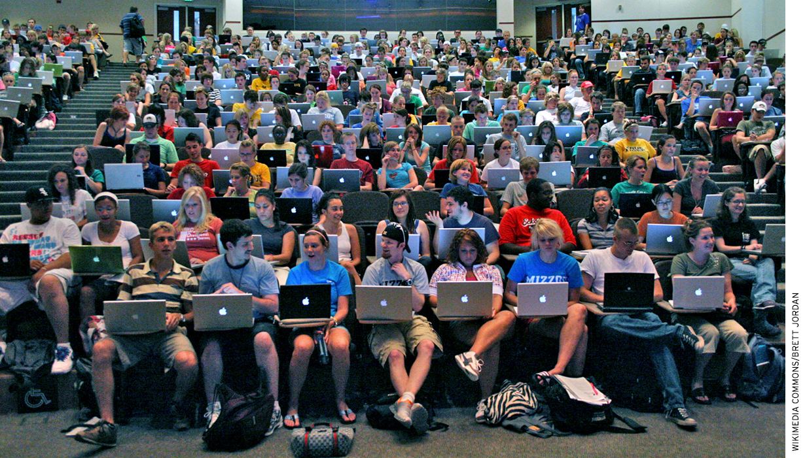

Slide 36
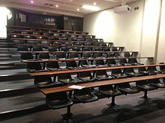
Read This Picture

Slide 37


Slide 38


Slide 39

“One-word Photo”

Slide 40
Sample 2
Grow Your Strengths
Clifton Strengths (often called “StrengthsFinder”) is an online assessment that helps you discover what you naturally do best, where you have the most potential, and what makes you exceptional.

Slide 41
Sample 3
How To Strengthen Perceiving Emotions?
Emotions are essential and help us think – A FORM OF DATA characters.
Be Intentional About “people watching”, and “people listening”.
Observe how you “feel” 10x per day-Pay attention to your behavior.
Journal, Journal, journal
Listen to Others

Slide 42
Proverbs 12:15 “The way of a fool is right in his own eyes, but a wise man listens to advice.”
Luke 5:22 But Jesus, aware of their reasoning's, answered and said to them, "Why are you reasoning in your hearts?
Proverbs 1:2 To know wisdom and instruction; to perceive the words of understanding;

Slide 43
Homework
Complete Exit Ticket
Be able to state and define your 5 strengths.
Journal how you can grow your weakest EI score using your Clifton’s Strengths
Journal Your Emotions (2 weeks)
Review Provided Websites and Material
Grow Your Perceiving Ability

Slide 44
Using Strengths
Using Your Strengths to Build Emotional
Intelligence in Higher Education
The End… Questions?

