Slide 1



Part
Using Strengths
Using Your Strengths to Build Emotional
Intelligence in Higher Education

Slide 2

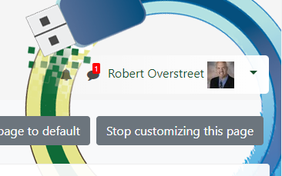
Feedback From Last Session
Candy/water was a good idea.
More Engaging Activities/Break?
Great Information
Provide more “To Do’s”
Truth-teller = A person who will share truth even if
will create hurt/pain/uneasiness.
How to use your Strengths to grow your EI
HOW do I make changes – Personally and Professionally?
eClass website: https://eclass.e.southern.edu/course/view.php?id=38743

Slide 3
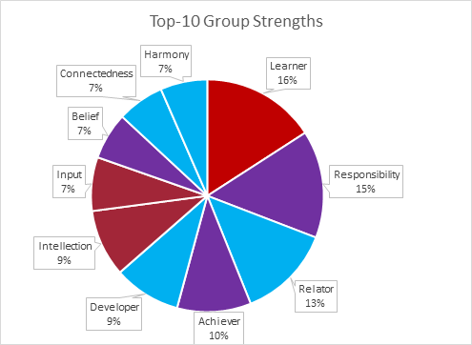
Overview of What Was Learned
From Last Session.

Slide 4
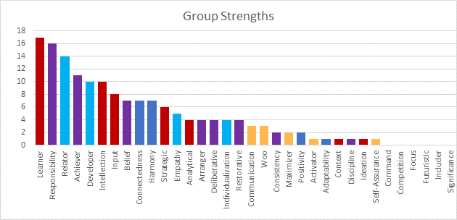
Overview of What Was Learned
From Last Session.

Slide 5
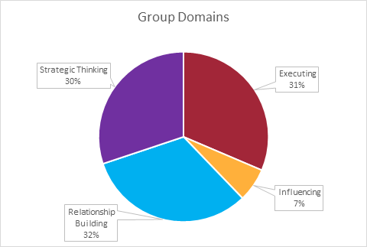
Overview of What Was Learned
From Last Session.

Slide 6



Have you made any Movement?
The very first step towards success in any occupation is to become interested in it.
William Osler

Slide 7


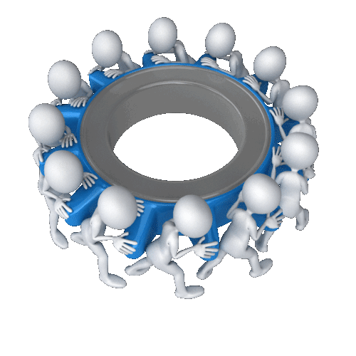
Sample 3
Together Everyone
Achieves More
As a leader, KNOW your strengths and your TEAM’s Strengths!
Clifton’s Strengths
Partner up and state your 5 strengths and define them..

Slide 8

Sample 3
I am Great,
But…
Pitfalls of Your Strengths
Clifton’s Strengths
What are your Pitfalls?
See Handout

Slide 9
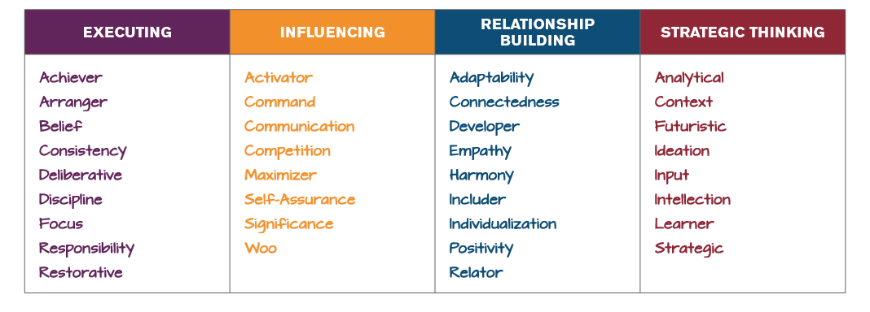
Do You Have Access to All 34 Talents?
Always – Sometimes – Hardly Ever

Slide 10


Sample 3
“THE CAPACITY FOR RECOGNIZING OUR OWN FEELINGS AND THOSE OF OTHERS, FOR MOTIVATING OURSELVES, AND FOR MANAGING EMOTIONS WELL IN OURSELVES AND IN OUR RELATIONSHIPS.
EI predicts 90% of success
Emotional Intelligence
Jesus wept, but not for Himself. He felt the pain of the entire human race. “Looking down the years to come, He saw the suffering and sorrow, tears and death, that were to be the lot of men. His heart was pierced with the pain of the human family of all ages and in all lands. . . . He longed to relieve all their distress.”—Ellen G. White, The Desire of Ages, p. 534

Slide 11



Sample 3
Create a List of Jesus Christ’s Top 5 Strengths
Jesus’s Strengths

Slide 12



How Well Do You Read People?
Perceiving Faces!
Log onto: kahoot.it

Slide 13
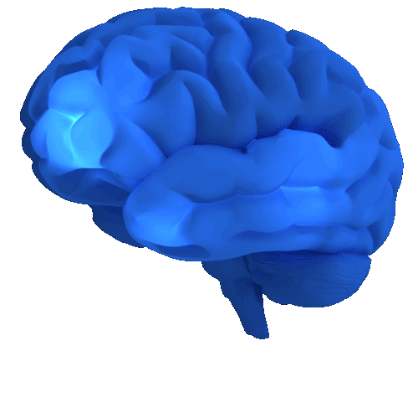
Facilitating Thought…What does it mean?
The ability to generate, use, and feel emotion as necessary to communicate feelings or employ them in other cognitive processes
Using Emotions

Slide 14
Using Emotions to FACILITATE THOUGHT
Using Emotions
…the absence of emotion and feeling can break down rationality and make wise decision making almost impossible. - Damasio

Slide 15
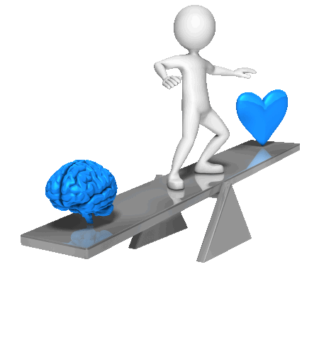

Using Emotions to Facilitate Thoughts
Using emotions to facilitate thought involves redirecting and prioritizing your thinking based on the feelings associated with those thoughts
Moore (2011)

Slide 16
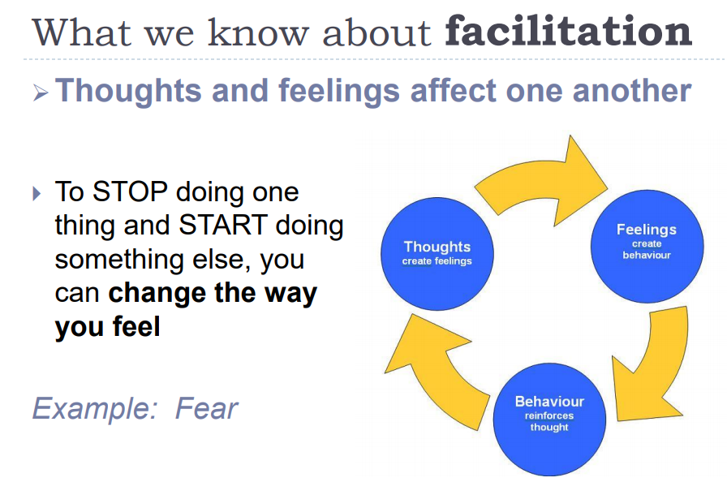
Of Shots

Slide 17


Slide 18

FEAR:
“Peter Walking on Water”
USE Emotions
Anger
Happiness
Surprise
Disgust
Sadness
Fear
Matthew 14:22-33
²⁸ “Lord, if it’s you,” Peter replied, “tell me to come to you on the water.”²⁹ “Come,” he said. Then Peter got down out of the boat, walked on the water and came toward Jesus. ³⁰ But when he saw the wind, he was afraid and, beginning to sink, cried out, “Lord, save me!”³¹ Immediately Jesus reached out his hand and caught him. “You of little faith,” he said, “why did you doubt?”

Slide 19
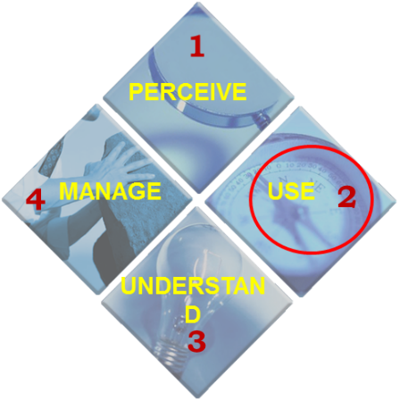


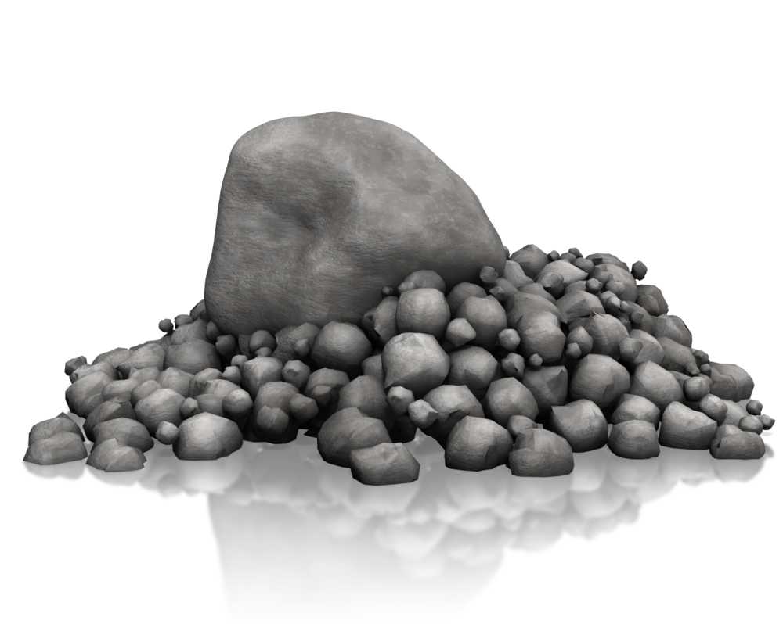
ANGER:
“Moses - Rock”
USE Emotions
Anger
Happiness
Surprise
Disgust
Sadness
Fear
“Listen, you rebels, must we bring you water out of this rock?” Then Moses raised his arm and struck the rock twice with his staff. Water gushed out, and the community and their livestock drank.” – Numbers 20:9-11.

Slide 20
Emotions - Interference
Anger
Happiness
Surprise
Disgust
Sadness
Fear
It’s worth noting that people with high EI don’t remove all emotions from their decision-making, just the ones that can interfere. This helps them stay more objective while also allowing them to rely on their feelings to a healthy extent.
Salovey (2017)
Anger
Happiness
Surprise
Disgust
Sadness
Fear

Slide 21


USE Emotions
YOUR positive mood will make you better at coming up with novel ideas, solving problems, and making decisions.
Anger
Happiness
Surprise
Disgust
Sadness
Fear
(Medina, 2018)

Slide 22
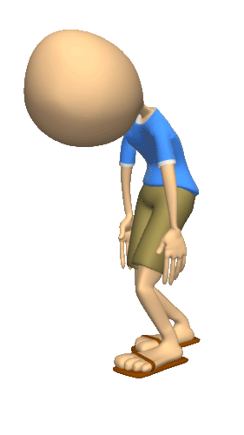
USE Emotions
The upside of being down, or at least more somber: we can more easily focus on those details we missed or ignored while we were upbeat - we pay more attention even to boring jobs.
(Yungi, 2009)
Anger
Happiness
Surprise
Disgust
Sadness
Fear

Slide 23

USE Emotions
Effective leadership TEACHING directly involves the use of emotion, often through symbolic management [where] the INSTRUCTOR leader uses symbols – stories, rituals, myths, fables – to rouse and motivate STUDENTS staff to guide them toward achievement of a shared vision.’
Anger
Happiness
Surprise
Disgust
Sadness
Fear
Caruso, Mayer & Salovey 2001

Slide 24
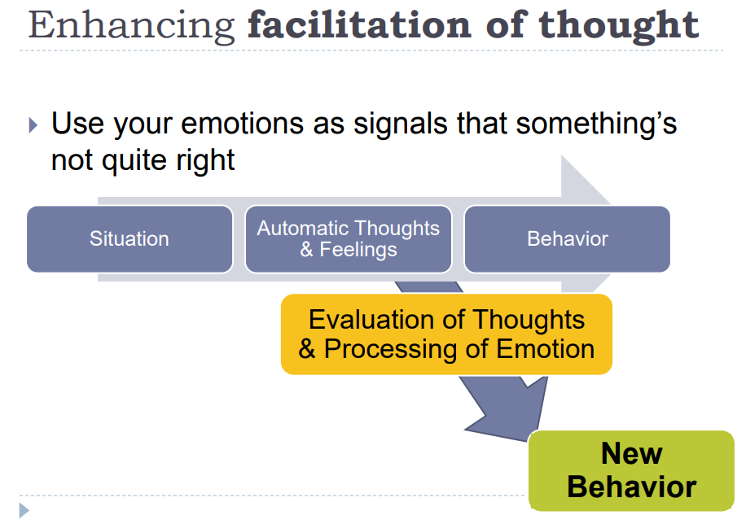

Images and Icons
How To Use Emotions

Slide 25


How To USE Emotions
Match Your Current Mood to the Task at Hand - Emotional empathy
Anger
Happiness
Surprise
Disgust
Sadness
Fear
‘Effective teaching directly involves the use of emotion, often through symbolic management [where] the leader uses symbols – stories, rituals, myths, fables – to rouse and motivate students to guide them toward achievement of a shared vision.’
Caruso, Mayer & Salovey 2001

Slide 26

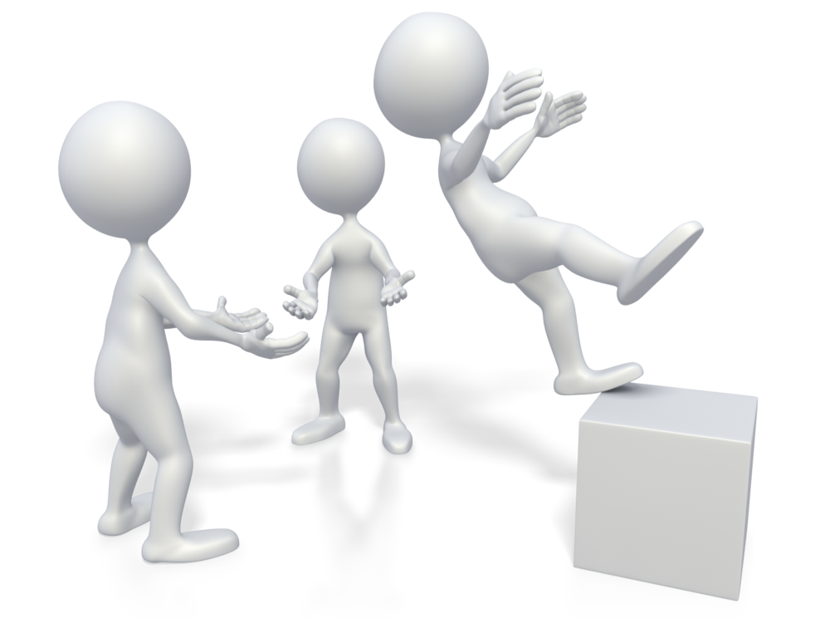
How To USE Emotions
Create Connections
With others…
Build trust and rapport
with your students/peers
TELL THEM “I believe in YOU”
Anger
Happiness
Surprise
Disgust
Sadness
Fear

Slide 27
More tidbits on
How To USE Emotions
Focus more on “we" and less on “me.”
2. Don’t Forget Personal forms of communication – write a note
3. ASK Questions about the other person’s experiences.
4. Learn about others expectations- what motivates others (Money, challenge, etc.)
5. INTENSIFY Your attention!
Anger
Happiness
Surprise
Disgust
Sadness
Fear

Slide 28
Match Mood to Task: Essential Tool
There is no good or bad emotion!
There are better emotions for certain situations
Remember – emotions are contagious
Anger
Happiness
Surprise
Disgust
Sadness
Fear

Slide 29
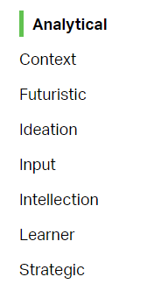

How to Use Your Strengths While You USE Emotions
INFLUENCING DOMAIN
Leaders must use their EI to absorb (Percieve), think about (Use) and analyze information and situations-Avoid judgement (Understand)!. When teams need to focus on what could be, they turn to leaders with Strategic Thinking themes to stretch the team's thinking for the future.
INFLUENCING DOMAIN

Slide 30
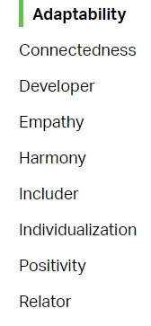
How to Use Your Strengths While You USE Emotions
RELATIONSHIP DOMAIN
How do you build and nurture strong relationships?" They may help you hold a team together.
When teams need to be greater than the sum of their parts, they turn to people with Relationship Building themes to strengthen their bonds. Leaders in this domain must remember to use their EI to SEE (Percieve) the talents and abilities in others. Use your relationship skill-set to get buy-in (Manage).
Relationship Domain

Slide 31
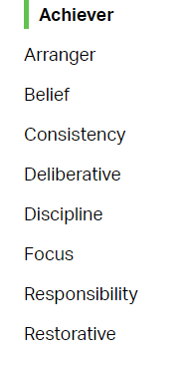
How to Use Your Strengths While You USE Emotions
EXECUTING DOMAIN
High-performing teams rely on people with strong Executing themes because they make things happen.
When your team needs to get things done, look to people with the following Executing themes. They can take an idea and make it a reality. And they'll work tirelessly to accomplish the goal. The best teams are made up of individuals who understand their own -- and others' -- unique contributions to the team. Use Your EI to examine (Perceive) the talents of your team and the contributions they possess.
Executing Theme

Slide 32
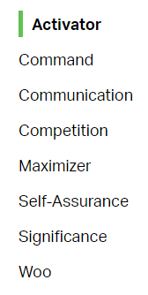
How to Use Your Strengths While You USE Emotions
INFLUENCING DOMAIN
How do you influence others? Do you take charge and speak up? Remember that great influencers also ensure that others are heard (Use/Understand).
When teams need to sell their ideas inside and outside the organization, they turn to people with Influencing themes to convince others.

Slide 33
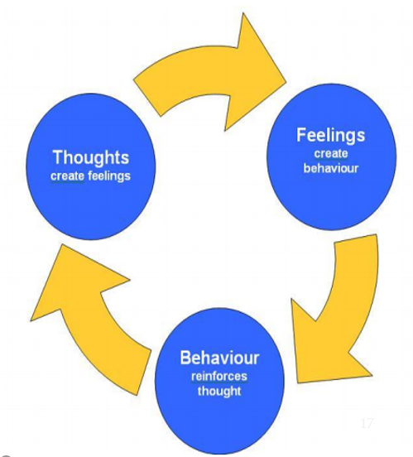
Jesus wept, but not for Himself. He felt the pain of the entire human race. “Looking down the years to come, He saw the suffering and sorrow, tears and death (Thoughts), that were to be the lot of men. His heart was pierced with the pain of the human family of all ages and in all lands. . . . (FEELINGS) He longed to relieve all their distress.”—Ellen G. White, The Desire of Ages, p. 534

Slide 34

Questions?

