Slide 1
Quality Enhancement Plan
University Assembly Update
February 27, 2012

Slide 2
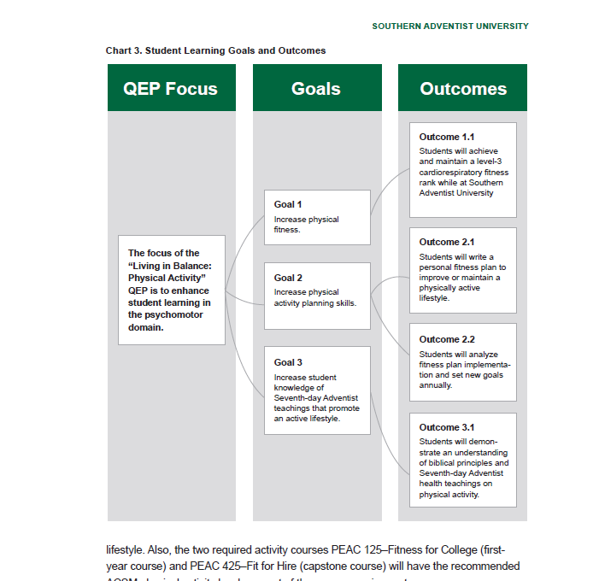

Slide 3
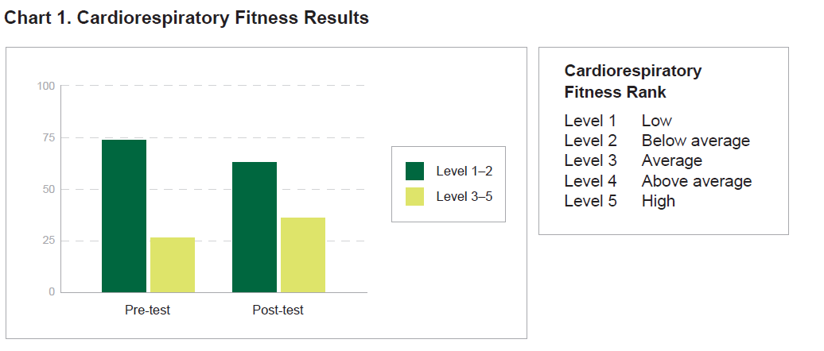
Research
Notes:
Cardiorespiratory fitness assessment results from fall 2007 through winter 2011 show that only 26.7% of the student population achieve a level-3 or higher rank on the pre-test and only 37.2% achieves a level-3 or higher rank on the post-test. A level-3 fitness rank is considered average. The results indicate that student fitness levels increase an average of 10.5% from the pre-test to the post-test.

Slide 4
Research
Health Assessment | College Norm | Southern Adventist University
Exercise Frequency 5+ times/week^{1,2} | 19% | 16%
¹ American College Health Association. National College Health Assessment. Spring 2010 Reference Group Executive Summary. p. 16
² BSDI – Fitness Analyst results from 4211 Southern Adventist University students over 8 years.
Notes:
Insufficient rest affecting function on 2 or more days a week
What might this translate into?
Well, if they stay in TN … only 51.8% of adults report being physically active according to the CDC 2010 report – which is the WORST in the nation! 27.3% report NO leisure time physical activity.

Slide 5
QEP Working Committee Team
Patti Anderson
Michael Dant
Leslie Evenson
Tyson Hall
Hollis James
Harold Mayer
Marge Seifert
Judy Sloan
DONE!

Slide 6
Implementation Taskforce
First meeting is being arranged
Prepare for onsite visit – April 16-18, 2012
Continue implementation of Living in Balance: Physical Activity

Slide 8
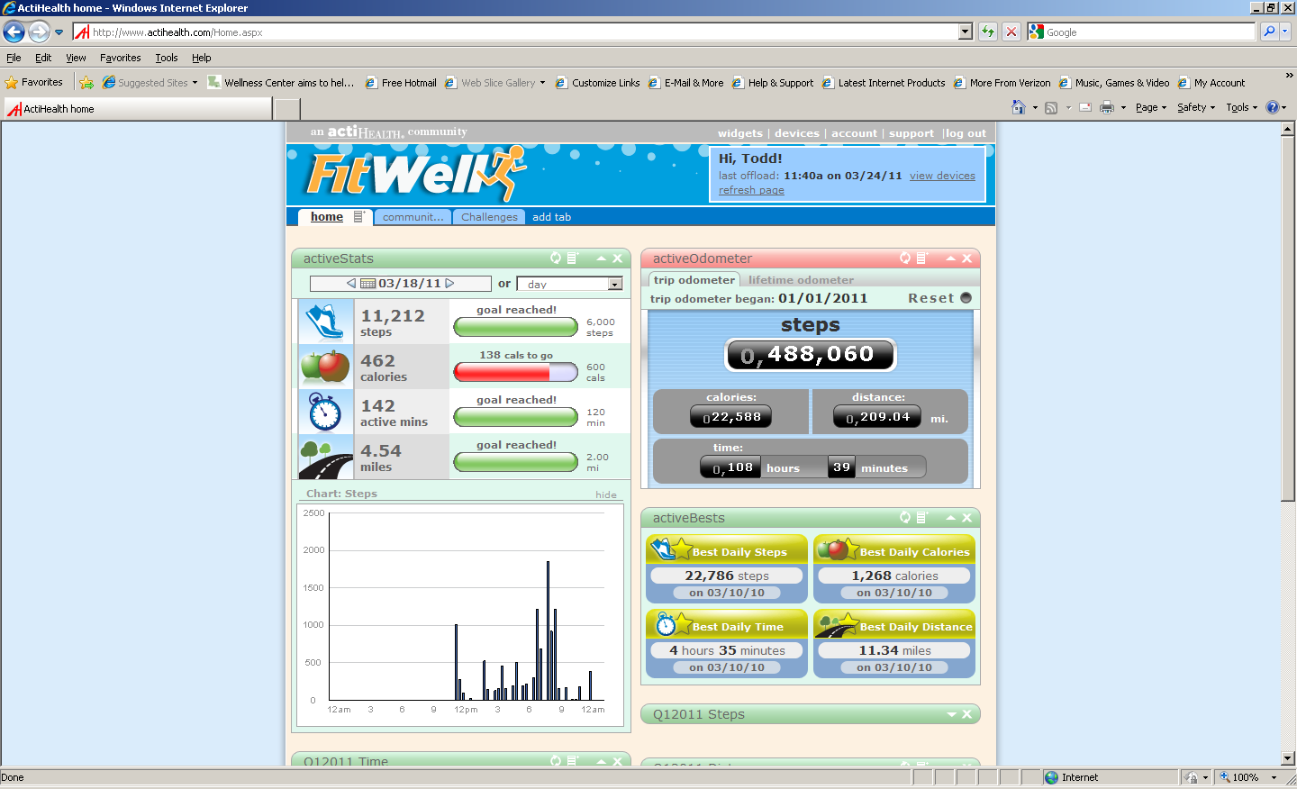

Slide 9
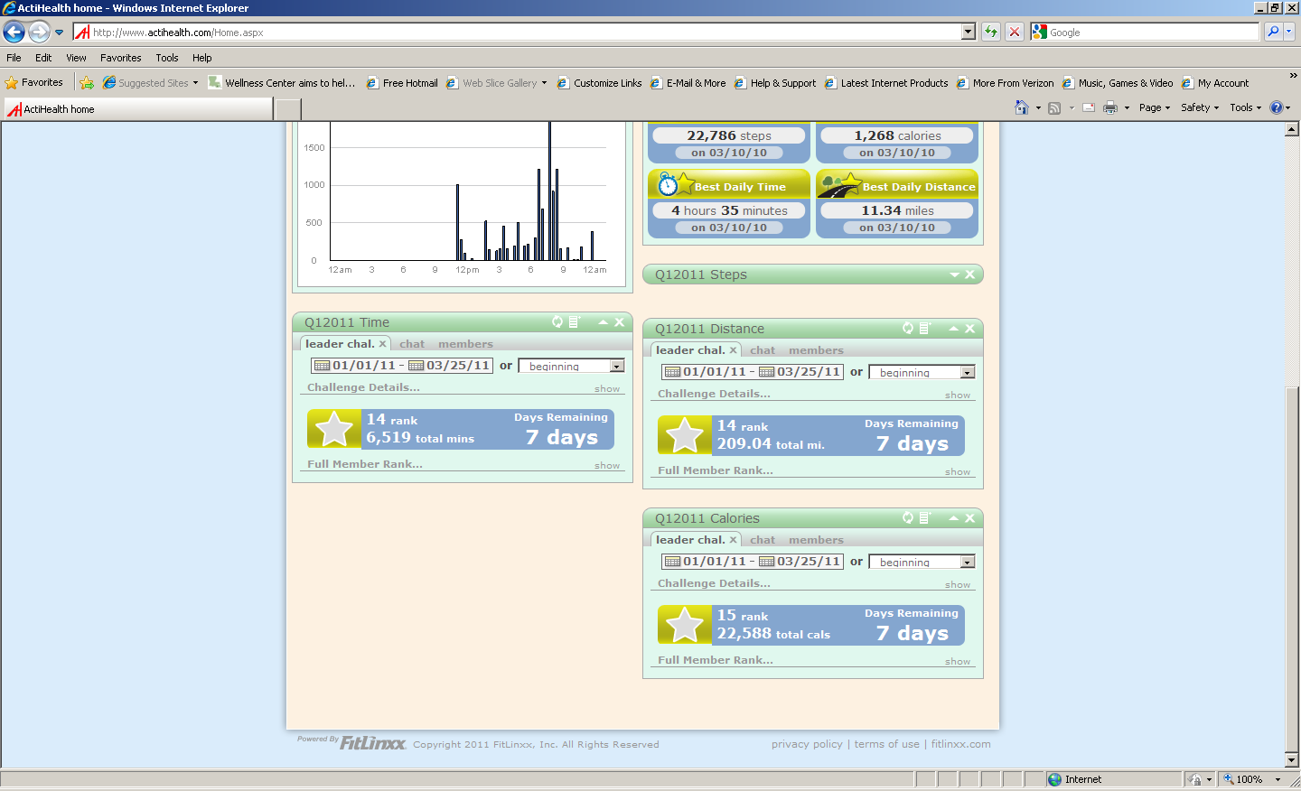

Slide 10
Quality Enhancement Plan
University Assembly Update
February 27, 2012

Slide 11

Living in Balance: Physical Activity
Quality Enhancement Plan
University Assembly Update
February 27, 2012

Slide 12
Mission
The focus of the “Living in Balance: Physical Activity” QEP is to enhance student learning in the psychomotor domain.

Slide 13
Goals
Increase:
Physical fitness
Physical activity planning skills
Knowledge of Seventh-day Adventist teachings that promote and active lifestyle

Slide 14
Student Learning Outcomes
Students will achieve and maintain a leve-3 cardiorespiratory fitness rank while at Southern Adventist University.
Students will write a personal fitness plan to improve or maintain a physically active lifestyle.

Slide 15
Student Learning Outcomes
Students will analyze fitness plan implementation and set new goals annually.
Students will demonstrate an understanding of biblical principles and Seventh-day Adventist health teachings on physical activity.

